Slide 1
Data, Why Collect It?
Presentation by Workcred, Professional Testing, and the Board of Certified Safety Professionals
March 22, 2022

Slide 2
Demonstrating Value of Industry Credentials
Workcred is engaging certification bodies around the value of linking their data
  There is no complete, centralized source of administrative data on the outcomes or impacts of certifications
  Certifications are not understood by policymakers, funders of research, state officials, consumers of certifications, and education and training providers
  There is a need to understand the role of certifications in credentialing pathways, including the impact on wages, which will help the certification bodies serve their clients better

Slide 3
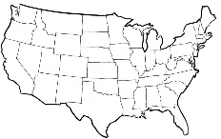


How the Industry Certification and Education Performance Data System Works
Student level credential
Information for Student Tracker for Colleges and Universities cohort
Course/credit
information
Colleges/States
Colleges/States
Industry credential
information
Aggregate wage outcomes for credential programs
Education outcomes
Student level
credential
information
Aggregate wage outcomes for credential programs
National Association of Manufacturers
American Welding Society (AWS)
Manufacturing Skill Standard Council (MSSC)
National Association of Manufacturers
NIMS

Slide 4
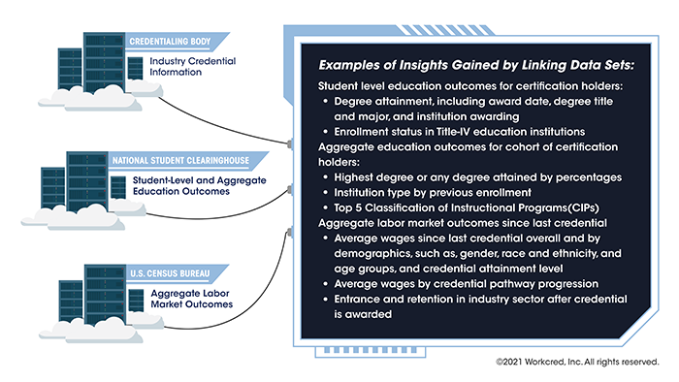
Examples of Insights Gained by Linking Data Sets

Slide 5
The Board of Certified Safety Professionals (BSCP) Experience with the Clearinghouse and the U.S. Census Bureau

Slide 6
BSCP Experience with the Clearinghouse and the U.S. Census Bureau
Data BCSP seeks
  Educational history
    School and program
    Enrollment period and status
    Graduation status and date
  Other credentials held
  Industries that employ our certificants
  Job titles held by our certificants
  Salary/wage information
  Job flows, pathways taken

Slide 7
BSCP Experience with the Clearinghouse and the U.S. Census Bureau Continued
Why BCSP seeks the data
We do not have:
  Robust industry/pathway data
  Educational data related to credentials that do not require a degree
  Full and timely salary/wage data (periodic salary survey provides good but not comprehensive data)
Shared data provides a complete picture for:
  Strategic planning: Identifying outcomes to help BCSP find future leaders in safety, health, and environmental (SH&E) practice
  Identifying previous blind spots related to BCSP’s target population: Which degree programs provide pathways to BCSP credentials?
  Refining targeted outreach to existing and new markets (e.g., youth, academic programs)

Slide 8
BSCP Experience with the Clearinghouse and the U.S. Census Bureau Continued
What BCSP will use the data for
Fill in gaps in pathway of success – where credential holders go after certification
Identify trends in pathways
  Education -> certification
  Certification -> industry
Strategic planning
Targeted outreach to new and existing markets
Support outreach to state and other governmental entities that provide funds to individuals seeking credentials
Answer outcome questions from stakeholders

Slide 9
BSCP Experience with the Clearinghouse and the U.S. Census Bureau Continued
Challenges and solutions
Challenge: Data integrity and integration with BCSP database system
  Solutions:
    Use a dedicated, secure FTP access to send and receive data
    Provide as much detail as our own data collection and privacy policies allow
    Map certification status and demographics between BCSP’s database and the Clearinghouse’s
Challenge: Data security
  Solutions:
    Conduct a written and on-site audit of the Clearinghouse’s facility
    Include breach response language in the agreement with the Clearinghouse

Slide 10
BSCP Experience with the Clearinghouse and the U.S. Census Bureau Continued
Challenges and solutions Continued
Challenge: Data privacy under the law and accreditation standards
  Solutions:
    Have a written agreement with the Clearinghouse defining what data will be shared and the specific use of the shared data
    Add a new section to BCSP’s privacy policy:
      Sharing Information for Research Purposes
      Personal information may be shared for research purposes, such as with third parties under written agreement with BCSP
    Implement an opt-out widget for those who do not want their data to be shared

Slide 11
BSCP Experience with the Clearinghouse and the U.S. Census Bureau Continued
What BCSP Received
First file from the Clearinghouse based on BCSP records going back 5 years matching to educational records going back 8 years
No Census data as yet – expected in the next file to be received in April

Slide 12
BSCP Experience with the Clearinghouse and the U.S. Census Bureau Continued
Context
BCSP age demographics:
About 70% of BCSP certificants are over the age of 35
16 to 24-year-olds in the US workforce are significantly underrepresented among BCSP certificants

Slide 13
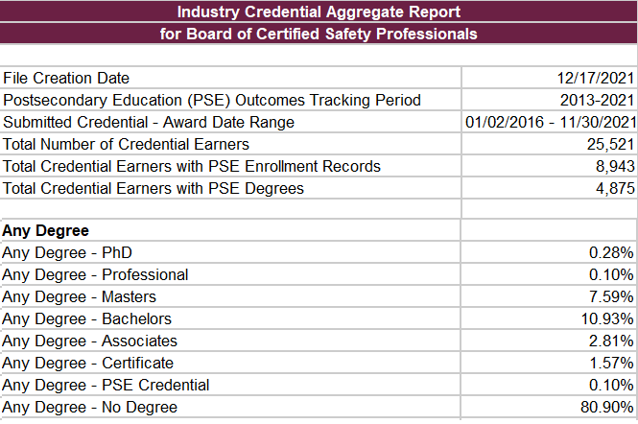
BSCP Experience with the Clearinghouse and the U.S. Census Bureau Continued
Limitation
Educational data not available for mid-to-late career certificants
Credential holders may have graduated >8 years ago
81% came back
with “no degree”

Slide 14
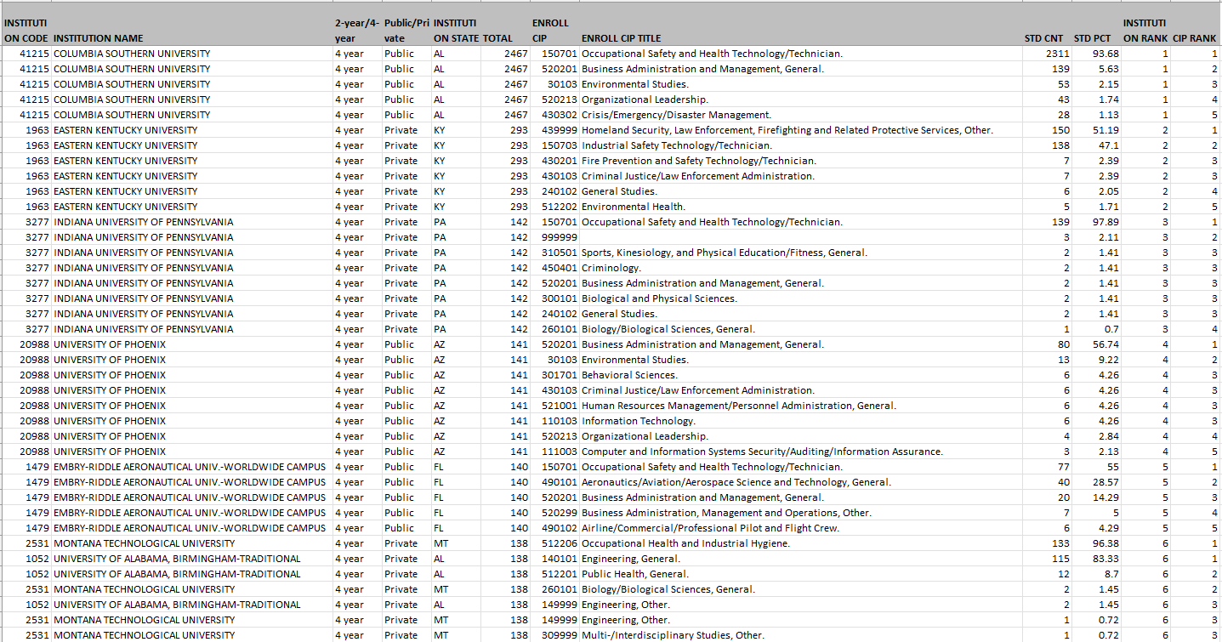
BSCP Experience with the Clearinghouse and the U.S. Census Bureau Continued
Unexpected Results
Online schools and programs heavily represented – target those already in the workforce

Slide 15
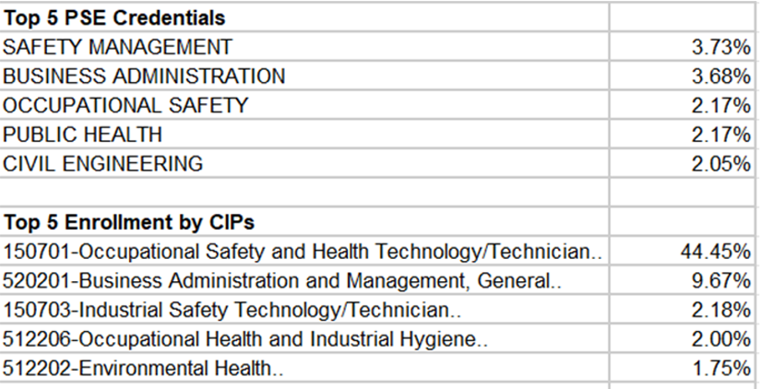
BSCP Experience with the Clearinghouse and the U.S. Census Bureau Continued
Valuable Insights
Surprised by some of the top schools and programs
Data for recent graduate can help us target early career professionals

Slide 16
BSCP Experience with the Clearinghouse and the U.S. Census Bureau Continued
The Future
Working with the Clearinghouse to provide educational records going back farther than 8 years
Requesting a breakout of the data by credential for more fine-tuned analysis
Working on ways to extrapolate information and apply it to unmatched records
Anticipating Census data in the file we will receive in April; to include industry and wage data
Addition of Census data may give us a higher percentage of matching records between databases

Slide 17
Data Collection and Uses of Data

Slide 18
Workcred Certification Body Data Collection Survey
“Voluntary Data Sharing Network Survey: Minimum Data Elements and Workforce Trends”
Conducted in 2020 by Workcred’s Senior Director of Research, Isabel Cardenas-Navia, PhD
Findings presented in several forums
Topics
Willingness to collect data elements for individual-level data-matching between certification bodies and Clearinghouse records
Certification bodies response and engagement with workforce trends
Impact of recent events on certification bodies and future planning

Slide 19
Workcred Certification Body Data Collection Survey Continued
High-level review of the findings for “Minimum Data Elements Needed”
Demographic Data (Data to Support Matching & Optional Data)
  Name
  Contact Information
  Gender
  Race/Ethnicity
  Degrees Held
  Military Status
  Disability Status
Certification Data
  Credential Name
  Credential Purpose
  Credential Award Date
  Recertification or Maintenance

Slide 20
Data Collection
Opportunities to Collect Data
Certified persons are a captive audience
Obtain post-credentialing data on the following:
  Value of certification
  Cost of certification versus value
  Benefits of certification—tangible and intangible
  Perception of certification by employers, industry, supervisors, etc.
  Is credential providing the outcomes and expectations you anticipated?
Obtain recertification data to determine trends:
  Why they recertified or did not?
  Have outcomes and expectations changed?
  Benefits still relevant
  Value the same or different
  What other credentialing opportunities could be provided?

Slide 21
Uses of Data
Use Data to Promote Your Certification Body
Use data to become the “keeper of metrics”
  Salary increases
  Job advancement
  Qualify for a job
  Skills/knowledge improvement (enhanced competence)
  Respect from peers
  Greater performance on the job
  Credibility for self
  Credibility for the profession
Use data to tell the story of your certification
  The certification body is the best teller of its story; others are telling it on social media, anecdotally, etc.

Slide 22
Uses of Data Continued
Use Data to Monitor the Relevance of the Certification
The need for certification can change over time
Prospective pool of certified persons changes
  Workforce (Gen Z)
  Workplace (e.g., jobs next generation desires)
  Skills needed (e.g., technology, soft skills)
Type of credential may change
  May not be an entire job anymore, but part of a job
  Role of alternative credentials (e.g., microcredentials)
Motivators
  More than credibility
  More tangible (e.g., need to reskill)
  Remain competitive in the job market

Slide 23
Benefits to Certification Bodies and Other Stakeholders

Slide 24
Benefits to Certification Bodies
Benefits to Certification Bodies
Credibility
Strategic Planning
Marketing
Visibility
Career Pathways

Slide 25
Benefits to Certification Bodies Continued
Visibility
  Bring increased awareness and visibility to the certification and the profession
Credibility
  Use third-party validated data to provide evidence about the value of the certification
  Educate policymakers, employers, government agencies, and individuals about the value of the certification and the profession
  Demonstrate to employers that if they hire certified persons, they can have higher employee retention rates
Strategic Planning
  Use data to improve strategic planning and marketing, and support decision making
  Gather information to inform the development of new products, including needs assessments for new certifications
  Obtain a more complete picture of the certification holders

Slide 26
Benefits to Certification Bodies Continued
Marketing
  Identify gaps in certifications earned by underserved populations
  Refine outreach to new and existing markets
  Show wages before and after earning the certification
  Use data to advance the industry and/or occupation
  Showcase the career pathways
Career Pathways
  Understand career pathways and earnings of certified persons
  Gather information on what certification holders studied, how they prepared for their career, what other certifications they hold
  How do people end up in the profession and what are their job titles
  Understand tangential careers and how to better target those audiences
  Identify people interested in the occupation earlier in their education or career

Slide 27
Benefits to Other Stakeholders
Industry/Employers
Understand retention and turnover in industry
Parents/Learners
Understand the labor market return on investment of education and certification programs
Education/Educators
Understand student pathways and ROI for non-degree credential programs to help student success initiatives
Provide information on programs to employers for continuing professional development
Identify industries and occupations that provide living wages and career pathways
Identify program improvement and expansion opportunities
Support reporting needs under federal legislation such as Every Student Succeeds Act, Workforce Innovation and Opportunity Act, or grant-related programs

Slide 28
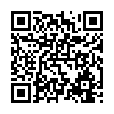
Data: A Value Proposition for Certification
We have developed this survey to help us better understand what administrative data is currently being collected, to help in determining the gap(s) between what is collected and what federal and national associations have determined is needed to make decisions about credentials.
https://www.surveymonkey.com/r/LNPW6RY

Slide 29








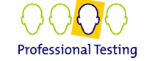
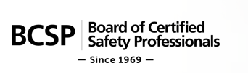

For More Information
Roy Swift, Ph.D.
Executive Director, Workcred
rswift@workcred.org
202.331.3617
Christine D. Niero, Ph.D.
Vice President, Professional Certification and Client Development
cniero@proftesting.com
703.430.1322
PO Box 650670
Potomac Falls, VA 20165
www.proftesting.com
Marya Ryan, Ph.D.,
CAE, ICE-CCP
Chief Operating Officer
marya.ryan@bcsp.org
317.960.3885
8645 Guion Road
Indianapolis, IN 46268
www.bcsp.org
1899 L Street, NW
Washington, DC 20036
www.workcred.org

