Slide 1
Industry Credentials Project
<Presenter>
<Date>

Slide 2
Table of Contents
Project Goal and Background
Partnership between Workcred and the National Student Clearinghouse
Value Propositions
Risks, Challenges, and Solutions
Outcomes from Pilot Project
Process to Participate

Slide 3
PROJECT Goal and BACKGROUND

Slide 4
Project Goal
Goal: To understand successful student pathways between education and the workforce by integrating certification attainment with educational data and aggregate labor-market outcomes.
Problem: There is no complete, centralized source of data on the outcomes or impact of certifications. While there have been isolated efforts to collect this data by states, as well as self-reported data from certification bodies, outcomes data are fragmented and incomplete.

Slide 5
Background
According to Credential Engine’s 2021 report, Counting U.S. Secondary and Postsecondary Credentials, there are more than 500,000 non-degree credential programs, more than 8,000 of which are certifications.
The quality of these programs as determined by third-party data is for the most part unknown.
This initiative creates aggregate labor-market outcomes for certifications so that educators, employers, learners, and parents can better understand the return on investment (ROI) in the labor market.

Slide 6
Launched a Pilot Program: Industry Credentials Project
Partners
National Student Clearinghouse (the Clearinghouse)
National Association of Manufacturers Manufacturing Institute (NAM/MI)
U.S. Census Bureau
Funder
Lumina Foundation
Certification Bodies
American Welding Society (AWS)
Manufacturing Skills Standard Council (MSSSC)
NIMS

Slide 7
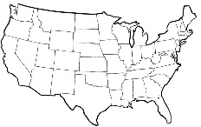


How the Industry Certification and Education Performance Data System Works
Student level credential
Information for Student Tracker for Colleges and Universities cohort
Course/credit
information
Colleges/States
Colleges/States
Industry credential
information
Aggregate wage outcomes for credential programs
Education outcomes
Student level
credential
information
Aggregate wage outcomes for credential programs
National Association of Manufacturers
American Welding Society (AWS)
Manufacturing Skill Standard Council (MSSC)
National Association of Manufacturers
NIMS

Slide 8
Journey to Date for the Clearinghouse’s Industry Credentials Project Pilot
Developed a strategic partnership with NAM/MI to onboard manufacturing credentialing organizations and promote initiative
Built industry credential attainment data intake process and reporting platform
Signed U.S. Census Bureau contract in August 2018
  Received approval to access IRS data in January 2020
  Piloting and analyzing industry credential attainment labor-market outcomes
Developed a strategic partnership with Workcred to drive adoption of Clearinghouse services with credentialing organizations

Slide 9
Partnership between Workcred and the National Student Clearinghouse

Slide 10
Demonstrating Value Through Linking Data Network
Workcred is engaging with a network of more than 30 certification bodies around the value of linking their data because:
  There is no complete, centralized source of administrative data on the outcomes or impacts of certifications
  Certifications are not understood by policymakers, funders of research, state officials, consumers of certifications, and education and training providers
  There is a need to understand the role of certifications in credentialing pathways, including the impact on wages, which will help the certification bodies serve their clients better

Slide 11
Certification Bodies Participating with Workcred
American Board of Multiple Specialties in Podiatry (ABMP)
American Council on Exercise (ACE)
American Health Information Management Association (AHIMA)
American Nurses Credentialing Center (ANCC)
American Roads and Transportation Builders Association (ARTBA)
American Society for Clinical Pathology Board of Certification (ASCP BOC)
Association for Supply Chain Management (ASCP)
Behavior Analyst Certification Board (BACB)
Board of Certified Safety Professionals (BSCP)
Building Performance Institute, Inc. (BPI)
Certified Fund Raising Executive International (CFRE)
Commission for Case Manager Certification (CCMC)
CompTIA
EC-Council
Human Resource Certification Institute (HRCI)
Institute for Operations Research and the Management Sciences (INFORMS)

Slide 12
Certification Bodies Participating with Workcred Continued
Institute of Hazardous Materials Management (IHMM)
International Association of Privacy Professionals (IAPP)
International Board of Heart Rhythm Examiners
International Board of Specialty Certification (IBHRE)
International Facility Management Association (IFMA)
International Information System Security Certification Consortium, Inc. (ISC)²
NALA - The Paralegal Association
National Commission for the Certification of Crane Operators (NCCCO)
National Environmental Health Association (NEHA)
National Healthcareer Association (NHA)
National Inspection Testing and Certification, Corp. (NITC)
National Restaurant Association/National Registry of Food Safety Professionals
National Retail Federation Foundation (NRFF)
Pharmacy Technician Certification Board (PTCB)
Project Management Institute (PMI)
Society for Human Resource Management (SHRM)
Society of Certified Senior Advisors (SCSA)

Slide 13
Data Elements Needed for Linking Data
Required Minimum Data | Additional Data that Supports Finding More Matches | Optional Data that Provides Additional Insights on Reporting | Data Elements Collected by Your Certification Body (check all that apply)
First Name
Last Name
Credential Organization Type
Credential Name
Credential Type
Credential Purpose
Credential Award Date
Credential Expiration Date
 | Date of Birth
 | Name of Educational Institution
 | Middle Name or Middle Initial
 | Previous First Name
 | Previous Last Name
 | Address
 | Zip Code
 | Cell Phone
 | Email Address
 |  | Race/Ethnicity
 |  | Gender
 |  | Military Status

Slide 14
Value Propositions

Slide 15
What is the value of linking certification bodies’ administrative data with data from the Clearinghouse and the U.S. Census Bureau?
Visibility
Credibility
Strategic Planning
Marketing
Career Pathways
Source: The value propositions were developed based on information gathered from 22 individual interviews with Workcred’s Demonstrating the Value of Linking Data Network members.

Slide 16
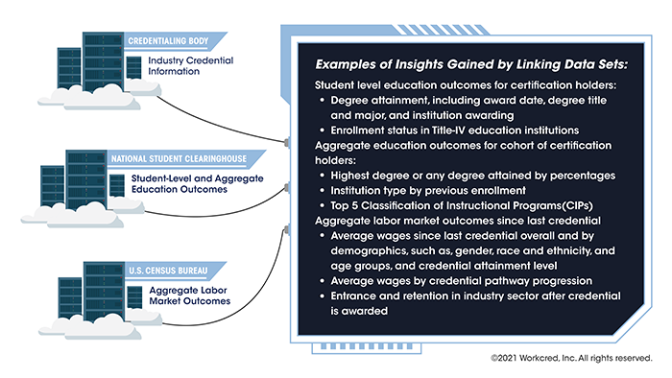
Examples of Insights Gained by Linking Data Sets

Slide 17
Benefits to Certification Bodies
Visibility
  Bring increased awareness and visibility to the certification and the profession
Credibility
  Use third-party validated data to provide evidence about the value of the certification
  Educate policymakers, employers, government agencies, and individuals about the value of the certification and the profession
  Demonstrate to employers that if they hire certified persons, they can have higher employee retention rates
Strategic Planning
  Use data to improve strategic planning and marketing, and support decision making
  Gather information to inform the development of new products, including needs assessments for new certifications
  Obtain a more complete picture of the certification holders

Slide 18
Benefits to Certification Bodies Continued
Marketing
  Identify gaps in certifications earned by underserved populations
  Refine outreach to new and existing markets
  Show wages before and after earning the certification
  Use data to advance the industry and/or occupation
  Showcase the career pathways
Career Pathways
  Understand career pathways and earnings of certified persons
  Gather information on what certification holders studied, how they prepared for their career, what other certifications they hold
  How do people end up in the profession and what are their job titles
  Understand tangential careers and how to better target those audiences
  Identify people interested in the occupation earlier in their education or career

Slide 19
Benefits to Other Stakeholders
Industry/Employers
  Understand retention and turnover in industry
  Provide information on programs to employers for continuing professional development
Parents/Learners
  Understand the labor market ROI of education and certification programs
  Identify industries and occupations that provide living wages and career pathways
Education Stakeholders
  Understand student pathways and ROI for non-degree credential programs to help student success initiatives
  Identify program improvement and expansion opportunities
  Support reporting needs under federal legislation such as Every Student Succeeds Act, Workforce Innovation and Opportunity Act, or grant-related programs

Slide 20
Risks, challenges, and solutions

Slide 21
Potential Barriers and Risks
Staff Resources
Board Approval
Data Security and Privacy
Data Collection
Accreditation
Technology
Source: The potential barriers were identified based on information gathered from 22 individual interviews with Workcred’s Demonstrating the Value of Linking Data Network members.

Slide 22
Potential Barriers and Risks Continued
Staff resources
  Time
  Lack of staff or staff expertise
Board approval
  Demonstrate the ROI to the leadership team and/or board of directors
  Address concerns about data privacy
Technology
  Unsure of the process to share data when a certification body works with a third-party data collection organization
  Technology needs to be as automated as much as possible to link data from the certification body to the Clearinghouse

Slide 23
Potential Barriers Continued
Data security and privacy
  Protect the certified person’s privacy and understand how the data will be secured
  Need to have opt-in or opt-out security and privacy
  Maintain compliance with data privacy laws
    Family Education Rights and Privacy Act (FERPA)
    General Data Protection Regulation (GDPR)
    California Consumer Privacy Act (CCPA)
    Regulations around handling of data for minors
  Data security concerns need to be balanced with the value of how the data can be used to help the certification body grow and be a stronger organization over time
  Provide the risk-benefit analysis of linking data and how the data helps people make better decisions
  May need to change internal data privacy policies

Slide 24
Potential Barriers and Risks Continued
Data collection
  Certification body may need to collect additional data
  Certification body may need to implement new policies
  Current data systems may be antiquated
Accreditation
  Ensure there is no negative impact to accreditation by linking certification body data with other data sets
  Ensure that data privacy policy aligns with accreditation standards related to confidentiality of credential holder data

Slide 25
Perceived Risk and Solution: Data Security – Breach of Personally Identifiable Information
Solution
Use ISO/IEC 27001 – Information security management standard as a framework
  The Clearinghouse is in compliance with ISO/IEC 27001
Certification body can conduct an on-site audit of the Clearinghouse
  Develop a questionnaire prior to site visit
  Conduct an on-site observation of measures to ensure the Clearinghouse facility is a secure site
  Discuss policies and procedures with the Clearinghouse’s cybersecurity personnel
Ensure destruction of data
  Certification bodies can end participation at any time with 90 days’ written notice
  The Clearinghouse will provide an affidavit of destruction of data
The Clearinghouse security breach procedures
  Time period to notify certification body in case of security breach
  Time period to resolve the security breach

Slide 26
Perceived Risk and Solution: Informing Individuals about Use of Data
Solution
Certification bodies can add language to their privacy policy and on their website such as:
  Sharing information for research purposes.
  Personal information may be shared for research purposes, such as with third parties under written agreement with [insert name of certification body]

Slide 27
Perceived Risk and Solution: Accreditation
Solution
For certifications accredited under ISO/IEC 17024:2012 Conformity assessment – General requirements for bodies operating certification of persons
  Section 7.3 requires certification bodies to:
    Have documented policies and procedures for maintaining and releasing information
    Keep confidential all information obtained during the certification process; individuals may provide written consent for release of information to a third party
Certification bodies that base privacy policies on GDPR
  Some certification bodies have indicated that they cannot certify a person or maintain their certification if the individual opts out of allowing the certification body to collect data about them
Anyone can:
    Opt to suppress their personally identifiable information
    Opt out of receiving promotional messages – anything that is not directly relevant to their certification

Slide 28
Outcomes from pilot project

Slide 29
Industry Credentials Pilot Project Partners
Partners
National Student Clearinghouse (the Clearinghouse)
National Association of Manufacturers Manufacturing Institute (NAM/MI)
U.S. Census Bureau
Funder
Lumina Foundation
Certification Bodies
American Welding Society (AWS)
Manufacturing Skills Standard Council (MSSSC)
NIMS

Slide 30
Examples of Insights Gained by Linking Data Sets

Slide 31
Matching Industry Credentials & Postsecondary Education
Postsecondary Education (PSE) Outcomes Tracking Period | 2011-2019
Any Degree
Any Degree – PhD | 0.05%
Any Degree – Professional | 0.02%
Any Degree – Masters | 0.71%
Any Degree – Bachelors | 2.32%
Any Degree – Associates | 6.14%
Any Degree – Certificate | 8.17%
Any Degree – PSE | 0.44%
Any Degree – No Degree | 86.3%
PSE Enrollment, No Degree | 28.64%
No PSE Enrollment, No Degree | 57.76%
File creation date: 2/28/2019

Slide 32
Disclaimer
Any opinions and conclusions expressed herein are those of the authors and do not reflect the views of the U.S. Census Bureau.
The Census Bureau’s Disclosure Review Board has approved all statistics and estimates presented today for public release under approval numbers CBDRB_FY2020-CES010-007 and CBDRB-FY2020-CES010-012.

Slide 33
Wages Before & After Certification by Age
33

Slide 34
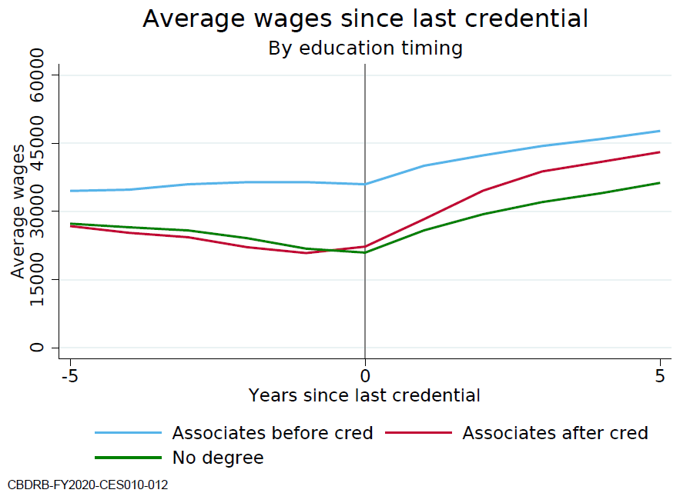
Certification and Associate Degree Pathways

Slide 35
Certification Pathway Outcomes

Slide 36
Certification Pathway Outcomes of Stackable Credentials

Slide 37
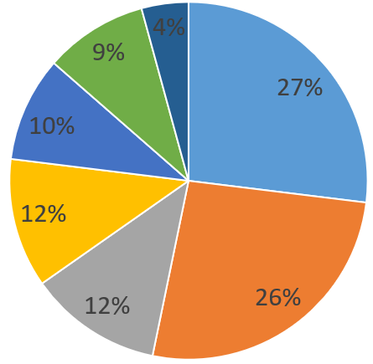
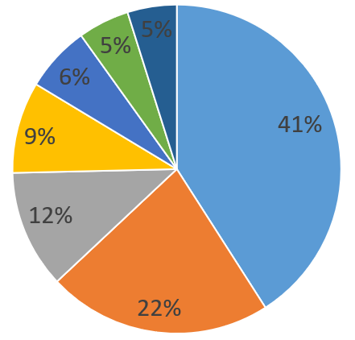


Slide 38
Gender in Certification Outcomes

Slide 39
Increased Gender Opportunities

Slide 40
Equity in Certification Outcomes

Slide 41
Increased Equity Opportunities

Slide 42
Next Steps – U.S. Census Bureau
Analyzing aggregate labor market outcomes for new certifications
Understanding types and sizes of employers for this population
Assessing retention in industry over time
Exploring demographic trends related to race/ethnicity and gender
Writing a research paper on pilot findings
All matching algorithms to U.S. Census and IRS data sources are now programmed and can be quickly used for other industry credential providers and has been tested with healthcare credentials.

Slide 43
PROCESS TO Participate

Slide 44
Benefits of Participation
Increase awareness and visibility to the certification and the profession
Provide third-party validated data about educational attainment and aggregate labor market information of certification holders
Demonstrate the value of the certification to employers, policymakers, educators, and individuals
Contribute to a research effort to better understand career and credential pathways
Participate in research that results in data that can be used by employers, policymakers, educators and individuals to make informed decisions about policies about the use of certifications

Slide 45
Interested? – Process to Participate
Step | Certifying Body | Clearinghouse
Negotiate data sharing agreement | X | X
Assess process to pull minimum data and historical data | X
Set up SFTP/application credentials for certifying body |  | X
Work with Clearinghouse to submit test data | X | X
Submit cohort data including historical data | X
Generate student-level and aggregate education outcomes reports |  | X
Create file to submit to U.S. Census Bureau |  | X
Review and analyze U.S. Census Bureau aggregate labor market outcomes | X | X

Slide 46







For More Information
Karen Elzey
Associate Executive Director
kelzey@workcred.org
202.331.3632
Vanessa Brown
Deputy Chief Data Officer
vbrown@studentclearinghouse.org
703.742.3244
1899 L Street, NW
Washington, DC 20036
www.workcred.org

