Slide 1
Summary of Key Provisions/Industry Implications of the Personal Data Protection Act B.E. 2562 (2019) (“TH PDPA”) and Guideline on Personal Data Protection for Thai Banks Veerachai Chuenchompoonut United Overseas Bank (Thai) PCL.

Slide 2
1. Section 6: Definitions (1/2)
“Personal Data” means any information relating to a Person, which enables the identification of such Person, whether directly or indirectly, but not including the information of the deceased Persons;
“Data Controller” (DC) means a Person or a juristic person having the power and duties to make decisions regarding the collection, use, or disclosure of the Personal Data;
“Data Processor” (DP) means a Person or a juristic person who operates in relation to the collection, use, or disclosure of the Personal Data pursuant to the orders given by or on behalf of a Data Controller, whereby such Person or juristic person is not the Data Controller;
“Person” means a natural person;
“data subject” (DS) means a natural person who is the subject of the Personal Data (not specifically defined under the PDPA).

Slide 3
1. Section 6: Definitions (2/2)
Examples of Personal Data:
Name and surname
Home address
Email address of an individual
ID card number
Location data
Online/Social Network identifiers: IP address, cookie ID, and advertising ID
Examples of Non-Personal Data:
Company registration number
Common company email address (e.g. company@company.com)
Anonymized data (i.e. data rendered anonymous in that the DS is no longer identifiable)
DC: A natural person or juristic person, who determines the purposes and means of the processing of the Personal Data (e.g. business operators).
DP: A natural person or juristic person, who processes the Personal Data pursuant to the instruction and on behalf of the DC (e.g. data processing service companies).

Slide 4
2. Section 5: Applicability of the TH PDPA
Extraterritorial Jurisdiction (similar to Article 3 of the GDPR (General Data Protection Regulation of the European Union)).
DC or DP located in Thailand, whether or not, whose processing activities take place in Thailand.
DC or DP located outside Thailand, whose processing activities are:
The offering of goods or services to the DS(s) in Thailand (i.e. “Marketplace Rule”); or
The monitoring of the DS’s behaviors taken place in Thailand.
Exemptions: Personal interest or family activity purpose only; government authorities having duties to maintain national security, trial and adjudication of courts and etc.

Slide 5
3. Section 19: Requirements for the DS’s Consent (1/3)
Consent of the DS is required prior to or at the time of processing of the Personal Data, unless permitted by TH PDPA (e.g. lawful basis for processing of the Personal Data).
A consent request must be explicitly made in writing forms or via electronic means.
Separated from other matters/statements in an easily accessible and intelligible form or statement.
Using clear and plain language.
Required notification of the clear, non-deceptive or non-misleading purposes of data processing (via Privacy Notice).
The consent must be “freely given” by the DS.

Slide 6
3. Section 19: Requirements for the DS’s Consent (2/3)
The consent shall not be conditional for entering into a contract or provision of the services, unless it is necessary or related to the contact or services.
Consent can be withdrawn at any time without affecting prior data processing activities.
The consent withdrawal must be as easy as giving consent.
The DC is required to inform the DS of consequences/impacts of such consent withdrawal.
Remark: Any non-compliant consent (including consent previously obtained) shall not be legally binding. The DC is no longer entitled to process the Personal Data in reliance upon such non-compliant consent.

Slide 7
3. Section 19: Requirements for the DS’s Consent (3/3)
Sample of Draft Consent Form

Slide 8
4. Section 95: Grandfathering Provision
Collection and Use
Disclosure
DC will be entitled to continue collecting and using the Personal Data for those purposes according to the past practice of the DC.
The disclosure of the Personal Data is OUT of scope of the grandfathering provision.
Remark: The DC shall publicize a consent withdrawal method to the DS in order for the DS to withdraw the consent easily.

Slide 9
5. Section 23: Required Notification to the DS (1/2)
Required notification to the DS prior to or at the time of collection of Personal Data of the following details (via Privacy Notice):
Purposes for collection, use, and disclosure of the Personal Data, and the purpose of the lawful basis for collection of the Personal Data under Section 24;
Notification for the provision of Personal Data for compliance with the laws or for entering into the contract, and consequences of failure to provide such Personal Data;
Retention period of the Personal Data;
Categories of persons or entities to whom the Personal Data may be disclosed;
Information and contact information of the DS, representative, or Data Protection Officer; and
Rights of the DS.

Slide 10
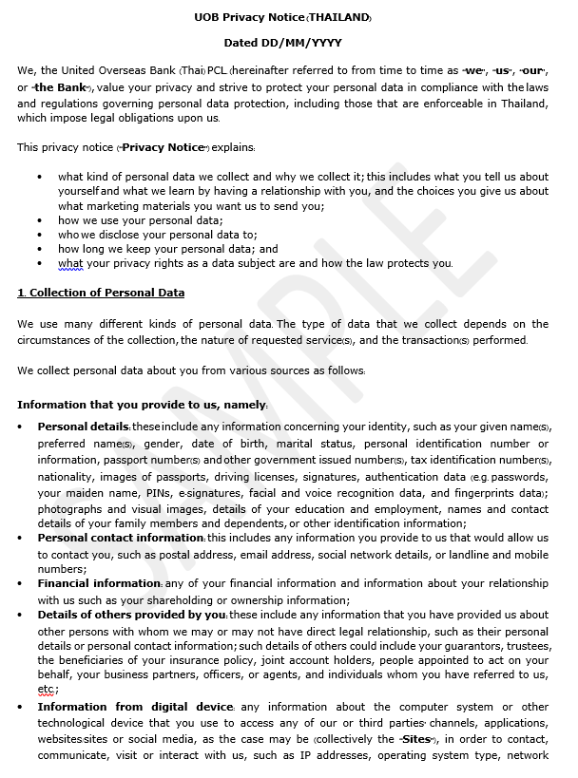
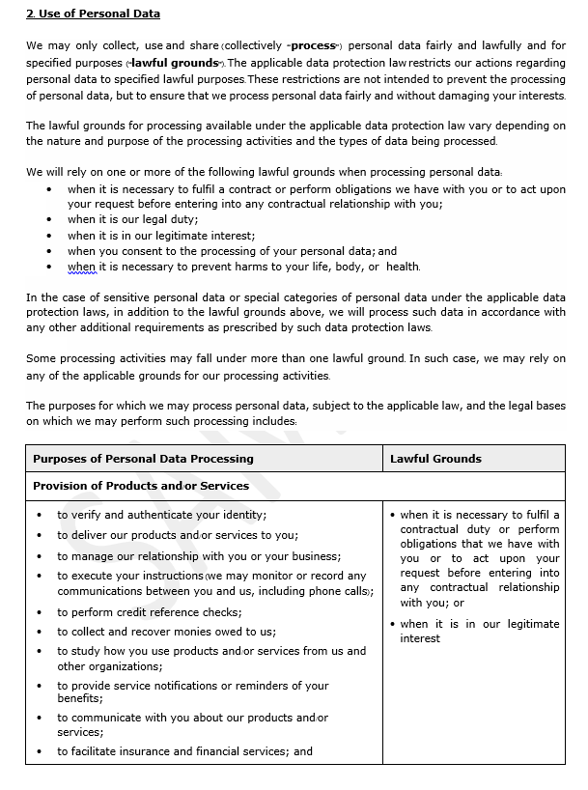
5. Section 23: Required Notification to the DS (2/2)
Sample of Extracted
Draft Privacy Notice

Slide 11
6. Sections 24 and 26: Lawful Basis for the Processing of Sensitive and Non-Sensitive Data (1/3)
Lawful Basis for Processing of Non-sensitive Personal Data (other than obtaining the consent of the DS):
Research/Statistic Purpose: To conduct research with appropriate safeguard measures of the Personal Data;
Vital Interest: To prevent danger to a person’s life, body or health;
Contractual Performance/Contractual Necessity: It is necessary for performing/delivering a contract to which the DS is a party, or to take steps at the request of the DS prior to entering into a contract;
Tasks in the public interest: It is necessary for the performance of tasks in the public interest or for the exercise of the state authority vested to the DC;
Legitimate Interest; and
Law Compliance/Legal Obligations.
Legitimate Interest means the legitimate interest of the DC or any other third party, which shall not be overridden by fundamental rights in the Personal Data of the DS (i.e. protection rights of the minors).

Slide 12
6. Sections 24 and 26: Lawful basis for the processing of sensitive and non-sensitive data (2/3)
Lawful Basis for Processing of Sensitive Personal Data/Special Categories of Personal Data (other than obtaining the consent of the DS):
Vital Interest;
Legitimate Activities with appropriate safeguards by the foundations, associations or any other not-for-profit bodies;
Data manifestly made public;
Necessity for the establishment, compliance, exercise or defence of legal claims; and
Law Compliance/Legal Obligations: Specific Laws.
Sensitive Personal Data/Special Categories of Personal Data: The Personal Data pertaining to racial, ethnic origin, political opinions, cult, religious or philosophical beliefs, sexual behavior, criminal records, health data, disability, trade union information, genetic data, biometric data, or any data which may affect the DS in the same manner.

Slide 13
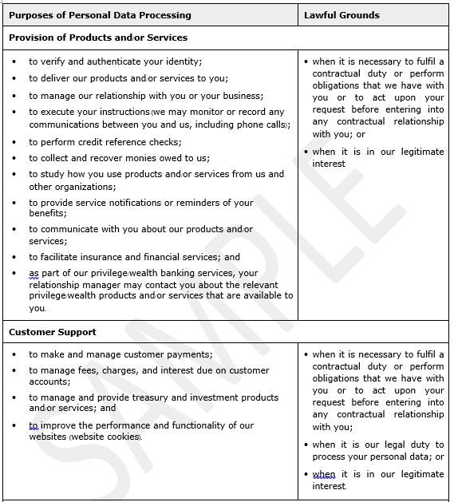
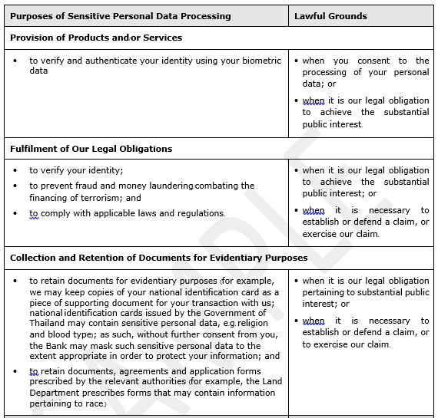
6. Sections 24 and 26: Lawful basis for the processing of sensitive and non-sensitive data (3/3)
Sample of
Extracted Draft
Privacy Notice

Slide 14
7. Section 27: Usage or Disclosure of Personal Data
Consent of the DS is required for the use or disclosure of the Personal Data, unless such Personal Data has been collected pursuant to the lawful basis under Section 24 and 26 (as described in slides 11-12).

Slide 15
8. Sections 19 and 30-36: Rights of the DS (1/2)
Right to Withdrawal of Consent: the DS is entitled, at any time, to withdraw his or her consent (except where limitations apply).¹
Right to Access: the DS has the right to access and obtain a copy of his or her Personal Data or to request the DC to disclose the acquisition of such Personal Data received without the consent of the DS. ²
Right to Portability: the DS has the right to receive his or her Personal Data and to transmit/transfer such Personal Data from the DC to another DC, in case that such Personal Data has been arranged in a commonly used and machine readable format by means of automatic tools, which can also be used or disclosed by automated means. ³
Right to Objection: the DS is entitled, at any time, to object any collection, use or disclosure of his or her Personal Data for certain purposes (including the objection of the processing of the Personal Data for direct marketing purposes). ⁴
¹ Section 19 paragraph five
² Section 30
³ Section 31
⁴ Section 32

Slide 16
8. Sections 19 and 30-36: Rights of the DS (2/2)
Right to be Forgotten: the DS has the right to request the DC to erase or destroy his or her Personal Data or to anonymize such Personal Data, which cannot identify the DS.⁵
Right to Restrict Processing (to suspend the use of the Personal Data): the DS is entitled to request the DC to restrict the processing of the Personal Data. ⁶
Right to Rectification: the DS is entitled to request the DC to maintain his or her Personal Data accurate, up-to-date, complete, and not misleading.⁷
⁵ Section 33
⁶ Section 34
⁷ Section 35 and Section 36

Slide 17
9. Section 37: Duties of the DC
The DC shall have the following duties:
To provide appropriate security measures for preventing the unauthorized or unlawful loss, access to, use, alteration, correction or disclosure of Personal Data;
Where the Personal Data disclosed to other person or legal entity, the DC shall take action to prevent such persons from using or disclosing the Personal Data unlawfully or without authorization;
To establish an examination system for erasure or destruction of the Personal Data when the retention period ends;
To notify the Office of the Personal Data Protection Committee of any breach of Personal Data without delay, and, where feasible, within 72 hours after becoming aware of such breach, unless such breach is unlikely to result in a risk to the rights and freedom of the DS; and
For an offshore DC who is subject the TH PDPA, to designate in writing a representative of such offshore DC, which shall be in Thailand and authorized to act on behalf of such DC without limitation of liability in relation to the processing of the Personal Data according to the purposes of the DS.

Slide 18
10. Sections 77 and 78: Penalties
Civil Liabilities:
Strict Liability
The DC or the DP shall be liable to compensate the DS for any violation of the TH PDPA, which causes damage to the DS (whether or not such violation is intentional or negligent), unless it can be proved that (1) such loss is caused due to force majeure or by an act or an omission of the DS; or (2) such violation is to comply with an order of a competent authority.
Punitive Damages
The court is empowered to levy punitive damages up to two times of the actual damages to be paid by the DC or DP.
Criminal Liabilities:
Unlawful disclosure of the Personal Data by the DC will be subject to criminal penalties, which, at the maximum threshold, include imprisonment for a term of not exceeding 1 year, and a fine of not exceeding Baht 1,000,000 or both.
Administrative Liabilities:
The administrative fines ranging from Baht 1,000,000 up to 5,000,000 are imposed on the DC and DP for various violations of the TH PDPA.
Director Liabilities:
If a juristic person commits a criminal offense under the TH PDPA, a director or a manager or any person who is responsible for the operation of such juristic person shall also be liable for such criminal offense if it can be proved that such criminal offense is caused by an order, an action or an omission of such person.

Slide 19
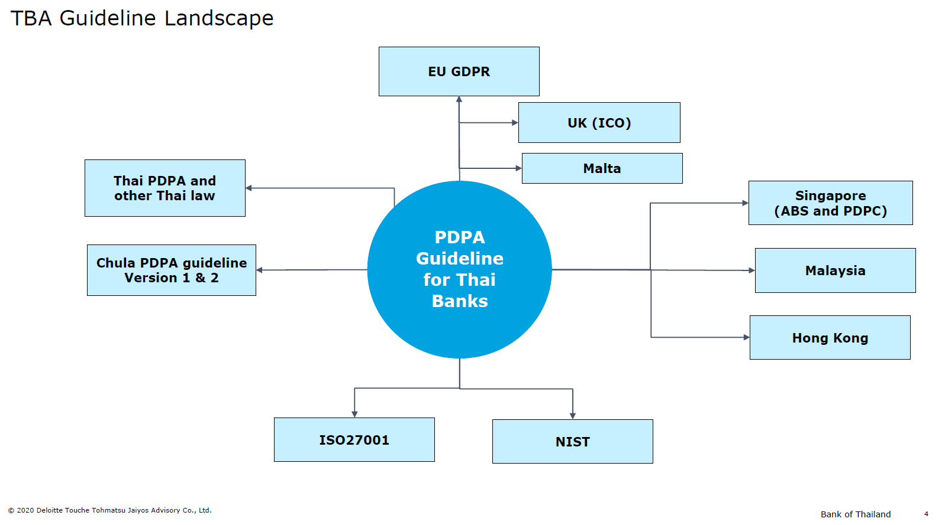
11. TBA’s TH PDPA Guideline (1/5)

Slide 20
11. TBA’s TH PDPA Guideline (2/5)

Slide 21
11. TBA’s TH PDPA Guideline (3/5)

Slide 22
11. TBA’s TH PDPA Guideline (4/5)
Content of TBA’s TH PDPA Guideline
Introduction
Definitions
Personal Data Scope and Classification
Identifying Personal Identifiable Information
Information Security
Data Protection Principles
Collection of Personal Data
Purposes of Collection
Lawful Basis
Consent
Sensitive Personal Data
Privacy Notice
Usage and Disclosure of Personal Data
Cross-border Data Transfer
Binding Corporate Rules
Appropriate Safeguards
Exemptions for Cross-border Data Transfer
Direct Marketing
Data Retention
Retention Period
Data Deletion and Data Destruction
Data Anonymization
Grandfathering Provision
Data Subject Rights
Data Controller Roles and Responsibilities
Data Protection Officer: DPO
Appointment and Qualifications
Responsibilities of DPO
Data Protection Impact Assessment: DPIA
Three Lines of Defense for Risk Management
Personal Data Breach

Slide 23
11. TBA’s TH PDPA Guideline (5/5)
Safe Harbor for the TH PDPA Implementation under the TH PDPA by Commercial Banks:
The TBA is now closely working with the BOT and MDES for the endorsement of the TBA’s TH PDPA Guideline, pursuant to which, upon such endorsement, the TBA’s TH PDPA Guideline will be regarded as a safe harbor guideline under the TH PDPA for the banking industry to rely on.
- END -

