Slide 1
Shared Responsibility Model in Cloud Computing
A data protection and security perspective
5 March 2021
Annabel Lee, Head of Data Policy (APJ)
lennbe@amazon.com
Notes:
Good Morning. My name is Annabel Lee I'm responsible for Data Public Policy issues for Amazon Web Services (or AWS) covering ASEAN, Asia Pacific and Japan. Prior to my time with AWS I was from Singapore's Data Protection Authority, working on Data Protection policy, over the first 4 years of the as the law in Singapore being implemented.

Slide 2
Introduction to Personal Data Protection in the Cloud

Slide 3
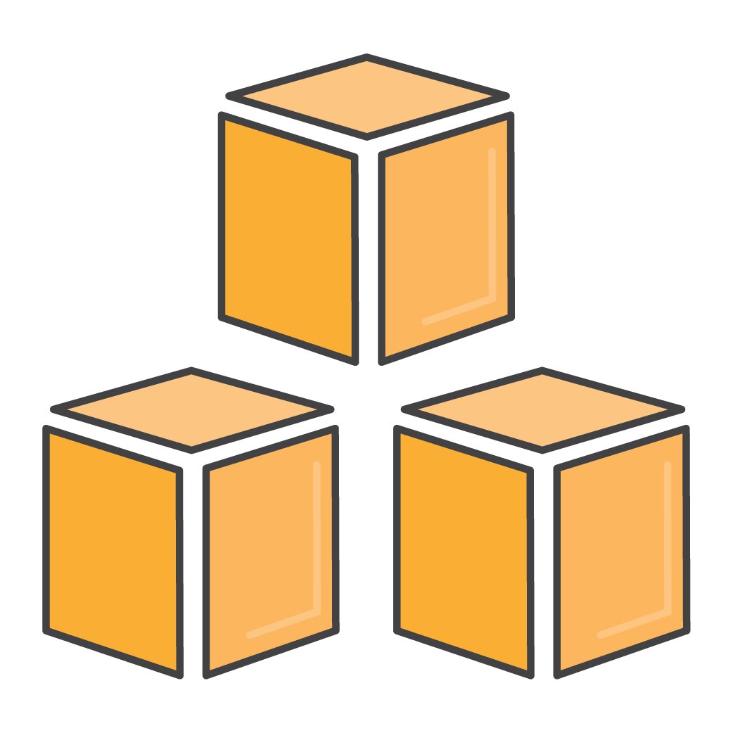
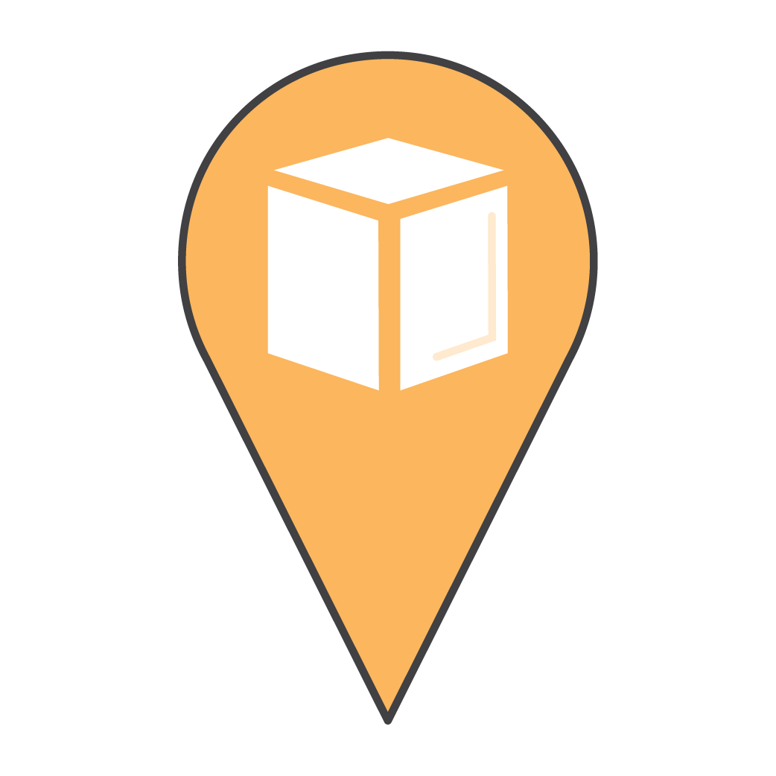
What is Cloud Computing?
“Cloud computing” is the on-demand delivery of IT resources via the internet with pay-as-you-go pricing.
Notes:
I am hopeful that most of you are familiar with AWS. However, for those of you meeting us for the first time, we are the world’s leading cloud services provider.
Starting in 2006, we began offering on demand IT infrastructure services to businesses in the form of web services – known as cloud computing. Our technology replaces up-front capital expenditures with low variable costs that scale with business demands; now, organizations of any size can instantly spin up thousands of servers in minutes to deliver results faster. The next day, if they don’t need this capacity, they don’t pay for it.
Our customers trust that our infrastructure and services will enable them to process, store and access their data securely. Data Protection and Security are top priority for AWS.

Slide 4
AWS Global Infrastructure 24 geographical regions, 77 availability zones
Region & Number of Availability Zones (AZs)
GovCloud (US) | Europe
US-East (3), US-West (3) | Frankfurt (3), Paris (3),
 | Ireland (3), Stockholm (3),
US West | London (3), Milan (3)
Oregon (4)
Northern California (3)
US East N. Virginia (6), Ohio (3) | Middle East Bahrain (3)
Canada | Asia Pacific
Central (3) | Singapore (3), Sydney (3),
 | Tokyo (4), Osaka-Local (1)
South America São Paulo (3) | Seoul (4), Mumbai (3), Hong Kong (3)
Africa | China
Cape Town (3) | Beijing (2), Ningxia (3)
Announced Regions
Three Regions and 9 AZs in Indonesia, Japan, and Spain
Notes:
AWS has the largest global infrastructure footprint of any provider. We currently have 77 availability zones in 24 regions and have announced plans for nine more Availability Zones and three more Regions in Indonesia, Japan, and Spain. But this is just a fraction of the geographies we're going to be in – this footprint is constantly increasing—and at a significant rate.
When deploying your applications and workloads to the cloud, you have the flexibility in selecting a cloud data center location, that is closest to your primary target of users. You can run your workloads on the cloud that delivers the best support for the broadest set of applications, even those with the highest throughput and lowest latency requirements.

Slide 5
Parties involved in data protection laws & their data protection considerations
Data Subject
Data Controller
Data Processor
End users or other individuals whose data are collected
Determines what data to collect & purpose
Communicates with the data subject & manages relationship
Determines how to use data & who has access
Responsible & accountable for data
Processes data on instruction
Does not typically know purpose of the data
Typically has no relationship with data subject
Notes:
There are typically 3 players in the data lifecycle
One of the critical principles that are enshrined in the APEC privacy framework is ensuring that there is clear accountability for protecting personal data. This responsibility is primarily on the data controller, because they are in the position to know why the data has been collected, direct its use and disclosure and to communicate and respond to data subjects.
Data processors typically play more passive roles.
Strong privacy frameworks around the world recognize this division in responsibility between the data controller and processor. The data controller is the primary party responsible and accountable; data processors must follow instructions of the data controller and not use the data for their own purposes.
data controller [full ownership of data]:
• Collects personal data from its end users or other individuals (data subjects), and determines the purpose for which the customer requires and will use the personal data
• Has the capacity to control who can access, update and use the personal data
• Manages the relationship with the individual about whom the personal data relates (referred to in this section as a data subject), including by communicating with the data subject as required to comply with any relevant disclosure and consent requirements

Slide 6
Shared Security Responsibility
Security IN the Cloud
Customer responsibility will be determined by the Cloud services that a customer selects
Cloud Service Provider (CSP) is responsible for protecting the infrastructure that runs all of the services offered in the Cloud
Security OF the Cloud
Customer
Cloud Service Provider

Slide 7
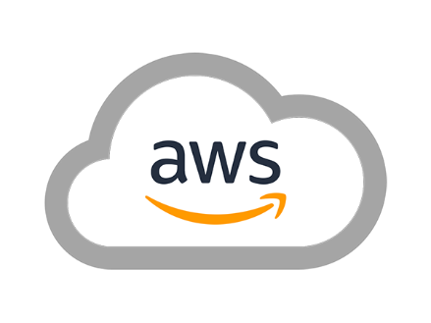
AWS Shared Responsibility Model
Customer data
Platform, applications, identity, & access management
Customers are responsible for security ‘in’ the cloud
Operating system, network, & firewall configuration
Client-side data Encryption & data integrity authentication
Server-side data File system and/or data
Network traffic Protection (encryption, integrity, identity)
Software
AWS is responsible for the security ‘of’ the cloud
Compute
Storage
Database
Networking
Hardware/AWS Global Infrastructure
Regions
Availability zones
Edge locations
Notes:
Security and compliance is a shared responsibility between a CSP and the customer. While each CSP has a different model and terminology, the key elements of shared responsibility can be broadly understood by looking at the AWS Shared Responsibility Model.
Customers are responsible for “Security in the Cloud” – Customer responsibility will be determined by the AWS Cloud services that a customer selects. This determines the amount of configuration work the customer must perform as part of their security responsibilities. For example, services such as Amazon Elastic Compute Cloud (Amazon EC2), Amazon Virtual Private Cloud (Amazon VPC), and Amazon S3 are categorized as Infrastructure as a Service (IaaS) and, as such, require the customer to perform all of the necessary security configuration and management tasks. If a customer deploys an Amazon EC2 instance, they are responsible for management of the guest operating system (including updates and security patches), any application software or utilities installed by the customer on the instances, and the configuration of the AWS-provided firewall (called a security group) on each instance.
AWS is responsible for “Security of the Cloud”. AWS is responsible for protecting the infrastructure that runs all of the services offered in the AWS Cloud. This infrastructure is composed of the hardware, software, networking, and facilities that run AWS Cloud services.

Slide 8
Mapping the Shared Responsibility to Personal Data Protection
Collection
Security
Use
Disclosure & Offshoring
Access & Correction
Deletion
Notes:
Regulators often also have questions about how personal data is protected in the cloud. A helpful way to consider this issue is by looking at the full lifecycle of the personal data.
Once again, managing the lifecycle of personal data comes down to the shared responsibility model.
As a reminder:
AWS: AWS is responsible for managing the security of the underlying cloud environment.
Customer: Customers are responsible for security in the cloud, including security of their content (and personal information included in their content).
So let’s take the shared responsibility model and see how it impacts each aspect of the data lifecycle.
Collection of personal data: the AWS customer collects personal data from their end users and determines the purpose for which the customer requires the data and will use that data. The customer is also responsible for notifying the “data subject”, if required, in accordance with applicable laws.
Data Controllers: should Seek consent before collecting their personal data & notify data subjects about the purpose for which their information will be collected, used or disclosed.
Security: Customers make choices about how they want to secure their data, for example by encrypting the data or creating layers of access controls (MFA) – in a moment we will dive a bit deeper on encryption options. AWS manages the security “of” the cloud. This means for example maintaining effective physical controls (e.g. access security to the data centers) and organizational controls (e.g. employees do not have access to customer content).
take steps to protect the security of personal data
Use: Customer: The customer determines why it collects personal information, and controls how it uses and discloses customer content that contains personal information and to whom it shares that information. The customer must ensure it does so for permitted purposes under applicable laws. AWS: AWS only uses customer content to provide the AWS services selected by each customer to that customer and does not use customer content for any secondary purposes.
Data controllers should only use or disclose personal data for the purpose for which it was collected
Disclosure & Offshoring: (this refers to when Customers disclose the personal data to third parties or move personal data cross-borders). Applicable privacy laws may regulate how this must be done.
Customer: As we discussed, the customer can choose the AWS Region or Regions in which their content will be located. The customer also chooses which third parties it will disclose the information to. It should make sure that it does this in compliance with the applicable requirements, e.g. some laws require that the customer obtain additional consents or ensure that the person to whom the data is disclosed is obligated to protect it to the same standard.
AWS: AWS commits not to move the customer’s data unless it is in accordance with their consent (or if there is a regulatory order requiring it to do so).
Data controllers: should inform individuals (data subjects) of the countries in which the customer will store their personal data
consider the comparable protections afforded by the privacy regime in the country where personal data will reside.
Access and Correction: Many privacy laws require customers to provide facilities for data subjects to access / correct their personal data.
The Customer determines and controls who can access the data and manages the relationship with its end users
Individuals (data subjects) may need to access their personal data, including for the purposes of correcting it.
Deletion: Customer determines when to retain personal data and when to delete it. Customers are responsible for making these decisions based on the privacy laws that apply to them.
Personal data typically should not be kept for longer than is reasonably required for the purposes for which the data was collected and should typically only be retained in accordance with relevant data retention laws.
Most privacy laws around the world recognize these general stages in the lifecycle of personal data and having guiding principles for each stage.
Personal data collection and use should be transparent and fair but recognize flexibility for range of circumstances where formalistic requirements are impractical or would impede technological development
Personal data collection – limited to information required for a defined purpose and with notice to, or consent of the individual concerned.
Use the personal data only of the purpose for which it was collected / the data subject is aware
Security safeguards to protect personal data should be implemented by data controllers
Personal data should be kept accurate and up to date
Individuals should be given appropriate choices and affordable mechanisms to exercise their rights
Individuals should be able to access and correct their personal data
When personal data is no longer required it should be deleted
Source: Using AWS in the Context of Common Privacy & Data Protection Considerations – May 2018 (https://d1.awsstatic.com/whitepapers/compliance/Using_AWS_in_the_context_of_Common_Privacy_and_Data_Protection_Considerations.pdf)

Slide 9
Ownership & control of customer content in the cloud
Customers continue to own their data. They can download or delete their data whenever they like
Customers choose the geographic location(s) in which to store their data—it does not move unless the customer decides to move it.
Customers decide on the data to be stored or processed using Cloud services
Customers decide on who has access to their content
Customers decide if and how to encrypt the data, based on the sensitivity of their data, while it is in transit and at rest.
Notes:
As you have seen from the previous slides, under the AWS Shared Responsibility Model, each AWS customer maintains ownership and control of their content, including control over:
What content they choose to store or process using AWS services, including whether or not that content includes personal data or personally identifiable information
Which AWS services they use with their content
The AWS Region(s) where their content is stored
The format, structure and security of their content, including whether it is masked, anonymized or encrypted
Who has access to their AWS accounts and content and how those access rights are granted, managed and revoked
Because AWS customers retain ownership and control over their content within the AWS environment, they also retain responsibilities relating to the security of that content as part of the AWS “shared responsibility” model. AWS does not have control over these decisions and is not in a position to make such determinations on behalf of Customers.
Customers continue to own their data.
Customers choose the geographic location(s) in which to store their data—it does not move unless the customer decides to move it.
Customers can download or delete their data whenever they like.
Customers can “crypto-delete” their data by deleting the master encryption keys that are required to decrypt the data keys, which are, in turn, required to decrypt the data.
Customers should consider the sensitivity of their data and decide if and how to encrypt the data while it is in transit and at rest.
Source: Data Residency White Paper (https://d1.awsstatic.com/whitepapers/compliance/Data_Residency_Whitepaper.pdf)

Slide 10
How cloud services can help with security

Slide 11
Modern security concerns and the role of data protection laws
Most vulnerabilities are exploited remotely
Manual processes and poor cyber hygiene Present Risk of Human Error
Real security depends on technical, operational and governance practices
Insider threats prevail as a significant risk
Notes:
When data is Digital, the physical location of the data has no bearing on any of the above listed realities.
Companies may have mistaken ideas that data is “safe” if they keep it onshore, or only on local servers, and in doing so can comply with data protection laws.
However, this perceive a sense of increased security for data processed and stored in local IT facilities because they offer physical proximity and control, is false. Deeper evaluation shows that limiting the use of local or on-premise IT does not provide better overall data security. From a risk- benefit perspective, hyperscale CSPs, like AWS, can better help manage cybersecurity risks.
Most Vulnerabilities are Exploited Remotely. The physical location of data has little to no impact on threats propagated over the Internet. Internetconnected systems expose an organization to a broad threat space, all of which are propagated from any location.
Manual Processes Present Risk of Human Error. Human process failure plays a role in root cause failure (if not the entire cause) of most cybersecurity events. A common example is a failure to patch vulnerable systems with published software updates for many months prior to an exploit.
Insider Threats Prevail as a Significant Risk. The vast majority of major data compromises have occurred either through unintentional errors or intentional malicious behavior by individuals using authorized accounts that have made data exploitation possible. The high-profile breaches of the last few years were largely attributed to poor cyber hygiene practices. The most common authorized account threat scenarios include:
• Inadvertent: credentials that are lost or mismanaged such that an attacker can act within a system as a valid user.
• Social engineering: phishing attacks and social engineering attacks that trick users or administrators into disclosing credentials to attackers.
• Malicious: classic insider threat – bad actors within the organization with nefarious intent

Slide 12
Tools for mitigating unauthorized access
Encryption
Tokenization
Data Decomposition
Cyber Deception Defense
Appropriately encrypting data can make the data unreadable
Defining a sequence of data to represent an otherwise sensitive piece of information
Reduces data sets into unrecognizable elements that have no significance on their own
Deception solutions use highly sophisticated traps and decoys against attackers
Notes:
Customers/ Data controllers have the responsibility to:
Determine where their content will be located, for example the type of storage they use on AWS and the geographic location (by AWS Region) of that storage
Control the format, structure and security of their content, including whether it is masked, anonymized or encrypted. AWS offers customers options to implement strong encryption for their customer content in transit or at rest, and also provides customers with the option to manage their own encryption keys or use third party encryption mechanisms of their choice
Manage other access controls, such as identity access management, permissions and security credentials
Preventing unauthorized acess requires practicing proper security hygiene and implementing robust preventive and detective capabilities.
Hyperscale CSPs, such as AWS, provide a full security tooling environment to enable customers to maintain encrypted communications and implement tampering protections to mitigate the risk of unauthorized access.
Encryption - Appropriately encrypting data can make the data unreadable. This means storing encrypted data in the cloud, regardless of location, can provide adequate protection against the vast majority of exfiltration threats. It is crucial that the encryption keys for the data are carefully managed to ensure strong protections are maintained against any intercepting party.
Tokenization – Tokenization is a process that allows you to define a sequence of data to represent an otherwise sensitive piece of information (e.g., a token to represent a customer’s credit card number). A token is meaningless on its own and cannot be mapped back to the data it represents without use of the tokenization system.
Data Decomposition – This is a process that reduces data sets into unrecognizable elements that have no significance on their own. These elements or fragments are then stored in a distributed fashion so that any compromise in one node would yield only an insignificant data fragment.
Cyber Deception Defense – Cyber deception architectures and solutions can be a key component for mitigating advanced adversaries. Deception solutions can use highly sophisticated traps and decoys to present an attacker with the perception that they have infiltrated the system while in reality diverting them to a highly controlled environment.

Slide 13
What does this mean collectively?
Companies need to learn how to create data governance frameworks to ensure that appropriate techniques are applied to the whole data lifecycle.
Companies can outsource some of this – relying on CSPs like AWS who have attained certification (including ISO 27001, 270018 and SOC2 Privacy Certification) – this helps companies know that the security of the CSP’s side of the shared responsibility is covered.
Governments can help with SME capacity building. Examples include:
Nymity Privacy Management Framework (https://iapp.org/resources/nymity-workbook-tool/)
Singapore PDPC Guide to Developing a Data Protection Management Programme (https://www.pdpc.gov.sg/-/media/Files/PDPC/PDF-Files/Other-Guides/DPMP/Guide-to-Developing-a-Data-Protection-Management-Programme-(18-Nov-2020).pdf?la=en)

