Slide 1
NMO Environmental Enforcement
Chris Smith
Technical Enforcement Manager

Slide 2
UK Enforcement
Background to Enforcement
NMO Policy and Approach
Practical Aspects of Recast
Labelling Recast

Slide 3
Macrory Review
Aim to change the behaviour of the offender
Aim to eliminate any financial gain or benefit from non-compliance
Be responsive and consider what is appropriate for the particular offender and the regulatory issue;
Be proportionate to the nature of the offence and the harm caused
Aim to restore the harm caused by the regulatory non-compliance, where appropriate and
Aim to deter future non-compliance
Notes:
Regulations - these are addressed to all member states and are applied in full. They are directly applicable without the need for national legislation Directives - they are addressed to all member states and require an objective to be achieved by a given date. National authorities must draw up legislation in order to conform with the Directive within a certain time frame (the date of implementation is known as the date of transposition). In the UK, Directives are usually implemented by Statutory Instruments and occasionally by Acts

Slide 4
Hampton Principles (1)
Regulators should provide authoritative, accessible advice
Regulators should use comprehensive risk assessment to concentrate resources on the areas that need them most
The businesses that persistently break regulations should face proportionate and meaningful sanctions
Regulators should be transparent in the way in which they apply and determine administrative penalties
Notes:
Regulations - these are addressed to all member states and are applied in full. They are directly applicable without the need for national legislation Directives - they are addressed to all member states and require an objective to be achieved by a given date. National authorities must draw up legislation in order to conform with the Directive within a certain time frame (the date of implementation is known as the date of transposition). In the UK, Directives are usually implemented by Statutory Instruments and occasionally by Acts

Slide 5
Hampton Principles (2)
Regulators should measure outcomes not just outputs
Regulators should recognise that a key element of their activity will be to allow, or even encourage, economic progress and only to intervene when there is a clear case for protection
Regulators should follow-up enforcement actions where appropriate
Notes:
Regulations - these are addressed to all member states and are applied in full. They are directly applicable without the need for national legislation Directives - they are addressed to all member states and require an objective to be achieved by a given date. National authorities must draw up legislation in order to conform with the Directive within a certain time frame (the date of implementation is known as the date of transposition). In the UK, Directives are usually implemented by Statutory Instruments and occasionally by Acts

Slide 6
PACE Police and Criminal Evidence
Control of evidence
Fair treatment of suspects
Investigate all relevant aspects

Slide 7
NMO Enforcement Policy
Enforcement Based on Intelligence and Risk
Compliance Through Co-operation
UK Only but…
Compliant UK
Outcomes
Proportionate Enforcement Actions
Meeting Hampton and Macrory

Slide 8
Enforcement is Based on Intelligence and Risk
Build Knowledge through understanding regulated markets
Individually risk organisations post investigation
Risk of non-conformity and impact of Nonconformity
React to intelligence appropriately

Slide 9
Proportionate Enforcement Action
Positive Solutions
Objectives of the Directive
Level and Scope of Breach
Response from the Producer
Fair Markets
Outcomes

Slide 10
Sanctions
Where an offence has been committed and after considering all of the evidence available and all of the actions of the economic operator concerned we will consider issuing some form of sanction as well as any other preventative or remedial action as deemed appropriate

Slide 11
Proportionate Actions
Education
Informal Warning
Improvement Plan
Compliance Notice
Enforcement Notice
Formal Caution
Civil Sanctions
Product Withdrawal
Court Action
Remedial Action
Publicity
Severity

Slide 12
Civil Sanctions
The NMO have 4 sanctions available:
Compliance Notice
Variable Monetary Penalty
Stop Notice
Enforcement Undertaking

Slide 13
Recovery of Costs
The NMO will where appropriate seek to recover costs associated with the purchase, disposal, administration and labour throughout the testing period, where a product tested under Article 19 of RAMS (Regulation (EC) No 765/2008) fails to comply with an applicable implementing measure.

Slide 14
Recovery of Costs
The NMO may recover the amount due as if payable under a court order
The NMO are not entitled to recover any costs proven to have been incurred unnecessarily
Unpaid costs will be enforced through the civil courts

Slide 15
RoHS
Recast

Slide 16
Recast Practical Considerations
Transitional arrangements and placing on the Market
CE marking
Declarations of Conformity
Technical Documentation
Production control
RAMS

Slide 17
Technical Documentation
Article 7(b)
manufacturers draw up the required technical documentation and carry out the internal production control procedure in line with module A of Annex II to Decision No 768/2008/EC or have it carried out;

Slide 18
Technical Documentation
Shall include where applicable:
Description of product
conceptual design and manufacturing drawings and schemes of components, sub-assemblies, circuits, etc.
descriptions and explanations necessary for the understanding of those drawings and schemes and the operation of the product,
Harmonised standards etc applied
Test results

Slide 19
Eco-Design

Slide 20
Environmental Objective

Slide 21
Energy Labelling Framework Energy Related Products Framework

Slide 22
WORST PERFORMERS
MARKET LEADERS
ERP
removes
ELF
Drives consumer choice

Slide 23
Framework
with broad scope
Specific Measure
Narrow scope
Specific Measure
Narrow scope
Specific Measure
Narrow scope

Slide 24
Energy Labeling
Recast

Slide 25
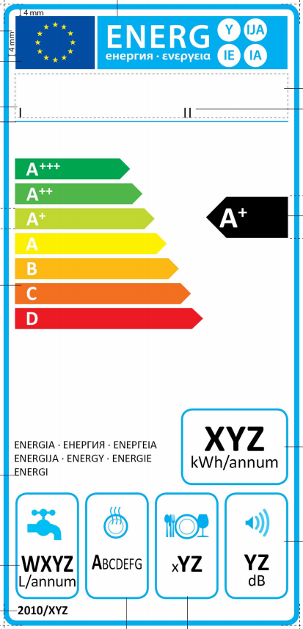

Slide 26
July 20 2011
Overall scope now all energy related products
Only specific products have implementing measures
A-G label is now protected (Article 15)
Energy class must be included in all advertising where performance or price mentioned
Catalogue, web and other distance selling covered
ALL environmental claims covered (Article 3.1(b))

Slide 27
Working with Industry to Ensure UK Compliance
www.bis.gov.uk/nmo/enforcement/

