Slide 1
THE FUTURE OF CONNECTIVITY IN NIGERIA January 2021
© 2021 ATC IP LLC. All rights reserved.

Slide 2
Nigeria in Numbers
208 million people, 50% aged 19 and below
Land Mass 923,768 km²
17,000+ km² urban with over 50% of population resident
880,000+ km² rural with 48.8% of population resident
11% contribution by Telecoms to GDP as of 2020
4 Mobile Operators, 2 Dominant Towercos
40000 km of fiber deployed
152 million active internet subscribers
45.9% broadband penetration
4G coverage is available to almost 50% of the population
31 million people in 564,000 km² underserved as of 2020
Sources: www.statista.com, World bank development indicators and data bank 2021, (CIESIN)/Columbia University, USPF, Nigerian Communications Commission, Deloitte National Broadband Plan Analysis

Slide 3
The numbers reveal challenges and opportunity
Land mass vs population distribution reveal interesting data sets
Approximately 6100 people per km² in Urban Nigeria
Delivering adequate connectivity requires significant investment
Dense population requires resilient and innovative telecoms infrastructure mix
Approximately 115 people per km² in rural Nigeria
Unit cost of delivering infrastructure high
Low population density and remoteness make it difficult to breakeven using traditional connectivity solutions
In summary, delivering connectivity is expensive in both urban and rural settings
Clever mix and balance needs to be achieved for both scenarios. Solve capacity issues in urban areas while solving coverage issues in rural
An enabling environment through policy, investment and innovation needs to be created to successfully proliferate connectivity
Sources: Nigeria National Broadband Plan 2020, World Bank, AA4i

Slide 4
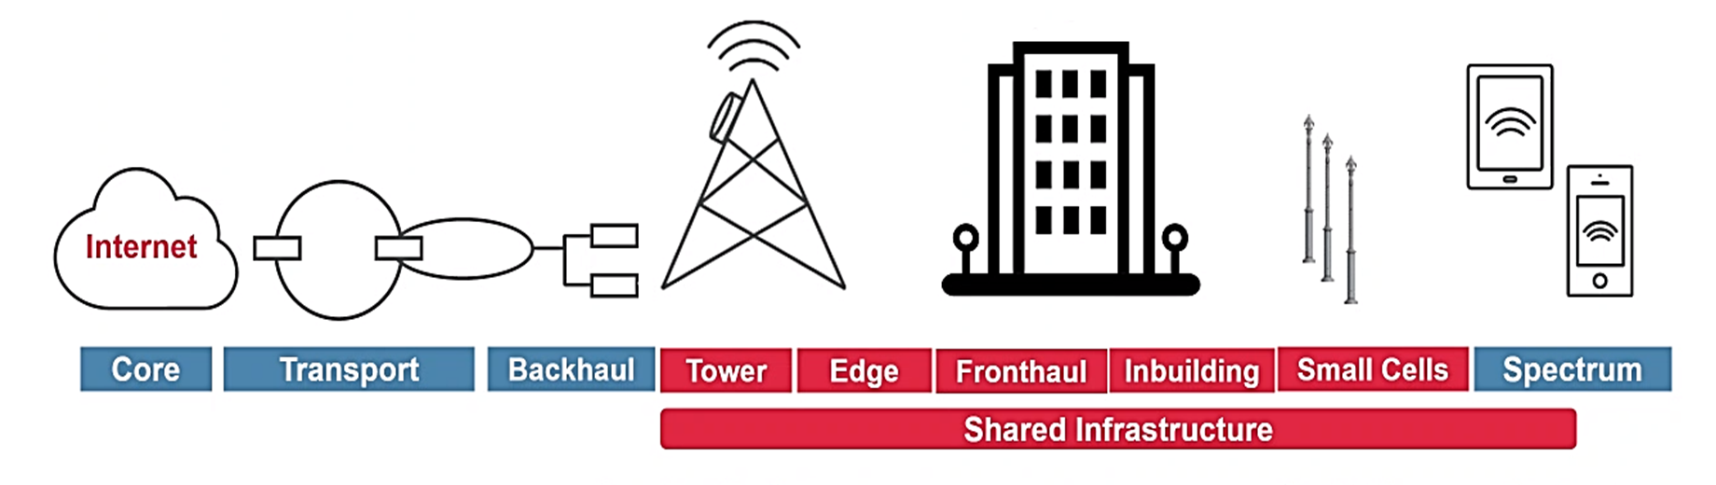
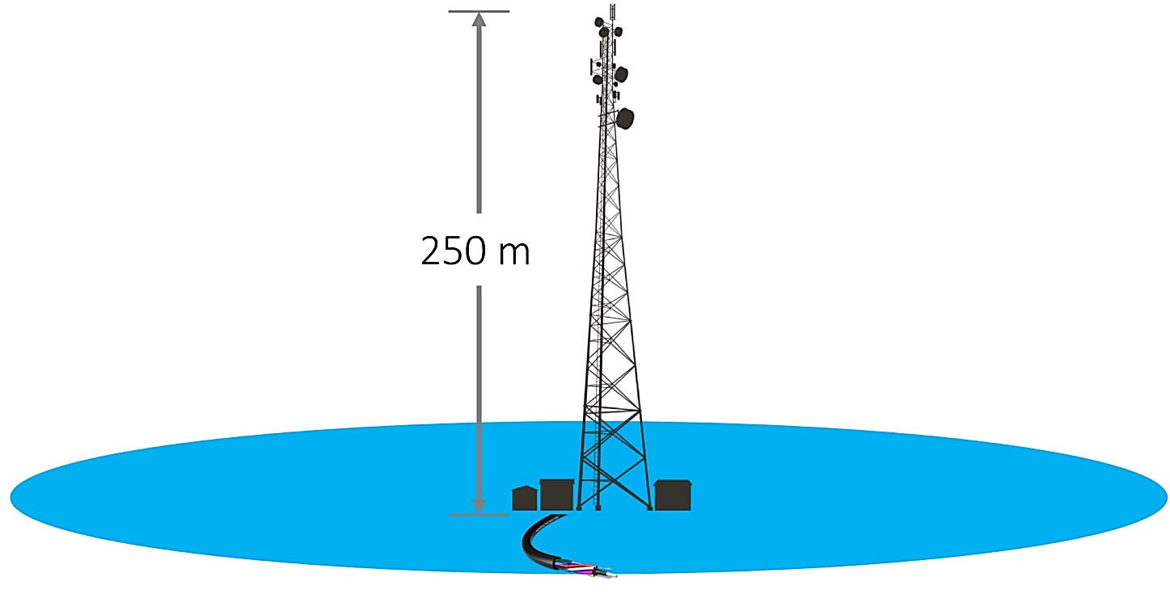
What the future will look like
URBAN CUSTOMER EXPERIENCE
Pervasive fiber connectivity to towers and residential clusters
Metro data centers beyond Lagos
Fiber to the tower
Small cells and non-traditional tower solutions
Core, Transmission and RAN to leverage more software
Low-cost rural towers
Off grid powered macro cells
Tall tower deployments
High altitude solutions
Active sharing and open ecosystems
RURAL CUSTOMER REACH

Slide 5
How do we get there?
Progressive policies and regulation in progress
2025 broadband plan to enable effective coverage and capacity
New broadband plan designed to deliver minimum of 25Mbps in urban areas, and 10Mbps in rural areas, with effective coverage available to at least 90% of the population by 2025
Government led national ROW intervention to accelerate fiber build
Progressive business rules (5G, Active sharing, Roaming, Colocation)
Industry innovation and investment
Attract FDI to existing local players and potential market entrants
Evolution of players in value chain to InfraCos and ServiceCos
Open protocols and systems enabling Open RAN, Active sharing etc.
Open access transmission and last mile enabling FTTH, FTTT, FTTB etc.
Local content caching via EDGE infrastructure to enable lower latencies
The
ITU econometric modelling report suggests that an increase of 10 per cent in fixed broadband penetration has the ability to yield an increase in 1.9 per cent in GDP per capita
Sources: ITU Econometric modelling report for the Americas 2019

Slide 6
ATC Nigeria
Thank you

