Slide 1
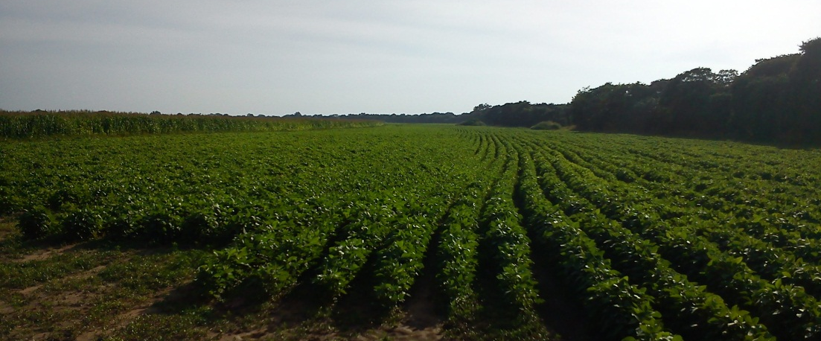
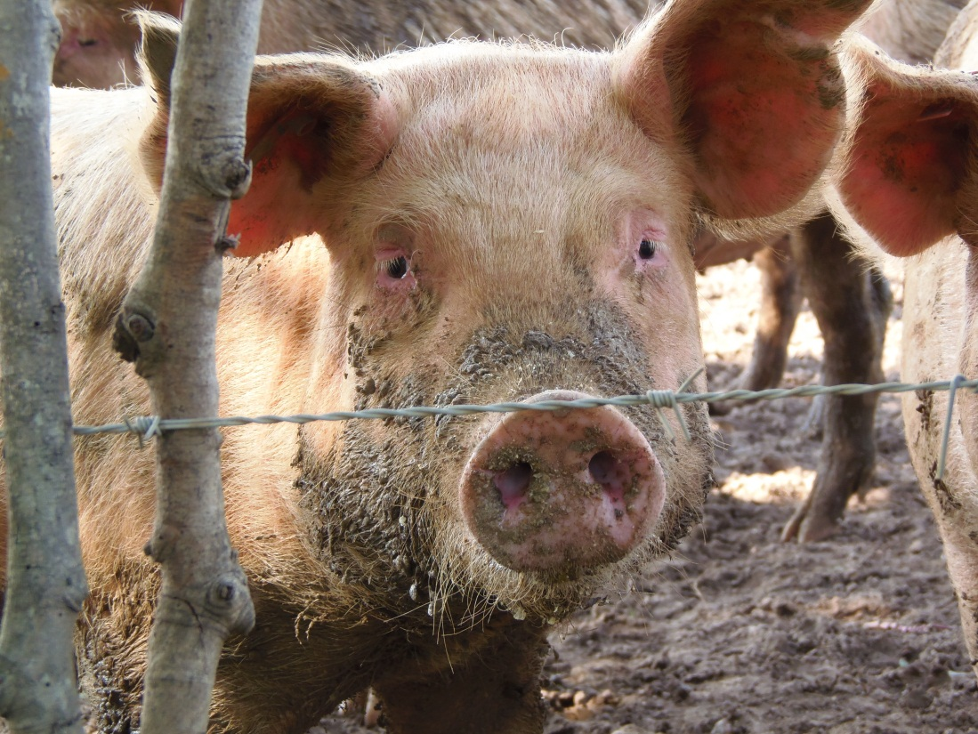
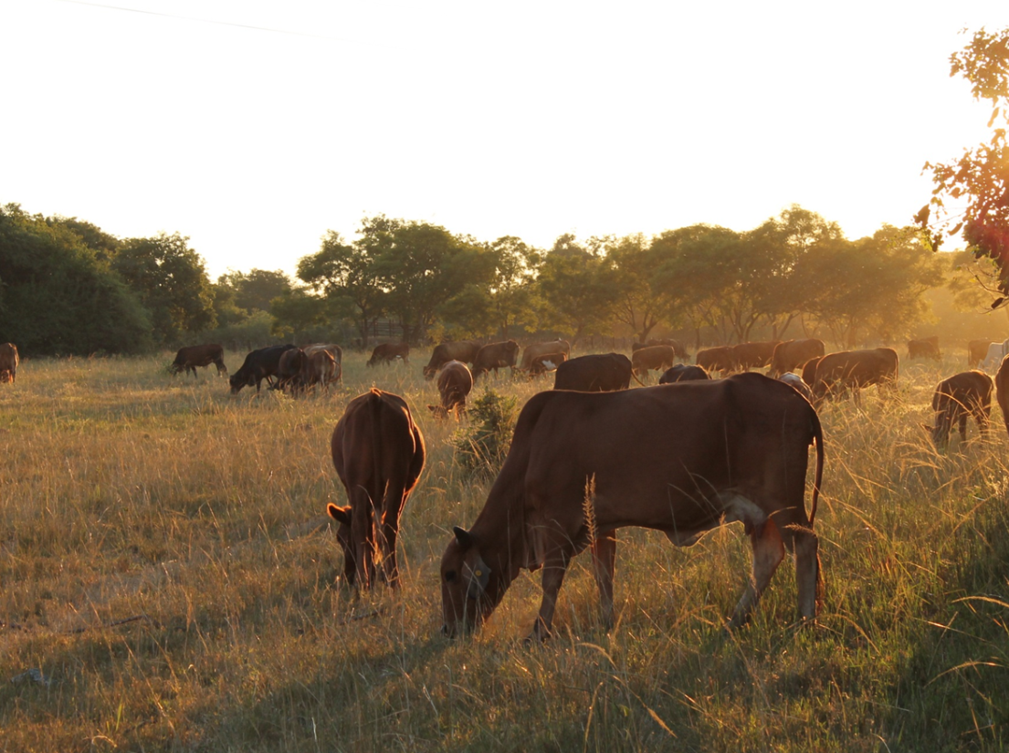
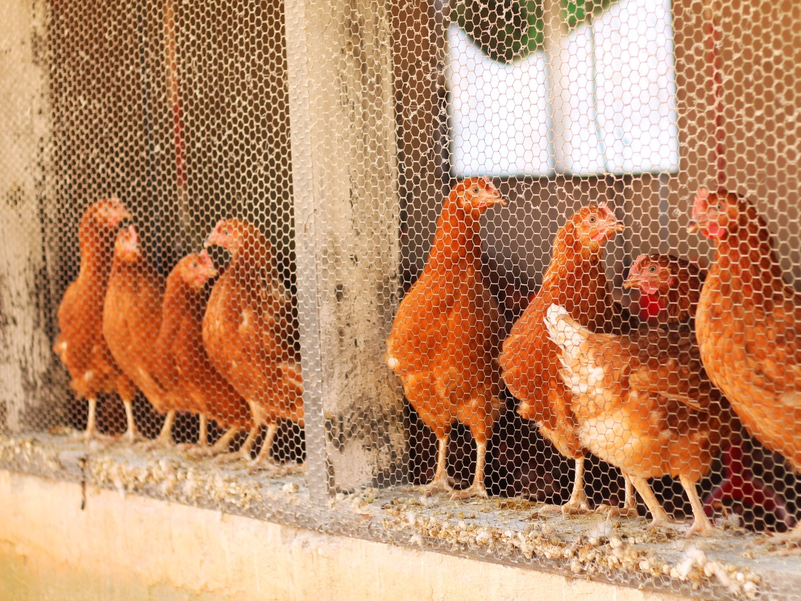
Chankwakwa Farm is an established commercial farm, since 1974, producing maize, soya beans, beef, pork, eggs and vegetables.

Slide 2
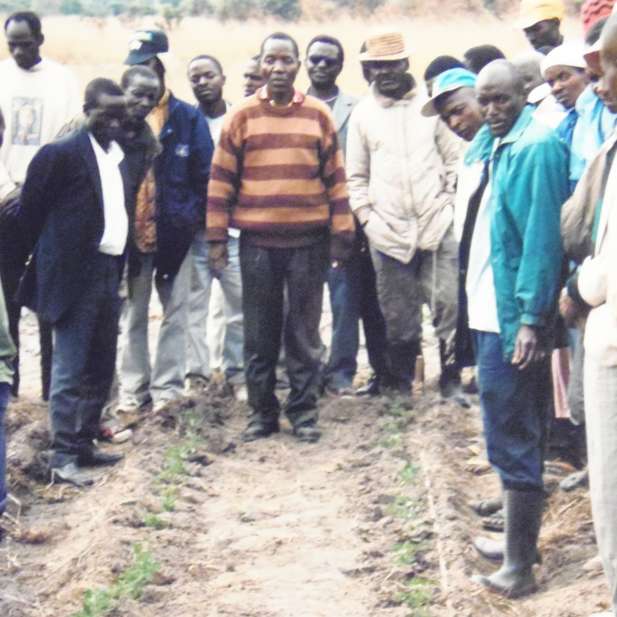
Chankwakwa very early had a desire to empower small scale farmers by teaching them tomato growing and thereby improving their crops.
Chankwakwa started a tomato out-growers scheme , where Chankwakwa provided inputs and know-how and then bought the tomatoes.

Slide 3
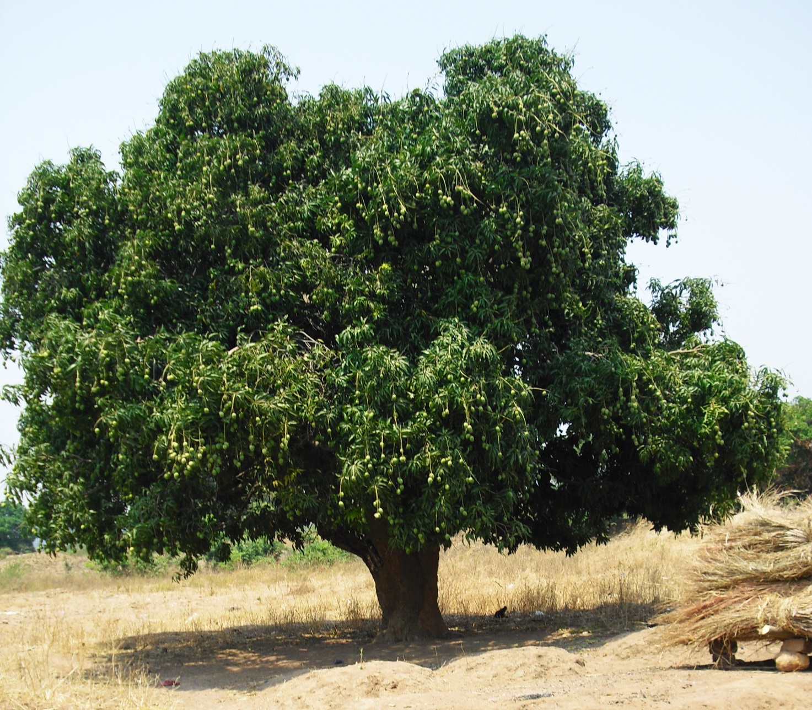
A single mango tree in Zambia can produce over 600 kg of fruit, but mostly the mangos goes to waste. In the year 2000 Chankwakwa started experimenting with drying the fruit, with the export market in mind.

Slide 4
To be able to export Chankwakwa needed the HACCP standard certification, from SGS in South Africa, in the factory and traceability back to the farmers.
And to be competitive it became necessary to look into ORGANIC certification from ECOCERT, South Africa, as well.

Slide 5
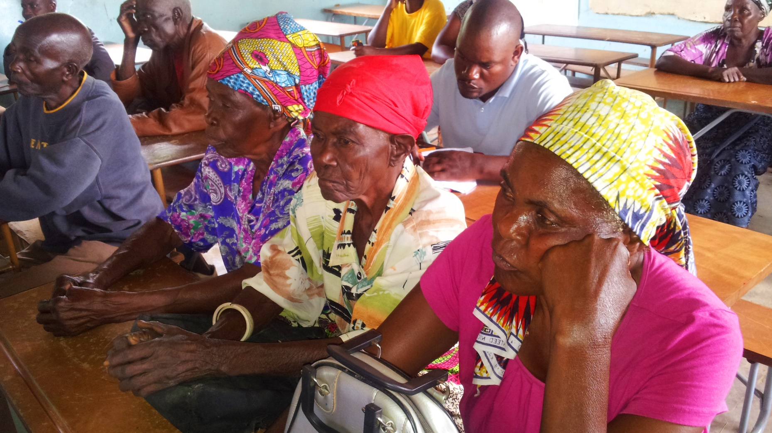
Chankwakwa continuously trains the famers that are registered and contracted, on management of the trees and principles of organic farming. There is also a fulltime field manager available to assist the farmers and to make sure they conform to the regulations set by the Organic association.

Slide 6
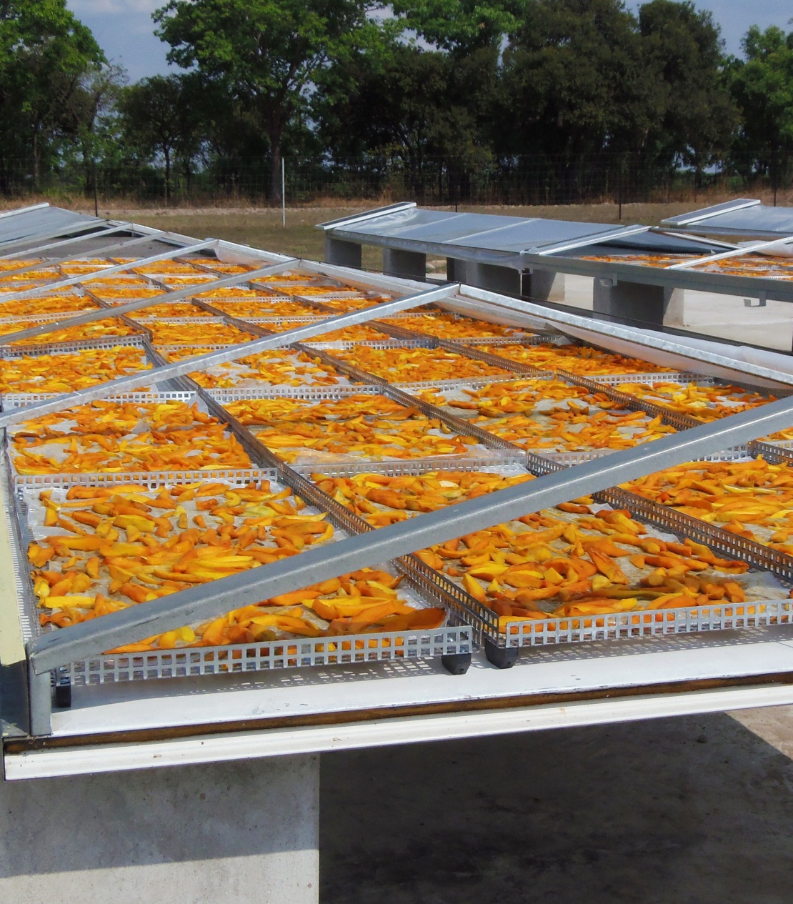
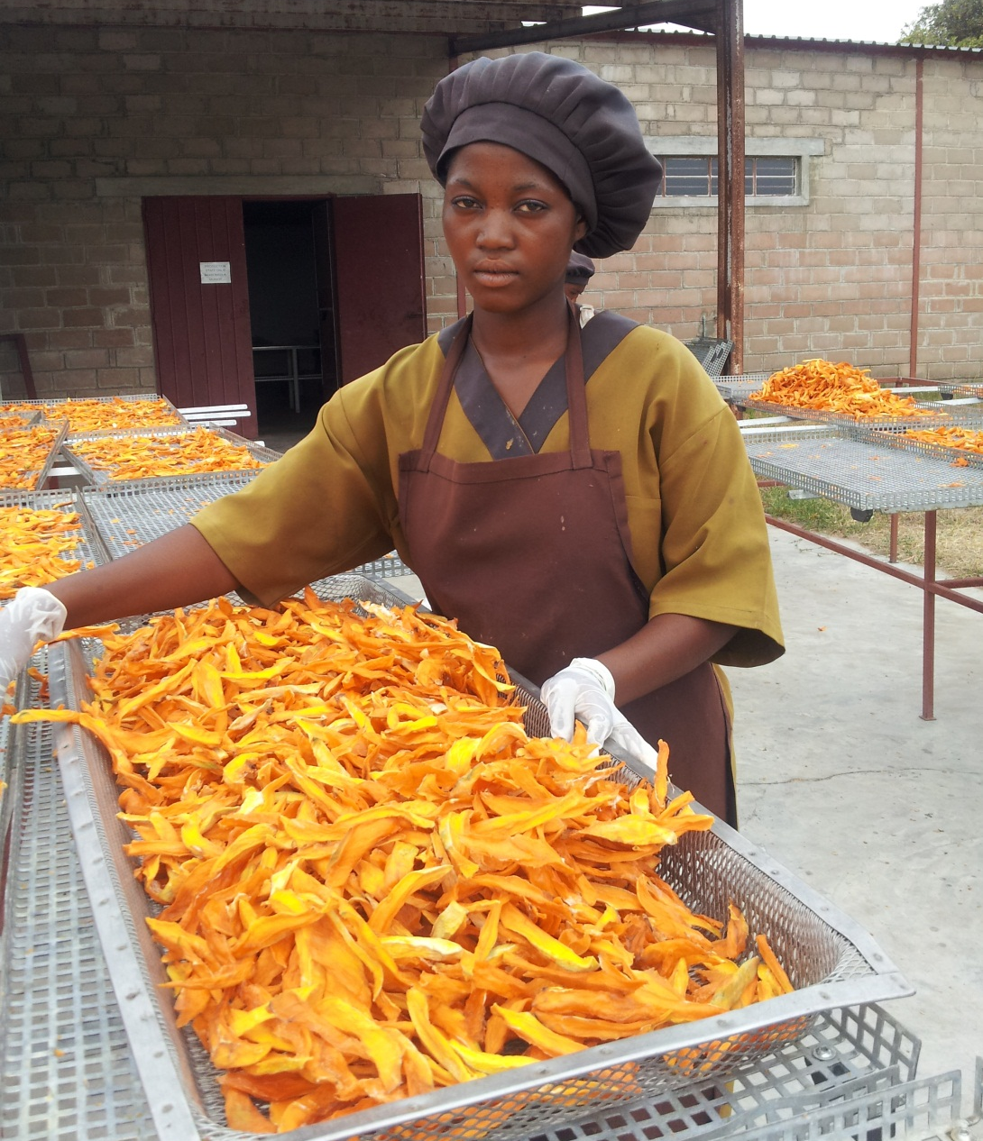
Chankwakwa Organic Dried Mango ready for export to Denmark in 2012. Today we have installed two electric dryers, with a capacity of 1000 kg of raw fruit every 10 hours, beside the six solar dryers.
Chankwakwa is working with over 1000 farmers in Luapula Province, as well as 250 farmers in Kabwe,Central Province.

Slide 7
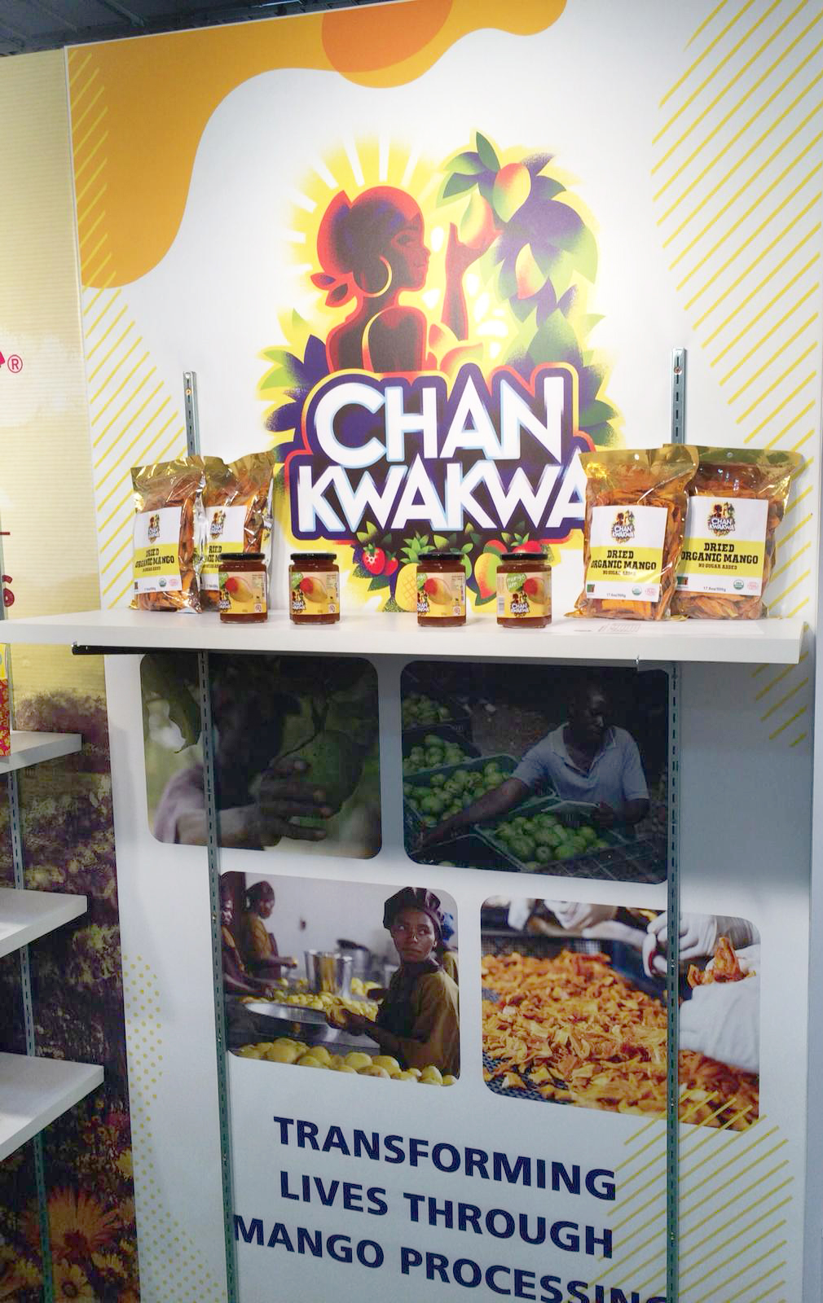
An opportunity emerged with Southern African International Trade Hub (SAITH) to attend the Fancy Food Show in New York in June 2019. Through the training held by SAITH in Lusaka the following was learnt and begun to be implemented:
a) FDA certification was needed which is available online.
b) Labelling has to be changed to American standards.
c) The HACCP certification is not valid, instead HARPC certification, which is very similar, is required.
Inspite of these challenges ahead of us we are very positive as we found that the market is so huge and the opportunity to export using the AGOA window makes us competitive.

