Slide 1
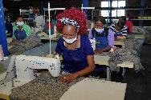



USAID southern Africa trade AND INVESTMENT hub
Exporting under AGOA | The Practicalities
Increasing Global Competitiveness, Intraregional Trade, and
Improving Food Security

Slide 2
Presentation Outline
The Trade Hub | Overview
AGOA | Snapshot
U.S. and Zambia
AGOA Today
Zambia AGOA Performance
Benefits of AGOA
Smart Use of AGOA
AGOA: Step-By-Step & Checklist
Key Resources
Notes:
There is a “blank” moment that comes up right before this slide that should be removed.

Slide 3
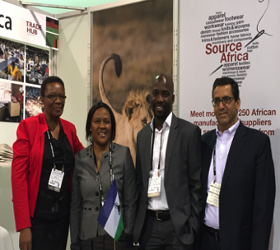
Southern Africa Trade and Investment Hub
  Fourth generation of USAID’s economic growth assistance to Southern Africa.
  Closely aligned with sister projects headquartered in Nairobi, Kenya, (the East Africa Trade and Investment Hub).
  Offices in Pretoria, South Africa, Presence in Gaborone, Botswana; and Lusaka, Zambia.
  Geographic scope includes Angola, DRC, and Zimbabwe but not currently covered.
  Five-year project – 2016-2021.
Notes:
There is a “blank” moment that comes up right before this slide that should be removed.

Slide 4
SACU:
Botswana
Lesotho
Namibia
South Africa
Swaziland
Feed the Future:
Malawi
Mozambique
Zambia
SEYCHELLES
TANZANIA
ANGOLA
ZAMBIA
Lusaka
MALAWI
Lilongwe
MADAGASCAR
NAMIBIA
Windhoek
ZIMBABWE
BOTSWANA
Gaborone
MAURITIUS
MOZAMBIQUE
Maputo
Pretoria
Johannesburg
SWAZILAND
Mbabane
LESOTHO
Maseru
SOUTH AFRICA
Cape Town
TRADE HUB FIELD OFFICES

Slide 5
Agribusiness Trade
Finance and Investment
Enabling Environment/Trade Facilitation
Export Competitiveness
Increasing competitiveness of agricultural value chains for export and regional trade through investment, technology transfer, and greater private sector participation.
Accelerating US and international investment and finance to small and medium-sized enterprises (SMEs) and strategic value chains that strengthen economic growth and trade.
Enhancing value chains and increasing exports from Southern African countries to world markets, leveraging AGOA.
Supporting regional and national partners in enabling transparent, reliable, efficient and cost-effective trade through policy-level and commercial approaches.

Slide 6
AFRICAN GROWTH & OPPORTUNITY ACT (AGOA)

Slide 7

AGOA | SNAPSHOT
Preferential, non-reciprocal trade arrangement
Enacted May 18, 2000 – as Public Law 106-200
Longest Extension in its History: 2015- 2025
Builds on the US ‘General Systems of Preferences’
Only benefits eligible Sub-Saharan Africa (SSA) Countries
Duty and quota-free preferences (over 6,500 tariff lines)
  - products listed as eligible under GSP/AGOA
  products produced locally /substantially transformed locally

Slide 8
What to Note About AGOA
AGOA is not permanent
AGOA is a preferential, non-reciprocal trade agreement and not a free trade agreement
Rules, conditions, access, individual beneficiary status can change when the US Congress / President decides
The US market is highly competitive yet a massive consumer market – if you successfully sell to the US, you can be competitive anywhere

Slide 9
AGOA RULES OF ORIGIN
Apparel Rules of Origin
AGOA’s ‘wearing apparel’ provisions reflective of the historic sensitivities around the trade in garments
Countries must first implement an apparel ‘visa system’
Once qualified, eligible countries may ship garments duty-free in a number of different categories, incl.
  Apparel from foreign fabric made in a lesser developed country
  Apparel from regional fabric from U.S. or African yarn
Subject to (theoretical) quota based on total US imports
Rules For Everything Else
Product must be the ‘product, growth or manufacture’ of the beneficiary country
Imported directly into the US
Cost of materials and direct costs of processing (incl. labour) must >35% of appraised value at US port of entry - up to 15% of 35% may comprise materials of US origin
Cumulation of origin: beneficiary countries may jointly meet local content rules (considered as “one”)

Slide 10
How Products Qualify for AGOA Duty-Free Treatment
Must be AGOA/GSP eligible.
Must be imported into the US directly from an AGOA beneficiary country or pass through another country in a sealed container.
Must be the growth, product, or manufacture of the AGOA beneficiary country.
Meet the 35% value requirement i.e. where foreign materials are imported for production, the sum of the cost of the materials produced in the AGOA beneficiary country, plus the costs of processing, must equal at least 35% of the final product’s value.
US importer must request duty-free treatment on the relevant customs entry form (Form 7501) by placing a “D” in column 27 in front of the U.S. tariff number that identifies the imported article.
Notes:
There is a “blank” moment that comes up right before this slide that should be removed.

Slide 11
AGOA TODAY
40 beneficiary countries
AGOA Exports
29.9% jump from US$10.6 billion in 2016 to US$13.8 billion in 2017
None-Oil Exports (NOE)
30.99% ($4.28 billion) of total AGOA Exports in 2017
39.13% ($4.16 billion) of total AGOA exports in 2016
Expires Sept 2025

Slide 12
Regional AGOA Exports
(2017) US$000’s)
 | Agric | Forest | Chemicals & related | Energy-related products | Textiles & apparel | Footwear | Minerals & metals | Machinery | Transportation equipment: | Electronic products: | Misc. Mnfrs | Totals (2017)
South Africa | 278,759 | 6,464 | 316,335 | 13,335 | 5,985 | 482 | 817,417 | 18,434 | 1,325,505 | 18,049 | 131,204 | 2,931,969
Lesotho | 61 | 0 | 117 |  | 288,885 |  |  |  |  | 5 |  | 289,068
Malawi | 42,958 |  |  |  | 321 |  |  |  |  |  | 20 | 43,299
Mozambique | 9,245 | 4 | 0 | 0 | 0 | 0 | 1,331 | 0 | 0 | 0 | 0 | 10,580
Namibia | 4 | 41 | 7 | 0 | 1 | 0 | 1,386 | 0 | 6 | 0 | 0 | 2,284
Zambia | 404 |  |  |  | 4 |  | 70 | 7 | 2 |  | 594 | 1,081
Botswana |  |  |  |  | 991 |  |  |  |  |  |  | 991
Eswatini (2018 YTD June) | 44 | 75 | 181 | 0 | 0 | 0 | 183 | 0 | 0 | 0 | 47 | 530

Slide 13
AGOA Exports Potential- by Country
ZAMBIA
Honey (organic) Dried Fruits Leather Crafts Horticulture products
MALAWI
Macadamia Nuts Honey Handicrafts Tea Paprika Mangoes Organics
NAMIBIA
Meat (beef/game) Table grapes Dates Home Décor Olive Oil
MOZAMBIQUE
Natural/Organic (baobab) Honey Dried kidney beans Macadamia nuts (shelled) & peanuts Crafts
BOTSWANA
Apparel Natural/Organic Products Handicrafts/Accessories Meat (beef)
ESWATINI
Apparel Accessories Macadamia Nuts Sauces
SOUTH AFRICA
Textile, Apparel & Macadamia Nuts Culinary Oil (Olive Oil + other) Beverages Confectioneries Dried Fruits
LESOTHO
Textile, Apparel & Footwear Natural/Organic product (rosehip) Dried fruit Medicinal Products
SOUTH AFRICA

Slide 14
United States and Zambia
Zambia is an AGOA eligible country, also Third Country Fabric (TCF) Provision eligible
Zambia ranks 155th among goods trading partners with the US
United States' 135th largest supplier of goods imports in 2017.
U.S. goods imports from Zambia totaled $66 million in 2017, up 41.9% ($19 million) from 2016, and up 35.4% from 2007.
Top exports in 2017: precious metal & stone (emeralds) ($44m), other base metals (cobalt) ($15m), copper ($5m), coffee, tea & spice (coffee) ($1m), and dairy, eggs, honey ($358,000).
U.S. total imports of agricultural products totaled $2m in 2017.

Slide 15
Zambia AGOA Performance
2015- 2017 US$’000s
Sector | 2015 | 2016 | 2017 | 2017 YTD June | 2018 YTD June | Totals (2015- 2017)
Agricultural products | 295 | 65 | 404 | 174 | 108 | 764
Forest products | 0 | 0 | 0 | 0 | 0 | 0
Chemicals & related products | 0 | 0 | 0 | 0 | 0 | 0
Energy-related products | 0 | 0 | 0 | 0 | 0 | 0
Textiles & apparel |  |  | 4 | 4 | 2 | 4
Footwear | 0 | 0 | 0 | 0 | 0 | 0
Minerals & metals | 3,205 | 1,735 | 70 |  | 21,429 | 5,010
Machinery |  | 4 | 7 |  |  | 11
Transportation equipment |  |  | 2 | 2 |  | 2
Electronic products | 0 | 0 | 0 | 0 | 9 | 0
Miscellaneous manufactures | 239 | 14 | 594 | 138 | 1 | 847
All sectors: | 3,739 | 1,818 | 1,081 | 318 | 21,549 | 6,638

Slide 16
Benefits of AGOA
….. to SSA /the Exporter
duty-free access – competitive advantage
6,500 tariff lines
access to the largest single market in the world
encourages export diversification
encourages regional integration + production sharing
job creation …. 350,000+ direct jobs in SSA, 1000,000 in the USA
supports value chain development and economic growth
strengthens US-SSA trade, investment, aid, cooperation relationships
builds capacity to explore other markets
international standards
supported by US technical expertise and resources
improves local business environment- due to eligibility requirements
Greater certainty than under standard GSP (expiration)

Slide 17

…… to the US /the Importer
job creation … 100,000 jobs in the US, 350,000+ in SSA
competitive source of products
technological transfer opportunities
partnership with SSA suppliers

Slide 18
Smart Use of AGOA
Duty | HTS Code | Knit or Crochet | Not Knit or Crochet | HTS Item Description (Truncated) | Fiber Content
32.0% | 6111.30.20.00 | X |  | Babies' blouses & shirts, except those imported as sets | of synthetic fibers
32.0% | 6111.30.30.00 | X |  | Babies' T-shirts, singlets & similar garments, except those imported as parts of sets (239) | of synthetic fibers
30.0% | 6111.30.40.00 | X |  | Babies' sweaters, pullovers, sweatshirts, waistcoats (vests), & similar articles, except those imported as parts of sets (239) | of synthetic fibers
32.0% | 6105.20.10.00 | X |  | Men's or boys' shirts | of man-made fibers
32.0% | 6106.20.20 | X |  | Women's or girls' blouses | of man-made fibers
32.0% | 6109.90.10 | X |  | T-shirts, singlets, tank tops & similar garments | of man-made fibers
32.0% | 6110.30.30 | X |  | Sweaters, pullovers, sweatshirts, waistcoats (vests) & similar articles | of man-made fibers
32.0% | 6114.30.20 | X |  | Other garments, bodysuits & bodyshirts | of man-made fibers
Capitalizing on high duty products
Notes:
Everyone needs to know what the Trade and Investment Hub is and understand that, despite that it has many components and implements a variety of activities, it is a single project. This statement sums up what the Trade and Investment Hub is and should be used whenever someone is asked, “What is the Trade and Investment Hub?” Emphasizing coherence of our components is strategically important. Please do not refer to the project as “SATIH.”

Slide 19




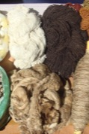

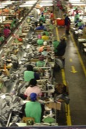
Issues & Opportunities
Competitiveness
Export diversification
International Standards Compliance
Export Utilization Strategies
Packaging and labelling
Esp. in food products
Packaging/Labelling Improvement
-from Hub research in 2018
Partnerships
Partnership era, like marriage
Negotiating
Improved negotiation with international buyers, retailers
Raw Material
Limited varieties and volumes from the region
Limited export diversification
Speed-to-Market
Productivity improvement
Some exporters end up air-freighting low-value to the US, which is costly
Factory inefficiencies
  55% (Africa) vs 70-80% in Asia (textiles)
Notes:
Everyone needs to know what the Trade and Investment Hub is and understand that, despite that it has many components and implements a variety of activities, it is a single project. This statement sums up what the Trade and Investment Hub is and should be used whenever someone is asked, “What is the Trade and Investment Hub?” Emphasizing coherence of our components is strategically important. Please do not refer to the project as “SATIH.”

Slide 20
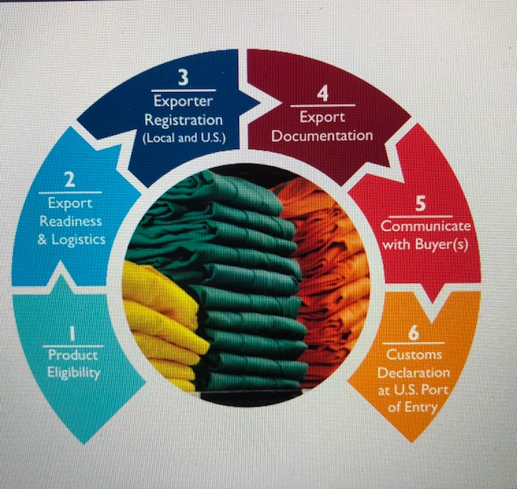
Step-By-Step | Exporting under AGOA

Slide 21
AGOA Export Checklist
Non-Textiles
Commercial Invoice, by the producer , describes goods and value , declaration certifying the value
Certificate of Origin, by the exporter /broker, certifies origin of goods, (country where at least 30% value has been added to the goods).
Broker Declaration, on behalf of the exporter based on the two documents listed above, - broker may physically inspect the goods
Customs of Exporting Country examines and certifies goods, presentation includes the Declaration and Certificate of Origin
Customs gives clearance for shipment, -Certificate of Origin endorsed by Customs
Exporter transmits the originals, -of the Commercial Invoice and Certificate of Origin,
official customs declaration at the US side by importer/agent
Textiles/Apparel
 Commercial Invoice
 Textile Certificate of Origin
 Broker Declaration (based on 2 documents above)
 Exporting Country Customs examines and certifies goods
 Goods cleared for shipment, by stamping Commercial Invoice and issuing a 9 digit VISA by Customs
 Exporter transmits the originals, of the Commercial Invoice and the Certificate of Origin
 Official Customs Declaration at US side, by importer/agent
Notes:
Everyone needs to know what the Trade and Investment Hub is and understand that, despite that it has many components and implements a variety of activities, it is a single project. This statement sums up what the Trade and Investment Hub is and should be used whenever someone is asked, “What is the Trade and Investment Hub?” Emphasizing coherence of our components is strategically important. Please do not refer to the project as “SATIH.”

Slide 22
Post 2025?

Slide 23
Key Resources
  African Growth & Opportunity Act: http://trade.gov/agoa | www.agoa.info
  US Trade Representative (USTR): www.ustr.gov
  US International Trade Commission (USITC): www.usitc.gov
  US Food and Drug Administration (FDA): www.fda.gov
  US Department of Commerce (DoC): www.doc.gov
  International Trade Administration (ITA): www.trade.gov
  US Department of Agriculture (USDA): www.usda.gov
  US Customs and Border Protection (CBP): www.cbp.gov
  Registrar Corp: www.registrarcorp.com
  Trade Law Centre: www.tralac.org
  The Hub: www.satihub.com
Notes:
Everyone needs to know what the Trade and Investment Hub is and understand that, despite that it has many components and implements a variety of activities, it is a single project. This statement sums up what the Trade and Investment Hub is and should be used whenever someone is asked, “What is the Trade and Investment Hub?” Emphasizing coherence of our components is strategically important. Please do not refer to the project as “SATIH.”

Slide 24
Zikomo kwambiri
www.satihub.com

