Slide 1
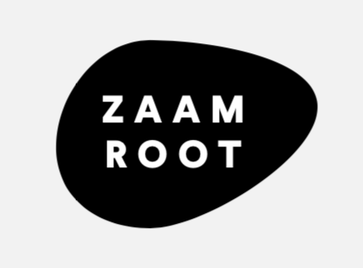
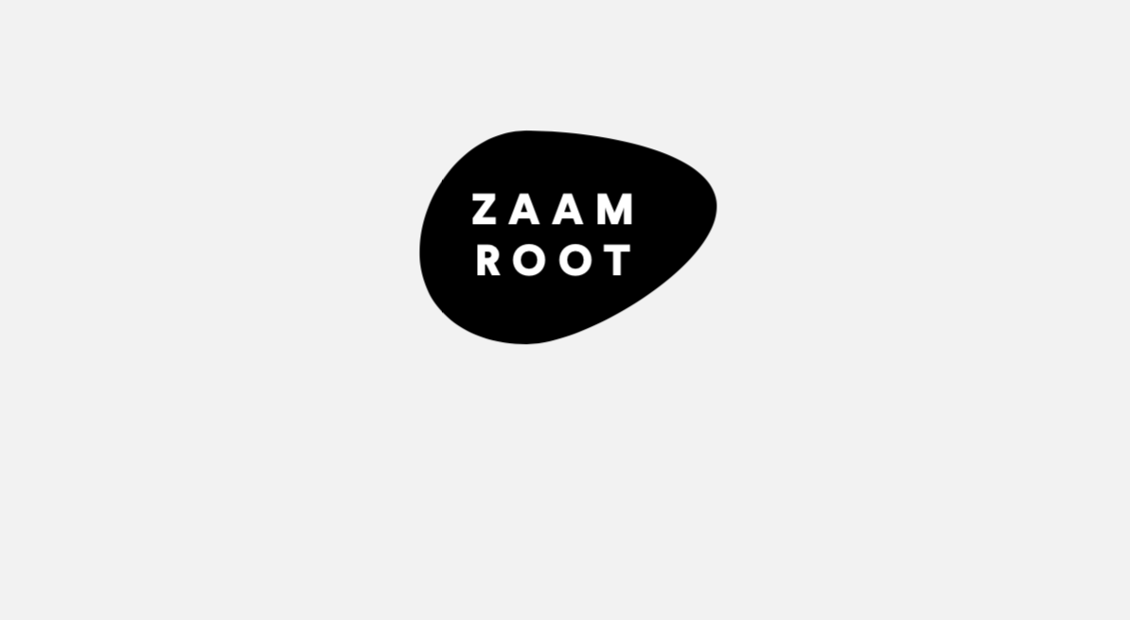
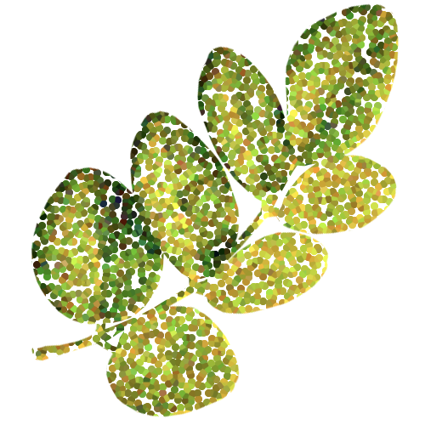
INTRODUCTION

Slide 2
ZAAMROOT
ZAAMROOT IS A B2B AFRICAN INGREDIENT COMPANY THAT SEEKS TO CREATE A SUSTAINABLE & TRANSPARENT SUPPLY CHAIN.
CONNECTING THE PIECES OF THE PUZZLE TOGETHER: FROM THE SEED, TO THE SALE.

Slide 3

SUSTAINABILITY & GROWTH IN OUR CORE

Slide 4
OUR FIRST PRODUCT
SUPER MORINGA is ethically sourced: 100% pure Moringa Leaves are used. Organic. The delicate green leaves and even the stems of the plant are packed with vitamins, amino acids, anti-oxidants and protein. Moringa leaves have a high nutritional value and contain amino acids, which are rarely found in other plants. Most of all its provides a caffeine free energy boost.

Slide 5
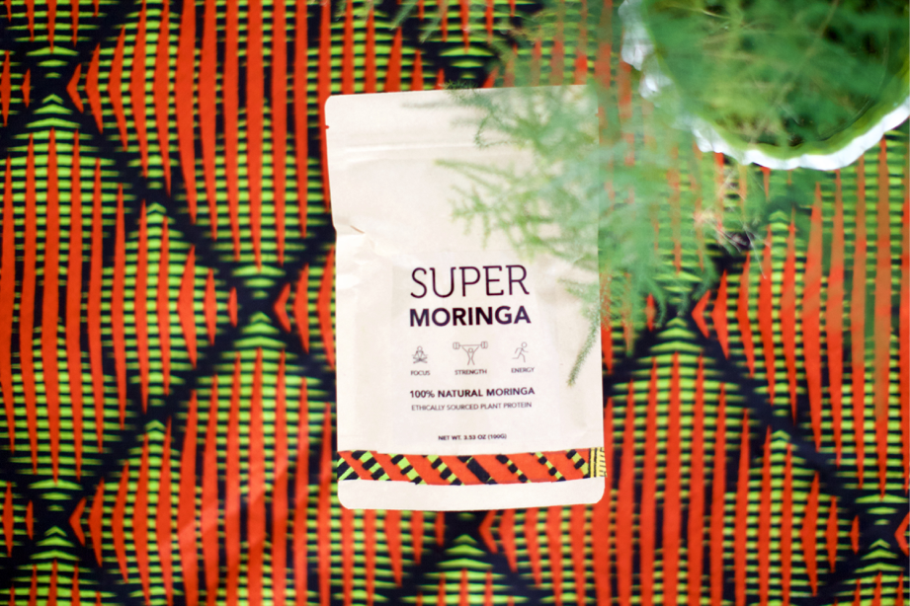
OUR PARTNERS
HEALTH FOCUSSED, INNOVATIVE BRANDS WITH A SOCIAL CONSCIOUS.

Slide 6
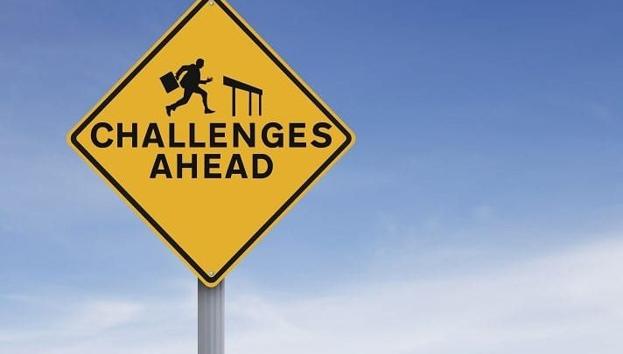
THERE ARE CHALLENGES

Slide 7
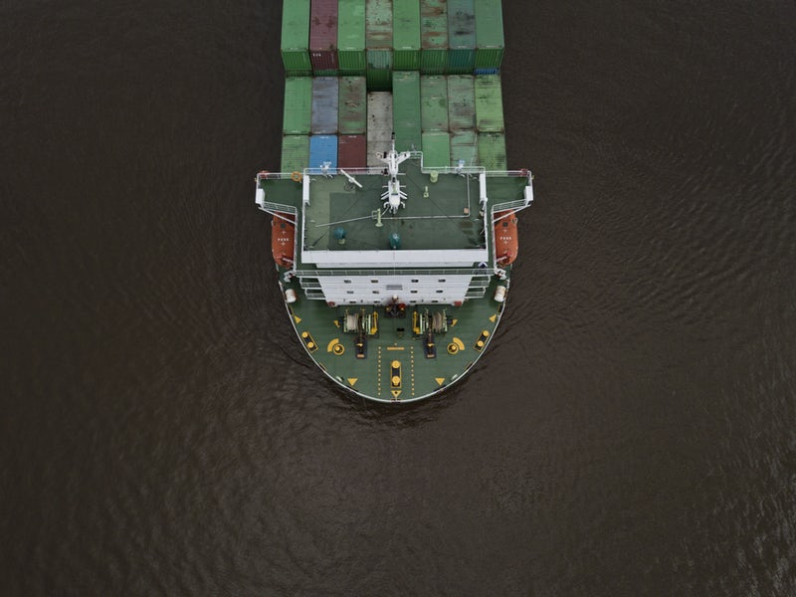
WHAT IS NEEDED TO BE EXPORT READY?
PRODUCT SPECIFICATION
US REGULATION COMPLIANCE

Slide 8
ANALYTICAL STANDARD
Aerobic Plate Count | Listeria
E.Coli | Arsenic
Total Coliforms | Heavy Metals
Salmonella | Lead
Mold Count | Total Heavy Metals

Slide 9
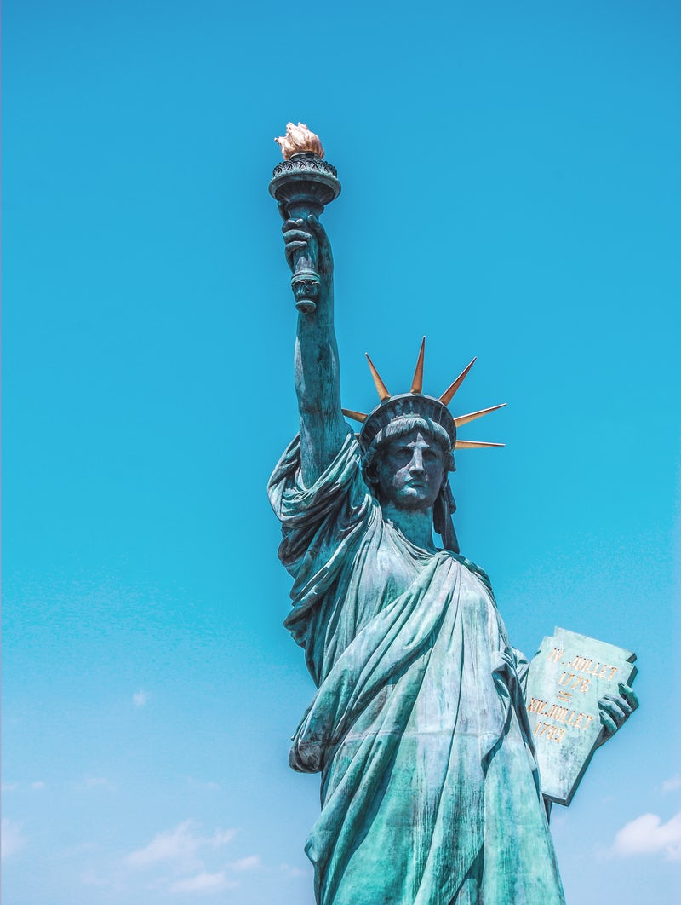
US REGULATIONS
REQUIRED DOCUMENTS
VERIFIED HACCP
PROCESS FLOW CHART
FDA REGISTRATION
USDA ORGANIC CERTIFICATION
3RD PARTY AUDIT
MOST RECENT COA

Slide 10
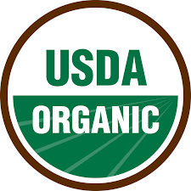
WHAT DOES ORGANIC MEAN?
The USDA states that the goal of organic foods and organic farming is to "integrate cultural, biological, and mechanical practices that foster cycling of resources, promote ecological balance, and conserve biodiversity.”
95% or more certified organic:
free of synthetic additives pesticides, chemical fertilizers, and dyes
must not be processed using industrial solvents, irradiation, or genetic engineering.

Slide 11
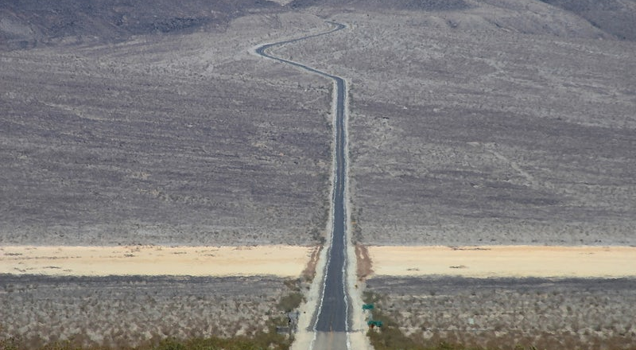
IT MAY FEEL LIKE A LONG ROAD

Slide 12
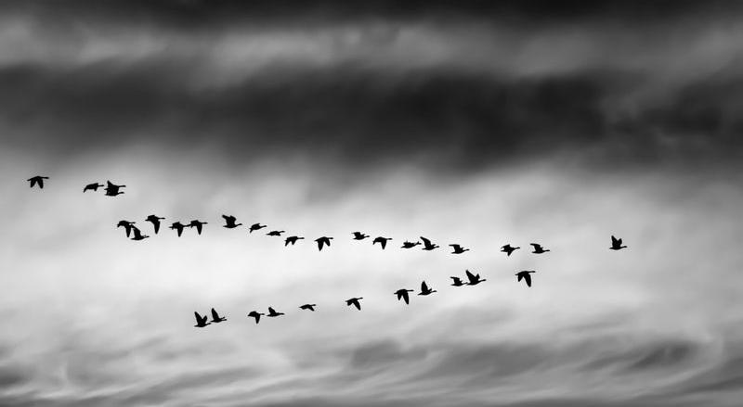
TOGETHER WE CAN LEARN

Slide 13
THANK YOU
E: INFO@ZAAMROOT.COM

