Slide 1
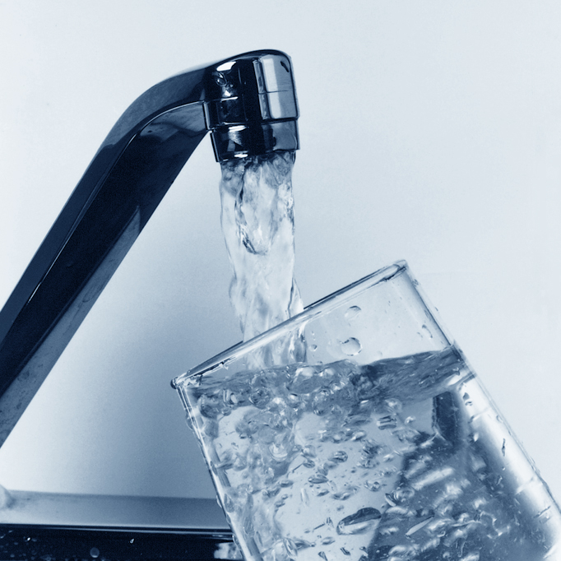
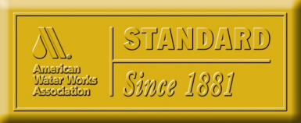
Standards and the
U.S. Public Water Sector
Frank Kurtz, P.E.
AWWA Standards Program
Workshop on Standards to Support
U.S. Trade and Investment in West Africa
March-April 2017
1

Slide 2
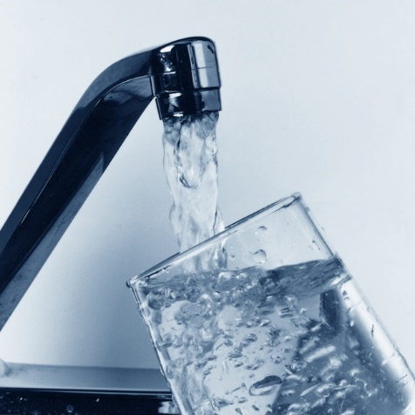
Agenda
Overview of the U.S. drinking water system and
how standards support economic growth
Relevant standards and certifying bodies for the
U.S. water industry
Water and wastewater products, services, and
processes covered by AWWA standards
AWWA activities and water industry resources
AWWA standards – What they are and how the U.S. water industry
uses them
Core principles of AWWA standards development
How AWWA standards are initiated, developed, and approved
2

Slide 3

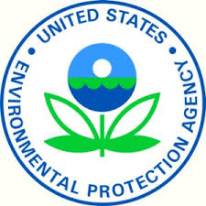
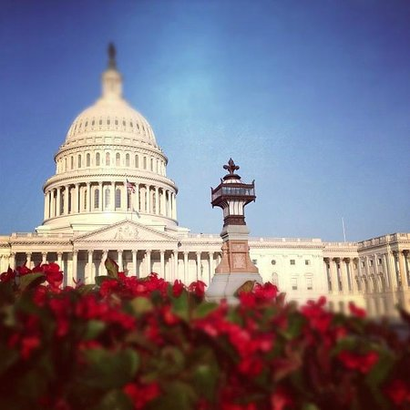
Safe Drinking Water Act (SDWA)
  The federal law that protects public drinking water supplies throughout the nation. Under the SDWA, EPA sets standards for drinking water quality and with its partners implements various technical and financial programs to ensure drinking water safety.
3

Slide 4
Clean Water Act (CWA)
  The basic structure for regulating pollutant discharges into the waters of the United States. Gives EPA the authority to implement pollution control programs such as setting wastewater standards for industry.
4

Slide 5

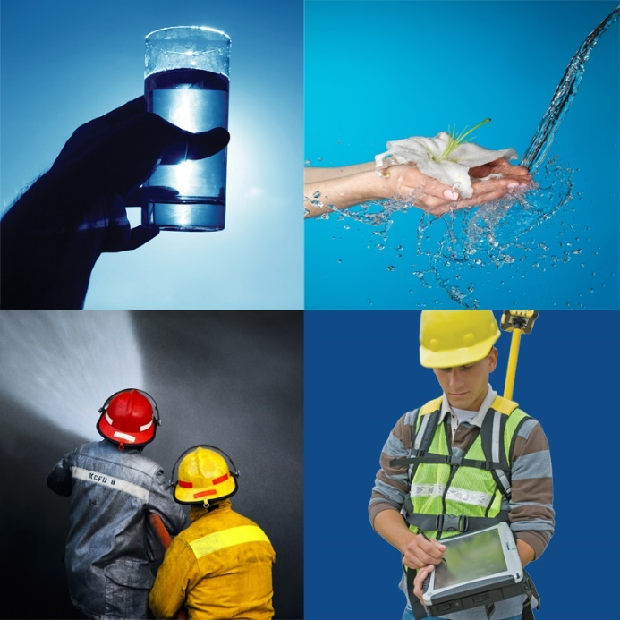
U.S. Drinking Water System
Public Health Protection
Fire Protection
Quality of Life
Support for the Economy
5

Slide 6
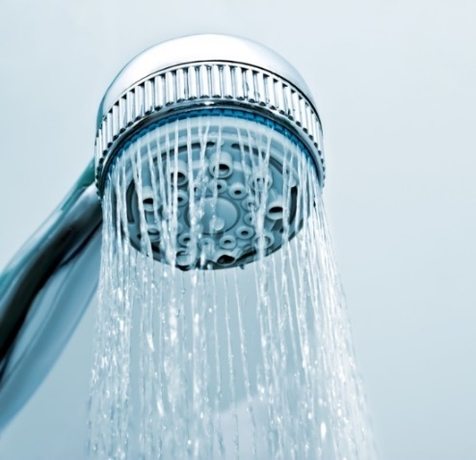

Public Health Protection
  A safe water supply is the first obligation of all water suppliers.
  Safe water systems eradicate diseases that claim human life around the
  world.
  Monitoring: The U.S. government
  requires testing for 100+ contaminants.
  Regulations: Utilities must meet close
  to 90 EPA standards for water safety
  and quality.
6

Slide 7
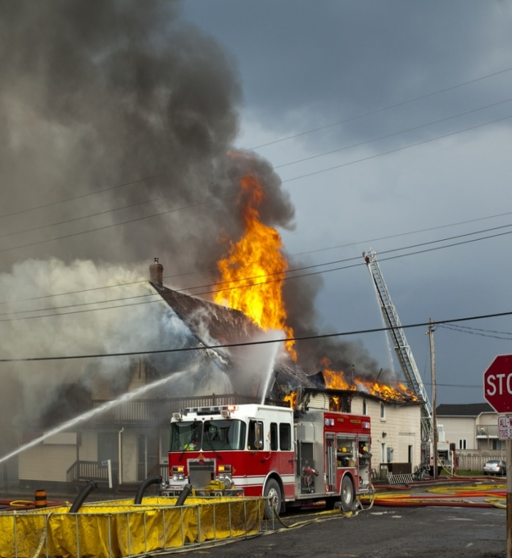
Fire Protection
  Urban fires led to creation
  of water systems.
  In 1906 the city of San
  Francisco was destroyed
  by a massive inferno.
  The ability to suppress fires influences:
    Home construction
    Insurance rates
7

Slide 8
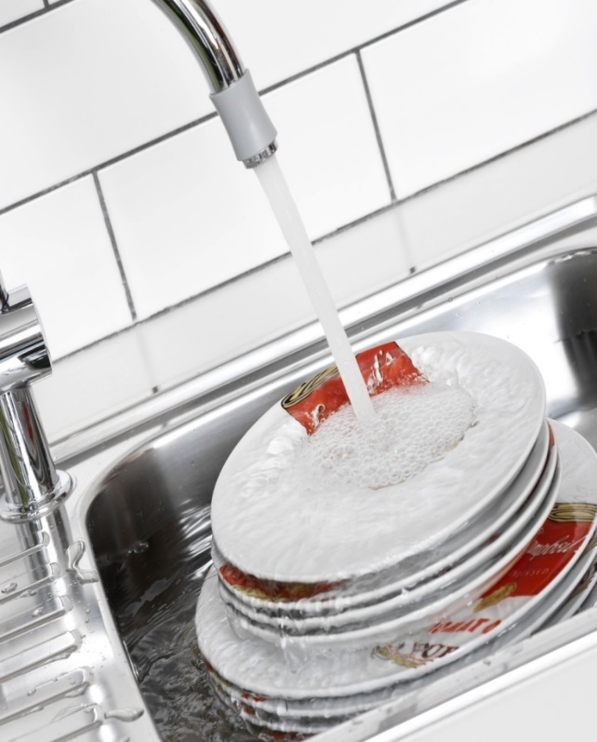
Quality of Life
  Any measure of a successful
  society – low mortality rates,
  economic diversity, productivity,
  and public safety – is tied to
  access to safe water.
  How would we rinse our produce, clean dishes, water plants, clean our clothes, or wash our cars?
  Where would we shower?
8

Slide 9

Support for the Economy
  Tap water is critical to business
  operations.
  Tap water is the primary ingredient in hundreds of thousands of everyday products.
  Adequate water resources are critical for commercial, residential developments.
  Businesses must consider availability of water when deciding where to locate.
9

Slide 10
How Standards Support the Economy
  Customer Confidence & Loyalty
  Consumers want products that are high-quality, reliable, consistent, and safe. They also want a greater selection of goods and services at continuously lower costs. Standards help make this possible.
10

Slide 11
How Standards Support the Economy
  Efficiency and Cost Savings
  Standards lower costs by eliminating redundancy, minimizing errors, and reducing time to market.
11

Slide 12
How Standards Support the Economy
  Competitive Advantage
  Gain competitive advantage over those
  WHO DO NOT:
  -- Gain insider knowledge and early access to information
  -- Exert influence on technical content
  -- Develop new markets for products, services, and technologies
12

Slide 13
How Standards Support the Economy
  Market Access & Trade
  Demonstrating compliance to standards helps our products, services, and personnel to cross borders and overcome trade barriers.
13

Slide 14
How Standards Support the Economy
  Mutually Beneficial
  Manufacturers benefit by knowing that all parties comply to the same requirements, and purchasers benefit knowing that the materials and products they are purchasing and using provide satisfactory service.
14

Slide 15
How Standards Support the Economy
  Innovation / Research & Development
  Building on previously standardized technologies and systems lowers R & D costs.
15

Slide 16
How Standards Support the Economy
  Alternative to Regulation
  If the U.S. standardization community (partnership between public and private sectors) does not deliver standards and conformance-based solutions for key national priorities or needs, then the U.S. government may satisfy those needs through regulation.
16

Slide 17
How Standards Support the Economy
  Bottom Line !
  The U.S. Department of Commerce estimates that standards and conformity assessment impact 80% of global commodity trade.
17

Slide 18
Relevant standards bodies for the U.S. Water Sector
ANSI – American National Standards Institute
AWWA – American Water Works Association
WEF – Water Environment Federation
NSF – National Sanitation Foundation
NFPA – National Fire Protection Association
ASTM – American Society for Testing and Materials
IAPMO – International Association of Plumbing and Mechanical Officials
UL – Underwriters Laboratories
18

Slide 19
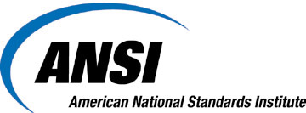
American National Standards Institute
  Mission – To enhance both the global competitiveness of U.S. business and the U.S. quality of life by promoting and facilitating voluntary consensus standards and conformity assessment systems, and safeguarding their integrity.
  Coordinates standards, conformity assessment, and related activities in the United States.
  Accredits standards developing organizations and approves American National Standards.
19

Slide 20
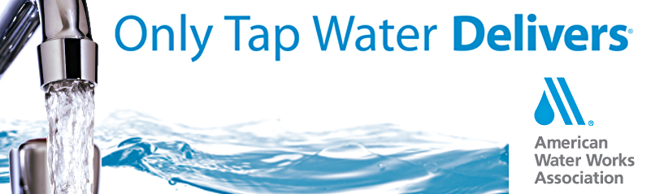
American Water Works Association
  Nonprofit scientific and educational association dedicated to managing and treating water
  180 existing standards;
  30+ standards in development
  Dedicated to the World’s Most Important Resource
  A better world through better water
20

Slide 21

Water Environment Federation
  Provides education and training for water quality professionals who clean water and return it safely to the environment.
  WEF members have proudly protected public health, served their local communities, and supported clean water worldwide since 1928.
  Not a standards developer, but provides important information in other forms.
21

Slide 22

National Sanitation Foundation
  Mission – To protect and improve global human health. Manufacturers, regulators and consumers look to NSF to develop public health standards and certifications that help protect food, water, consumer products, and the environment.
  An independent, accredited organization that tests, audits, and certifies products and systems as well as provide education and risk management.
  Most AWWA standards reference NSF standards and often require NSF certifications.
22

Slide 23

National Fire Protection Association
  Mission – To minimize the risk and effects of fire by establishing criteria for building, processing, design, service, and installation around the world.
  More than 200 technical code- and standard- development committees.
  NFPA 22 – Standard for Water Tanks for Private Fire Protection
  NFPA 13 – Standard for the Installation of Sprinkler Systems
23

Slide 24
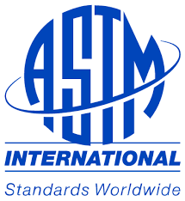
American Society for
Testing and Materials
  Over 12,000 ASTM standards operate globally.
  ASTM standards improve the lives of millions every day.
  Most AWWA manufacturing standards reference ASTM standards.
24

Slide 25

International Association of Plumbing and Mechanical Officials
  Protects the public’s health and safety by working in concert with government and industry to implement comprehensive plumbing and mechanical systems around the world.
  Provides code development assistance, industry-leading education, plumbing and mechanical product testing and certification, building product evaluation and a manufacturer-preferred quality assurance program.
25

Slide 26
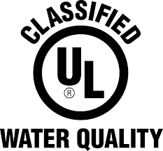
Underwriters Laboratories
  UL certifies, validates, tests, verifies, inspects, audits, advises and educates. UL provides the knowledge and expertise to help navigate growing complexities across the supply chain from compliance and regulatory issues to trade challenges and market access.
  The mark for Water Quality Classification Service appears on drinking water products evaluated to drinking water standards. These marks can be found on drinking water treatment additives, drinking water treatment or filtration units, drinking water system components and materials, and distribution and plumbing products.
26

Slide 27
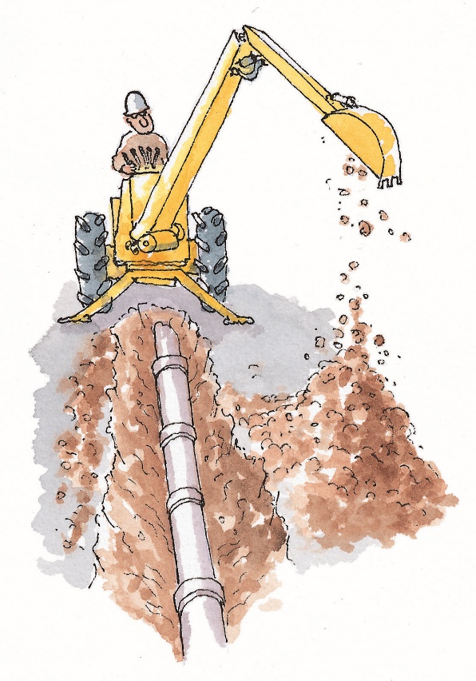
Applications for AWWA Standards
Primary focus has historically been for use with potable water and raw source water
Over 80 AWWA standards now include specific provisions for applying the use of the standard to wastewater and reclaimed water
27

Slide 28
Applications for AWWA Standards
180 Existing Standards
30 new standards under development
16 Manuals of Practice that provide guidance in support of the standards
Expanding the family of AWWA standards to include wastewater, raw water, reuse, stormwater and other applications
28

Slide 29
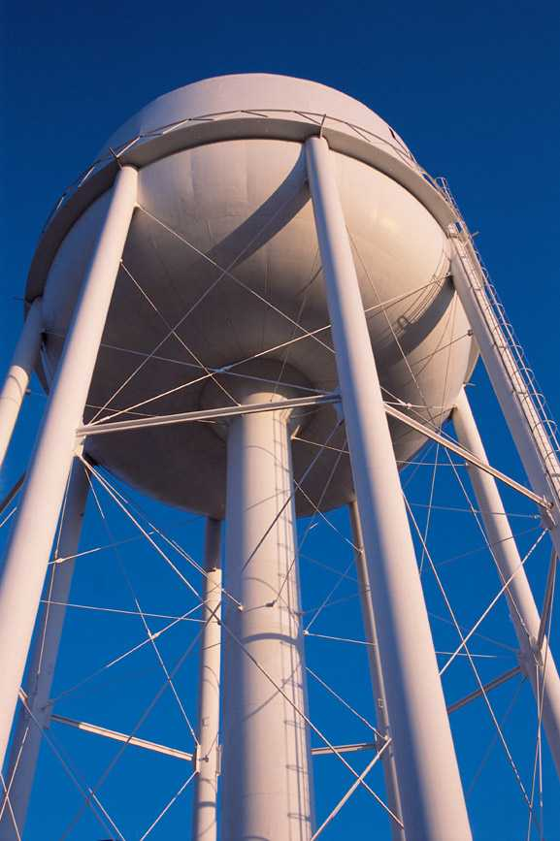
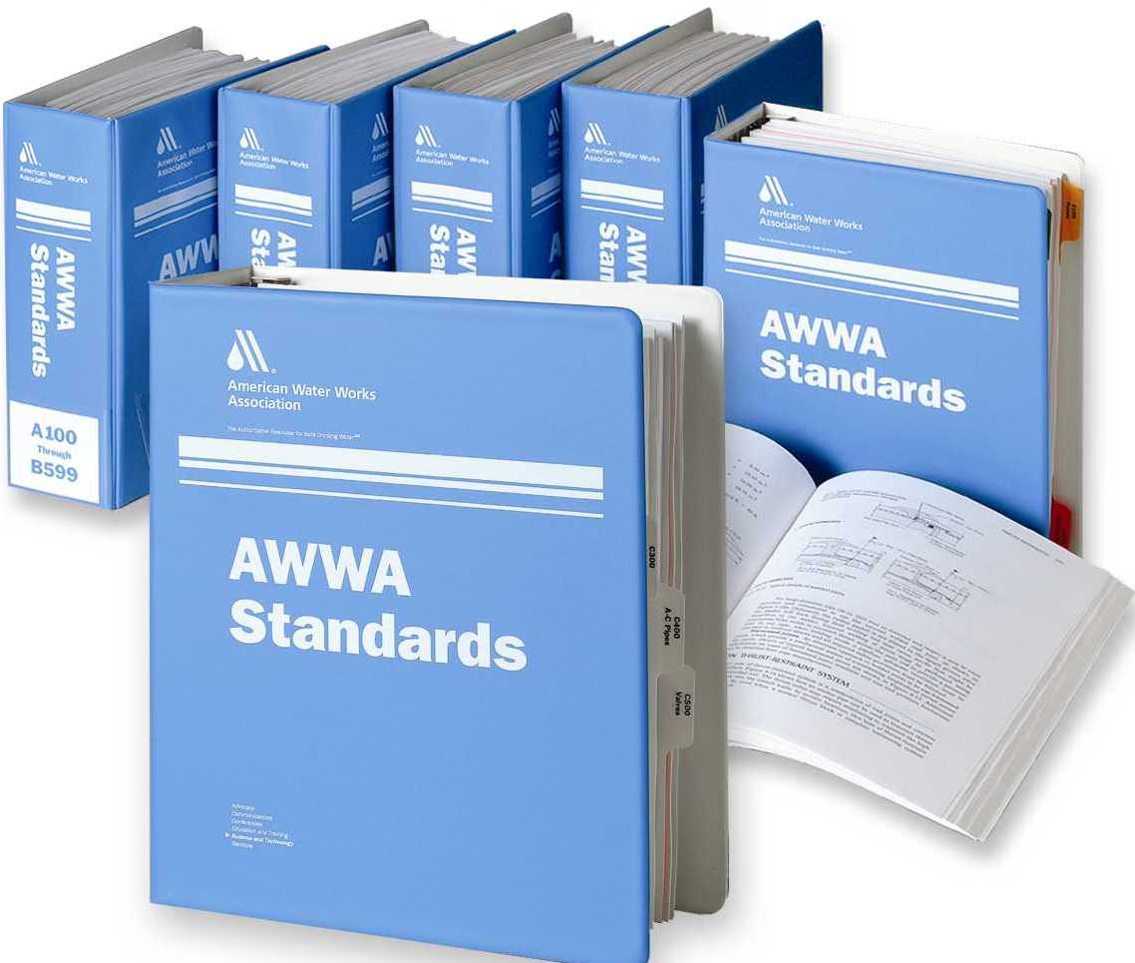
AWWA Standards Topic Categories
  Water treatment products
  Water distribution system products
  Water wells
  Services
  Utility
  management
29

Slide 30
AWWA Standards Topics
  Water Treatment Products
  Filtration materials and systems
  Softening agents
  Disinfection chemicals
  Coagulation
  Scale and corrosion control
  Taste and odor control
  Prophylaxis
  Plant equipment
30

Slide 31
AWWA Standards Topics
  Water Distribution System Products
  Pipe and accessories, including ductile iron pipe, steel pipe, concrete pressure pipe, plastic pipe, and asbestos-cement pressure pipe
  Valves
  Fire hydrants
  Meters
  Service lines
  Storage facilities, including steel tanks, concrete tanks, composite elevated tanks, and fiberglass-reinforce plastic tanks
  Pumps
31

Slide 32
AWWA Standards Topics
  Water Wells
  Water Wells
  Services
  Pipe installation
  Disinfection of facilities
32

Slide 33
AWWA Standards Topics
Utility Management
Water Treatment Plant Operation and Management
Distribution Systems Operation and Management
Source Water Protection
Business Practices for Operation and Management
Communications and Customer Relations
Security Practices for Operation and Management
Emergency Preparedness Practices
Water Conservation Program Operation & Management
Reclaimed Water Program Operation and Management
Wastewater Treatment Plant Operation and Management
Collection System Operations
Wastewater Biosolids Handling and Management
Wastewater Pretreatment Programs Management
Sustainable Water Environment O & M
International Customer Service
International Water Utility Management
International Wastewater Utility Management
Risk and Resilience Management of Water and Wastewater Systems
33

Slide 34
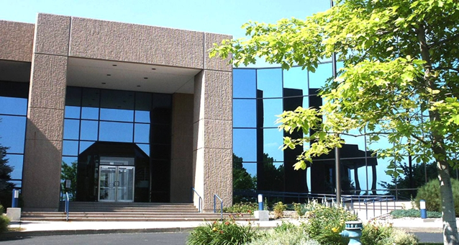
AWWA Activities
  AWWA standards and manuals
  Conferences and expositions
  (ACE)
  Educational workshops
  and webinars
  Utility operator training
  Government affairs and advocacy
  Research (Water Research Foundation)
  Philanthropy (Water Equation, Water For People)
  Participation on other standards consensus bodies
  including ISO
34

Slide 35
AWWA Resources
International activities
  ISO participation
  Global membership
  Trade Missions
  International alliances through
  MOUs and cooperative agreements
  AWWA-India office in 2015
35

Slide 36

AWWA participation in
ISO Standards
  ISO TC 282 – Water reuse in urban areas – Guidelines for centralized water reuse systems – Design, management, and safety
  ISO TC 224 – Service activities related to drinking water and wastewater services
  ISO TC 5 / SC 2 – Cast iron pipes, fittings and joints
  ISO TC 30 / SC 7 – Measurement of fluid flow in closed conduits – Volume methods including water meters
36

Slide 37
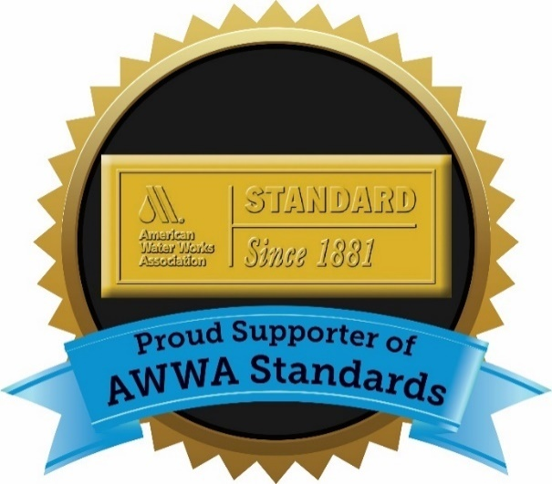
AWWA Membership
Benefits
AWWA Standards and Manuals of Practice
Subscriptions to AWWA Journal, Opflow magazine, AWWA Connections member newsletter, and others
Select from member categories and focus – Individual, Service Provider, Utility, Utility Operator, Small Systems, Students
Discounts to AWWA conferences, publications, videos, on-line courses, and webinars
Involvement in AWWA committees

Slide 38
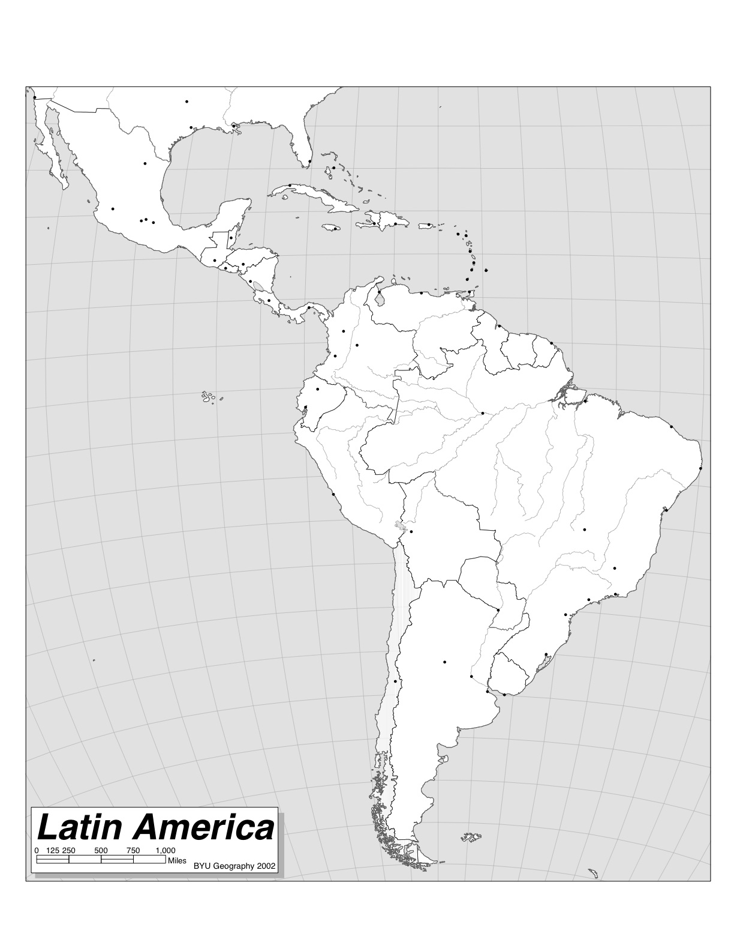
Cuba
2016
Colombia
2015
AWWA Trade Missions
U.S. Commercial Service
Peru
2017
The U.S. Commercial Service is the trade promotion arm of the U.S. Department of Commerce's International Trade Administration
Chile
2015
38

Slide 39

International Cooperative Agreements
International Water Association (IWA)
Korea Water and Wastewater Works Association (KWWA)
Indian Water Works Association (IWWA)
Asociación Interamericana de Ingeniería Sanitaria y Ambiental (AlDIS)
Singapore International Water Week (SIWW)
Australian Water Association (AWA)

Slide 40
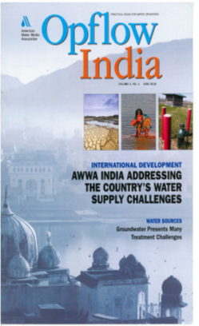
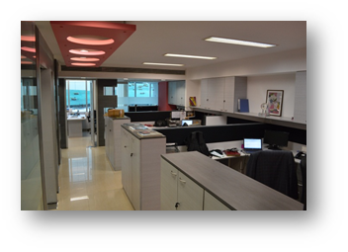
AWWA-India
AWWA-India Office
Mumbai, India
AWWA-India Staff & Strategic Board
Increased membership from 30 to 241
Conducted trainings sessions in Mumbai, New Delhi, & Hyderabad
Planning annual conference for November 10-11, 2017
40

Slide 41
Standards Alliance
West Africa Roadshow
March-April 2017
ANSI / USAID
41

Slide 42
Understanding and Using AWWA Standards
Minimum requirements for design, installation, performance, and manufacture
Not specifications
  Standards can be the basis for a specification,
  but site specific criteria must be added and
  the purchaser options selected to complete
  a specification
Standards serve as an aid to, not a substitute for,
engineering expertise and judgment
AWWA standards are not endorsements of any product, service,
or company
AWWA does not test, certify, or approve any product.
Voluntarily used (not legal regulations)
Water Industry Consensus (North America)
AWWA Standards provide for validation criteria in the form of an
“Affidavit of Compliance”.
Designing a system using AWWA standards leads to simplified designs and construction,
and cost efficiency
42

Slide 43

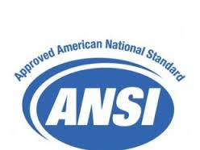
AWWA Standards Program is accredited by the American National Standards Institute (ANSI)
ANSI audit of AWWA process every 5 years
Each AWWA standard is approved as an
ANSI/AWWA Standard
43

Slide 44
Standards Program Structure
AWWA Standards Council
  Oversight body, sets policy
70 Technical Committees
  Focused on specific technical topics
  Over 1400 Volunteer Experts participate
AWWA Staff Facilitation
44

Slide 45
Core Principles of Standards Committees
Representation by a balance of stakeholders –
Users (typically the water utility), Producers, and General Interest members. Producer representation cannot exceed one-third of the total voting membership.
Due process principles of Openness, Lack of dominance, Balance of interests, Coordination and harmonization, Notification of standards development, Consideration of views and objections, Consensus vote, Appeals, and Written procedures.
45

Slide 46
Standards Development Process
Request for standard by any interested party
Standards Council authorizes development & assigns the standard to a committee.
Committee develops and approves a draft of the Standard
Standards Council approves the draft Standard.
Standard is announced for pubic review & comment
All comments are addressed & final document approved
Standard approved by Board of Directors
Standard reviewed and approved by ANSI
46

Slide 47
Get involved!
Volunteer for a standards committee
Participate through the public comment process
47

Slide 48
For more information
Frank Kurtz, P.E.
AWWA Standards Engineer
fkurtz@awwa.org
303-347-6221
Paul Olson, P.E.
AWWA Standards Senior Manager
polson@awwa.org
303-347-6178
Susan Franceschi
AWWA Chief Membership
Officer
sfranceschi@awwa.org
303-347-6205
John Anderson
AWWA Manager of
International Activities
janderson@awwa.org
303-734-3427
48

