Slide 1



ASTM International
Overview and Collaboration with West Africa
March- April 2017
Kimberly Simms
www.astm.org

Slide 2

Touching Every Part of Everyday Life
  Introduction
  12,636 ASTM standards operate globally
  they enhance performance and
  create confidence
  Across borders, disciplines, and industries
  Harnessing the expertise of over 30,000 members
  Across manufacturing and materials, products
  and processes, systems and services
  Touching every part of everyday life: helping
  our world work better

Slide 3

Effective and Relevant Around The World
  The Role of Standards
  We rely on our world-wide members’ expertise and commitment – their good science, good
  engineering and good judgment
  Recognizing expertise not geography –
  149 countries are represented by our members
  Our voluntary consensus process gives everyone
  an opportunity to participate – ensuring standards
  are effective and relevant across diverse markets
  Our standards help everyone: consumers,
  businesses, governments and manufacturers
  Embracing all the principles of the World Trade Organization’s Agreement on Technical Barriers to Trade
  Incorporated into contracts, regulations, codes, and laws, they support all economies, and free and fair global trade

Slide 4

Global Cooperation at ASTM
2001
ASTM is complying with the WTO/TBT agreement –
  Principles for development of international standards-
Transparency Coherence
Openness Impartiality and Consensus
Effectiveness and Relevance Development Dimension*
*”Constraints on developing countries, in particular to effectively participate in standards development, should be taken into consideration in the standards development process.”
4

Slide 5
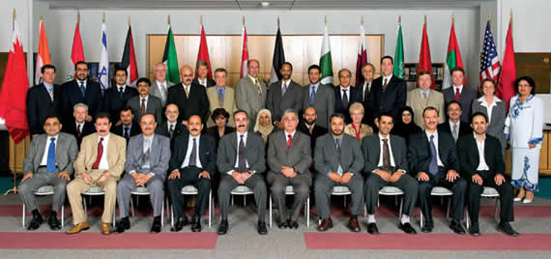
Open House Events
2001 – Latin America, Caribbean, North America
2003 – Asia/Pacific- China
2005 – Middle East, North Africa, South Asia
2007 - Sub-Saharan Africa

Slide 6
Core Global Outreach Program
Memorandum of Understanding
101 MoU partners worldwide
ASTM provides:
Full collection of ASTM Standards
Membership at no cost to participants
Information, training and partnership
NSB Partner provides:
Access to ASTM standards in its Information Center
Annual Report on use of ASTM standards
Use and application of ASTM standards where relevant and appropriate
> 7000 ASTM standards in use outside of U.S.

Slide 7
National Standards Bodies (101) with ASTM MOU
ASIA | EUROPE | SOUTH AMERICA | CARIBBEAN | MIDDLE EAST & NORTH AFRICA | EASTERN, WESTERN & CENTRAL AFRICA | SOUTHERN AFRICA
AFGHANISTAN | ALBANIA* | BOLIVIA | ANTIGUA AND BARBUDA | BAHRAIN | ARSO | ANGOLA
AZERBAIJAN | BOSNIA | CHILE | BAHAMAS | EGYPT | BURUNDI | BOTSWANA
BHUTAN | BULGARIA | COLOMBIA | BARBADOS | GCC (GULF STATES) | CAMEROON | MALAWI
BRUNEI DARUSSALAM | CROATIA | COSTA RICA | BELIZE | IRAQ | DEMOCRATIC REPUBLIC OF CONGO | MAURITIUS
CHINA | KAZAKHSTAN | ECUADOR | CROSQ | ISRAEL | ETHIOPIA | NAMIBIA
INDONESIA | KOSOVO | EL SALVADOR | DOMINICA | JORDAN | GAMBIA | SEYCHELLES
KOREA | MOLDOVA | GUATEMALA | DOMINICAN REPUBLIC | KUWAIT | GHANA | SOUTHERN AFRICA DEVELOPMENT COOPERATION
MALAYSIA | MONTENEGRO | HONDURAS | GRENADA | MOROCCO | KENYA | SOUTH AFRICA
MONGOLIA | ROMANIA* | NICARAGUA | GUYANA | OMAN | MOZAMBIQUE | SWAZILAND
MYANMAR | RUSSIA | PANAMA | HAITI | PALESTINE | NIGERIA | ZAMBIA
NEPAL | SERBIA | PARAGUAY | JAMAICA | QATAR | RWANDA | ZIMBABWE
PAKISTAN |  | PERU | MONSERRAT | SAUDI ARABIA | SIERRA LEONE
PAPUA NEW GUINEA |  | SURINAM | ST. KITTS-NEVIS | TUNISIA | TANZANIA
PHILIPPINES |  | URUGUAY | ST. LUCIA | TURKEY | UGANDA
SINGAPORE |  |  | ST. VINCENT AND THE GRENADINES | U.A.E.
SRI LANKA |  |  | TRINIDAD & TOBAGO | YEMEN
TAIWAN |  |  |  |  | *Former MOU Partner
THAILAND
VIETNAM

Slide 8
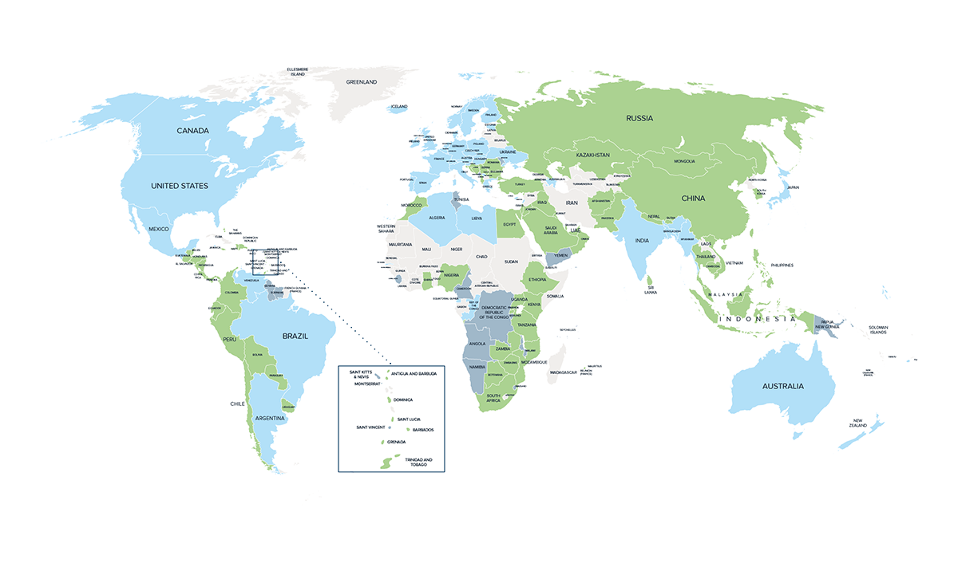
Where is ASTM?

Slide 9


MOU Agreements- Ghana and Cote d’Ivoire
GHANA---
Ghana Standards Authority, GSA
Date: 2007
Members: 19
Citations: 351 ASTM standards
COTE d’IVOIRE--
CODINORM
Date: 2017
New MOU Agreement

Slide 10


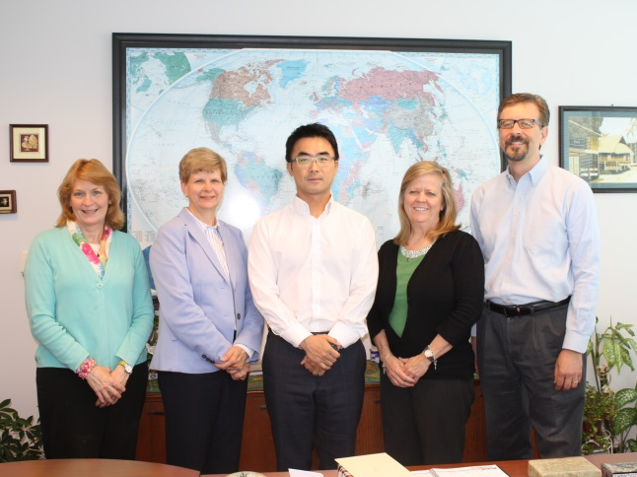

Unique Training Within the MoU Program
Standards Expert Program
TVGP
Other International Visitors
Procedural focus
Typically three nations/year; to date have hosted 35 experts from 32 nations
NSB identifies two candidates, ASTM interviews and selects one
Participant becomes an expert and a resource
– In 2016: Mauritius, Kazakhstan, Dominican Republic
– In 2017: Israel, Ecuador, Bhutan
Technical focus
Competitive process
Partners invited to submit applications from staff and industry experts, ASTM selects two
2015 - Nana Sekyi, Ghana – GSA
Studied: Standards for oil/gas pipeline 2016 – Thai Hoa, Vietnam - VSQI
Studied; Bio-based Plastics
2017 -- Stephen Adu, Ghana-- GSA
Attached staff and Intensive Training Programs –Candidate selection varies by sponsoring organization
Chief Sponsor defines study topics
Duration of one week to eleven months
To date:
Attachments – Botswana, China, Japan, South Africa, South Korea
ITP – Chechen Republic, China, GSO, Latin America, South Korea, Trinidad and Tobago and Jamaica, Saudi Arabia
Notes:
Note SEP from ARSO nations: Egypt, Ghana, South Africa, Zambia, Zimbabwe

Slide 11


Global Member Participation
Made easy through use of the internet
No travel, economical, consistent and efficient
Access to standards 24/ 7, 365 days per year

Slide 12
Six Ways to Adopt and Reference ASTM
Available to all Public and Private Standards’ Users
Referenced in Regulations
Normative Reference
Code Reference
Available Only to MoU Partners
Identical Adoption
Equivalent Adoption
Used as the Basis of a National Standard or Consulted
Used as the Basis of National Standard or Consulted
Referenced in Regulation
Equivalent Adoption
Simple Ways to Adopt or Reference ASTM International Standards
Normative Reference
Identical Adoption
Code Reference

Slide 13
Balance of Interests
Manufacturer &
Producer
User
&
General Interest
ASTM
Technical Committees are balanced.
No excess influence by any interest group, i.e., government.
13

Slide 14
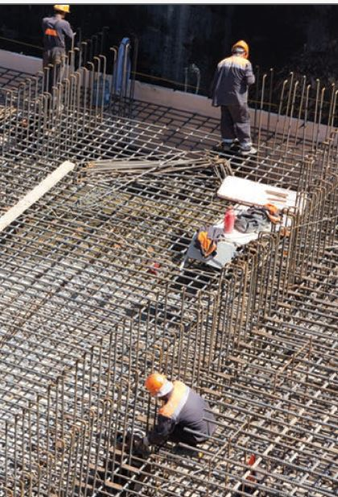
ASTM and Infrastructure
Technical Committees in Sector:
Cement, C01
-- Concrete and Aggregates, C09
-- Gypsum and Building Materials, C11
--- Mortars and Grouts for Masonry, C12
--- Glass and Glass Products, C14
--- Manufactured Masonry Units, C15
--- Fiber-reinforced Cement products, C17
--- Stone, C18
--- Building Seals and Sealants, C24
--- Wood, D07
--- Roofing and Waterproofing, D08

Slide 15
ASTM and Roads - Paving
Technical Committees in sector:
  --- Road and Paving Materials, D04
  --- Geosynthetics, D35
  --- Vehicle-Pavement Systems, E17
  --- Soil and Rock, D18
  --- Steel, Stainless Steel and related, A01
  --- Fasteners, F16
  --- Plastic Piping Systems, F17

Slide 16
ASTM and Water-related
Technical Committees in sector:
--- Water, D19
--- Concrete Pipe, C13
--- Plastic Pipe, F17
--- Soil and Rock, D18
--- Waste management, D34
--- Environmental Assessment, Risk Management and Corrective Action, E50
--- Activated Carbon- filters, D28

Slide 17

ASTM Energy-related
Technical Committees in Sector:
--- Petroleum products, Liquid Fuels, and Lubricants, D02
--- Gaseous Fuels, D03
--- Coal and coke, D05
--- Solar, Geothermal, and Other Alternative Sources, E44
--- Bioenergy and Industrial Chemicals from Biomass, E48

Slide 18
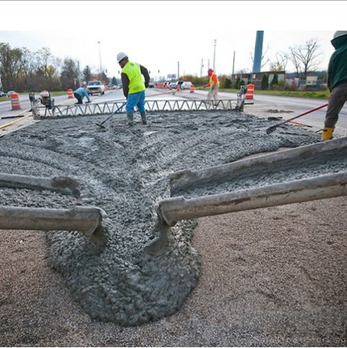
Success Story: Road construction
South Africa--
is in the midst of new road construction and expansion.
“ASTM’s C309 is the go-to spec for curing compounds for use in concrete road construction.”
ASTM’s Standard Specification for Liquid Membrane-Forming Compounds for Curing Concrete is the key. South Africa has just adopted it as a national standard and included it in the guidebook.

Slide 19

Success Story: Energy
Uganda--
The home use of cooking fuels like wood or charcoal causes widespread illness and death in developing countries. In response, ASTM International’s bioenergy committee developed a standard to support the introduction of ethanol as a cooking fuel.
“ASTM specification for using denatured ethanol as a cooking and appliance fuel (E3050) will help support the buying, selling and transporting of ethanol around Africa.”

Slide 20
Thank you
Teresa Cendrowska, tcendrowska@astm.org
Jim Olshefsky, jolshefsky@astm.org
Kimberly Simms, ksimms@astm.org

