Slide 1
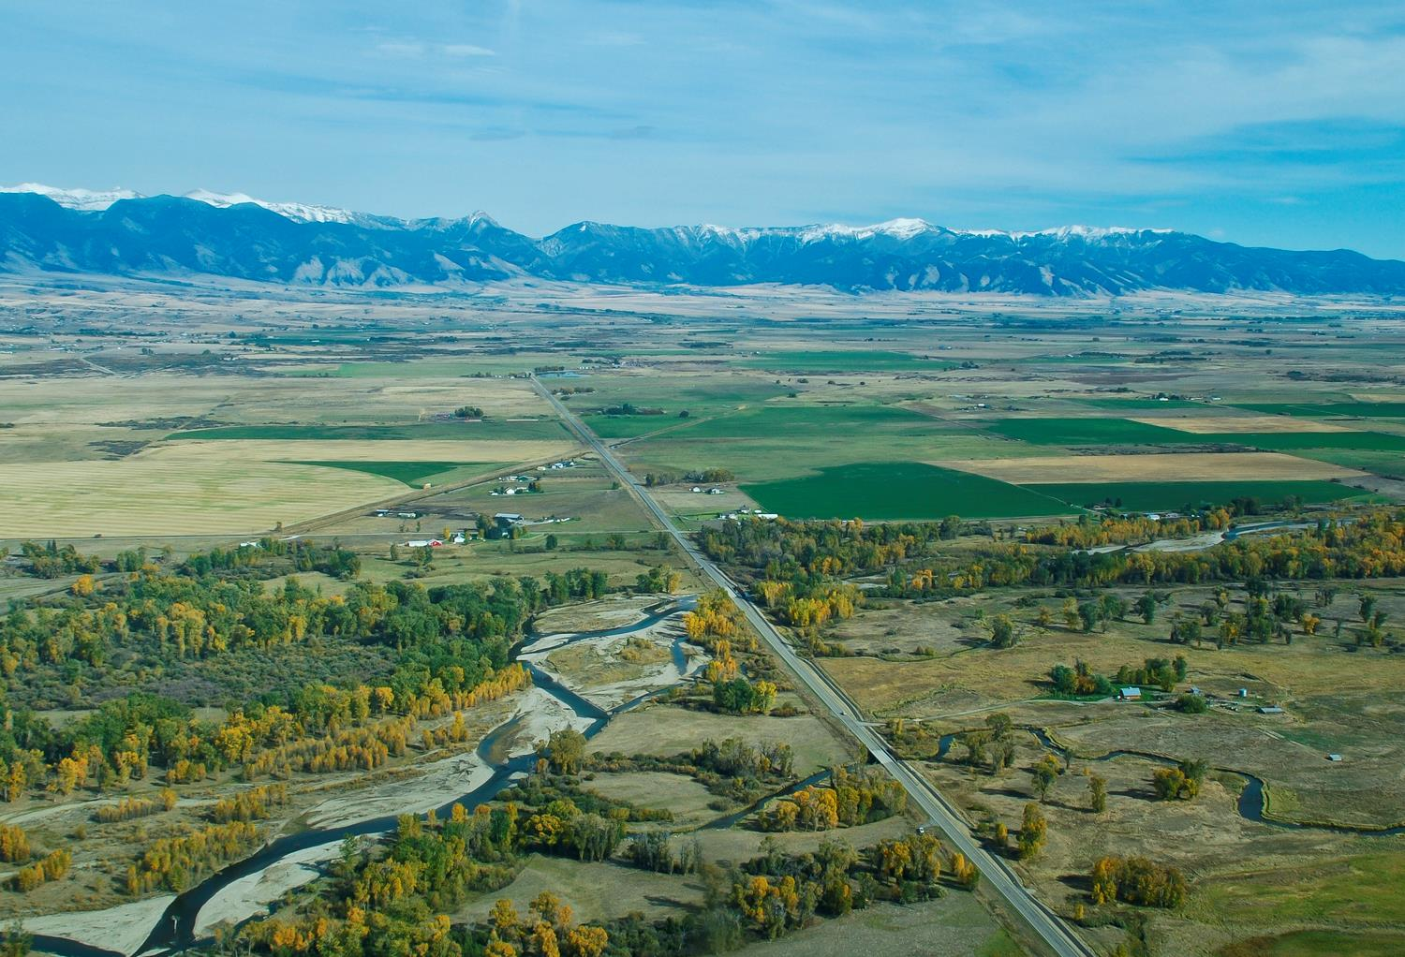
Transportation Infrastructure:
Pathways to Vitality and Growth
Eli Cuelho, P.E.
Western Transportation Institute
Montana State University

Slide 2
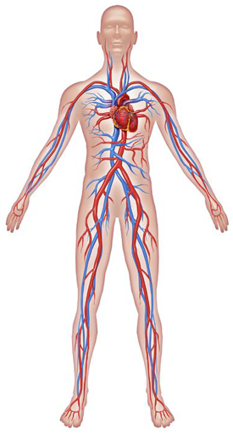
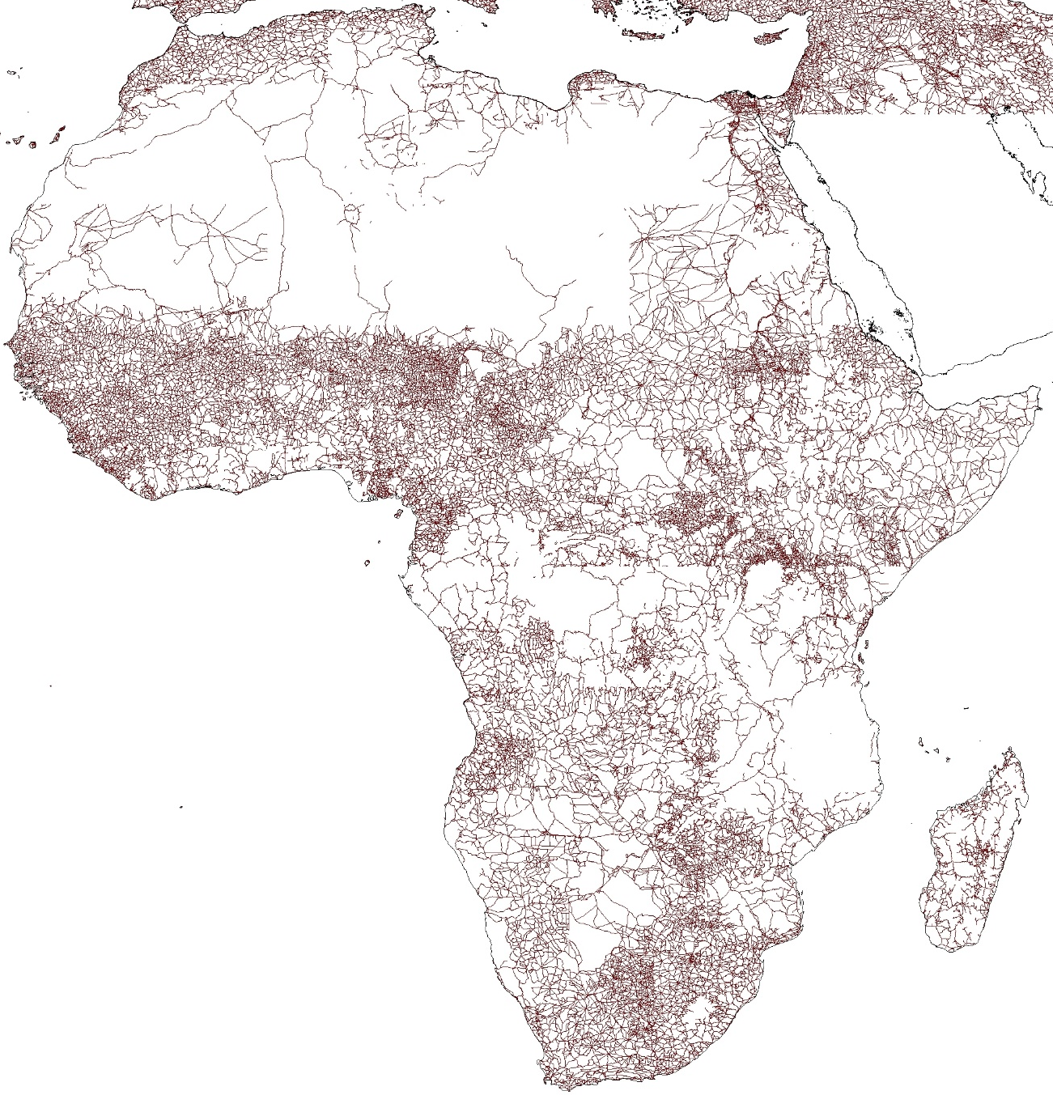
Life Flow

Slide 3

Analogy
Capillaries feed every cell which is critical to the survival of the organism
Nutrients are brought through blood to promote growth
Cutting off circulation causes loss
Low-volume roads are like capillaries
Healthy circulation is similar to healthy transportation
Healthy transportation means a healthy economy

Slide 4
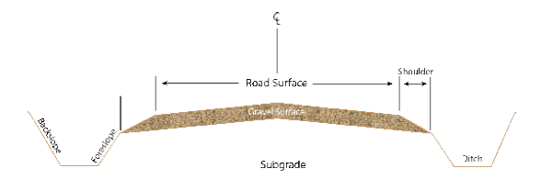
Keys to a Healthy Road System
Good design
+
Quality materials
+
Appropriate use
+
Maintenance
=
LONG LIFE!

Slide 5
Two Common Challenges
Poorer support materials (subgrade)
    Soft, fine-grained (clays, silts)
    Water sensitive – soft when wet
    Weak – low shear strength, poor bearing capacity
Poorer surfacing materials
    Loose – raveling, wash-boarding, dust
    Water sensitive – soft when wet
    Weak – ruts easily

Slide 6
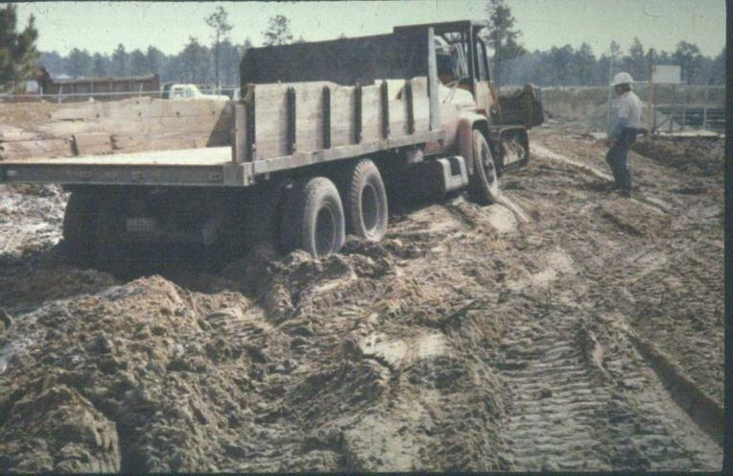
Addressing Support Material Issues
Remove and replace poorer materials with good materials
    gravel, crushed rock, asphalt
Limit use during wet weather or seasons
Stabilize weak materials
Chemical stabilization – lime, cement
Mechanical stabilization – compaction, reinforcement products

Slide 7
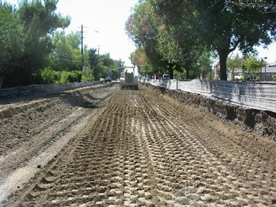
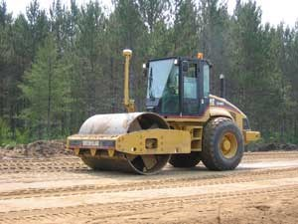
Mechanical Stabilization – Compaction

Slide 8
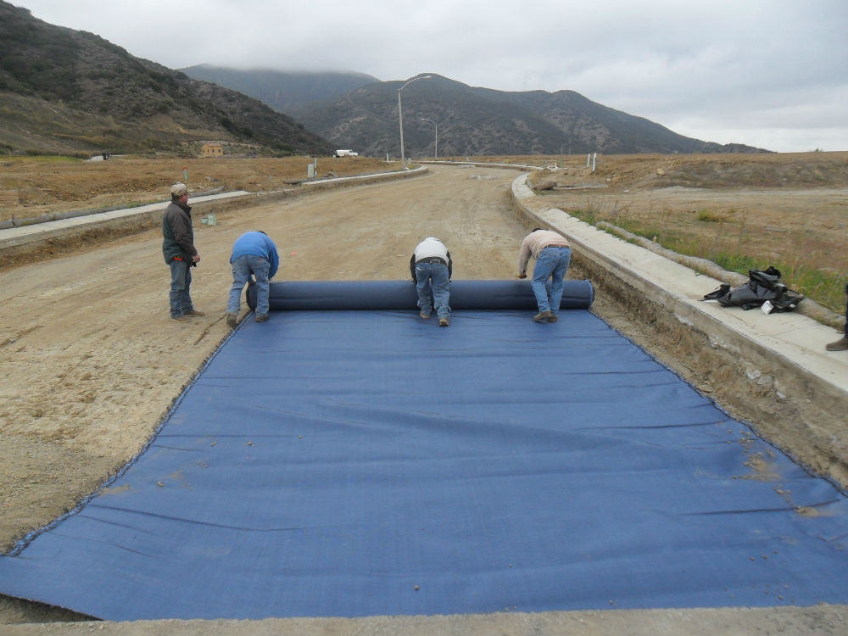
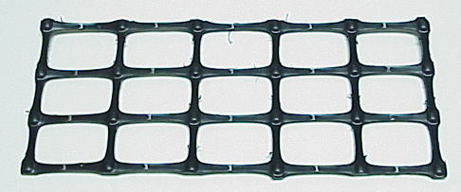
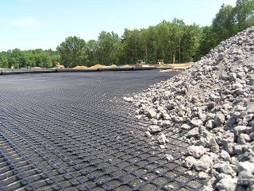
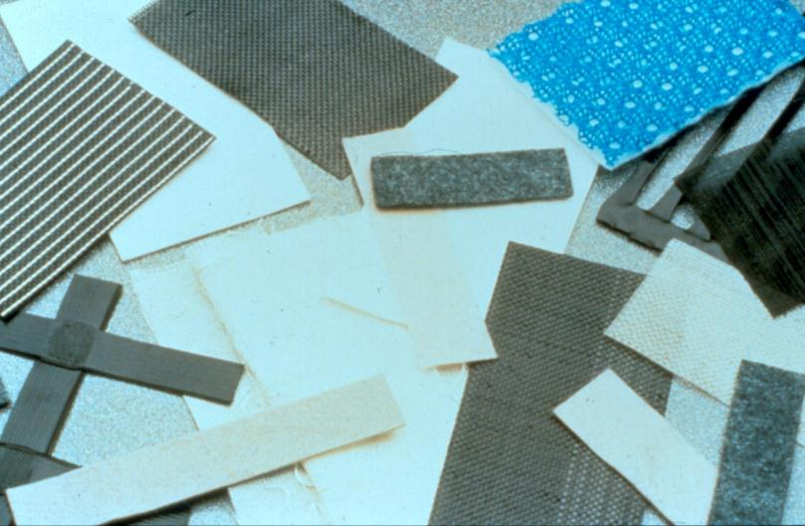
Mechanical Stabilization – Geosynthetics

Slide 9
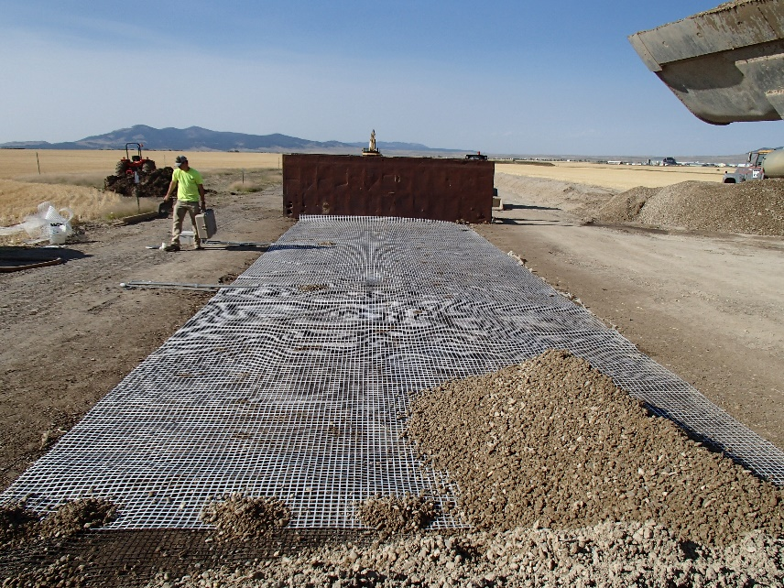
Studies Show Geosynthetics…
Perform well
Save money
Increase life of roadway
Reduce the need for other raw materials
Reduce need for maintenance

Slide 10
Addressing Surface Material Issues
Remove and replace poorer materials with good materials
    Good mixture of gravel
Limit use during wet weather or seasons
Stabilize weak materials
Proper gradation
Chemical stabilization – MgCl₂, CaCl₂, lignin, oils, polymers, enzyme, proprietary products

Slide 11
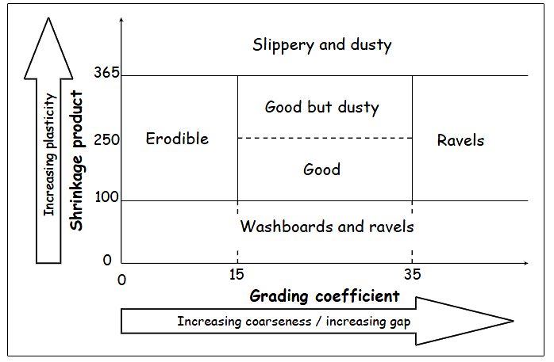
Road Surface Materials
Particle size distribution – ASTM C136
Plasticity – ASTM D4318
Strength (CBR) – ASTM D1883

Slide 12
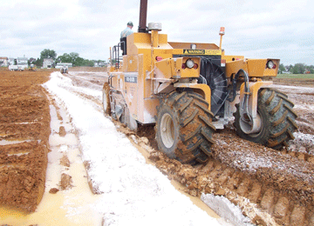
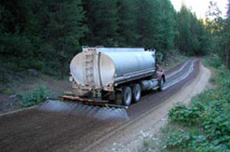
Chemical Stabilization
Lime
Cement
Lignin
Oil
Chlorides
Bitumen

Slide 13
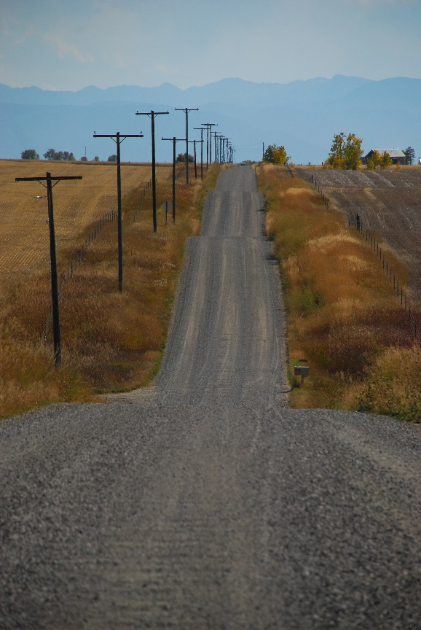
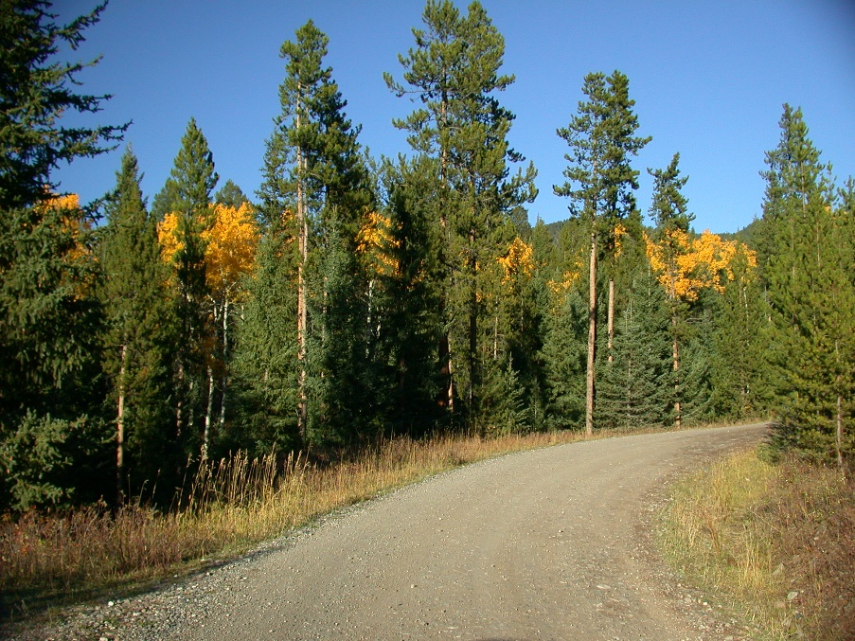
Studies Show Stabilizers…
Perform well
Save money
Reduce the need for other raw materials
Increase life of roadway
Reduce need for maintenance

Slide 14
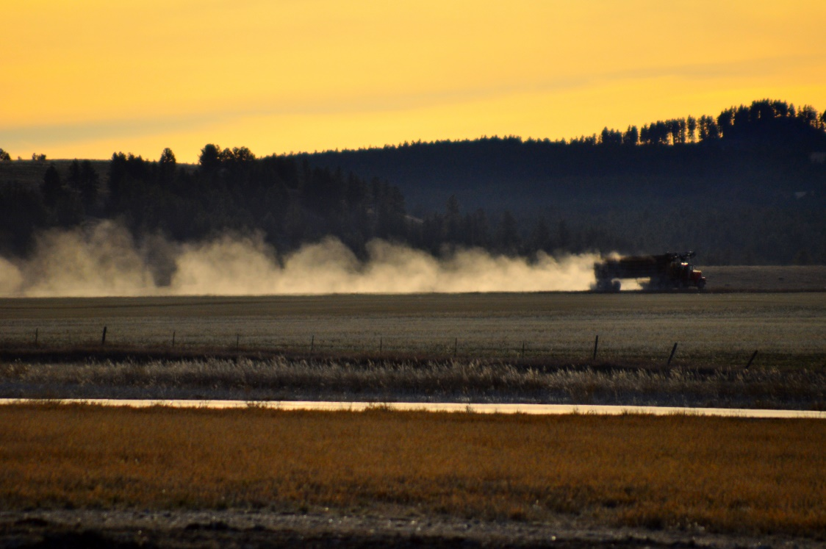
Challenge
Variety of products that claim they work best
Cheaper is not always better!
How do you know you are making the right decision?

Slide 15
Standards Development
Evaluate field performance
Evaluate material properties
Find relationship between the two
Develop standard methods to determine material properties associated with performance
Incorporate properties in design method
Establish minimum required values
Standards help ensure good performance based on a given set of conditions

Slide 16
Standards Development Process
Participation by variety of parties
  Practitioners / users
  Manufacturers
  Researchers
  Quality assurance testing
Open forum for discussion
Consensus
Process creates opportunity to collaborate and build trust

Slide 17
Demonstrate Success
Conduct small pilot projects
Inform managers of successful processes
Train staff

Slide 18
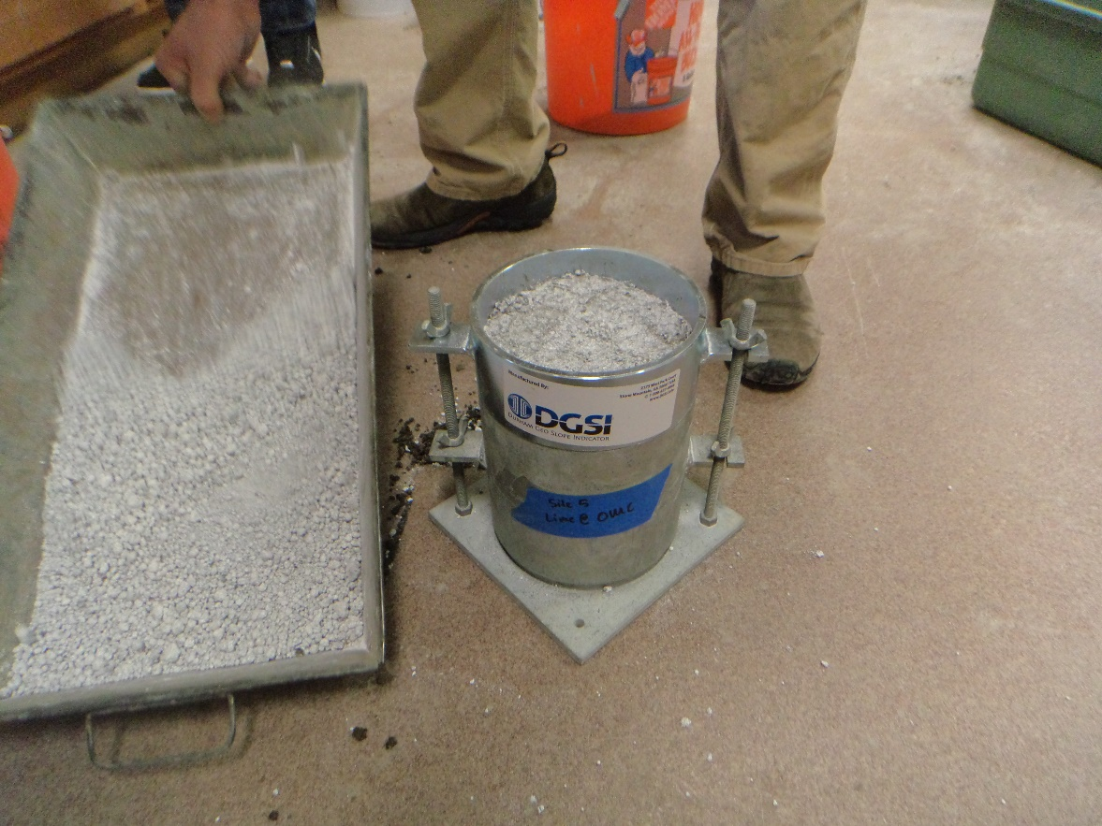
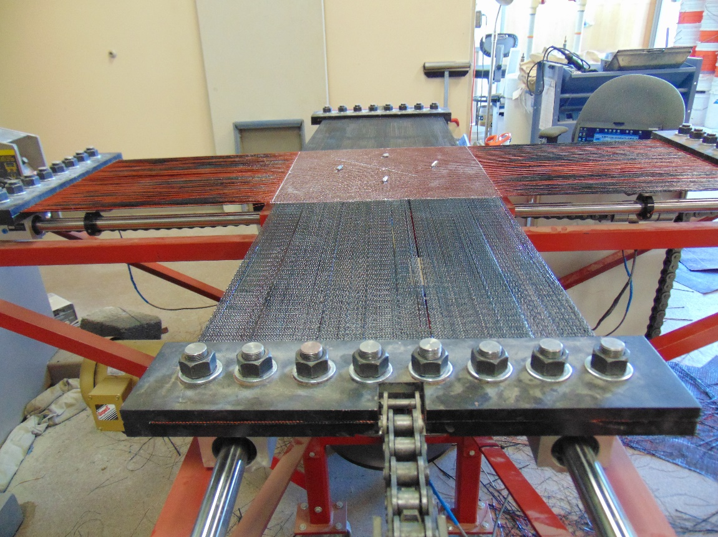
Materials Testing

Slide 19
Design and Specifications
USDOT – United States Department of Transportation
National Highway Institute, Designing with Geosynthetics
Low-Volume Roads Engineering, Best Management Practices Field Guide
Gravel Roads Manual

Slide 20
Road Building Standards
ASTM International – American Society for Testing and Materials
AASHTO – American Association of State Highway Transportation Officials
ASCE – American Society of Civil Engineers
URi – Unpaved Roads Institute
GSI – Geosynthetics Institute

Slide 21
Geosynthetics
Tensile strength – ASTM D4595,
ASTM D6637
Junction strength – ASTM D7737
Surface friction – ASTM D6706
Permittivity – ASTM D4751
Cyclic tensile properties – ASTM D7556
Ultraviolet stability – ASTM D4355
Biaxial tension – under development

Slide 22
Dust Palliatives / Surface Stabilizers
Strength (CBR) – ASTM D1883
Density – ASTM D698, ASTM D1557
Water content – ASTM D4643
Abrasion – under development
Chemical content – under development
Environmental safety – under development
Performance – under development

Slide 23
Benefits of Standards for
Low-Volume Roads
Standards help ensure good performance
  Predictable performance helps planning and design efforts
  Helps managers select the best option
Standards development process creates opportunity to collaborate, and helps build trust
Good performance results in a strong economy
  Save money
  Save time
  Save limited resources
HEALTHY ROADS = HEALTHY ECONOMY

Slide 24
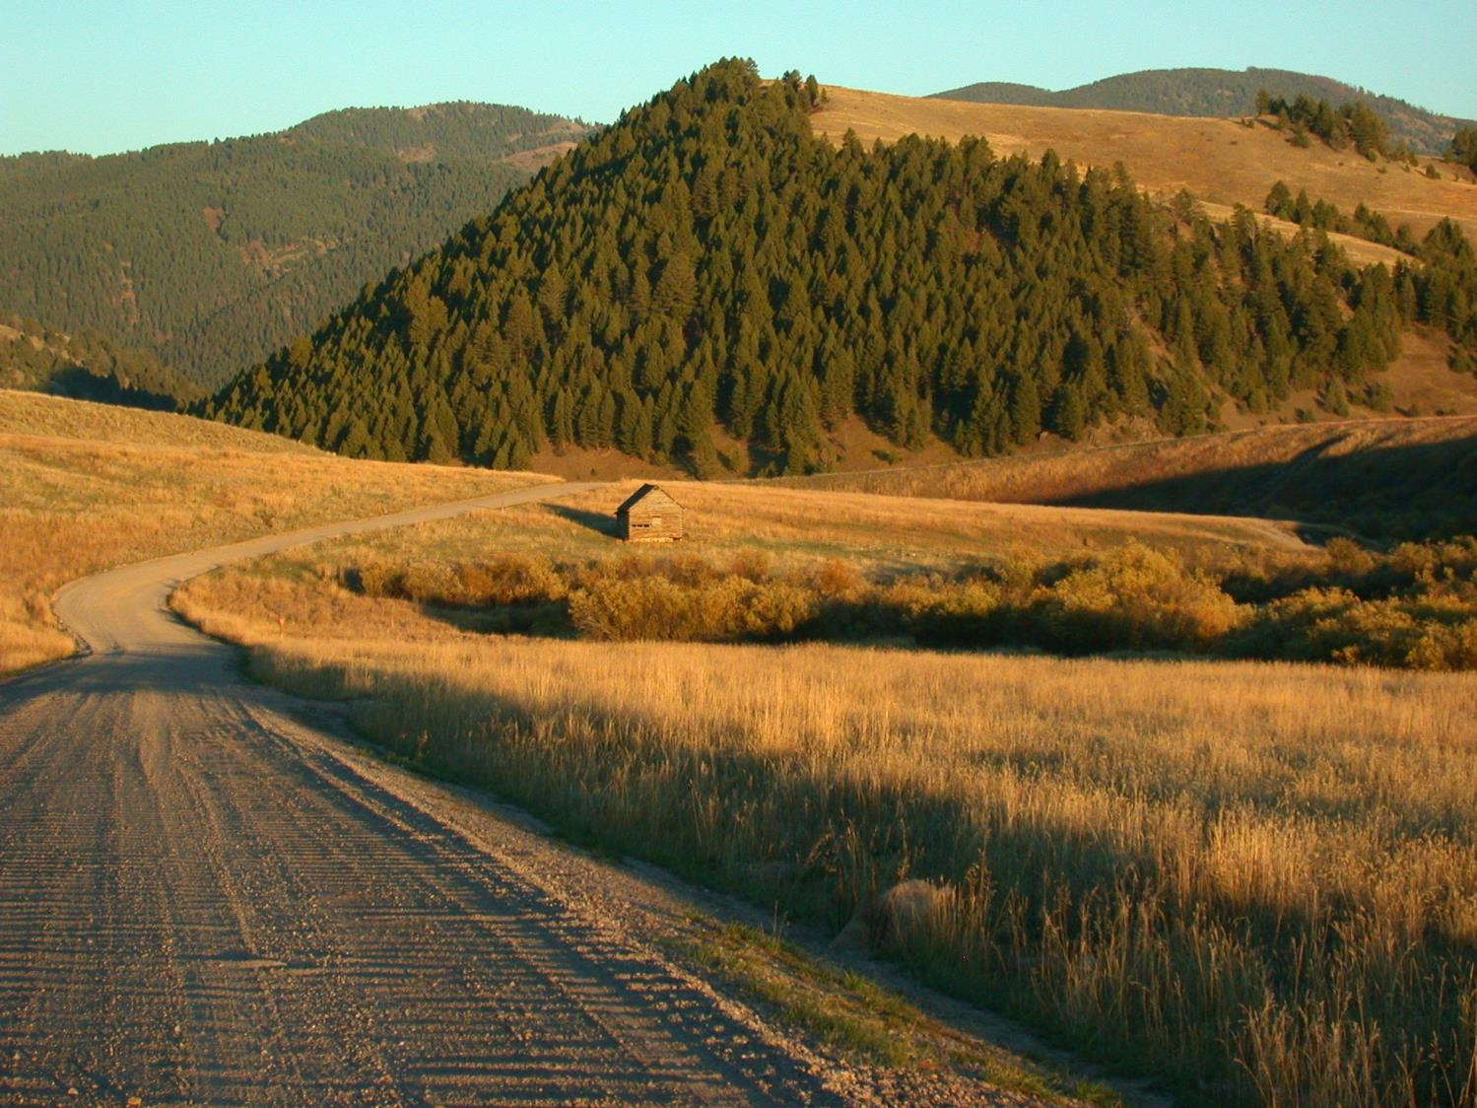
Thank you!
Eli Cuelho, P.E.
Western Transportation Institute
Montana State University
elic@montana.edu | +1 406 994 7886

