Slide 1
DFR Presentation on
Delivery of Infrastructure: State-of-Play in Ghana with Particular emphasis on Standards for Rural Transportation System
By Ing. Dr. Kwasi Osafo Ampadu & Ing. R. O. Otoo
(Department of Feeder Roads, MRH)

Slide 2
ORDER OF PRESENTATION
Definitions
Specific Areas in the application of Standards in road construction
Types of Rural Roads
General Road Design Standards
5. Ghana Standard Specifications
6. Trade and Investment Opportunities
7. Challenges
8. Conclusion

Slide 3
Definition of Standard
Something set up and established by authority as a rule for the measure of quantity, weight, extent, value, or quality, etc.
The definition tells us that there is the need for an institution to be set up to regulate and ensure that a product or service meets a certain minimum requirements.
A standard is typically developed according to a specified set of rules and procedures providing consensus amongst many parties and is published by a neutral party. While standards have different purposes, they are mostly used as a reference for design or production.

Slide 4
Standards, Code and Specification-1
Standards are documents that establish physical, engineering or technical requirements for products, practices, methods or operations:
  It Builds confidence about quality among users
  It lowers the cost of production as requirements are standardize.
Specification defines the standard and quality of materials and workmanship for a product or service. It is generally considered a working or business document.
  Specifications provide additional requirements for materials, components or services above and beyond code or standard.

Slide 5
Standards, Code and Specification-2
A code is a standard that has been adopted by one or more governmental bodies and has the force of law, or when it has been incorporated into a business contract.
A code Provides a set of rules that specify the minimum acceptable level of safety for manufactured, fabricated or constructed objects.
A Code may also serve as generally accepted guidelines for design, construction and installation, if it has not been adopted as Law.

Slide 6
REASONS WHY Standards Are Required In the Construction of Rural Roads
Safety issues
Health issues
Environmental issues
Economy issues
Aesthetic issues
Professional ethics

Slide 7
1. Safety Issues
Safety of passengers
Safety of Pedestrians
Safety of the vehicles
  With line markings, warning signs, pedestrian crossings, speed humps, radius of vertical and horizontal curves, road widths, reflectors, traffic signs, roudabouts, road surface friction, etc.
THIS IS ENSURED DURING THE DESIGN AND EXECUTION OF THE WORKS, AND ALSO WITH CONSTANT MAINTENANCE WORKS.

Slide 8
2. Health Issues
Condition of the road surface
  Riding Quality
  Quality and number of speed humps
  NB: This very critical especially for the aged, the sick and the pregnant women.
THIS IS ENSURED DURING THE DESIGN AND EXECUTION OF THE WORKS, AND ALSO WITH CONSTANT MAINTENANCE WORKS.

Slide 9
3. Environmental Issues
Pollution of water, air, flora (economic trees) and fauna
Degradation of the natural soil, especially for farming
Destruction of farms and properties
Destruction of historical monuments, sacred grooves/shrines, tourists attractions, etc.
THIS IS ENSURED DURING THE DESIGN AND EXECUTION OF THE WORKS, AND CONSULTATIONS WITH THE PEOPLE OF THE AREA.

Slide 10
4. Economy Issues
To work to achieve project objectives:
  Cost
  Time
  Quantity
  Quality
  Must impact on the lives of the beneficiaries.
  Mus try to use locally available materials as much as possible.
  THIS IS ENSURED DURING THE DESIGN AND EXECUTION OF THE WORKS, AND ALSO WITH CONSTANT MAINTENANCE WORKS.

Slide 11
5. Aesthetic Issues
The attractiveness of the road must be pleasing to the eyes.
THIS IS ENSURED DURING THE DESIGN AND EXECUTION OF THE WORKS, AND ALSO WITH CONSTANT MAINTENANCE WORKS.

Slide 12
6. Ethical Issues
Responsibility
  Share experience
  Protect life, property, health, rights of individuals, etc.
  Show honesty, fortitude, justice, etc.
  Uphold the prestige of the profession
Conduct
  Conflict of interest, bribery, kick-backs, etc.
Whistleblowing
  Report of a possible risk to the employer or the government promptly.

Slide 13
Types of Rural Roads
1.Technical Classification
Engineered feeder roads are roads which have had comprehensive improvements throughout their length. Side drain ditches have been excavated, culverts have been installed wherever they are needed, low lying areas have been raised, the surface of the road has been compacted and shaped to a camber and a gravel or bituminous wearing course surface layer has been provided.
Partially engineered feeder roads are roads on which some improvement has taken place, for instance some shaping of the road surface may have taken place and or a few culverts may have been added at critical points, but the road has not yet been brought up to the standard of an engineered feeder road.
Un-engineered feeder roads are roads that exist in the form of footpaths or farm tracks which have not had any form of construction activity on them.

Slide 14
Types of Rural Roads (cont’d)
2. Functional Classification of Feeder Roads
An Access feeder road is a feeder road that provides services to one or more communities but ends in a community without linking to any other road.
An inter-district feeder road is a feeder road that connects one community in one district to another community in another district.
A connector is a feeder road that connects one feeder road to another feeder road or

Slide 15
Types of Rural Roads (cont’d)
3. Surface Type
An earth road is a road whose surface soil material is the same as that of the subgrade (see below). In this case the subgrade material may not be gravel or any type of soil which may be strong enough to withstand traffic load.
A paved road is road that has its surface overlaid with a higher quality imported construction material as a finished layer to improve riding quality and durability. Examples are gravel roads, a bituminous surfaced roads and concrete paved roads.
A gravel road is a road whose finished layer is made of gravel material.
A bituminous surfaced road is a road whose finished layer is made of a thin layer of bitumen material.
A concrete paved road is a road whose finished layer is made of concrete material.

Slide 16
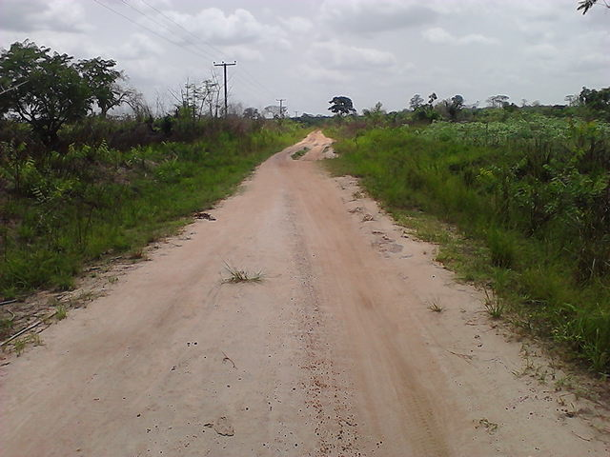
An earth rural road

Slide 17
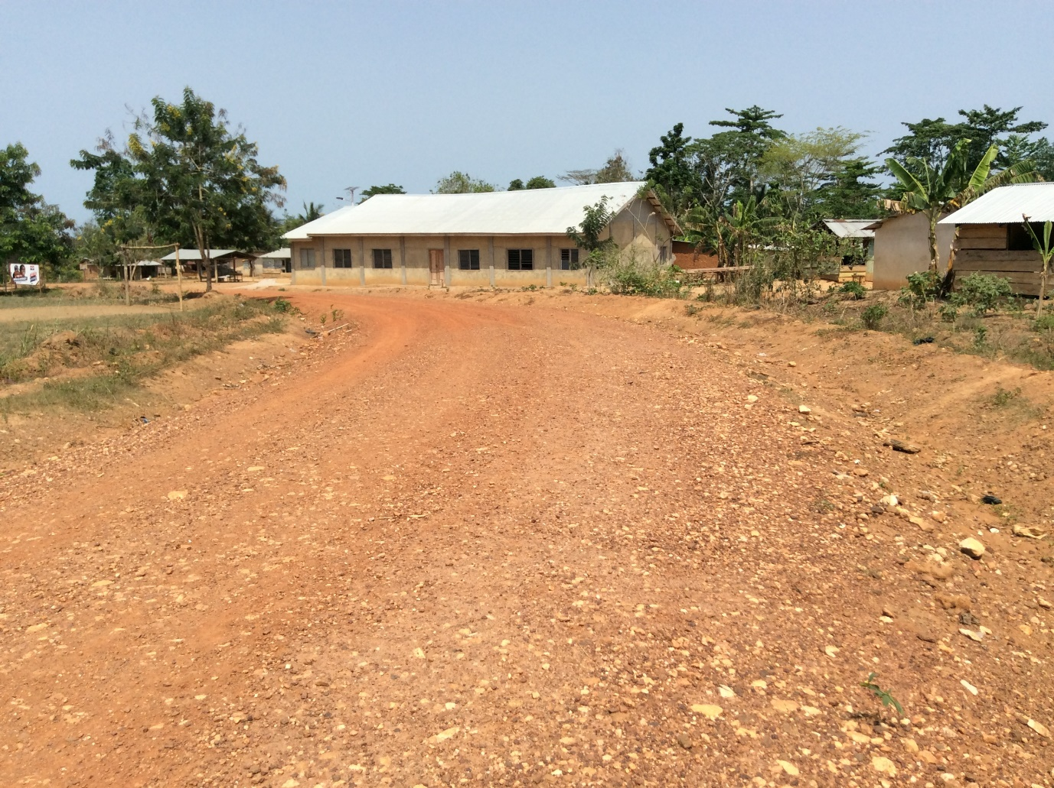
Unpaved Gravel-surfaced Rural Road

Slide 18
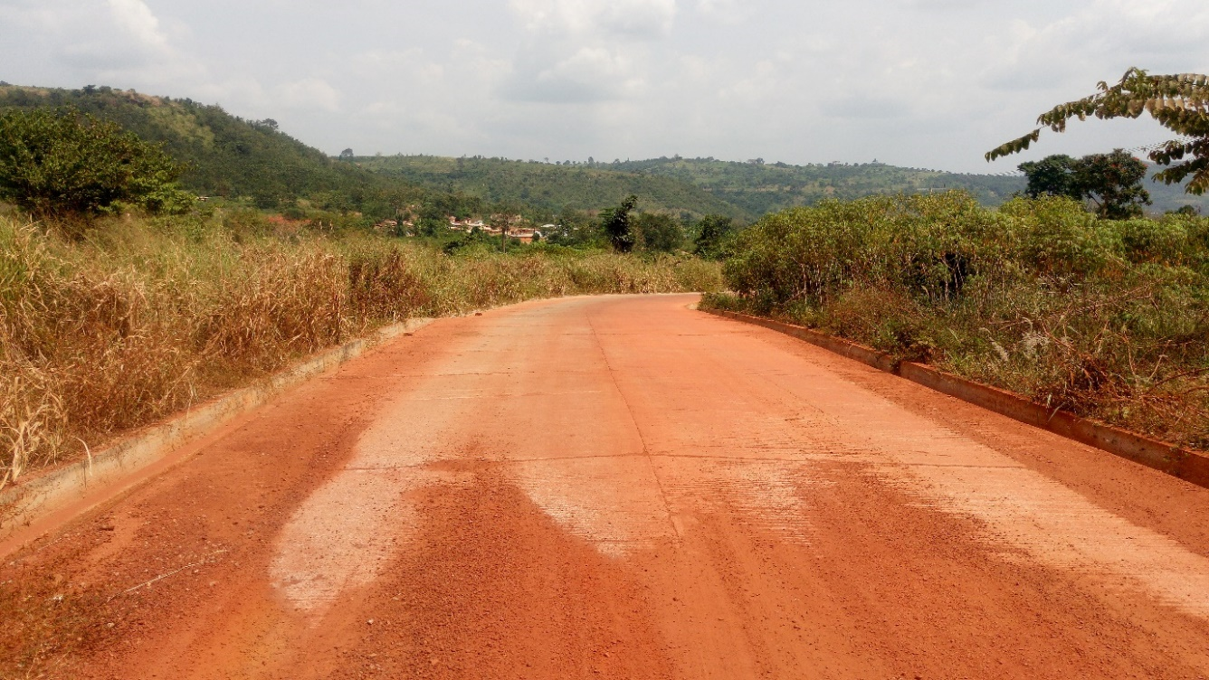
Concrete-paved Rural Road

Slide 19
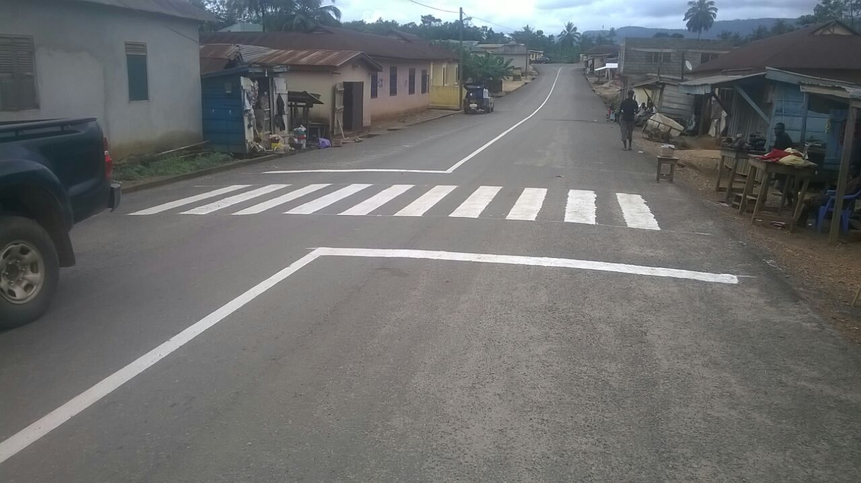
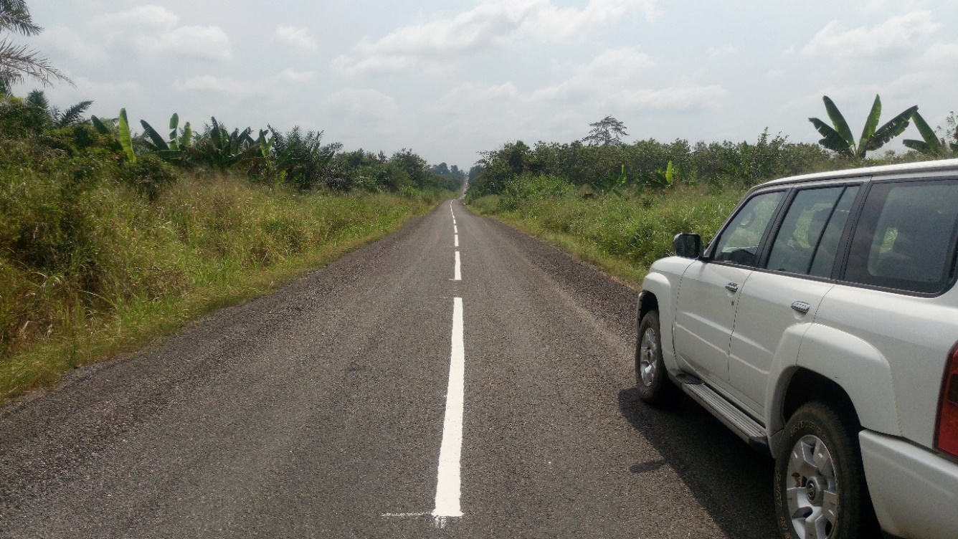
Bituminous surfaced Rural Road with a pedestrian crossing

Slide 20

Bituminous surfaced Rural Road with rumble strips

Slide 21
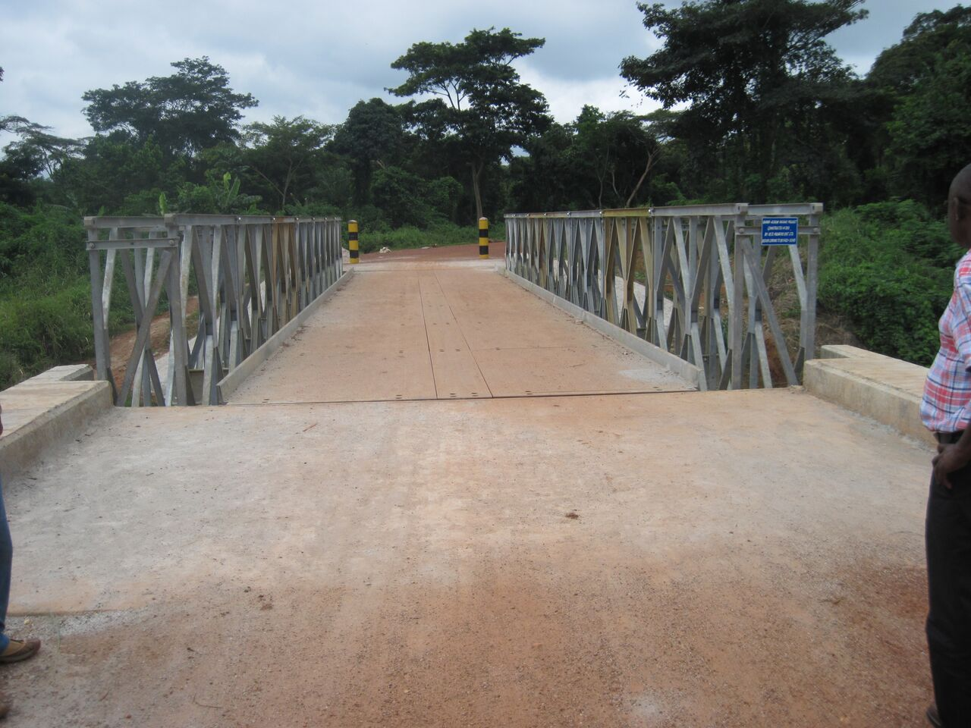
Example of bridges constructed by DFR

Slide 22
Standards as applied in Construction of rural roads
In the Construction Industry we substitute standards with specifications.
Ideally, all specification documents would reference the applicable standard(s), so that any requirement is not taken out of context.
Materials used for road construction; cement, sand, stones, iron rods, timber, natural soil, gravel bitumen, etc. are required to meet certain standards.
Test methods used to measure the quality of constructed artefacts are published as Standards.

Slide 23
Design Standards and Specifications used by DFR
Design Standards/guide: This defines the minimum requirement for the various elements of a road.
Example of standards for a few road elements
  The Design speed for various classes of roads are stated in Design Standards, eg. Design speed for a feeder road is 60km/hr, though vehicles speed more than that on the roads.
  Road cross-sectional elements for feeder roads
  Carriageway width (eg. 6m for roads classified as access)
  Shoulder width ( 1.5m for connectors and inter-district roads, but no shoulders for access)
  Cross-section of a side ditch (V-drain top width of 1,800mm with a depth of 600mm.

Slide 24
Road cross-section

Slide 25
Design Standards for Geometric Design
Geometric Design
  Minimum curve radii
  Maximum super-elevation
  Sight distances

Slide 26
Design Standard for Horizontal Curves
- Minimum Curve Radius
Terrain |  | Connector
 |  | Speed Km/hr | Absolute |  |  | Desirable
 |  |  | e % | f | R (m) | e % | f | R (m)
Flat | GS | 60 | 9 | 0.13 | 130 | 5 | 0.08 | 220
 | BS | 80 | 9 | 0.13 | 230 | 5 | 0.07 | 420
Rolling | GS | 50 | 9 | 0.14 | 85 | 5 | 0.08 | 150
 | BS | 60 | 9 | 0.13 | 130 | 5 | 0.08 | 220
Mountain | GS | 30 | 9 | 0.15 | 30 | 9 | 0.15 | 30
 | BS | 30 | 9 | 0.15 | 30 | 9 | 0.15 | 30

Slide 27

Superelevation
R_{v}
≈
F_{c}
α
F_{cn}
F_{cp}
α
e
W
1 ft
W_{n}
F_{f}
F_{f}
W_{p}
α

Slide 28
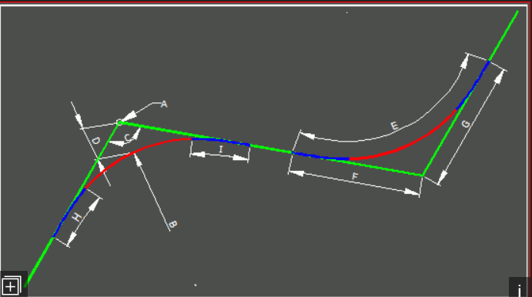
Design Standards for Geometric Design
Geometric Design
  Minimum curve radii for horizontal curves

Slide 29
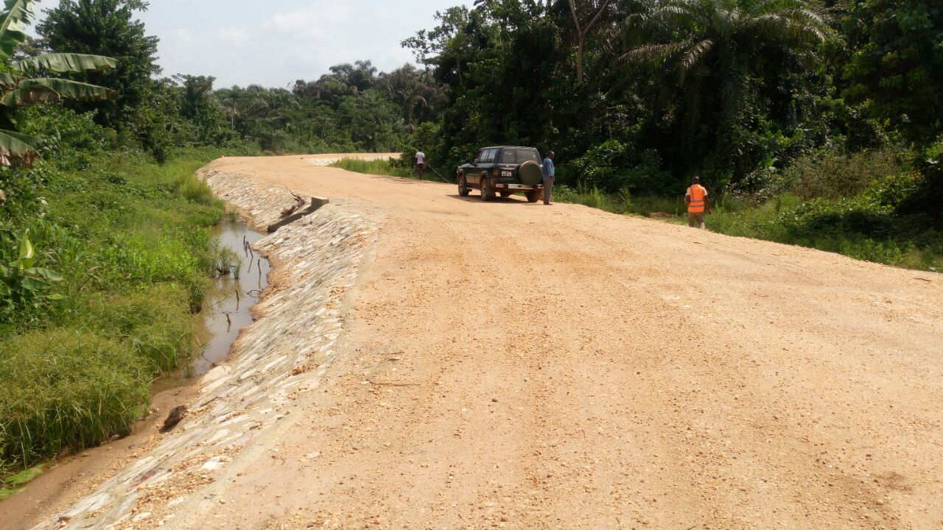
Horizontal Curve

Slide 30
Passing Sight Distance
This is the distance required for a vehicle to safely and successfully pass another vehicle, typically on a two-lane road. Adequate horizontal and vertical passing sight distances are to be provided frequently for safety of road users.
Roads that have very few sections meeting this requirement tries the patient of drivers and results in the dare devil ones making dangerous overtaking.
Eg, Koforidua –Mamfe Road, Accra – Cape Coast Road

Slide 31
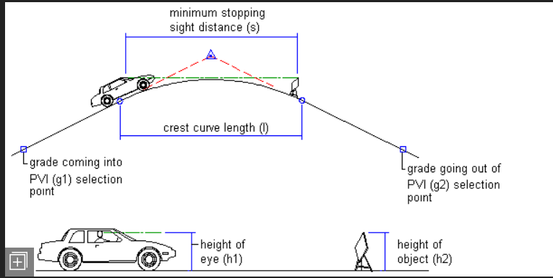
Design Standards for Vertical Alignment
Vertical Alignment Design
  Minimum Curve length
  Maximum gradient
  Minimum stopping sight distance

Slide 32
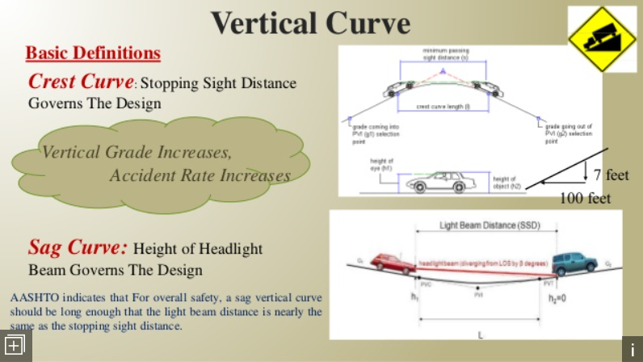
Vertical Curve

Slide 33
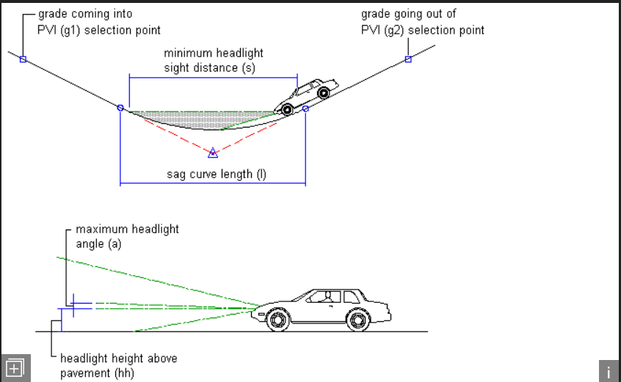
Sag Vertical Curve

Slide 34
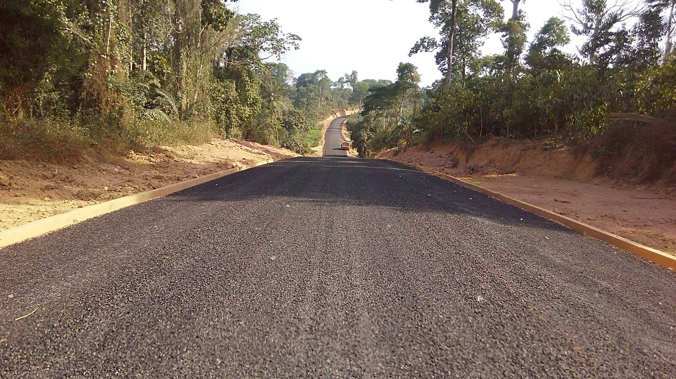
A rural road with vertical curves

Slide 35
Ghana Standard Specifications for Roads and Bridges
(Ministry of Roads and Highways)
General Scope
This Specification defines the standard and quality of materials and workmanship to be used in the construction of roads and bridges in the Republic of Ghana.
It is applicable for trunk, urban and feeder roads administered by the Ministry of Roads and Highways and its Agencies, namely:
1. Ghana Highway Authority (GHA)
2. Department of Urban Roads (DUR), and
3. Department of Feeder Roads (DFR).
The Specifications should be read in conjunction with the Special Specification, which may amplify or modify this Standard Specification, as well as the Conditions of Contract, the Drawings and any other documents forming the Contract.

Slide 36
Specifications- Materials and Testing
Cement
The composition of Portland Cements (CEM I) shall comply with GS 22 or BS EN 197 and be sampled and tested in accordance with BS EN 196. Cements with more than 6% extender shall comply with GS 766 or BS EN 197.
Aggregates
Tests on stone, aggregate, sand and filler shall be performed in accordance with the standard methods given in Table 2.2.

Slide 37
Some Specifications
FILLING MATERIAL ≥ 93% compaction
SUBBASE 95-98% -do-
BASE 99-100% -do-
SUBGRADE (CBR) >15%
7 DAYS CONC. ≥10N/MM2 (PORTLAND CEMENT)
28 DAYS ≥25N/MM2 (size of chippings – 20mm)
SPREAD RATE 98-100M2/M3 (chippings)
SPRAY RATE 1.25-1.27L/M3 (bitumen)
PRE-COATING RATE 12L/M2
PRE-COATING MIX 50% DIESEL+50% BITUMEN

Slide 38
Some Specifications (cont’d)
Thickness of subbase material – 100mm to 150mm
Thickness of base material – 150mm to 200mm
Size of chippings for primerseal – 14mm
Size of chippings for final seal - 10mm
NB: Soil materials of low California Bearing Ratio (CBR) are stabilized with quarry stones.

Slide 39
Slump Test
TYPE OF CONSTRUCTION | MAXIMUM (MM) | MINIMUM (MM)
All precast work | 75 | 50
R.C. structures, blinding concrete | 125 | 50
Mass concrete | 100 | 25

Slide 40
Table 2.2: Test Procedures Applicable to Stone and Aggregate
Determination of | Test Procedure
Particle size distribution Clay, silt and dust in aggregate Flakiness Index Relative density- water absorption Bulk density, voids and bulking Moisture content Aggregate Crushing Value Organic impurities in sands Los Angeles Abrasion Sand equivalent 10% Fines Aggregate Crushing Value | BS EN 933-1 BS 812-103.2 BS EN 933-3 BS EN 1097-6 BS EN 1097-3 BS 812-109 (Standard method – oven drying) BS 812-110 AASHTO T 21 AASHTO T 96 (ASTM C 131) (coarse aggregate) ASTM C 535 (Large size coarse aggregate) AASHTO T 176 (Mechanical shaker or manual shaker method) BS 812-111

Slide 41
Trade and Investment Opportunities in delivery of rural road infrastructure in Ghana
Investment in improvement of roads leading to tourism destinations.
Investment in Construction of footbridges over water crossings across farm tracks and accesses to farming communities.
Investment in construction of major box culverts over rivers across roads leading to deprived communities.
Investment in bituminous surfacing of some rural roads Ghana using labour-intensive method in the near future. A pilot project is on-going in the Eastern region and is being funded by JICA.
Investment in improvement of rural gravel roads using labour-based technology to generate employment for the rural folk.
Funds for the payment of civil works in the construction of steel bridges over certain rivers. The metal components are already in stock for use.

Slide 42
Challenges
Delay in the payment of works done by the employer.
Inadequate contractors’ capacity.
Difficulty of contractors in accessing credit facility and also high cost of capital.
Contractors’ obsolete plants and equipment.

Slide 43
Conclusion
Use of standards to design and construct rural roads cannot be over-emphasized. This is because life, health, safety and the environment are paramount. Of course, the agreed standards will also help to attain value for money.
In fact, the use of Standards and Specifications are key in the delivery of infrastructure especially in the Rural Transportation Systems in Ghana. If standards and specifications are strictly adhered to, the benefits to the nation and the rural folk (about 60-65% of the population) will be enormous.

Slide 44
End of Presentation
Thank You

