Slide 1
Vietnamese Autos delegation September 13, 2017 ANSI & the Standards Alliance

Slide 2
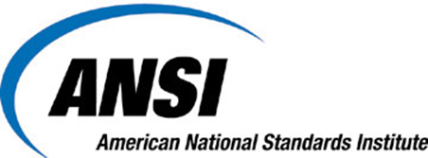
The American National Standards Institute coordinates standards, conformity assessment, and related activities in the United States
Founded in 1918, ANSI is a private, non-profit organization
ANSI is not a government agency or a standards developer

Slide 4
Represents U.S. globally
Accredits standards developing organizations and approves American National Standards
Accredits / approves technical advisory groups (mirror committees) for ISO / IEC technical work
Accredits conformity assessment bodies
Standards re-seller
Education and training
Offers neutral forum for identifying standards needs and discussion of issues
Serves as a bridge between U.S. public & private sectors
Ensures integrity of the standards and conformity assessment system

Slide 6
U.S. Standards System market driven
Approach in many economies
Many other economies Top Down
Standards bodies drive standardization activities
United States Bottom Up
Standards users drive standardization activities
Approach in the United States

Slide 7
U.S. Standards System
System is led by private sector, supported by public sector
Emphasizes private-sector standards and conformity assessment solutions
Provides a strong voice and greater authority to standards users and individual stakeholders
Strength from diversity

Slide 8
The Public-Private Partnership
No single government agency has control over standards
Each agency determines which standards meet its needs
National Technology Transfer and Advancement Act (NTTAA) — Public Law 104-113
Encourages each government agency to seek existing private-sector standards that are appropriate for its purpose and mission
Standards are “Incorporated by Reference” into regulation

Slide 9
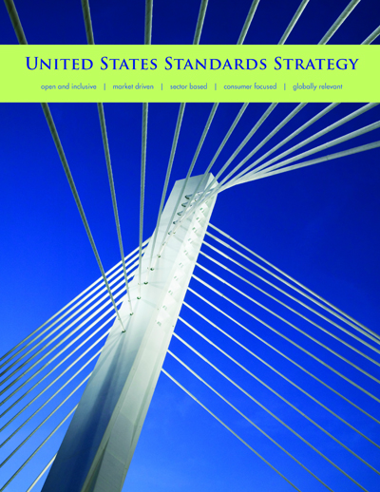
U.S. Standards System reliable – flexible – responsive
Market driven
Flexible and sector-based
Industry-led and government-supported
This system is designed to . . .
Support a broad range of stakeholder engagement
Address emerging priorities and new technologies
Allow stakeholders to find the solutions that best fit their respective needs
As defined in the United States Standards Strategy
www.us-standards-strategy.org

Slide 10
U.S. Standards System guiding principles
The U.S. endorses the globally accepted standardization principles of the World Trade Organization Technical Barriers to Trade Agreement
Transparency
Openness
Impartiality
Effectiveness and relevance
Consensus
Performance-based
Standards should meet societal and market needs and should not be developed to act as barriers to trade
SDOs should avoid duplication of, and overlap with, the work of other standardizing bodies
Coherence
Due process
Technical Assistance
Flexible
Timely
Balanced

Slide 11
Multiple–Path Approach different tools for globally relevant standards
Use in the global marketplace is the best measure of an international standard, not which organization developed the standard
Some standards bodies adopt ISO and IEC standards, and define these as international
ANSI and U.S. stakeholders take multiple-path approach
Globally relevant standards may be developed by ISO, IEC, or any other standards developer that adheres to WTO/TBT principles
Users decide which standards meet their needs, which SDOs they want to work with

Slide 12
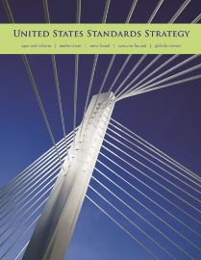
U.S. Standardization System
ANSI accreditation of SDOs and U.S. TAGs promotes alignment with the WTO’s Internationally Recognized Principles for Standards Development
ANSI Essential Requirements for the development of American National Standards
World Trade Organization Technical Barriers to Trade Agreement
Openness
Transparency
Due Process
Consensus
Referenced in the United States Standards Strategy
Referenced in the WTO TBT Committee Second Triennial Review – Annex 4

Slide 13
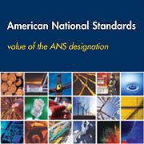
American National Standards (ANS)
Currently there are approximately 240 ANSI-accredited standards developers
Not all standards developed by these organizations are submitted for consideration as ANS
Standards developers are accredited based on the “ANSI Essential Requirements”
There are more than 11,000 American National Standards
Learn more: www.ansi.org/ansvalue
www.ansi.org/essentialrequirements

Slide 14
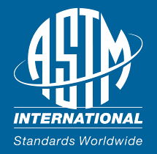
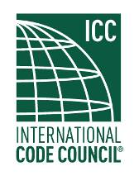
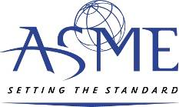
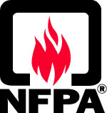
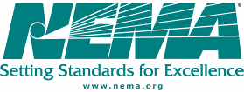
U.S. Standardization System examples of ANSI-accredited SDOs and U.S. TAGs
ASTM International
American Society of Mechanical Engineers
International Code Council
American Dental Association
National Electrical
Manufacturers
Association
National Fire Protection Association
Society of Automotive Engineers
Institute of Electrical and Electronics Engineers
Underwriters Laboratories Inc.
American
Society
of Civil
Engineers
American Petroleum Institute
And more than 200 additional organizations

Slide 15
U.S. Standards System examples of roles and responsibilities
 | ANSI | Standards Developers | Companies | Consumers | Government | NIST
Coordinates U.S. system and policy development
Independently runs standards development activities
Coordinates and monitors USG use of and participation in VCS activities
Legal metrology and WTO-TBT enquiry point
Provides technical input for standards development
Participates in U.S. policy development

Slide 16
The STANDARDS ALLIANCE

Slide 17
Program Overview
ANSI-USAID public private partnership
Unique capacity building facility to support developing countries implement commitments under the WTO’s Technical Barriers to Trade (TBT) agreement
Period of performance: 2013-2018 (2018-2021 in Africa)
USAID requires a 1:1 private sector contribution (in-kind or cash)
Notes:
The Standards Alliance was announced by USAID in November 2012 as a new funding facility designed to provide capacity-building assistance to developing countries, specifically related to implementation of the World Trade Organization (WTO) Technical Barriers to Trade (TBT) Agreement.

Slide 18
Scope of Potential Activities
Any sector or topic within standardization can be covered, as long as it supports one of the following objectives:
Increased understanding of WTO TBT principles
Implementation of the Code of Good Practice for the Preparation, Adoption and Application of Standards
Improved transparency in the development and alteration of technical regulations
More robust and transparent engagement with the private sector in standards development and use

Slide 19
Partner Countries/Regions
Central America (CAFTA-DR participants)
Colombia
Indonesia
Mexico
Peru
Vietnam
Middle East/North Africa (Morocco, Jordan)
Southern African Development Community
East African Community
New in 2016 – Cote d’Ivoire, Ghana, Mozambique, Senegal and Zambia

Slide 20
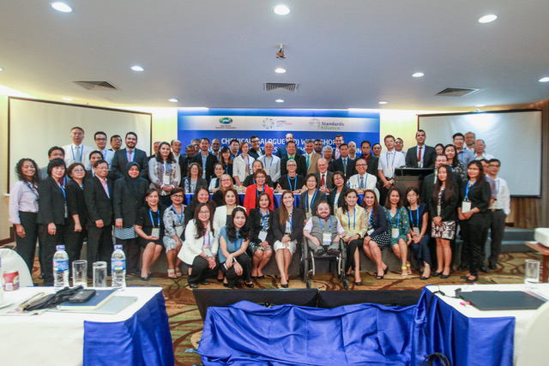
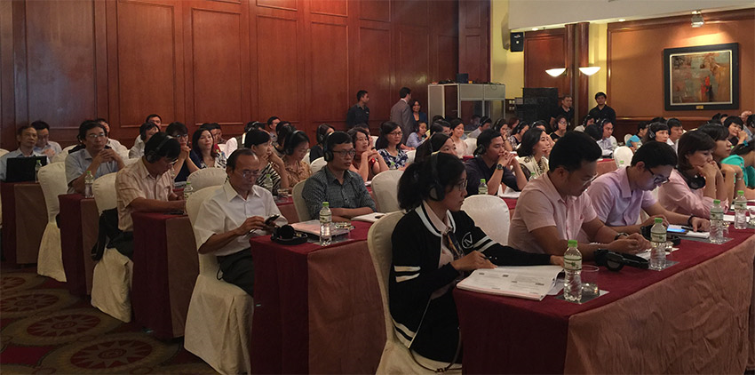
Successes Supporting Vietnam
Standards Alliance Workshop on Sharing Best Practices in Chemicals Regulation: APEC Meeting, August 22-23, 2017 in Ho Chi Minh City, Viet Nam 1.5 day Workshop arranged in partnership with American Chemistry Council (ACC)
Food Additives, A Global Perspective on Safety Evaluation and Use in Vietnam and Indonesia: September 2016
Notes:
The 1.5 day project was an extension of the 2014 Beijing Regulatory Cooperation Workshop designed to deepen experience-sharing in regulatory cooperation, through a capacity-building training program for APEC regulators. Having identified a need for sustained rather than one-off-training, the program includes a three-step capacity building activity based on tangible outcomes comprised of: 1) pre-training course work qualification element delivered by webinars conducted earlier this month 2) face to face training with best practice case studies and specific applications in a workshop setting and 3) a follow-up webinar series on specific chemical regulatory concepts. The project’s overarching objective is to link regulator knowledge with practical application. It is designed to enhance regional economic integration in chemicals though knowledge sharing, capacity building, and regulatory cooperation and convergence. In addition, it provides for exchange of information on best practices in the sound management of chemicals in order to lift the capability and capacity of developing economies.
The Standards Alliance with the support of the U.S. Department of Agriculture (USDA) organized two workshops on food additives in Hanoi, Vietnam and Jakarta, Indonesia on September 13 and 15, 2016. The workshops were intended to develop capacity in these emerging markets on food additive issues, with a particular emphasis on global harmonization, basing regulatory policy on science, increasing understanding of toxicological assessments, improving risk communication and fostering a more collaborative environment for industry and government cooperation on these issues.
The September 13 workshop in Hanoi, provided an informative look at Generally Recognized as Safe (GRAS) processes and the suitability of food additives with a focus on the natural versus artificial debate. Other topics of discussion included toxicological evaluations of food additives, flavor, color, sweetener and MSG regulations. The event was attended more than 90 participants from the Testing Management Division at the Vietnam Food Administration (VFA), Ministry of Health (MOH), Ministry of Agriculture and Rural Development (MARD), Ministry of Industry and Trade (MOIT), Ministry of Science and Technology (MOST), several Vietnamese trade associations and industry. Representatives from the U.S. Embassy in Hanoi, International Food Additives Council (IFAC), American Beverage Association (ABA), International Council of Grocery Manufacturers Associations (ICGMA), Calorie Control Council (CCC), Flavors Extracts Manufacturers Association (FEMA), International Association of Color Manufacturers (IACM), Wine Institute of California and International Glutamate Technical Committee (IGTC) shared U.S. perspectives.

Slide 21
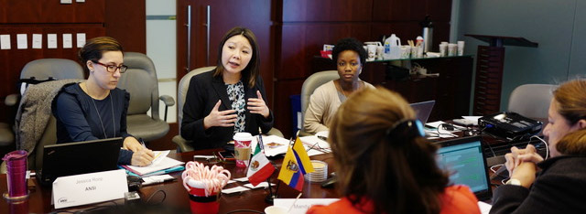
Resources
Website: http://standardsalliance.ansi.org

Slide 22
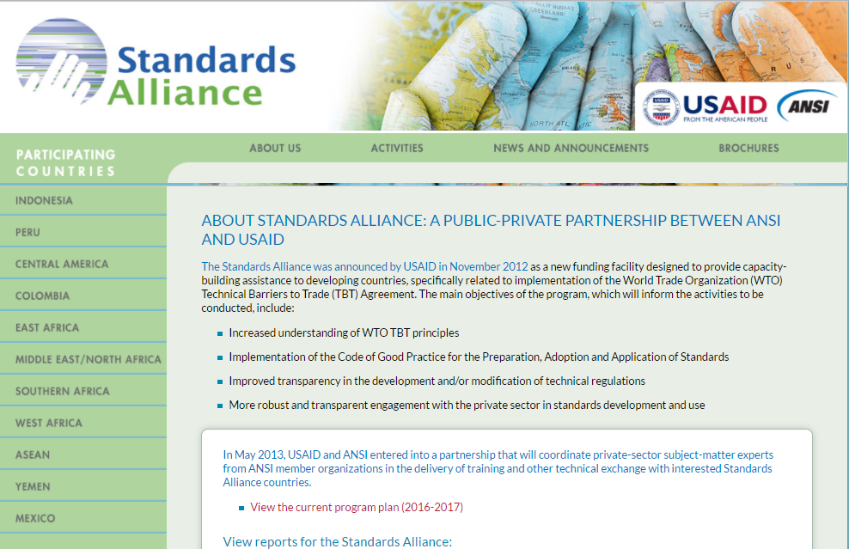

Slide 23
Leslie McDermott
lmcdermott@ansi.org
Jessica Roop
jroop@ansi.org
David Jankowski
djankowski@ansi.org

