Slide 1
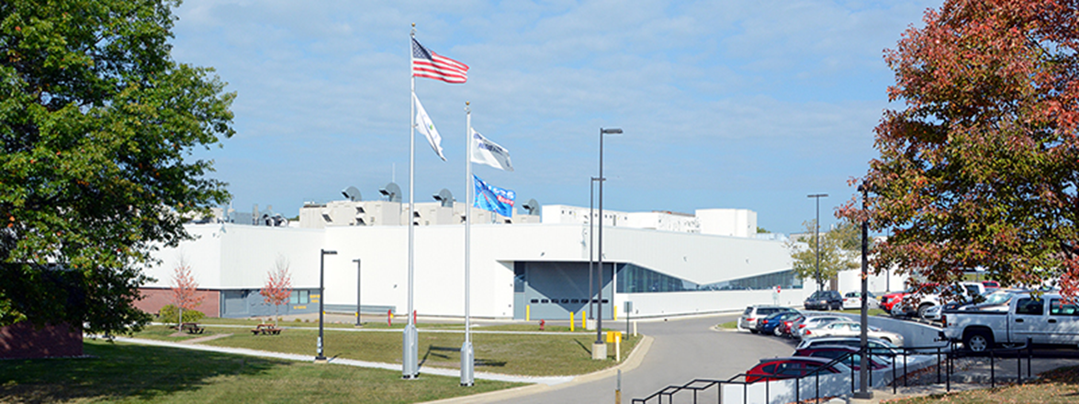
Office of Transportation and Air Quality
Vehicle Emissions Compliance,
Testing and Enforcement Programs

Slide 2
Light-Duty Vehicle Compliance Program
EPA Action
Durability Review and Approval Process
Manufacturer Action
EPA Follow-Up (Defect and Recall Reports, Mfr. In-Use Testing, EPA Testing)
EPA Test Data Review/Analysis
CARB Coordination (Warranty Reporting)
OECA Coordination (Enforcement)
EPA Issues Certificate of Conformity
EPA Review of Manufacturer Application
EPA Confirmatory Testing (Random and Targeted)
EPA In-Use Surveillance Testing
EPA Certification Preview and Pre-model Year Reports
0 Miles
10,000 Miles
20,000 Miles
50,000 Miles
90,000 Miles
120,000 Miles
(End of Useful Life)
Vehicle Design and Build
Low-mileage In-Use Verification Testing Performed by Manufacturer
High-Mileage In-Use Verification Testing Performed by Manufacturer
Vehicle May Enter Commerce
End of Useful Life (per CAA)
Manufacturer Emissions Vehicle Prototype and Durability Testing
Warranty Tracking and Emission Warranty Reports (EWIRs) to CARB
Emission Defect Information and Voluntary Emission Recall Reports (EDIRs/VERRs) to EPA
(introduction into commerce – useful life miles)

Slide 3
Importance of Compliance
Emissions from transportation sources can do immense harm to public health, welfare and the environment
Clean Air Benefits
1990 Clean Air Act Amendments:
From 1990-2020, 4.2 million lives saved, benefit outweighs costs ~30:1
In 2030 alone,
Eliminate more than 38,000 premature deaths
Realize more than $380 billion in health and welfare benefits
The LDV GHG program is projected to result in:
$1.7 trillion dollars of fuel savings over the lifetime of vehicles produced between 2011 and 2025
12 billion fewer barrels of oil consumed
Level Playing Field
Vehicle, engine, and fuels industries are highly competitive, especially in today’s global environment
Regulated industries expect and rely on EPA to protect their investment in emissions compliance

Slide 4
Vehicle and Engine Emissions Compliance Oversight
Our approach to compliance oversight is multi-faceted and multi-dimensional
We monitor emissions compliance throughout product lifecycle (see following slides)
Pre-production
Products coming off production lines
Vehicles and engines already in customer service
We apply a flexible mix of testing, audits, manufacturer tracking/reporting review, and partnerships with other stakeholders and regulators to collect compliance information

Slide 5
Light-Duty Vehicle Compliance Strategy
Three Step Strategy:
Pre-production (certification)
Production
In-use
Risk-Based
New technologies and vehicles
High emissions
Sales volumes
Other factors (e.g., bad actors, past issues, new companies, etc.)
Testing/Evaluation Tools
Chassis dynamometer
Remote Sensing
Real world testing (PEMs)
OBD, vehicle sensors and diagnostics

Slide 6
Pre-Production (Certification)
Review certification application
Emission test data, durability data, OBD,
AECD review
Durability process review
Emission Data Vehicle (EDV) confirmatory testing
Emission test manufacturer official certification EDV at EPA’s National Vehicle and Fuel Emissions Laboratory (NVFEL)
Test vehicle over five emissions test cycles
Chassis dynamometer testing
FTP (City), Highway, US06, SC03, Cold FTP (20°F)
Evaporative emissions testing
Test approximately 200 vehicles per year (15-20% of available emissions test fleet)
Beginning in 2015, special cycles to screen for defeat devices or other off-cycle concerns

Slide 7
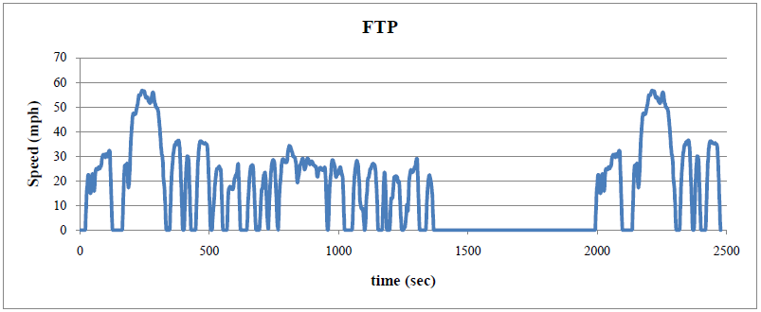
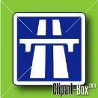
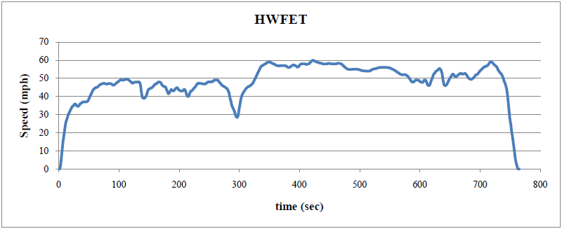
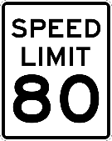
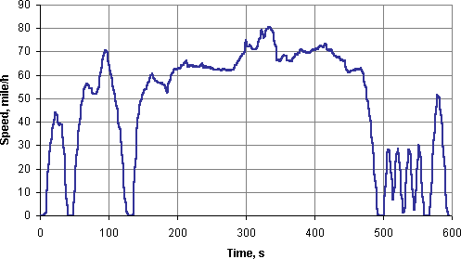
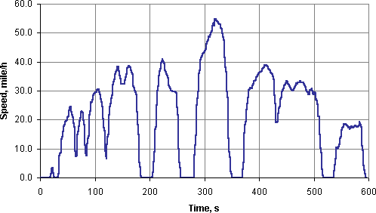
Five Test Procedures are performed on LD vehicles for criteria pollutants, GHG, & Fuel Economy
EPA City and Highway label values are calculated as weighted combinations of five key tests. The weighted values are posted on a new vehicle’s window label along with its competitive segment position.
FTP City Drive Cycle
57 mph
HWFET Highway Drive Cycle
60 mph
US06 High Speed Drive Cycle
81 mph
SC03 Air Conditioning Drive Cycle
55 mph
The results from the FTP City and HWFET test procedures are also combined into an EPA unadjusted value for use to determine Corporate Average Fuel Economy (CAFÉ) values.
20°F Cold City Drive Cycle
57 mph
Note: The city, highway and cold city cycles feature light engine loads and mostly low vehicle speeds.

Slide 8
Light-Duty Vehicle Production
Production vehicle audits
Procure new vehicles from manufacturers shortly after production begins
EPA selects vehicle from production and verifies it has production software
EPA performs vehicle mileage accumulation for testing
Test 5-10 different vehicles
New models, engines, technologies, remote sensing data, In-use data, high volume
Conduct the following testing:
Road load (coastdown) testing (non-EPA test track)
Baseline emission testing (EPA test cycles @ NVFEL)
Fuel economy evaluation
Real world (PEMs) testing (off-cycle emissions – defeat device, tampering, defective part/strategy, etc.)
GHG audit – correct footprint, correct emission control hardware, off-cycle credits

Slide 9
Light-Duty Vehicle In-Use
In-use testing looks for a number of possible emissions problems
Durability concerns, poor designs, defective parts, production/assembly issues, defeat devices, tampering
EPA remote sensing data
Real-world emissions data from various state programs
Considerable amounts of data (thousands to millions of records)
Provide CD emissions updates, including “dirty dozen” (top 12 dirty vehicle classes/models)
Manufacturer In-Use Verification Program (IUVP)
Manufactures are required to test annually one and four year old vehicles from the general public
Dyno testing – FTP, US06, Highway, Evaporative emissions
Typically get about 2,000 emissions tests
EPA In-Use Surveillance Program
We test approximately 150 in-use vehicles annually at NVFEL
Focus on problems from IUVP, remote sensing data, warranty, defect reports, public complaints
Dyno testing – FTP, Highway, US06, SC03, Cold FTP, Evaporative emissions
On-road testing

Slide 10
Conclusion
Effective compliance is critical to addressing transportation emissions
EPA compliance programs are designed to maximize air quality benefits and to help ensure that manufacturers investing to comply with these programs can compete on a level playing field

