Slide 1
The Federal Motor Carrier Safety Administration
FMCSA 101

Slide 2
Who We Are: The Federal Motor Carrier Safety Administration
One of 11 operating administrations at the U.S. Department of Transportation
Established January 1, 2000 (formerly a part of Federal Highway Administration)
  1,100 Employees (800 located in our field offices)
Regulates interstate transportation by large trucks and buses, household goods operations, and interstate/intrastate HAZMAT transportation.
Our Mission: Reduce crashes, injuries and fatalities involving large trucks and buses through education, innovation, regulation and enforcement.

Slide 3
Who We Are: Our Jurisdiction
Commercial Motor Vehicles
  Safety Authority (USDOT#): CMVs that travel in non-exempt interstate commerce which meet certain weight (10,001 lbs.) and passenger thresholds.
  Operating Authority (MC#): For hire CMVs that travel in non-exempt interstate commerce. These motor carriers must ALSO have safety registration. (Under URS 1, for-hire carriers will only have a USDOT#).
Commercial Drivers License
  Commercial Drivers License (Issued by the states). Drivers of commercial motor vehicles that meet certain weight thresholds (GVWR 26,001 lbs.), vehicles transporting Hazardous Materials, or vehicles designed to carry 16 or more passengers including the driver are required to have a valid commercial drivers license. The license number is a unique identifier which links to the driver’s driving history and criminal record. Drivers need a Commercial Drivers License (CDL) with proper endorsements when operating.

Slide 4
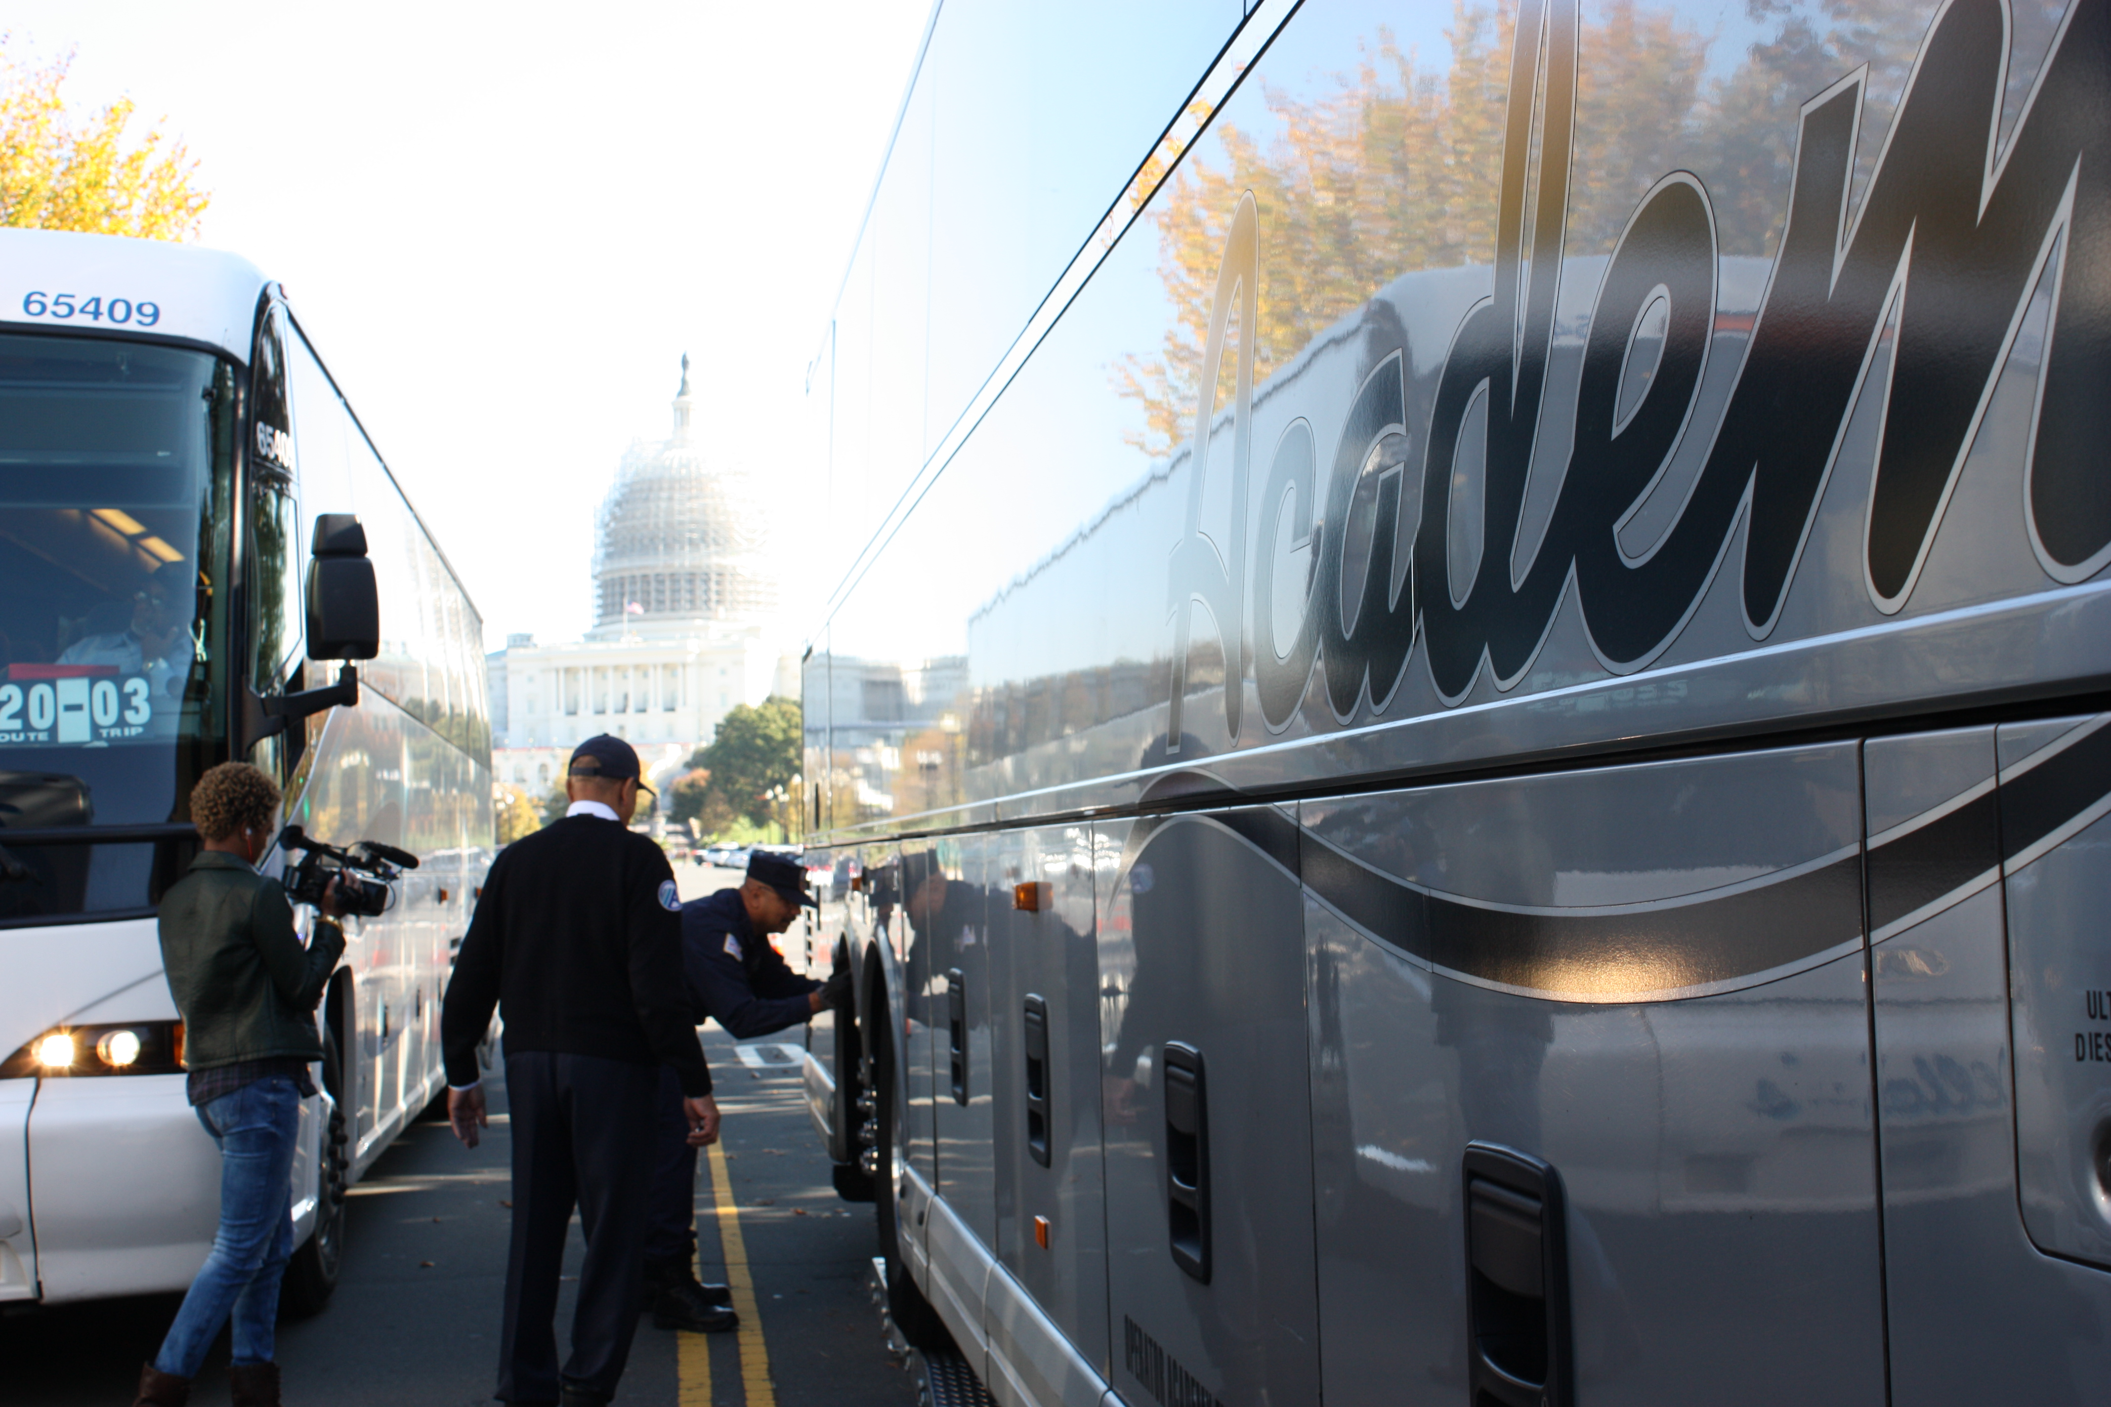
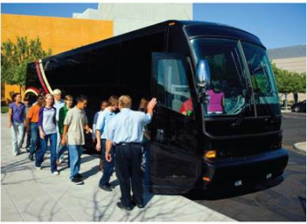
FMCSA Regulates
3,095,373 =
Commercial motor vehicle miles traveled in 2015
524,058
active motor carriers
12,603
passenger carriers
88,406
hazardous materials carriers
4,206
household good carriers
3,930,430
4.5 million =
Increase in commercial trucks registered in the U.S. over the past 20 years
commercial motor vehicle drivers
By 2040
Truck freight will increase from 11.4 billion tons (2015) to 18.8 billion tons
52,052
medical examiners

Slide 5
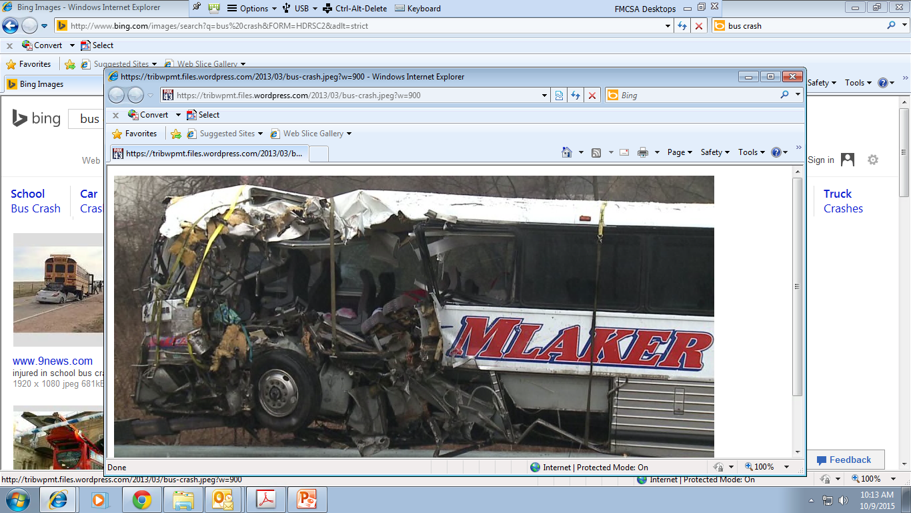
In 2016, there were 4,660 fatalities and 91,088 injuries in crashes involving large trucks or buses. There were 165,536 total crashes involving large trucks or buses.
- Source: Motor Carrier Safety Progress Report (as of March 31, 2017)

Slide 6
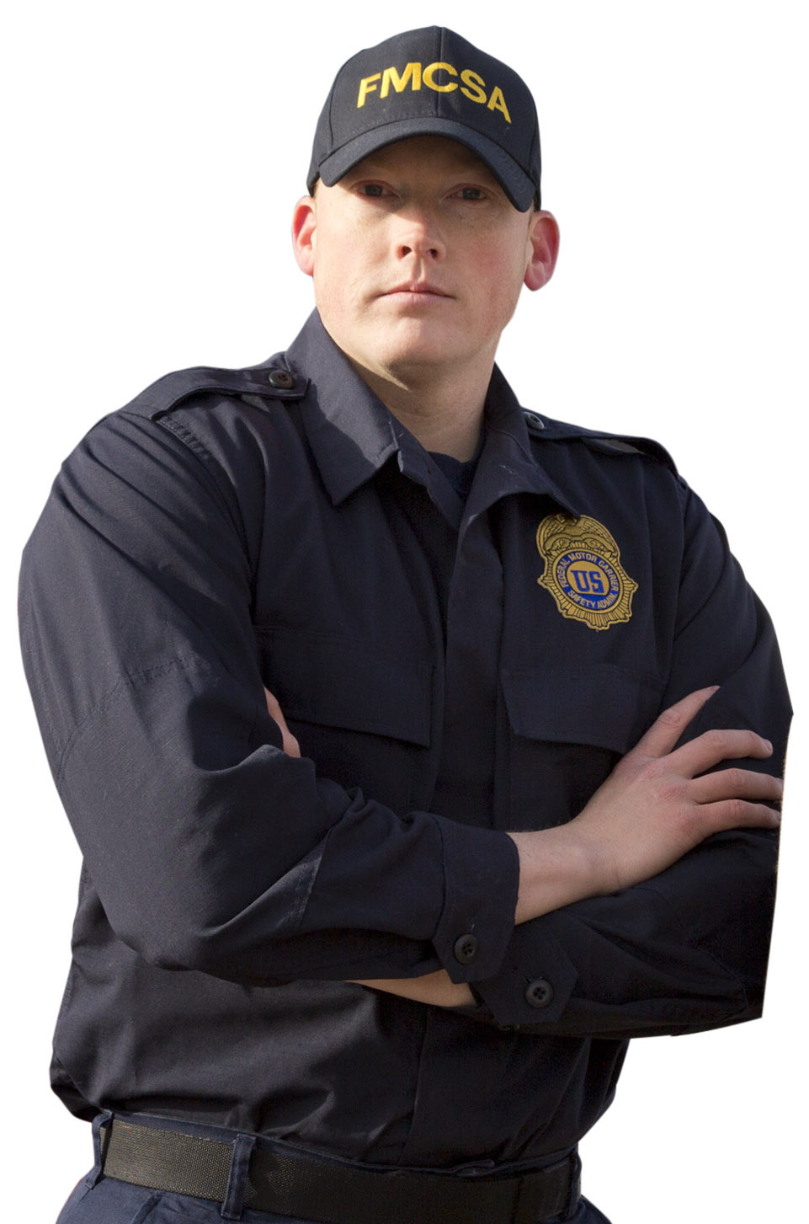
Our Three Core Principles
Raising the safety bar to enter the motor carrier industry
Requiring motor carriers and drivers to comply with rigorous safety standards
Removing high-risk motor carriers, and unsafe companies, drivers and vehicles from the road

Slide 7

What We Do: Safety Oversight
Driver Hours of Service
Physical Qualification of Drivers and Qualification of Medical Examiners/Examinations
Commercial Driver’s License (including oversight of State Operations)
Drug and Alcohol Testing for Drivers
Driver Training
Vehicle Maintenance
Transportation of Hazardous Materials
Minimum Levels of Financial Responsibility
Household Goods / Commercial Regulations
Registration Processes

Slide 8
Vehicle Inspections - Motor Carrier Safety Assistance Program (MCSAP)
FMCSA provides MCSAP grants to States for Roadside Inspections
Over $300 million (US dollars) / year (54% of total agency budget)
States adopt compatible regulations for motor carrier safety and hazardous materials operations
Approximately 7,000 certified State roadside inspectors throughout the United States
Conduct approximately 3.4 million roadside inspections / year
Violations are linked to a carrier’s USDOT#.
Conduct approximately 8,000 investigations / year
Provides for uniformity in enforcement and compliance

Slide 9
Roadside Inspection Levels
North American Standard Levels of Inspection:
  Level I: Driver, vehicle and load
  Level II: Walk-around Driver/Vehicle Inspection
  Level III: Driver/Credential Inspection
  Level IV: Special Inspection (one time, one item)
  Level V: Vehicle Only
  Level VI: Highway Route Controlled Radioactive Materials
  Level VII: State Designated Inspection

Slide 10
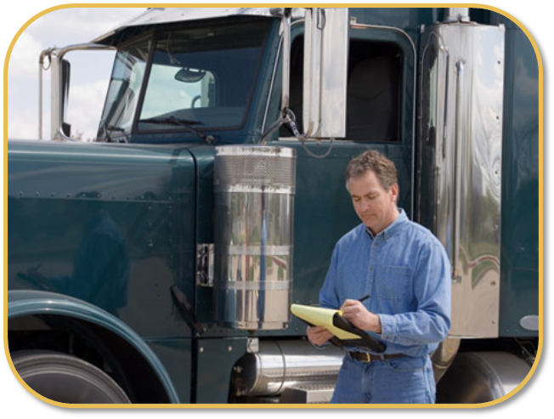
Roadside Inspections
Locations
  Conducted at various locations, often at truck weight and inspection stations and ports of entry.
Violations Can Include:
  Violations of CMV laws of the state in which the inspection is being conducted.
  Federal Motor Carrier Safety Regulations (FMCSRs)
  The Federal Hazardous Materials Regulations (HMR)
  Criminal violations, e.g. drug smuggling.
Violations are linked to a carrier’s USDOT#.

Slide 11

Compliance, Safety, Accountability (CSA)
FMCSA’s data-driven safety compliance and enforcement program
Designed to improve safety and prevent commercial motor vehicle crashes, injuries, and fatalities by aggregating data and identify high-risk motor carriers
Helps motor carriers, including owner-operators, and drivers see patterns in safety performance to improve safety compliance
Notes:
Uses real-time driver and vehicle performance data

Slide 12
Compliance Activities
Safety Audits
  Performed by FMCSA personnel and state partners.
  Do not result in a safety rating.
Compliance Reviews
  Performed by FMCSA personnel and state partners.
  Investigation to document a carrier’s compliance with FMCSRs
  Result in a safety rating: Satisfactory, Conditional, Unsatisfactory.

Slide 13
New Entrant Safety Audit (NESA) Program
The purpose of the NESA program is to monitor motor carriers within the first 18 months of operations to identify operational deficiencies and assist with their compliance with the FMCSRs.
Performed within 12 months of operations will result in a pass/fail.
Passenger Carrier Oversight Programs
NESA performed within 120 days of receiving operating authority
Full Compliance Review performed every 3 years

Slide 14
Commercial Driver’s License
This presentation provides an overview of the laws, regulations, and enforcement relating to commercial vehicle administration.
Introduction to the major responsibilities of the Federal Motor Carrier Safety Administration.
49 CFR 383/384 – the procedures for the commercial vehicle driver’s license exam and skills test, and mechanism of update.
Coordination and cooperation between Federal and State agencies in the administration of commercial vehicle drivers.

Slide 15
Commercial Driver’s License Division
- Major Responsibility
The most important role of the Federal Motor Carrier Safety Administration’s - Commercial Drivers License Division is to assure compliance by the State Driver Licensing Agencies (SDLA).

Slide 16
How it started –
Commercial Motor Vehicle Safety Act of 1986
To prevent commercial vehicle drivers from concealing unsafe driving records by carrying licenses from more than one state.
To ensure that all commercial vehicle drivers demonstrate the minimum levels of knowledge and skills needed to safely operate commercial motor vehicles before being licensed.
To subject commercial motor vehicle drivers to new, uniform sanctions for certain unsafe driving practices.

Slide 17
Prior to the –
Commercial Motor Vehicle Safety Act of 1986
States had wide variations in:
  Testing and licensing standards; and
  Disciplinary actions for violating traffic control laws.
Drivers had multiple licenses.

Slide 18
Commercial Driver’s License Standards
Requirements and Penalties
49 CFR Part 383
Requires drivers to have a single license and disqualifies drivers who operate a vehicle in an unsafe manner;
Requires Drivers to notify their employer of convictions;
Establishes disqualification and penalties for convictions;
Defines commercial motor vehicle groups and various endorsements; and
Establishes minimum criteria for written and skills test.

Slide 19
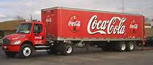
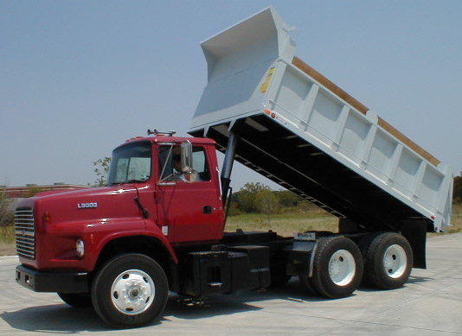
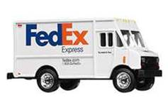
Who’s Required to have a CDL?
Any Person Who Operates a Commercial Motor Vehicle (CMV), in commerce, to transport passengers or property.
Classes of CMVs
A B C

Slide 20
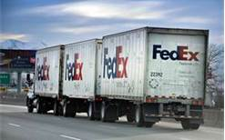
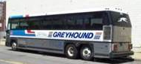
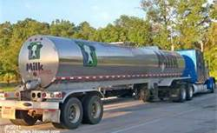
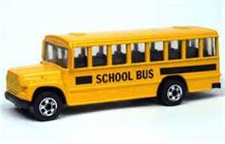
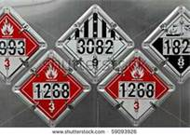
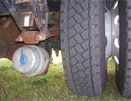
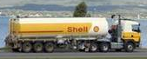
Commercial Motor Vehicle
CDL - Endorsements
The Federal regulations establish uniform endorsements for commercial driver’s licenses. “P” - Passenger Vehicles
“T” - Double/Triple Trailers
“S” - School bus
“N” - Tank Vehicles
“H” - Hazardous Materials
Air Brakes
“X” - Combined “H” and “N” Endorsements

Slide 21
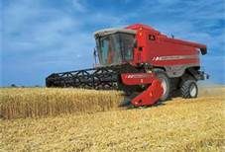
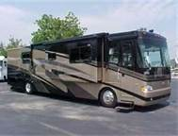
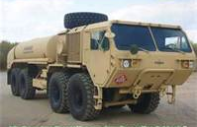
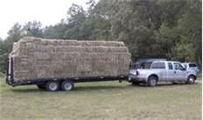
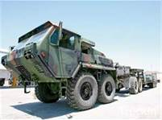
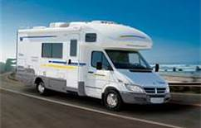
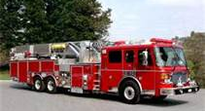
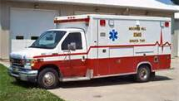
Special Exemptions from CDL Regulations
Military Vehicles
Farm
Vehicles
Recreational
Vehicles
Emergency
Vehicles

Slide 22
Disqualifying Offenses
Major Offenses
Serious Traffic Violations
Railroad Grade Crossing Violations
Violations of Out-Of-Service Orders

Slide 23
CDL Driver Testing
General Knowledge Test
    Multiple choice questions
    50 questions
    80 percent correct
Driving Skills Test
    Pre-Trip Inspection
    Basic Control Skills
    On Road

Slide 24


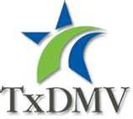

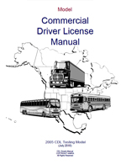

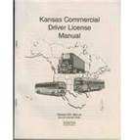
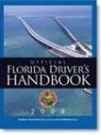

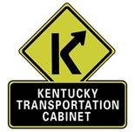



State and Federal Coordination
Minimum Federal Regulations – 49 Code of Federal Regulations (CFR)
State Administration

Slide 25
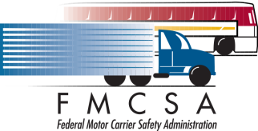

CDL Testing Updates
Test Maintenance
sub-Committee
+
=

Slide 26
Questions

Slide 27
FMCSA Contact Information
Selden Fritschner
  Selden.fritschner@dot.gov
Carla Vagnini
    Carla.Vagnini@dot.gov
  Catterson Oh
    Catterson.oh@dot.gov

