Slide 1
History of Safety Evaluation and Regulatory Status of Monosodium Glutamate (MSG)
Eyassu G. Abegaz, Ph.D.
On behalf of
International Glutamate Technical Committee
September 15, 2016

Slide 2
International Glutamate
Technical Committee (IGTC)
  The IGTC is a scientific non-profit organization.
  Consists of 6 regional bodies from 13 countries around the world.
  Supports glutamate research in the area of physiology, biochemistry, pharmacology and toxicology.
  Share scientific and regulatory information on glutamates to national and international regulatory authorities.
  Address scientific and regulatory questions on glutamate safety.

Slide 3

IGTC
Organization members
ECU
TGA
ASANA
TAAMA
RCGS
IGSSA
Notes:
IGIS is composed of 7 Regional Organizations 1) Northeast Asia 2) Southeast Asia 3) Taiwan 4) Australia 5) Europe 6) North America 7) South America. This year there is no annual IGIS meeting but SEAAGS and IGSSA are having their yearly meeting

Slide 4





Approved around the world

Slide 5
Safety Database on MSG
Extensive toxicological database exists that includes: acute, sub-chronic and chronic, reproductive toxicity and teratology studies in animals.
Many human clinical studies
Walker and Lupien, Rev. in J. Nutr. 130:1049S-1052S, 2000

Slide 6
Risk Assessment
Risk
Hazard (potential to cause harm)
=
Exposure
X

Slide 7
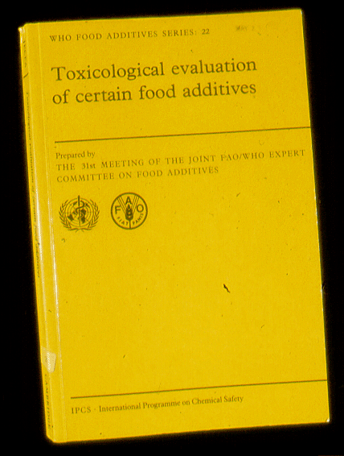
What do Major Regulatory Agencies Say About MSG?
JECFA Review, 1970, 1973, (1987)- ADI Not Specified
EC/Scientific Committee for Food (SCF) Review (1991)– ADI Not Specified
Federation of American Societies for Experimental Biology (FASEB) Report (1995)- MSG is Safe
Food Standards Australia New Zealand (FSANZ)-2003 review - Safety of MSG was confirmed
Codex General Standards on Food Additives (GFSA)- MSG is approved in many food categories at GMP levels

Slide 8
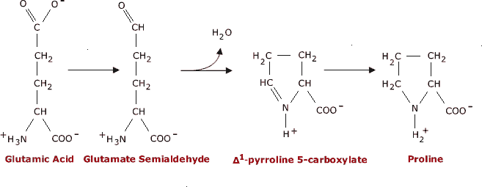
What is Monosodium Glutamate?
The sodium salt of glutamic acid
Ubiquitous amino acid found in nature
Readily dissolves in solution to sodium and glutamic acid
Taste of glutamate (Umami) is the 5th basic taste
Enhances the natural flavor and palatability of foods
The human body does not differentiate glutamate whether it comes naturally present in foods or added MSG

Slide 9
Glutamate in the Diet
Dietary source | GLU Content | Approximate daily glutamate intake
Dietary Protein(80-100g/d) | 8-10g /d | 110-150mg/kg
Free glutamate in foods Tomato, 1 medium Parmesan, 1 oz. Soy or fish sauce, 1 oz. | 250-750mg 500-900mg 200-330mg | 20-40mg/kg
Total natural sources | 10- 12g/d | 110-190mg/kg
Human breast milk contains abundant glutamic acid (>50% of total aa)
Broasan et al. 2014, Amino acids ; Yamaguchi S and Ninomiya K. J. Nutrition.
USDA nutrient database . https://ndb.nal.usda.gov/ndb/search/list

Slide 10
Dietary Glutamate Intake from MSG
Country | Daily intake
EU (2006) | 0.3-0.5g/d up to 1g/d
United States | 0.4-0.8g/d
Vietnam (2013) | 2.2g/d
Thailand (2012) | 2-3g/day up to 6g/d included MSG from Fish sauce
China (2010) | 3.8g/d up to 6.8g/d included MSG from soy sauce
Total Natural sources | 10-12 g/d from foods without MSG
Beyrether et al. 2006; Shi et al. 2010; Insawang et al. 2012; Vu et al. 2013;
Brosanan et al. 2014

Slide 11
Importance of Glutamate in the Body
Present as free amino acid in most organs and tissues
Important substrate in energy metabolism, amino acid and protein synthesis, and glutathione synthesis
Production of glutamate from glucose in the brain that acts in excitatory neurotransmitter
Signal umami taste in the oral cavity
Post-ingestive effect on in digestive processes, nutrient absorption and metabolism, energy hemostasis via vagal nerve activation
Tori et al. J. Gastroenterol (2013) 48:442-451

Slide 12

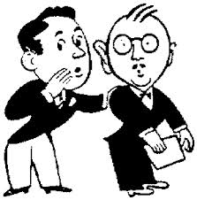

Studies Reporting Adverse Effects
Injection into animal brain to overcome BBB
Injection into animal body by overcoming GI barrier
Extremely high doses
Administration after fasting without food to eliminate normal effect of food
Individual and case-report observations

Slide 13
Safety Concerns in Late 1960’s
Olney, J.W. Science 164 719 (1969)- Brain Lesions, Obesity and Other Disturbances in Mice Treated with Monosodium Glutamate
Species: neonatal mice (2 - 8 days after birth)
Treatment: subcutaneous administrations of MSG
Doses: (2 - 5g/kg → 120-300g/60kg man)
Results: Damage within the nucleus arcuatus in hypothalamus of the brain, stunting and adult obesity

Slide 14
Early Neonatal Treatments
Scientific evidence in higher primates:
Monosodium Glutamate: Absence of Hypothalamic Lesions After Ingestion by New Born Primates -Reynolds, W.A. et al Science 172 1342 (1971)
Takasaki et al - Toxicology 9 307 (1978) - MSG in the diet does not cause any acute or long-range adverse effect on the brain
  No lesions in higher primates
  Does not happen when MSG is administered in milk

Slide 15
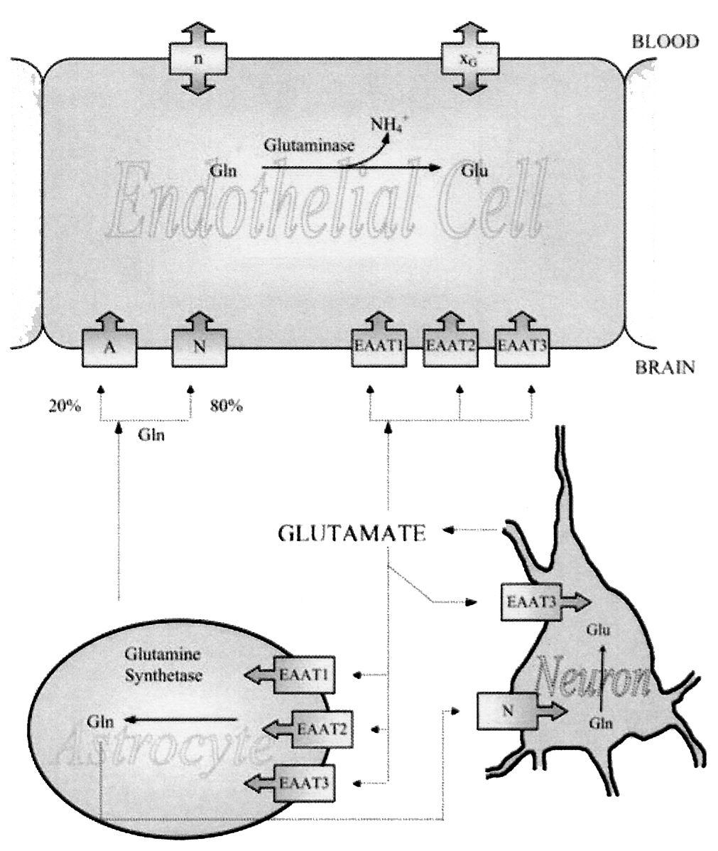
The Blood-Brain Barrier and Glutamate
BBB is virtually impermeable to the net movement of glutamate from circulation into brain
GLU in brain is tightly controlled by transporters
Hawkins RA et al., Structure of the Blood–Brain Barrier and Its Role in the Transport of Amino Acids. J Nutr 136: 218S–226S, 2006.

Slide 16
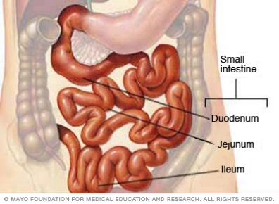
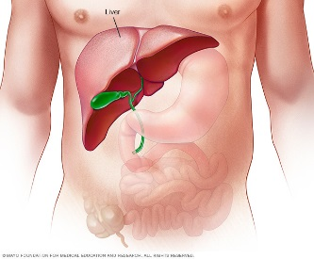
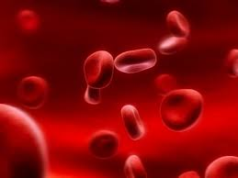

MSG Entry to the Blood
Mouth
100%
Small
Intestines
Liver
Blood
Glu
Glu
>94%
Energy
Protein synthesis
Very
little
Alanine,
Glutamine
Thermogenesis
Burin & Stoll, Am J Clin Nutr., 90:850S, 2009

Slide 17
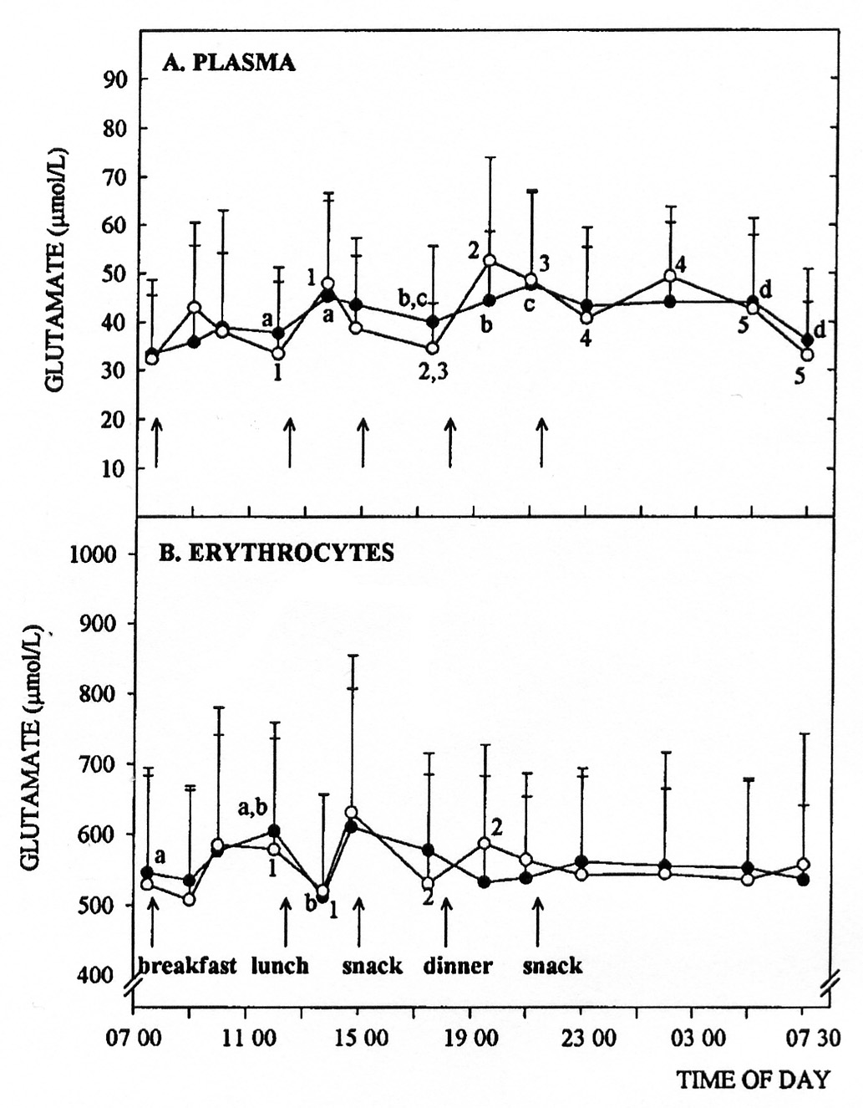
24-Hour variations in Plasma GLU when MSG is ingested with meals.
Daily MSG dose = 100 mg/kg
(n = 10)
Black circle: no MSG
White circle: MSG.
Tsai P-J, Huang P-C Metabolism 48: 1455-1460, 1999.

Slide 18
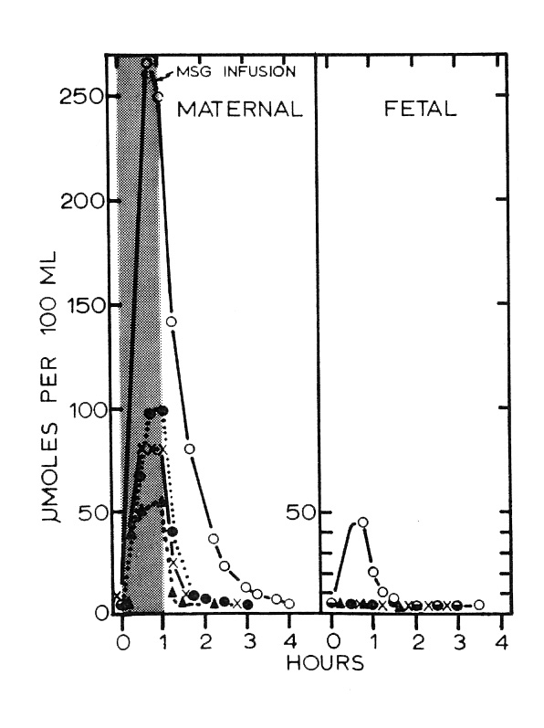
Placental Barrier of MSG entry into Fetus
The placenta extracts
GLU from circulation
and utilizes it as energy source
Placental Barrier to Maternal Glutamate
Stegink LD et al Am J Obstet Gynecol 122: 70-78 (1975)
Monkey study.
Highest dose (400 mg/kg iv, open circles) produced plasma GLU 70-times normal.
Notes:
Stegink study in monkeys. MSG infused intravenously. Doses, 150 mg/kg (triangle), 170-190 mg/kg (x), 220 mg/kg (closed circle), 400 mg/kg (open circle), infused over 1 hour.
Highest dose produced Plasma GLU 70-times baseline, and caused a rise in fetal plasma GLU.

Slide 19
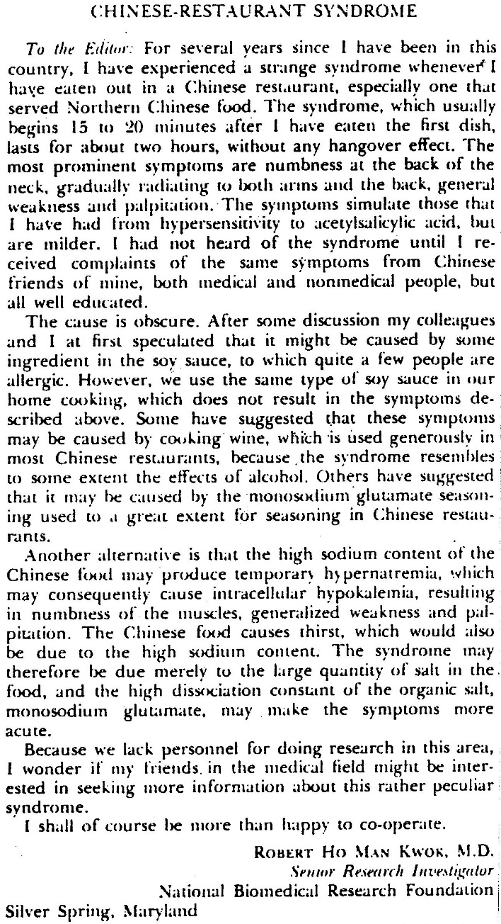
Safety Concerns in the Late 1960’s?
H.M. Kwok April 4, 1968 –Letter to Editor in New England Journal of Medicine- “Chinese Restaurant Syndrome (CRS)”
Chest pain; flushing; headache; numbness; sense of facial pressure or swelling; sweating

Slide 20
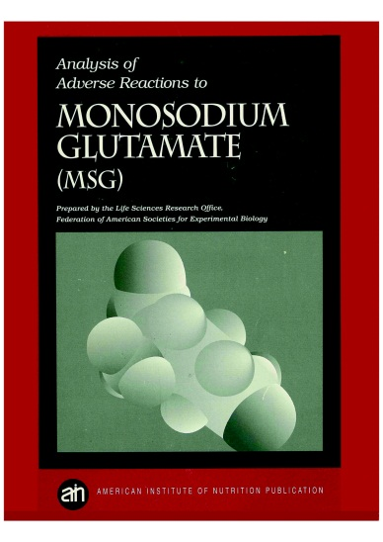

Chinese Restaurant Syndrome (CRS)
Double-blind, placebo-controlled, multiple-challenge evaluations could not reproduce adverse reactions to monosodium glutamate (Geha et al., 2000; Yang et al. 1997; Kenny 1986)
The FDA asked the independent scientific group, the Federation of American Societies for Experimental Biology (FASEB) to examine the safety of MSG in 1992.
“Over the years, FDA has received reports of symptoms such as headache and nausea after eating foods containing MSG. However, we were never able to confirm that the MSG caused the reported effects.”-U.S. FDA

Slide 21
How About MSG and Alleged Asthma and Allergies ?
Allen et al. (1987) and Moneret-Vautrin (1987) conducted oral monosodium glutamate (MSG) challenges with asthmatic patients and reported reactions to MSG.
However, four well designed additional studies have been conducted and none has confirmed the results of the above authors (Schwartzstein et al. (1987), Germano (1991), Woods et al. (1998) and Woessner et al. (1999).

Slide 22
What about MSG Consumption and Obesity Rate?
He et al. (2008)-Association of monosodium glutamate intake with overweight in Chinese adults: the INTERMAP Study. Obesity; 16(8): 1875–1880.
Shi et al. (2010)-Monosodium glutamate is not associated with obesity or a greater prevalence of weight gain over 5 years: findings from the Jiangsu Nutrition Study of Chinese adults. British Journal of Nutrition ; 104, 457–463
MSG intake suppress body fat in rats (Kondo et al. 2008).

Slide 23
Summary
Industrially manufactured MSG has been consumed safely for over 100 years
Glutamates are naturally found in foods
The human body does not differentiate glutamate whether it comes naturally present in foods or added MSG
Global regulatory agencies such as JECFA, US FDA, EFSA, ANZFA consider MSG a safe ingredient
Taste of glutamate (Umami) is the 5th basic taste
MSG can be used to reduce the intake of sodium
Glutamate (i.e., MSG) have physiological functions
  digestive processes
  nutrient absorption and metabolism,
  energy hemostasis via vagal nerve activation

Slide 24

