Slide 1
Suitability of Food Additives: Natural vs. Artificial
Carl Bao
CP Kelco
International Food Additives Council
Food Additives: A Global Perspective on Safety Evaluation and Use
Jakarta, Indonesia September 15, 2016

Slide 2
Presentation Overview
Food Additive Safety & Suitability
Benefits of Food Additives
Self-Limiting Properties of Food Additives
Food Additive GMPs and IFAC GMP Guide
Misconceptions about Food Additives
Chemophobia and the Role of the Media
Role of Regulators and Industry
Conclusion

Slide 3
Safety of Food Additives
Testing includes short-term and long-term toxicity studies, including carcinogenicity studies with a built in safety factor to account for uncertainties
U.S. FDA “Guidance for Industry and Other Stakeholders: Toxicological Principles for the Safety Assessment of Food Ingredients” (Redbook)
Food additives are thoroughly studied, including extensive toxicological testing, before they are approved for use in food
Food additive identity, purity and quality is provided through adherence to specifications, which are developed prior to use in food
Food additives have been used safely for decades

Slide 4
Suitability of Food Additives
Food additives afford consumers added convenience and enjoyment of a wide variety of appetizing and nutritious foods and beverages
Food additives are critical to the safety and nutritional composition of many foods and beverages
Food additives used for technical purposes in finished foods and beverages fall into four main categories:
Support nutrition delivery
Maintenance of food quality and freshness
Processing and preparation aids
Enhanced appeal

Slide 5
Food Additives Help Feed the World
Global Population Growth:
7 billion in 2010
9+ billion by 2050
That means there will be 75 million more people to feed each year
Almost 1 billion people do not have enough food today
One solution to ensure food safety, maintain affordability, extend shelf-life, simplify preparation and minimize waste

Slide 6
Food Additives Have Many Technological Functions in Foods
Codex International Numbering System (INS) lists 23 functional classes for food additives
Ex., functional classes include acidity regulator, anticaking agent, coloring, emulsifier, flavor enhancer, gelling agent, stabilizer and thickener
The INS is hierarchical in that each of the 23 functional classes has sub-classes with additional functions
Ex., sub-classes under “anticaking agent” include antistick agent, drying agent, dusting powder and release agent

Slide 7
Food Additives are Self-Limiting
Inherent properties of food additives like taste or technological functions limit the amount that can be added to foods
Too much of an additive can result in undesirable effects or off-taste
Example: using a high level of a particular food gum in salad dressing production causes the product to become viscous, thick and undesirable
For these reasons, manufacturers use no more of any food additive than absolutely necessary to achieve a desired technical effect

Slide 8
Good Manufacturing Practices for Food Additives and GRAS Substances
Good Manufacturing Practices (GMPs) help ensure the safety and quality of foods and beverages
Hazard Analysis and Critical Control Point (HACCP) plans, including GMPs, are required through U.S. Food Safety Modernization Act
General practice is the lowest level of a particular food additive necessary to achieve the intended technological function should be used in a food or beverage
The food additive industry is significantly different than the food industry (e.g., production, packaging, etc.)
Food additives undergo further downstream processing by customers/manufacturers
GMPs for finished foods are therefore not necessarily relevant to food additives

Slide 9
IFAC GMP and Audit Guides for Food Additives and GRAS Substances
Represent voluntary guidance for food ingredient industry
Provide GMP and quality assurance principles to ensure safe manufacture of food additives and GRAS substances
Being updated to incorporate concepts/requirements in FDA Food Safety Modernization Act requirements
May be used to aid in FSMA compliance for domestic and foreign suppliers
Guides developed by IFAC Food Safety Committee
Ashland
Chr. Hansen
Colorcon
CP Kelco
DuPont
FMC Corporation
ICL Food Specialties
Innophos
Kerry Ingredients & Flavours
Pinova
Prayon

Slide 10
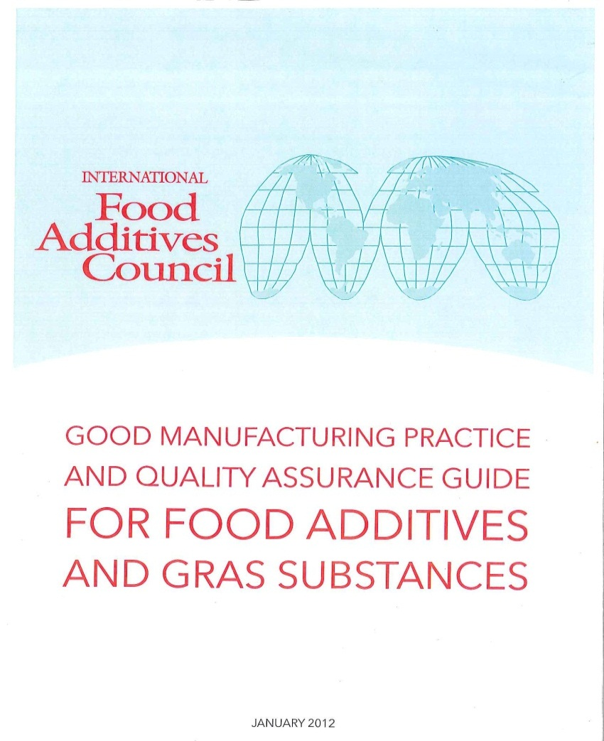
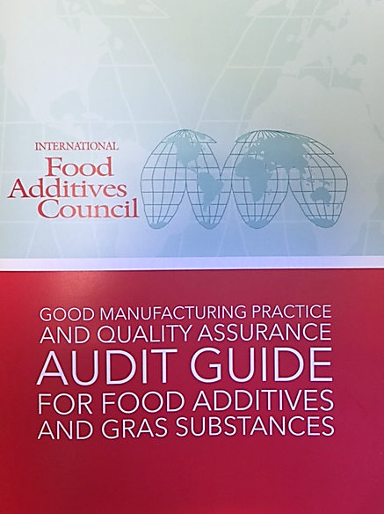
IFAC GMP and Audit Guides
Copies available at http://foodingredientfacts.org/about-us/resources/ifac-resources/
Notes:
GMP Guide development began in 2010 (completed in 2012); Audit Guide development began in 2012, completed in 2013
Modeled after joint IPEC-PQG GMP and Audit Guides
Represents voluntary guidance for the food additive and GRAS substance industry
Provides GMP and quality assurance principles to ensure safe manufacture of food additives and GRAS substances; Audit guide helps manufacturers audit to the GMPs.
Incorporates FSMA requirements and may be used to supplement existing regulations in other countries
Not regulatory requirements
Other Organizations have Received and/or Provided Input on the Guide, including US FDA, GMA, China CFSA, ETA, FEMA, IACM, CCC and others
IFAC GMP Guide is the “go to” guide for the food ingredient industry
Working on adoption of audit guide by accreditation bodies.

Slide 11
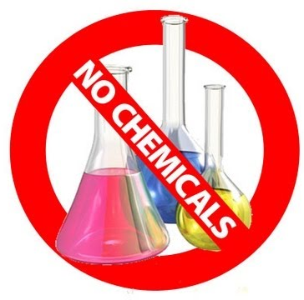
Safety & Suitability of Food Additives
Natural vs. Artificial

Slide 12
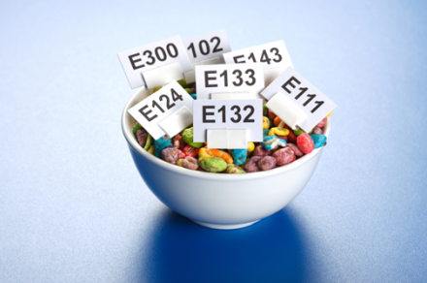
Natural vs. Artificial
Emerging trend that consumers are afraid of ingredients in foods and beverages due to the perception that they are “unnatural,” unnecessary or unhealthy = Chemophobia
Consumers now more than ever want to know what’s in their food
Consumers are increasingly pushing for “clean” labels
However, most consumers have a fundamental misunderstanding of the role of food additives:
Do not understand safety evaluations
Do not understand benefits
Do not understand food additive names

Slide 13
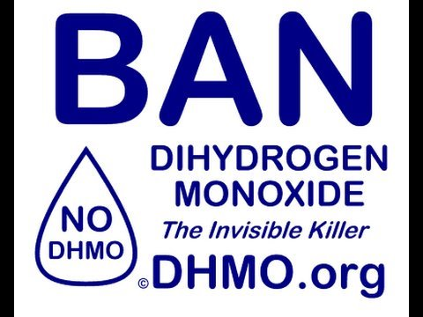
Misunderstandings of Safety
“Natural” ingredients and food itself (i.e., grain, meat, vegetables) are “substances” comprised of chemicals
Most consumers don’t realize common substances are in fact chemicals (ex., NaCl = salt)
Food additives are “substances” too
“Natural” ingredients are no more inherently safe than food additives
Many natural ingredients can be toxic and harmful:
Just because something is “natural” doesn’t mean it is inherently safe
Just because something is “synthetic” doesn’t make it inherently unsafe

Slide 14
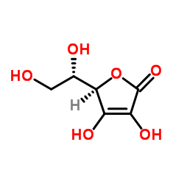
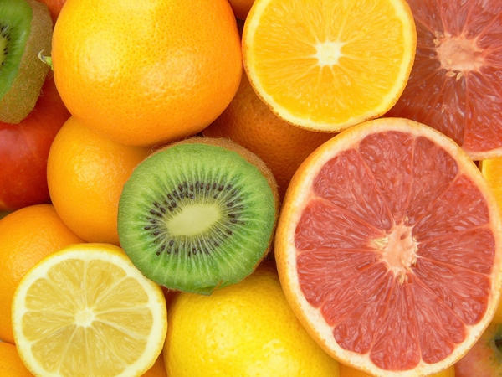
Example: Ascorbic Acid vs. Vitamin C
Vs.

Slide 15
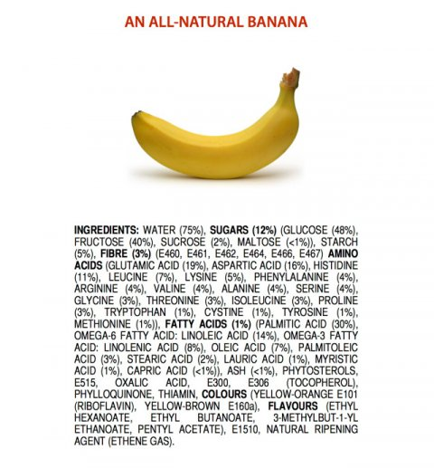
Example: Ingredient List of a Banana

Slide 16
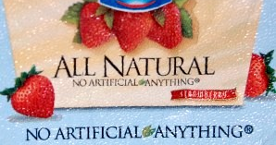
Chemophobia perpetuated by the media and food companies
WhiteWave pulling carrageenan from Silk, Horizon milk products (Aug 2014)
Chipotle goes non-GMO, and embarks on ‘quest to eliminate additives’ (Apr 2015)
Panera unveils long ‘no no’ list of over 150 banned ingredients (May 2015)
Pizza Hut, Taco Bell to remove artificial colors, flavors from foods (May 2015)
Subway to remove all artificial flavors, colors and preservatives from North American menu (June 2015)
General Mills to remove artificial flavors and colors (June 2015)

Slide 17
Role of Regulators and Industry
Collaborate on the development of food additive standards and specifications that are based on sound science and globally harmonized.
Maintain food additive standards that are based on technological need/function.
Educate consumers about the safety of food additives.
Provide simple, clear messages about the role food additives play and their necessity for a safe and stable food supply.
FoodIngredientFacts.org

Slide 18
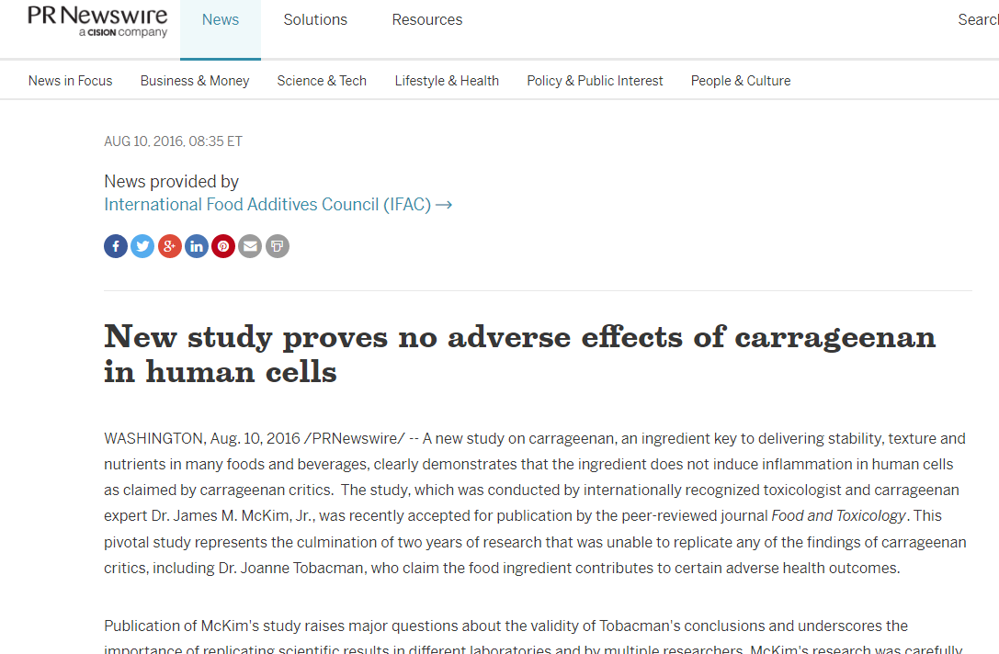
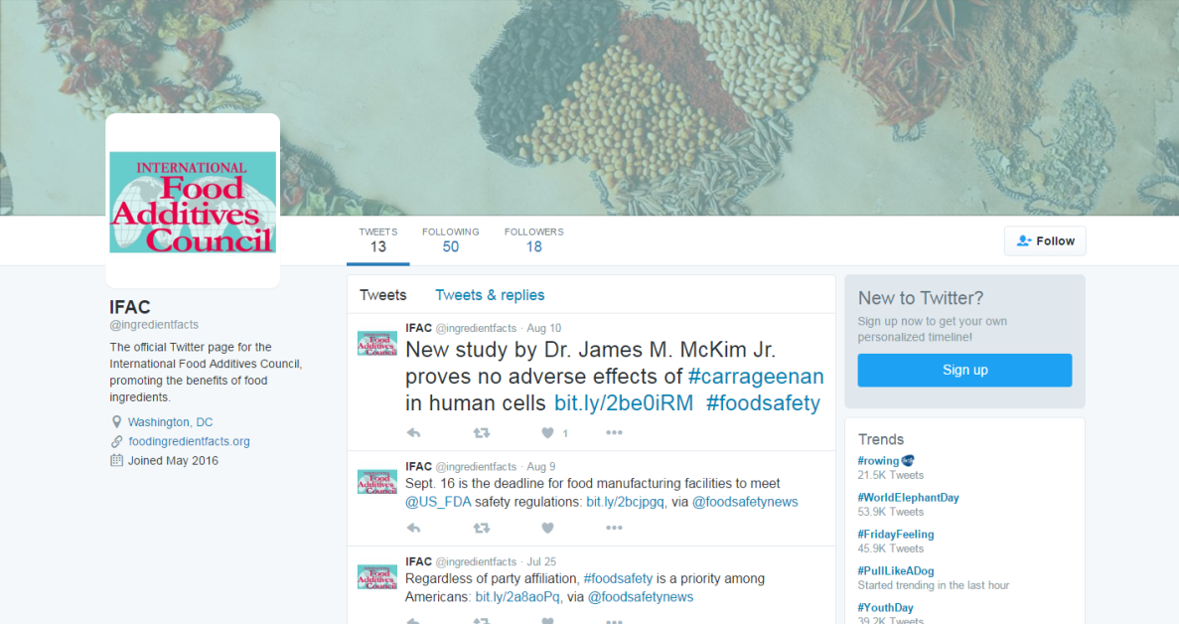
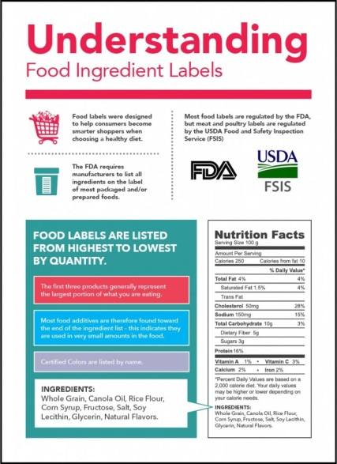
IFAC’s Ongoing Efforts

Slide 19
Conclusion
Additives have a long history of safe use and provide benefits to food processors and consumers; will help address future food supply challenges.
Food additives have unique GMPs and should be produced accordingly.
Misconceptions about chemicals in food and preference for “natural” are driving consumer concerns about food additives.
All foods contain chemicals; “natural” is not always better.
Both industry and government have a role in helping to better inform all stakeholders about food additives and the modern food system.

Slide 20
Helpful URLs
IFAC website – foodingredientfacts.org
Codex INS List – www.codexalimentarius.org/download/standards/11341/CXG_036e_2015.pdf
FDA Redbook – http://www.fda.gov/Food/GuidanceRegulation/GuidanceDocumentsRegulatoryInformation/ucm2006826.htm
IFAC GMP Guides – http://foodingredientfacts.org/knowledge-center/food-regulation/

Slide 21
Questions?
Thank you!
Carl Bao
Asia Pacific Regulatory Affairs Manager
CP Kelco
Carl.Bao@cpkelco.com
International Food Additives Council
750 National Press Building
Washington, DC USA
foodingredientfacts.org

