Slide 1
Safety of food additives: The regulatory Roadmap
Manojit Basu, PhD
Grocery Manufacturers Association (GMA)

Slide 2
Outline
GMA overview
Food Additives
Determining Regulatory Status - FDA
Risk Assessment Process
FDA Safety Standards

Slide 3

Grocery Manufacturers Association(GMA)
Founded in 1908, GMA is an active, vocal advocate for its member companies and a trusted source of information about the industry and the products consumers rely on and enjoy every day.
The association and its member companies are committed to meeting the needs of consumers through product innovation, responsible business practices and effective public policy solutions developed through a genuine partnership with policymakers and other stakeholders.

Slide 4































































GMA Member Companies
General Members
Associate Members
*Represents a sample of GMA members

Slide 5
GMA – Global Focus
U.S. government, bilateral, and multilateral advocacy
Area of Focus | Platforms for Engagement
Product Safety | APEC (FSCF, PTIN) GFSP Science Training Codex (ICGMA, FICC), ISO
Health and Wellness | APEC (advertising) LAWG WHO, FAO, Codex
Trade Liberalization and Regulatory Coherence | U.S. Trade Advisory Committees APEC (GRP, Export Certificates, etc.) WTO, Codex, ISO Trade Negotiations

Slide 6

GMA Participation in Codex
Mission:
  Advance science-based international policy in Codex Alimentarius
    Promoting harmonization within Codex standards and policies, and
    Facilitating international trade
  ICGMA is accredited as an observer organization in Codex
  ICGMA participates in selected Codex Committees and the CAC

Slide 7
Food Additives - FDA
What is a Food Additive?
  The term ''food additive'' means any substance the intended use of which results or may reasonably be expected to result, directly or indirectly, in its becoming a component or otherwise affecting the characteristics of any food (including any substance intended for use in producing, manufacturing, packing, processing, preparing, treating, packaging, transporting, or holding food);…. if such substance is not Generally Recognized As Safe (GRAS)
Sec. 201(s) FFDCA: Definition

Slide 8
How much food additive do we consume?
A person eats more than 1 kg of food a day, every day of the year for almost an entire life
  1kg/d x 365 d/yr x 82 yr = 29,930 kg/life or ~30 tons/life**
A person eats approx 65 kg of direct food additives a year, every year for almost an entire life
  65 kg/yr x 82 yr = 5330 kg food additives/life**
    After removing the common food additives (~95%) – salts, sugar, etc. – a person eats 1.43 kg food additives a year
    1.4 kg/yr x 82 yr. = 115 kg all other food additives/life
    1.4 kg/yr ÷ 365 d/yr. = 4 g all other food additives/d
There are hundreds of direct food additives, so most are consumed in sub-milligram amounts, and not every day
**Advanced Comprehensive Toxicology, American College of Toxicology
Notes:
Same amount or more for beverages

Slide 9
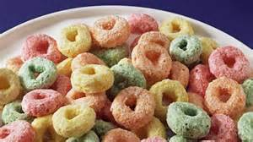
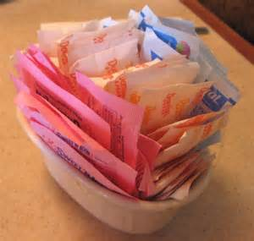
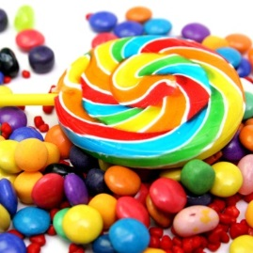
Types of Food Additives
Added Directly to Food for an Intended Effect
  Direct Additives: Sweeteners; preservatives; nutrients; fat substitutes; texturizers (e.g., thickeners, emulsifiers); flavors
  Color Additives: In food (also includes animal feed, drugs, cosmetics, and medical devices

Slide 10
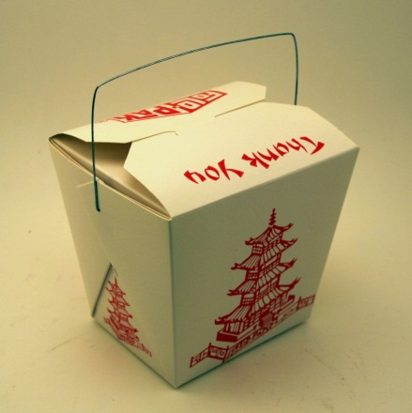
Type of Food Additives
Indirect Additives
  Food Contact Substances: Coatings (paper, metal, etc.); new/recycled plastics including polymers and monomers; paper; adhesives; colorants, antimicrobials, and antioxidants in packaging; packaging materials used during food irradiation; packaging “formulations”
  Processing Aids: Antimicrobials (meat
  and poultry processing); defoamers;
  ion exchange resins

Slide 11
Other Food Ingredients
Other “Ingredients”:
  Food Irradiation Equipment: To process food or to inspect food
  GRAS Substances: Enzymes; fibers; proteins; lipids; carbohydrates
  Foods/Ingredients Produced Via Biotechnology: Plants with herbicide resistance or insect resistance; delayed ripening, etc.

Slide 12
Types of Food Ingredients
Preservatives
Anti-Caking Agents
Humectants
Sweeteners
Color Additives
Flavor and Spices
Flavor Enhancers
Fat Replacers
Nutrients
Emulsifiers
Stabilizers & Thickeners, Binders, Texturizers
Leavening Agents
Yeast Nutrients
Dough Strengtheners & Conditioners
Firming Agents
Enzyme Preparation
Gases
http://www.fda.gov/downloads/Food/FoodIngredientsPackaging/ucm094249.pdf

Slide 13
Determining Regulatory Status of a Food Ingredient
Continued…

Slide 14
Determining Regulatory Status of a Food Ingredient
http://www.fda.gov/Food/IngredientsPackagingLabeling/FoodAdditivesIngredients/ucm228269.htm

Slide 15
GRAS vs Food Additive Petition
Technical Element : Are the safety data adequate for the intended use?
Need
Data
No
Yes
Common Knowledge Element: Are the data and information generally available and generally accepted by experts?
No
Yes
Food Additive
GRAS Status
Notes:
Through Scientific Procedure or experience based on Common use

Slide 16
Risk Assessment Process
Hazard
Exposure
Risk

Slide 17
Hazard Determination
Toxicological Studies
  Does the additive affect the genetic material?
  Where does additive go when we consume it?
  What adverse effects does the additive cause?
    Carcinogen*
  Any effect on Reproduction?
Determining No-Observed Adverse Effect Level (NOAEL) and Lowest Observed Adverse Effect Level (LOAEL)
Determine an Acceptable Daily Intake (ADI) Level
  ADI = NOAEL / Safety Factor (100)
Notes:
* Delaney Clause

Slide 18
Delaney Clause*
The Food Additives Amendment of 1958 contained what is known as the Delaney Clause
  Section 409(C)(3)(A) ... no additive shall be deemed to be safe if it is found to induce cancer when ingested by man or animal, or if it is found, after tests which are appropriate for the evaluation of the safety of food additives, to induce cancer in man or animal ...
Has been invoked a few times
  Aminotriazole on cranberries
  Colorings: FD&C Red #3

Slide 19
Exposure Estimate (Human Consumption)
Max Level of Food Additive allowed in each food / beverage
Amount of each food and beverage consumed
Amount of food additive consumed

Slide 20
Risk Assessment Paradigm
Identify Hazard Characterize Dose-Response
Assess Exposure
Estimate Acceptable Daily Intake
Estimate Human Consumption
Characterize Risk
Notes:
What fraction of the population, if any, incurs intakes greater than the ADI? To what extent do intakes exceed the ADI?

Slide 21
Safety Standards for Food Additives - FDA
“Reasonable certainty of no harm”
What is Harm?
Harm refers to Health
Man or Animal
The safety standard for additives are higher than food. So they need to be even safer than food
Petitioner burden to demonstrate a “reasonable certainty of no harm”
21 CFR 170.3(i)
Notes:
Safe or safety means that there is a reasonable certainty in the
minds of competent scientists that the substance is not harmful
under the intended conditions of use. It is impossible in the
present state of scientific knowledge to establish with complete
certainty the absolute harmlessness of the use of any substance.
Safety may be determined by scientific procedures or by general
recognition of safety

Slide 22
FDA - How is safety determined?
Following factors are considered:
  The probable consumption of the substance and of any substance formed in or on food because of its use
  The cumulative effect of the substance in the diet, taking into account any chemically or pharmacologically related substance or substances in such diet
  Safety factors which, in the opinion of experts qualified by scientific training and experience to evaluate the safety of food and food ingredients, are generally recognized as appropriate.

Slide 23
Establishing Safety
The FDA provides guidance to industry and the public concerning the procedures and methods for safety assessment of food and color additives.
  "Redbook" ("Toxicological Principles for the Safety Assessment of Direct Food Additives and Color Additives Used in Food") was first published in 1982
  Latest edition of Redbook - 2000, Revised July 2007
Establish maximum exposure (Acceptable Daily Intake) based on hazard assessment
Benefits are not weighed in during safety decision

Slide 24
Redbook: Recommended Toxicological Tests
Toxicity Tests
Genetic Toxicity Tests
Short-term toxicity tests with rodents
Subchronic toxicity studies with rodents
Subchronic toxicity studies with non-rodents
One-year toxicity studies with non-rodents
Chronic toxicity or Combined chronic toxicity/carcinogenicity studies with rodents
Carcinogenicity studies with rodents
Reproduction studies
Developmental toxicity studies
Metabolism and Pharmacokinetic Studies
Human studies

Slide 25
FDA: Assessment of Cancer Risk
C
A
C
Pathology Review
Toxicology Review
Mathematical Analysis
Chemistry Review
Director CFSAN
QRAC
Exposure Estimate
Notes:
CAC – Cancer Assessment Committee
QRAC – Quantitative Risk Assessment Committee
CFSAN – Center for Food Safety and Applied Nutrition

Slide 26
Technical Review
FDA scientist review data and evaluate petitioner’s safety argument
FDA communicates with petitioner to resolve any questions and/or additional data needs
FDA review, documentation
FDA reaches a scientific conclusion and makes a recommendation
Notes:
The technical review process is very thorough----READ SLIDE

Slide 27
Legal Aspects of Food Additive Approvals
Food Additives unsafe until FDA decision
Regulations stipulate an identity, specifications and conditions of safe use
Regulations do not provide specific product approvals
Direct additives or Food-contact substance
Notes:
For review, the legal framework for food additive approvals provides---READ SLIDE
Regulations state an identity, specifications and conditions of safe use and the detailed specifications may include the types of food in which the additive is permitted, the manner of use, and any special labeling required.
This process for review of additives is for those added directly to food as well as food-contact substances such as packaging.

Slide 28
Take Home Message
Historic use of Food Additives
Today additives are used for adding flavor, color…
Regulated by the FDA for product safety
Petitioner is responsible for demonstrating safety
FDA is responsible for data evaluation and issuing regulation

Slide 29
Thank You!!!
&
Questions???

Slide 30
Appendix

Slide 31
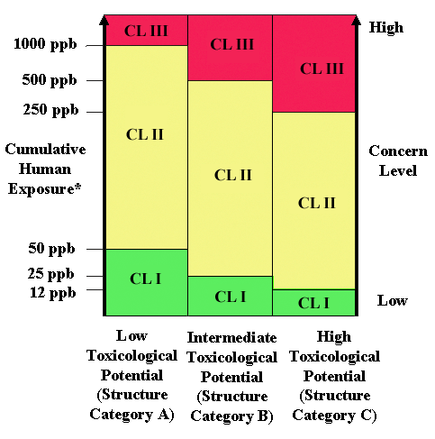
Redbook: Concern Levels

Slide 32
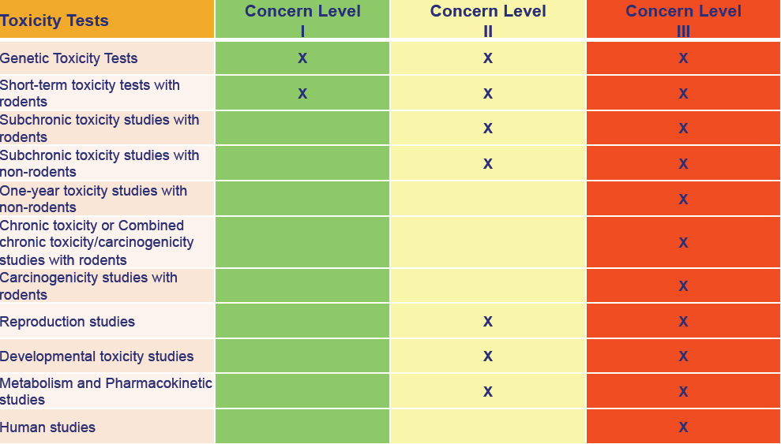
Redbook: Toxicological Tests

