Slide 1
Research, Policy, and Compliance: The three pillars supporting the CPG Industry
Manojit Basu, PhD
Grocery Manufacturers Association (GMA)

Slide 2
Outline
GMA Overview
Consumer Packaged Goods
Driving Food Safety through Research, Policy and Compliance
  FSMA
Science Education Foundation

Slide 3

Grocery Manufacturers Association(GMA)
Founded in 1908, GMA is an active, vocal advocate for its member companies and a trusted source of information about the industry and the products consumers rely on and enjoy every day.
The association and its member companies are committed to meeting the needs of consumers through product innovation, responsible business practices and effective public policy solutions developed through a genuine partnership with policymakers and other stakeholders.

Slide 4



















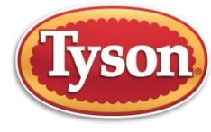











































GMA Member Companies
General Members
Associate Members
*Represents a sample of GMA members

Slide 5
GMA – Global Focus
U.S. government, bilateral, and multilateral advocacy
Area of Focus | Platforms for Engagement
Product Safety | APEC (FSCF, PTIN) GFSP Science Training Codex (ICGMA, FICC), ISO
Health and Wellness | APEC (advertising) LAWG WHO, FAO, Codex
Trade Liberalization and Regulatory Coherence | U.S. Trade Advisory Committees APEC (GRP, Export Certificates, etc.) WTO, Codex, ISO Trade Negotiations

Slide 6

GMA Participation in Codex
Mission:
  Advance science-based international policy in Codex Alimentarius
    Promoting harmonization within Codex standards and policies, and
    Facilitating international trade
  ICGMA is accredited as an observer organization in Codex
  ICGMA participates in selected Codex Committees and the CAC

Slide 7
Shared Responsibility, Common Goals
Industry, government & academia must work together to enhance food safety
Government (Policy)
Industry (Compliance)
Safe Food
Academia (Research)

Slide 8
Facilitating Collaborations
GMA
Research
Industry
Regulators & Govt. Agencies
International Groups
Legislators

Slide 9
Research, Policy And Compliance: FSMA
Food Safety Modernization Act (FSMA)
Signed into law by President January 4, 2011
Amends the Food Drug and Cosmetic Act
Will Require over 50 new FDA Regulations
Seven Major Rules Have Been Finalized
Has Significant Implications for Trade
With FSMA Approach to Food Safety Changed!
  Reactive Approach
  Preventive Approach
Notes:
Most significant food safety reform in 70 years
Made possible through partnerships with allied Non-Governmental Groups (NGOs) groups
Under Some 50 new regulations are expected
GMA took the lead on implementation of private sector AND regulatory aspects of FSMA

Slide 10
Understanding FSMA
Food Safety Modernization Act Implementation
Policy Development (Rules & Regulations)
Domestic Regulatory Compliance
Food Safety Preventive Controls Alliance (Education & Training)
Domestic In-Plant Member Assistance
International Regulatory Compliance

Slide 11




Policy: Elements of New FSMA Law
Placed New Responsibilities on Companies
New Controls over Imported Food
Enhanced Enforcement Powers
Created New Fees on Companies and Importers
7

Slide 12
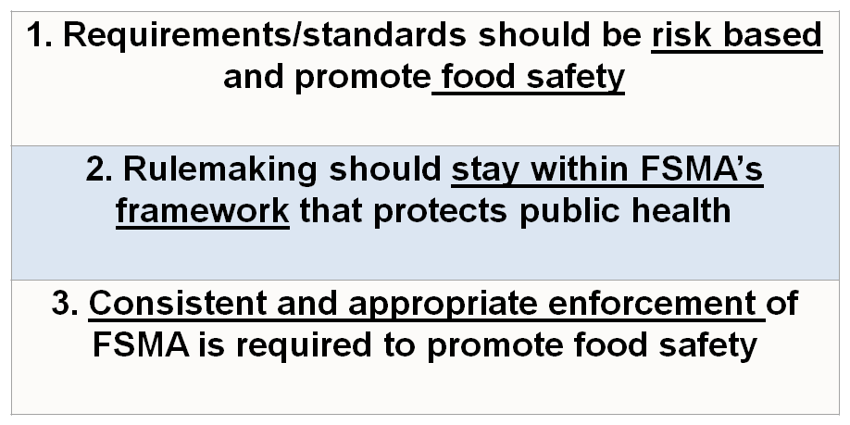
Policy: Goals of FSMA Final Rules

Slide 13
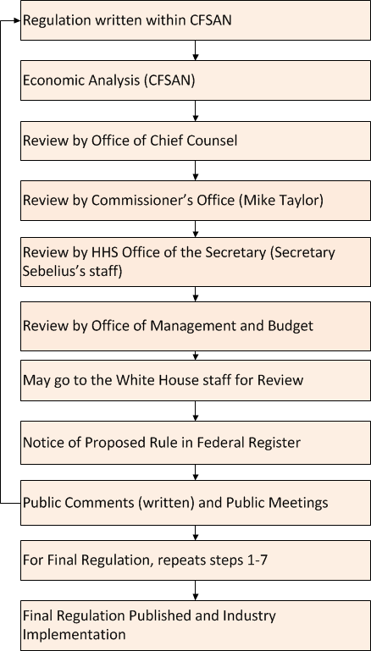
Policy: Industry Input
At appropriate stages
combine knowledge from:
Industry
Government Agencies
Many other interested groups
To produce effective regulations

Slide 14
Policy: Stakeholder Engagement
Participation at Public Consultations – Not Restricted to U.S. Citizens
  Congressional hearings
  Public Meetings
  Federal Register Notices – Requests for Comments
  WTO Notifications – https://tsapps.nist.gov/notifyus
Participation in Trade Advisory Committees
    USDA
    Department of Commerce
    White House
Meetings with U.S. Officials Upon Request – Open and Transparent

Slide 15
Success: Research Policy Compliance
Face to Face Meetings with FDA and Subject Matter Experts
FDA Public Meetings
Comments to Public Dockets
Collaborative Meetings with GMA FSMA Coalition to include Foreign Delegations and Embassies
All FSMA related materials can be located on the FDA website and also on the GMA website

Slide 16
Food Safety Modernization Act
  To Date All 7 FSMA FINAL Rules Are Published
  Preventive Controls for Human Food
  Preventive Controls for Animal Food
  Foreign Supplier Verification Program (FSVP)
  Produce Safety
  Third-Party Accreditation
  Sanitary Food Transportation
  Food Defense (Intentional Adulteration)
FSMA

Slide 17
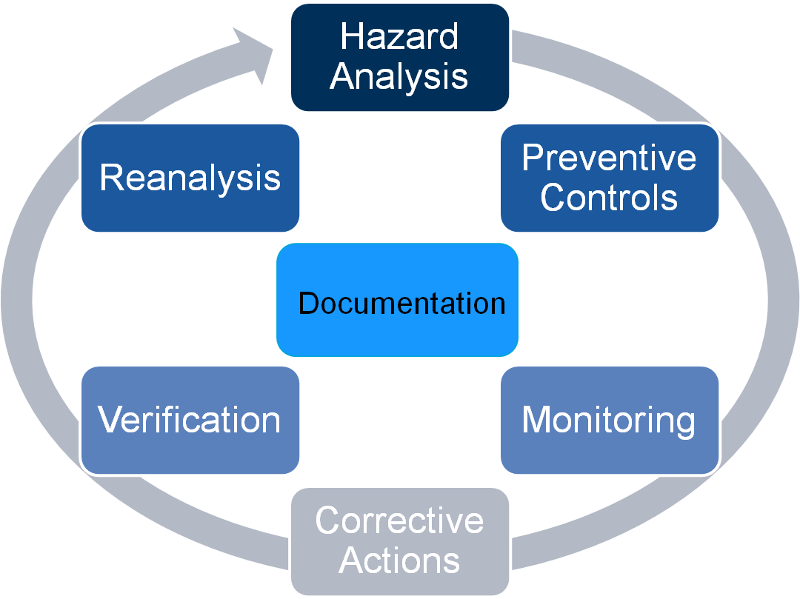

Compliance: FSMA Food Safety Planning Process

Slide 18
Compliance: Supply Chain Management
Areas of Focus and Attention
Establish a plan for assuring adherence to food safety requirements
  Risk-based
  Suitable for product type and facility history
Know your suppliers (not just distributors)
Operate your program effectively and in control
Be able to show you’ve done it!
13

Slide 19
Compliance: Records Maintenance and Access
FDA will have legal access to:
  Food safety plan and related documents
  Includes environmental and finished product testing
  Includes corrective actions and related rationale
  Includes monitoring of supply chain
  Includes consumer complaint documents related to a food safety event
Good documentation and record-keeping practices will be critical
14

Slide 20
Key Messages
Throughout the FSMA rule-making process FDA was directly responsive to many requests from the food industry
The revised FSMA rules are more flexible, more risk-based and preventive in nature
All but one major issue in the FSMA rule-making process has been resolved and GMA, and industry, requested that FDA devise a solution to this major issue, which they are currently working on

Slide 21

Key Messages
Through GMA the industry is significantly influencing the development FSMA regulations
  GMA Members
  Industry Coalition
GMA has established a robust program to assist industry with practical implementation of FSMA requirements, including delivery of FSPCA training
GMA is working with members and stakeholders to anticipate issues associated with the final rules and inspections and is prepared to respond as needed

Slide 22

GMA Science and Education Foundation
  Research
    Industry needs
    Collaborative research
  Education
    Middle School Hands-On program
    Currently in 15 states ➔ 50 states and 25 countries by 2025
  Training
    Technical based on GMA members needs: Plant operators ➔ Managers
    HACCP Training of Trainers
    Better Process Control Schools
    Food Safety Modernization Act (FSMA) ➔ PCQI
    Certified in Comprehensive Food Safety (NEHA)
  International programming
    Training
    Technical assistance projects and consulting
    International network of partner institutions

Slide 23
International Food Safety Training
Better Process Control Schools Network
  USFDA/USDA required curriculum for canned foods
  Partner Schools in Europe, Latin America and Asia
HACCP Training of Trainers
  Certified International HACCP Alliance Trainers
  Latin America & Caribbean, Japan, China, ASEAN
GFSI Global Markets Protocols Food Safety Training for Suppliers
FSMA FSPCA Curriculum ➔ Preventive Controls Qualified Individual for export to US through partner schools in Europe, Latin America and Asia
Food Safety Culture

Slide 24
Thank You!!!
&
Questions???

