Slide 1
The winemaking process, from vine to wine
Food Additives: A Global Perspective on Safety Evaluation and Use
Hilton Opera Hotel, Hanoi, Vietnam
September 13, 2016

Slide 2
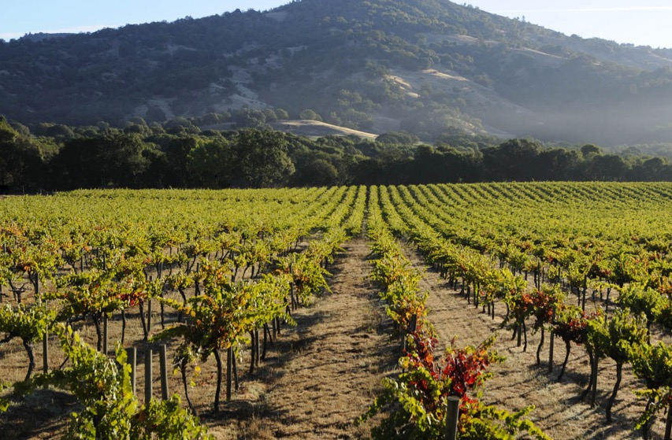
Presentation Overview
U.S. Wine / International Collaborations
Wine Additives in U.S. and Vietnam
What is “Wine”?
Fining and Finishing
Other Additives/Processing Aids

Slide 3
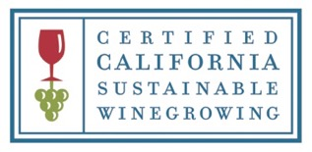
U.S. Wine
8,700 wineries;
Grapes grown and wine made in all 50 states;
U.S. accounts for 10.7% of world wine production (#4);
U.S. wine exports totaled $1.6 billion in 2015;
Exports to Vietnam totaled $11.7 million;
U.S. consumes 13% of world production (#1).

Slide 4
International Collaborations
Trans-Pacific Partnership
World Wine Trade Group
International Wine Technical Summit
Notes:
We appreciate Vietnam’s participation as an Observer in the World Wine Trade Group (WWTG).

Slide 5
Asia-Pacific Economic Cooperation
Notes:
The WRF is in year three of a five-year APEC project that continues the work begun by the United States in 2011 and New Zealand in 2012. The goal of the WRF is to eliminate non-science based testing and certification requirements for wine trade in the region in an effort to increase wine production, to expand trade and to create jobs.

Slide 6
APEC Wine Regulatory Forum
WRF established in 2008 to harmonize APEC wine regulations;
Vietnam:
Is a WRF Co-Sponsor,
Is an active WRF participant, and
Will host 2017 WRF meeting (2017 APEC chair)
Six WRF meetings /workshops held;
Working Groups on laboratory testing, pesticides, wine regulations, export Certificates, and Good Regulatory Practices.

Slide 7
U.S. Law on Wine Additives
In United States, approved wine additives and processing aids are listed in 27 CFR 24.246:
https://www.ttb.gov/wine/wine_treating_materials.shtml
These wine “treating materials” have been evaluated and approved for safety over a long period time by many governments around the world.
Notes:
Additives and processing aids allowed for use in the USA are listed in 27 CFR 24.246

Slide 8
U.S. Wine Additives
Notes:
Additives and processing aids allowed for use in the USA are listed in 27 CFR 24.246

Slide 9
Vietnam and Wine Additives
Vietnam’s List of Food Additives updated in 2015 and incorporates CODEX additives;
VFA could accept a producing country’s standards for additives that CODEX has not adopted:
Codex General Standard for Food Additives contains only five wine additives (Carbon dioxide, Dimethyl Dicarbonate, Lysozyme, Sorbates, and Sulfites);
Many other wine materials are approved internationally;
U.S. Wine Industry requests Vietnam approve internationally recognized additives and processing aids.

Slide 10
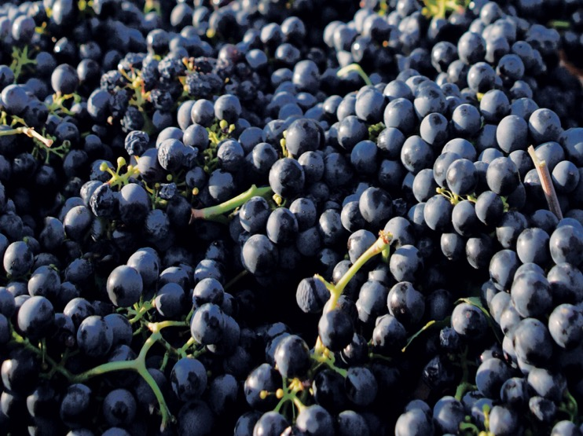
The Winemaking Process

Slide 11
What is Wine?
Beverage produced by alcoholic fermentation of:
Fresh grapes;
Grape must; or
Products derived from fresh grapes.
Wine is a “Single-ingredient” product;
It cannot be made by a recipe;
Wines vary by region, vintage, soil, climate, etc.
Notes:
Microbiologically, it is a “low risk food” due to:
High acid content (pH 3.1 to 3.9),
High polyphenol content,
Alcohol content (7% to 24%),
Sorbate and sulfite
These ALL work synergistically to prevent survival and growth of food-borne human pathogens.

Slide 12
How Wine is Made…
Notes:
Testing of the grapes and wine is conducted throughout the entire process, from vine to wine, for:
sugar,
alcohol,
acid,
Sulphur dioxide and
pH

Slide 13
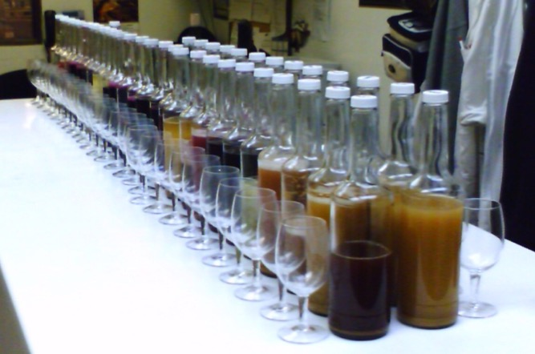
What is Fining and Finishing?
Once fermentation is complete, the job is not done. The wine still includes grape solids, yeast, proteins and other organic materials.

Slide 14
Fining and Finishing
“Fining” -- the addition of material to reduce or eliminate the presence of certain less desirable components.
Fining agents (most of which were already present in the wine) are used to modify clarity, color, texture or flavor or to ensure wine remains in stable state.
Fining materials designed to be entirely removed.
(FIVS Good Fining Practice Guidelines for Wine)

Slide 15
G00d Manufacturing Practice
"All food additives …. shall be used under conditions of good manufacturing practice, which include the following:
the quantity of the additive added to food shall be limited to the lowest possible level necessary to accomplish its desired effect;
the quantity of the additive that becomes a component of food … is reduced to the extent reasonably possible…”
(Codex Gen. Std. for Food Additives)

Slide 16
Fining and Finishing
Wine needs to be not only made visually acceptable, it may also need:
Tartrate Stabilization
pH Adjustment
Acid Additions
Protein Removal
Tannin Adjustment
Color Adjustment

Slide 17
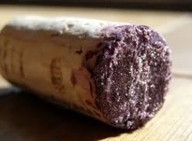
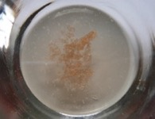
Fining and Finishing
“Tartrate” Stabilization (Cold-Stable wine)
Wine, by nature, contains a significant amount of Tartrate.
Eventually precipitates, especially if the wine is chilled for a significant amount of time;
They are harmless, but:
Visually unattractive; and
Problematic if precipitates post-bottling.

Slide 18
Fining and Finishing
“Tartrate” Stabilization (aka Cold-Stable wine)
What | Stabilization by chilling and filtering | Adding Bitartrate | Selective Tartrate Removal System via Electrodialysis (STARS)
How | Chill tank down to 25°F, hold temp, then filter | Add Potassium Bitartrate to precipitate tartrates | Tartrates removed by passing through membrane
Pro | Many wineries store wines cold anyway | Just add Bitartrate. No extra equipment needed. | Relatively little waste and minimal wine loss
Con | Cost of refrigeration can be very high. Filtration costs and wine loss. | Cost of Bitartrate. Filtration costs and wine loss. | Cost of equipment. Best suited for small lots.

Slide 19
Fining and Finishing
pH Adjustment – Why?
As a grape matures, the acid level decreases. This is especially common for grapes grown in warm areas, or those left on the vine longer.
If a wine does not have adequate acidity, the palate will be out of balance (“lacking structure”).

Slide 20
Fining and Finishing
pH Adjustment – How?
Ion Exchange – Very effective, but not every winery has access to this technology.
A winemaker can also add acid:
Tartaric
Malic
Citric
Lactic.
Some winemakers prefer to add a specific acid based on:
Perceived taste differences
Microbial stability
The stage of fermentation
Cost.

Slide 21
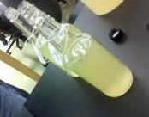
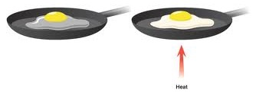
Fining and Finishing
Protein Removal
Wines contain a certain amount of protein.
When the proteins in wine are heated, they denature and form a haze. This occurs very slowly naturally, but if a wine is in a warm or hot location, it can occur very rapidly.

Slide 22
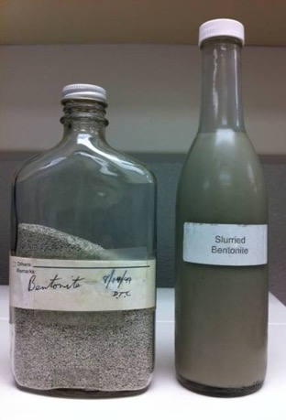
Fining and Finishing
Protein Removal
To remove protein from wine, the most common remedy is the use of Bentonite (clay);
Bentonite is used to make a slurry that is mixed with wine;
The proteins bind to the bentonite and are removed by filtration.

Slide 23
Fining and Finishing
Tannin Adjustment
Too Much Tannin
The wine is too tannic to enjoy (bitter/astringent)
Tannins can be removed by addition of Protein to precipitate the Tannins
Egg white, Milk (casein), Isinglass, PVPP
Too Little Tannin
The wine will be bland, may have reduced ageability, and may not keep its color (reds)
Tannins levels can be increased by adding Grape or Oak Tannin.
Tannin + Protein = Precipitate

Slide 24
Fining and Finishing
Color Correction – Why?
A prime example of a case for color adjustment is “Pinot Grigio/Pinot Gris”;
This grape can produce a wine that is somewhere between light red and light brown, yet the wine in the bottle is a brilliant white wine;
So, how do you get a white wine from a colored wine?: Remove some color!

Slide 25
Fining and Finishing
Color Correction – How?
Two main methods: Activated Carbon and Polyvinylpolypyrrolidone (PVPP);
Both products are attracted to the colored molecules in wine;
The compounds are not entirely selective, though, and can remove other (desirable) compounds in the wine;
They also add costs to the production of the wine.

Slide 26
Fining and Finishing
We covered the most common fining and finishing techniques, but others are also in use such as:
Copper Sulfate for treatment of H₂S & Mercaptans;
Enzymes for “removal” of a number of undesirable compounds including proteins, polysaccharides, etc. and to arrest ML fermentation;
Clarifying agents like Gum Arabic and SiO_{2.}
U.S.: Always refer to 27 CFR 24.246

Slide 27
Additives used in Fermentation
Additive
Use
Source of nitrogen for yeast growth
Yeast nutrient
Ammonium Phosphate
Thiamine (Vitamin B1)

Slide 28
Additives used in Fermentation
Additive
Use
Provides nutrients
Provide proteins and adsorb toxic fatty acids
Source of tannin to provide structure and color stability
Autolyzed Yeast
Yeast Hulls
Oak Products

Slide 29
Additives used for Processing
Additive
Use
Carbon Dioxide
Nitrogen Gas
Both gasses used to:
Purge tanks, lines and bottles
Headspace for partial tanks
Nitrogen used to remove oxygen from wine

Slide 30
Additives for Fining/Clarification/Stabilization
Additive
Use
Tannin
Malolactic Bacteria (Oenococcus Oeni)
Supplements natural deficiencies in wines; Effects include:
Color stabilization
Organoleptic structure
Stabilizes wine by controlled fermentation of single fermentable acid

Slide 31
Additives for Component Correction
Additive
Use
Oxygen (micro-oxygenation)
Potassium carbonate or bicarbonate
Oak Products
Promotes natural maturity in wine by simulating minute oxygen transfer of a barrel (often used with Oak Products)
Correct excess acidity in wines and juices
Used to simulate barrel extraction

Slide 32
Additives for Preservation
Additive
Use
Potassium meta-bisulfite, Sulfur Dioxide
Dimethyl Dicarbonate (Velcorin®)
Ascorbic Acid
To increase sulfites to protect from microbial and oxidative pressures
Antimicrobial Properties
Prevents oxidation in wines

Slide 33
Conclusions
U.S. law allows many safe wine treatment materials:
Most are naturally occurring in grapes or food;
Few of which actually remain in the wine bottle.
While Codex is beneficial, GSFA and Vietnam’s food additives list do not align fully with foreign regulations;
The U.S. Wine Industry requests that approved additives and processing aids be incorporated into Vietnam’s standards;
Vietnam should recognize “Good Manufacturing Practice” rather than setting numerical usage limits where no health concerns exist.

Slide 34
Thank you…
Tom LaFaille
tlafaille@wineinstitute.org
http://www.wineinstitute.org
http://wineamerica.org

