Slide 1
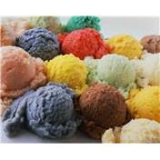
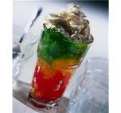
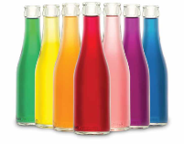
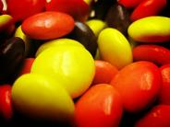
Safety and Benefits of Food Colors
Christi Simon
Sensient

Slide 2
IACM Objectives
To protect and expand the worldwide use of colors.
To serve as a trusted resource to interact with regulatory bodies and global organizations.
To enhance confidence in the safe use of color.
To provide members with a central source of scientific and regulatory expertise.
To advocate global harmonization of standards and regulations.
Notes:
We work to promote the safety, and the public and regulatory awareness of that safety, for both certified colors and those exempt from certification. We also work with our member companies to directly interact with the FDA, DG Sanco, EFSA, and Codex/JECFA.

Slide 3



















Current Members
Notes:
20 member companies – users and manufacturers of color

Slide 4
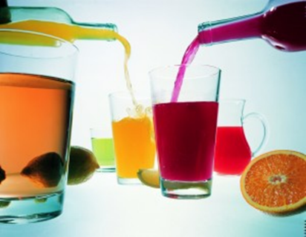
Agenda
Uses and Benefits of Colors
Regulation of Colors in the United States
Safety of Colors in the United States
  Safety Data Sets
  Pre-Market Approval
Labeling of Colors in Food
Colors at Codex

Slide 5
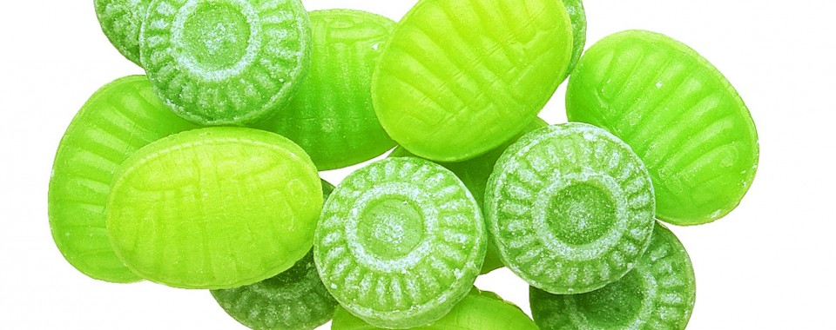
Uses and benefits of colors

Slide 6
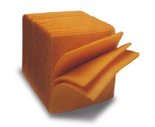
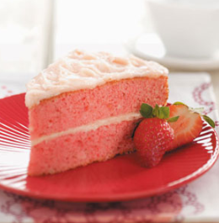

Why Use Colors?
Identification
Flavor Perception
Aesthetic Value

Slide 7
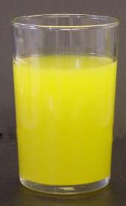
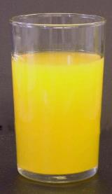
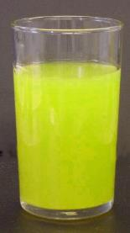
Why Use Colors?
Aesthetic Value
Identification
Flavor Perception
Offset color loss due to light, air,
extremes of temperature,
moisture,
and storage conditions

Slide 8
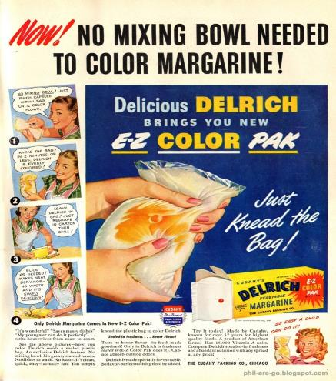
A Long, Safe History of Use in Food
Society has come to accept coloring not as fraudulent, but as a permissible and useful signal of food taste
Simply, colors make food more enjoyable.
Consumer studies shown consumers will not buy foods with color variations from the ‘norm’
Notes:
Color additives from natural sources such as vegetable and mineral were used to color foods, and cosmetics since ancient times.

Slide 9
Regulation of Colors in the United States

Slide 10
US FDA Legal Framework
1906 Pure Food and Drug Act
  Defined "misbranding" and "adulteration" for the first time and prescribed penalties for each
  Regulated food and drugs moving in interstate commerce
1938 Food, Drug, and Cosmetics Act
  Established safety standard – harmless and suitable
  Established certification/FD&C certified
1960 Color Additive Amendments
  Defined color additive
  Identified new safety standard – reasonable certainty of no harm
  Required pre-market approval
  Authorized exempt from certification
Notes:
The Federal Food, Drug, and Cosmetic Act provides that a substance that imparts color is a color additive and is subject to premarket approval requirements unless it is used solely for a purpose other than coloring.

Slide 11
FDA Definition of Color Additive
(FD&C Act Section 201(t))
A material which is a dye, pigment, or other substance … and when added or applied to a food, drug, or cosmetic, or to the human body or any part thereof, is capable (alone or through reaction with other substance) of imparting color thereto;
  Excludes substances determined by the Secretary to be used solely for a purpose other than coloring
A color additive is unsafe if not used in accord with a regulation/exemption
No generally recognized as safe (GRAS) exemption
Notes:
The U.S. Food and Drug Administration (FDA) defines a color additive as any dye, pigment, or other substance made or obtained from a vegetable, animal, mineral, or other source capable of coloring a food, drug, or cosmetic or any part of the human body. Regulations regarding color additives are published in Title 21 Parts 70–82 of the Code of Federal Regulations (CFR). The use of an unlisted color additive, the improper use of a listed color additive, or the use of a color additive that does not meet the purity and identity specifications of the listing regulation may cause a product to be adulterated and subject to FDA enforcement action.

Slide 12
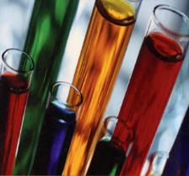
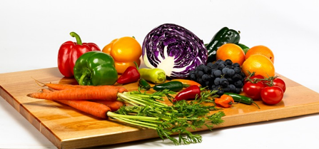
Types of FDA Regulated Colors
Certified Colors
  Are known as FD&C colors
  Known structure/Synthetically produced
  Generally do not impart undesirable flavors to food
  High purity specifications established by the FDA
  Each batch is tested by the FDA to confirm safety based on identity and specifications
  Impart intense, uniform color
  Less expensive
  Blend more easily
  Stable
Colors Exempt from Certification
  Colors typically referred to as ‘natural colors’ by the food industry
  Synthetic duplicates of naturally existing colorants
  No batch testing required
  Derived from natural sources such as vegetables, minerals, or animals
  May not be stable in certain food
  May add unintended flavors to food
Notes:
The FDA classifies color additives as either certified color additives or color additives exempt from certification. Certified colors, also known as FD&C colors, must be certified by the FDA as meeting the identity and purity specifications and use limitations described in the regulations in 21 CFR part 74. Color additives exempt from certification, often referred to as natural colors, are produced from fruit, vegetable, animal, and mineral sources; they do not require certification but must meet the identity and specifications described in the regulations in 21 CFR part 73. Chemical duplicates of natural colors ("nature-identical" synthetics) are also exempt from certification, but generally recognized as safe (GRAS) substances that impart color are not.

Slide 13
HYPERACTIVITY CONCERNS

Slide 14

The Southampton Study
Notes:
Due to the Southampton Study in 2007, a myth has persisted that synthetic dyes cause hyperactivity in children.

Slide 15
Two Mixes Used
FD&C (E-Number) | Common Name | Mix A | Mix B
FD&C Yellow 5 (E102) | Tartrazine
E104 | Quinoline yellow
FD&C Yellow 6 (E110) | Sunset Yellow
E122 | Carmoisine
E124 | Ponceau 4R
FD&C Red 40 (E129) | Allura Red AC
E211 (Preservative) | Sodium benzoate
Children given either Mix A or Mix B during the ‘challenge’ periods
Notes:
Some view the results of the Southampton Study to suggest that some mixtures of certain synthetic food colors and benzoate preservative may affect the level of hyperactive behavior in children.

Slide 16
Southampton Study
Authors’ Conclusions
Mixtures of certain artificial colors together with a sodium benzoate preservative in the diet increased hyperactivity in 3 and 8/9 year old children in the general population
The average effect varied depending upon the mix and the age group
Although the results of the study suggest that some mixtures of certain artificial food colors and benzoate preservative may affect the level of hyperactive behavior in children, removal of these additives from the diet would not be a panacea for ADHD

Slide 17
No Proven Causality to Hyperactivity
Behavior assessment data not collected for the respective placebo phases (weeks 1, 3 and 5)
  No easy assessment of intra-individual variability
Observed effects lack clear statistical significance
  Across both age groups
  Across both additive groups (Mix A and Mix B)
Notes:
17
However, there are many problems with the study: behavior assessment data were not collected for the respective placebo phases; the observed effects lacked clear statistical significance;

Slide 18
No Proven Causality to Hyperactivity
Behavior changes only partially significant
  Measured in the non-standard global hyperactivity audit
The very weakly statistically significant effects were only measured under a constant seven-day treatment period
  Would longer exposure exacerbate or eliminate the subtle effects?
  Are the effects transient or persistent?
    If the effects are transient, probably not relevant within a human health discussion
No biological mechanism for causal association between the intake of the corresponding additives and the onset of hyperactivity can be derived from the results
  Stevenson et al., 2011
Notes:
behavioral changes were only partially significant; the very weakly statistically significant effects were only measured under a constant seven-day treatment period; and no biological mechanism for causal association between the intake of the corresponding additives and the onset of hyperactivity can be derived from the results.
18

Slide 19
EFSA Opinion
EFSA’s AFC Panel were assisted by experts in behavior, child psychiatry, allergy and statistics
Conclusions:
  The significance of the effects on the behavior of the children was unclear since it was not known if the small changes in the attention and activity observed would interfere with schoolwork or other intellectual functioning.
  Findings of the McCann et al study could not be used as a basis for altering the acceptable daily intakes
Noted limitations:
  Inability to pinpoint which additives may have been responsible for the effects observed in the children given that mixtures and not individual additives were tested.
  The Panel noted that the majority of the previous studies used children described as hyperactive and these were therefore not representative of the general population.
Notes:
The European Food Safety Authority (EFSA) concluded that the significance of the effects on the behavior of the children was unclear since it was not known if the small changes in attention and activity observed would interfere with schoolwork or other intellectual functioning. EFSA noted that the study was unable to pinpoint which additives may have been responsible for the effects observed in the children, since mixtures and not individual additives were tested.

Slide 20
Safety of Colors in the United States
Safety Data Sets

Slide 21
Color Additive Petitions
FDA Recommended Tox Testing
Toxicity Tests | Concern Level Low (I) | Concern Level Intermediate (II) | Concern Level High (III)
Genetic Toxicity Tests | X | X | X
Short-term toxicity tests with rodents | X | X | X
Subchronic toxicity studies with rodents |  | X | X
Subchronic toxicity studies with non-rodents |  | X | X
One-year toxicity studies with non-rodents |  |  | X
Chronic toxicity or Combined chronic toxicity/carcinogenicity studies with rodents |  |  | X
Carcinogenicity studies with rodents |  |  | X
Reproduction studies |  | X | X
Developmental toxicity studies |  | X | X
Metabolism and Pharmacokinetic studies |  | X | X
Human studies |  |  | X
Level of Concern based on exposure and structure
Notes:
There is an extensive barrage of toxicological tests required for submitting a color additive petition to the FDA.

Slide 22
Color Risk Assessment
US requirements for color additive petitions have created substantial safety data for many colors
This data has also been reviewed by WHO/FAO Joint Expert Committee on Food Additives (JECFA) to establish acceptable daily intakes (ADIs)
Some additional data has been collected since FDA & JECFA reviews
  Genotoxicity, allergenicity, other studies
Notes:
As I will review shortly, there is quite a depth of technical information that must be provided regarding identity and composition, method of manufacture, specifications and purity, use level and exposure, and technological justification for intended use when submitting a color additive petition. The resulting data sets mean that colors are among the most studied additives allowed to be used in food.

Slide 23
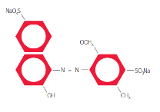
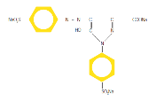
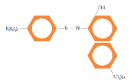
Certified Colors
Name of color | FD&C Red No. 40 Allura Red AC | FD&C Yellow No. 5 Tartrazine | FD&C Yellow No. 6 Sunset Yellow FCF
In use since | 1971 | 1916 | 1929
Genetox | Negative | Negative | Negative
Acute/Subchronic | Animals | Mice | R,M/90d
Chronic | Rats/Mice | Rats/Mice | Rats/Mice
Carcinogenicity | Rats/Mice | Rats/Mice | Rats/Mice
Reproductive/ Teratological | Neg/Neg | Neg/Neg | Neg/Neg
Special studies |  | Allergenicity | Allergenicity
Human studies |  | Allergenicity | Allergenicity
ADMEK | Dogs, rats | Humans, animals | Humans, animals
JECFA ADI (mg/kg/d) | 0-7 | 0-10 | 0-4
Notes:
Examples of extensive data sets created for certified colors.

Slide 24
Exempt Colors
Name of color | Annatto Extracts (Bixin, Norbixin) | Grape Skin Extract (Anthocyanins) | Beet Red
In use since | 1890
Genetox | Negative | Negative | Negative
Acute/ Subchronic | Rat | Rat/90-day | Rat/14-day
Chronic | Rats/Mice |  | Rat
Oncogenicity | Rats/Mice
Reproductive/ Teratological | Neg/Neg | Neg/Neg | Neg/Neg
Special studies | Allergenicity
Human studies | Allergenicity |  | ADMEK
ADMEK |  | Animals | Animals/ Humans
JECFA ADI (mg/kg/d) | 0-12 (Bixin) | None allocated | Not specified
Notes:
Examples of safety data sets for exempt colors.

Slide 25
Safety of Colors in the United States
Pre-Market Approval

Slide 26
Color Additives Require
Pre-Market Approval in US
All color additives, except for some hair dyes, are subject to FDA pre-market approval before they may be used in:
  Food
  Drugs
  Cosmetics
  Medical devices that come in contact with the bodies of people or animals for a significant period of time
Notes:
Any interested person may petition the FDA to list a new color additive or a new use of a listed color additive.

Slide 27
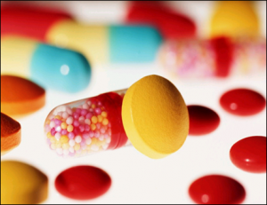
Color Additive Petition Review
What exactly is the substance and what is the projected exposure?
  Identity and composition
  Method of manufacture
  Specifications and purity
  Use level and exposure
  Technological justification
Is it safe for its intended use?
  Toxicology studies
  FDA Redbook requirements
Is other case-specific information needed?
Notes:
The petitioner must provide information on the identity of the proposed color additive; its physical, chemical, and biological properties; chemical specifications; manufacturing process; stability data; intended uses and restrictions; labeling; tolerances and limitations; analytical methods for enforcing chemical specifications; analytical methods for determination of the color additive in products; identification and determination of any substance formed in or on products because of the use of the color additive; safety studies; estimate of probable exposure; proposed regulation; environmental assessment; and a reason why certification is not necessary if exemption from batch certification is requested. The FDA will then evaluate the data in the petition, publish a request for public comment, review the comments and other relevant data in its files, and issue, if appropriate, a final regulation for the color additive.

Slide 28
Color Additive Petition
Identity and Specifications
Chemical Identity
  Analytical chemistry and spectra
  For plant sources, description of plant source
  Physical, chemical and biological properties
Specifications and Methods (for enforcing specs)
  Multi-batch analyses
  Identification of secondary coloring matters
  Identification of non-coloring matters, impurities
Manufacturing Process
  Conditions; methods
  Solvents; reagents
  Variation/purity
Stability

Slide 29
Color Additive Petition
Use/Technological Justification
What food categories will the color additive be used in? Dairy Products, Baked Goods, etc.
How much is required for technical effect? generally ppm, excluding caramel color and some unique applications
How will application levels vary within a food category? 10-100 ppm? 100-1000 ppm?
Tolerances and restrictions
Why is the color additive useful?
Notes:
This information allows the FDA to consider potential exposure and gauge the need for use of the color additive within a food category

Slide 30
Color Additive Petitions
Exposure
Petitions must include exposure estimate
  Proposed concentrations that will be used in food
  Consumer intake of foods that will contain the potential color additive
For main color additive, FDA generally considers chronic intake
Worst case scenario of exposure is considered
FDA experts will produce an Estimated Daily Intake (EDI) for the color additive, and determine safety based on results of toxicity testing and no-observed effect levels

Slide 31
Labeling of Colors in Food

Slide 32
US Labeling
In the US all color additives are considered artificial for labeling purposes
  Artificial Color
  Color Added
The addition of color to a product must be indicated on a label regardless of whether it is an exempt or certified (FD & C) color.
Cannot label any color additive in the US as a “Natural Color”
Notes:
All color additives, whether certified or exempt, are considered artificial for labeling purposes in the United States, and the addition of color to a product must be identified on the label (e.g., "artificial color," "color added"). Use of the term "natural color" is not permitted, as the FDA has not defined the term "natural." The agency has long considered it to mean that nothing artificial or synthetic, including colors regardless of source, has been included in or added to a product that would not normally be expected to be present. FDA did recently request comments on the use of Natural in labeling and IACM would support a regulatory definition of natural color and/or the allowance of color derived from natural sources and minimally processed to be included in a product labeled as made with natural ingredients.

Slide 33
European Labeling
In Europe, all food additives are given labeling codes commonly referred to as “E-numbers”
Colors are traditionally labeled not by name but by E-number
Europe now requires labeling for 6 synthetic colors included in the Southampton Study:
  “may have effects on activity and attention in children”
Notes:
In Europe, all food additives are given labeling codes commonly referred to as “E-numbers,” e.g., Allura Red is labeled as E129 and amaranth as E123. The EU also requires a warning label for the Southampton colors, saying that they may have effects on activity and attention in children. While the EU has required a warning label for the colors included in the McCann et al. study, this requirement was not based on adequate scientific evidence or on the opinion of EFSA, but instead on a political decision taken by members of the European Parliament who chose to forsake the EFSA opinion of the safety of the colors and respond to the emotionally charged public. Consumers, including children, are not in any way at risk from the presence of color additives in foods and therefore a warning label is completely unnecessary and will instead likely confuse consumers by indicating cause for concern where none exists.

Slide 34
FDA Food Advisory Committee Meeting
Reviewed USFDA report discussing available scientific data and whether there is evidence for a link between synthetic colors and hyperactive behavior in children
2-Day meeting, March 30/31, 2011
Food Advisory Committee, 14 members
  Academic experts (pediatrics, psychiatry, neurotoxicity, behavioral, development)
  2 consumer representatives
  2 industry representatives (no voting privileges)
Invited participants, consumer groups
  IACM only industry representative
Public comments
Notes:
Due to the Southampton Study in 2007, a myth has persisted that synthetic dyes cause hyperactivity in children. Some view the results of the Southampton Study to suggest that some mixtures of certain synthetic food colors and benzoate preservative may affect the level of hyperactive behavior in children. However, there are many problems with the study, such as behavior assessment data were not collected for the respective placebo phases and the observed effects lacked clear statistical significance

Slide 35
US Rejects Warning Label
Were FDA evaluation criteria robust?
  Yes, 13-1
  Should criteria/review be modified? Yes 8-6
Is there a causal relationship?
  No, 11-3
Should recommendation regarding additive free diet for children which show effects still be given?
  Yes 13-1
Should a warning labeling be required?
  No, 8-6
Are further studies needed?
  Yes, 13-1
Notes:
The FDA, however, after review of all scientific data, concluded that there was no causal relationship and a warning label is not needed. FDA recently completed a comprehensive exposure assessment of all FD&C colors and concluded that the exposure was significantly below the ADIs for all colors and in all age groups.

Slide 36
Do ingredient labels need a warning for colors?
  IACM does not support a warning for colors on ingredient labels
  Governments should make regulatory decisions based on sound science, rather than respond to emotionally charged requests or political pressure
Notes:
IACM does not support a warning for colors on ingredient labels, as there is no proven causality to hyperactivity; data from the Southampton study does not clearly indicate a causal association between the intake of color additives and hyperactive behavior; and as with all food ingredients, if consumers choose to not eat a specific ingredient, they can see it listed on the label and make an informed product choice.
IACM feels strongly that governments should make regulatory decisions based on sound science, rather than respond to an emotionally charged or political request that may not understand the implication and unintended consequences resulting from such a decision.
For this reason, warning statements for the Southampton colors are not used in geographies that use science to set policy, such as the United States, Canada, Australia, New Zealand, China or Japan.

Slide 37
COLORS AT CODEX

Slide 38
Colors at Codex
IACM participates as non-governmental observer (NGO) at Codex Alimentarius
  Active participant in Committee on Food Additives (CCFA)
IACM encourages countries to look to Codex standards and levels when developing new or amending food regulations
  However, some colors approved for use in US and/or EU not currently in General Standard for Food Additives (GSFA) due to slow, deliberate Codex process, not due to safety concerns
Notes:
IACM is also supportive generally of global harmonization of color additive regulations where possible. IACM participates as a non-governmental observer (NGO) at the Codex Alimentarius Commission and is an active participant in the Codex Committee on Food Additives. Each country takes its own approach to color additive approval and reauthorization and populations have different needs and requirements for colors due to cultural variations.

Slide 39
GSFA Not a Positive List
Additionally, it was not the intent of the creators of the GSFA for it to be adopted as a positive list at this stage of development. Footnote 1 of the GSFA states,
  Notwithstanding the provisions of this Section of the General Standard, the lack of reference to a particular additive or to a particular use of an additive in a food in the General Standard as currently drafted, does not imply that the additive is unsafe or unsuitable for use in food. The Commission shall review the necessity for maintaining this footnote on a regular basis, with a view to its deletion once the General Standard is substantially complete.

Slide 40
Codex GSFA Step Process
46 colors with draft and/or adopted provisions in GSFA
  1,895 draft and adopted provisions for colors in the GSFA
Colors that have not completed the Step process for adoption are largely at Steps 4 and 7.
  Step 4: the draft text has been prepared, circulated to member countries and all interested parties for comment and are awaiting review at the Committee level before being sent to the Commission for review
  Step 7 additives have already been endorsed by the Commission, agreed to be put forth for finalization and are simply awaiting finalization by the Committee

Slide 41
IACM Supports Global Harmonization
Since current omission from GSFA not due to safety concerns, IACM encourages countries to consider colors approved for use in US, EU OR Codex as basis for regulations
  Adopting the GSFA as a positive list means that currently approved colors and/or uses for certain colors will be banned
Due to Note 161 concerns, no new colors are being considered for inclusion in GSFA currently
  Each country takes its own approach to color additive approval and reauthorization and should consider need for colors not in GSFA
  Populations have different needs and requirements for colors due to cultural variations
There is no reason for a country to disallow the use of a color or a use already approved due its position at Step 7 rather than Step 8
Notes:
We encourage countries to consider colors that are approved for use by the United States, European Union, or Codex as the basis for their regulations.

Slide 42
Key Takeaways
Colors are useful additives that provide important and beneficial technical effects
Strong and robust dataset supports the safety of colors
Colors are clearly labeled as ingredients in the US and this allows consumers to make informed choices
IACM supports science-based regulations on color use and labeling and global harmonization to the extent possible
Codex GSFA should not be adopted as positive list; need to consider draft provisions as well as those already adopted

Slide 43
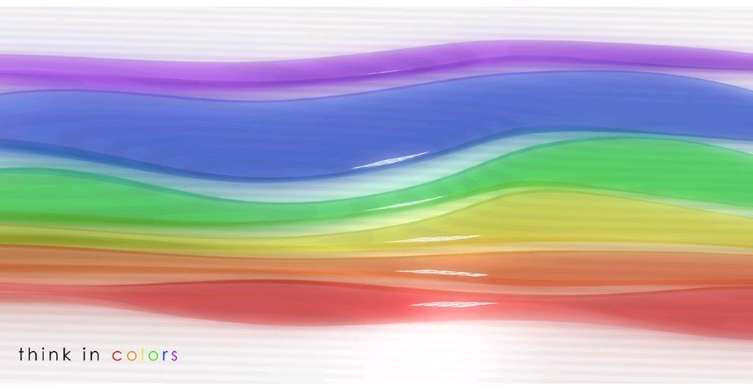
Thank You

