Slide 1
The FEMA GRAS Program and Global Flavor Safety Evaluation Food Additives: A Global Perspective on Safety Evaluation and Use 13 September 2016 Hanoi
John B. Hallagan
Senior Advisor and General Counsel
The Flavor & Extract Manufacturers Association of the United States
Washington, D.C.

Slide 2
Summary
FEMA and Flavors
U.S. Regulation of Flavors
The FEMA GRAS Program
GRAS assessment and the FEMA Expert Panel
Global safety evaluation and approval

Slide 3
FEMA
Flavor and Extract Manufacturers Association of the U.S.
FEMA was established in 1909.
130 members that include companies that make and use flavors.
Primary mission – Assure flavor safety through the FEMA GRAS program.
Other work – Workplace safety, flavor and food labeling compliance, other regulatory matters.

Slide 4
FEMA and IOFI
The International Organization of the Flavor Industry (IOFI)
FEMA and other national and regional flavor associations are members of IOFI
IOFI supports the global flavor industry
IOFI addresses global flavor safety and regulatory matters
The FEMA GRAS program is a key part of global flavor safety efforts

Slide 5
What is Flavor
Terminology
Flavor vs. “flavor,“ “flavoring,“ “flavor ingredient,“ “flavoring substance“
Flavoring substances – they impart or modify flavor
Individual chemically-defined flavoring substances – vanillin, benzaldehyde, many others
2. Natural flavoring complexes – extracts, essential oils, oleoresins
Approximately 2,800 individual chemcially-defined flavoring substances and 300 NFCs are FEMA GRAS
Codex Alimentarius Definition (CAC/GL 66-2008) :
Flavor is the sum of those characteristics of any material taken in the mouth, perceived principally by the senses of taste and smell, and also the general pain and tactile receptors in the mouth, as received and interpreted by the brain. The perception of flavour is a property of flavourings.

Slide 6
Flavorings added to foods
Compounded flavors
These are the flavorings added to foods to provide flavor
Compounded flavors are often complex mixtures of individual flavoring substances and natural flavor complexes that impart or modify flavor, and adjuvants that help the compounded flavor function in food such as solvents, emulsifiers and preservatives.
Some general principles
Flavorings are not intended to be consumed as such.
Flavorings are not nutritional
Flavorings should be used at the lowest level necessary to accomplish the desired flavoring effect.
Flavorings do not include substances that have an exclusively sweet, sour, or salty taste (e.g. sugar, vinegar, and salt)
Flavorings shall not be used to mislead consumers about the nature or quality of food.

Slide 7
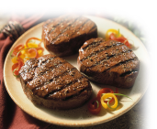
Compounded flavors – individual constituents impart flavor
Foods contain a very large number of individual flavoring substances so compounded flavors must also to provide the same flavor sensation
Banana around 250
Strawberry around 350
Chocolate around 600
Coffee, freshly brewed around 1000
Steak, grilled over 2000
Notes:
7
Coffee

Slide 8
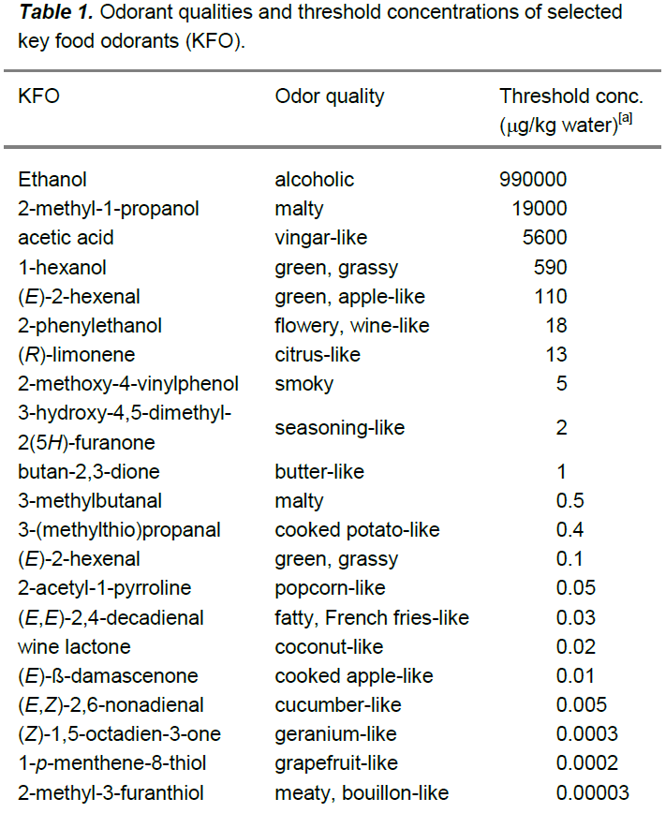
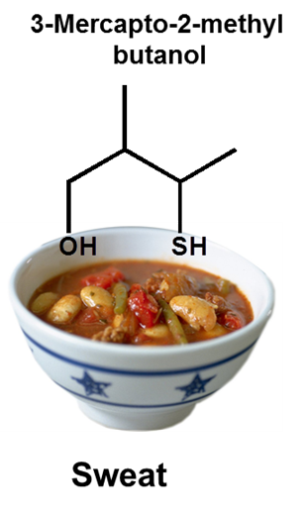
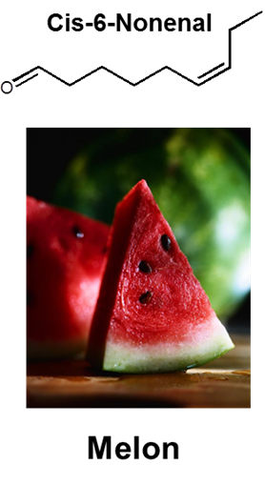
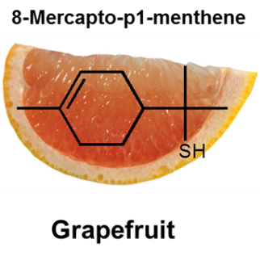
Flavoring substances
~10,000 + substances predicted to occur in foods
~8,000 already identified
~3,100 ingredients used commercially for creation of food flavorings
Factors affecting flavoring use levels in food
Broad range of flavor profiles and concentrations depending on perception thresholds
Interaction with other flavorings
Interaction with food matrix
Loss during manufacturing and storage
Notes:
8

Slide 9
Regulation of Flavors in the U.S.
U.S. Food and Drug Administration (FDA) regulates the safety of substances added to food.
Federal Food, Drug, and Cosmetic Act (FFDCA) of 1938
Food Additives Amendments of 1958
Established FDA premarket approval for all food ingredients unless ingredients are “generally recognized as safe” (GRAS).

Slide 10
Regulation of Flavors in the U.S.
Pathways to “regulatory authority to use” flavoring substances
1. FDA food additive status
2. FDA GRAS notification
3. “Private” GRAS conclusion
4. FEMA GRAS program

Slide 11
1958 Food Additives Amendments to FFDCA
Defined “food additive” and required premarket approval
Established standards for safety and review
Created exception to food additive definition
GRAS concept: applies only to a specific use of a substance – it is the use of the substance that is GRAS, not the substance itself.

Slide 12
U.S. Definition of “Food Additive”
FFDCA Section 201(s)
The term “food additive” means any substance the intended use of which results or may reasonably be expected to result, directly or indirectly, in its becoming a component or otherwise affecting the characteristics of any food…
…if such substance is not generally recognized among experts qualified by scientific training and experience to evaluate its safety, as having been adequately shown… to be safe under the conditions of its intended use…”

Slide 13
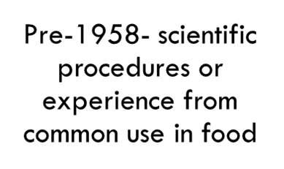
Basis for GRAS Status
GRAS based on the views of experts qualified by scientific training and experience to evaluate the safety of substances added to food
Safety-based only: no risk/benefit
Safety means “a reasonable certainty of no harm” as defined by FDA.
Post-1958- scientific procedures

Slide 14
Food Additive and GRAS
Review & Approval by FDA
Evidence of Safety
Food Additive
General Recognition
Evidence of Safety
GRAS Substance
Widely Known
Consensus by Qualified Experts

Slide 15
GRAS is a U.S. regulatory concept
GRAS status can be determined in several ways for flavors:
1. FDA voluntary GRAS notification program
Final regulations published 17 August 2016; 81 Fed. Reg. 54960.
The final rule provides guidance on several important GRAS issues
2. “Private” GRAS conclusion – permitted by FFDCA.
These two pathways are very rarely, if ever, used for flavors.
Most common pathway to regulatory authority to use flavors in the U.S. is the FEMA GRAS program.
The FEMA GRAS program has global significance.

Slide 16
The FEMA GRAS Program

Slide 17
The FEMA GRAS Program
Established in 1960 and is the longest-running and most extensive safety evaluation program for flavors.
Most important component is the FEMA Expert Panel
The Expert Panel is supported by the FEMA Scientific Staff
4 Ph.D. scientists and 6 scientific support staff.

Slide 18
The FEMA Expert Panel
Dr. Sam Cohen (chair)
Pathology
University of Nebraska Medical Center
2002
Dr. Ivonne Rietjens (vice-chair)
Toxicology
University of Wageningen, Netherlands
2006
Dr. F. Peter Guengerich,
Biochemistry
Vanderbilt University
2015
Dr. Robert Smith
Pharmacology
University of London
1981
Dr. Stephen Hecht
Medicinal Chemistry
University of Minnesota
2011
Dr. Nigel Gooderham
Molecular Toxicology
Imperial College
2009
Dr. Shoji Fukushima
Toxicology
Japan Bioassay Research Center
2010

Slide 19
Expert Panel Composition
~8 Members
Independent of food industry
expertise in:
Organic / biological chemistry
Metabolism / PK
Toxicology
Exposure
Medicinal chemistry
Biostatistics
Pathology
Molecular Genetics

Slide 20
FEMA Expert Panel procedures for GRAS assessment for flavoring substances
The FEMA Expert Panel evaluates substances for GRAS status ONLY under their conditions of intended use as flavoring substances that impart or modify flavor or as flavor adjuvants.
Other technical effects are not considered (e.g. sweetening)
FEMA Expert Panel has well-defined and published procedures
Strict conflict of interest protections
Transparency requirements
All safety information provided to FDA and made available to the public through publication and other means
Well-defined safety evaluation procedures

Slide 21
FEMA Expert Panel procedures for GRAS assessment for flavoring substances
GRAS assessment of chemically defined flavoring substances
Well-defined criteria for safety assessment – Smith et al., 2005
Characterization – chemical identity, sensory
Safety data – toxicology, metabolism, pharmacokinetics
Exposure – Anticipated volume of use and use levels
GRAS assessment of natural flavor complexes
Well-defined criteria for safety assessment – Smith et al., 2004
Characterization
Constituent-based approach
Safety data on constituents-toxicology, metabolism and pharmacokinetics
Exposure - anticipated volume of use and use levels

Slide 22
FEMA Expert Panel procedures for GRAS assessment for flavoring substances
How does the FEMA GRAS program work?
FEMA member submits application for evaluation
Application must contain all available, relevant information
Expert Panel evaluates information provided by the applicant plus all other available relevant information
Published and unpublished information
Conditions of intended use must be stated and includes designated technical effect (must be to impart or modify flavor), and use categories and use levels.

Slide 23
Safety evaluation and GRAS assessment for flavoring substances
Key objective is safety to protect public health
Many materials for review – naturally or synthetically derived
~ 2,800 single chemically-defined flavoring substances
~ 300 natural flavoring complexes
Many belong to similar, well-defined structural classes
e.g. More than 400 simple esters used as flavoring substances
Significant majority are used at less than 50,000 kg./year globally.

Slide 24
Scientific evidence used in FEMA GRAS evaluations
Identity of substance, specifications
Toxicology data - results of animal studies
Anticipated biological fate of substance and structurally-related substances
Absorption, distribution, metabolism and excretion
Target organ toxicity?
Use level and exposure calculations
Margin of safety - under conditions of intended use

Slide 25
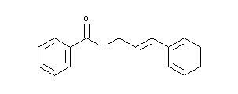
Example: FEMA GRAS Evaluation of Cinnamyl Benzoate
Exposure
0.0003 mg/kg bw/d (MSDI)
51 mg/kg bw/d (PADI)
Sensory Data-Imparts Fruity, Spice Note
Database on structurally related substances
ADME
90-Day and 2-year
Predicted hydrolysis to cinnamyl alcohol and benzoic acid
14-Day studies in rats, NOAEL
>2000 mg/kg bw/d
Result: Cinnamyl benzoate
granted FEMA GRAS status (FEMA 4703)
Safety Factor
> 35,000

Slide 26
FEMA GRAS Conclusions
Applicant receives GRAS letter
GRAS or Additional Data Needed
Publication
GRAS article in Food Technology
FEMA website
Identity
Use levels and food categories
Data sent to US FDA
Summaries made publicly available
GRAS affirmation, reaffirmation
Food and Chemical Toxicology

Slide 27
Relationship with U.S. FDA
FEMA and FDA enjoy a positive, long-standing, productive relationship
FDA acknowledges FEMA GRAS determinations but is free to challenge them at any time
FEMA GRAS status does not mean “FDA approval”
FEMA has an obligation to keep FDA fully informed about FEMA GRAS determinations
FDA is the ultimate regulatory authority

Slide 28
Global Safety Evaluation and Regulation
Recognition of FEMA GRAS
by other countries
From FEMA GRAS to JECFA, countries/regions
FEMA- GRAS
Evaluation
FEMA- GRAS List
US-FDA
Codex Committee on Food Additives (CCFA)
WHO/FAO Joint Expert
Committee on
Food Additives
(JECFA)
EU Union List
China
Japan
Joint Expert
Committee on
Food Additives
(JECFA)

Slide 29
The FEMA GRAS Program
There is much publicly available information on the FEMA GRAS Program
FEMA website – femaflavor.org - “About the FEMA GRAS Program”
FEMA Flavor Ingredient Library- much information on flavoring substances including safety information and conditions of intended use as the basis for the GRAS conclusion.
Publications
More than 250 published reports and other scientific reports

Slide 30
Recent Initiatives
Computational toxicology strategies to enhance safety assessments
FEMA Flavor Ingredient Library

Slide 31
Key publication

Slide 32
Thank You!
We are happy to share information on flavor safety and regulation, and the FEMA GRAS program. Please contact me:
John Hallagan
FEMA
1101 17th Street, N.W.
Suite 700
Washington, D.C. 20036
202.331.2333
Hondobear@aol.com

