Slide 1
Developing Standards for International Market Access and Relevance – ASTM and Committee D13 on Textiles
Ghanaian Textile and Apparel Producers Standards Alliance Programming
7 December 2016
Jennifer Rodgers
Director, ASTM Technical Committee Operations

Slide 2
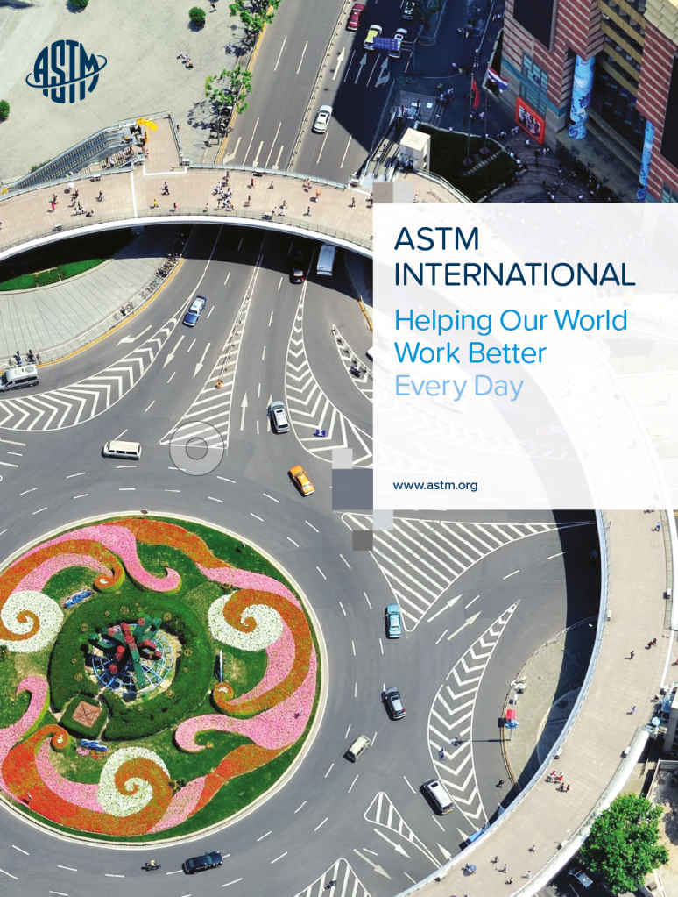
Topics Covered
Introduction to ASTM International
ASTM as an International Standards Developer
Memorandum of Understanding Program
The Consensus Process
D13 Quick Overview Benefits of Participation
Questions?
Notes:
-possibly include a note on each.

Slide 3
Helping Our World Work Better
12,000+ ASTM standards operate globally
Applied to just about everything from steel to sustainability
They improve the lives of millions every day
Notes:
Founded in 1898 in Philadelphia, Pennsylvania, USA
Largest U.S. based international voluntary consensus standards writing organization
Independent, private sector, not-for-profit – NOT A GOVERMENT AGENCY
-12,000+ Standards
-Applied to everthing
– Over 30,000 members from 148 countries.
Committed to serving global societal needs through a positive impact on public health and safety, consumer confidence and overall quality of life. ASTM integrates innovative services and consensus standards, developed through those 30,000+ international membership of volunteer technical experts, to advance trade and improve quality, safety and reliability of products, systems and services.

Slide 4
Important. Every Day.
The Role of ASTM Standards
Ensures safety, quality and reliability
Constantly responding to new challenges, new technology and new markets
Built on principle of voluntary consensus: giving everyone an opportunity to participate
Effective and relevant across diverse markets
Helping everyone: consumers, businesses, manufacturers, innovators and governments
Incorporated into contracts, regulations, codes, and laws around the world; they support established and emerging economies and free and fair global trade.
6,733
ASTM standards have been adopted, used as a reference, or used as the basis of national standards outside the USA
Notes:
Building on the work of our founders in the early rail industry – ASTM’s standards continue to ensure safety, quality and reliability.
The process is very open and transparent, allowing anyone with an interest to join with low membership fees and electronic tools that result in low barriers to participation
This allows for a responsive environment in order to address new challenges, new technology and new markets where new standards and enhancements to existing ones are needed
The diverse stakeholder representation (producers, users, consumers, academia, government, laboratories) results in standards that are effective and relevant across the diverse markets we serve.
They underpin contracts, laws and regulations. They support established and emerging economies – and ultimately – free and fair global trade. This is demonstrated in the 6500+ references incorporated into contracts, regulations, and laws throughout the world.

Slide 5
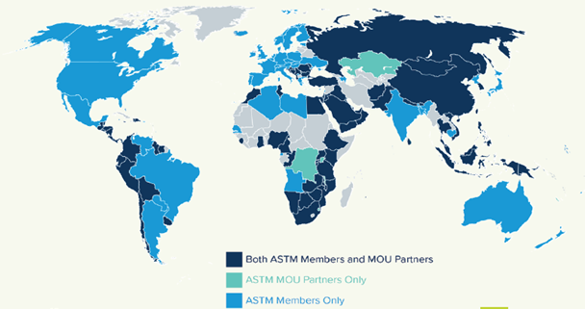
Operating Globally
Why ASTM is International
ASTM is one of the world’s largest Standards Developing Organizations, with global reach and influence
Embraces all the principles of the World Trade Organization’s Agreement on Technical Barriers to Trade
Works across all geographic borders
Recognizes expertise by individual, not country of origin
Trusted for market relevance and technical quality
The choice for many global industries – 50% of ASTM sales are outside the USA
Our Memorandum of Understanding Program provides tangible encouragement to developing economies
30,000+ global members from 148 countries
145 Main Committees; 12,500 standards; represent 90 industry sectors
40 countries reference ASTM standards in regulation
Notes:
– ASTM is one of the world’s largest international SDOs, (standards development organizations)
– The World Trade Organization is the body that defines the principles for what is considered an International Standards Developer. ASTM complies with the six WTO (World Trade Organization) principles for international standards development: transparency, openness, consensus, relevance, coherence, development dimension.
–ASTM recognizes expertise, not country of origin. This promotes a massive range of activity and exchange of knowledge by individuals.
– This international status is demonstrated not only in the compliance of our process, but in the choice to use ASTM standards in many global industries – 50% of ASTM sales are outside the USA.
–A dedicated global outreach activity helps to increase understanding about standards and their application.
–Memorandum of Understanding Program further aids developing countries and economies through access to ASTM standards and participation in the process

Slide 6
Memorandums of Understanding
Promotion of Communication, Awareness, Development & Support
The ASTM MOU program promotes:
Communication between signatory member standards bodies;
Awareness of each other’s standardization systems;
Development of national standards;
De-duplication of efforts;
Support of the development activities of members
Encourage the participation of technical experts from around the world in the ASTM standards development process and broaden the global acceptance and use of ASTM International standards.
Technical experts from any country with an MOU can participate at no charge as full voting members in the ASTM standards development process.
Access to all ASTM standards is provided to the national standards body.
African Organization for Standardisation, and many of the ARSO members, have ASTM MOUs.
100 signed MOUs as of October 2016
100
memorandums of understanding
Notes:
– ASTM is one of the world’s largest international SDOs, (standards development organizations)
– The World Trade Organization is the body that defines the principles for what is considered an International Standards Developer. ASTM complies with the six WTO (World Trade Organization) principles for international standards development: transparency, openness, consensus, relevance, coherence, development dimension.
–ASTM recognizes expertise, not country of origin. This promotes a massive range of activity and exchange of knowledge by individuals.
– This international status is demonstrated not only in the compliance of our process, but in the choice to use ASTM standards in many global industries – 50% of ASTM sales are outside the USA.
–A dedicated global outreach activity helps to increase understanding about standards and their application.
–Memorandum of Understanding Program further aids developing countries and economies through access to ASTM standards and participation in the process

Slide 7
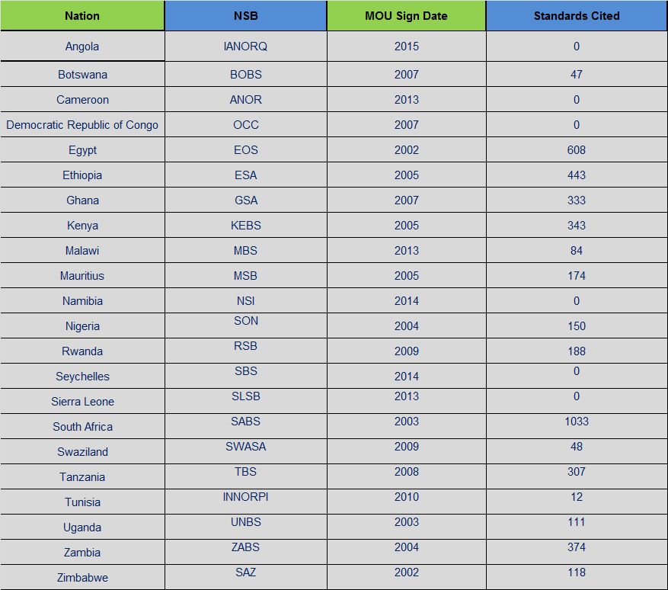
ARSO Members with ASTM MoU Agreements

Slide 8
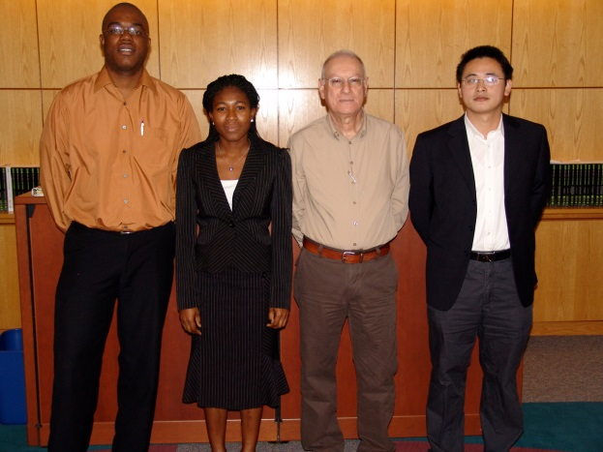
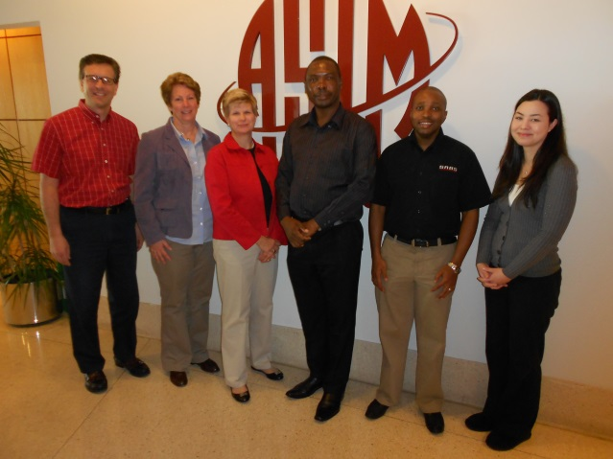
Unique Training Within the MoU Program
Standards Expert Program
Technical Visitor Program
Other International Visitors
Procedural focus
Typically three nations/year; to date have hosted 28 experts from 25 nations
NSB identifies two candidates, ASTM interviews and selects one
Participant becomes an expert and a resource
Recent Participants:
– 2015: Costa Rica, Indonesia
– In 2016: Candidates from Mauritius, Kazakhstan, Dominican Republic
Technical focus
Competitive process
Partners invited to submit applications from staff and industry experts, ASTM selects
2015 - Nana Sekyi, Ghana – GSA
Studied: Standards for pipeline integrity for the oil/gas sector
2016 Program – Participants from Vietnam and Trinidad & Tobago
Attached staff and Intensive Training Programs – Topics vary
Candidate selection varies by sponsoring organization
Sponsor helps define study topics
Duration of one week to eleven months
To date:
Attachments – Botswana, China, Japan, South Africa, South Korea (3)
ITP – India, China, GSO, Latin America, South Korea, Trinidad and Tobago, Jamaica and Singapore
Notes:
Note SEP from Ghana, 2009 - Adelaide Leigh
Technical Visitor from Ghana, 2015 – Nana Sekyi
Attachments 2012 – Botswana and South Africa

Slide 9
Positive Results from the MOU Program
﻿Reported Citations of Standards and Membership
﻿ Citations by GSA
﻿ Membership from Ghana
Adoptions - 156
Consulted - 102
Normative Reference - 47
Referenced in Regulations - 1
Basis of National Standard - 66
Technical Committees – 14
Student Members - 7

Slide 10
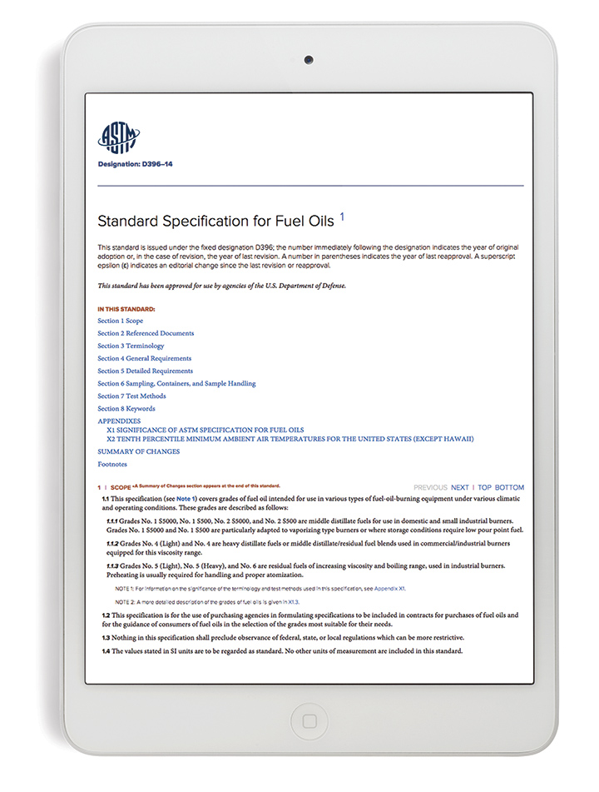
Process for Standards Development
What is a standard in ASTM?
Test Methods
Specifications
Practices
Guides
Classifications
Terminology
12,500
Standards
Notes:
–A standard is a technical document that has been developed and approved through the ASTM consensus process. Test methods, specs, practices, guides, classifications and terminology.
All standards are living documents and can be revised or proposed at any time. ASTM requires that they be reviewed every 5 years, but, in fast-moving sectors, it’s more frequent than that. There allows for responsiveness to market needs and technology changes. The manadtory five year review exists to ensure they remain relevant.
– It’s backed by powerful tools and technologies that enhance global connectivity, such as collaboration areas for drafting standards, electronic balloting, virtual meetings and online member tools and resources.
– These systems give members the freedom to be in instant contact, to share thinking and to review and develop standards more quickly.
– This reinforces our reputation for timely as well as relevant standards.

Slide 11
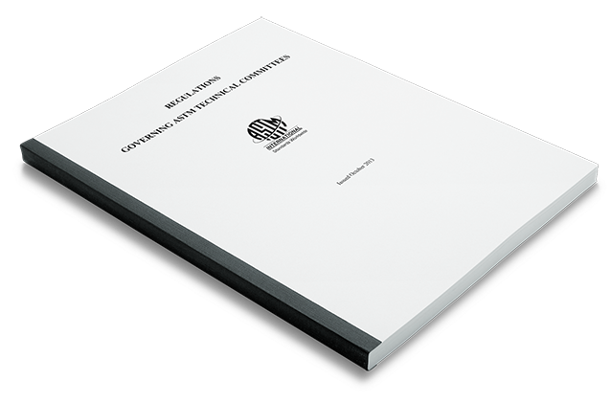
The Consensus Process
Ensures Due Process
Everyone has the opportunity to provide input to the process
One vote per voting interest (as opposed to one vote per country)
All responses must be considered and resolved by the technical committee
Technical and Procedural Appeals Process
Process further validated through accreditations with the American National Standards Institute (ANSI) and the Standards Council of Canada (SCC)
ASTM Regulations
Defines and enforces ASTM’s open, transparent, consensus and coherent process
Notes:
ASTM has our guidance document; the Regulations.
The Society uses these regulations to govern the consensus process.
My job and that of my peers is to ensure that these are always upheld.
They cover everything from new activity development, to member classification, to the handling of negatives votes.
Different than other SDOs, like ISO, where there is only 1 vote per country.

Slide 12
Technical Committee Organization
Technical Committees form to address specific industry needs
Subcommittees are established to address subsets of specialized subject matter
Subcommittees organize their expertise into Task Groups to write standards
Main Committee
D13.11
D13.50
D13.60
D13.50.01
D13.50.02

Slide 13
Balloting
Documents are drafted and revised in the task group
New standards are required to be balloted at the subcommittee level at least once
After subcommittee approval, the main committee & entire Society
Appeals process and oversight through Committee on Standards
Committee on Standards
Society and Main Committee
Sub- committee
Task Group

Slide 14
Handling Voting Results
A single negative vote halts the ballot process until resolution is reached
Technical changes require re-balloting

Slide 15
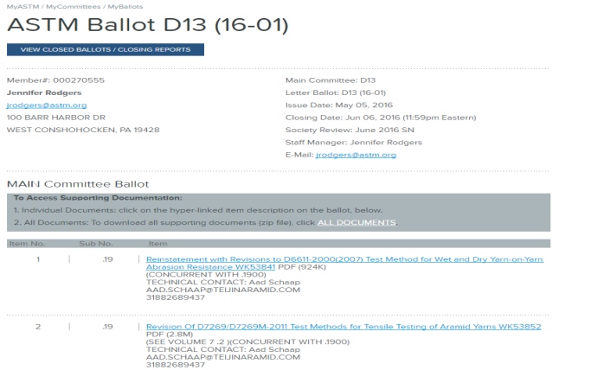
Responsive Standards Development
Dynamic, responsive, process with supporting technology that allows members to develop standards quickly and efficiently through web conferencing, electronic drafting, balloting, voting and resolution system
New standard can be developed in 16-18 months (on average, can be faster)
Revisions approved in 6-8 months (average)
Standards can be revised at any time
Mandatory review every 5 years to ensure market relevance

Slide 16
Committee D13 on Textiles
Organized in 1914
More than 600 Members
30 Subcommittees
346 Standards
International Membership Represented
Participation from 36 countries
Committee D13 on Textiles

Slide 17
Committee D13 on Textiles
Scope and Areas of Interest
Fabrics from textile fibers or yarns (natural, manufactured fibers or combination thereof) using felting, weaving, knitting, and needle-punching, or other methods of production
Textiles used in the manufacture of fabrics, components, or subassemblies for consumer or industrial applications
Components or subassemblies used in the manufacture of textile products, such as sewing thread, tapes, zippers, snaps, buttons, hook and loop closures, battings, and interlinings
Consumer and industrial textile end products, such as apparel, home furnishings, pile floor coverings, rope and cordage, tire cords, inflatable restraints, smart textile products
Systems for reporting consumer information, such as UV protection by textiles (when such a claim is made for the textile), product and care labeling, and body measurements for apparel sizing
Flammability of textile products
Dip pick-up of cords and adhesion of cords used with rubber or other elastomeric material (developed in cooperation with ASTM Committee D11 on Rubber
Notes:
D13 covers everything from Fibers, yarns, and fabrics, to textiles used in the manufacture of fabrics, such as components, or subassemblies for consumer or industrial applications.
D13 standards include consumer and industrial textile end products, such as apparel, home furnishings, pile floor coverings, rope and cordage, tire cords, and inflatable restraints; as well as dip pick-up of cords and adhesion of cords used with rubber or other elastomeric material (developed in cooperation with ASTM Committee D11 on Rubber).
D13 standards also address systems for reporting consumer information, such as UV protection by textiles (when such a claim is made for the textile), product and care labeling, and body measurements for apparel sizing;
Most recently (January 2016), D13 approved a new subcommittee on Smart Textiles.
D13 maintains liaison relationships with other ASTM committees and outside organizations, such as Industrial Fabrics Association International (IFAI), American Apparel and Footwear Association (AAFA), and American Association for Textile Chemists and Colorists (AATCC) to name a few. These liaison relationships are a very common and encouraged practice within all ASTM committees. We look forward to outreach and coordination with new organizations related to Smart Textiles that D13 has not yet worked with in the past, such as IEEE.

Slide 18
Committee D13 on Textiles
Subcommittees
D13.11 Cotton Fibers
D13.13 Wool and Felt
D13.17 Flax and Linen
D13.18 Glass Fiber and its Products
D13.19 Industrial Fibers and Metallic Reinforcements
D13.20 Inflatable Restraints
D13.21 Pile Floor Coverings
D13.40 Sustainability of Textiles
D13.50 on Smart Textiles ^{New!}
D13.51 Conditioning, Chemical and Thermal Properties
D13.52 Flammability
D13.54 Subassemblies
D13.55 Body Measurement for
Apparel Sizing
D13.58 Yarns and Fibers
D13.59 Fabric Test Methods, General
D13.60 Fabric Test Methods, Specific
D13.61 Apparel
D13.62 Labeling
D13.63 Home Furnishings
D13.65 UV Protective Fabrics and Clothing
D13.66 Sewn Product Automation
D13.99 Coordination Committee for
ISO & Foreign Textile Standards
Notes:
Development of standards, related to characteristics, properties, nomenclature, and uses of textiles.

Slide 19
Sampling of D13 Standards
D13.54 on Subassemblies
D1683/D1683M-11a Standard Test Method for Failure in Sewn Seams of Woven Apparel Fabrics
D3512/D3512M-16 Standard Test Method for Pilling Resistance and Other Related Surface Changes of Textile Fabrics: Random Tumble Pilling Tester
D5034-09(2013) Standard Test Method for Breaking Strength and Elongation of Textile Fabrics (Grab Test)
D5035-11(2015) Standard Test Method for Breaking Force and Elongation of Textile Fabrics (Strip Method)
D7811-13 Standard Test Method for Bow and Skew Using a Measuring Tool
D1776/D1776M-16 Standard Practice for Conditioning and Testing Textiles
D6413/D6413M-15 Standard Test Method for Flame Resistance of Textiles (Vertical Test)
D6545-10 Standard Test Method for Flammability of Textiles Used in Children's Sleepwear
D13.59 & .60 Fabric Test Methods
D13.51 Conditioning, Chemical and Thermal Properties
D13.52 on Flammability

Slide 20
Sampling of D13 Standards
D13.62 on Body Measurements for Apparel Sizing
D4910/D4910M Standard Tables of Body Measurements for Children, Infant Sizes (Preemie - 24 mos)
D5585 & D7878/D7878M Standard Tables of Body Measurements for Adult Female Misses
D6240/D6240M Standard Tables of Body Measurements for Mature Men
D3938-13 Standard Guide for Determining or Confirming Care Instructions for Apparel and Other Textile Products
D5489-14 Standard Guide for Care Symbols for Care Instructions on Textile Products
D3887-96(2008) Standard Specification for Tolerances for Knitted Fabrics
D7017-14 Standard Performance Specification for Rainwear and All-Purpose, Water-Repellent Coat Fabrics
D13.62 on Labeling
D13.61 on Apparel

Slide 21
Key Industry Partners in Textiles
D13 Coordinates with many outside organizations and agencies
American Association of Textile Chemists and Colorists (AATCC)
American Apparel and Footwear Association (AAFA)
Industrial Fabrics Association International (IFAI)
International Textile and Apparel Association (ITAA)
International Standards Organization (ISO)
National Coalition of Textile Organizations (NCTO)
American Home Furnishings Alliance (AHFA)
US Department of Agriculture (USDA)
Us Department of Defense (US DoD)
Federal Trade Commission (FTC)
Consumer Product Safety Commission (CPSC)
Notes:
D13 maintains liaison relationships with other ASTM committees and outside organizations, such as Industrial Fabrics Association International (IFAI), American Apparel and Footwear Association (AAFA), and American Association for Textile Chemists and Colorists (AATCC) to name a few. These liaison relationships are a very common and encouraged practice within all ASTM committees.
IEEE will need to be a new industry partner for D13 as we continue to explore areas like 3D go

Slide 22
Standards Development Resources
Reduce geographic and financial barriers
Staff manager for each committee
Staff editor for each committee
Electronic templates for new standards
Web-based Collaboration Areas for Task Group work (members and non-members can participate on task groups)
Electronic balloting
Virtual Meeting & Hybrid meeting capabilities
Postings of all committee-related information to Members Only area of website
Print & Subscription-based access to published standards
Notes:
ASTM Staff’s role is to manage & support the technical committees

Slide 23
Membership
Helping to Make the Difference
Through the MOU program, you can contact your standards body for information on participation or contact Kimberly Simms directly at ASTM to join the ASTM committee of your choice
Membership is open to anyone who wants to use their expertise to influence standards
Members develop new and revise existing standards – they can also network with peers and gain professional development opportunities
For more information: www.astm.org/MEMBERSHIP
Notes:
– Anyone who wants to utilize their expertise to influence standards is welcome to join ASTM.
– There are three types of membership: Participating Membership, Organizational Membership and Student Membership.
– Participating Members actively develop new standards and revise existing ones in a uniquely open environment. They can also form invaluable relationships, exchange ideas and access professional development opportunities.
– Organizational Members also help to shape standards and get privileged access to information that directly affect their business. Membership also supports growth, international trade and employee development.
– Student Membership is free and open to all undergraduates. It provides a thorough understanding of the standardization process and how it applies in the workplace.

Slide 24
Thank you
http://www4.astm.org/images/astm-corporate.mp4
Jennifer Rodgers
jrodgers@astm.org
610.832.9694
Notes:
There are a few ASTM members from various committees in attendance today, and as a member of the Board of Directors I would like to personally thank you for your dedication
For those of you who have not yet had the opportunity to be involved with ASTM, I personally would like to invite you.
Please check out our website www.astm.org to sign up and feel free to contact myself or our D13 Staff Manager Jennifer Rodgers (who was unable to attend this presentation due to a scheduling conflict)… her business card should be in the handouts located….. At the back of the room???
Thank you!

