Slide 1
U.S Consumer Product Safety Commission
Central America Conference on Textiles Standards and Customs Procedures
June 23 – 24, 2015
Frank J. Nava
Deputy Director, Field Operations
This presentation was prepared by CPSC staff, has not been reviewed or approved by, and may not reflect the views of the Commission.

Slide 2

U.S. Consumer Product Safety Commission
(CPSC)
Design for Safety
These comments are those of the CPSC staff, have not been reviewed or approved by, and may not necessarily reflect the views of, the Commission.
Notes:
2

Slide 3
Principles of Design Analysis
Product hazards
Hierarchy of safety strategies
Design analysis/foreseeable use
Test and evaluation
Safety culture

Slide 4
Product Hazards
Know the Hazards Associated with Your Product
Life Threatening/Serious Injury
Strangulation
Entrapment
Positional asphyxia
Fall/head injury
Choking/ingestion/aspiration
Drowning
Shock/electrocution
Fire/burn
Amputation
Laceration
Fracture
Eye injury
Impalement
Fall

Slide 5
Hierarchy of Safety Strategies
Design out the hazard
Limit access to the hazard (shield/guard)
Inform user of the hazard (warning label)
Change behavior to avoid the hazard (training)
Ban the product (no remedy)
Accept the hazard (no remedy)

Slide 6
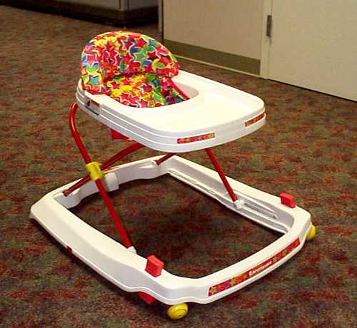
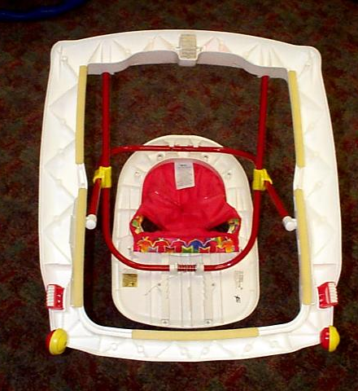
Hierarchy of Safety Strategies
1. Design out the hazard
Baby Walker

Slide 7
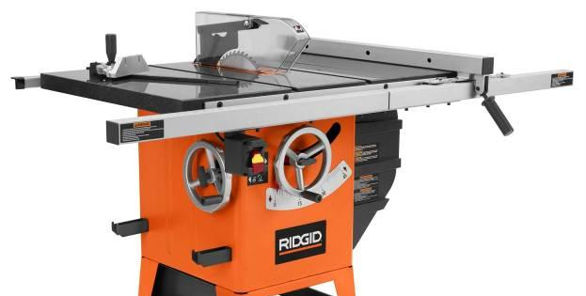
Hierarchy of Safety Strategies
2. Limit access to the hazard (shield/guard)
Table Saw – Blade Guard

Slide 8
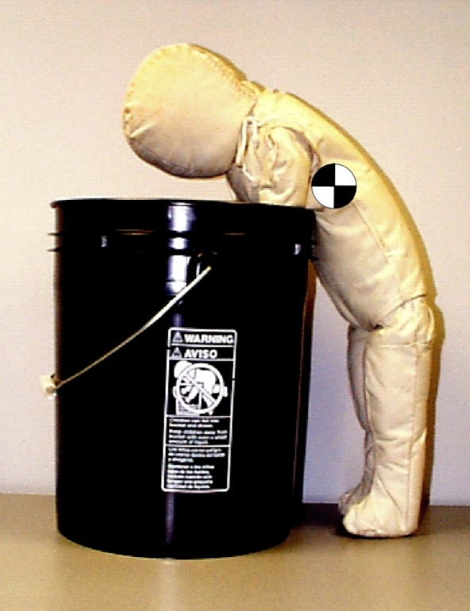
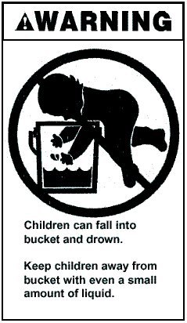
Hierarchy of Safety Strategies
3. Inform user of the hazard (warning)
Bucket

Slide 9

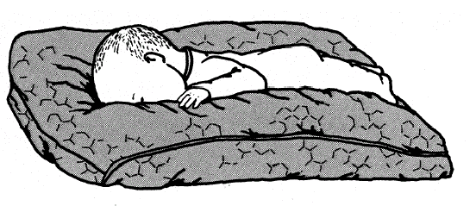
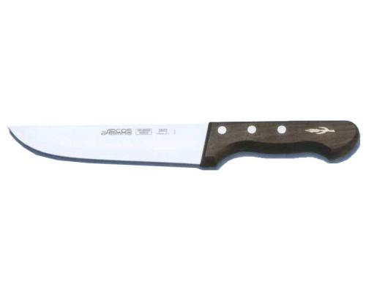
Hierarchy of Safety Strategies
Change behavior to avoid the hazard (training)
Ban the product (no remedy)
Accept the hazard (no remedy)
ATV
Infant Pillow
(With granular bead filling)
Knife

Slide 10
Design Analysis
Form a review team
Define users
Define environments
Define the life cycle of the product
Identify failure modes
Determine the foreseeable use, misuse, abuse
Identify potential hazards
Review data
Review standards – understand the rationale
Keep asking “What if…..?”
Notes:
Forme un equipo de examen:
ingeniero, factores humanos, científico de la salud, epidemiólogo
Defina usuario: niño, adulto, anciano, límites físicos y cognitivos
Defina ambientes: interior, exterior, mojado, seco, caliente, frío, UV, húmedo, corrosivo, etc.
Defina el ciclo de vida del producto: envejecimiento, desgaste/fatiga/ estrés cíclico, ensamblado/desensamblado
Identificar modos de falla –a prueba de falla– fallan componentes críticos
Uso previsible –uso previsto por el fabricante y uso no previsto por el fabricante pero que es razonablemente previsible
Examen de los datos –datos sobre lesiones con productos similares pueden ayudar a determinar el uso inadecuado y el abuso previsibles
Examinar las normas –entender la justificación de los requisitos– a menudo estos se deben al uso no previsible.
¿Qué pasaría si? Siempre haga la pregunta “¿qué pasaría si…..?” - también conocida como análisis de los modos de falla y sus efectos (FMEA) o análisis de falla si usted tiene los datos del modo de la falla.
10

Slide 11
Foreseeable Use
Manufacturer’s intended use
Foreseeable use analysis: potential ways that a consumer will interact with and/or operate a product
  Reasonably foreseeable misuse or abuse
Notes:
11

Slide 12
Test and Evaluation
Minimum – test to the applicable standards
Good practice – go beyond the standards
  Simulate foreseeable use/misuse
  Test to failure; design to fail safe
  Overstress critical components
  Life cycle testing to evaluate environment, fatigue
  Test effects of incorrect assembly, partial assembly
  Test effects if no maintenance

Slide 13
Safety Culture
Safety is most effective at the design stage of the product
Consumer Use
1,000,000
Distribution & Marketing
N u m b e r o f C o n t a c t s
Manufacture
1,000
Design
100
10

Slide 14
Safety Culture
Establish a formal safety design review team
Design safety into the product
Develop a rigorous in-house test program that goes beyond the minimum standards
Conduct safety reviews at critical stages of product design
Design for intended use and foreseeable misuse

Slide 15
Best Manufacturing Practices
Manufacturers and importers should use best practices to ensure safe products enter into the chain of commerce.
  Importers/suppliers must work as a team.
  Know where and how your product will be used.
  Know and understand all requirements and standards.
  Comply with consensus standards and technical regulations.

Slide 16
Best Manufacturing Practices
  Design safety into product. It is your responsibility to work with the designer.
  Control your supply chain (supply chain integrity).
  Preventive action is better than corrective action.
  Avoid long-term repercussions: Damage to Brand Name and “Made in My Country”.

Slide 17
Best Manufacturing Practices
  To avoid problems, samples should be tested randomly, early and often.
  The cost of testing is a tiny fraction of the costs associated with recalls and violations.
  Seek products with third-party certification.
  Unauthorized component substitutions can easily lead to a recall.
  Conduct spot inspections.

Slide 18
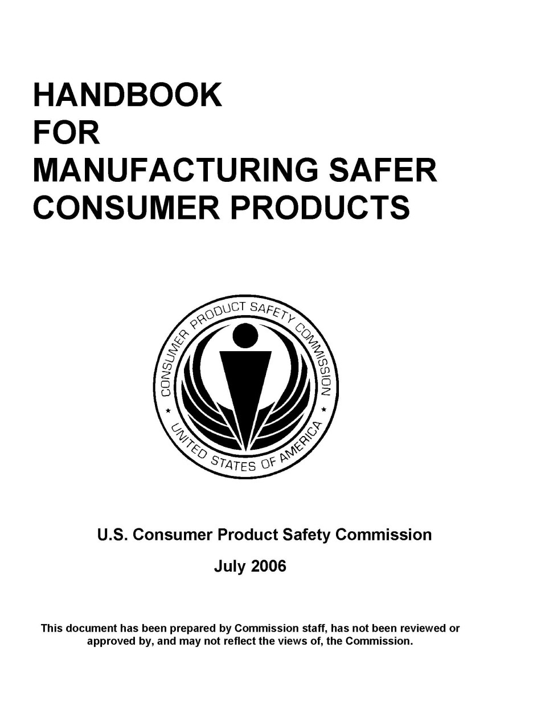
Best Manufacturing Practices

Slide 19
Resources in Spanish
You can find more information in Spanish at:
www.slideshare.net/USCPSC/profeco-proconsumer-week-requirements-for-furniture-cribs-and-toddler-beds-spanish
www.slideshare.net/USCPSC/profeco-proconsumer-week-requirements-for-childrens-products-and-certification-testing-for-non-childrens-products-spanish
www.slideshare.net/USCPSC/profeco-proconsumer-week-requirement-for
www.slideshare.net/USCPSC/profeco-proconsumer-week-electrical-safety-stratety-spanish
www.cpsc.gov/es/Business--Manufacturing/International/Spanish/

Slide 20

U.S. Consumer Product Safety Commission
Textile Flammability and
Regulatory Enforcement
This presentation was prepared by CPSC staff, has not been reviewed or approved by, and may not reflect the views of the Commission.

Slide 21

Today’s Topics
Consumer Product Safety Commission (CPSC)
Specific requirements that apply to clothing, textiles used for clothing, and sleepwear
  Regulations under the Flammable Fabrics Act (FFA)
  Drawstring requirements
  Consumer Product Safety Improvement Act of 2008 (CPSIA)
CPSC’s Office of Compliance and Field Operations
  Who, what, where: responsibilities, penalties, reporting

Slide 22
U.S. Consumer Product Safety Commission (CPSC)
CPSC is an independent federal (United States government) regulatory agency created to protect the American public from unreasonable risks of injury associated with consumer products.
Commissioners are appointed by the President for multiyear terms with confirmation by the Senate.

Slide 23
CPSC Jurisdiction
Jurisdiction over thousands of different consumer products under the Consumer Product Safety Act
Excludes some products covered by other federal agencies, such as:
  cars and related equipment (NHTSA);
  food, drugs, medical devices, cosmetics (FDA);
  firearms (BATF);
  airplanes (FAA);
  boats (Coast Guard); and
  pesticides (EPA).

Slide 24
CPSC Jurisdictional Authority
Jurisdictional Authority in 7 Acts
  Consumer Product Safety Act (CPSA)
  Federal Hazardous Substances Act (FHSA)
  Poison Prevention Packaging Act (PPPA)
  Refrigerator Safety Act (RSA)
  Virginia Graeme Baker Pool & Spa Safety Act (VGBA)
  Children’s Gasoline Burn Prevention Act (CGBPA)
  Flammable Fabrics Act (FFA)

Slide 25
Flammable Fabrics Act (FFA)
Regulated Products
  Clothing Textiles, 16 CFR Part 1610
  Vinyl Plastic Film, 16 CFR Part 1611
  Children’s Sleepwear, 16 CFR Parts 1615/1616
  Carpets and Rugs, 16 CFR Parts 1630/1631
  Mattresses and Mattress Pads, 16 CFR Part 1632
  Mattress Sets, 16 CFR Part 1633

Slide 26
16 CFR Part 1610-Standard for the Flammability of Clothing Textiles
16 CFR Part 1610 – commonly known as the General Wearing Apparel Standard
Effective January 1953
Keeps the most dangerously flammable textile products and garments out of the marketplace

Slide 27
16 CFR Part 1610-Test Summary
The Standard applies to all adult and children’s wearing apparel
  except children’s sleepwear, which must meet a more stringent standard
  does not apply to certain hats, gloves, footwear, interlining fabrics
The Standard specifies testing procedures and determines the relative flammability of textiles used in apparel using three classes of flammability.
Fabrics that meet a specific exemption do not require testing
First step: Determine fabric type and specifications
  Plain surface textile fabric or raised surface textile fabric
  Fabric weight
  Fiber content

Slide 28

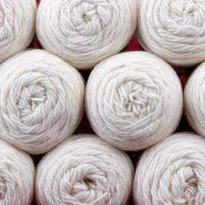
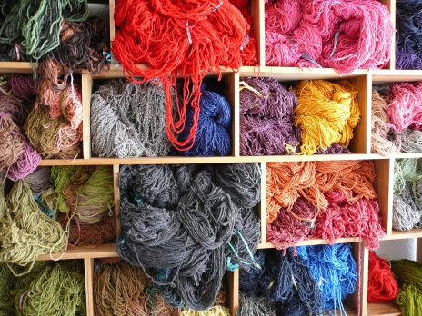
§1610.1(d)-Specific Exemptions
Fabrics that meet a specific exemption do not require testing
Plain surface fabrics ≥88.2 g/m² (2.6 oz/yd²), regardless of fiber content
Plain and raised surface fabrics made of:
acrylic,
modacrylic,
nylon,
olefin,
polyester,
wool,
or any combination of these fibers, regardless of weight.

Slide 29
16 CFR Part 1610-Test Summary
Preliminary burns are conducted to determine the fastest burning area and direction of fabric.
Fabrics are tested in their original state, 5 specimens
  Tested in direction of fastest burn time
  Raised surface fabrics are brushed to raise fibers
Class 1 and 2 fabrics are refurbished and tested again, another 5 specimens
  All samples are dry cleaned
  All samples are washed and tumble dried, 1 cycle
The burn time of several specimens is averaged and a Class (Class 1, 2, or 3) designation is made based on the average burn time (speed of burning) and surface characteristics of the sample.
Class 3 textiles are considered dangerously flammable and are not suitable for use in clothing due to their rapid and intense burning.

Slide 30
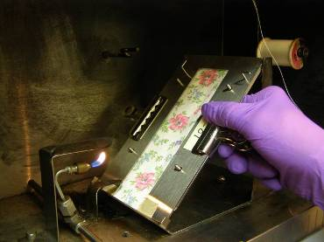
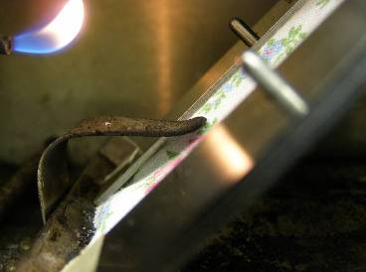
16 CFR Part 1610-Test Summary
50mm x 150mm (2 inches x 6 inches) specimen
Conditioning requirements
Specified test cabinet
A 16 mm (5/8 in) flame impinges on a specimen mounted at a 45 degree angle for 1 second.
The specimen is allowed to burn its full length or until the stop thread is broken (burn time is recorded).

Slide 31
16 CFR Part 1610: Classifications
Class 1 – plain and raised surface fabrics that have no unusual burning characteristics and are acceptable for use in clothing
Class 2 – raised surface fabrics only, intermediate flammability- use with caution
Class 3 – fabrics are dangerously flammable and CANNOT be used in wearing apparel

Slide 32
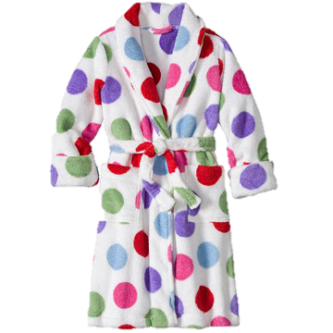
16 CFR Part 1610:
Occasional Noncomplying Fabrics
Sheer 100% rayon skirts and scarves
Sheer 100% silk scarves
100% rayon chenille sweaters
Rayon/nylon chenille and long-hair sweaters
Polyester/cotton and 100% cotton fleece garments
100% cotton terry cloth robes

Slide 33
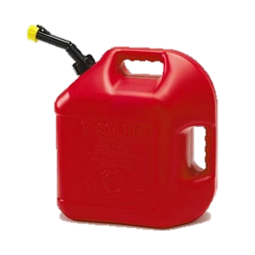
16 CFR Parts 1615 & 1616- Standards for the Flammability of Children’s Sleepwear
The children’s sleepwear standards, 16 CFR Parts 1615 and 1616, were developed in the early 1970s to address the ignition of children’s sleepwear, such as nightgowns, pajamas, and robes.
The standards are designed to protect children from small open-flame sources, such as matches/lighters, candles.
The standards are not intended to protect children wearing sleepwear from large flame sources.

Slide 34
Children’s Sleepwear Standards
16 CFR Parts 1615 & 1616
Children’s sleepwear means any product of wearing apparel intended to be worn primarily for sleeping or activities related to sleep in sizes larger than 9 months through size 14.
Nightgowns, pajamas, robes, or similar or related items, such as loungewear, are included.
Several factors determine if a garment is sleepwear:
  Suitability for sleeping, likelihood of garment to be used for sleeping
  Garment and fabric features
  Marketing, merchandising/display, intended use

Slide 35
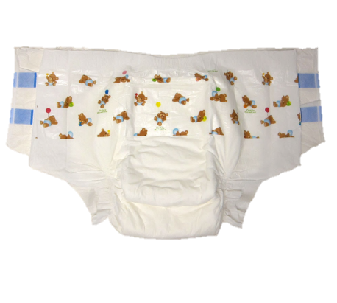
Children’s Sleepwear Standards
16 CFR Parts 1615 & 1616
Category Exceptions:
Diapers and Underwear (exempt)
Must comply with 16 CFR Part 1610
Infant garments (exempt)
Sizes 9 months or younger
One-piece garment does not exceed 64.8 cm (25.75”) in length
Two-piece garment has no piece exceeding 40 cm (15.75”) in length
Must comply with 16 CFR Part 1610

Slide 36
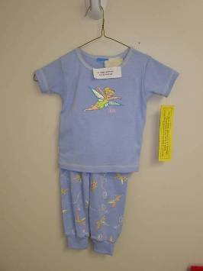
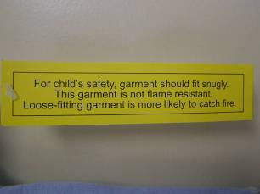
Children’s Sleepwear Standards
16 CFR Parts 1615 & 1616
Tight-Fitting Sleepwear (exempt)
Tight-fitting garments (defined by the Standards) are exempt from testing to the sleepwear requirements.
Must meet specific maximum dimensions.
Must comply with 16 CFR Part 1610.
Must meet labeling requirements.

Slide 37
Children’s Sleepwear Standards
16 CFR Parts 1615 & 1616
Children’s sleepwear (that is not tight-fitting) must pass the flammability requirements.
All fabrics and garments must be flame resistant and self-extinguish (not continue to burn) when removed from a small, open-flame ignition source.
The fabric, garments, seams, and trims must pass certain flammability tests.

Slide 38
Children’s Sleepwear Standards
16 CFR Parts 1615 & 1616-Summary
Standard requires tests of fabric, seams, and trim.
Each test sample consists of five specimens.
Each specimen is placed in a metal holder and suspended vertically in the test cabinet.
Tests conducted in original state and after 50 laundering cycles (if the sample passes the original state test).

Slide 39
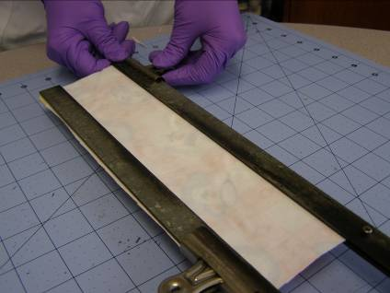
Children’s Sleepwear Standards
Five 8.9 cm x 25.4 cm (3.5 inches x10 inches) specimens of fabric, seams, and trim.
Specimens are conditioned before testing.
The gas flame of 3.8 cm (1.5 inches) is applied to the bottom edge of the specimen for 3 seconds.
Char (burn) length is measured after the flame/afterglow has ceased.
Specimen is placed in a metal holder

Slide 40
Children’s Sleepwear Standards
16 CFR Parts 1615 & 1616-Results
The average char length of five specimens cannot exceed 17.8 cm (7.0 inches).
No individual specimen can have a char length of 25.4cm (10.0 inches) (full-specimen burn).
Tested samples are required to be retained
Standards include production testing and recordkeeping requirements

Slide 41
Summary of
Part 1610 and Parts 1615/16
16 CFR Part 1610
16 CFR Parts 1615/16
  2 x 6 inch specimen
  45 degree angle
  16 mm flame
  1 second ignition
  Surface ignition
  Burn time is recorded
  3.5 x 10 inch specimen
  Vertical position
  38 mm flame
  3 second ignition
  Bottom edge ignition
  Char length is measured

Slide 42
CPSIA Requirements
Consumer Product Safety Improvement Act of 2008 (CPSIA)—imposes new requirements for consumer products, non-children’s and children’s.
Non-children’s: A General Certification of Conformity (GCC) is required for all products subject to a rule, ban, standard, or regulation under and enforced by the CPSC
  GCC shows conformance to applicable requirements (e.g., flammability)
  GCC is required for all products subject to 16 CFR Part 1610, including items that meet the Part 1610 specific exemptions and do not require testing
  manufacturer or importer must issue a certificate to indicate that the product complies and why a test has not been conducted.

Slide 43
CPSIA Requirements-Children’s
Children’s products: Many of the new requirements are specifically for children’s products.
Children’s products are products designed or intended primarily for children 12 years or younger.
Additional requirements for child care articles, items that are used for feeding/sleeping for children 3 years or younger.

Slide 44
CPSIA Requirements-Children’s
Third party testing: Certification based on testing performed by an accredited third-party laboratory recognized by the CPSC
Children’s Product Certificate (CPC) required
  CPC shows conformance to applicable requirements (e.g., flammability, lead, phthalates), based on third party testing
Lead content and surface coating limits must be met for certain components of textile products.
  For example, buttons, snaps, grommets, zippers, heat transfers, and screen prints
Tracking labels required
Child care articles (sleepwear for children 3 and under) subject to phthalate requirements

Slide 45
CPSIA Requirements-Lead
16 CFR Part 1303 protects consumers, especially children, from being poisoned by excessive lead in surface coatings on certain products. Includes surface coatings on toys or other articles intended for use by children, including clothing accessories.
The ban covers paint or any other similar surface coating that contains more than 0.009% (90 ppm) lead (lead containing paint).
Section 101 limits the amount of lead content to 100 ppm.

Slide 46
CPSIA Requirements-Lead
Lead content and surface coating limits must be met for certain components of textile products.
  For example, buttons, snaps, grommets, zippers, heat transfers, and screen prints
February 6, 2009, CPSC staff issued an enforcement policy on lead that is significant to the textile industry.
16 CFR Part 1500.91 lists determinations made by CPSC staff where certain materials will not exceed lead limits; includes dyed or undyed textiles and nonmetallic thread and trim used in children’s apparel and fabric products.

Slide 47
CPSIA Requirements-Tracking Labels
Require manufacturers of children’s products, to the extent practicable, to place distinguishing marks on a product and its packaging that would enable the purchaser to ascertain the source, date, and cohort (including the batch, run number, or other identifying characteristic) of production of the product by reference to those marks.
Labels must be permanently affixed to the product and its packaging to allow identification of the manufacturer, date, and place of manufacture, and cohort information (batch or run number).

Slide 48
Certification, GCC or CPC
Identification of the product
Citation to each applicable product safety rule
Name of manufacturer or U.S. importer
    Name, mailing address, telephone number
Contact information for the individual maintaining records
    Must be an individual
    Name, mailing address, telephone number, e-mail address
Date of manufacture (month and year) and place of manufacture (city and country, factory specific)
Date and place of testing
Identification of third-party laboratory, if any (CPC)
    Name, mailing address, telephone number

Slide 49
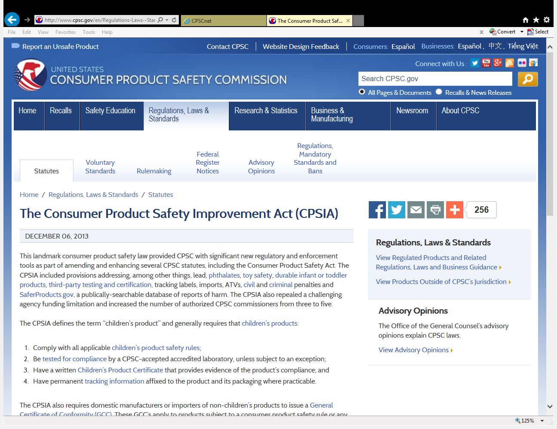

Slide 50
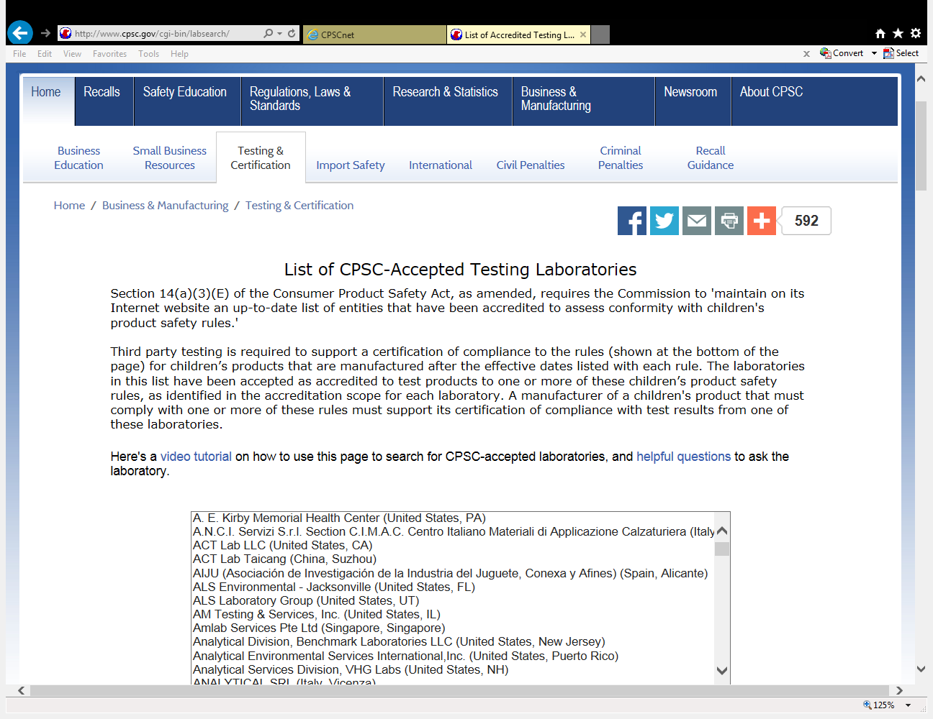
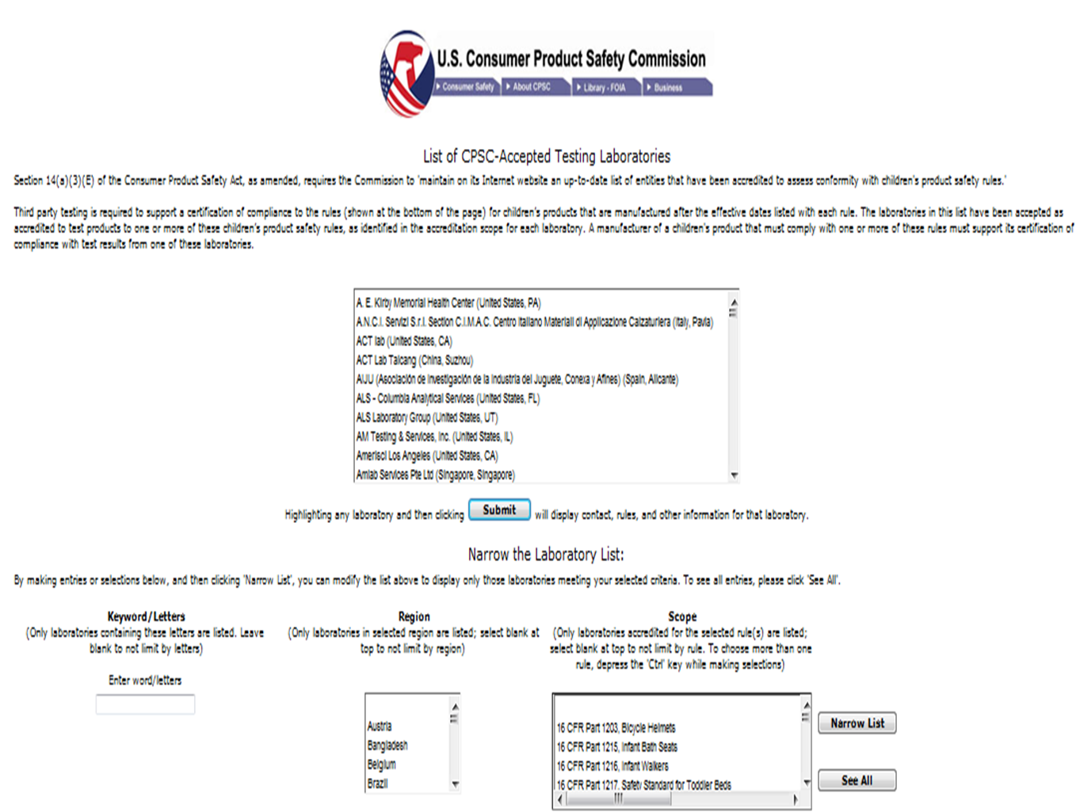
Searchable List of Laboratories
http://www.cpsc.gov/cgi-bin/labsearch/

Slide 51
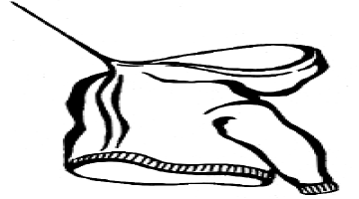
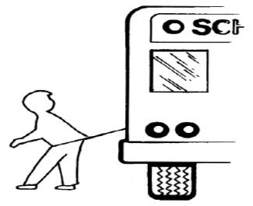
Drawstring Requirements
Children’s Clothing
In 1996, CPSC issued guidelines later adopted by ASTM in 1997 (ASTM F1816-97).
May 2006 letter to industry
Substantial product hazard
Applies to drawstrings on upper outerwear, jackets, and sweatshirts
  Sizes 2T-12 (or equivalent) with neck or hood drawstrings
  Sizes 2T-16 (or equivalent) with
  waist or bottom drawstrings
  that do not meet specified
  criteria
Dresses are not upper outerwear.
Belts are not drawstrings.

Slide 52
What’s Required-Clothing
Adult clothing:
  16 CFR Part 1610 (Flammability)
  GCC required, including for products that are exempt from testing

Slide 53
What’s Required-Children’s Clothing
Children’s Clothing:
  16 CFR Part 1610 (Flammability)
  CPC Required, Third Party Testing
  Lead Content
  Lead Surface Coating
  Tracking Labels
  Drawstring Requirements
  Phthalate Requirements (bibs)

Slide 54
What’s Required-Children’s Sleepwear
Children’s Sleepwear:
  16 CFR Parts 1615 and 1616 (Flammability)
  CPC Required, Third Party Testing
  Lead Content
  Lead Surface Coating
  Tracking Labels
  Phthalate Requirements (sleepwear for children under 3)

Slide 55
CPSC Office of Compliance
Two divisions
  Regulatory Enforcement and Defect Investigations
Regulated Products Enforcement Division
  Enforces CPSC’s regulations and standards
  Conducts investigations
  Initiates and negotiates corrective actions
  Provides advice and guidance to industry

Slide 56
Compliance Overview
Manage programs that investigate firms, collect and test samples, determine compliance status.
Review 15(b) reports
Compliant-
No Action
Stop-sale, remove product from market, re-condition/correct,
order destruction, correct, RECALL
Violations-
Corrective Action
Receive LOA from CPSC
Possible Penalties

Slide 57
Violations/Prohibited Acts
The Consumer Product Safety Act (CPSA), Flammable Fabrics Act (FFA), and the Federal Hazardous Substances Act (FHSA) make it unlawful to:
  manufacture for sale, sell, offer for sale, distribute or import any product that does not comply with a mandatory standard or ban under any act the Commission enforces;
  fail to report information as required by section 15(b) (CPSA);
  fail to certify; and
  fail to include tracking labels when appropriate.

Slide 58
Product Safety Concerns
Products that fail to comply with a mandatory safety standard or ban under the Acts;
Products that fail to comply with voluntary standards, and Commission staff has determined such failure to be a substantial product hazard, such as strangulation and entrapment hazards from drawstrings on children’s upper outerwear;
Products that contain a defect which could create a “substantial product hazard”; and
Products that create an “unreasonable risk” of serious injury or death.

Slide 59
Refusal of Admission
Under section 17(a), a consumer product must be refused admission to the U.S. if it:
  fails to comply with an applicable consumer product safety rule (CPSA standard or ban)
  is not accompanied by a required certificate or tracking label or is accompanied by a false certificate
  is or has been determined to be imminently hazardous in a section 12 proceeding
  has a defect that constitutes a substantial product hazard
  was imported by a person not in compliance with inspection and recordkeeping requirements.

Slide 60
Corrective Actions
Section 15(b) of the Consumer Product Safety Act requires manufacturers, distributors, and retailers to report to CPSC “immediately” if they obtain information that a product contains a defect than could create a substantial product hazard or creates an unreasonable risk of serious injury.
The Commission may order a manufacturer, distributor or retailer to:
  Recall, notify the public of the problem, and/or to take corrective action, and/or
  Repair, replace the product at no charge, or refund the purchase price.

Slide 61
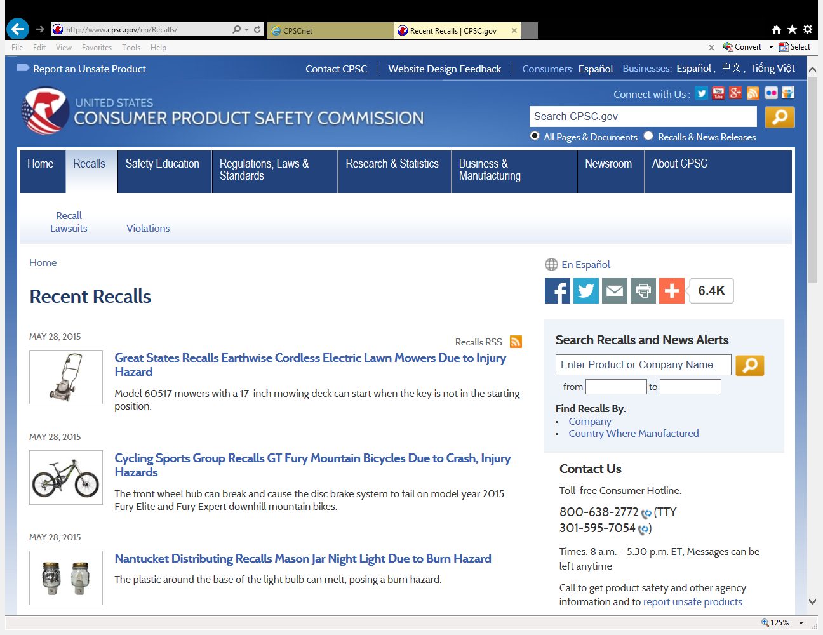
Recall Info on CPSC Homepage
Go to www.cpsc.gov
Click on the Recalls Tab at the top of the page.
Here is where you will find recent recalls and also info on how to sign up to get recalls sent directly to you.

Slide 62
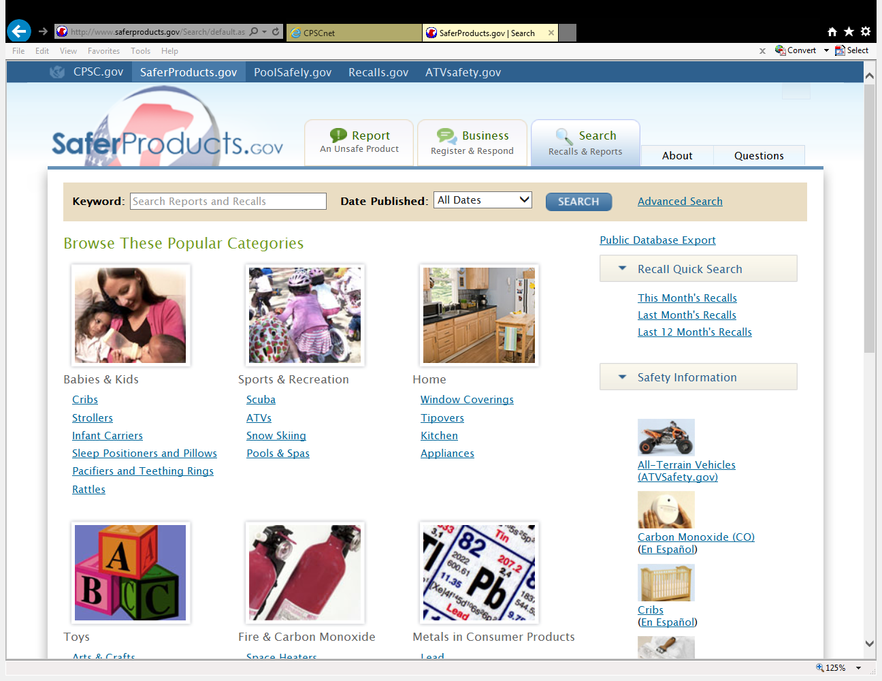

Slide 63
Penalties
Any person who knowingly commits a violation is subject to a civil penalty of $100,000 for each violation (CPSIA).
The maximum civil penalty for a related series of violations is capped at $15,150,000 (January 2012).
Criminal penalties (including imprisonment) are also possible for willful violations.

Slide 64
Penalty History
Non Compliant Company Fines
Forman Mills $600.00 for Failing to Report Drawstrings
Williams-Sonoma $700,000 for Failing to Report Defective Blinds/Shades
Reebok $1 Million for Lead Bracelets
General Electric $3.5 Million for Failing to Report Defective Ranges and Dishwashers
Importer/Exporter Sentenced to Federal Prison for Importing Banned Products
Graco Children’s Products Inc. $4 Million for Toddler Beds
STK $270,000 for Importing Dangerous Toys
Batta $400,000 for Failing to Report Magnet Toys
The Limited Inc. $500,000 for Selling Flammable Children’s Sleepwear
Office Deport $3.4 Million for Failing to Report Defective Office Chairs
Cinmar $1.3 Million for Failing to Report Defective Step Ladders
http://www.cpsc.gov/ABOUT/Cpsia/sect217.html

Slide 65

Safer Products
http://www.saferproducts.gov/

Slide 66
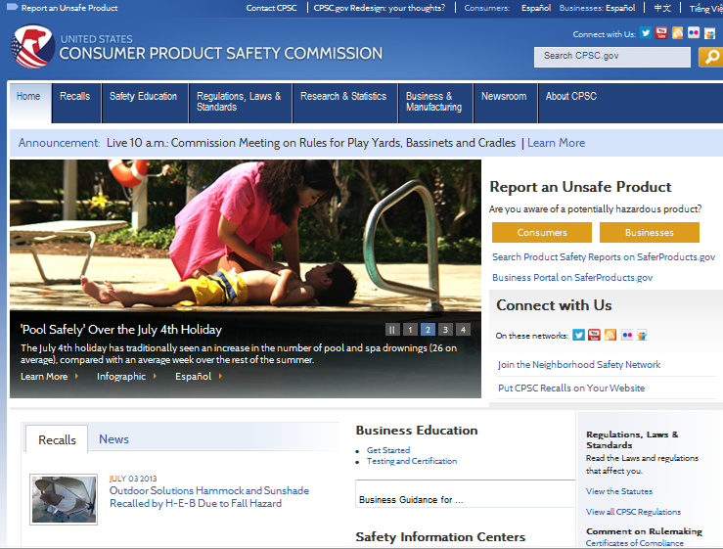
Ways to Stay Updated:
CPSC Main Website
www.cpsc.gov

Slide 67

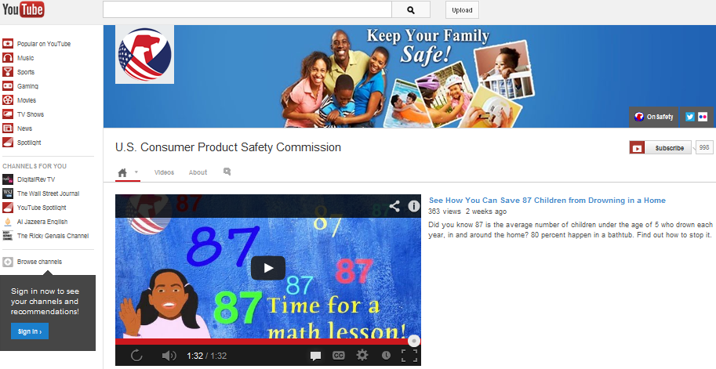
Ways to Stay Updated:
YouTube Channel
www.youtube.com/uscpsc

Slide 68
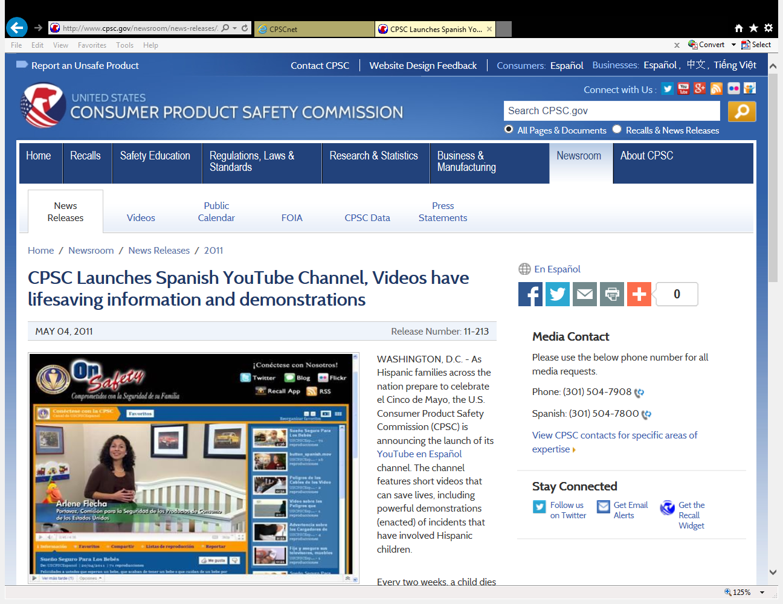

Slide 69

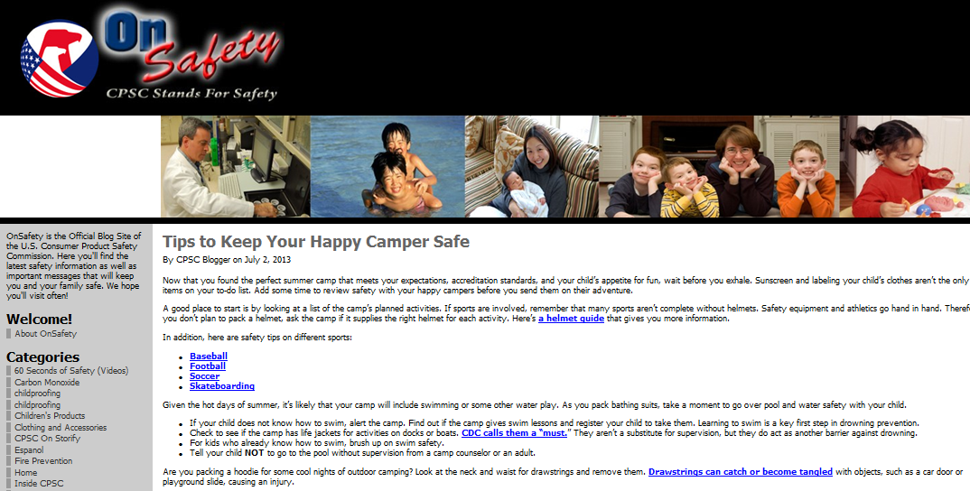
Ways to Stay Updated:
CPSC On Safety Blog
www.cpsc.gov/onsafety/

Slide 70

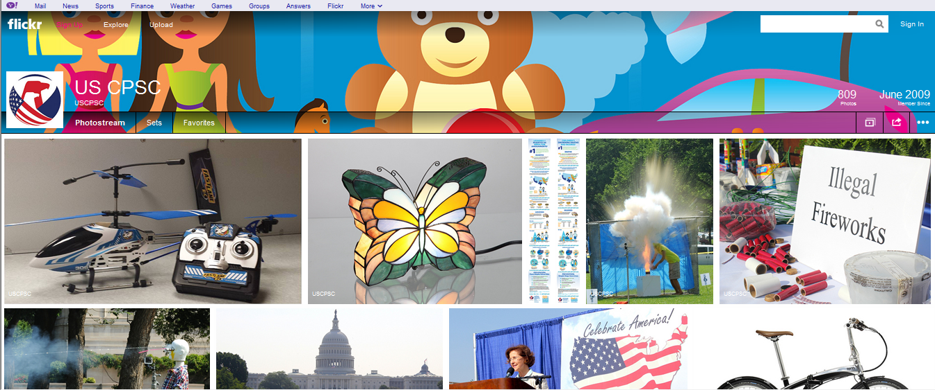
Ways to Stay Updated:
CPSC Flickr
www.flickr.com/photos/uscpsc

Slide 71

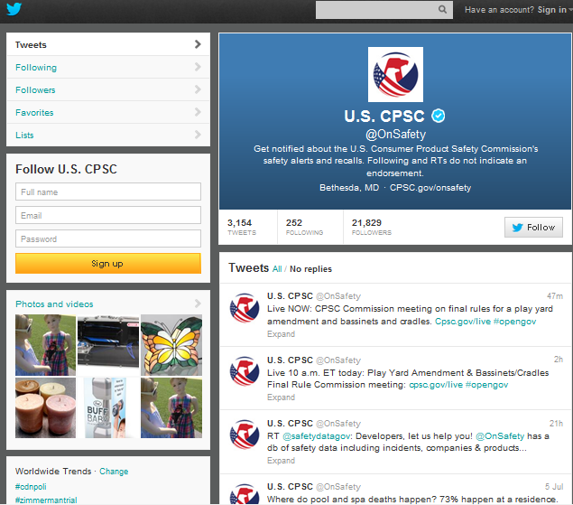
Ways to Stay Updated:
CPSC Twitter
https://twitter.com/OnSafety

Slide 72
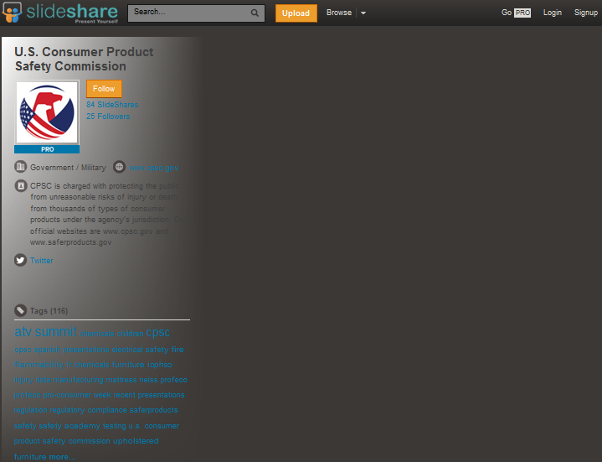

Ways to Stay Updated:
CPSC SlideShare
http://www.slideshare.net/USCPSC

Slide 73

For Further Information:
Frank Nava
Deputy Director
Office of Compliance and Field Operations
916-285-0564
fnava@cpsc.gov
U.S. Consumer Product Safety Commission
4330 East-West Highway
Bethesda, MD USA 20814-4408
www.cpsc.gov

