Slide 1
Growing the Global Market for Ethanol Lucas Szabo Manager of Global Ethanol Market Development U.S. Grains Council LSzabo@grains.org

Slide 2
Table of Contents
About the U.S. Grains Council
Global Expansion of Ethanol Policy
Key Factors Driving Policy Expansion
Environmental
Human Health
Economic
Policy with a role for trade
Conclusion

Slide 3
About the U.S. Grains Council
The U.S. Grains Council develops export markets for U.S. coarse grains and value added products such as ethanol and distillers dried grains.
Fundamental shift towards ethanol global market development. USGC works closely with industry partners, membership and the USDA Foreign Agricultural Service.
Full-time presence in 13 key markets and representatives in an additional 15 locations, the Council operates programs in more than 50 countries and the European Union.
The Council believes that access to stable global markets is vital for economic prosperity

Slide 4
Global Ethanol Production Has Surpassed 110 Billion Liters A Year … And Could Expand Significantly In The Next Decade Renewable fuels policy drives expanded use of ethanol, particularly in Brazil and China
Source: U.S. Energy Information Administration & USDA/FAS Office of Global Analysis Projections

Slide 5
More Than 60 Countries Have Ethanol Policies In Place Since 2017, 10 have announced new policies or with significant expansions to their policies
Expanding global use
Bolivia – E25 by 2025
Brazil – RenovaBio, 4-5 billion gallons new demand by 2030
China – E10 by 2020 or 4.6 billion gallons total demand
Canada – Federal: Clean Fuel Standard (CFS); Also, Ontario: E10 by 2020; Other provinces may boost blending, too.
Ireland – E10, 2019
EU – maintains role of 1st gen feedstocks, not reduce further
India – new feedstocks
Japan – new suppliers
Mexico – E10
Vietnam – E5 to E10, 2020
Notes:
Bolivia E10 January 2019 and E25 by 2025. Where are they at with E10… significant investment 1.5 Bil total. Adding 18000 hectares of sugarcane
Ontario –
Canada writing the Canada Fuel Standard. GHG reductions 30% by 2030
Ireland E10 taking effect Jan 1 2019. up from the current 8% mandate. This is a year ahead of the RED mandating 10% renewable enregy in transport
EU maintains the cap on first generation crop based biofuels at 7% despite a proposal to phase down to 3.8% by 2030.
India biofuels policy has been hindered by lack of feedstock the 2018 National Policy on Biofuels expanded the allowable feedstocks to include sugarcane juice, sugar beets and corn starch as well as damaged food grains. During times of food surplus farmers will also be allowed to use excess produce for ethanol production.
Japan – traditionally only sourced ETBE made from Brazilian sugar cane ethanol, to meet their 50% GHG reduction score extended that GHG reduction to 55% but recognized the ability of US ethanol to meet that reevaluated LCA and now allow for US corn based ethanol for up to 44% of market share. Contracts were set through 2019, we are expecting to see shipments of ETBE made from US corn ethanol begin around April of 2019. US score is 48% reduction Brazil 60% reduction when you work out the math to get to 55% we can make up 44% of the market which is about 96 Mil gallons of ethanol equivalent.
Mexico – E5.8 to E10 nationwide excluding the three largest metropolitan area of MXC Guadalajara and Monterrey largely due to concerns over evaporative emissions and ground level ozone. Department of Energy and the CRE commission the IMP to conduct a study evaluating E10 under these conditions. The results look to be favorable. Most differences in E10 vs regular gasoline were described as non significant, but will let Ryan speak further about this later on.
Vietnam – after a failed attempt a decade ago, Vietnam recommitted and introduced an E5 policy is 2018 and has a plan to move to E10 by 2020. 2020 demand at E10 could be 225 million gallon market gasoline pool is expected to grow 15 % by 2022. It is the fastest growing economy in Southeast Asia.

Slide 6
Policy And Economic Drivers Going Forward These 3+ drivers will impact the ultimate size/growth of the global ethanol market
ENVIRONMENTAL BENEFITS – Ethanol blending lowers the carbon footprint of finished fuel compared to pure fossil fuel. (savings credited against Paris Agreement).
HUMAN HEALTH BENEFITS – Ethanol blending improves air quality, reduces respiratory and cardiac illness and mortality rates, lowering healthcare costs.
ECONOMIC BENEFITS – Improves fuel economics – blending can reduce finished fuel costs depending on relative fuel prices and petroleum refinery optimization.
NOTE: These benefits all increase as the blend rate increases. If you like E10, you will love E15 or E20. Brazil, Paraguay, U.S., Thailand and others have proven that mid-level blends are safe for unmodified engines

Slide 7
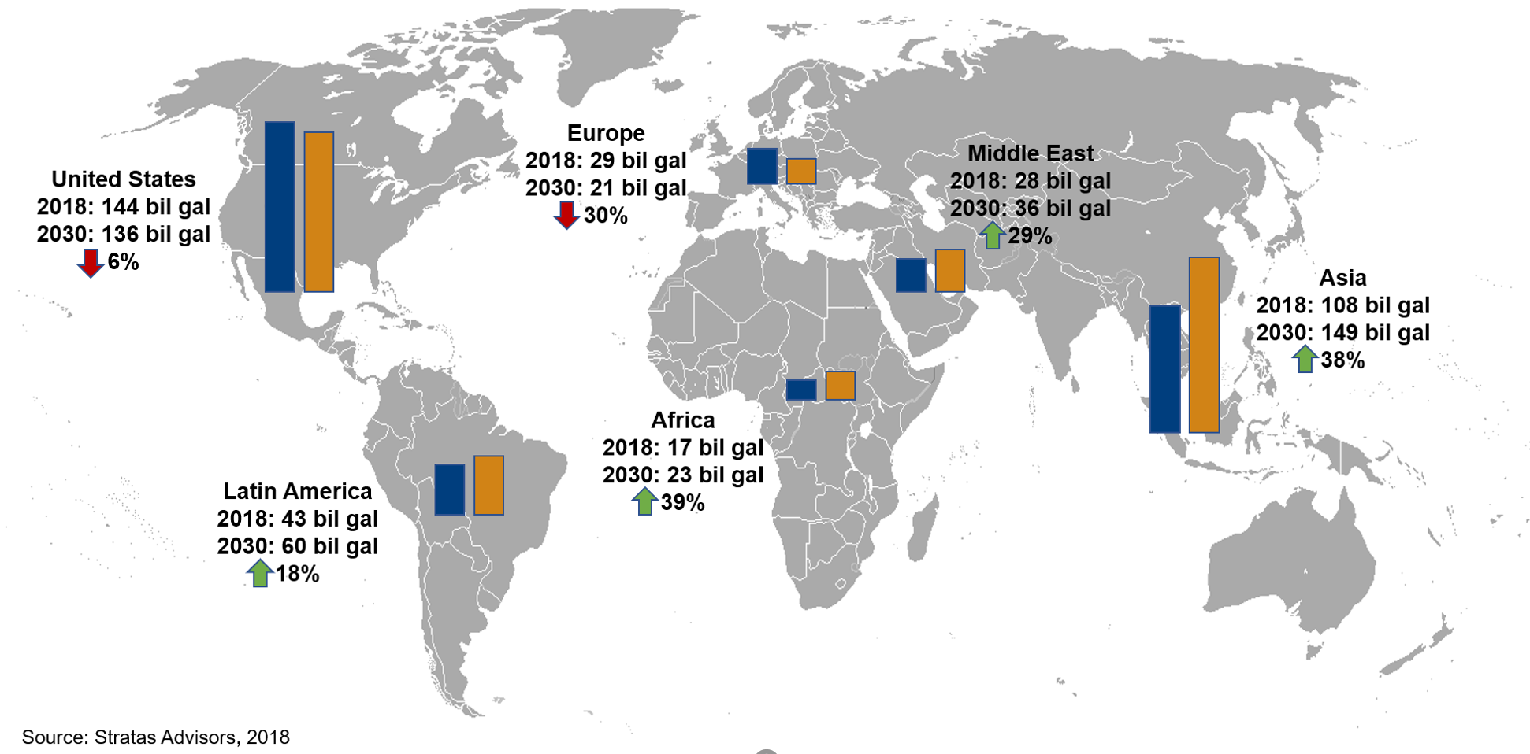
Environmental: Ethanol is a low carbon alternative to pure fossil fuel (Paris Agreement)
Increased Gasoline Demand Signals Opportunity For Ethanol Blending
Notes:
In addition to meeting global food demand, this chart reveals that developing countries will offer strong potential for increased gasoline demand, and thus ethanol demand by 2030.
Not surprisingly, the United States and Europe, as mature markets, will see declining demand while Latin America, Africa, the Middle East and the largest growth segment in Asia will see sharp increases in gasoline demand driven by faster growing populations with growth in a middle class that will include a car or motorcycle in their household.
Obviously, our ethanol export promotion program efforts are being targeted in each of these regions.

Slide 8
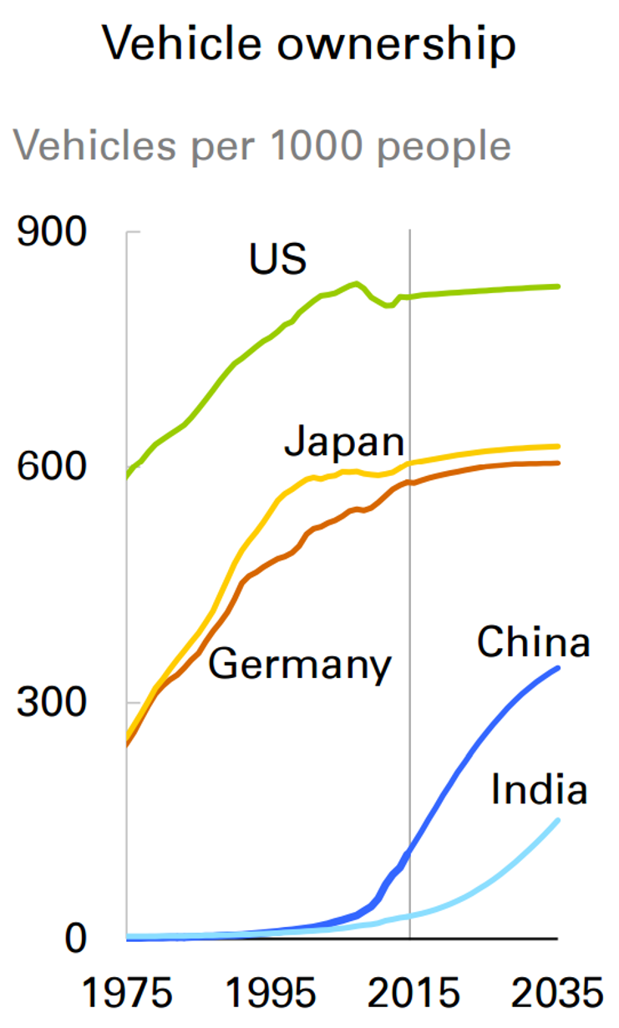
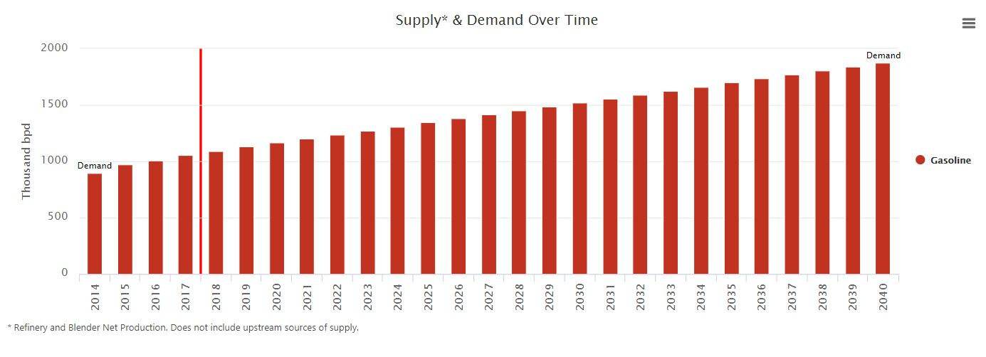
Middle class expansion, vehicle ownership set to surge boosting fuel demand & GHG emissions, creating opportunities for expansion of ethanol use
African Gasoline Demand Projected 2040

Slide 9
Bioethanol: A Low Carbon Alternative To Fossil Fuels Bioethanol blending at E10 or higher lowers the carbon intensity of transportation fuel (can be applied towards Paris Agreement commitments)
Carbon intensity of gasoline estimated by EPA, CARB, and EU at 94-100 grams CO2/mJ of energy. Bioethanol from US and Brazil available at 30-43 grams/CO2/mJ
New 2017 study by USDA found U.S. corn-based ethanol continues to reduce its carbon footprint relative to gasoline. Reductions of 39-43% today and upwards of 70% possible by 2022.
Shows importance of using recent, accurate data for feedstock production and energy usage in biorefinery operations.
Sugar cane ethanol can have a lower carbon intensity than US corn ethanol but that depends on many factors. U.S. corn ethanol is narrowing the gap, quickly
Investment in new technology can and has narrowed the gap between sugarcane and corn.
Gap will continue to narrow as plants reduce energy use and costs, new feedstock and plant technologies boost yields, and U.S. export customers continue to seek low carbon intensity energy solutions.

Slide 10
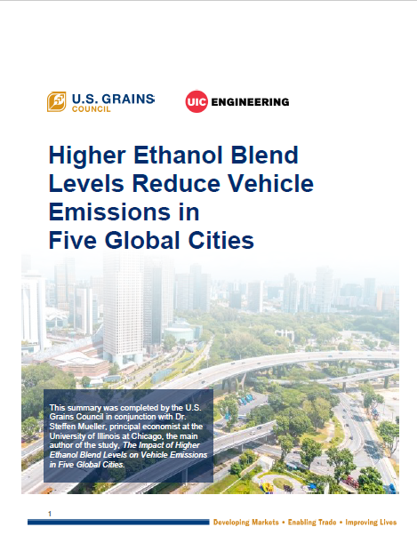
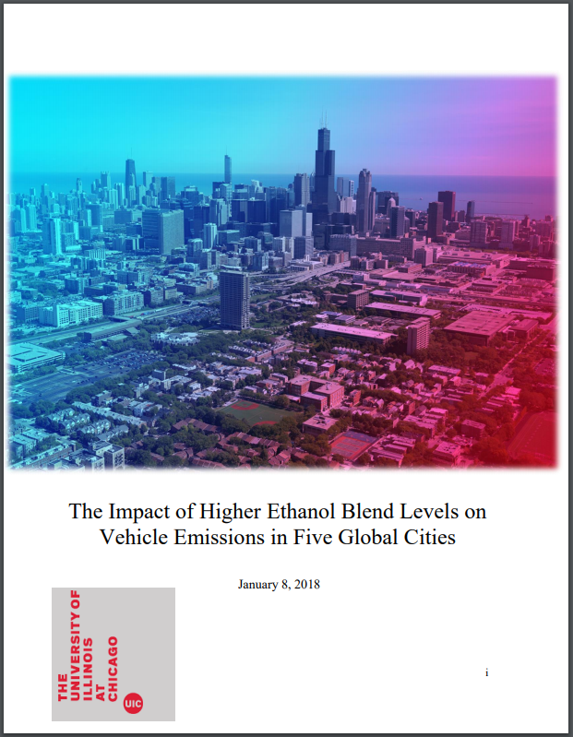
Bioethanol Improves Air Quality and Reduces Respiratory Illness
Five Cities Study analysis conducted by Dr. Steffen Mueller, University of Illinois at Chicago
Examines effects if blending E10 and E20 in 5 major global metropolitan cities (Beijing, Tokyo, Seoul, Delhi, Mexico City)
Key Takeaways:
Adoption of E10 and E20 delivers SIGNIFICANT air quality and human health benefits
Blending E10 can reduce weighted air toxins (weighted by their cancer potency) by an average of 15%.
Blending E20 can lead to even greater health benefits by reducing weighted toxins by and average of 32%,
Reduction in CO emissions associated with heart disease of up to 20% at an E20 blend.
Lower emissions from blending ethanol would provide a reduction on hundreds of cancer cases in each of the five cities, resulting in millions of dollars in life years saved.

Slide 11
Improved Fuel Economics: The Value Proposition of Bioethanol US corn-based ethanol is cheapest octane over the last decade … and beyond!

Slide 12
Improved Fuel Economics: The Value Proposition of Bioethanol US corn-based ethanol is cheapest octane over the last decade … and beyond!
Octane Rating Comparison of Gasoline Additives
114
110
107
104
101
95
93
Regular grade gasoline (87 AKI)
84
Sources: RFA; DOE; Chevron; MathPro, Inc.

Slide 13
Improved Fuel Economics: Value Proposition Of Bioethanol U.S. corn ethanol has been the “cheapest octane on Earth” over the last decade
Ethanol on average over the last 7 years: 18 cents/liter cheaper than MTBE

Slide 14
Benefits of Enforced Biofuels Policies That Embrace A Role For Trade
Set blend rate and commit to fulfilling year after year, even if it means importing in the early years. Signals stable demand for capital investment which incentivizes a local industry to build out. Too many policies go unenforced and are unsuccessful as a result.
Allowing a role for imports demonstrates commitment to policy and blend goals to investors. If imports are allowed, blend goals can be met every year.
Petroleum and fossil fuel import tariffs (gasoline and octane enhancers) are considerably lower than ethanol in most countries. This distorts energy markets and slows adoption of biofuels.
Bioethanol feedstocks come from agricultural production (sugarcane juice, molasses, corn, cassava) which are subject to weather variability more than fossil fuels. Imports backstop local ethanol production that suffer from feedstock production shortfalls.

Slide 15
Ethanol imports critical to get Philippines E10 policy underway Reliance on imports declined as domestic infrastructure was built out
Source: USDA/FAS Global Agricultural Information Network – 2018 Philippines Biofuels Annual

Slide 16
U.S. & Brazil Ethanol Exports to the World U.S. has overtaken Brazil and is now the world’s largest exporter
Note: Covers all US non-beverage ethanol (fuel + other industrial ethanol), and all Brazilian ethanol (HS 2207, undenatured + denatured)
Sources: US Data: US Bureau of Census; Brazil Data: SECEX (official government data) sourced thru Global Trade Atlas (IHS Markit)

Slide 17
Question: As global ethanol demand rises, how reliable is the U.S. as an exporter of ethanol? Answer: Extremely reliable. U.S. has massive supplies of feedstock (corn) at world prices, well-developed transportation infrastructure (and storage), export-focused ethanol industry, and producers that are willing to build additional capacity (new plants or increase capacity of existing plants). This means US producers can respond to growing domestic demand from E15 AND growing demand from developing countries … simultaneously.

Slide 18
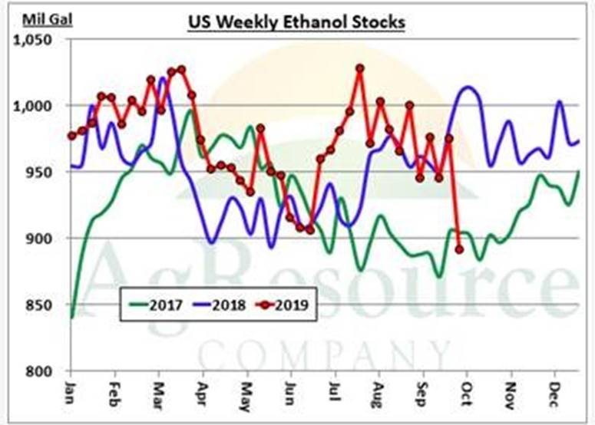
U.S. Ethanol Stocks Averaging Almost 1 Billion Gallons (3.7 Billion liters)
U.S. ethanol stocks act as a market “stabilizer” to support most other countries ethanol production deficits
- even China and India
Latest data shows a large drawdown last week, supporting market prices.
Source: AgResource

Slide 19
Worldwide Trade In Ethanol In 2018 Rises To 2.6 Billion Gallons U.S. is top exporter as share of world exports expands to 61% -- up from 9% in a decade.

Slide 20
Worldwide Engagement: Recent and Upcoming Activities
Ethanol Summits – hosted by the U.S. ethanol industry. Part of the strategy to build alliances throughout the world. Western Hemisphere 2017, Asia Pacific 2018, Global 2019.
Trade Missions and Reverse missions to the U.S. USDA Agricultural Trade Missions, LTA Refiners Mission to the US, etc.
Technical Trainings and Regional Workshops – Handling, storage, transportability, vehicle compatibility, etc.
Bilateral Working Groups – Building partnerships meet once or twice a year to discuss technical or policy related issues.
Multilateral Engagements – APEC, COP, GBEP, etc.
Roadmaps – Tailored country specific plans for successfully implementing policy and blending.

Slide 21
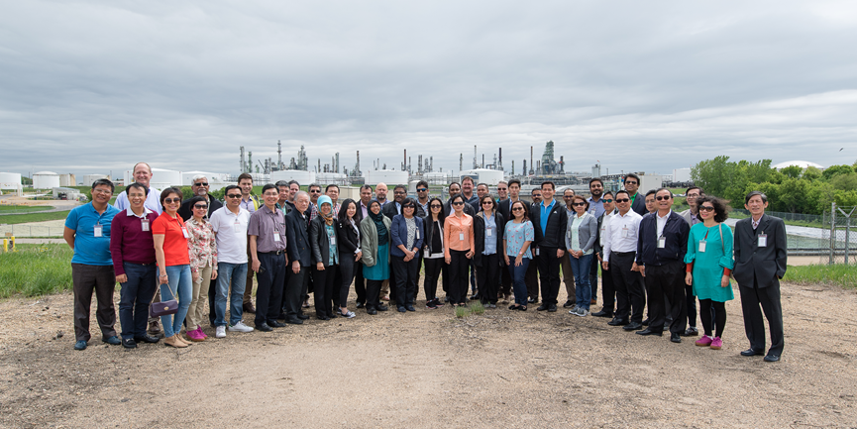

Slide 22
Conclusion:
Incredible opportunity for growth of global ethanol consumption and production as countries seek to identify permanent solutions for climate change, cleaner air, improved health, and cheaper fuel.
Increased need for higher blend rates globally– E10 is just the beginning. Mid-level blends are attractive and safe for engines and the economics are compelling.
Need for greater collaboration to build a global bioethanol market by highlighting the environmental, human health, and economic benefits of fuel blending with ethanol.

