Slide 1
Ethanol Classifications: Global Perspectives
Dan Seals, Garner Advisors
Session 7: Standards Alliance Workshop
Maputo, Mozambique
November 14, 2019

Slide 2
AGENDA
Ethanol as a Commodity
Ethanol Uses
Ethanol Classifications
Global Tax Snapshot
Case Studies
Haiti
Kenya
Benefits of Standards
Actions for Mozambique

Slide 3
Defining Ethanol
At the most basic molecular level, ethanol is made of:
Carbon
Hydrogen
Oxygen

Slide 4
ETHANOL AS A COMMODITY
Globally more than 110 billion liters of ethanol are produced every year
In 2018, more than 10.5 billion liters were traded worldwide
Global Ethanol Summit. U.S. Grains Council. October 2019

Slide 5
Common Ethanol Uses & Classifications
TRANSPORTATION
BEVERAGE
PHARMACEUTICAL
INDUSTRIAL

Slide 6
Common Ethanol Classifications 1/3
1. Industrial ethanol exports
Ethyl Alcohol Undenatured: alcoholic strength volume 80% or higher
2207106090
2207200090

Slide 7
Common Ethanol Classifications 2/3
2. FUEL ethanol exports
There are two codes for fuel ethanol:
Ethyl alcohol, undenatured, of an alcoholic strength by volume of 80% or higher, for fuel use.
2207106010
Ethyl alcohol and other spirits, denatured, of any strength, for fuel use.
2207200010
*Over 60 countries have fuel blending policies in place
* The majority of denaturant used is a 2% blend of gasoline

Slide 8
Common Ethanol Classifications 3/3
3. BEVERAGE GRADE EXPORT
Ethyl Alcohol Undenatured 80% or higher, For Beverage
2207200010

Slide 9
COOKING FUEL?

Slide 10
REGULATORY CHALLENGES
No clear way to classify ethanol as a cooking fuel
No clear way to tax ethanol as a cooking fuel

Slide 11
GLOBAL SNAPSHOT
A survey of 21 Sub-Saharan countries with available data showed that the majority of countries tax ethanol cooking fuel at 33%
Such taxes can make up around 25% or ¼ of the fuel price

Slide 12
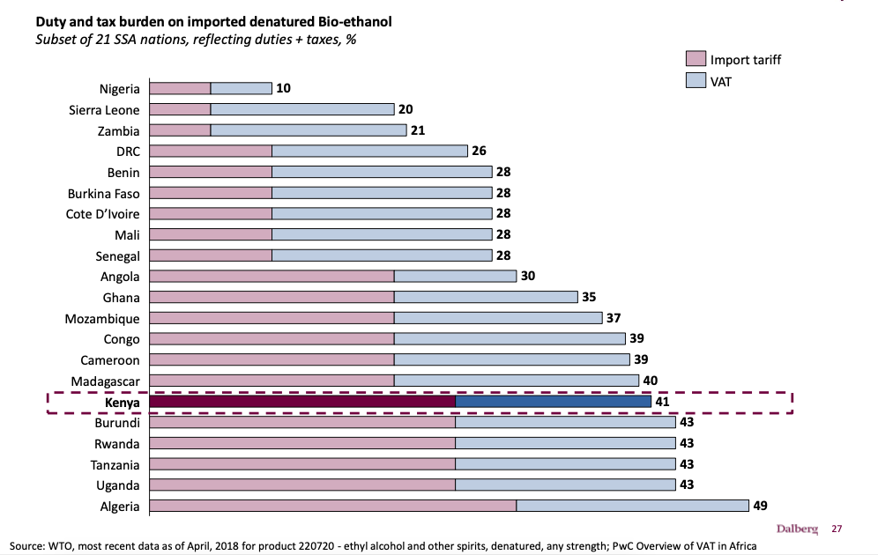
Duty & Tax Burden on Imported Denatured Bio-Ethanol
Scaling up Clean Cooking in Urban Kenya with LPG & Bio-Ethanol. Dalberg Advisors. June 2018

Slide 13
HAITI

Slide 14
BACKGROUND
HAITI
5 isotanks have been shipped from US to Haiti for cooking
Over 5,000 stoves sold
Currently, demonstrating the positive impacts for a strong ethanol policy

Slide 15
CUSTOMS PROCESS
HAITI
Isotanker arrives at port
90-118 days transit time
Sample is taken
Delegates from Ministry of Trade, Haitian Bureau of Standards, etc.
Sample is processed
Delay of weeks or months (Industrial or pharmaceutical grade ethanol determined)
Taxes and duties are accessed
Not based on the fuel’s application

Slide 16
HAITI
COST BREAKDOWN
10%
Sales Tax (VAT)
+
21+%
Customs Duties
=
31+% Total Taxes + Duties
All other fuels have tax regulations:
LPG: not taxed
Kerosene: not taxed
Charcoal: not taxed but arguably 50 – 80% of cost is transportation (fuel) and gasoline is not taxed and additionally subsidized

Slide 17
KENYA

Slide 18
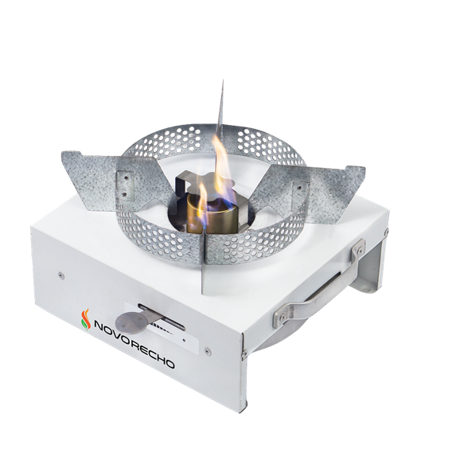
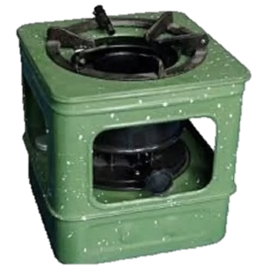
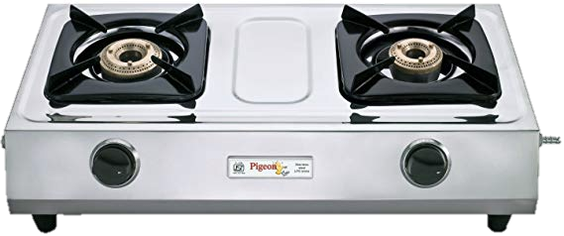
FUEL TAX STRUCTURE
KENYA
ETHANOL
25% import tariffs
+
16% VAT
= 41% tax
LPG
No import duty
+
No VAT
= 0% tax
KEROSENE
9% excise duty
+
No VAT
= 9% tax

Slide 19
MOZAMBIQUE

Slide 20
HOW E3050 BENEFITS CONSUMERS & COUNTRY
Avoids fuel interruption & delays as customs process is streamlined
Potential cost savings
If duties reassessed, ethanol would be even more affordable for consumers and create more value to retailers
Denaturant is known
Ethanol as a cooking fuel cannot enter beverage market
No fear of ingestion
Provides a basis for policymakers to access tax structure vs. other fuels

Slide 21
ACTIONS FOR MOZAMBIQUE
Consider how ASTM E3050 could be adopted/adapted as a national standard to benefit Mozambique by setting a standard based on performance and safety
Reassess import duties for ethanol’s use as a cooking and appliance fuel, considering the multiple benefits
Analyze and suggest fair VAT treatment of cooking fuel, particularly as compared to other fuels
Previous programs (Ndzilo) reported a 16 – 17% VAT

Slide 22
THANK YOU dan@garneradvisors.com

