Slide 1
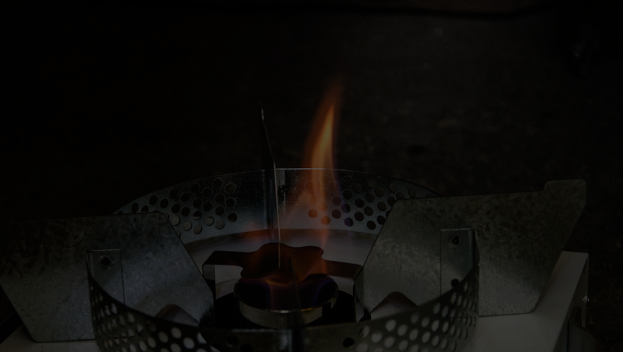
Experience Standardizing Ethanol as a Cooking & Appliance Fuel
Standards Alliance Workshop
Brady Seals, Garner Advisors
Maputo, Mozambique
November 14, 2019
Notes:
Photo credit: Georges Harry Rouzier

Slide 2
AGENDA
Why Ethanol?
Why Standards?
The International Standardization Process
Our Process Developing Standard E3050
Standard Details
Prior Capacity Building Activities
Next Steps – Mozambique & Beyond
Notes:
Pick up where Alicia left off

Slide 3
WHY ETHANOL?
Nearly half the world’s population still cooks with polluting fuels, causing numerous health, environmental, and economic problems.

Slide 4
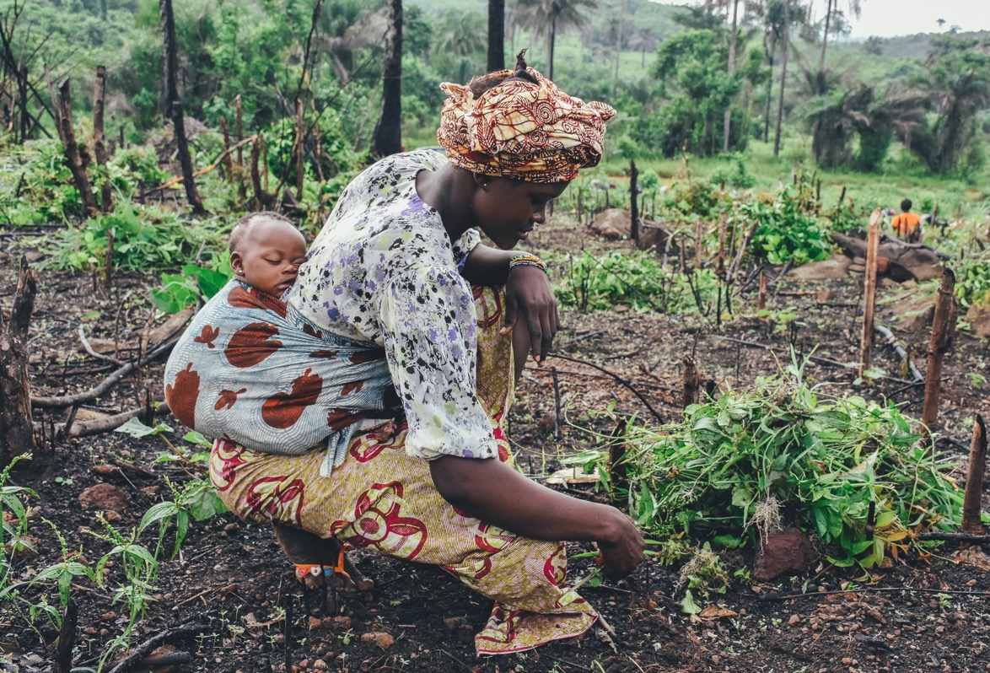
HEALTH & GENDER
Air pollution reduces our life expectancy by
20 months
60%
of all premature deaths from household air pollution
are women and children
Notes:
https://www.stateofglobalair.org/life-expectancy
https://www.who.int/life-course/news/household-air-pollution/en/
Photo by Annie Spratt on Unsplash

Slide 5
Choosing renewable fuel over nonrenewables
CLIMATE & ENVIRONMENT
Notes:
Photo by John Westrock on Unsplash
Image by <a href="https://pixabay.com/users/wasi1370-8259843/?utm_source=link-attribution&amp;utm_medium=referral&amp;utm_campaign=image&amp;utm_content=3272673">wasi1370</a> from <a href="https://pixabay.com/?utm_source=link-attribution&amp;utm_medium=referral&amp;utm_campaign=image&amp;utm_content=3272673">Pixabay</a>

Slide 6
LOCAL ECONOMY
An ethanol economy provides opportunities for local production of fuel and creates jobs
Notes:
Photo by Wynand Uys on Unsplash

Slide 7
WHY LEAD WITH STANDARDS?
Create a standard based on performance parameters which will:
Protect the consumer from purchasing sub-par quality fuel
Prevent ethanol as a cooking fuel from being consumed
Identify ethanol as a cooking fuel from other types of ethanol
Provide a benchmark for the classification of a new product
Notes:
Pick up where Alicia left off

Slide 8
HOW DO YOU START THE PROCESS?
One of the largest voluntary standards developing organizations in the world
National standards based on ASTM in 75 nations
Over 12,700 ASTM standards operate globally
Representation from more than 150 countries
Standards are market-driven
Standards used voluntarily
Over 34,000 members

Slide 9
WHO VOTES ON STANDARDS?
Equal Voice, Equal Vote
User
&
General Interest
Producer
ASTM
Openness
Consensus based
Balance between Producers and Users/General Interest
One official vote per “voting Interest”
All members can vote
All negatives are addressed
Technical Committees are balanced.
Notes:
Further distinguishing the ASTM standards development process is its fair and balanced voting process. Simply stated, at ASTM International, all members have an equal vote and equal voice in the development of technical standards. Fairness is further ensured through balanced participation among producers, users and general interest members of an ASTM standards writing committee.
Openness, transparency and a balanced, consensus process are the hallmarks of the ASTM system and have contributed to the quality, integrity and worldwide acceptance of ASTM standards for over 110 years.

Slide 10
WORKING IN PARTNERSHIP
ASIA | EUROPE | CENTRAL & SOUTH AMERICA | CARIBBEAN | MIDDLE EAST & NORTH AFRICA | EASTERN, WESTERN & CENTRAL AFRICA | SOUTHERN AFRICA
BANGLADESH | ALBANIA | BOLIVIA | ANTIGUA AND BARBUDA | AFGHANISTAN | ARSO | ANGOLA
BHUTAN | ARMENIA | CHILE | BAHAMAS | BAHRAIN | BURUNDI | BOTSWANA
BRUNEI DARUSSALAM | AZERBAIJAN | COLOMBIA | BARBADOS | EGYPT | CAMEROON | MALAWI
CAMBODIA | BOSNIA | COSTA RICA | BELIZE | GSO | COTE d'IVOIRE | MAURITIUS
CHINA | BULGARIA | ECUADOR | CROSQ | IRAQ | DEM.REP. CONGO | NAMIBIA
INDONESIA | CROATIA | EL SALVADOR | DOMINICA | ISRAEL | ETHIOPIA | SEYCHELLES
KOREA | EASC | GUATEMALA | DOMINICAN REPUBLIC | JORDAN | GAMBIA | SADC
LAO | GEORGIA | HONDURAS | GRENADA | KUWAIT | GHANA | SOUTH AFRICA
MALAYSIA | KAZAKHSTAN | NICARAGUA | GUYANA | MOROCCO | KENYA | SWAZILAND
MONGOLIA | KOSOVO | PANAMA | HAITI | OMAN | MOZAMBIQUE | ZAMBIA
MYANMAR | MOLDOVA | PARAGUAY | JAMAICA | PALESTINE | NIGERIA | ZIMBABWE
NEPAL | MONTENEGRO | PERU | MONTSERRAT | QATAR | RWANDA
PAKISTAN | ROMANIA* | URUGUAY | ST. KITTS-NEVIS | SAUDI ARABIA | SIERRA LEONE
PAPUA NEW GUINEA | RUSSIA |  | ST. LUCIA | TUNISIA | SENEGAL
PHILIPPINES | SERBIA |  | ST. VINCENT - GRENADINES | TURKEY | TANZANIA
SINGAPORE | UKRAINE |  | SURINAME | U.A.E. | UGANDA
SRI LANKA |  |  | TRINIDAD & TOBAGO | YEMEN
TAIWAN
THAILAND
VIETNAM
110
memorandums of understanding
MoU signed in 2008
Notes:
– ASTM is one of the world’s largest SDOs, but it’s the scale of our involvement and influence that counts for more.
– Complies with the six WTO principles for international standards development: transparency, openness, consensus, relevance, coherence, development dimension
– We work across political, cultural and geographic borders – recognizing expertise, not country of origin. This promotes a massive range of activity and a phenomenal exchange of knowledge.
– Trusted and known for market relevance and technical quality, our standards are the choice for many global industries – 49% outside the USA.
– We also believe in the power of standards to inspire and enable people and economies.
– Our global outreach activities increase understanding about standards and their application.
– And our Memorandum of Understanding Program provides tangible encouragement to developing economies.

Slide 11
HOW DID OUR E-3050 PROCESS WORK?
1. Choose Committee
E48 Committee (Bioenergy and Industrial Chemicals from Biomass)
2. Choose Subcommittee
E48.05 Subcommittee (Biomass Conversion)
3. Assemble Task Group
32 diverse members:
Regulatory experts
Packaging and transportation industry
Implementers
Distributors
Seven times in 2015 over a 5 month period
2 in-person meetings every year (Dec/June)
4. Meet virtually
Ethanol producers

Slide 12
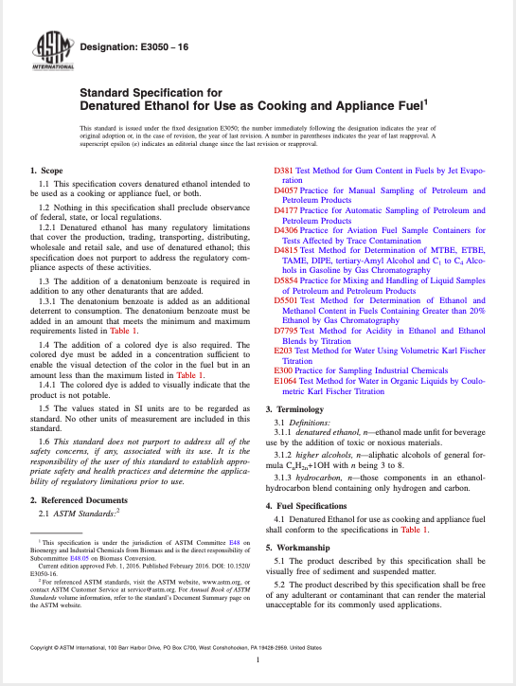
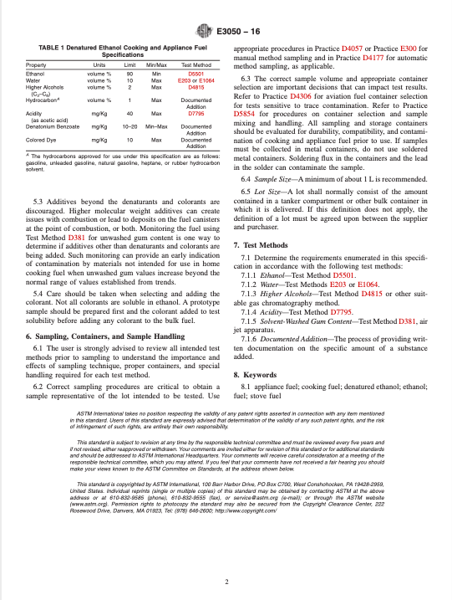
WHAT DOES THE STANDARD LOOK LIKE?

Slide 13
SCOPE
Denatured fuel for cooking and/or appliance fuel
Not to preclude observance of other regulations (federal, state, local)
** Not addressing regulatory compliance
Does not purport to address all safety concerns, if any, associated with use

Slide 14
SAFETY OBJECTIVES
Denatonium benzoate (bittering agent) required in addition to any other denaturants
Amounts must meet min/max levels in spec table
** Deterrent to consumption of fuel.
Colored dye also required.
Must meet min/max levels in spec table
** Visual indicates that the product is not potable

Slide 15
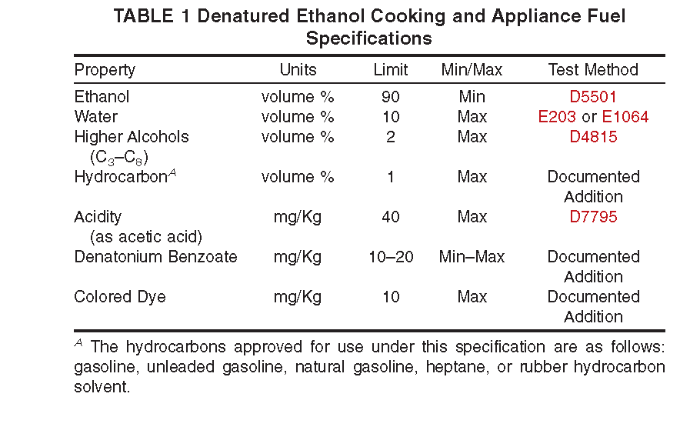
WORKMANSHIP
Specifications on additives and colorant in including minimum and maximum levels for ethanol composition.

Slide 16
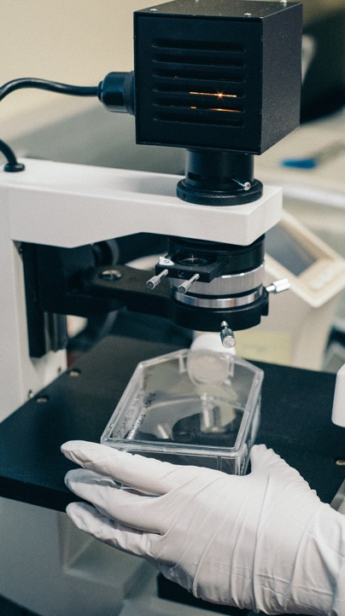
SAMPLING, TESTING & BEYOND
Specified within the standard
User strongly advised to review all intended test methods prior to sampling.
Sample size = minimum of 1 liter recommended
Enforcing the standard
Regulators should determine a plan for enforcing any quality standards, including protocols for testing
Communicating with the consumer
Stakeholders can determine ossible label identification for consumers

Slide 17
PRIOR CAPACITY BUILDING ACTIVITIES
UGANDA 2016
ZAMBIA 2018
Workshop focused specifically on the Ethanol as a Cooking & Appliance Fuel Standard
- Ugandan National Standard, based on ASTM E3050 was developed and passed within 8 months of the workshop
Workshop focused on ethanol and other liquid cooking fuels

Slide 18
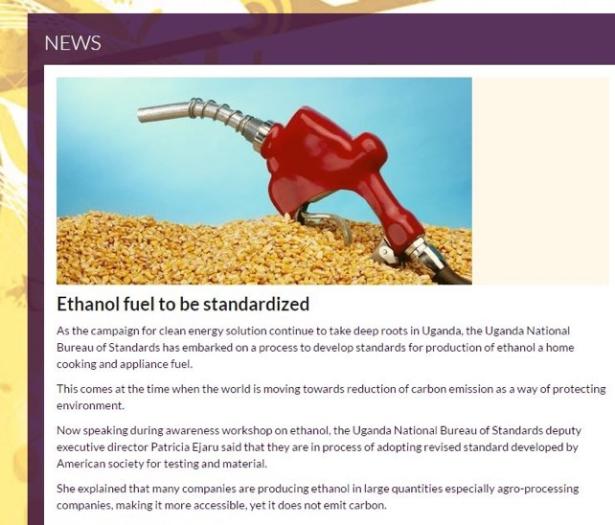
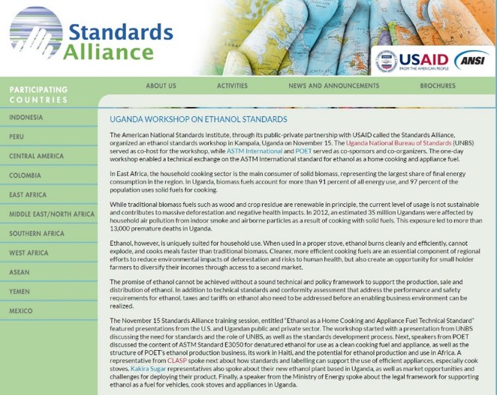
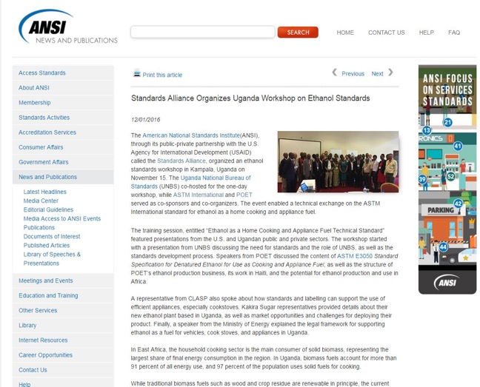
PROMOTION OF STANDARDS

Slide 19
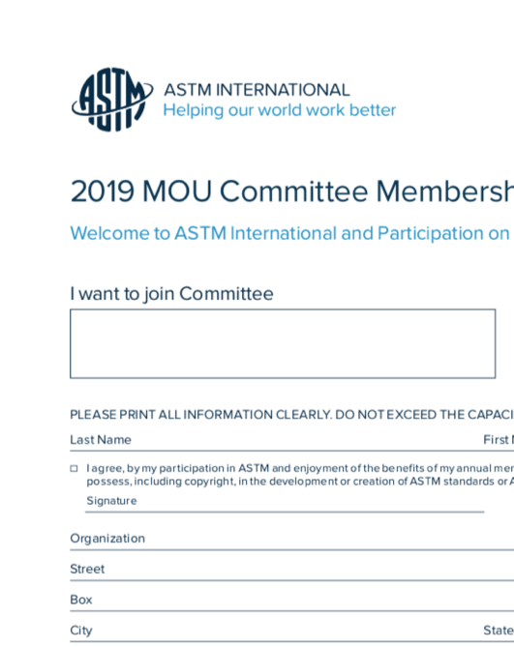
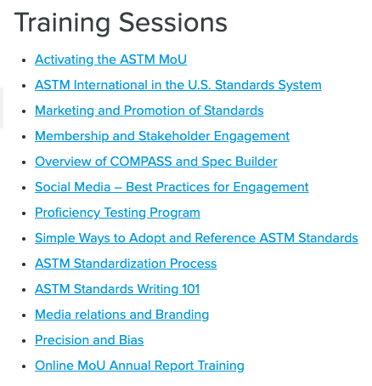
NEXT STEPS
Other countries, like Mozambique, can consider adopting ASTM E3050 to ensure quality fuel reaches consumers.
Individuals can become members of ASTM
Free ASTM membership for Mozambicans
(MOU with ASTM)
Free capacity building trainings online

Slide 20
THANK YOU!
brady@garneradvisors.com

