Slide 1
Implementação Mundial de Programas de Combustível Líquido
Session 3

Slide 2
Who We Are
Seeds of Change is a non-profit based within POET, the largest biofuels producer in the world
Located in Sioux Falls, SD, USA
Founded in 2014
Started by the Broin family after a trip to Kenya in 2012
Picture of family?
Seeds of Change
formado em 2014
Notes:
Introduce myself, open with introduction on what Seeds of Change is, history of the organization

Slide 3
Cultivating hope across nations by transforming education, agriculture and environmental conditions to support worldwide, sustainable development.
Quality
Education
Reliable Food Supply
Clean Air
Notes:
Main tenets of organization across the missions – vision statement – sustainable projects – working with partners in country

Slide 4
Mission
Hope
Mission
Grow
Mission
Breathe
Notes:
Quick overview of three main missions

Slide 5
Mission
Hope
To nourish the souls, minds, & bodies of some of Kenya’s brightest but most vulnerable students by providing them with a quality, faith-based education in a safe environment
Notes:
Brief overview of Kakuswi and Light Up Hope partnerships - Kenya

Slide 6
Mission
Grow
To use what god provided – the sun, the soil,& the seed – to teach sustainable agricultural practices that will enable sub-subsistence farmers and their families to obtain food security and improved livelihoods
Notes:
Brief overview of FIPS Kenya

Slide 7
Mission
Breathe
To improve the health & living conditions of families – particularly women & children – by eliminating indoor
Air pollution through access to cookstoves
Fueled by clean-burning biofuel
Notes:
Brief overview of how Mission Breathe operates. Cookstove assistance, funding for startup businesses with infrastructure, marketing, and data collection

Slide 8
NEARLY 3 BILLION PEOPLE COOK WITH SOLID FUELS
Notes:
Wood, charcoal, and dung; global problem

Slide 9
4.3 MILLION DEATHS PER YEAR
LINKED TO AIR POLLUTION VIA SOLID FUEL COOKING
Notes:
More people die from indoor air pollution than malaria, HIV and TB combined! It is the #1 environmental risk factor for burden of disease (more than unclean drinking water & sanitation).
7 million deaths worldwide when you combine outdoor air pollution. 1 out of every 10 deaths worldwide is due to air pollution.

Slide 10
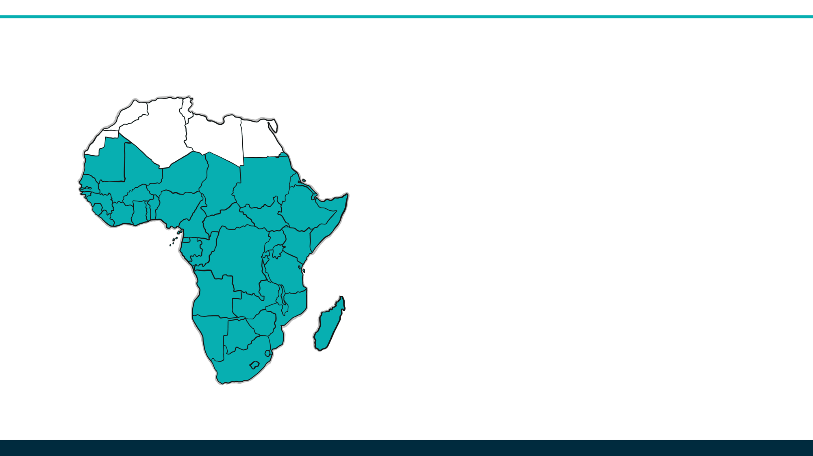
1 billion people live in Sub-Saharan Africa
475 million people live in urban areas - that population will double over the next 25 years
80% of the urban areas (380 million people) are cooking with solid fuel like charcoal
Notes:
(Center for Strategic International Studies, 2018) Lets take a look at the numbers just for Africa.

Slide 11
LIMPO
RENOVÁVEL
ETANOL COMBUSTÍVEL
Ethanol fueled cookstoves address these issues
Over 100,000 stoves distributed in numerous countries
Not as prominent in the marketplace as reduced wood options, therefore limited standards for ethanol as a household energy source/cooking fuel
Notes:
There is a great solution! Ethanol is the best alternative to solid fuels – it solves the health, environmental and economic problems created by solid fuels or petroleum based products.

Slide 12
Notes:
Annual Health impact from largest killers globally:
Malaria 584,000 deaths
TB 1.6 million deaths
HIV/AIDS 770,000 deaths
Poor sanitation/clean water 850,000 deaths
Air pollution 4.3 million deaths

Slide 13
Benefit of clean cookstoves
No indoor air pollution
produces only CO₂ and H₂O
No negative health effects
caused by carcinogens
Notes:
Benefit of clean cookstoves
No indoor air pollution – only CO₂ and H₂O produced
No negative health effects caused by carcinogens (respiratory and cardiovascular)

Slide 14
Environmental Impact
Cooking with solid fuels is a big contributor to deforestation
Notes:
Note that while they produce CO2, it is a net zero effect due to the utilization of CO2 by sugarcane and corn during the growth stage. Each stove accounts for 4 tons of C per year for the life of the stove.

Slide 15
Environmental Impact
Cooking with solid fuels is a big contributor to deforestation
Soil erosion that prevents healthy plant growth
Notes:
Note that while they produce CO2, it is a net zero effect due to the utilization of CO2 by sugarcane and corn during the growth stage. Each stove accounts for 4 tons of C per year for the life of the stove.

Slide 16
Environmental Impact
Cooking with solid fuels is a big contributor to deforestation
Soil erosion that prevents healthy plant growth
Desertification
Notes:
Note that while they produce CO2, it is a net zero effect due to the utilization of CO2 by sugarcane and corn during the growth stage. Each stove accounts for 4 tons of C per year for the life of the stove.

Slide 17
Environmental Impact
Cooking with solid fuels is a big contributor to deforestation
More susceptible to natural disasters
Soil erosion that prevents healthy plant growth
Desertification
Notes:
Note that while they produce CO2, it is a net zero effect due to the utilization of CO2 by sugarcane and corn during the growth stage. Each stove accounts for 4 tons of C per year for the life of the stove.

Slide 18
Environmental Impact
Popular stoves on the market place that reduce wood use still impact deforestation and contribute to greenhouse gases
Using biofuels and clean cookstoves create zero increased demand for solid fuels
Notes:
Note that while they produce CO2, it is a net zero effect due to the utilization of CO2 by sugarcane and corn during the growth stage. Each stove accounts for 4 tons of C per year for the life of the stove.

Slide 19
Economic Impact
Lowers household energy costs
Able to purchase other necessities
Creates local jobs
Manufacturing, business, marketing, and industry
Provides increased markets for ethanol
Local suppliers and imports

Slide 20
Social Impact
Maintains security
Wood collection far from home no longer necessary
Improved health, leads to greater ability to learn and work
Less money spent on healthcare, more on quality food and education
Women and children save time with chores
Children able to attend school

Slide 21
A Closer Look
Seeds of Change focuses on sustainable programs that help fortify local economies
Recognize the value in local partnerships that lend clarity to the culture, economics, and political landscape
We are set up to support the clean cooking industry in multiple ways; looking toward expansion

Slide 22
BUSINESS (PRIVATE SECTOR)
NATIONAL /GLOBAL LANDSCAPE
CONSUMER
STOVE ASSISTANCE
INFRASTRUCTURE
POLICY/STANDARDS
MARKETING
CARBON FINANCE
BULK STOVE PURCHASES

Slide 23
Stove Considerations
Lasts for over 10 years
Quality is Key!
Investing in a product that lasts
Cookstoves are sturdy and last for more than ten years
Instant heat adjusted with a simple regulator
Canisters replaceable in the event of any issues
Safe and easy to use; have been no reported incidents over years of work with the stoves
Able to provide stove assistance as needed
Lowers the end cost to consumers that can’t afford the initial purchase
Simple heat regulator
Replaceable canisters
Qualidade
é muito
importante
Safe and easy to use
Notes:
Safety is critical – no reported incidents of injury or harm in all stove work to this point in time; consumers love the product. Never a returned stove out of the 5,000 distributed in Haiti
Innovate Technology
Assemble stoves locally Created in Africa
Manufacturer working to lower costs by creating novel adaptations
Stove Disbursement/Canister Replacement
Stove assistance to consumers when necessary to reach base of the pyramid
Potential partnerships with companies to offer gradual payment systems with employees
Provide canisters for existing stoves to recapture damaged stoves in the market
Stove Financing – Revolving Loan
Capital/financing to businesses for bulk purchases of CLEANCOOK stoves
Spearhead fundraising efforts; private sector support

Slide 24
Business Loan
Small business startups can face challenges with large capital expenses
Small amount of funding set aside for bulk stove purchases
Frees up working capital for small businesses
Reserved specifically for cookstove purchases; repaid upon sale of stoves
Fund is mobile so that multiple companies benefit over time; does not remain with a single company

Slide 25
Infrastructure Development
Along with inventory, infrastructure limitations are a challenge
Infrastructure development for small businesses can help expansion
Flagship stores that are brand specific
Co-branding with existing locations to promote stoves and fuel
Recognize that storage, warehouse facilities, and equipment is necessary to build out the business
Support a strong supply chain with quality fuel and stoves
Notes:
Adequate Operations Infrastructure
Ensure adequate space for inventory and additional products
Support blending/bottling/packaging operations through structure or equipment provisions
Retail Expansion
Provide resources for utilizing existing retail locations
Opportunity for building out new retail locations that are brand specific for stoves and fuel
Service locations for stoves and necessary repairs
Fuel Availability
Working with local fuel retailers or establishing separate locations for self-service pumps
Potential development of additional fuel storage to ensure adequate and consistent supply
Distribution and supply chain management through vehicles or other transport
Ensure fuel quality
Water filtration system for fuel blending to remove contaminants
Good quality fuel from suppliers, appropriate composition (limited detrimental organic compounds)
Strengthen relationship with ethanol suppliers
Secure ethanol supply for scale-up
Availability of imports vs local supply

Slide 26
Essentials to a Successful Startup
Marketing
P
Policy
Promoting awareness
and sharing benefits
Governments establishing policy for a foundation in clean energy
M
C
Data Capture
Carbon Finance
Tracking inventory and customer information
The future of sustainable funding and advancement
D
Notes:
Data Capture
Market Information
Introduce stove Point of Sale capture of user information linked to stove serial numbers
Development of mobile applications (Mobile phone/SMS link to communicate with households)
Aftermarket Service
Stove user follow up and maximization of use
SMS Communication System
Direct safety and proper use messaging campaigns
Service and sales reminders
User Surveys
SMS link to access valuable end user information regarding stove use, fuel use, stove and canister function etc.
Inventory Management
Develop system for accurate inventory and reporting
Government Policy and Carbon
Stove and Fuel Standards
Adopt national policy for ethanol stoves and fuel – adopt new ASTM E3050 Standard (only 10% water)
Quality control protocols established and followed
Taxation Policy
Remove duty on stove and fuel imports
Import Regulations
Ensure policy supports ethanol importation
Validation Software for Carbon
Point of Sale capture and user surveys allow for accurate reporting on stove + fuel use for carbon validation purposes
Branding and Marketing
Establish Effective Brand
Paint-outs on existing stores; new storefronts for brand specific locations
New promotional signs and pricing charts
Stove totes/other swag
New ambassador apparel
Alternative Media
Television promotion
SMS direct marketing
Radio ads
Billboards
Civic Education Campaigns
Consumer education essential for effective sales
Drives-quality control, safety & brand recognition

Slide 27
Keys to Successful Implementation
Affordability to the Consumer
Empower Local Businesses
Data
Capture
Supply Chain
Raising Awareness
Supportive Local Environments
Ethanol availability
and quality
Civic Campaigns for Education
Government Policy and Tax Regulation
Marketing and Branding
Carbon
Notes:
Slides 17 – 22 don’t necessarily need infographics, but could maybe just pull from the main infographic slide 16 according to their titles (ie. stove financing and supply)
Innovate technology (stoves can be assembled locally, produced in Africa, not Asia) and THEN support financing mechanisms like stove assistance programs or employer partnerships/fuel available at factories

Slide 28
Questões?

Slide 29
Obrigado!

