Slide 1
PRACTICAL APPLICATION OF ASTM STANDARD E3050
A case study in Haiti
November 15, 2016
Kampala, Uganda

Slide 4
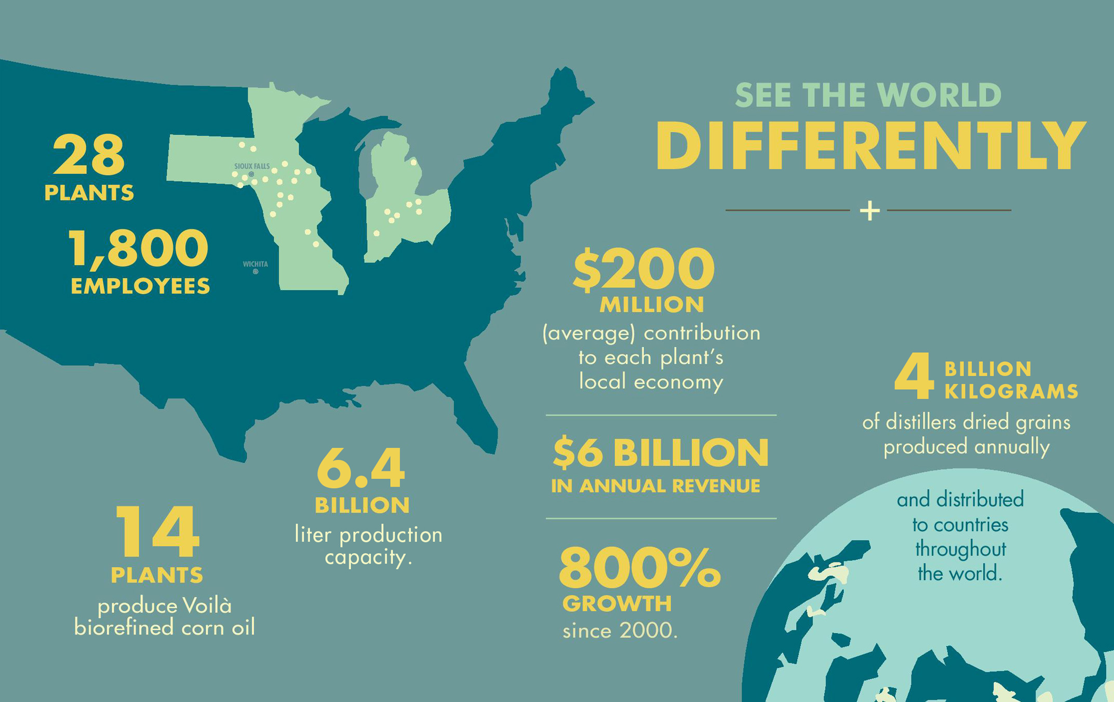

Slide 11
POET’S INVOLVEMENT IN HAITI
Became interested in supporting after the January 2010 earthquake
More than 200,000 fatalities
More than 98% deforested
Donated two isotanks of ethanol to provide fuel for ethanol cookstoves (50,000 liters)
Formed commercial relationship with local company, Novogaz

Slide 12
TIMELINE
2013 – 2014
Achieved regulatory approval for a Specially Denatured Alcohol Formula
Achieve International Hazmat shipping certification for two production sites (28 total)
October, 2014
POET Ships first load (approximately 6,500 gallons) from its production site in Jewell, Iowa to Port-au-Prince, Haiti
December, 2014
First load passes Haiti customs after a significant delay and Novogaz takes possession (91 day transit time)
January, 2015
Distribution of POET imported ethanol begins in and around Port-au-Prince
February, 2015
POET ships second load (approximately 6,500 gallons) from its production site in Jewell, IA to Port-au-Prince, Haiti
June, 2015
Second load delivered to Novogaz (arrived in Haiti March 31) after a significant delay (118 total transit time)
February, 2016
ASTM E3050, Specification for Denatured Ethanol for Use as Cooking and Appliance Fuel is published
Third isotank ships from POET’s Jewell plant, first isotank load of ethanol purchased by Novogaz

Slide 13
REGULATORY CHALLENGES
No standard for shipping ethanol as a cooking fuel
Most ethanol shipped around the world is as a blending fuel for transportation (denatured with gasoline/hydrocarbon)
POET ships almost 8 billion liters of ethanol every year

Slide 14
CUSTOMS PROCESS
Isotanker arrives at port
90-118 days transit time
Sample is taken
Delegates from Ministry of Trade, Haitian Bureau of Standards, etc.
Sample is processed
Delay of weeks or months
Industrial ethanol
Pharmaceutical grade ethanol
Taxes and duties are accessed
Not based on the fuel’s application

Slide 15
COST BREAKDOWN
10%
Sales Tax (VAT)
+
20+%
Customs Duties
=
30+% Total Taxes + Duties
All other fuels have tax regulations:
LPG: not taxed
Kerosene: not taxed
Charcoal: not taxed but 50 – 80% of cost is transportation (fuel) and gasoline is not taxed and additionally subsidizied

Slide 16
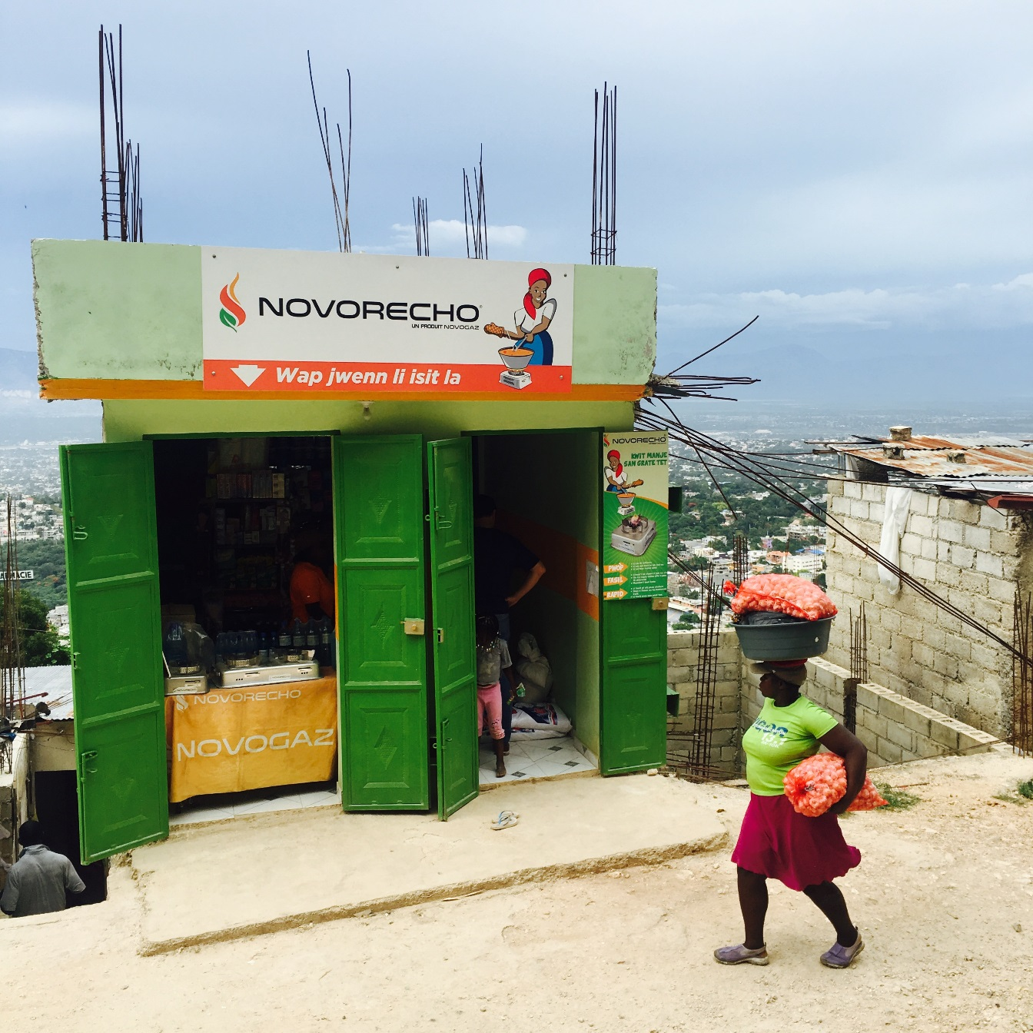
IMPACTS TO THE CONSUMER
Avoids possible fuel interruption delays as customs process could impact the supply chain
Potential cost savings
If duties reassessed, ethanol would be more affordable to lower-income consumers
Quality of product is known
Denaturant is known
No fear of ingestion

Slide 17
HOW E3050 BENEFITS HAITI
Provides a classification for a new product
Imports
Local production
Should facilitate the customs process
Provides VAT revenue to Government
Provides a basis for policymakers to access tax structure vis-a-vis other fuels
Denaturant is known and ethanol as a cooking/appliance fuel cannot enter beverage market

Slide 19
REPLICABILITY
First successful project shipping ethanol as cooking/appliance fuel from the USA
Exemption from US trade authorities to ship as cooking fuel
Lessons learned: classification, customs, etc.
Existence of a standard helps Government Ministries in classification issues (testing samples)
Identification of fuel is often first step to reassessing tax structure to level the playing field
Removes fear of ingestion of ethanol as a beverage fuel
Provides a basis for consumer interaction (CLASP)

