Slide 1
Development of Technical Regulations U.S. Process
Maupto, Mozambique
May 21-22, 2018
Kent Shigetomi
Office of the U.S. Trade Representative

Slide 2
Agenda
Core Aspects of Good Regulatory Practice
Interagency Coordination of Rulemaking
Centralized Management and Leadership/Presidential Oversight
OMB and the Office of Information and Regulatory Affairs
Executive Orders 12866 and 13563
Regulatory Impact Analysis
Regulatory Transparency and Participation
Administrative Procedure Act of 1946
Disclosure of Information under Executive Order 12866
Other Mechanisms for Public Stakeholder Input

Slide 3
Core Elements of Good Regulatory Practice
Internal Coordination of Rulemaking Activity
Regulatory Impact Analysis
Transparency and Public Consultation

Slide 4
On Regulation
Supreme Court Justice Felix Frankfurter explained regulatory action this way:
Hardly a measure passes Congress the effective execution of which is not conditioned upon rules and regulations emanating from the enforcing authorities. These administrative complements are euphemistically called “filling in the details” of a policy set forth in statutes. But the “details” are of the essence; they give meaning and content to vague contours.¹
¹Frankfurter, Felix. The Task of Administrative Law, 75 U. Pa. L. Rev. 614 (1927)

Slide 5
Legislative Branch
Executive Branch
Judicial Branch
U.S. Rulemaking Process
1. Congress passes law authorizing/requiring regulation.
Congress.gov
2. Agency drafts and clears internally a proposed rule.
3. If “significant,” OMB reviews and clears draft proposed rule.
4. Agency publishes notice of proposed rulemaking (NPRM)
5. Public reviews NPRM/docket and submits comments to agency.
6. Agency reviews public comments and develops/clears draft final rule.
7. If “significant,” OMB reviews and clears draft final rule.
8. Agency publishes final rule.
9. Rule takes effect.
www.RegInfo.gov www.Regulations.gov
Unified Agenda &
Regulatory Plans
www.FederalRegister.gov
www.Regulations.gov
www.FederalRegister.gov
www.Regulations.gov
www.RegInfo.gov
www.Regulations.gov
www.RegInfo.gov
Congress reviews final rule.
Rule challenged in court.
Rule takes effect
Disapproval resolution passed.
Court “vacates” all or part of rule.

Slide 6
Regulations in the U.S.
The Executive Branch can make law.
Congress delegates authority to Executive Branch agencies to implement statutes through rulemaking.
Some statutes are so broad that agencies can make new programs without new statutes.
Many important public policy decisions are made during rulemaking.
Regulatory enforcement and allocation of resources.
Grants, loans, and loan guarantees.
Rights and responsibilities of the 50 States and the public.

Slide 7
Centralized Management and Leadership
Presidential Oversight of Government Regulatory Policy:
1975: President Ford, required, for the first time, regulatory impact analysis (RIA) requirement for major regulations (over $100 million in impact).
1981: President Reagan solidified centralized regulatory oversight authority within the White House, issuing Executive Order 12291, which required OMB review and approval of rules.
1993: President Clinton: Issued Executive Order 12866, which focused OMB oversight on “significant” rules and increased the disclosure of contacts with outside parties.
2011: President Obama: Issued Executive Order 13563, which affirms EO 12866 and outlines his regulatory strategy to support continued economic growth and job creation.
2017: President Trump: Issued Executive Order 13371 which outlines a regulatory budget and a requirement for identifying deregulatory rules before issuing regulatory rules, as allowed by law.

Slide 8
Centralized Management and Leadership Office of Management and Budget (OMB)
OMB assists the President in the development and implementation of budget, program, management, and regulatory policies.
Develops the President’s annual budget submission to Congress.
Assists the President in managing the Executive Branch, developing the Administration’s position on legislation before Congress and executing the law.
Provides high quality regulatory analysis.

Slide 9
Centralized Management and Leadership: Office of Information and Regulatory Affairs (OIRA)
Role of the Office of Information and Regulatory Affairs:
OIRA was established by the Paperwork Reduction Act of 1980, partially in response to the explosion in regulation that occurred in the 1970s and earlier in the U.S.
As part of the Office of Management and Budget, OIRA is a central body that has special standing with the agencies.
OIRA is the lead division of OMB for regulatory oversight and interagency review of “significant” regulations.
OIRA also develops and oversees government-wide policies in the areas of information collection, information policy, privacy, and statistical and science policy.

Slide 10
Office of Information and Regulatory Affairs
Administrator
-Presidential appointment
Senate confirmed
Deputy Administrator
Information
Policy
- 6 policy analysts
- 1 IT manager
Statistical &
Science Policy
-4 statisticians
-1 epidemiologist
-1 toxicologist
Natural Resources &
Environment
- 6 policy analysts
- 1 economist
Transportation &
Security
- 7 policy analysts
- 1 economist
Food, Health &
Labor
- 6 policy analysts
- 1 economist
Associate Administrator
Records Management
Center

Slide 11
Executive Order 12866: “Regulatory Planning and Review”
Issued by President Clinton in October 1993.
Governs OIRA’s centralized, interagency review of draft regulations.
Establishes principles of regulation.
Regulation must be consistent with law.
Regulations must identify nature and significance of problem.
Alternatives to address the problem must be identified and assessed.
The costs and benefits of each alternative must be assessed.
The alternative selected should maximize net benefits to society.
These principles guide OIRA’s review of regulations.

Slide 12
What regulations must OIRA review?
“Significant” Rules
Create a serious inconsistency or otherwise interfere with another agency’s actions.
Materially alter the budgetary impact of Federal programs.
Raise novel legal or policy issues.
OIRA reviews 500-700 proposed and final regulations per year—those we determine to be significant—out of about 6,500 that are published in the Federal Register.
“Economically Significant” Rules
Subset of “significant” rules.
Annual effect on the economy of $100 million or more or adversely affect in a material way the economy, a sector of the economy, productivity, competition, jobs, the environment, public health or safety, or State, local, or tribal governments or communities.
About 70-100 of the regulations reviewed are “economically significant.”

Slide 13
EO 12866: Important Requirements and Scope
EO 12866 has deadlines for OIRA review (usually 90 days).
EO 12866 requires economic analysis.
Economically significant regulations require more analysis than smaller rules.
OIRA examines the RIA and the regulation and makes suggestions to improve both the RIA and the rule’s cost-effectiveness, ensure adherence to the Executive Order’s principles, and consistency with the President’s priorities.
Independent Regulatory Agencies are not covered.
For example, Consumer Product Safety Commission, Federal Communications Commission, and the financial regulators.

Slide 14
Possible Actions at the End of OIRA Review
Allow the agency to issue the rule.
A rule is usually sent directly to the Federal Register at the conclusion of review.
Agency withdrawal of the rule.
If we are unable to resolve issues during the review process, or the agency needs more time to make changes, the agency can withdraw the rule.
“Return Letter”
OIRA may return a regulation for agency reconsideration to address OIRA concerns.
Very public and very rare.

Slide 15
Executive Order 13563: “Improving Regulation and Regulatory Review”
Issued by President Obama in January 2011.
Reaffirms the principles, processes, and structures of EO 12866.
Calls for public participation to promote an open exchange with stakeholders.
Directs agencies to harmonize, simplify, and coordinate rules to reduce costs and to promote simplicity.
Considers flexible approaches that reduce burdens and maintain freedom of choice for the public (e.g., public warnings or provisional information).
Calls for scientific integrity.
Directs agencies to conduct retrospective analysis of existing rules and produce preliminary plans for periodic review.

Slide 16
Executive Order 13771: “Reducing Regulation and Controlling Regulatory Costs”
Issued by President Trump in January 2017.
Directs agencies to repeal two prior regulations for every one regulation issued, as allowed by law.
Establishes annual regulatory cost submissions by agencies to the Office of Management and Budget to set a regulatory budget.
Requires approval by the Director of OMB if a regulation is not within the Unified Regulatory Agenda.

Slide 17
Regulatory Impact Analysis (RIA)
Basic Goals
Maximize net benefits to society—or at least ensure that benefits justify costs.
Promote economic efficiency by regulating only where markets fail, and when regulating, by using cost-effective and market-based approaches.
Increase the transparency of the regulatory system.
Elements of a Regulatory Impact Analysis
Statement of need for the proposed rule that identifies the nature and significance of the problem (e.g., identification of the market failure).
Examination of alternative approaches to addressing the problem.
Analysis of the costs and benefits of each alternative.
OMB Circular A-4: Guidelines for the Conduct of Regulatory Analysis (September 2003)

Slide 18
Regulatory Transparency and Participation
Administrative Procedure Act of 1946 (APA)
The APA requires that agencies go through a notice and comment process open to all members of the affected public, both U.S. and foreign.
Before agencies can issue a final regulation, they must respond to the public comments, make sure that the final regulation is a logical out-growth of the proposal and the administrative record, and is not arbitrary or capricious.
The public record is used by the courts in settling any challenge to the regulations brought by the affected public.

Slide 19
Regulatory Transparency and Participation
Disclosure of Information Under Executive Order 12866:
The public can consult OMB’s online “Regulatory Review Dashboard” to learn each day which rules are under formal review at OMB.
Meetings with outside parties – OIRA and the issuing agency will meet with external stakeholders regarding rules under review. OMB’s website notes which outside groups have met with OIRA, including the participants, and docket written materials provided to OIRA during the meeting.
All written information given to us while a rule is under review is sent to the agency, placed in OIRA’s docket, and posted online.
Return letters sent to the agencies outlining our concerns with rules we send back are posted on our website.

Slide 20
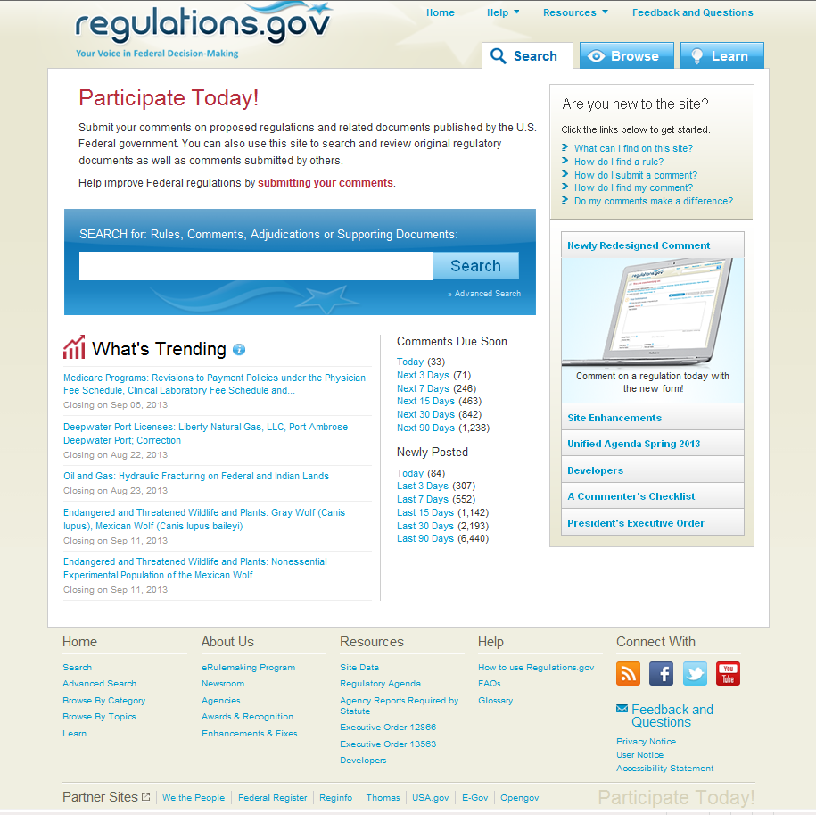
Regulatory Transparency and Public Participation: Regulatory Review Dashboard

Slide 21
Regulatory Transparency and Participation
Other Mechanisms for Public Stakeholder Input:
Unified Agenda and Regulatory Plan – The public can access the Unified Agenda of Regulatory and Deregulatory Actions and the Annual Regulatory Plan to learn about agencies’ upcoming regulatory actions.
The Unified Agenda is published twice each year and can be accessed on
Regulations.gov and RegInfo.gov.
Federal Register (www.FederalRegister.gov) – The official daily publication for final rules, proposed rules, and notices of Federal agencies and organizations, as well as executive orders and other presidential documents.

