Slide 1
Regulatory Impact Analysis Exercise
Kent Shigetomi
Office of the U.S. Trade Representative
Maputo, Mozambique
May 21-22, 2018

Slide 2
RIA Checklist
Identify the problem.
Establish a baseline.
Assess benefits.
Assess costs.
Consider alternatives.
Consider the net.

Slide 3
Identify the problem to establish the need for the regulatory action.

Slide 4
RIA Case Study: Warning Labels for Cigarette Packages
  PROBLEM: Insufficient/ineffective information available to the public regarding the harmful health effects of smoking cigarettes.
  Market failure: information asymmetry and lack of information salience (lack of attention to and ineffectiveness of existing cigarette health labels).
  Other examples? Externalities, market collusion

Slide 5
RIA Case Study: Warning Labels for Cigarette Packages
One of nine new health warnings to be displayed directly, and on the upper portion and rear panel of cigarette packages.
Health warnings must be included in advertisements for cigarettes.
Cigarette labels must include information on resources to assist individuals to quit smoking.

Slide 6
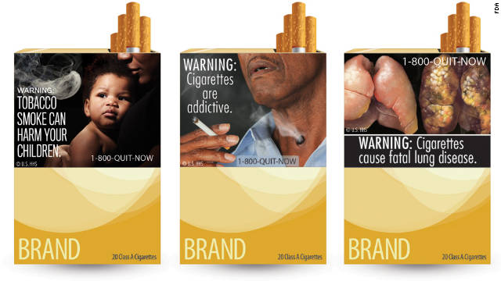

Slide 7
Establish the baseline.
What does the world without the regulation look like?

Slide 8
RIA Case Study: Warning Labels for Cigarette Packages
BASELINE: The number of smokers that would be expected, based upon currently projected trends, during the time horizon of the analysis.
Set the Time Horizon for Analysis – period long enough to encompass all important benefits and costs likely to result from the regulation.
TIMEFRAME: 20 years to capture one-generation of smokers (2012-2031)
Other considerations? state of technology, available substitutes

Slide 9
Assess the benefits.
How do proposed solutions improve on the problem?

Slide 10
RIA Case Study: Warning Labels for Cigarette Packages
Benefits of the rule:
  Reduction in the number of U.S. smokers. (Smokers’ life years saved)
  Health status improvements - reduction in number of people who will ultimately become ill or die from diseases caused by smoking.
  Medical expenditure reduction
  Fire loss averted (less homes burned down by cigarettes!)
  Other financial effects
Other examples? Public health (asthma, IQ, birth defects), visibility, natural resources, safety (avoided death/injury)

Slide 11
How much do you think a life is worth?
How much do you think a an extra year of life is worth?

Slide 12
RIA Case Study: Warning Labels for Cigarette Packages
For this rule, the U.S. Federal and Drug Administration established a Value of Statistical Life Year (VSLY) of:
  $106,308
  $212,615
  $318,923

Slide 13
Assess the costs.
What costs do the proposed solutions impose?

Slide 14
RIA Case Study: Warning Labels for Cigarette Packages
Costs of the rule:
  Manufacturing costs to change cigarette labels.
  Market testing of new cigarette package labels.
  Recordkeeping and administrative costs to ensure equal and random display of 9 warning labels over time.
  Costs to manufacturers and retailers to remove point of sale advertising that does not comply with the regulation.
  Government cost associated with administering and enforcing the regulation.
Other examples? Available substitutes? Loss to society? Distributional impacts – who bears costs (e.g. supply chains)?

Slide 15
RIA Case Study: Warning Labels for Cigarette Packages
Best Practices:
Quantify and Monetize the Benefits and Costs of the Regulation using the best obtainable scientific, technical, economic and other information.
Discount Future Benefits and Costs
Evaluate Non-Quantified and Non-monetized Benefits and Costs (those that are difficult or impossible to quantify/monetize)
Characterize uncertainty in benefits, costs, and net benefits.

Slide 16
Consider alternatives.
What trade offs do alternate approaches present?

Slide 17
RIA Case Study: Warning Labels for Cigarette Packages
Identify a Range of Regulatory Alternatives
Alternatives should especially consider flexible approaches, economic incentives (user fees/marketable permits), information disclosure.
ALTERNATIVES to the Proposed Cigarette Labeling Rule:
Shorter (6 month) or longer (24 month) compliance period for cigarette manufacturers.
Different graphical images/messages to be displayed on cigarette label.
Other examples? Achieving same benefits at lower costs (e.g. half-life); when no substitute readily available in the market (industry agreement)

Slide 18
Consider the Net.
What approach maximizes net benefits?

Slide 19
RIA Case Study: Warning Labels for Cigarette Packages
SUMMARY OF BENEFITS AND COSTS
 | PRIMARY ESTIMATE | LOW ESTIMATE | HIGH ESTIMATE | YEAR DOLLARS | DISCOUNT RATE | PERIOD COVERED
BENEFITS
$ MILLIONS/YEAR | $221.50 | $0 | $3,360.70 | 2009 | 7% | 2012-2031
COSTS
$ MILLIONS/YEAR | $37.00 | $34.70 | $52.70 | 2009 | 7% | 2012-2031

