Slide 1
International Standards in Regulation
Best Practices – Identification and Referencing
Teresa J. Cendrowska
Standards Alliance Program – 21-22 May 2018

Slide 2
Why Are Standards Important in Mozambique?
They are key tools and resources
Standards
are an integral part of any quality infrastructure
improve the performance of your industrial and agricultural sectors and the lives of your citizens
support health and safety, protect the environment, enable innovation, enhance reliability and quality, and facilitate trade, and
enable compliance with the WTO obligations
I’ll share information on standards in regulation from an ASTM perspective

Slide 3
ASTM International
Global platform for the development of international standards; address market challenges
Private sector, not-for-profit organization
ANSI and SCC accredited SDO
33,000 members from 150⁺ nations
147 TCs serving 90 industry sectors; develop/maintain 12,700+ standards
Complaint with WTO/TBT principles
Also providing related services (proficiency testing, training, certification)

Slide 4
Collaboration with The Public and Private Sector
Solutions through standards
ASTM’s process is open to and includes both public and private sectors for the development of high quality standards that are globally relevant
Standards are market driven and voluntary
Address technical, market, regulatory needs
Focus is on science and technology
Based on relationships with National Standards Bodies
109 individual Memorandums of Understanding (MoU) including 5 regional agreements
ASTM standards are referenced by governments around the world for their high quality and market relevance
No ASTM standard has ever been cited by the World Trade Organization as a Technical Barrier to Trade
1000+
ASTM members come from international governments
Notes:
When referring to the ASTM standards, many organizations and nations can more easily develop their own regulations necessary for a variety of projects or to protect their environmental resources.
The ASTM International standards also support the needs of various industries in several countries around the world in their efforts to comply with the import requirements of the United States and other global markets. The ASTM standards reduce confusion in the market, reduce production costs, and helps position companies manufacturing products to meet consumer needs and providing quality covering the reliability and safety.

Slide 5
ASTM, Africa and INNOQ
Memoranda of Understanding
MoU Benefits
ASTM has agreements with two regional bodies on the Continent
ARSO
SADC
ASTM has 179 members from African economies engaged in 61 percent of our standards development activities
And, agreements with national standards bodies of 28 African nations, including Mozambique.
INNOQ signed the MoU in 2008
Provides a full collection of ASTM Standards to INNOQ for use as decided by INNOQ and its TCs
Provides Mozambique with choice and flexibility
Use of ASTM standards as a technical and economic resource (best option for stakeholders’ needs)
Offers membership to Mozambican stakeholders at no cost
Equal ability to identify needs, influence content
Facilitates information exchange and training
Requires the NSB to provide an annual report indicating:
Use of ASTM standards,
Engagement with ASTM, and
Training requests

Slide 6
ASTM International and INNOQ
MoU signed in 2008
Use of ASTM standards as a result of the MoU

Slide 7
How to Access ASTM Standards: Compass® Dashboard
Standards
12,500+ ASTM standards operate globally
Multiple Language Translations
Other Content
Collaboration Tools
Technical Papers
1,500+ Books
16,800+ Journal Articles
47,000+ Papers, Chapters and Articles
Training
Online Courses
Video demos of test methods
Learning Management System with grades and certifications
Notes:
﻿As a benefit of the MOU program, not only can technical experts from any country with an ASTM MOU participate at no charge as full voting members in the ASTM standards development process, free access to all ASTM standards is also provided to the national standards bodies. This year, the platform for accessing standards for all our members, customers, and MoU partners will be changing to ASTM COMPASS.
Over the past several years, Compass has served as our flagship product, offering companies access to value-added programs and content while also providing productivity tools that businesses, associations, and others are seeking.
Compass has become one of the most respected platforms in the global standards community.

Slide 8
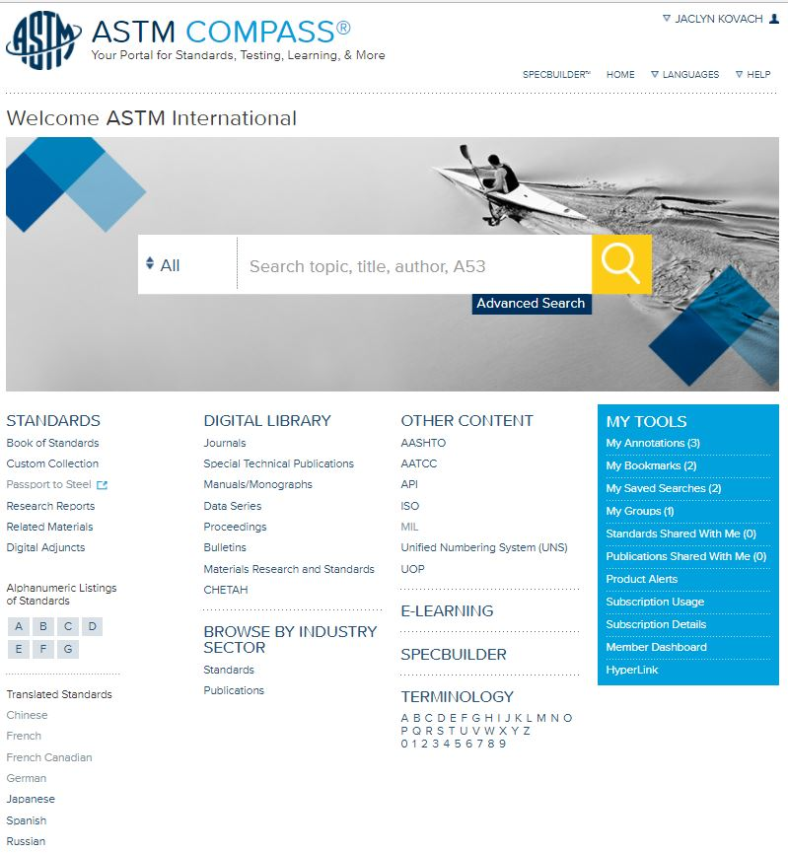
Compass Features
Navigation in 14 languages
Including Portuguese
Bookmarks/Saved Search
Annotations
Terminology Dictionary
Robust taxonomy of 4,000 categories and 45,000+ keywords
Digital Adjuncts
Research Reports
Notes:
As of April 9th , when the ASTM contact person at your organization logs into their MyASTM page and clicks on Digital Subscriptions, they will automatically be directed the Compass homepage, where they will access the ASTM International standards.
You'll continue to view your standards in HTML or PDF format, but you'll now have access to additional content as well as workflow tools to help you work faster and smarter.
You will be able to search for standards in 14 languages
Bookmarking so you can return quickly to frequently used standards
Annotation Feature – add personal notes to any section of active standards and ability to send feedback notes with tracked changes to the related ASTM committee
Terminology Dictionary – The dictionary collects all ASTM terms and definitions into one resource - a total of more than 80,000 terms. It's updated twice a year.
User tutorials providing guidance on how to best use the Compass tools
We believe the tools in Compass to be very intuitive, but two training sessions will be provided for all the Caribbean contacts via web conference next week on April 10 at 2:00 pm and April 12 at 10:00 am

Slide 9
Another Way to Access the Information You Need
ASTM Membership (Types/Benefits)
Other types of membership
Membership identifies those that serve on ASTM technical committees
Vote on content of ASTM Standards
Currently over 24,000 ballot items
10% Discount off ASTM Publications
Free Volume of BOS (online access or print)
Subscription to Standardization News and eNews
Free Meeting Attendance
Reduced Fees for Qualified Symposium and Workshops
Professional Development Opportunities
MoU (no cost to MoU partners)
(Same benefits except for free volume since full collection is provided to INNOQ)
Student
(No cost; access to information on-line)
ASTM Members are a global network of peers, customers, competitors, regulators, researchers, academics
Exceptional knowledge of standards, current issues, challenges, options
Link via website
Other options
ASTM staff
ASK ASTM on-line tool to raise inquiries

Slide 10
Options for Citing ASTM Standards
Adoption (identical or with deviation)
ASTM Options to address your needs!
Available to all Public and Private Standards’ Users
Referenced in Regulations
Normative Reference
Available Only to MoU Partners
Identical Adoption
Equivalent Adoption
Used as the Basis of a National Standard
Consulted
Used as
the basis
Options for citing ASTM International Standards
Referenced in Regulation
Consulted
Normative Reference

Slide 11
Uses of ASTM International Standards
Referenced in Regulation
ASTM International standard is called out, either in whole or in part, in a regulation, law, decree, rule, act, directive, order, edict, etc. (i.e. any official government document other than a National Standard).
The content of the ASTM standard, either in whole or in part, is intended to be used as an additional requirement of the new regulation.
7,700+
Citations to ASTM standards for adoption, use as a reference, or as the basis of national standards outside the USA

Slide 12
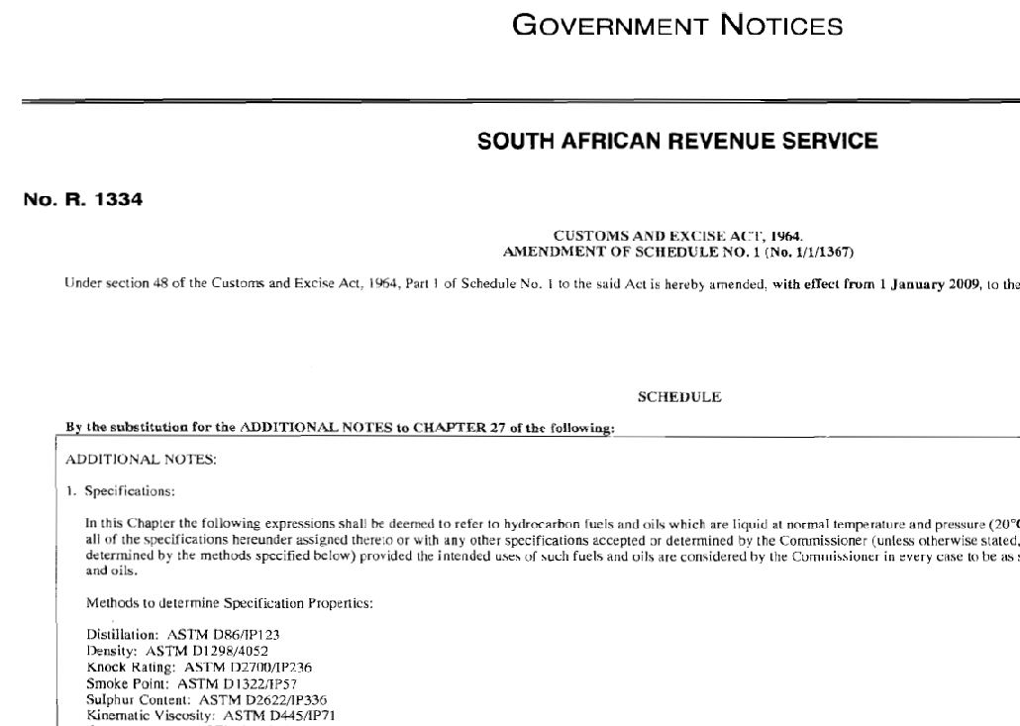
Referenced in Regulation

Slide 13
Uses of ASTM International Standards
Normative Reference
ASTM International standard (title only) is called out in the text of National Standard and its title also appears in the “Referenced Documents” section of the National Standard. The content of the ASTM standard, either in whole or in part, is intended to be used as an additional requirement of the new National Standard.
ASTM International complies with
all 6 principles of an International Standards Developer as defined by the WTO

Slide 14
Normative Reference

Slide 15
Additional Uses of ASTM International Standards for MoU Countries
Adopted as an Identical Standard
ASTM International standard is considered, in its entirety, to be the National Standard recognized by the National Standards Body
Adopted as an Equivalent Standard
ASTM International standard is considered, with limited deviation, to be the National Standard recognized by the National Standards Body
“ASTM standards help us develop our national standards and are deeply utilized in industries such as construction, petroleum products and medical equipment.”
STAMEQ, Vietnam
Notes:
An additional use of ASTM International standards by an MoU signatory includes the right to adopt a standard as identical or equivalent.
Both the adoption of an ASTM International standard, in its entirety, to be the National Standard recognized by the National Standards Body OR when an ASTM International standard is considered, with limited deviation, to be the National Standard recognized by the National Standards Body is permitted under the terms of the MoU agreement.

Slide 16
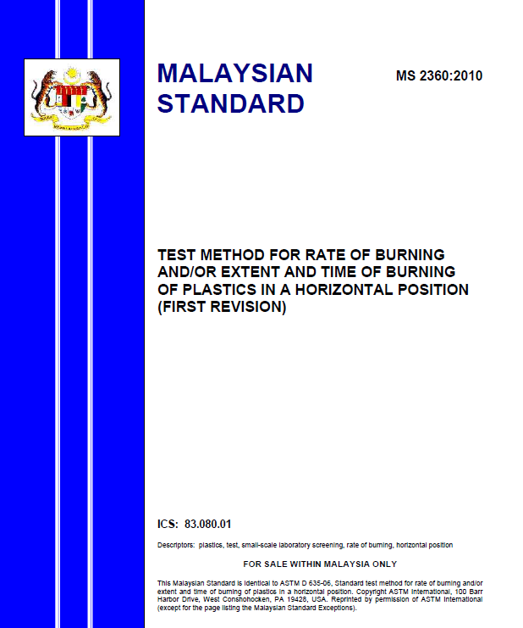
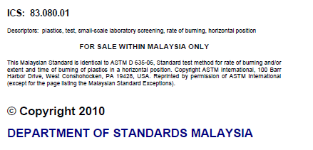
Identical National Adoption of an ASTM standard

Slide 17
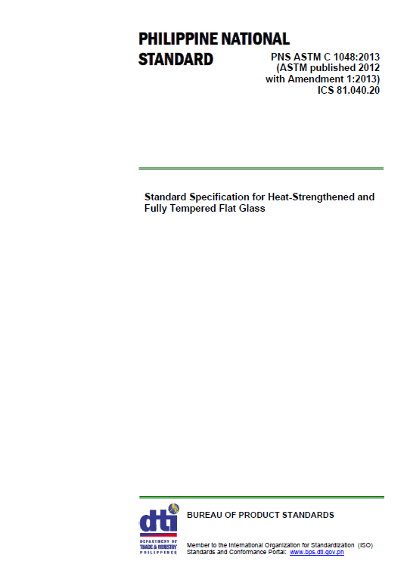
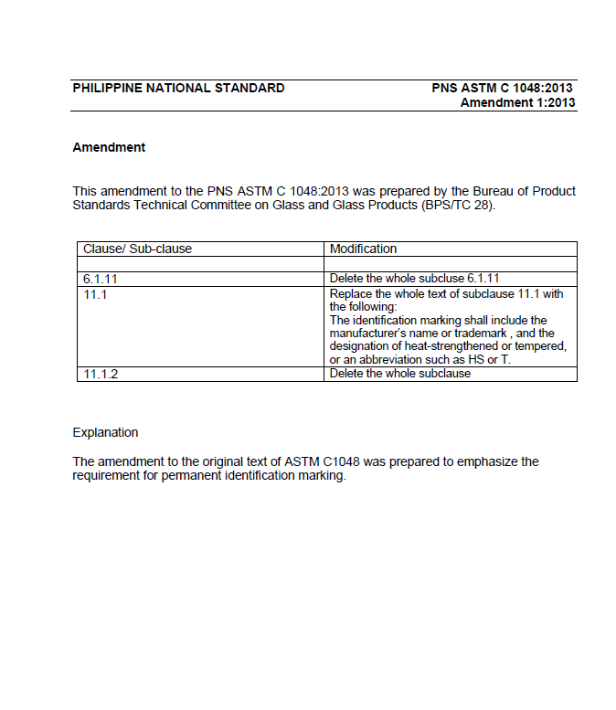
Equivalent National Adoption of an ASTM standard

Slide 18
Requirements for Adoptions
Provide ASTM written notice of the ASTM standards proposed for adoption – obtain written approval prior to adoption
Publish adoptions (a derivative work) of ASTM Standards without, as much as possible, change to the original to maintain the integrity of the ASTM Standards
However, deviations are possible and must be noted
Shall not assign or transfer any rights you have in the adoptions, nor submit or provide the ASTM Standards or the adoptions to any other standards body(s) or organizations without written consent of the ASTM President
Provide ASTM with an electronic copy of the adoption
Provide recognition: “This National Standard is identical to ASTM XXXX-XX, Title, Copyright ASTM International, 100 Barr Harbor Drive, West Conshohocken, PA 19428, USA. Published and reprinted pursuant to license agreement with ASTM International”
Acknowledge and agree that the adoption, enactment, reference, or incorporation of any of the ASTM Standards by any government or agency, including the national standards body, has not and will not effect, transfer, modify or alter the copyrights of the ASTM Standards in any way;
To provide ASTM with a complete list of its adopted ASTM Standards in the Annual Report to ASTM or upon request.

Slide 19
Used as a Basis
Used as the Basis of a National Standard
The ASTM International standard is reviewed by national technical experts during the development process and used as the basis of a new National Standard for the National Standards Body.
Examples follow…
NOTE:
Although this method is authorized under the terms of the MoU, technical information used in this manner may quickly become outdated.

Slide 20
As the Basis of a National Standard
This national standard is based on ASTM C969…

Slide 21
Use of ASTM Standard for a National and Regional Standard

Slide 22
Use of ASTM Standard for a National Standard

Slide 23
Additional Uses of ASTM International Standards for MoU Countries
Consulted
ASTM document is reviewed by national technical experts during the development process of a new National Standard for the National Standards Body
ASTM document is reviewed by a stakeholder who visits the NSB’s Information Center to review/consider the ASTM Standard
NOTE:
Although this method is authorized under the terms of the MoU, technical information used in this manner may quickly become outdated.

Slide 24
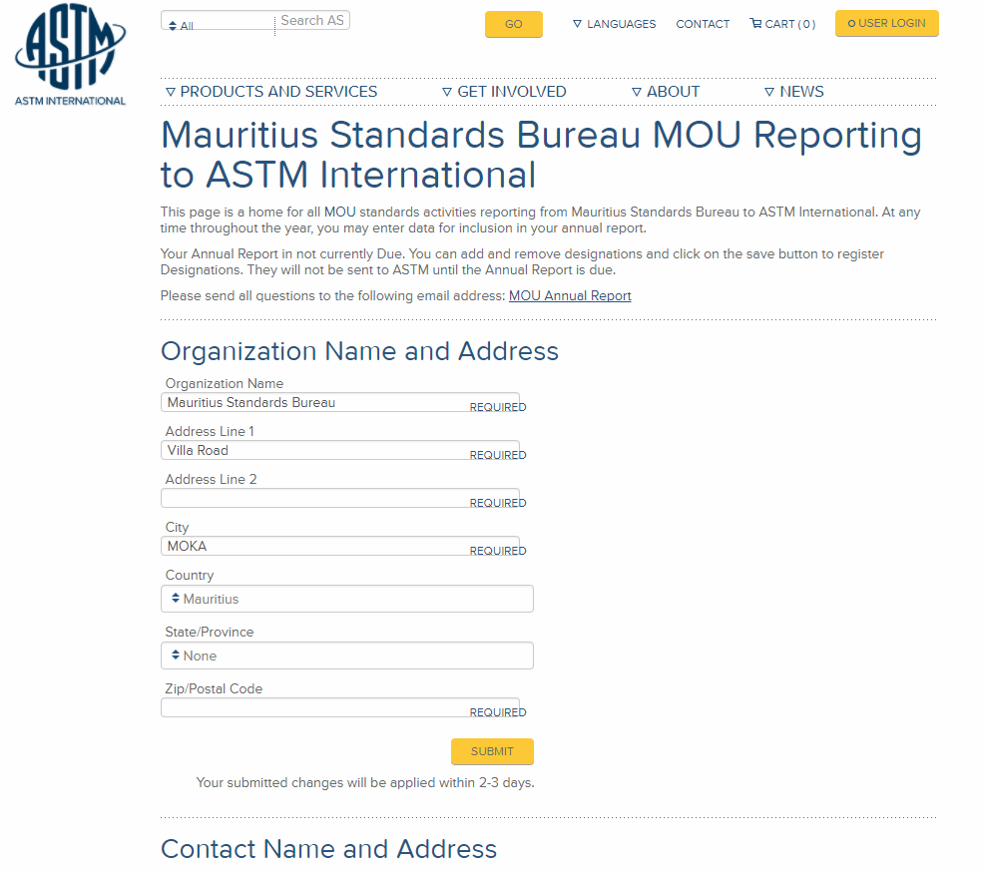
The MoU Annual Report
Due each year on the Anniversary date of the MoU signing.
We will send an email reminder to the primary contact a month before the due date with the online link.

Slide 25
The ASTM-INNOQ MoU Facilitates
Authorized use of ASTM International standards (with appropriate permission and attribution) if they meet the needs of the end users
Enables INNOQ to use the best technical guidance based on the science in the standard, not the “brand” of the standard
The use of high quality, universally accepted standards is a benefit to industry, regulators and patrons
Multiple paths exist to facilitate the understanding and use of ASTM information in Mozambique

Slide 26
Moving Forward Together
Working together, we can promote public–private cooperation through standards development by:
Applying the WTO TBT principles
Promoting consideration by regulators of all relevant international standards developed according to the TBT Committee Decision
Advancing the ability of industries to choose the international standards which best meet their needs, regardless of where they are developed
Encouraging government and private sector participation in standards development
The high-quality, market-relevant international standards we create together can help to support public policy goals by:
Underpinning effective regulations that help make global business more predictable and transparent, while making it more simple and inexpensive for businesses to comply
Making products and materials interoperable and more responsible to environmental, safety and health concerns to meet expectations of consumers
Advancing R&D, product manufacturing, testing, quality assurance, marketing, and trade
In summary, together we can help the world to work better through improved products, increased trade, and greater prosperity for the future.

Slide 27
Contact Information for INNOQ Questions/Issues
ASTM colleagues to contact with questions:
Issues with submitting annual report, access to standards subscription – Courtney Hepler (chepler@astm.org)
Details or understanding of the MoU and related documents – Weiwei Swei
(wswei@astm.org)
Details of various training programs –
Jim Olshefsky
(jolshefsky@astm.org)
Notes:
Account Username: 2033337

Slide 28
Thank you
Teresa Cendrowska
Vice President, Global Cooperation
tcendrowska@astm.org

