Slide 1
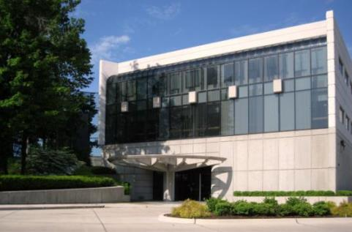

ACI – Stakeholder
Engagement
Notes:
These slides present an overview of ACI and its operations. They touch on most facets of ACI, and as such, users will likely want to edit the slides to accommodate the needs of a specific audience and the speaker’s own style of presentation. For any given presentation, slides may need to be added or either hidden or deleted. It is anticipated that this “base” presentation will grow over time as users request slides on specific topic areas. Thus, this slide set is intended to be more like a library of slides that will serve as a resource document to future users. Please send comments, edits, or suggestions for additional slides to ron.burg@concrete.org.
Updated April 14, 2014

Slide 2
ACI’s Vision
ACI envisions a future where everyone has the knowledge needed to use concrete effectively to meet the demands of a changing world.
Notes:
From revised Strategic Plan March 2012

Slide 3
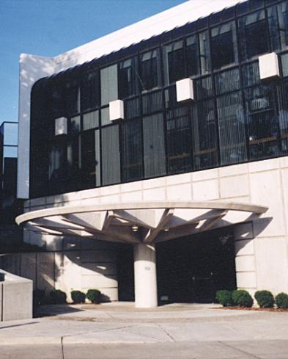
ACI’s Mission
ACI develops, disseminates, and advances the adoption of its consensus-based knowledge on concrete and its uses.
Notes:
Directly from the Strategic Plan

Slide 4
Brief History of ACI
1904: Founded-St. Louis, MO-Nat. Ass. of Cement Users
1910: Published first building code
1913: Name changed to American Concrete Institute
1941: First 318 building code
1947: Technical Activities Committee created
1956: First convention held outside the U.S.
1958: First ACI Chapter
1967: First Manual of Concrete Practice
1980: Certification Committee created
2004: 100th Anniversary
Notes:
The 1956 Convention was in Montreal, QC, Canada.

Slide 5
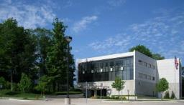
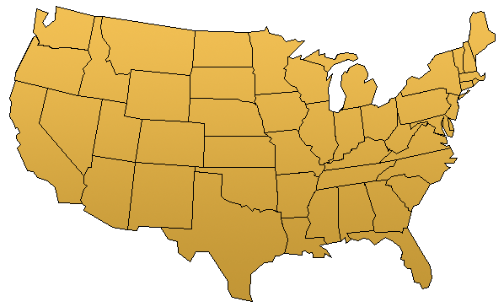
ACI Headquarters, Michigan, USA
Notes:
Office is located in Farmington Hills, Michigan, a suburb of Detroit, Michigan

Slide 6
ACI is:
A non-profit, technical and educational society dedicated to improving the design, construction, maintenance and repair of concrete structures
One of the world’s largest sources of concrete knowledge
ACI is NOT:
A Trade or Promotional Association
A Government Agency
A University

Slide 7

In reality ACI is…

Slide 8
ACI stakeholders are:
Engineers
Researchers
Designers
Professors
Architects
Consultants
Materials Suppliers
Code Officials
Contractors
Craftsmen
Technicians
Inspectors
Trainers
Students
Lawyers
Quality Controllers
Anyone interested in concrete

Slide 9
ACI International Stakeholders
International Chapters & International Partners
41 ACI Chapters in 32 countries outside USA
45 International Partners in Asia, Europe, North and South America, Australia and Africa
  Purpose: Increase collaboration and improve concrete construction by making technical expertise available through mutually agreed upon activities.

Slide 10
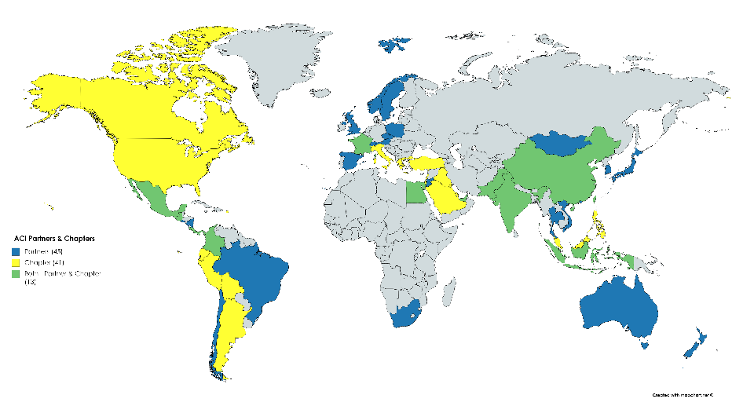
Distribution of ACI Partners and Chapters
Notes:
Blue = Partners
Yellow = chapters
Green = Both

Slide 11
Many Stakeholders Become ACI Members
Approximately 20,000 members in 129 countries
Approximately 14,500 additional Chapter Members
5,400 members outside North America
Over 15,000 Student Members
1,000 Organizational Members
4,000 Active Committee Members
Notes:
There is a total of about 18,500 chapter members, 4000 of which are ACI members.

Slide 12
Committees of Stakeholders Share Knowledge
Board
Executive Committee
Operational Committees
Advisory Committees

Slide 13
ACI Committees - Operational:
Certification Programs Committee
Chapter Activities Committee
Codes & Standards Advocacy & Outreach
Committee on Nominations
Convention Committee
Educational Activities Committee
Standards Board
Technical Activities Committee

Slide 14
Technical Committees (120 total)
General Committees - 11
ACI Board
Materials and Properties of Concrete - 28
Technical Activities Committee
Design and Construction - 50
Concrete Reinforcement and Structural Analysis - 12
Specialized Applications
and Repair - 19
Notes:
Committees are grouped by type as noted. Total technical committees – 120.

Slide 15
ACI Technical Committees - Characteristics:
Open committee membership
Stakeholder balance/lack of dominance
Coordination and harmonization of information
Transparency of committee activities to public
Consideration of views and objections
Resolution through consensus process
Standardization is the most rigorous consensus process used by ACI. It provides the widest input and highest overall quality assurance for a document.

Slide 16
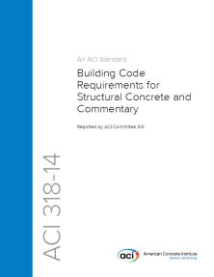
More than 400 technical documents, including:
Codes (ACI 318 Building Code)
Standards/Specifications
Reports and Guides
References
“The ACI Collection” - contains all of the ACI documents you need to answer questions on code requirements, specifications, tolerances, concrete proportions, construction methods, evaluations of test results, and many more topics.
Notes:
These are documents are produced by technical committees.

Slide 17
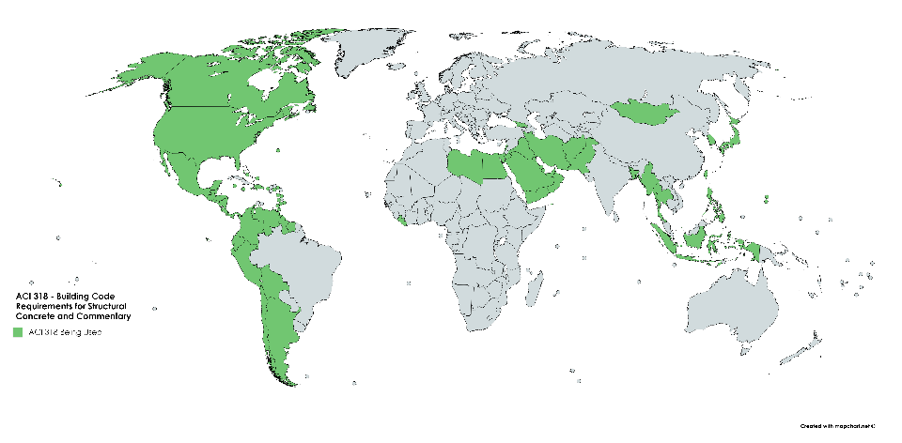
ACI 318 - Used in 65 Countries (and Growing)
Notes:
All pins represent countries in which ACI-Certified individuals reside
Purple pins represent areas serviced by U.S.-based Sponsoring Groups
Red pins represent countries that have ACI Sponsoring Group(s)
Pink pins represent countries serviced by International Sponsoring Groups

Slide 18
Other Representative Committee Documents:
121 - Quality Assurance Systems for Concrete
201 - Durability of Concrete
207 - Mass Concrete
211 - Proportioning Concrete Mixtures
301 - Specifications for Concrete
304 - Measuring, Mixing, Transporting & Placing Concrete
305 - Hot Weather Concreting
306 - Cold Weather Concreting
350 - Environmental Engineering Concrete Structures
Notes:
These are just a few examples of technical committee reports that might be of interest to engineers and contractors involved with the design or construction of hydroelectric plants.

Slide 19
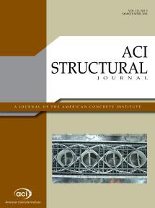
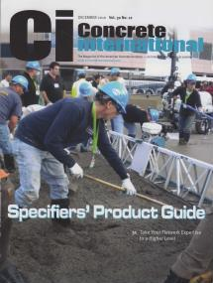
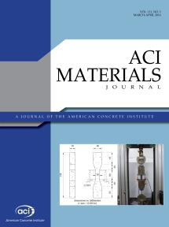
Stakeholders Contribute to ACI Periodicals:
ACI Structural Journal
Concrete International (CI)
ACI Materials Journal

Slide 20
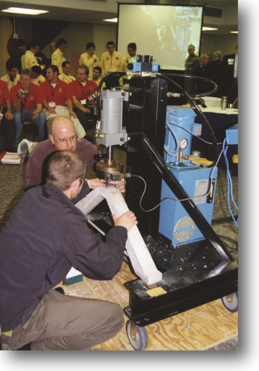
ACI Educational Support:
ACI University - Over 150 online learning modules
Continuing Education:
  -Seminars (example 318-14)
  -Publications
  -Online learning / Webinars
  -Convention technical sessions
  -Training videos
Student competitions
Scholarships/Fellowships
Free online education presentations

Slide 21
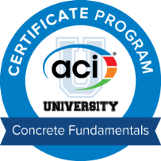

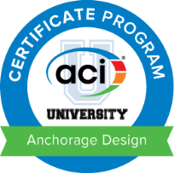
ACI Educational “Certificate Programs”:
Concrete Fundamentals – 12 courses
Repair Application Procedures – 10 courses
Anchorage Design – 10 courses
Notes:
The ACI Certificate Program, delivered through ACI University, encourages concrete professionals to gain in-depth knowledge about particular topics in concrete materials, design, or construction by following a defined online course of study. Once a certificate program has been completed, the participant will receive a certificate from ACI.
NEW! Complete a Certificate Program and earn a digital badge that you can share on social networks, job search sites, portfolio pages, email signature lines, and more.

Slide 22
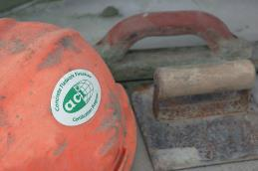
ACI Certification:
Largest certifying body in the concrete industry
Over 30,000 exams conducted each year
Over 555,000 exams administered to date
Certified individuals residing in 67 countries
Certification programs in English, Spanish, French, and Chinese
Over 117,000 Active Certifications
Verify certifications on ACI website

Slide 23
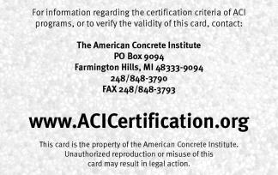
ACI Certification Programs (24 and growing):
Field Technician
Laboratory Technician (3)
Aggregate/Soils Technician (3)
Masonry Technician (2)
Cement Physical Tester
Construction Inspector
Transportation Inspector
Residential Foundation Technician
Flatwork Finisher
Commercial/Industrial Finisher
Tilt-Up Supervisor
Shotcrete Nozzleman (2)
Adhesive Anchor Installer
Anchor Installation Inspector
Quality Technical Manager
Notes:
Numbers in parentheses indicate the number of programs in that category. Programs currently under development include Decorative Concrete Finisher, Non-Destructive Testing Technician, Concrete Construction Sustainability and Resilience Assessor, Self Consolidating Concrete Technician, Shotcrete Inspector, New programs are the responsibility of ACI Committee C601.

Slide 24
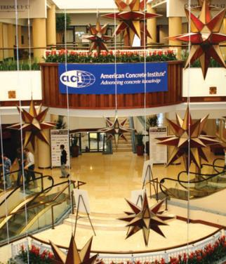
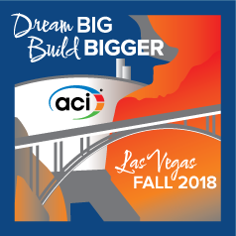
ACI Conventions:
Spring and fall conventions
Over 300 committee meetings
40 technical sessions
Student competitions
1800 to 2200 attendees
from over 35 countries
2018 Fall Convention
  October 14-18, 2018
  Rio All-Suites Hotel & Casino
  Las Vegas, NV
Notes:
Fall 2014 - October 26-30, Hilton Washington, Washington, DC
Spring 2015 - April 12-15, Marriott & Kansas City Convention Center, Kansas City, MO Fall 2015 - November 8-12, Sheraton, Denver, CO
Spring 2016 - April 17-21, Hyatt & Frontier Airlines Center, Milwaukee, WI Fall 2016 - October 23-27, Marriott Philadelphia, Philadelphia, PA
Spring 2017 - March 26-30, Marriott Detroit at the Renaissance Center, Detroit, MI Fall 2017 – October 15-19, Anaheim, California (Disneyland)
Spring 2018 - March 25-29, Salt Lake City, Utah Fall 2018 – October 14-18, Rio All-Suites Hotel & Casino, Las Vegas, NV
Spring 2019 – March 24-28, Quebec City, Canada Fall 2019 – October 20-24, Cincinnati, OH
Spring 2020 – March 29-April 2, Rosemont, IL Fall 2020 – October 25-29, Raleigh, NC

Slide 25
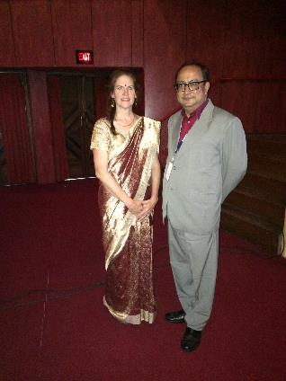
Examples of ACI Stakeholder Engagement:
ACI 562-16 - Concrete Repair Code started by ACI members in concrete repair industry.
ACI 318-14 customized for local conditions in Saudi Arabia by Saudi Arabian professors.
Dubai Municipality suggests creating a new ACI committee on 3D printing of concrete.
IAC began ACI Ambassador Speaker Program to fund speakers to best international concrete conferences.
Notes:
Prof. THERESA “Tess” AHLBORN
Associate Professor
Michigan Technological University
Houghton, MI
2015 Ambassador Speaker in Kolkata, India

Slide 26

Examples of ACI Stakeholder Engagement:
ACI Indonesia Chapter translating 318-14 into Bahasa Indonesian for government to use in code adoption.
ACI / CIDC joint certification program developed to improve quality of concrete in India.
Vietnam code adoption project started by Vietnamese professor who went to university in the USA.
All stakeholders around the world are welcome to participate in the ACI development of concrete knowledge.

Slide 27

Summary:
ACI Stakeholder Engagement
The key ingredient to creating timely, relevant and practical information to help ACI achieve its vision of “a future where everyone has the knowledge needed to use concrete effectively to meet the demands of a changing world.”

