Slide 1
Good Manufacturing Practices for Cosmetics
Presenting Team:
Cathleen Owen, Q Laboratories
Joanne Nikitakis, Personal Care Products Council
May 9, 2022

Slide 2
Outline
What are GMPs
Regulatory Framework in U.S.
Practical Approaches to GMPs
Industry Perspective

Slide 3
What are GMPs?
GMPs refer to a system designed to ensure that products are consistently manufactured to a quality appropriate for their intended use. It is a term recognized worldwide for the management of quality and manufacturing.

Slide 4
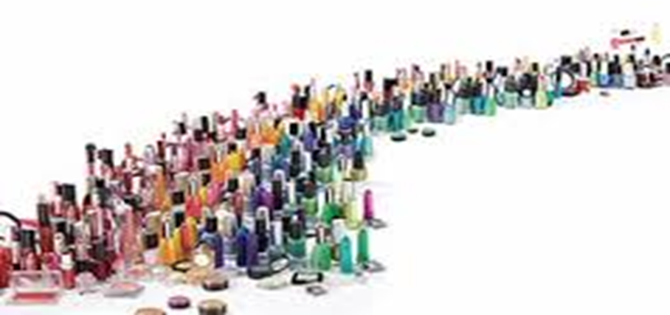
Why are GMPs Important?
Following GMPs ensures that safe, quality products are consistently manufactured each and every time.

Slide 5
GMPs in the U.S.
U.S. law provides the framework for GMPs. Cosmetics are regulated by the Federal Food, Drug & Cosmetic Act:
FD&C Act Sec. 301 prohibits the introduction into interstate commerce cosmetics, drugs or devices that are adulterated or misbranded
Although there are no prescriptive GMP regulations, failure to follow GMPs could result with a product that is out of compliance.

Slide 6
U.S. Regulatory Framework
Adulteration as defined in FD&C Sec. 601:
Is injurious to the user under customary conditions of use
Contains a filthy, putrid, or decomposed substance
Container is composed of a harmful substance
Is manufactured or held under insanitary conditions
Contains a non-permitted color additive in a product other than a hair dye

Slide 7
U.S. Regulatory Framework
Misbranded is defined in FD&C Act Sec. 602:
False or misleading labeling
Lack of required information
Failure to prominently display any required information
Misleading container presentation or fill

Slide 8
U.S. Regulatory Framework
How are these measures enforced?
To implement the law, FDA conducts inspections:
FD&C Act Sec. 704(a) gives FDA the authority to inspect establishments where products are manufactured or held, as well as equipment, unfinished and finished materials, containers and labeling.

Slide 9
U.S. Regulatory Framework
To assist inspectors, FDA published a GMP checklist:
“Rigorous adherence to good manufacturing practice minimizes the risk of adulteration or misbranding of cosmetics. The following establishment instructions, excerpted from FDA’s Inspection Operations Manual, may serve as guidelines for effective self-inspection. A good inspection score means that an establishment follows good manufacturing practice.”

Slide 10
U.S. Regulatory Framework
FDA Cosmetic GMP Inspections Checklist
Manufacturing areas subject to inspection:
Buildings and Facilities
Equipment
Personnel
Raw Materials
Production
Laboratory Controls
Records
Labelling
Complaints

Slide 11
U.S. Regulatory Framework
FDA 2013 Cosmetic GMP Draft Guidance
“If you manufacture cosmetics, you can reduce the risk of adulterating or misbranding cosmetics by following the GMP recommendations in this guidance. By following these recommendations, you can effectively conduct a self-inspection to rate your operations.“
ISO 22716 Cosmetic GMPs are referenced in FDA Guidance
Notes:
International Standard for Cosmetic GMPs
Published in 2007
Final standard was endorsed by more than 160 international standards organizations
Provides a solid framework for cosmetic manufacturing based on GMPs
Communities which have formally adopted the standard into regulation include the EU and ASEAN; and countries which have endorsed the standard include the US, Japan, Canada and Brazil

Slide 12
Practical Approaches
Industry Initiatives -- PCPC Quality Assurance Guidelines
Industry effort guided by PCPC
Voluntary consensus-based GMP guidelines
Initiated in 1980s
Substantial revision over past 35 years
Aligns with ISO 22716 Cosmetic GMPs
Includes self-assessment checklist tool based on ISO 22716 Cosmetic GMPs

Slide 13
Practical Approaches
PCPC Quality Assurance Guidelines Contents:
Personnel and Training
Premises (Facility)
Equipment
Raw Materials and Packaging Materials
Production Control
Finished Products/Lot Identification and Control
Quality Control Laboratory Operation
Treatment of Product that is Out of Specification
Recalls
Subcontractor Quality Assurance
Deviations
Consumer Complaints and Comments
Change Control
Internal Audit
Information Management Systems
Calibration Systems
Sampling
Specifications
Indices of Quality Performance
Evaluating New or Revised Products
New Packaging Quality
Classification of Defects
FDA Inspections
Regulatory Compliance Considerations

Slide 14
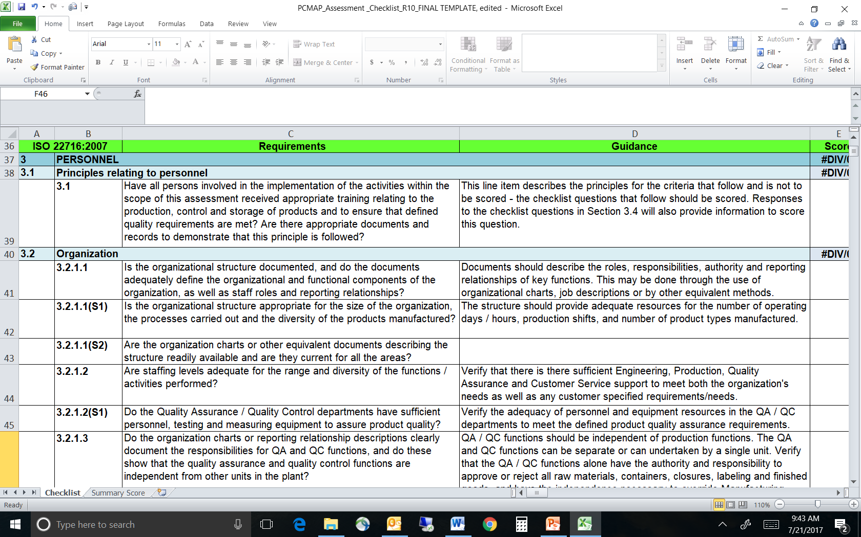
Practical Approaches
PCPC Quality Assurance Guidelines ISO 22716 Checklist:

Slide 15
Practical Approaches
Value of consensus-based guidelines
Principles of GMP are vetted across a broad sector and as a result are widely accepted
Changes can be managed efficiently to support new technologies
The process promotes safety and quality in manufacturing and supports innovation which is business-friendly

Slide 16
Practical Approaches
Value of industry outreach and collaboration:
Industry outreach on how to practice GMPs may be conducted through webinars and workshops
Peer-to-peer interaction facilitates best practice sharing
New or modified approaches can be communicated efficiently through white papers or amendments to voluntary guidelines

Slide 17
Q Laboratories
Cathleen Owen
Director, Pharmaceutical & Personal Care Services
Essential Elements of Cosmetic Quality Assurance

Slide 18
U. S. FD & C Act
The U.S. FD&C Act does not require cGMP for Cosmetics but it absolutely :
Prohibits adulterated or misbranded cosmetics whether from ingredients, contaminants, processing, packaging, or shipping.
Good Manufacturing Practices are the practical ways to manage this expectation.

Slide 19
What Makes a Cosmetic Adulterated?
Section 601 of the FD&C Act [21 U.S.C. 361] describes what causes a cosmetic to be considered adulterated:
"A cosmetic shall be deemed to be adulterated--
(a) If it bears or contains any poisonous or deleterious substance which may render it injurious to users under the conditions of use prescribed in the labeling thereof, or, under such conditions of use that are customary or usual, except that this provision shall not apply to coal-tar hair dye, the label of which bears the following legend conspicuously displayed thereon: "Caution-This product contains ingredients which may cause skin irritation on certain individuals and a preliminary test according to accompanying directions should first be made. This product must not be used for dyeing the eyelashes or eyebrows; to do so may cause blindness.", and the labeling of which bears adequate directions for such preliminary testing. For the purposes of this paragraph and paragraph (e) the term "hair dye" shall not include eyelash dyes or eyebrow dyes.
(b) If it consists in whole or in part of any filthy, putrid, or decomposed substance.
(c) If it has been prepared, packed, or held under insanitary conditions whereby it may have become contaminated with filth, or whereby it may have been rendered injurious to health.
(d) If its container is composed, in whole or in part, of any poisonous or deleterious substance which may render the contents injurious to health.
(e) If it is not a hair dye and it is, or it bears or contains, a color additive which is unsafe within the meaning of section 721(a)." (Section 721(a) of the FD&C Act [21 U.S.C. 379(a)], states the circumstances under which color additives are deemed unsafe.)
Note that the law addresses
the composition of the product itself,
the conditions under which the product is manufactured, shipped, and stored,
the product's container, and
an exception for coal-tar hair dyes.

Slide 20
What makes a cosmetic misbranded?
Section 602 of the FD&C Act [21 U.S.C. 362] describes what causes a cosmetic to be considered misbranded:
"A cosmetic shall be deemed to be misbranded--
(a) If its labeling is false or misleading in any particular.
(b) If in package form unless it bears a label containing (1) the name and place of business of the manufacturer, packer, or distributor; and (2) an accurate statement of the quantity of the contents in terms of weight, measure, or numerical count: Provided, That under clause (2) of this paragraph reasonable variations shall be permitted, and exemptions as to small packages shall be established, by regulations prescribed by the Secretary.
(c) If any word, statement, or other information required by or under authority of this Act to appear on the label or labeling is not prominently placed thereon with such conspicuousness (as compared with other words, statements, designs, or devices in the labeling) and in such terms as to render it likely to be read and understood by the ordinary individual under customary conditions of purchase and use.
(d) If its container is so made, formed, or filled as to be misleading.
(e) If it is a color additive, unless its packaging and labeling are in conformity with such packaging and labeling requirements, applicable to such color additive, as may be contained in regulations issued under section 721. This paragraph shall not apply to packages of color additives which, with respect to their use for cosmetics, are marketed and intended for use only in or on hair dyes (as defined in the last sentence of section 601(a)).
(f) If its packaging or labeling is in violation of an applicable regulation issued pursuant to section 3 or 4 of the Poison Prevention Packaging Act of 1970.
Note that the law addresses
False or misleading information,*
Lack of required information,
Conspicuousness and readability of required information,
Misleading packaging,
Improper packaging and labeling of color additives, and
Deficiencies where the Poison Prevention Packaging Act requires special packaging.
Labeling regulations are very complex. Detailed information on cosmetic labeling is available in FDA's Cosmetic Labeling Manual and the labeling regulations themselves [21 CFR 701].

Slide 21
Prevent Contamination
Prevent Mix-Ups
Have Controls in Place

Slide 22
Key to Remember
You have the burden of proof that your product is not adulterated or misbranded
If it is NOT DOCUMENTED, it NEVER happened.
Good Manufacturing Practices are your best strategy.

Slide 23
Draft FDA Guidance Document

Slide 24
Look for Control Points Throughout the Product Process
Personnel
Building or Facilities
Raw materials
Containers & Closures
Labels
Equipment
Bulk Production Process
Finished Good Production Process
Laboratory Controls
Internal Audits
Distribution
Documentation/Records

Slide 25
Managing Risk Associated with People
Define Responsibilities
Required education, training & experience
Temporary workforce considerations
Define Processes and Procedures
Hairnets, beard nets, gloves, and uniforms/smocks
No food, beverage or tobacco in production/warehouse areas
Restricted Access (especially for visitors/contractors)
Training
Hygiene (personnel, clothing, handwashing, wellness, etc)
Job Specific

Slide 26
Building/Facilities Considerations
Adequate construction & layout
Space and segregation (mix up prevention)
Maintenance (food grade lubricants)
Repairs
Utilities
Power (Generators)
Lighting
HVAC (dust, temperature, humidity)
Water System (Major Risk for micro contamination)
Pest Control
Cleaning
Notes:
Layout - Overhead pipes, drains, toilet and locker facilities, flow of materials and personnel

Slide 27
Raw Material Considerations
Teamwork between Innovation (R&D) and Quality is essential to success.
Minimum Testing
Color/Odor/Appearance
Identity
Functional Test
Purity

Slide 28
Raw Material Considerations
Specifications/Standards
Supplier Qualification/Import alerts
Control of Receipt (Inspection/Quarantine)
Certificate of Analysis
Certificate of Compliance (Country of Origin)
Lot Control
Sampling
Testing
Storage
Sample Retention

Slide 29
Containers and Closures Considerations
Specifications/Standards
Supplier Qualification/Import
Control of Receipt (Inspection/Quarantine)
Certificate of Analysis
Certificate of Compliance (Materials of Construction)
Lot Control
Sampling
Testing
Storage
Sample Retention

Slide 30
Containers and Closures Considerations
Minimum Testing
Color/Odor/Appearance
Identity
Functional Test

Slide 31
Control of Labels
Develop a plan for segregation and control
Compare artwork to printed material
Simple Identification
Storage
Adhesives can be sensitive to storage conditions

Slide 32
Equipment Considerations
Materials of Construction
Identification System
Maintenance
Repair
Calibration
Functional Capability
Cleaning
Records

Slide 33
Bulk Production Considerations
Bulk Product Considerations
Manufacturing Paperwork
How will they be issued?
Where will the documents be stored?
Verification/Validation
Business Decision
Critical Process Parameters/Testing
Cleaning
Retain samples are a best practice
Batch Identification
Storage/Transfer to Filling Lines

Slide 34
Finished Goods Considerations
Production Paperwork
How will they be issued?
Where will the documents be stored?
Verification/Validation
Business Decision
Critical Process Parameters
Cleaning
Retain samples
Batch Identification
Standards/Testing/Certificate of Analysis
Storage

Slide 35
Distribution Considerations
How do you manage quarantine/release?
Shipping Controls
Distribution Records
Batch/lot specific
Location specific
How will you handle compliance audits?
Who will handle complaints?
Digital Cameras can be a valuable tool.
How will you handle Recall and Recovery?

Slide 36
Controlling Change
Written Policies and Procedures
How do you communicate change
Formula Control
Production Process Paperwork
Continuous Improvement

Slide 37
What is your Quality Culture?

Slide 38
Summary
Identify and utilize “Control Points” throughout the product process to manage your risk.
Teamwork, communication and change control will be critical to your success.

Slide 39
References
FDA Draft Guidance for Industry: Cosmetic Good Manufacturing Practices
ISO 22716:2007 Cosmetics -- Good Manufacturing Practices (GMP) -- Guidelines on Good Manufacturing Practices
PCPC Quality Assurance Guidelines
BSE
http://www.fda.gov/ora/ Import Alert 17-04
http://www.cfsan.fda.gov Program 7329.001

Slide 40
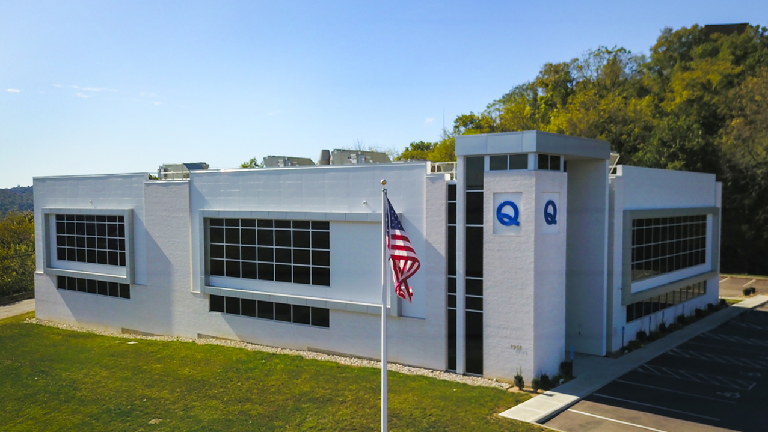
Cathleen Owen Director of Pharmaceutical and Personal Care Services 1930 Radcliff Drive Cincinnati, Ohio 45204-1823 513-471-1300 | cowen@qlaboratories.com

Slide 41
Questions

