Slide 1
“Regulations are Big Decisions that Affect Us” Improving Quality of Regulation through Regulatory Impact Assessment
drs. Kees R. Jonkheer
26 September, 2019

Slide 2
Regulation: role and relevance
Regulations
are
big decisions that affect
‘us’, or ‘other people’

Slide 3
Why do we engage in Regulatory Impact Assessment?
Technically, regulation is the most drastic, thorough and far-reaching intervention governments can take:
Regulation usually addresses systemic issues, such as elimination of market failure, preventing economic swings, improve market infrastructure & discipline, increase economic growth, etc.
Once in place, regulation becomes the prevailing, structural, framework and reference of checks and balances.
The regulatory process is lengthy, costly and time-consuming. Regulation is costly for the administrator, to conceptualize, draft, implement, and enforce. Regulation is costly for society, markets, and specifically for the regulatory target group, in terms of compliance costs.
Regulation often have unintended consequences.

Slide 4
Regulation
“We don’t regulate, unless”

Slide 5
Regulatory Impact Assessment
“We regulate, unless”

Slide 6
Definition of Regulatory Impact Assessment
Regulatory Impact Assessment (RIA) is an evidence-based tool
to critically assess the positive and negative effects
of proposed and existing regulations
by a structured exploration of different policy options.

Slide 7
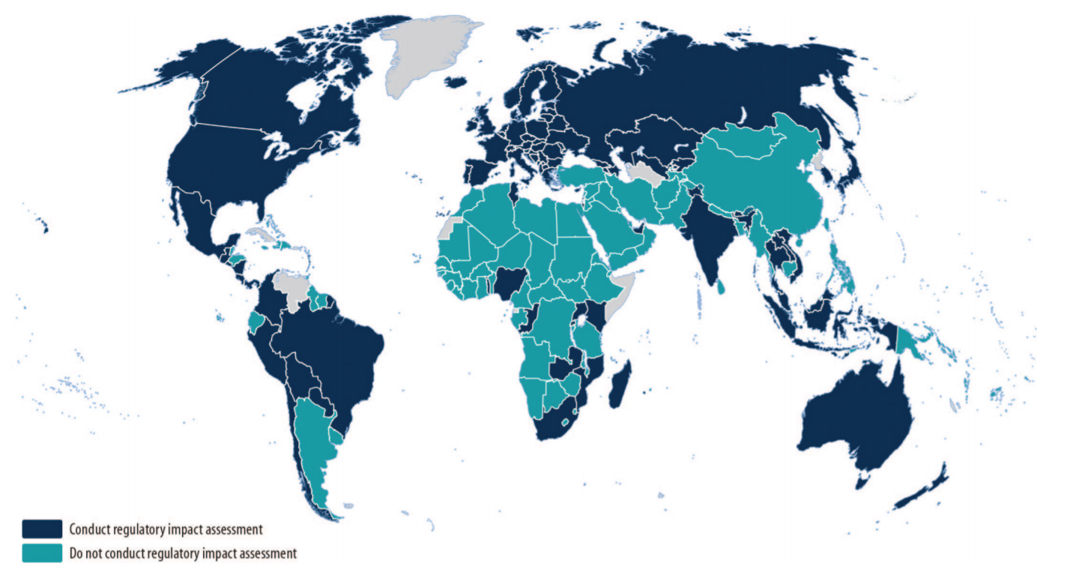
RIA adoption internationally

Slide 8
Can We Quantify Why RIA is important?
Merits of RIA
Costs of Regulation

Slide 9
Merits of RIA. Bosnia Herzegovina: Regulatory Simplification leads to Significant Results in Local Investment-Friendly Environment (LIFE) Project (December 2015 - January 2019)
The LIFE Project is building on lessons learnt in previous World Bank Group engagement where synergetic effects of regulatory simplification lead to significant results, such as increased employment by 6,4% in targeted localities. Moreover, Regulatory Improvement has yielded in the following results so far:
Increased competitiveness of private sector by reducing costs for businesses (direct costs by $7 million, and 20% reduction in indirect costs) by project completion;
Distance to Frontier measure (as related to Doing Business report) improved by five (5) points at any point in time in each of the business start-up, registering property, getting electricity and construction permits before project completion;
$10 million in investment generated, facilitated and retained one year following the Project completion through the work of strengthening collaborative network of policymakers to resolve investor grievances and investor servicing;
Increased transparency of local level government regulatory delivery for businesses through creation of a 20 fully functional public electronic registers of administrative procedures, and 20 inventories of investment incentives by project completion to provide information on administrative procedures for businesses;
Transferred tools for continuation of regulatory reforms work to Federation of Bosnia and Herzegovina ministries.

Slide 10
Merits of RIA. The Netherlands: Better Regulation yields in a total of € 5 billion Administrative Burden Reduction in 10 years (2007-2017)
Administrative burdens for SMEs are estimated at an annual € 8.2 billion at year-end 2012. SMEs includes companies with less than 250 workers.
On average, the administrative burden per SME is more than € 5,700 for businesses with fewer than ten workers to more than € 150,000 for companies with 100 to 250 workers. This shows, administrative costs increase with company-size. Firstly, because the information requirements become heavier as a company is bigger. Secondly, the number of information obligations for companies is also higher as company-size increases.
The average administrative burden per worker ranges from almost € 2,900 for businesses with fewer than ten workers to € 900 for companies with 100 to 250 workers. As companies employ more staff, the burden on the average larger number of workers are spread. Relatively speaking, the administrative burdens are more heavy on smaller companies (around 2% of operating costs) than on larger companies (0.5% of operating costs).

Slide 11
Merits of RIA. Uganda: Business Licensing Reforms 2012-2017 leads to 11.8% less Compliance Costs.
(UGX)

Slide 12
Costs of Regulations. USA: Cumulative Effects (1977-2012)
A study shows the effects of federal regulation on value added to GDP for a panel of 22 industries in the United States over a period of 35 years (1977–2012).
Results show that economic growth in the US has been dampened by regulation by approximately 0.8 percent per year, since 1980.
This means that in 2012, the economy was $4 trillion smaller than it would have been in the absence of regulatory growth since 1980.
Had regulation been held constant at levels observed in 1980, the model predicts that the US economy would have been nearly 25 percent larger by 2012 (i.e., regulatory growth since 1980 cost GDP $4 trillion in 2012, or about $13,000 per capita).
Regulation - by distorting the investment choices that lead to innovation - has created a considerable drag on the economy. The accumulation of regulation over time leads to greater and greater distortion of investment choices.
Source: The Cumulative Cost of Regulations, Bentley Coffey, Patrick A. McLaughlin, and Pietro Peretto, Mercatus Working Paper, April 2016. Mercatus Center, George Mason University, Washington.

Slide 14
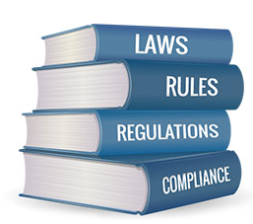
Domain Regulatory Impact Assessment
intent government
interface
government-
society
Government
Society
set of interventions
regulation
‘most drastic’
intervention

Slide 15
Domain Regulatory Impact Assessment
Domain RIA
Government
Regulatory
Target Group
Government subject
Goals to be achieved
Implemented
Guideline of intent
Internal operation
Regulatory Target Group subject
Rules to be complied with
Enforced
Framework of practise
Regulatory burden

Slide 16
RIA is part of the Legislative Process
Policy Development
Legislative process

Slide 17
Challenges RIA on Policies
Policies
A policy is a set of policy options which are oriented towards a long-term purpose, or to a particular policy topic.
Policies are drafted by policymakers and concerns the process that outlines what a government is going to do and what it can achieve for the society as a whole.
Policies concern with guidelines of essentially large, fundamental decisions by governments and parliaments.
Policies may vary due to changing political agendas.
Policies are non-binding. What has been listed is not necessarily done.
Policies are usually drafted with a focus on internal workings and with a motive of applying for government budget.
What impact do you measure when you take a Policy as a Policy Option?
Policies are implemented.
Policy can be ‘any subject’: fertilizer, aquaculture, seed, IP, ODPP, etc.

Slide 18
Challenges RIA on Policies
Regulations
Laws are enacted by a legislature or the governing body of a country. It should be done by a technical body.
Regulations are drafted by legislators, NOT policy makers. It deals with the process of making the law, etc.
Delicate task, setting down the framework of the practical rules for everyday working.
Regulations are meant to be a stable, regardless of changing political agendas.
Regulations are binding.
Rules determine what the regulatory target group must adhere to, to comply with the regulation.
The impact of a Regulatory Policy Option is primarily the impact on the regulatory target group.
Regulations are enforced.
RIAs’ subject or title is either a piece of regulation, or a problem.

Slide 19
Institutional Consequences
Role MDAs
Role PAUs
Role Cabinet Secretariat
Role ULRC, FPC, etc.

Slide 20
RIA as part of the Legislative Process
RIA should have a place in the Legislative Process.
The RIA process should start at Principal stage upon after the finalization of drafting of the Bill.
Actors in RIA drafting: civil servants, PAUs, First Parliamentary Counsel. Noticed here is that the reviewing of Laws is already a mandate of the Uganda Law Reform Commission (ULRC). All of these actors are involved in doing consultations, that is sometimes confusing.
It is acknowledged that currently there is no role for Cabinet Secretariat in the Legislative Process.
In March 2018, Policy Analysis Units have been assigned the responsibility to produce RIAs. The role of Policy Analysis Units in the regulatory process remains ambiguous. Half of the regulation issuing government institutions do not have a PAU (agencies, authorities, ministries, LGs).

Slide 21
RIA in Kenya
The Constitution of Kenya, 2010, demands that all legislation is prepared on the basis of transparent, comprehensive and balanced evidence. “RIA is aimed at ensuring rigorous analysis of regulatory proposals, effective and appropriate consultation and transparency of process".
National Handbook Policy Making (2012).
The Statutory Instruments Act, 2013, requires regulatory authorities to prepare a regulatory impact statement for every statutory instrument (rule, order, regulation, form, by-law, resolution, etc.). The statement shall include an analysis of the impact on the private sector. The Act requires public consultation of all the statutory instruments.
Kenya Law Reform Commission (the Commission), established by the Kenya Law Reform Commission Act, 2013 (No. 19 of 2013), keeps under review all the laws, has a mandate to ensure that all the laws in the Statute Book are reviewed, provide technical assistance to and capacity building.
A Guide to the Legislative Process in Kenya, 2015.

Slide 22
RIA in Kenya
RIA is expressly included in Guide to the Legislative Process (Part XII).
KLRC: Committtee ‘Research, Development and Regulatory Impact Assessment’.
Post-Promulgation Audit Report, RIA on existing stock of Regulations.

Slide 23
Institutionalizing RIA: RIA Strategy is needed
RIA Practise, interdependent pieces of the puzzle:
RIA mandatory in regulatory process Regulatory Oversight Body (ROB)
Goal commitment MDAs
High level Commitment ROB influence and power
Integral approach Coordination and Internalization MDAs
Responsibility RIA with ministries ROB capacity can remain
limited to auditing RIA
Government Strategy Involvement MDAs
RIA part of budget cycle Investment in RIA activities justified

Slide 24
Institutionalizing RIA: RIA Strategy is needed
Some characteristics:
Mandate of Regulatory Oversight Body (ROB), made responsible for advocating, conducting and overseeing RIA practise.
Agreements ROB with MDAs (MoUs, Covenants, Letters of Intent).
Technical Regulatory Impact Assessment Units within MDAs? (see: Policy Analysis Units?).
High-level Coordination Steering Group. ‘One Government’.
Champions: f.e. President’s Office, Members of Parliament.
Regulatory Impact Assessment Council, public-private sector.
Communicate Merits of RIA: why and with what goal RIA is introduced? Goal: %GDP, also justifies investment in RIA practise.

Slide 25
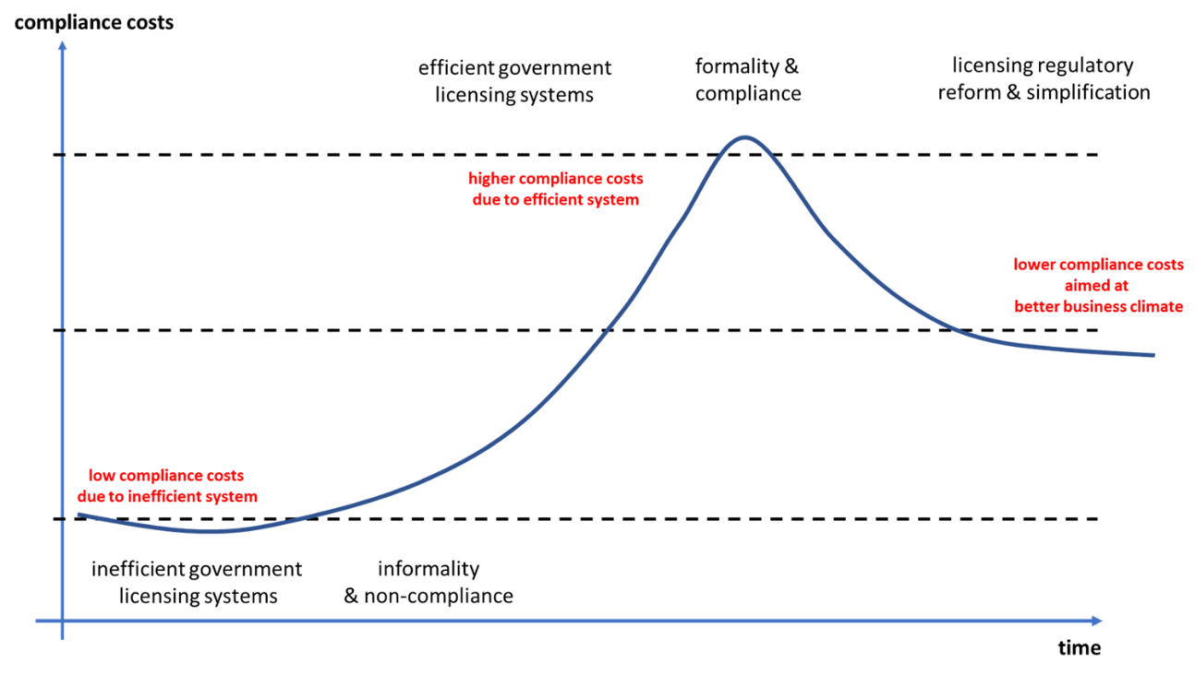
Acknowledging Different Stages in Regulatory Progress per sector within Government of Zambia

Slide 26
Quantitative Impact Assessments
Calculating costs of regulation is important, because there is almost always ‘more than meets the eye’: more to cost than just the obvious costs to implement regulation.
Quantifying the impact of regulation usually is a huge eye-opener for government. Government may know the implications of their regulations on an individual business level, understanding the compliance process its regulation imposes. However, government often is not aware of the extrapolated sector-wise effects.
Applying measured impact analysis of several options may show that a lower cost option still addresses the highest risks and lead to less intrusive regulation. Calculating costs and benefits of each policy option enables a comparison.
In some cases it might demonstrate that the costs would be disproportionate and not justified by the benefits, overall or in relation to particular sectors and therefore alternative options should be adopted.

Slide 27
Impact Assessment
Cost Compliance Assessment
Cost Benefit Analysis
?
v
Cost-Effectiveness Analysis
Multi-Criteria Analysis
?

Slide 28
Conclusions
Regulatory Impact Assessment (RIA) is a tool for improving the quality of regulations. As such, RIA is part of the Legislative Process.
Governments need a strategy to implement RIA, including mandates, roles and responsibilities, fixed mechanisms, and budgeting. A strategy is well-served by including evidence-based promotion of the merits of RIA, and introducing a monetized goal. Zambia has no RIA Strategy.
RIA assesses the impacts of regulations and alternative policy options through applying quantitative methods of measurement. Currently, quantitative impact assessments are not being conducted in Zambia.
Implementation of regulations and therefore RIA recommendations remains a huge challenge.

Slide 29
Way forward
Recommendation 1: Develop a Strategy to sustainably implement RIA.
Recommendation 2: Consider legally Institutionalizing RIA.
Recommendation 3: Do Quantitative Regulatory Impact Assessments.
Recommendation 4: Improve Planning and Implementation & Enforcement Capacities of Regulators and their Executive Bodies.

