Slide 1
Examining RIA Methodologies
drs. Kees R. Jonkheer
23 September, 2019

Slide 2
Examining RIA Methodologies
Core Elements of RIA
RIA Methodologies

Slide 3
Core Elements of RIA
drs. Kees R. Jonkheer
23 September, 2019

Slide 4
Definition of Regulatory Impact Assessment
Regulatory Impact Assessment (RIA) is a systematic tool
to critically assess the positive and negative effects
of proposed and existing regulations
by a structured exploration of different policy options.

Slide 5
The four essential evaluative RIA-questions
The essence of a RIA on a regulatory proposal are these four basic questions:
Are the expected impacts in terms of compliance costs, cost & benefits, and/or cost-effectiveness sufficiently quantified and is the calculation appropriately based?
Are alternative Policy Options that achieve similar results, but are potentially less costly, sufficiently been addressed and considered?
Within the nature, intent and goal of the law/regulation: has the least burdensome Policy Option been chosen?
Has been chosen for the least-cost execution modality of the preferred Policy Option?

Slide 6
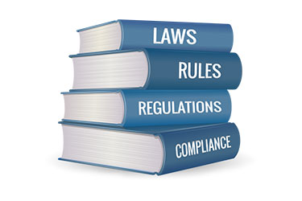
Domain Regulatory Impact Assessment
intent government
interface
regulator-
regulatee
Government
Regulatory
Target Group
set of interventions
regulation
‘most drastic’
intervention

Slide 7
Domain Regulatory Impact Assessment
Domain RIA
Government
Regulatory
Target Group
Government subject
Goals to be achieved
Implemented
Guideline of intent
Internal operation
Regulatory Target Group subject
Rules to be complied with
Enforced
Framework of practise
Regulatory burden

Slide 8
Ex ante ‘IMPACT ASSESSMENT’ acknowledges ‘INTERFACING’
Interfacing with society
Interfacing amongst government
The more focus on interfacing,
the more meaningful Impact Assessments are

Slide 9
Good Regulatory Practise
acknowledges impact through interface with society
WHY
WHAT
HOW
Policies &
Cab Memos
Acts &
Regulations
Implementation & enforcement

Slide 10
As an illustration: ACTAL-audits on ex ante RIAs
0%
30%
70%
WHY
WHAT
HOW
Policies &
Cab Memos
Acts &
Regulations
Implementation & enforcement
Best practises
HOW
IAs more meaningful

Slide 11
Good Regulatory Practise
acknowledges impact through interface amongst government
Health inspections
Tourism license
APK – “health” of car
Driver’s license
Police inspections
Traffic offenses, for example: a broken light

Slide 12
Regulatory Impact Assessment is:
A process initiated by the government.
A process YOU control as key government official.
A tool YOU use to arrive at better, more effective, regulation.
A structured, technical exercise based on evidence.
A critical review of regulatory intent, to minimize unintended consequences of government regulatory intervention.

Slide 13
Regulatory Impact Assessment is not:
Give stakeholders disproportionate say over regulatory proposals.
Changing the nature of regulation’s intent or policy agenda.
Saying that regulation is bad.
About opinions or personal ideas, from any stakeholder.
A policy approval document.

Slide 14
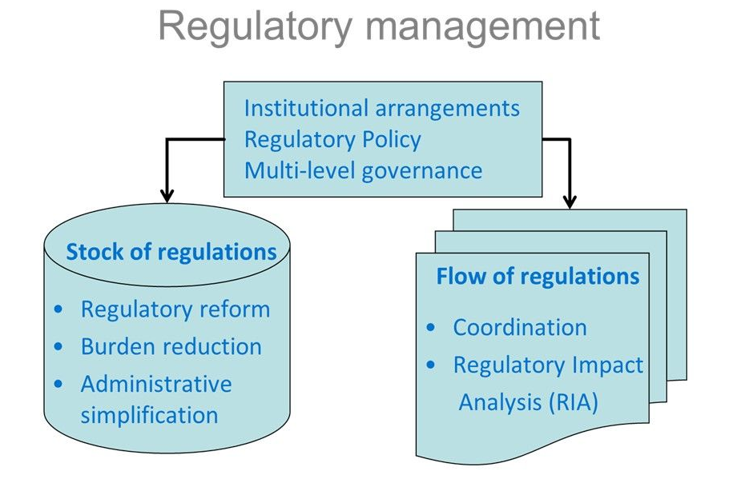
Improving Regulatory Quality: the ‘ideal’ place of RIA in the Regulatory System

Slide 15
Regulatory Impact Assessment: three critical notions
Regulation is always the point of departure. Regulation is always one of the considered options in RIA. The preferred option of intervention may eventually be non-regulatory.
Impact Assessments: Social Impact Assessment, Economic Impact Assessment, or Environmental Impact Assessment. These measure the impact ON society, economy, environment.
Regulatory Impact Assessment however, measures the impact OF regulation. Regulation is the ACTIVE topic.
Regulatory Impact Assessment ≠ Public Finance Management

Slide 16
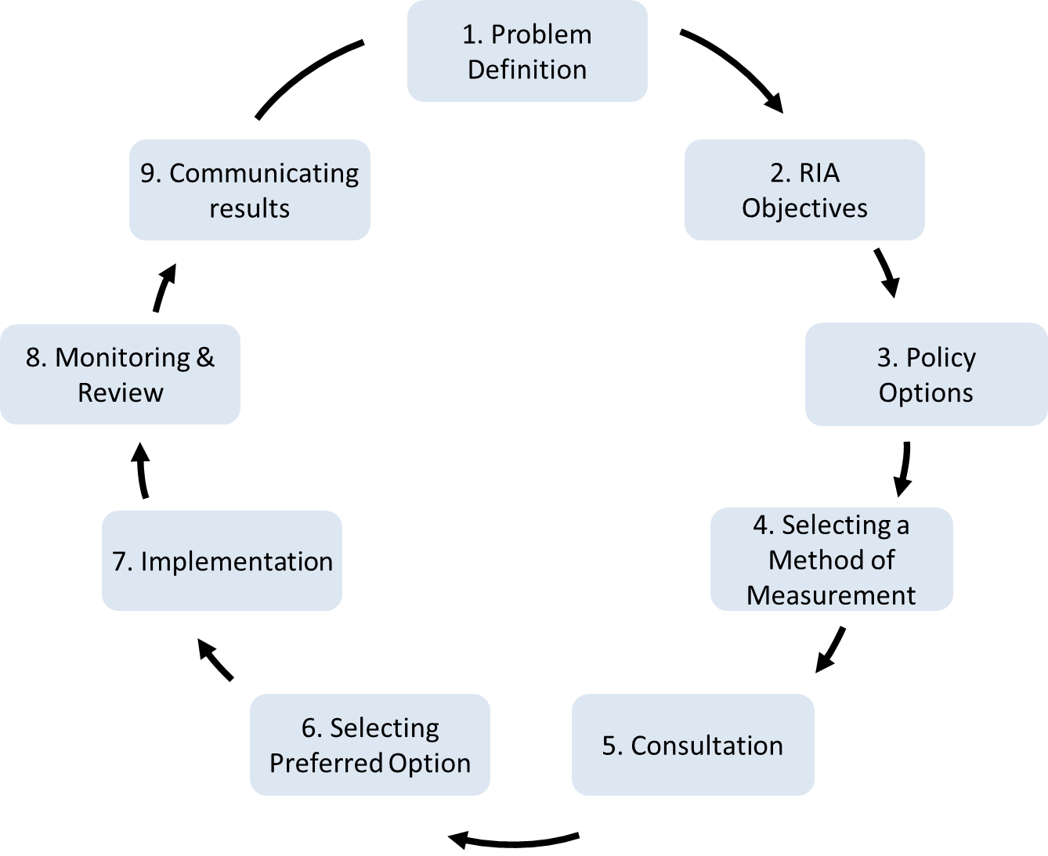
RIA is Process of Steps: the 9 Steps of RIA

Slide 17
RIA Steps in 3 Stages
Building the Case
Results
of RIA
Assessment of Policy Options

Slide 18
Basic Principles of RIA
Basic Principles to take into account with RIA are:
Consistency of Building the Case
Timing of RIA
Policy Context
RIA is Evidence-Based
Data Collection
Significance
Proportionality
Distribution of Regulatory Impact
Alternatives

Slide 19
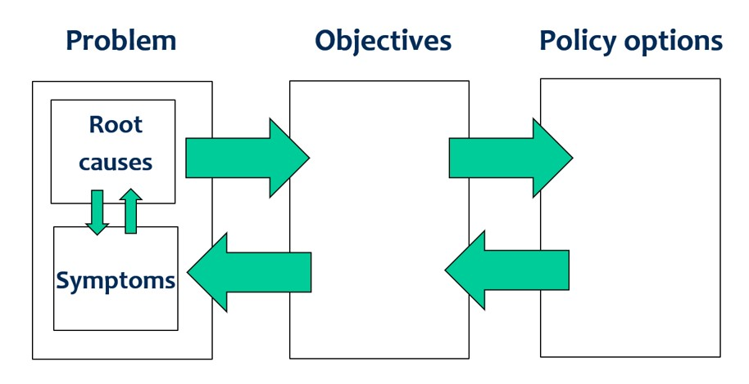
Consistency in Building the Case: do ‘POP’ test

Slide 20
Alternatives
It is most important to have considered non-regulatory options in RIA as these require less drastic, usually less costly, government intervention.
These options may include a wide variety of measures, including subsidies, general charges, or trading schemes.
In many cases, a non-regulatory option will policy-wise be easier to implement than new regulation. In this regard, a non-regulatory option that is equally as effective as the regulatory option would be the preferred option.

Slide 21
Examples alternatives to new regulation
use existing regulation
information and education
market-based incentives
goal-based measures
self-regulation
co-regulation

Slide 22
Methods of Measurement
drs. Kees R. Jonkheer
23 September, 2019

Slide 23
RIA is Process of Steps: the 9 Steps of RIA

Slide 24
RIA Steps in 3 Parts
Building the Case
Results
of RIA
Assessment of Policy Options

Slide 25
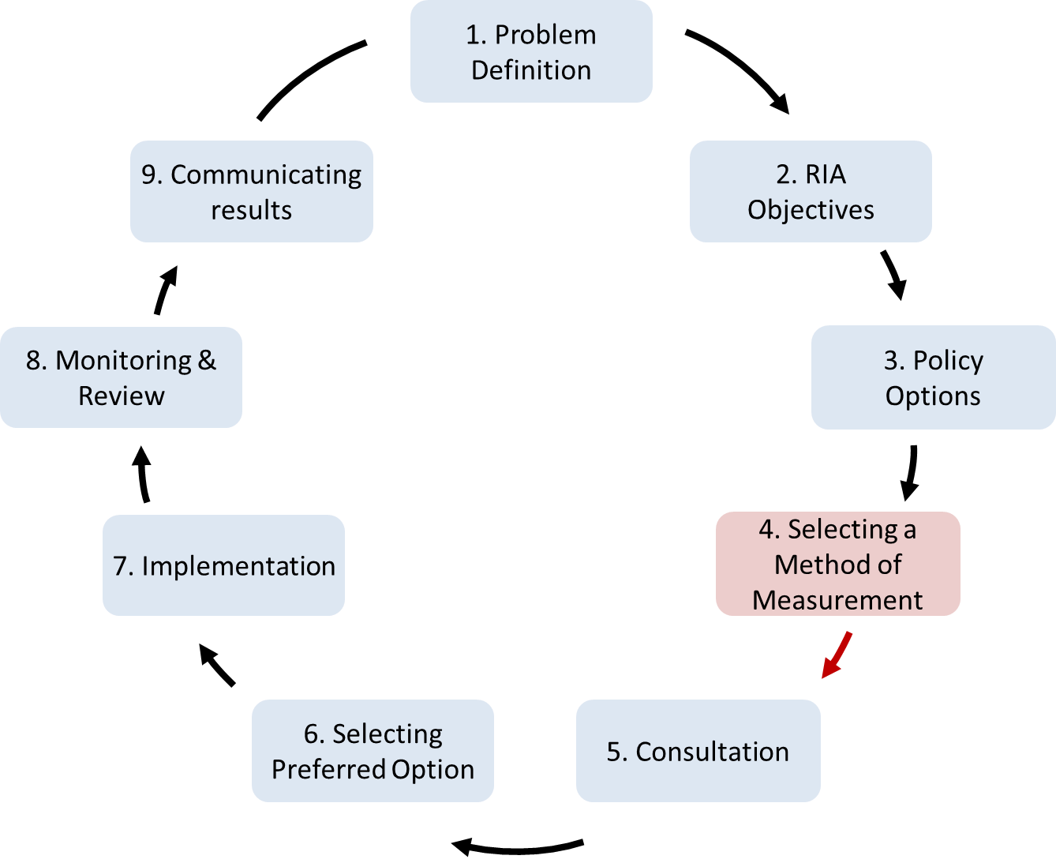
Session 3: Selecting Methods of Measurement
Assessing the
Policy Options

Slide 26
Assessing the Impact of Policy Options
by Use of Methods of Measurement
Costs
Benefits

Slide 27
Why Does Cost Assessment Matter?
Calculating costs of regulation is important, because there is almost always ‘more than meets the eye’: more to cost than just the obvious costs in order to comply with regulations, such as license fees, registration fees and application costs.
Less obvious costs of compliance incurred by businesses are for example travel time, waiting time, frequency of contact with government officials, re-submitting of data, collecting relevant documents, receiving and coordinating inspections.
Calculating costs allows for a sector-wise insight of regulatory costs. Government may know the implications of their regulations on an individual business level, in terms of understanding the compliance process its regulation imposes. However, government often is not aware of the extrapolated sector-wise effects.

Slide 28
Why Does Cost Assessment Matter?

Slide 29
Why Does Cost Analysis Matter? Example: The Costs of Airport Security Regulation
direct costs
Transportation Security Administration
USD 4.3 billion (2005)
People travel less
Reduced air travel
USD 2.35 billion (2005)
It costs more time
Increased waiting times
USD 2.76 billion (2005)
People resort to other
modes of transport
Increased fatalities due to substitution
from flying to driving
116 individuals
(4th quarter 2002)
Source: Mercatus Center, George Mason University, Viriginia, USA

Slide 30
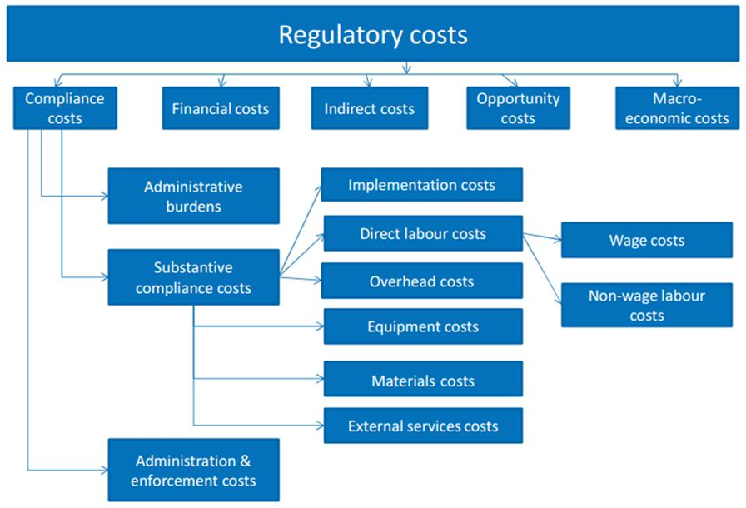
Regulatory Costs

Slide 31
Regulatory Costs
first-round costs
second-round costs

Slide 32
Benefits
Benefits in RIA are the overall positive impacts of the proposed regulation. The main types of benefits are:
Economic benefits are valued in the market and therefore are directly monetized.
Non-economic benefits that can be quantified in numbers and units and may be monetized.
Non-economic benefits that can not be quantified and therefore are more difficult to monetize.

Slide 33
Selecting Methods of Measurement
Assessing the
Policy Options

Slide 34
RIA Step 4: Selecting a Method of Measurement
Four main Methods of Measurements in RIA:
Compliance Cost Analysis (e.g. SCM)
Cost Benefit Analysis
Cost Effectiveness Analysis
Multi-Criteria Analysis

Slide 35
When what method of measurement?
The main 4 criteria to decide when to use which method are:
to identify the type of regulatory cost involved,
whether to assess impact over time,
whether the intended impact is fixed, or chosen, and
whether the impacts can be quantified.

Slide 36
When what method of measurement?
Compliance Cost Analysis is used to assess the direct, first-round costs of regulation and is limited in scope. It focuses on administrative burdens, however often substantive compliance costs, such as costs for external services are also taken into account. These costs have a clearly identifiable target group.
Cost-Benefit Analysis is used for the most comprehensive assessments of intervention options. The impacts are unknown - in terms of both costs and benefits, the target group may as well be, and the impacts are estimated over a period of time. Hence is suitable for major multi-facetted regulatory proposals/options.
Cost-Effectiveness Analysis in a way is the opposite of CBA. It asks what options of intervention are available to most effectively/efficiently reach an intended impact, where probably the benefits may remain unclear.
Multi-Criteria Analysis allows for combining impacts of a set of criteria expressed in different quantitative/qualitative metrics or entities, together in one analysis. The MCA ensures that the different metrics/entities are harmonized, and the criteria properly weighed. In comparison to the use of MCA, a quantitative analysis of costs and/or benefits remains preferred.

Slide 37
When what method of measurement?
Compliance Cost Analysis
Cost Benefit Analysis
?
v
Cost-Effectiveness Analysis
Multi-Criteria Analysis
?

