Slide 1
Global Perspectives on RIA Implementation
drs. Kees R. Jonkheer
23 September 2019

Slide 2
Good Afternoon, my name is: Kees Roeland Jonkheer
MSc in Economic Geography
specialized in European Trade Law
Economic Researcher for first 10 years of career
at the largest economic research institute of The Netherlands, EIM, that developed the first fully operational regulatory impact assessment tool
Ministry of Finance – Advisory Board on Regulatory Burden
World Bank Review 2007: World Leader Regulatory Impact Assessment
Last 11 years: international Regulatory Impact Assessment consultant

Slide 3
Agenda
The Agenda of this Global Trends in RIA Session on Regulatory Impact Assessment:
Relevance of Regulation Why do we engage in Regulatory Impact Assessment?
RIA in international context
Five RIA trends in RIA practise
RIA practise Africa: examples

Slide 4
Regulation: role and relevance
Regulations
are
big decisions that affect
‘us’, or ‘other people’

Slide 5
Regulation: role and relevance
Regulation is aimed at bringing guiding order in societies, with direct repercussions of compliance for large groups of people, over a substantial geographical area, usually for a long period of time.
Regulations address problems and provide conditions to solve these.
Regulations are essential references, will always be referred to, and may intrinsically provoke new (re)actions, will constantly be challenged and will be suffering from abuse where possible, in cases where people see (economic) benefit.
Regulation is at the heart of the fabric of a system that allows for checks and balances. Without the unequivocal reference points of regulation, checks and balances would not be possible.
Regulation exists within a regulatory framework. New regulation is bound to fit, correspond and be consistent with an existing regulatory framework.

Slide 6
2017 OECD Forum
The role of regulation is increasingly crucial in "Unlocking investment" for fostering the right Investment Climate.
Regulatory Reform and Non-Tarriff Barriers are increasingly key to Trade Development (see f.e. EAC, COMESA, SADC, Tripartite Free Trade Area).
All the challenges of implementation that better regulators are familiar with, are key to integrated policies such as Sustainable Development Goals (see f.e. Uganda Agenda 2030, Uganda Vision 2040).

Slide 7
Why do we engage in Regulatory Impact Assessment?
Technically, regulation is the most drastic, thorough and far-reaching intervention governments can take:
Regulation usually addresses systemic issues, such as elimination of market failure, preventing economic swings, maintaining quality standards, improve market infrastructure & discipline, increase economic growth, etc.
The regulatory process is lengthy and time-consuming.
Regulation is costly for the administrator, to conceptualize, draft, implement, and enforce.
Regulation is costly for society, markets, and specifically for the regulatory target group, in terms of compliance costs.

Slide 8
Why do we engage in Regulatory Impact Assessment? cont’d
Regulation has legal and judicial consequences, and requires to be coherent with an overall legal framework and constitution.
Once in place, regulation becomes the prevailing, structural, reference.
Because of its ‘radicalism’, thoroughness and far-reach, impact of regulations are often hard to predict, and are often unintended and unforeseen.
Regulation should be an intervention option governments would only resort to in the ultimate instance when other options do not suffice.
“We don’t regulate, unless”

Slide 9
Regulatory Impact Assessment
A principle decision has been reached to regulate. Ideally, it is a process and a document created before a new government regulation is introduced.
Regulation is the motive for a RIA. As such, it is part of the Legislative Process.
RIA is a decision tool applied to regulation that identifies the optimal form of a piece of Regulation, and possible alternative Policy Options.
Ultimately, the RIA assesses the intended regulation by ‘the four basic RIA questions’.
RIA is applied when there is a regulatory intent.
“We regulate, unless”

Slide 10
The four essential evaluative RIA-questions
The essence of a RIA on a regulatory proposal are these four basic questions:
Are the expected impacts in terms of compliance costs, cost & benefits, and/or cost-effectiveness sufficiently quantified and is the calculation appropriately based?
Are alternative Policy Options that achieve similar results, but are potentially less costly, sufficiently been addressed and considered?
Within the nature, intent and goal of the law/regulation: has the least burdensome Policy Option been chosen?
Has been chosen for the least-cost execution modality of the preferred Policy Option?

Slide 11
Therefore: for Good Regulatory Practise (GRP), Regulatory Impact Assessment is crucial
RIA supports Good Regulation, in assessing that Regulation is:
Necessary and Effective
Appropriate and Balanced
Implementable and Maintainable
Lawful
Consistent
Simple, Clear, Transparent and Accessible
Well-Founded and Well Discussed
Relevant and Up-to-Date

Slide 12
Definition of Regulatory Impact Assessment
Regulatory Impact Assessment (RIA) is a systematic tool
to critically assess the positive and negative effects
of proposed and existing regulations
by a structured exploration of different policy options.

Slide 13
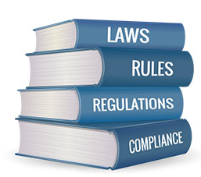
Domain Regulatory Impact Assessment
intent government
interface
regulator-
regulatee
Government
Regulatory
Target Group
set of interventions
regulation
‘most drastic’
intervention

Slide 14
Domain Regulatory Impact Assessment
Domain RIA
Government
Regulatory
Target Group
Government subject
Goals to be achieved
Implemented
Guideline of intent
Internal operation
Regulatory Target Group subject
Rules to be complied with
Enforced
Framework of practise
Regulatory burden

Slide 15
RIA adoption internationally

Slide 16
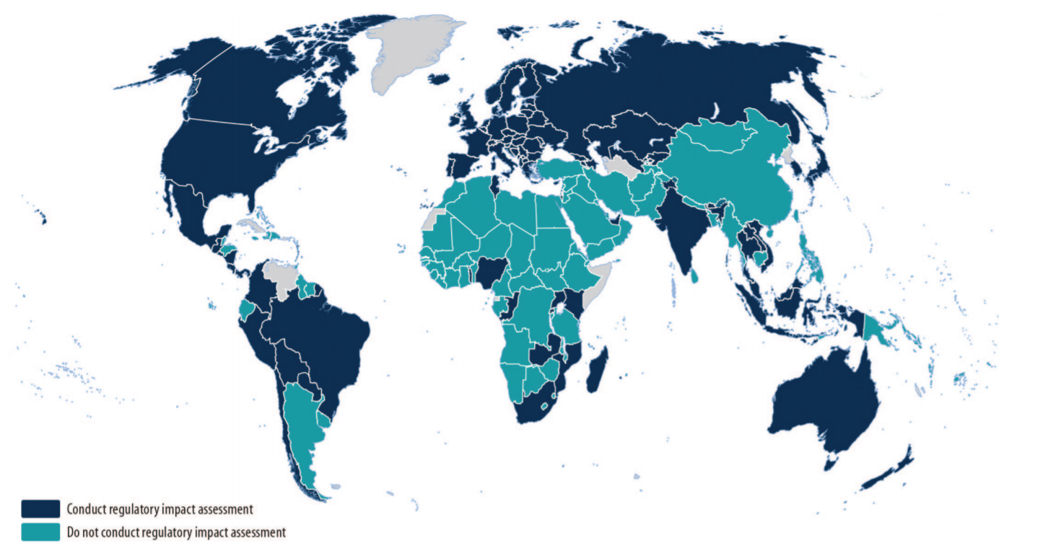
RIA adoption internationally

Slide 17
RIA adoption internationally (WB, 2018)

Slide 18
Countries and RIA

Slide 19
More countries than on the list
El Salvador
Saint Lucia
Trinidad and Tobago
Dominica
Lesotho
RIA-like initiatives around the world:
Suriname Reform of the Decree E-24 SB, 145 and 147, on business Licensing.
Guyana, Improvement Regulatory Framework oil & gas sector.

Slide 20
Trend 1: Regulatory Impact Assessment Legally Institutionalized?
It is often stated that a legal basis for a RIA system is a good indicator by which may be understood how well the RIA system is being implemented. Legal basis: law, presidential order, prime ministerial decree, cabinet or policy directive, etc.?
The main 3 basic questions concerning RIA in international comparison:
Is RIA legally institutionalized?
Is a Regulatory Oversight Body legally institutionalized?
Are MDAs legally bound to conduct RIA?

Slide 21
Trend 2: RIA part of Policy Development or Legislative Process?
The place of RIA in government institutional framework?
When do you start RIA?
Who are the actors?
Conclusion: it depends, and it may differ from country to country

Slide 22
Trend 3: RIA Practise in order to align with International Regulatory Framework, to promote trade
RIA in relation to standards (SLBS, BOBS, etc.)
WTO-TBT
SDGs
EPA
Regional harmonization (SADC-TRF)

Slide 23
Trend 4: However RIA Practise often still donor-driven, momentum changes
Experience from countries like Tanzania shows that RIA as an external, donor-driven programme shows little sustainability.
Source: Towards Water Resources Regulation in South Africa, 3rd report (2011)
Uganda in 2018 reinforced RIA Practise from President’s Office.

Slide 24
Trend 5: RIA Methodology Poorly Applied
Incoherent Business Case: Problem Definition, Objectives, and Policy Options not fully aligned.
Poor Data Availability and/or Collection.
Poor Application and Justification of chosen Method of Measurement.
Impact Assessment still often about what Impact is endured by Government as opposed to impact on the Regulatory Target Group.

Slide 25
RIA in African countries: MENA
In Tunisia, Circular No. 14 of the Prime Ministry (2011), followed by a Decree in 2012 requires that for new laws or regulations an assessment is made of the regulatory impacts.
In Morrocco the Government Programme 2012-2016 foresees a “whole-of-government reform” of the regulatory system. To this end, Morrocco has launched a pilot project at the Ministry for Public Sector Modernisation to simplify 100 administrative procedures.

Slide 26
RIA in Egypt
Mega projects and FDI are a good push for Egypt’s economy. However: Egypt has to create 700,000 new jobs yearly, to keep up with the birth rate.
SMEs employ 83% of the population, jobs will be created by growing and stimulating Egyptian companies.
This requires an “opening up” of the private sector’s base by removing bureaucracy, red tape and over-regulation.
By simplifying regulation, opening access to foreign currency and contracts, government will help Egyptian SMEs as well as encourage foreign investors.
Regulatory Impact Assessment is a process tool to support better regulation and create a better business environment.
Regulatory Oversight Body ERRADA plays a key role in conducting and advocating RIA in Egypt. The initiative was officially launched in 2008 by Ministerial Decree No. 1089/2008, and is chaired by the Minister of Finance.

Slide 27
RIA in Sub-Saharan countries
Tanzania. RIA introduced in 2004. RIA was introduced and embedded in the ‘Business Environment Strengthening for Tanzania’ (BEST) programme. The Office of the Cabinet Secretariat is the focal point for RIA compliance.
South Africa. Cabinet of South Africa approved RIA in 2007. The Central RIA Unit is located in the Presidencies’ Cabinet Office to provide oversight function and support government departments in implementing RIA. The National Treasury provides technical assistance to departments. From 1 October 2015 Cabinet Memoranda seeking approval for draft policies, Bills or regulations must include an impact assessment that has been signed off by the SEIAS Unit. April 2016, Red Tape Impact Assessment Bill.

Slide 28
RIA in Kenya (1)
The Constitution of Kenya, 2010, demands that all legislation is prepared on the basis of transparent, comprehensive and balanced evidence. “RIA is aimed at ensuring rigorous analysis of regulatory proposals, effective and appropriate consultation and transparency of process".
National Handbook Policy Making (2012).
The Statutory Instruments Act, 2013, requires regulatory authorities to prepare a regulatory impact statement for every statutory instrument (rule, order, regulation, form, by-law, resolution, etc.). The statement shall include an analysis of the impact on the private sector. The Act requires public consultation of all the statutory instruments.
Kenya Law Reform Commission (the Commission), established by the Kenya Law Reform Commission Act, 2013 (No. 19 of 2013), keeps under review all the laws, has a mandate to ensure that all the laws in the Statute Book are reviewed, provide technical assistance to and capacity building.
A Guide to the Legislative Process in Kenya, 2015.

Slide 29
RIA in Kenya (2)
RIA is expressly included in Guide to the Legislative Process (Part XII).
KLRC: Committtee ‘Research, Development and Regulatory Impact Assessment’.
Post-Promulgation Audit Report, RIA on existing stock of Regulations.

Slide 30
RIA in Uganda (1)
In Uganda Better Regulation – and, RIA being part of this - is seen as a key tool to achieve its economic growth targets.
In Uganda, most of the government reform programmes/policies are set up separately within each ministry, to support efforts in building a regulatory management system to review and streamline business-related regulations.
RIA is not found to be legally binding in Uganda. Despite RIA being included in a large-scale program of regulatory reform and publications of Guide of Good Regulations and Regulatory Impact Assesment, approval for the legal requirement to include RIA in policy/legislation submissions to Cabinet is still to be obtained.
The institutional framework of the initiative is currently oversighted by the Cabinet Secretariat of the President’s Office.
RIA are frequently done on policies. World Bank 2017 Global RIA Award (Honorable mention) for RIA on National Fertilizer Policy: “Influential RIA”.

Slide 31
RIA in Uganda (2)
The current Framework has been designed without an enforcement mechanism.
The capacity of the Cabinet Secretariat to assess the quality of RIAs and audit RIAs remains low.
The monitoring and evaluation framework of RIA has not been provided. The lack of dedicated institution for the monitoring and evaluation of RIA remains a major weakness. By nature, this institution should have an audit mandate and should not be involved in the implementation process to avoid conflict of interest.
Lack of Cabinet Forward Policy Agenda (planning agenda).

Slide 32
RIA in Botswana
Review of the Standards (Import Inspection) Regulations (SIIR) and the Carrying Out of the RIA on the Proposed Revised SIIR.
To review the SIIR with the view of; i. Aligning it to the WTO TBT Agreement. ii. Strengthening of the sanctions to ensure that the SIIR achieves its objectives.
Conduct Regulatory Impact Assessment (RIA) on the proposed revised Technical Regulation with the view of; i. Improving coordination among government departments and regulatory bodies. ii. Ensuring transparency in the decision process as well as help to eliminate any Non-Tariff Barriers. iii. Conducting an assessment on the impact of the regulatory requirements on regulated products (2018).
Coordinated by the Botswana Bureau of Standards (BOBS)

Slide 33
RIA in Lesotho
Regulatory Impact Assessment framework to design RIA framework for electricity and water, and to undertake detailed RIA assessment for the two regulated industries in the country (2018).
Develop a Legaal and Regulatory Framework for Standards and Quality, Supporting sSale of Bottled Water, a Regulatory Impact Assessment of the regulation of bottled water (2018).

Slide 34
RIA in Mauritius
Trade Regulatory Impact Assessment. TBT programme promotes “Studies, reviews and regulatory impact assessments (RIA) to assess the adequacy of the national/regional/continental Quality Infrastructure and regulatory capacity in order to allow elimination of TBT to intra-REC (Art 31.1 Abuja Treaty), intra-continental and intra-ACP trade, to assess needs, to define strategies and action plans, to evaluate the impact of harmonized TR and standards (2017).
OECD-funded project regarding capacity building for RIA practise at the Economic Development Board of Mauritius (2019).
RIA-project, Mauritius EPA Support Project for Improving the Business and Investment Climate financed under European Development Fund (pending).

Slide 35
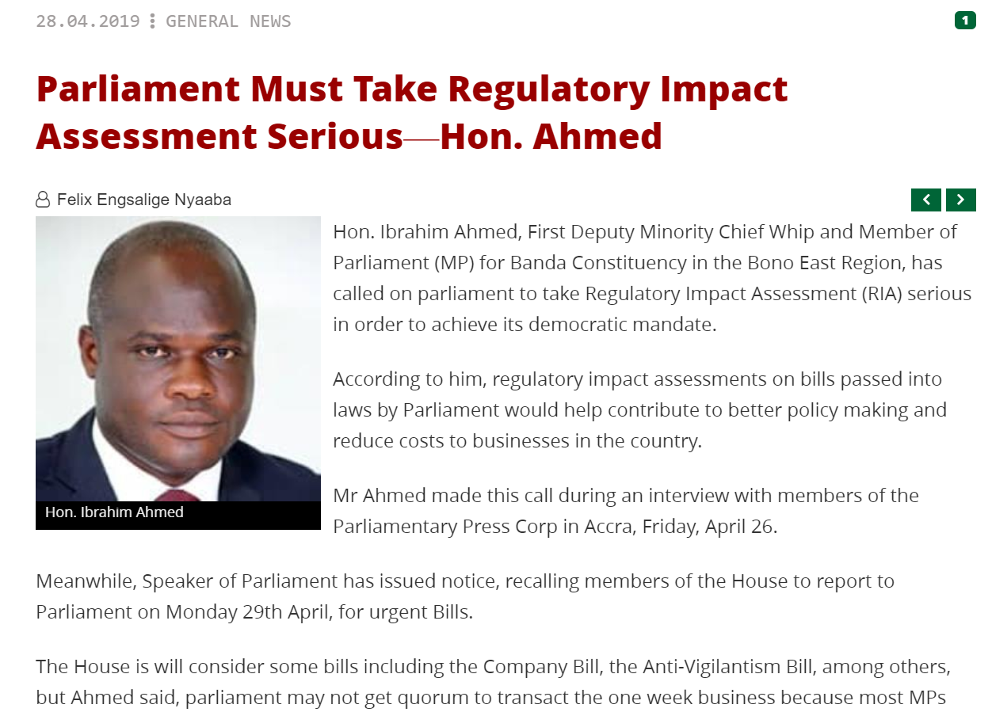
RIA in Ghana
www.modernghana.com

Slide 36
RIA-like initiatives in Sub-Saharan countries
In some countries projects are conducted that are not labelled RIA, but bear the characteristics:
Mauretania is not yet using RIA systematically, however for high impact regulations ministries are requested to provide a summary on the social, economic, health, political and environmental effects of the regulation.
Nigeria Public-Private Dialogue projects because of its consultative nature may bear ample resemblances to RIAs, review Decree No. 21 of 1998, Taxes and Levies (Approved List for Collection) Decree. Economic Impact Assessments, yes.

Slide 37
RIA in Zambia (1)
The Business Regulatory Act N0. 3 of 2014.
Business Regulatory Review Agency (before BLRC, from 2008 onwards).
Successful implementation of business registration and licensing reforms in Zambia (best practise).
Two main documents: the Regulatory Impact Assessment (RIA). standards and guidelines and the BRRA RIA Handbook for public bodies in Zambia.
Any Public body that intends to introduce any policy or proposed law for regulating business activities should perform a Regulatory Impact Assessment (RIA).
Many RIAs on proposed regulation.

Slide 38
RIA in Zambia (2)
There are three main types of policymaking/regulations drafting in Zambia.
Policies
Acts of Parliament
Regulations (Statutory Instruments, fees, authorisations, licenses, permits and certificates). These are usually backed by Acts of Parliaments or are promulgated in Acts of Parliaments.

Slide 39
RIA in Zambia (3)
Policymaking process:
A Government Ministry prepares a Cabinet Memoranda on the policy and sends to Cabinet.
Policy Analysis and Coordination Division (PAC) Analyses proposed policies and makes recommendation to Cabinet.
Cabinet approves policy and notifies initiating Ministry.
Government Ministries conduct consultations.
A RIA is required for policies that impact business activity or the private sector.
BRRA has not yet had a case of a RIA on a policy.
The PS supervises the process of policy formulation. The Minister gives policy direction and seeks Cabinet approval of the proposed policy.

Slide 40
RIA in Zambia (4)
Lawmaking process:
Government Ministry or Regulatory Agency initiates a proposal to introduce a law (Act). The decision to introduce a law is communicated to Cabinet by the relevant Ministry in a Cabinet Memorandum (Cab Memo). At this stage the law is in concept form.
Ministry drafts a lay man’s Bill (forms the major instructions to the Ministry of Justice of what should be contained in the law). The Ministry circulates the lay man’s Bill to other Ministries.
Drafting by the Ministry of Justice. This follows consultations in form of circulation for comments with other Ministries. The lay man’s bill or instructions are sent to the Ministry of Justice for drafting.
Internal legislative committee. Once the Ministry of Justice has drafted the Bill, it presents the draft Bill to the Internal Legislative Committee within MoJ. The Committee is chaired by the Minister of Justice and co-chaired by the Minister of the initiating Ministry.

Slide 41
RIA in Zambia (5)
Lawmaking process:
The draft bill is presented to the Cabinet Legislative Committee composed of fifteen Cabinet Ministers. The Committee scrutinises and makes recommendations to the main Cabinet chaired by the President. Cabinet approves for introduction to the National Assembly of the Bill.
The Bill is then sent to the National Assembly. Readings follow.
Ascent. If the Bill passes the 2/3 majority vote in the House, it is then referred to the President for ascent. Generally the Bill becomes Law the day it passes a 2/3 majority vote.
During the second stage above a RIA and consultation are done.
At the drafting stage, the Ministry of Justice checks to see whether or not a RIA was performed before drafting commences. The Ministry of Justice does not draft and or refer to Cabinet Bills on which RIAs should have been done if not complied with.

Slide 42
RIA in Zambia (6)
The process for formulation of Regulations, Statutory Instruments:
A Public Body or Regulatory Agency notifies BRRA of its intention to introduce, regulations;
A Public Body or Regulatory Agency performs a RIA and consultation, if required;
RIA and Consultation report submitted to BRRA for approval;
If the RIA is approved, a Public Body or Regulatory Agency engages Ministry of Justice to draft regulations. The Ministry of Justice drafts the regulation if the public body complied with Business Regulatory Act else it is referred to BRRA;
The responsible Minister issues the Statutory Instruments.
The PS (or CEO of a Regulatory Agency) supervises the process of formulating a Statutory Instrument. The Minister signs the Statutory Instrument into law.

