Slide 1
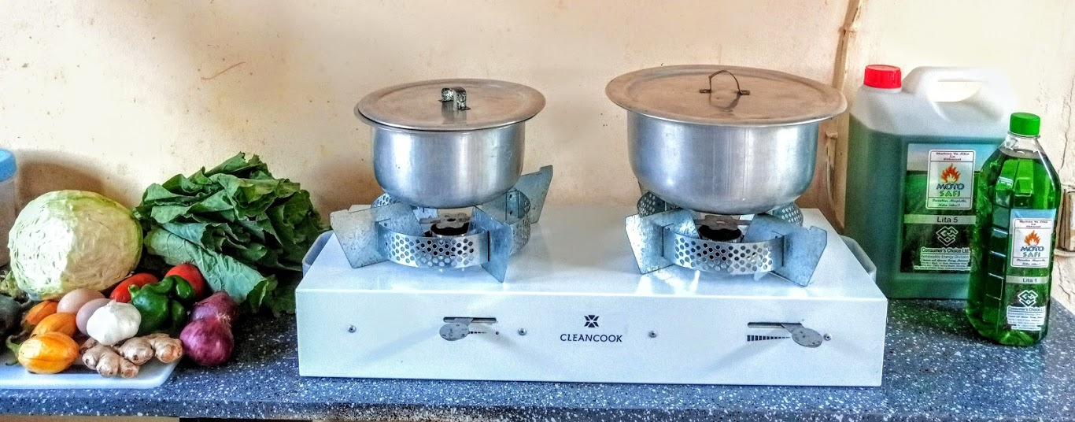
THE DAR-ES-SALAAM MOTO SAFI™ ETHANOL STOVE & FUEL BUSINESS PROJECT. Training Workshop of the Standards Alliance on Bioethanol for Clean Cooking for Bangui, The Gambia and Lome, Togo. March 2022.
By Mohammed Uhuru Kadhi
East Africa Director,
Strategy & Business
Development
CONSUMER’S CHOICE LIMITED.

Slide 2
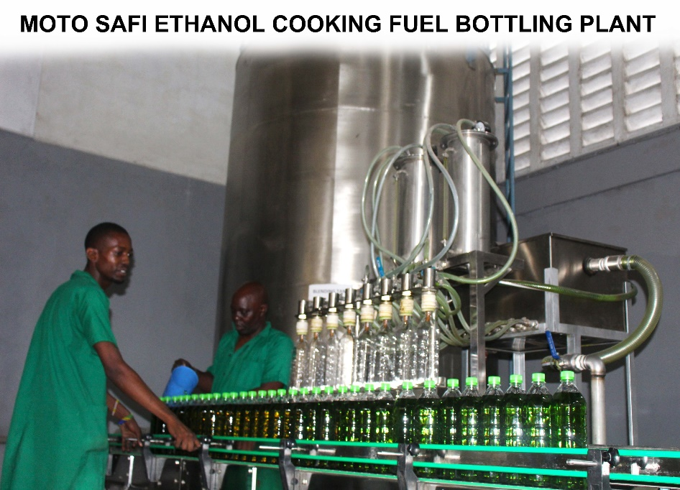
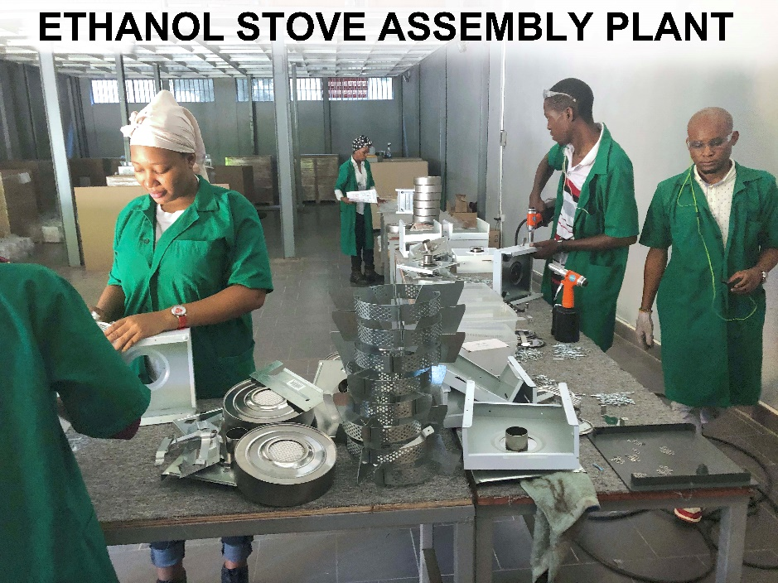
WHO ARE CONSUMER’S CHOICE LIMITED
In 2011 CCL opened a new Renewable Energy Division in
Nairobi, Kenya, distributing ethanol gel stoves and ethanol
gel fuel produced in Tanzania.
In 2012 CCL created its own brand of ethanol gel stoves
branded – Moto Safi.
In Kenya we have sold over 20,000 ethanol gel stoves
and many hundreds of thousand of litres of ethanol gel fuel.
In 2018 CCL Tanzania, opened it’s Renewable Energy Division. In January 2019, CCL won a Govt. of Tanzania & UNIDO tender to distribute 65,000 ethanol stoves in the commercial capital Dar-es-Salaam.
Between February to October 2019, we built a ethanol fuel bottling plant and an ethanol stove assembly plant.
The bottling plant can produce 200,000 litres per month and the stove assembly plant can produce 4,000 stoves per month.
To date we have sold 7,000 stoves and over 100,000 litres of fuel.

Slide 3
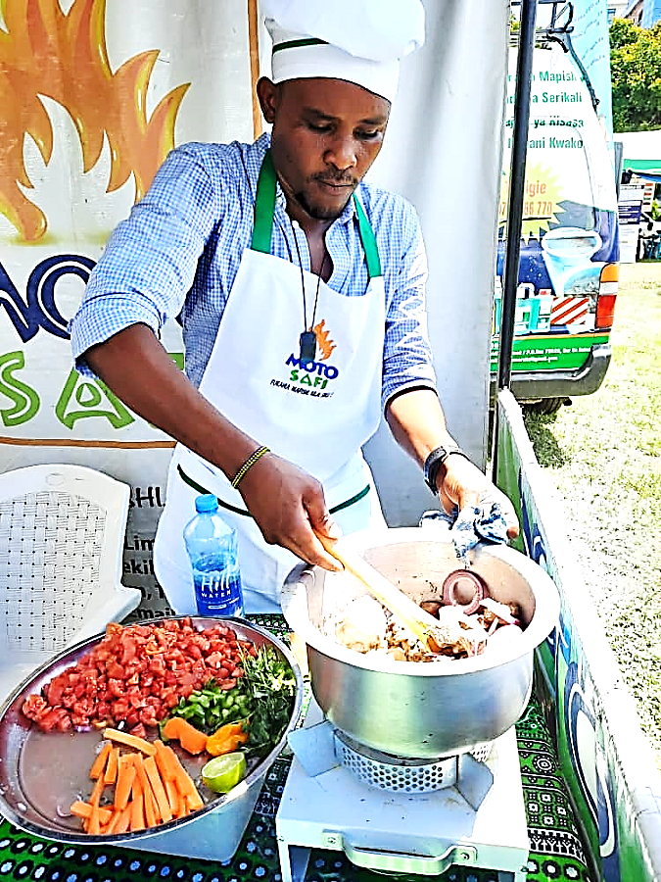
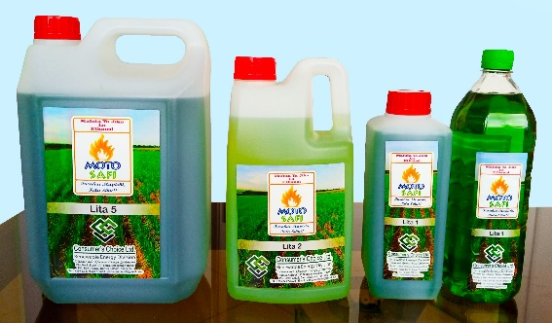
What Is The Problem, and Why Adopt Ethanol As A Cooking Fuel?
Households Cooking Fuel Use
1. 63.5% use firewood
2. 26.2% use charcoal
1 + 2 = 89.7%
3. 5.1% use LPG
4. 3% use Electricity
5. 2.2% use Other Alternatives
Over 50% of all charcoal produced in Tz is consumed in Dar-es-Salaam.
THIS IS NOT SUSTAINABLE AS IT PROMOTES DEFORESTATION.
Today hundreds of thousands of people mainly women and children suffer from IAP related ailments caused by emissions from firewood and charcoal. 14,000 deaths are attributed to HAP.
1. Cleaner than firewood and charcoal, with no smoke or soot.
2. It is sustainably produced and renewable.
3 It is affordable and available in small quantities.
4. Fuel is locally produced.
5. Cooking with an ethanol stove is comparable with a LPG stove.
6. Ethanol stoves are safe and don’t spill and canister is non-explosive.
7. Ethanol stove can cook most African meals.
8. Ethanol stoves are durable and last over 5 years.
There is a potential market of 3.4 million homesteads in urban and peri-urban Tanzania that can use ethanol stoves in and create a demand of 600 million litres of ethanol fuel per year over the next 10 years!
Why Ethanol As A Cooking Fuel
Consumers lack options to buy clean cooking appliances & clean cooking fuel in small affordable quantities.

Slide 4
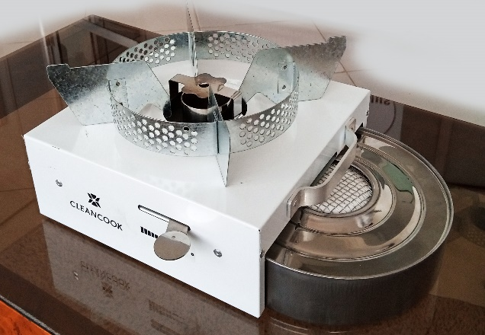
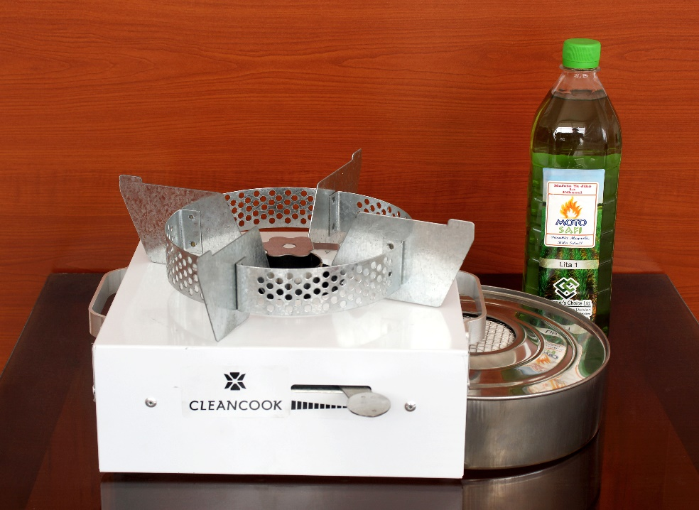
Our Products
Advantages of Moto Safi Ethanol Fuel.
1. 1 litre will burn for minimum 3.5 hours continuously.
2. 1 litre costing Tzs.2,000/- ($0.87) will last a family of 5 persons, 2 days of cooking.
While Tzs.2,000/- of charcoal once lit will extinguish after some hours.
3. Ethanol is made from locally grown sugarcane.
4. Ethanol does not produce smoke while cooking.
5. Ethanol fuel is readily available at local retail outlets.
6. Packed in 0.5, 1, 2 and 5 litres.
Advantages of The CleanCook Ethanol Stove.
Very Portable.
Can carry pots of upto 15kg.
Canister is non-explosive.
Very Durable and will last atleast 5 years.
Tested and passed all emissions and safety tests globally.
Available as a single or double burner.
MOTO SAFI ETHANOL FUEL &
CLEANCOOK ETHANOL STOVE.

Slide 5
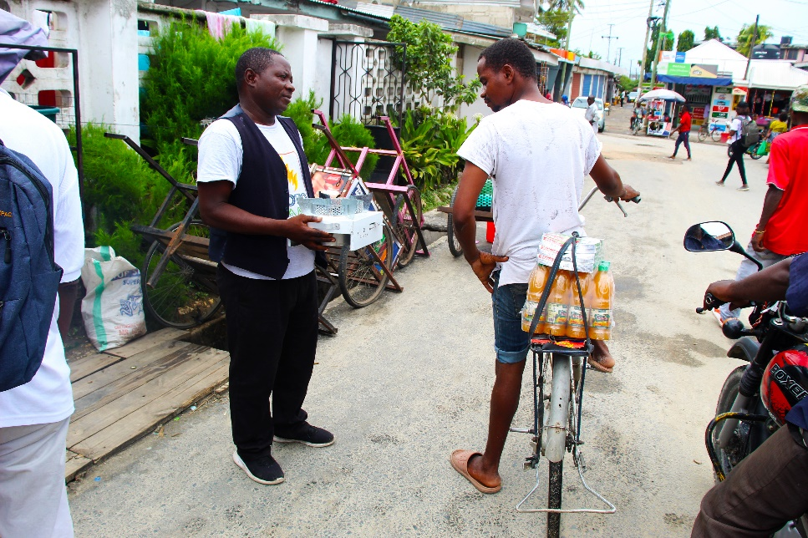
20 Wards Contracted to Distribute

Slide 6
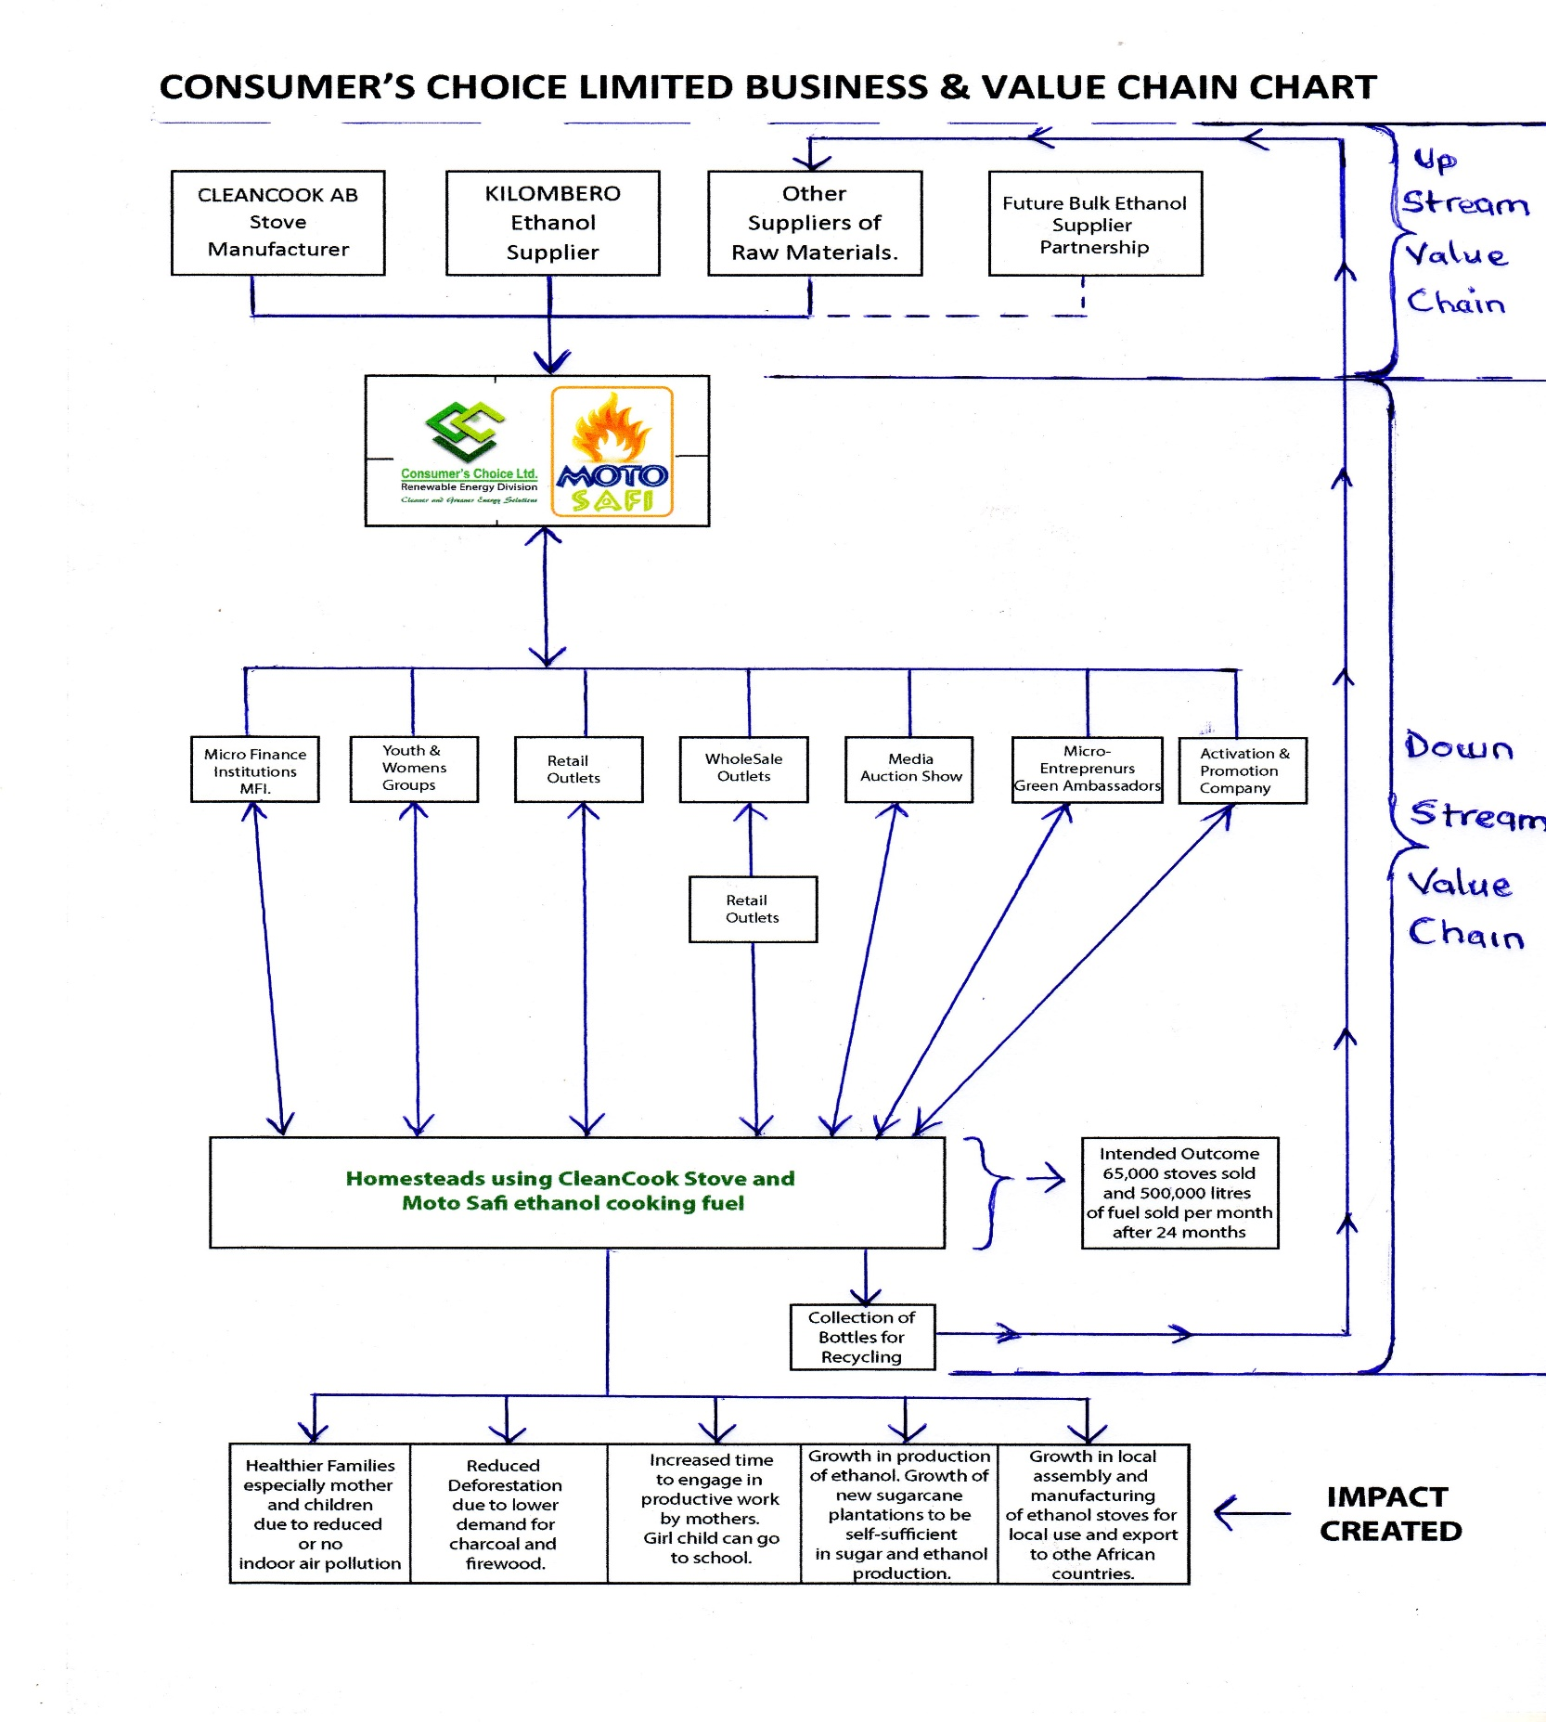
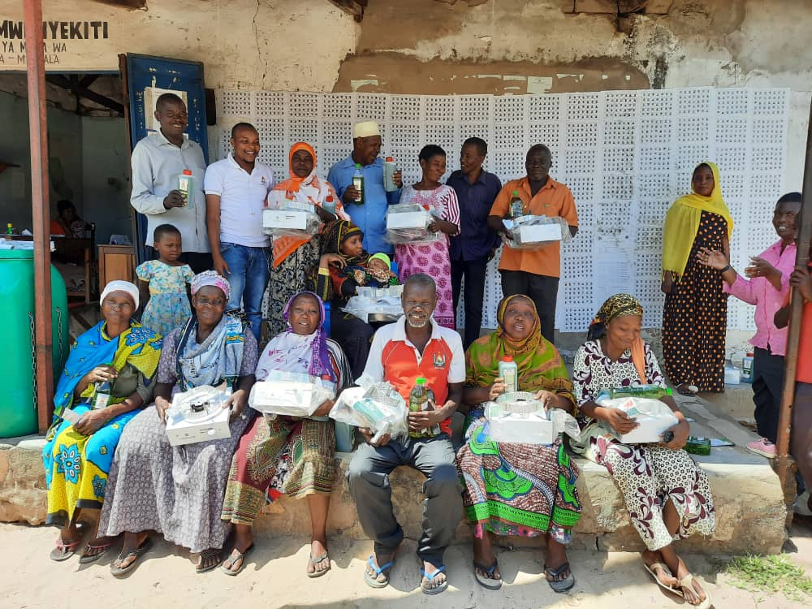
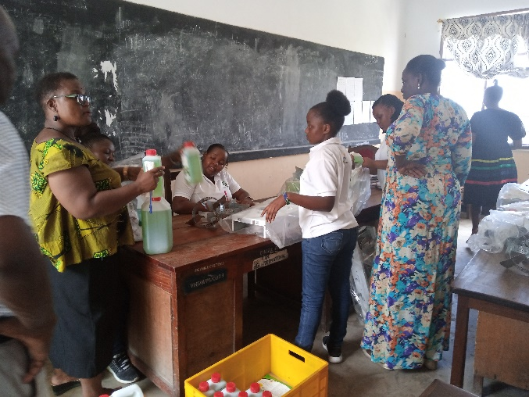
Our Go-To-Market Strategy

Slide 7
Our Expected Impact after 2-3 years
Economic Impact
Direct employment of 30 youths in our factory
Empower 60 micro-entrepreneurs selling stoves and fuel in their communities.
Social Impact
Instant lighting and extinguishing of ethanol stove will greatly reduced cooking times as opposed to using charcoal and firewood stoves.
Environmental Impact
With every 1 litre of ethanol fuel used displaces 3kg of charcoal.
On distribution of 65,000 stoves will save 8,613 hectares of forest from being harvested for charcoal production.
660,000 tons of carbon emissions will be avoided per year.
650 retail outlets will selling our products earning shop keepers higher income per month.
New feedstock such as cashew apple fruit and cassava identified for ethanol production.
Positive health and well being of consumers with reduced or no indoor air pollution.

Slide 8
What Are The Main Challenges Faced
SME Level
Sector Level
Government Level
Lack of unity among clean cooking players and stakeholders to speak in one voice and be able to partner with various institutions to lobby Government for better working environment.
Lack of public awareness on issues of clean cooking.
High cost of creating mass awareness campaigns.
Consumer’s find it difficult to buy stoves with cash upfront.
Competing with LPG cooking technology that is VAT exempt and heavily subsidized, and an unregulated charcoal sector.
No country quality Standards for ethanol fuel and stoves, bringing danger of low quality fuels and stoves.
Lack of partnerships with MFI to avail clean cooking technologies to the public at affordable rates & PAYGO.
Lack of sector focused media campaigns to promote clean cooking technologies, to create mass awareness through bring behavior communication.
Not promoting Clean Cooking Technologies as a National Priority.
VAT imposed on ethanol cook stoves while other technologies like LPG are exempt.
Import duty imposed on denatured ethanol sourced from international markets.
Import duty imposed on clean cooking stoves imported from international markets whether fully built or knock-down.
High cost of setting up an fuel bottling and stove assembly plant.

Slide 9
How To Accelerate Growth & Development.
SME Level
Sector Level
Government Level
Formation of a clean cooking association to cater for members and stakeholders needs.
Provision of Consumer Finance.
Work with Government at inter-ministerial level to address clean cooking issues
Government together with stakeholder to prepare a long term National Clean Cooking Strategy Plan to eradicate dirty cooking within 10-15 years.
Ability to import cheap denatured ethanol from international markets in the short term to fill demand.
Open market to more players to assemble/manufacture stoves and distribution of ethanol fuel countrywide.
Removal of VAT on ethanol fuel and stoves to make them affordable to low income households
Tanzania Association of Clean Cooking Stakeholders (TACCS) will work with academia, TBS and TIRDO to create quality Standards for clean cook stoves and fuels.
TACCS will lobby Government on behalf of members and stakeholders to formulate policies that encourage growth of the sector.
TACCS and it’s stakeholders MUST undertake a new cooking sector study to asses the supply and demand of cooking solutions across the whole country.
Create policies that will promote the growth of the sector.
Initiate a countrywide Behaviour Change Communication campaign on importance of clean cooking and encourage behavior change in urban and rural areas.
Access to affordable capital for businesses to scale.
Give incentives for investments in production of ethanol for self sufficiency.

Slide 10
Basic Requirements To Open A Ethanol Fuel and Stove Business.
First Stage
Second Stage
Third Stage
Deeply understand the cooking technologies currently used in your community and all the challenges faced using them.
TEAM: Hire a motivated team, beginning with a qualified Accountant who will record every investment from inception of business. An experienced head of Sales & Marketing and a qualified Production Manager.
What are the legal requirements to open a ethanol cooking fuel and stove business.
See if ethanol cooking technology can alleviate their current problems.
Conduct a small pilot project in the community who could benefit from the technology. From the results will let you know whether to start a business or not.
Know where to source the raw materials locally – Ethanol, dyes, denaturants, perfume, bottles..etc
Are there ethanol cooking fuel and stove standards in your country or region?
Register a private limited company that will undertake the business.
Obtain all the licenses required to undertake the business.
Locate premises to undertake the business with enough space in an industrial area.
INVESTMENT: Bottling line, stove assembly, rent, office furniture and automation, safety requirements, fuel storage tanks, non-explosive pumps, flow meters, lab equipment, distribution vehicle, sales team vehicle, P.A system, uniforms.
TECHNOLOGY: Use technology to make work easier and profitable. Computers and laptops, smart phones for Sales teams. CRM Soft Ware. Accounting Software: QuickBooks.
Have partnerships with MFI’s, Government, Donor community, Carbon Credits to make stove affordable. Impact Investors.
Join a power business Association that will lobby Government on behalf of the clean cooking sector.
Have a good local bank behind you.

