Slide 1
Training Workshop of the Standards Alliance on Bioethanol for Clean Cooking : Trade & Policy
Mike Lorenz /SVP of Market Development/ Growth Energy

Slide 2
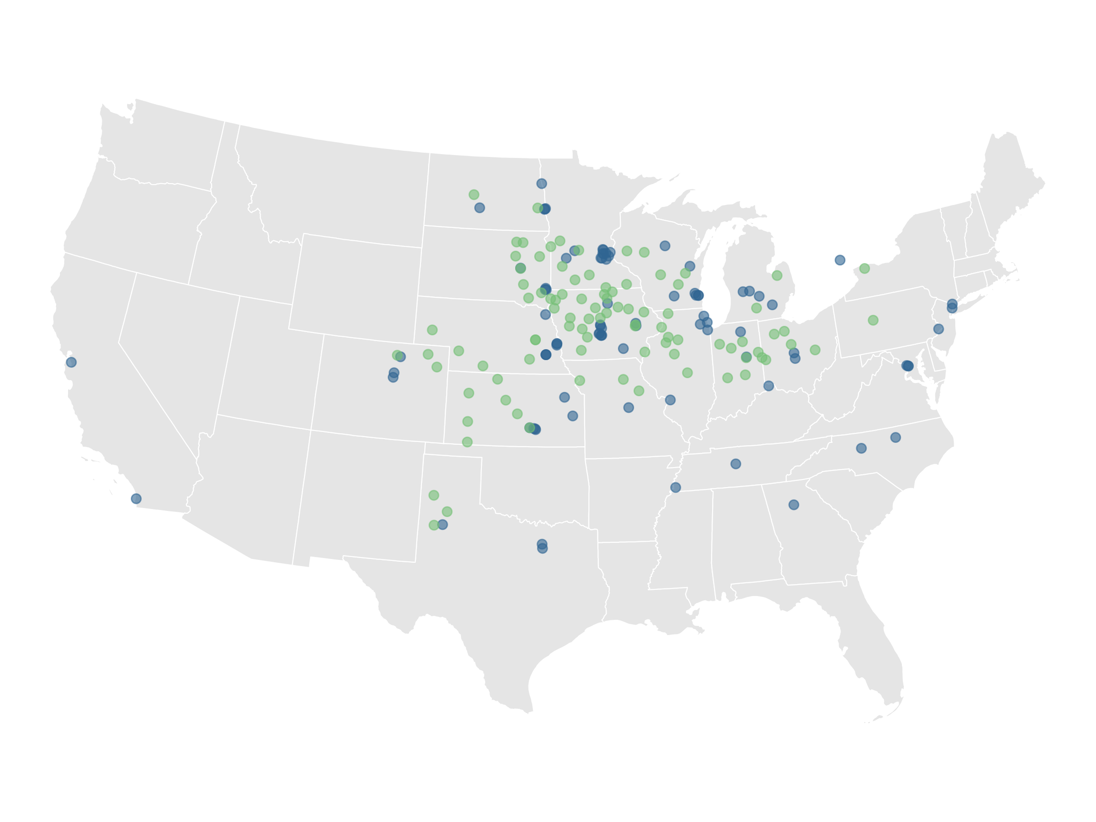
92
89
Engine Smart. Earth Kind.
PRODUCER PLANTS
ASSOCIATE MEMBERS

Slide 3
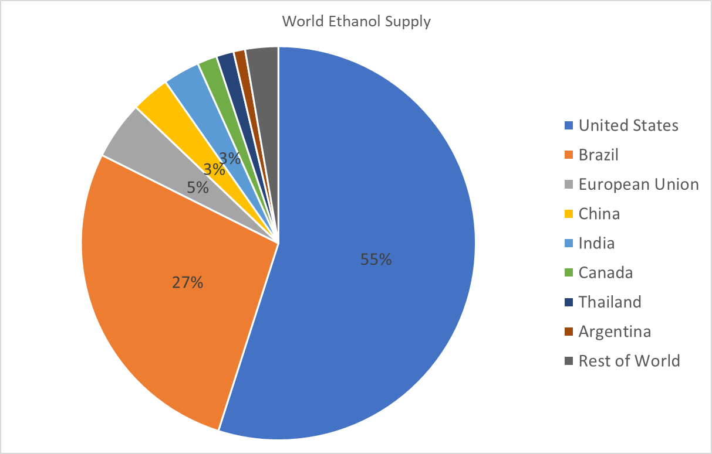

Slide 5
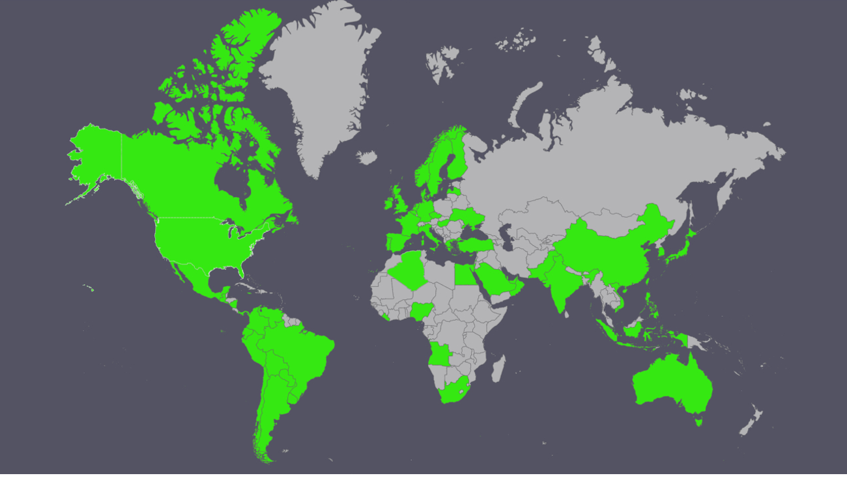
U.S. Ethanol Destinations

Slide 6
Uses For Ethanol
Beverage
Fuel
Industrial
Chemical Production
Hand Sanitizer
Windshield Wiper Fluid
Cooking

Slide 7
Benefits of Ethanol
Environment
Health/Safety
Renewable
Cost Effective
Efficient
Availability

Slide 8
Supply Chain
Security
Flexibility
Cost
Optionality
This Photo by Unknown Author is licensed under CC BY-SA

Slide 9
Imports are Critical
Jump Start program
Supply/Demand Balancing
Ensure Continuity
Provide Competitive Alternative

Slide 10
Legacy Policy: Renewable
Commonly, policy and regulations were formed for fossil fuels and do not embrace renewable fuels.
Fossil fuels are heavily regulated due to their great harm to the environment.
Policies must embrace, not hinder, the full replacement of these harmful crude oil derivatives.
New clean fuels must be treated identically, or better yet preferentially, when recognized, taxed or regulated.

Slide 11
Ethanol Applications: Tax
When used as a motor fuel, there are road tax assessments.
When used as a solvent, there are no tax assessments due to the chemical intermediate use.
When used as a beverage, there are liquor tax assessments.
When used as a clean cooking fuel, there should be no tax assessments.

Slide 12
Program Goals
Reduce Emissions
Improve Health & Safe
Increase Productivity
Sustainability
Economic

Slide 13
Policy : Key Factors
Education of Benefits
Phase In Period
Bans
Mandates
Incentives/Subsidies
Enforcement/Penalties
Certainty

Slide 14
Trade Policy Issues
Commitment
Compliance
Penalties
Unsustainable
Loopholes
Cost/Benefits
Short-Term Economics
Unintended Consequences

Slide 15
Conclusions
Need commitment and certainty
Stakeholder communication
Policy that drives change
Regulations that ensure and enforce compliance
Eliminate barriers to adoption and use

