Slide 1
ECOWAS Bioethanol for Clean Cooking Workshop
Training Workshop of the Standards Alliance
on Bioethanol for Clean Cooking
March 17th - March 18th, 2022
Jad Wakileh
U.S. Grains Council
MEA Ethanol Consultant
JWakileh@grains.org

Slide 2
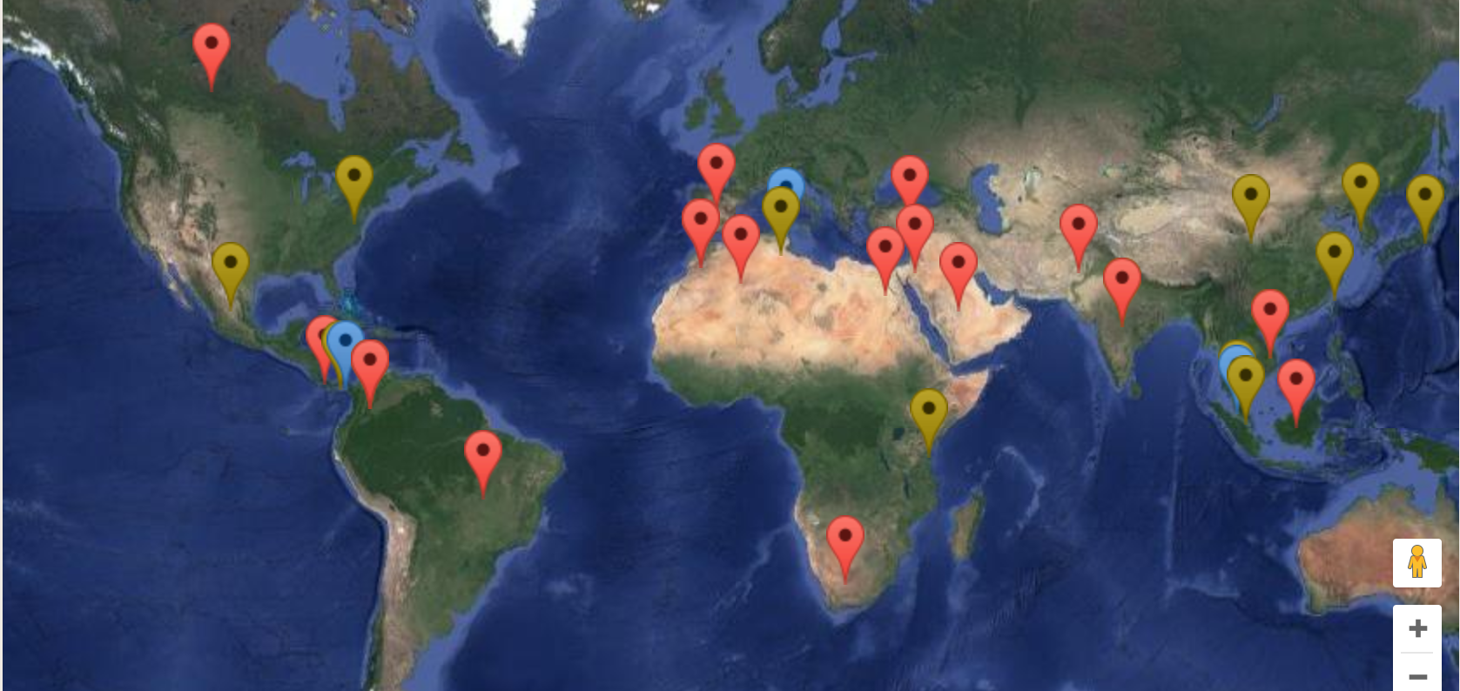
About the U.S. Grains Council
The U.S. Grains Council develops export markets for U.S. barley, corn, sorghum and related products including distiller’s dried grains with solubles (DDGS) and ethanol. With full-time presence in 13 key markets and representatives in an additional 15 locations, the Council operates programs in more than 50 countries and the European Union. The Council believes exports are vital to global economic development and to U.S. agriculture’s profitability.

Slide 3
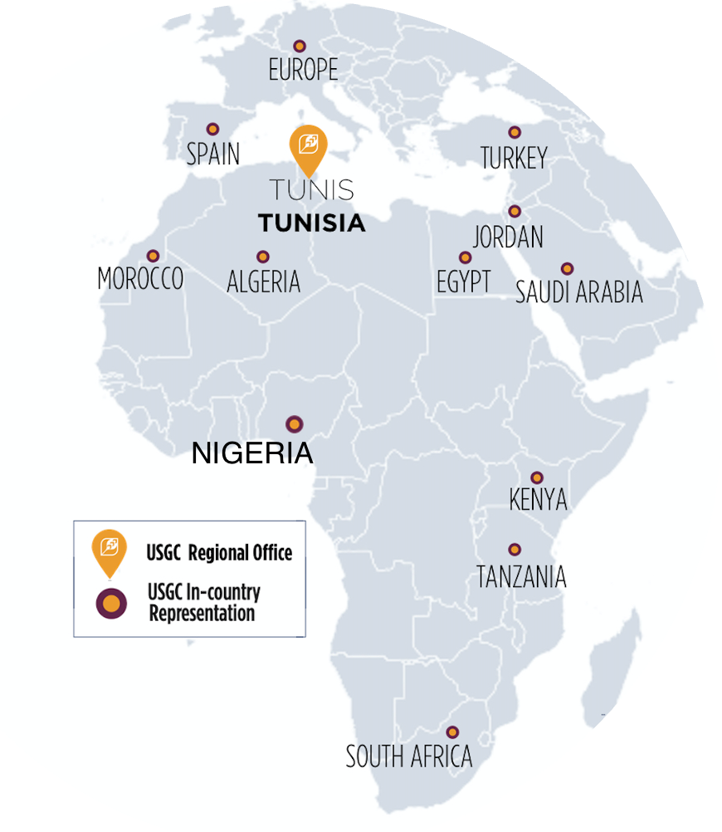
Europe, Middle East, Africa Team
A Network of Influence
& Innovation
The U.S. Grains Council’s MEA Office actively works with countries interested in developing or expanding ethanol policies and use.
The Council’s MEA office actively operates programs in more than 20 countries as well as Europe.

Slide 4
Introduction to Ethanol and Ethanol for the Cookstove Market

Slide 5
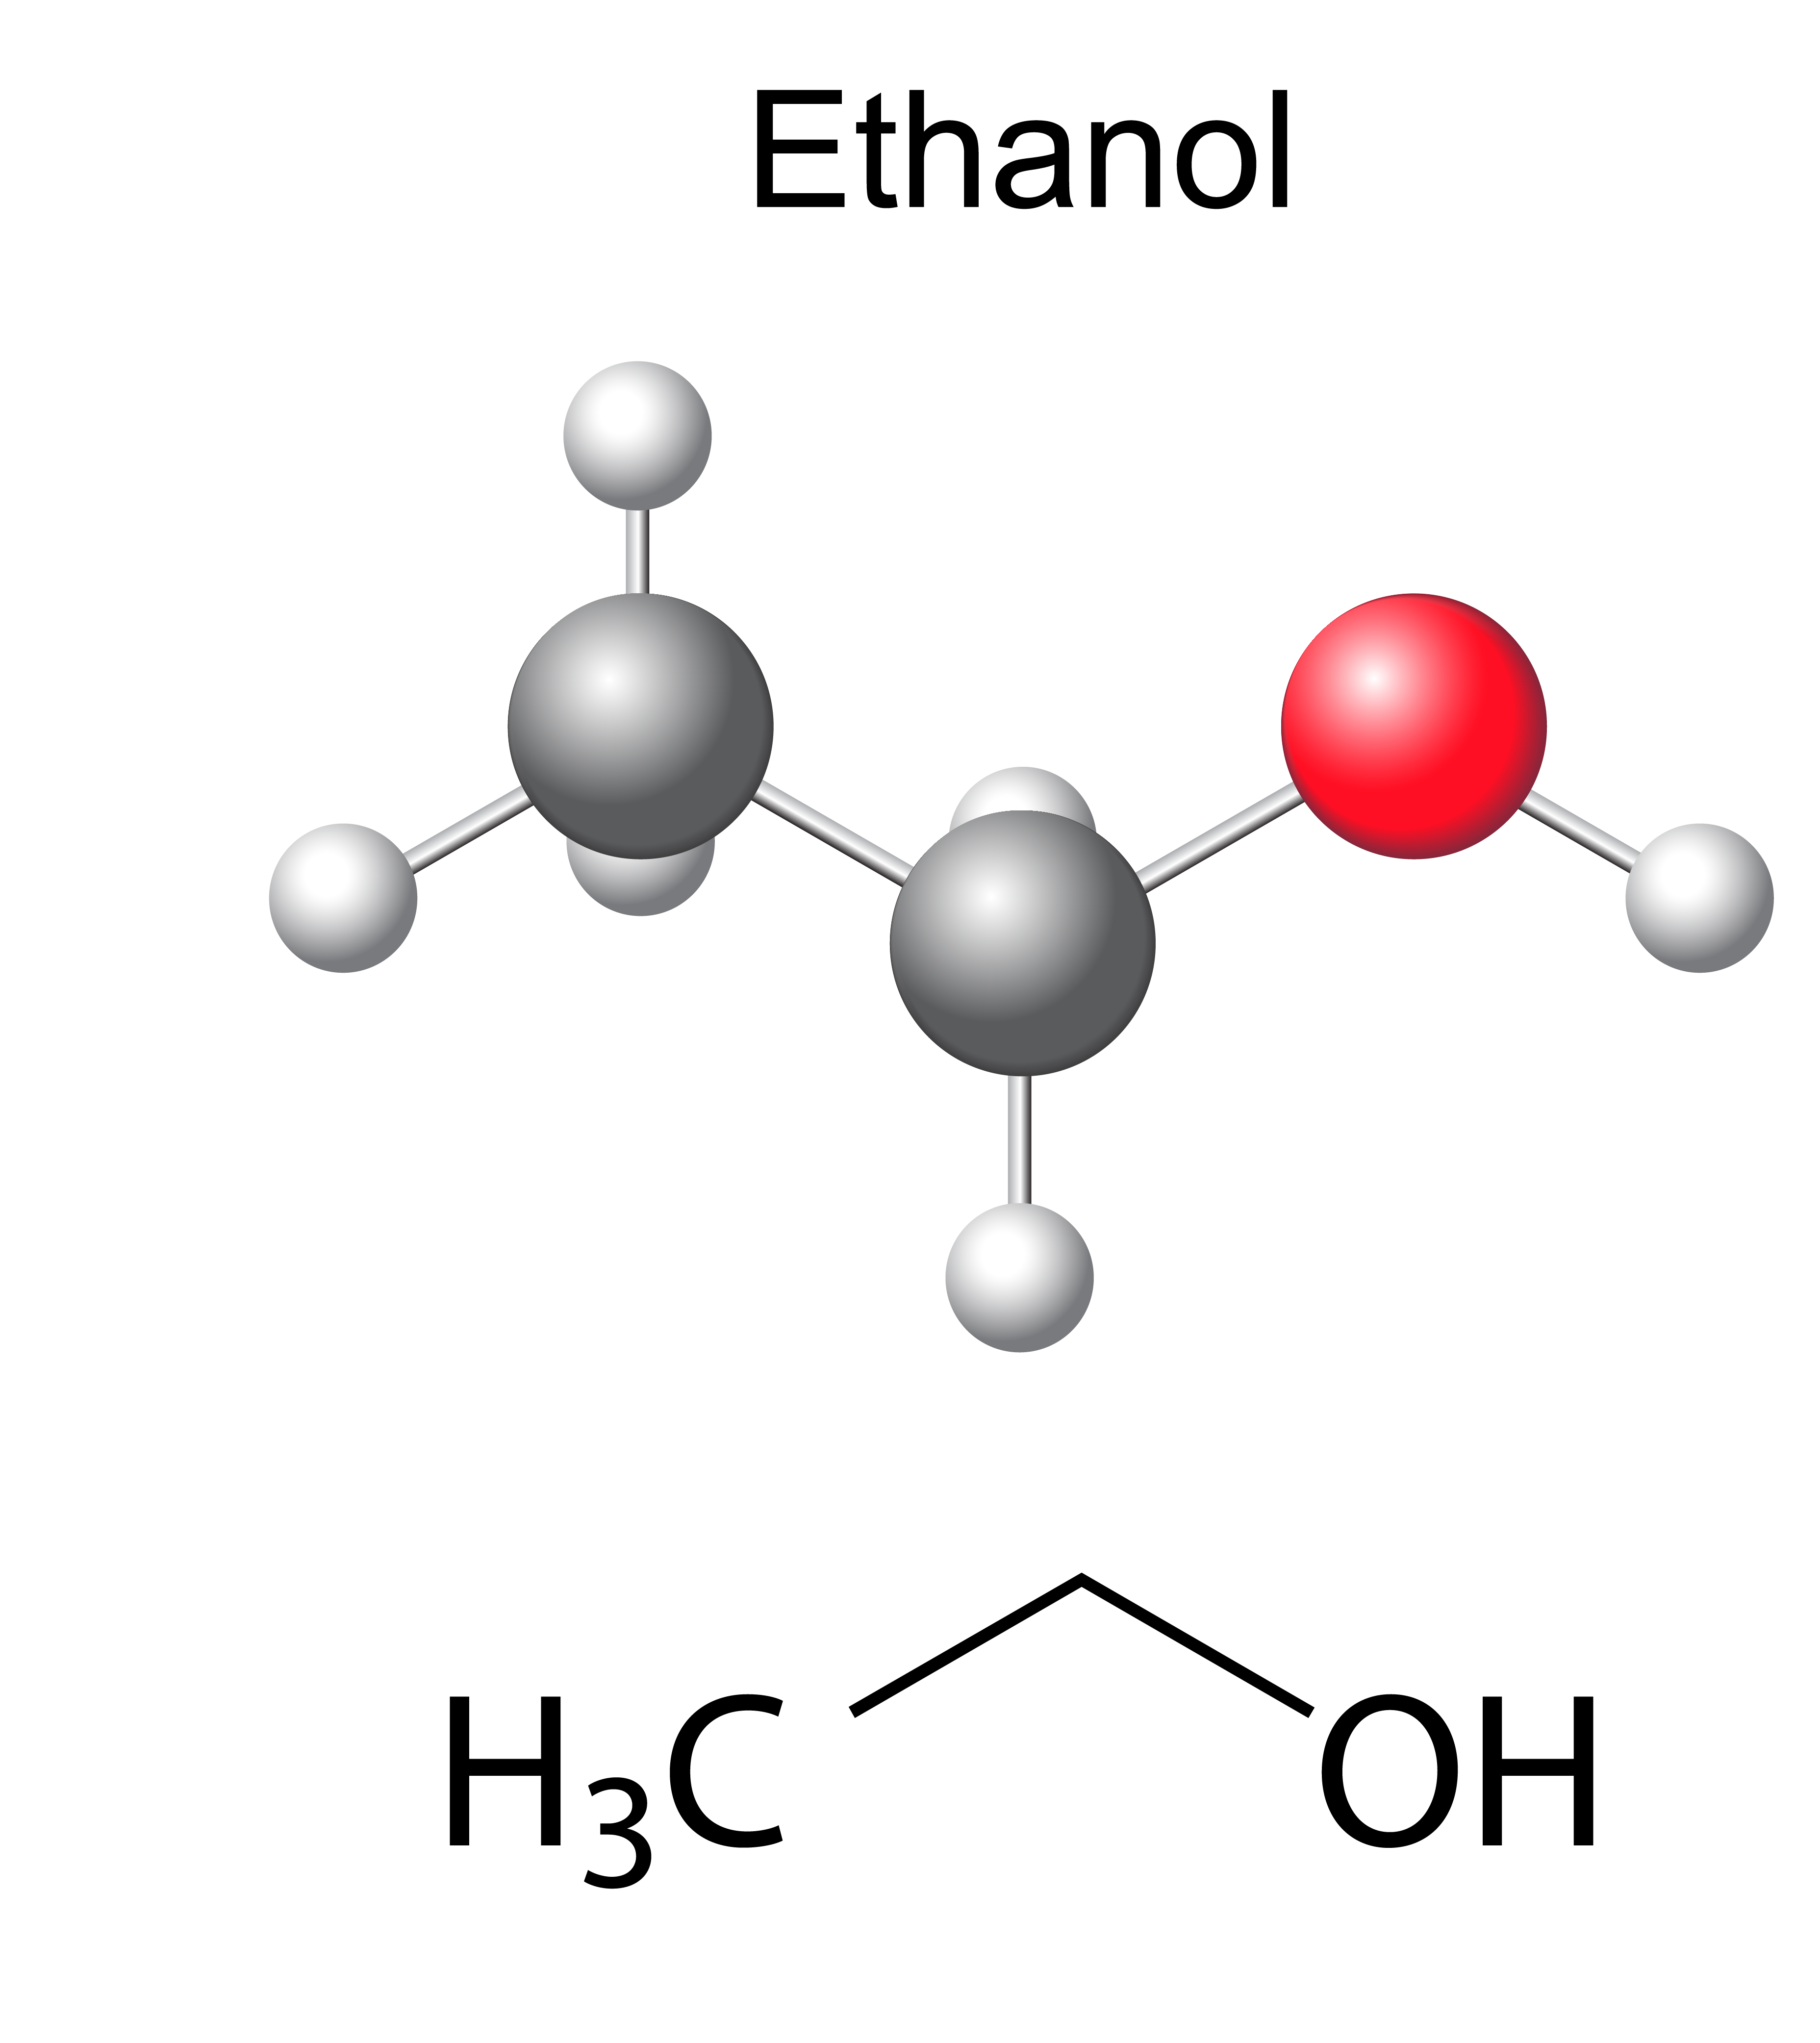
Introduction to Fuel Ethanol
Ethanol is a biodegradable, high-octane motor fuel which is produced from starch or sugar with typical feedstocks:
  Corn (maize), wheat;
  Cassava;
  Sugar cane, sugar beets, sorghum
Whether improving air quality, extending the current fuel supply, creating domestic energy production or arresting global warming, ethanol is a successful answer to all these complex problems.

Slide 6
Africa’s Ethanol for the Cookstove Market Background
In Africa, the rising middle-class households' expenditures will increase which will increase current expenditure for the cookstove market.
Today, 40% of the world relies on simple cookstoves of open flames to cook their food creating a market of 20 billion USD in Africa’s top 40 cities.
The use of ethanol for the cookstove market in the Africa and the ECOWAS region will diversify energy access and will provide clean energy access.

Slide 7
Ethanol for the cookstove market drives significant commercial, social & environmental benefits
Ethanol cooking can disrupt this market at scale, driving significant commercial, social & environmental benefits.
  Affordable: 40% cheaper than charcoal on average
  Accessible: sold in small refill volumes
  Modern: upgrades to quality of life vs. dirty fuels
  Clean: burns cleanly with low particulate emissions
  Safe: no risk of explosion when handled responsibly

Slide 8
Impact of Tax and Duties
Training Workshop of the Standards Alliance
on Bioethanol for Clean Cooking
Thursday, March 17th, 2022

Slide 9
Low tariffs are essential to ensuring consistent, steady supplies of fuel ethanol for the cookstove market
Low tariffs on ethanol for the cookstove market promotes the use of ethanol over other alternatives such as (charcoal, kerosene, …)
Today in Togo, current tariff rates for denatured alcohol of any strength is bound to the below:
  Bound rate of 80%;
  Other duties of 7%;
  Statistics Tax of 3%;
  Toll tax on maritime freight of 200 FCFA/ton indivisible;
  AND Customs stamp on liquidated duty of 4%.
A successful bioethanol cookstove program needs to be supported with fiscal incentives/penalties as well as support the industry in making the necessary changes to deploy bioethanol cookstoves.

Slide 10
Low tariffs are essential to ensuring consistent, steady supplies of fuel ethanol for the cookstove market
Low tariffs on ethanol for the cookstove market promotes the use of ethanol over other alternatives such as (charcoal, kerosene, …)
Today in the Gambia, current tariff rates for denatured alcohol of any strength is bound to the below:
  Bound rate of 110%;
  Other duties of 10%;
  AND VAT of 15%, which would be applied to all fuel/appliances made in country or imported.
A successful bioethanol cookstove program needs to be supported with fiscal incentives/penalties as well as support the industry in making the necessary changes to deploy bioethanol cookstoves.

Slide 11
Trade Implications
Training Workshop of the Standards Alliance
on Bioethanol for Clean Cooking
Thursday, March 17th, 2022

Slide 12
The future for energy demand will continue to increase particularly in Africa
Global demand for energy will continue to rise, and the use of ethanol for the cookstove market will mitigate the increased use and burning of fossil fuels.
Rising middle class households in ECOWAS region and Africa in general over the next decade will sharply boost bio-cookstoves ownership and ethanol consumption.

Slide 13
Open markets are essential to ensuring consistent, steady supplies of fuel ethanol for the cookstove market
Allowing ethanol from overseas allows for greater diversification of supply, greater market competition and potentially lower prices for end users.
  The positive role of trade; imports can help support the cookstove market if domestic production lags or does not exist.
Highlight the benefits to society that result from the increased use of the bioethanol cookstoves
  GHG emissions reductions, air quality improvements, and energy diversification.
  Also, rural economic development for those countries with competitively priced feedstock such as (Nigeria, Sierra Leone, Senegal, and Ghana).

Slide 14

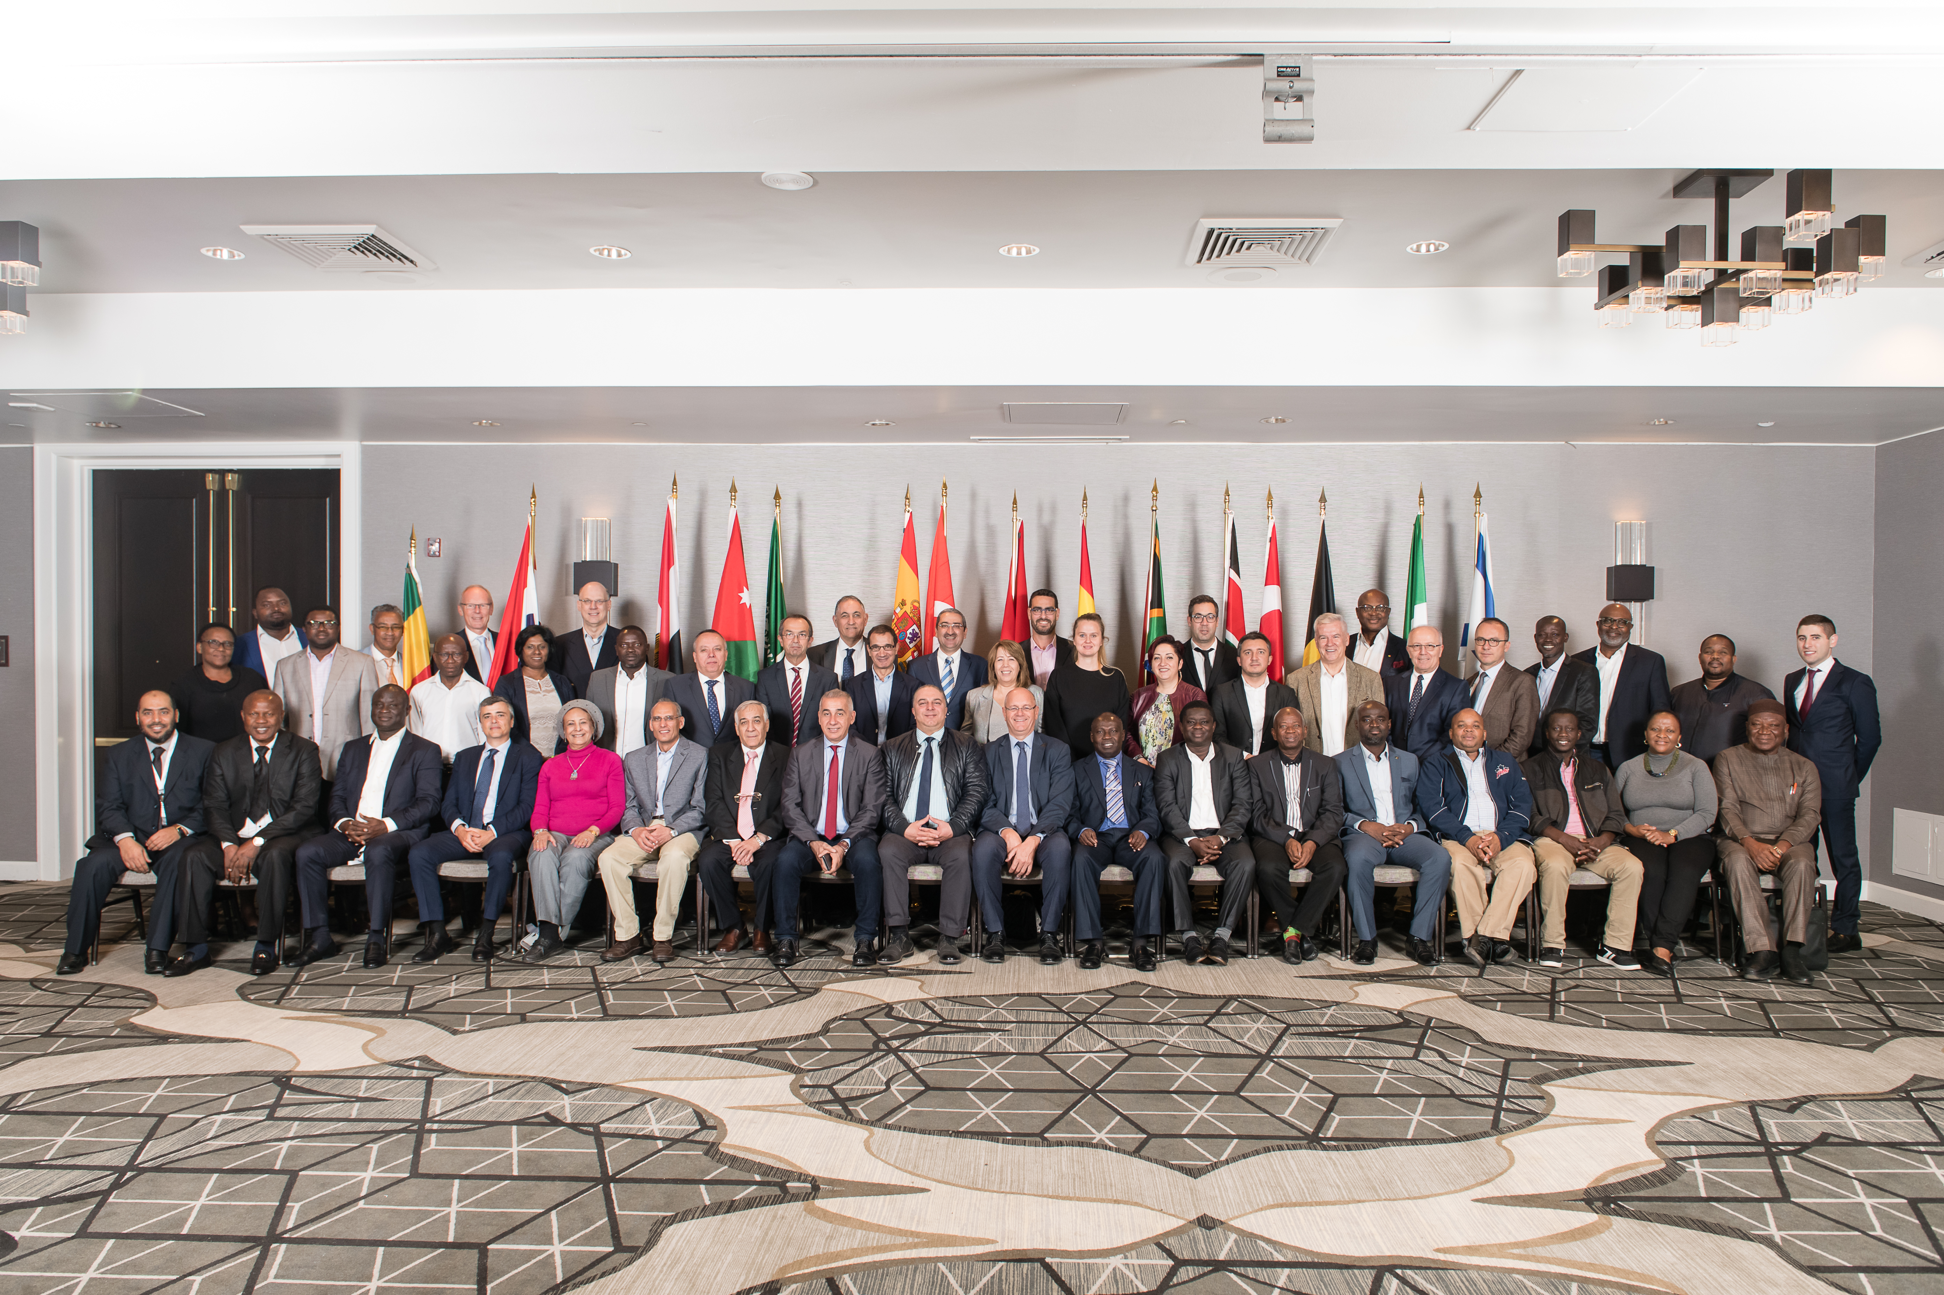
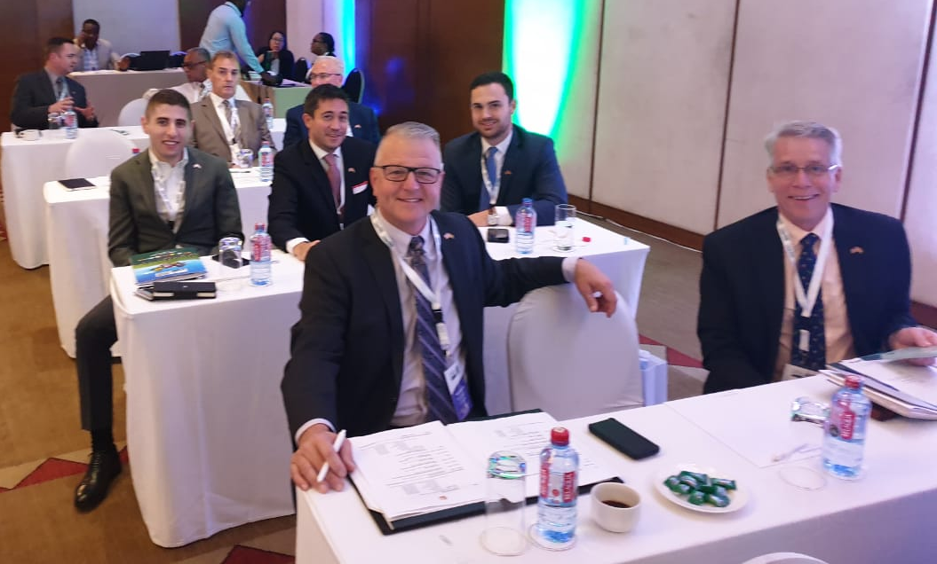
Thank You!

Slide 15

QUESTIONS!
Jad Wakileh
U.S. Grains Council
MEA Ethanol Consultant
JWakileh@grains.org
www.grains.org

Slide 16
ECOWAS Bioethanol for Clean Cooking Workshop
Training Workshop of the Standards Alliance
on Bioethanol for Clean Cooking
March 17th - March 18th, 2022
Jad Wakileh
U.S. Grains Council
MEA Ethanol Consultant
JWakileh@grains.org

Slide 17
Key Considerations in Policy and Standards
Training Workshop of the Standards Alliance
on Bioethanol for Clean Cooking
Friday, March 18th, 2022

Slide 18
Create awareness among governments; to create better policies and create awareness to the public
The most important thing is to create awareness among governments; to create better policies and create awareness to the public.
  Today, the biggest hindrance is awareness by the public.
Need to work to create enhanced market awareness and understanding of ethanol and ethanol use for the cookstove market.
  And most importantly creating a policy environment and regulatory change for a policy that favors the use of clean fuels over other resources.

Slide 19
Collation Building; to share experiences and industry best practices
Key considerations include:
Adopting a unique standardization for ethanol for the cookstove market across the ECOWAS region.
  To enable consistent monitoring.
Building alliances and collations
  To share experiences and industry best practices.
Develop a consistent system for monitoring specifications.
  To ensure consistent quality across the bioethanol space.

Slide 20
Thank You!

Slide 21
QUESTIONS!
Jad Wakileh
U.S. Grains Council
MEA Ethanol Consultant
JWakileh@grains.org
www.grains.org

