Slide 1
Doug Berven
VP Corporate Affairs
1-24-22

Slide 2
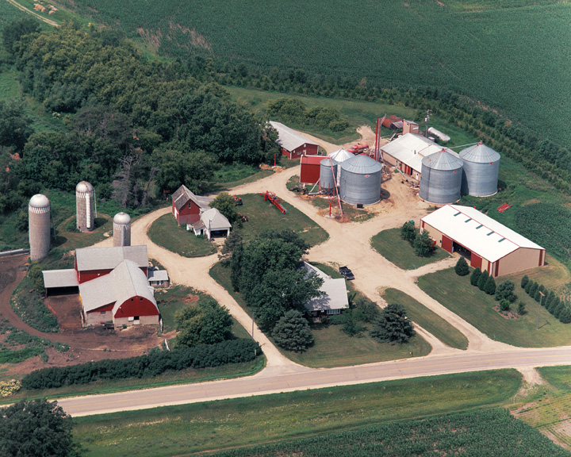
Notes:
PHOTO: Broin family farm near Wanamingo, MN
POET got it’s start on the Broin family farm near Wanamingo, MN in the early 1980s
Because grain was so oversupplied, the US government was paying farmers not to farm.
Broin’s did not want to get paid for not farming
So they built an ethanol plant on the family farm to soak up surplus grain.

Slide 3
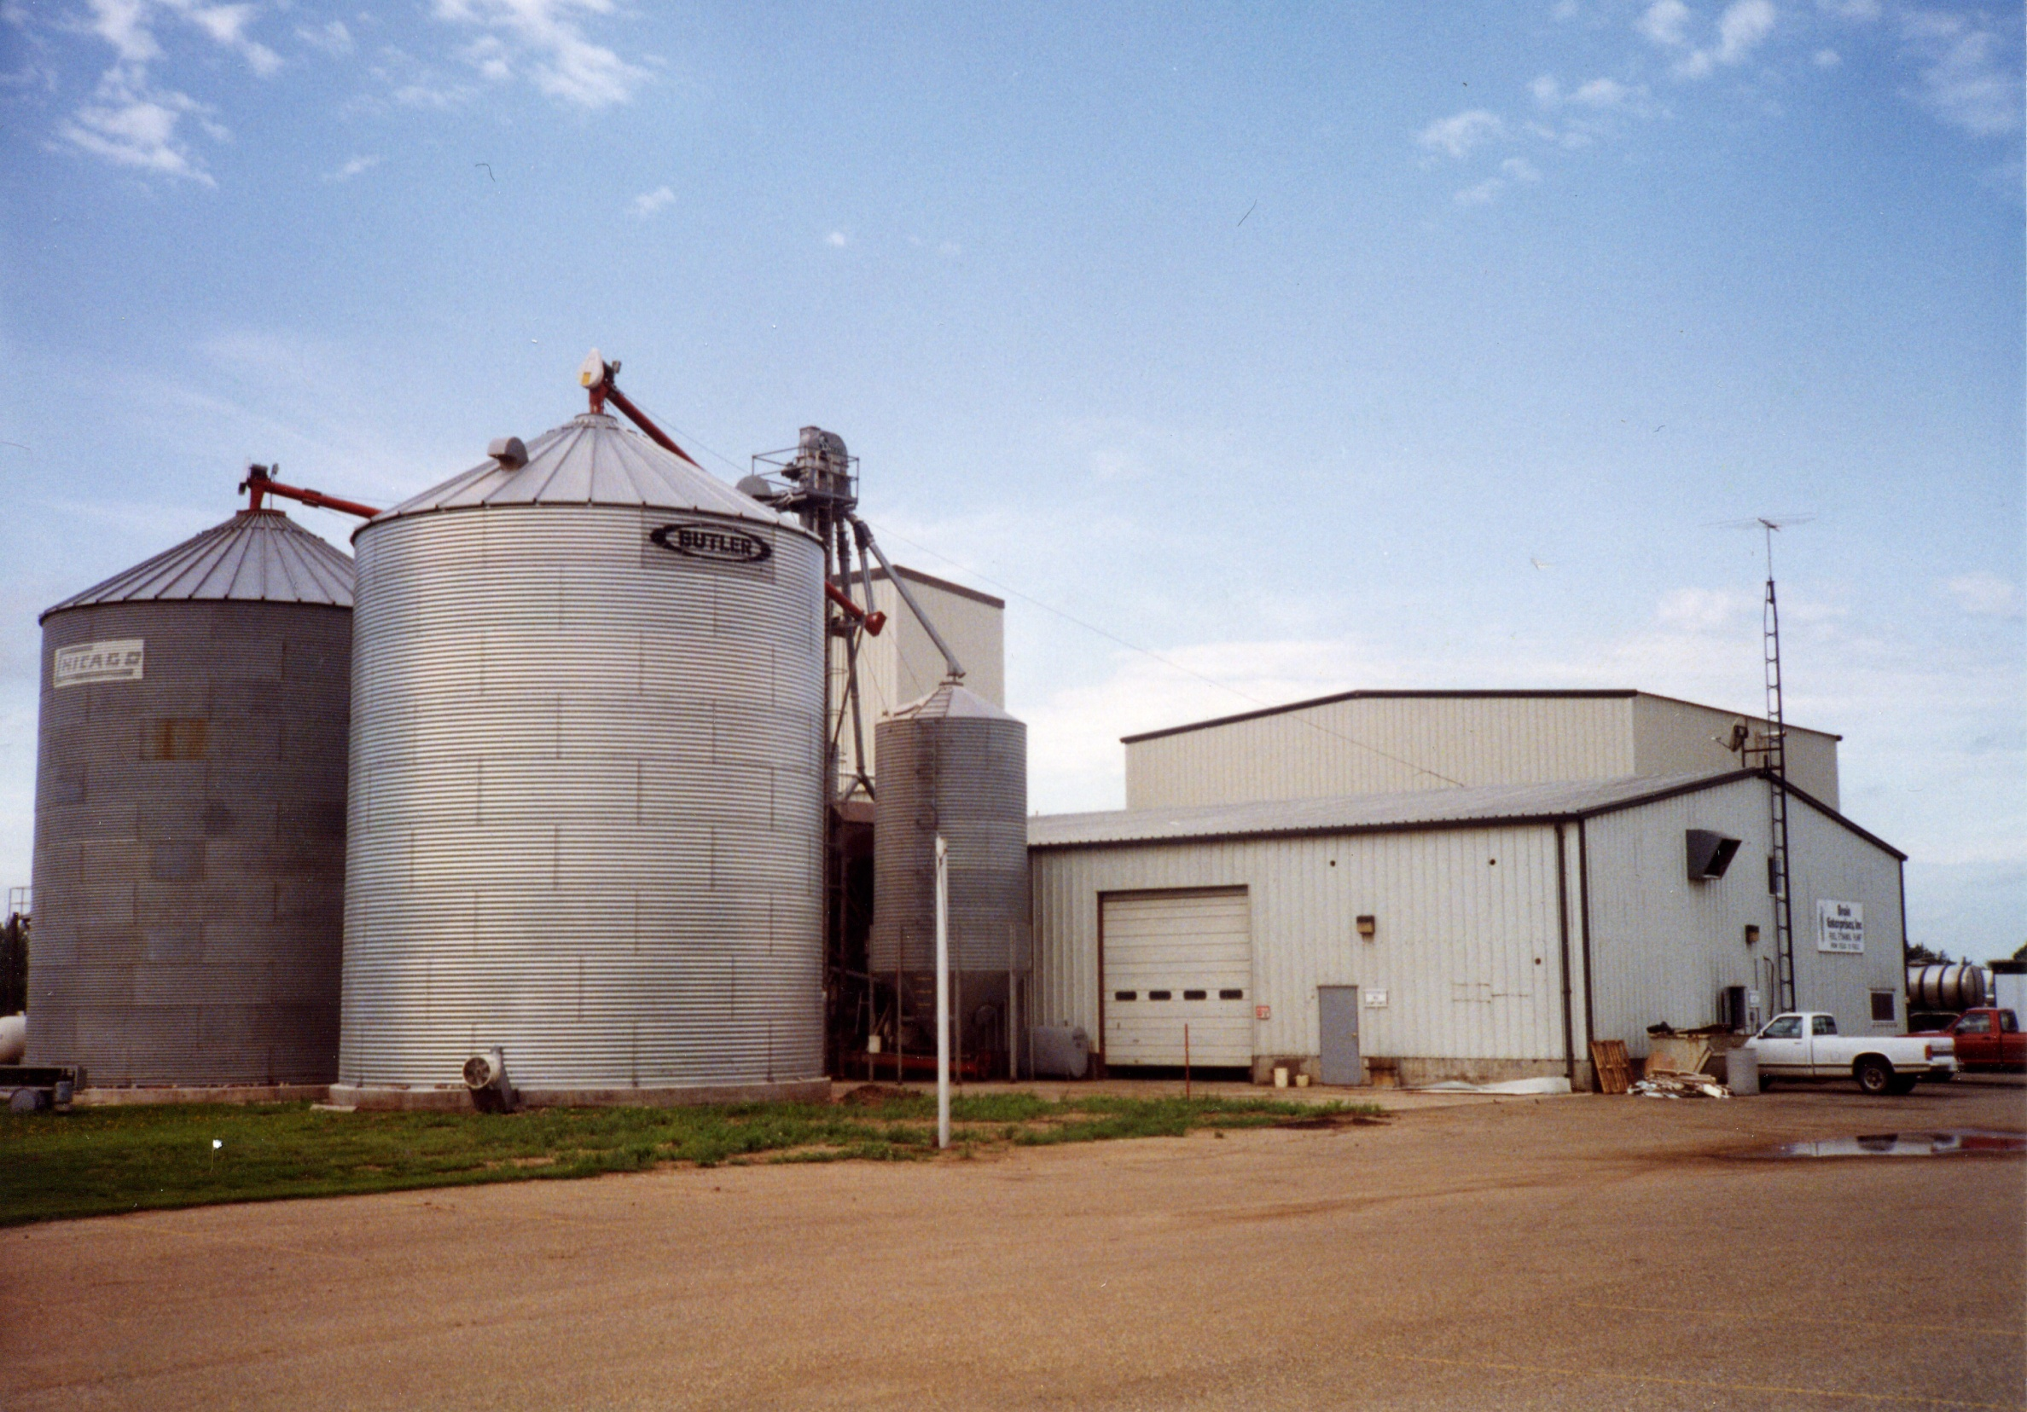
Notes:
PHOTO: Broin Enterprises in Scotland, SD
In 1987, the farm plant needed some parts.
Jeff’s mom, Judy, saw an ad for an equipment auction in Scotland, SD. It was during this auction Lowell Broin (Jeff’s dad) decided to purchase the entire foreclosed plant.
Jeff slept in that plant while working to make it operate efficiently.
Once word got out that this plant was running successfully, other farmer groups called asking Broins to build them a plant. They built a few plants for other groups and started several service companies to accommodate those operations.
In 1991, the Broins formed Broin & Associates and started to unroll the current business structure.
This plant eventually becomes POET Research Center where technologies are tested before being rolled out to all POET plants.

Slide 4
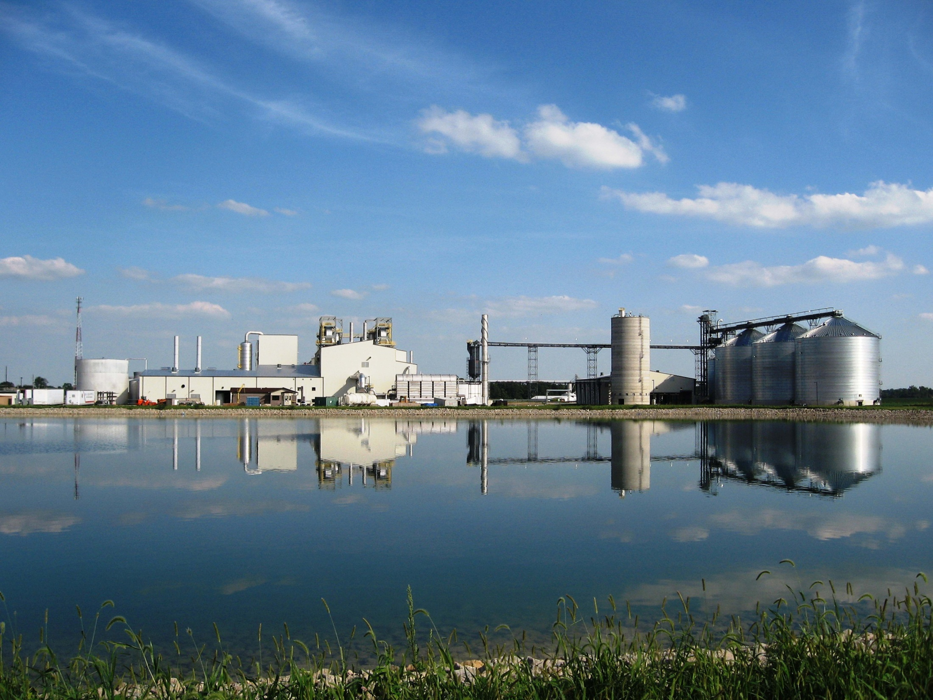
Notes:
Bioethanol has built the foundation / platform for the future of bioprocessing and biotechnology. This model must continue to grow to fuel the innovation and potential of what is to come.
We are not going to replace the bioethanol industry. We are going to build on it for a more sustainable future.

Slide 5
Notes:
With our recent acquisition of Flint Hills, we now have 33 bioprocessing facilities in 8 states with 3 billion gallons of production capacity.

Slide 6
Notes:
Biofuel plays a major role in all three categories

Slide 8
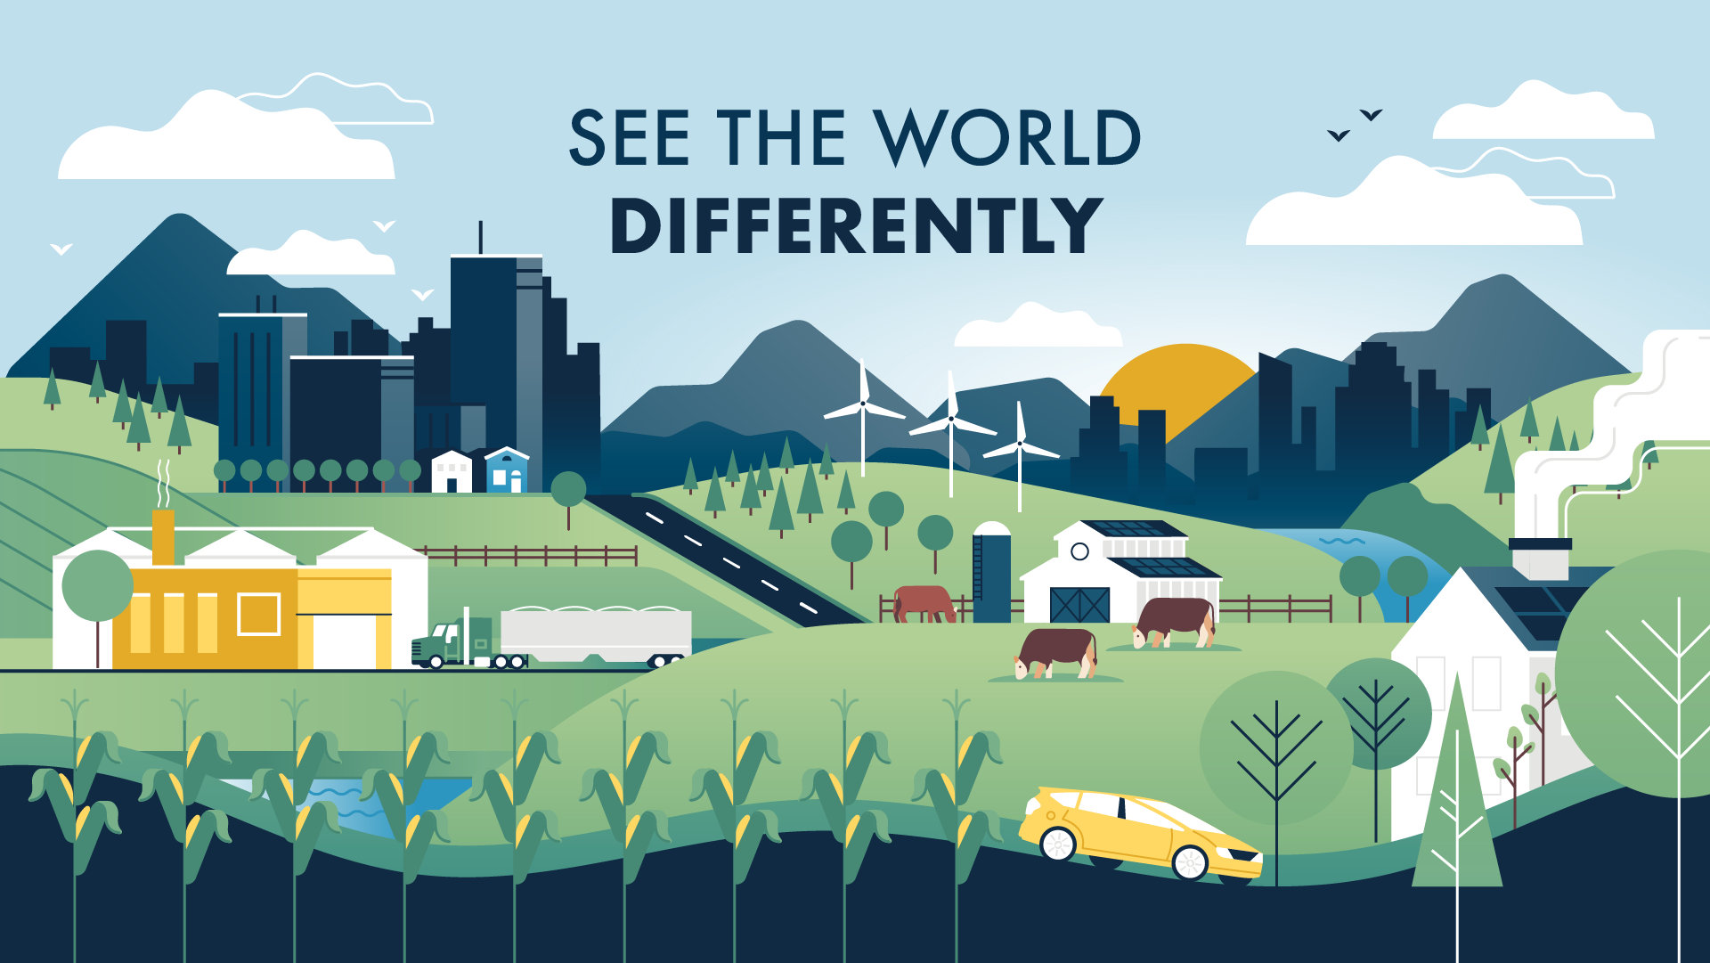
Notes:
The potential of agriculture to provide more than we know today. - Food, grain, livestock – Energy, Decarbonization, bioplastics, bioproducts, biofuels of all kinds
We must start to get more of our resources from the surface of the land rather than the center of the earth. We have a climate problem today because we’ve been taking coal and oil from the center of the earth and spewing it into the atmosphere.
The oil era is 200 years of history, when humanity has been here for thousands of years in the past and thousands of years to come.

Slide 9
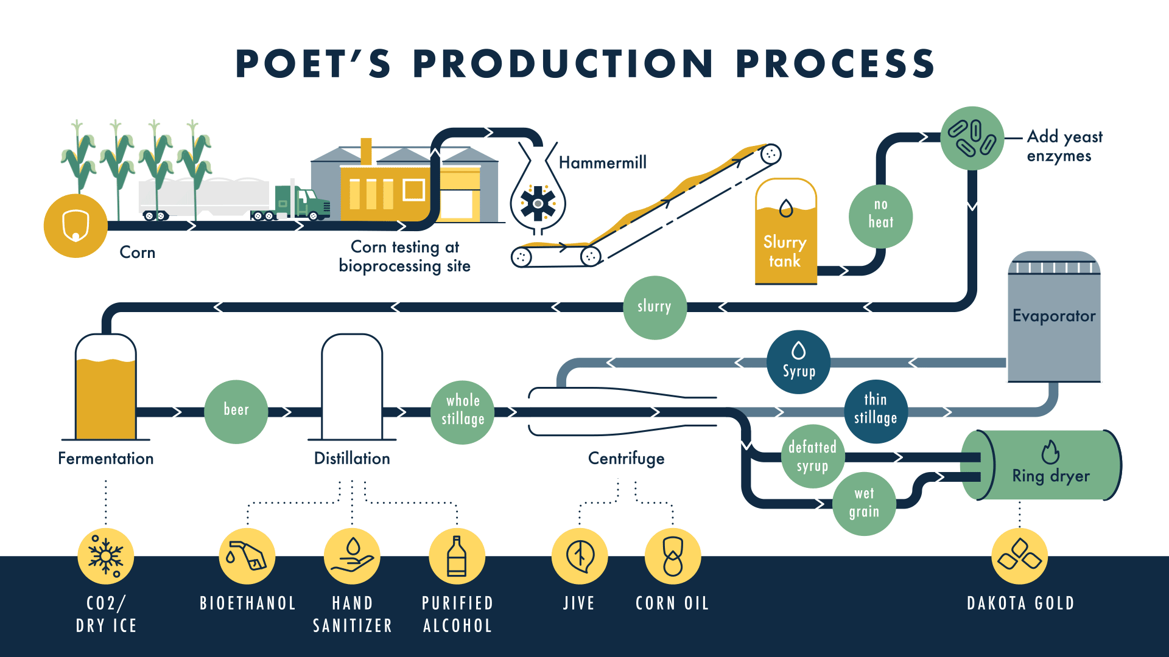
Notes:
POET’s bioproducts production process
The product portfolio continues to expand significantly into different industries.

Slide 10
ENVIRONMENTAL IMPACT
Ethanol reduces Greenhouse Gas (GHG) Emissions:
According to Environmental Health and Engineers, the greenhouse gas emissions of corn ethanol was found to be 46% lower than traditional gasoline.
-This CI score considers corn ethanol’s current emissions impact. The CI score of ethanol will continue to improve with technological advances and as production practices become more efficient.
-The CI value for land use change (LUC) has been improved significantly (25-fold reduction since 2008
Ethanol Reduces Harmful Toxins in the Air
According to the EPA, 10 percent ethanol/gasoline mix can reduce volatile organic compounds by 9.7%, carbon monoxide by 36% and exhaust benzene by 38.9%.
Environmental Protection Agency, “Renewable Fuel Standard Program (RFS2) Regulatory Impact Analysis,” February 2010.
Notes:
Today ethanol in the US is on average about 50% better than gasoline. The path to carbon neutral has many potential paths, but the box to the right show a few of the very realistic paths that POET is considering
Improved farming alone show a potential to improve our carbon score by 30 CI points.
Our Gradable program is a partnership with Farmers, FBN, DOE, California and many other groups.
Through this partnership, we realized a way to incentivize farmers to improve their operations through several climate smart practices, which in turn offered higher value products to the state of California and other end users. So we shared in the higher value products throughout the supply chain, and CA received cleaner products. This is a win win all the way through the value chain, from the farmer all the way to the consumers.
If large companies want to meet their own sustainability goals, they can show their products come from low CI grains. This is actual action in decarbonizing.
Voluntary
Credible
Validated
Valuable
Farmers in the US and around the world can solve so many issues with the proper incentives.

Slide 11
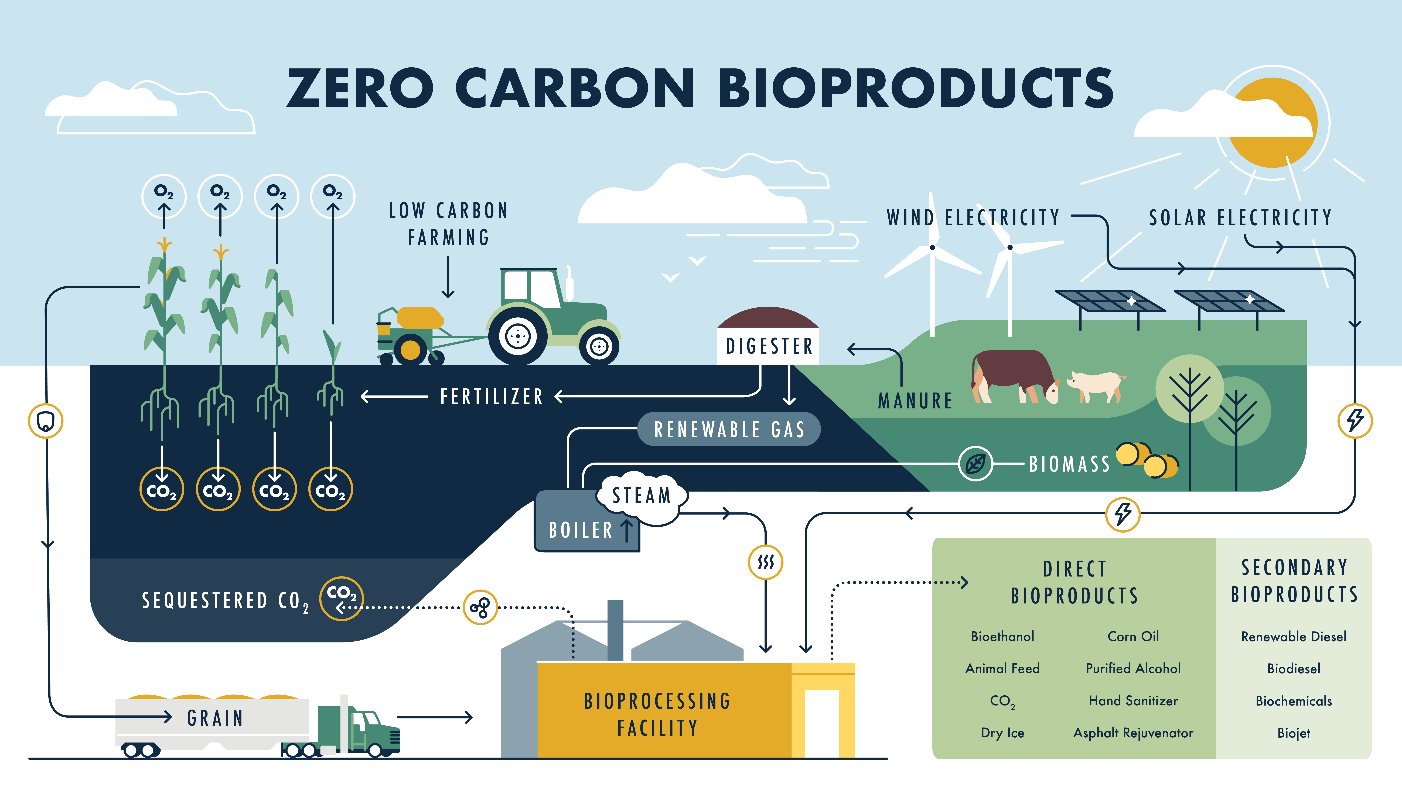
Notes:
This is just a simple vision of where POET and the industry are headed. New inputs to the bioprocessing facilities will lead to a diversified product stream, new forms of energy, and a truly game changing scenario for the future. We are building on that biotechnology platform of more Conventional bioethanol facilities as we talked about before.
In order to fulfil this vision, POET is interested in pursuing many new technologies. So please reach out if your organization has a role in this new vision.
I you look closely, this type of system starts to represent the Circular Economy we’ve been searching for for years.

Slide 12
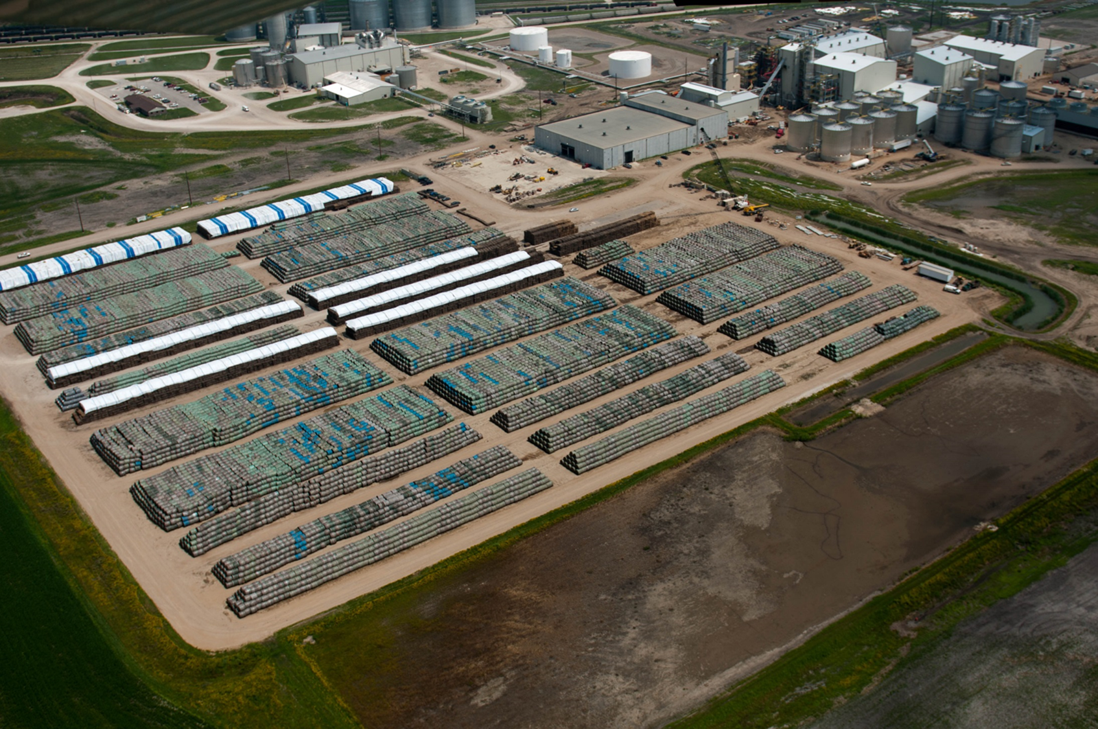
Notes:
Project LIBERTY, (our first commercial cellulosic ethanol plant) in partnership with DSM taught us many lessons, but none more valuable than that of Biomass collection, transport and storage. The one thing we really mastered with the assistance of our local farmers.
Biomass will play a very significant role in decarbonizing the world, and new energy scenarios of the future. Every country has excess biomass that can be used for very constructive purposes. Biomass may be a new frontier in agriculture.
Biofuels are the catalyst for successful agriculture. Successful agriculture is key to solving some of the worlds most pressing issues including, climate change, poverty hunger and disease.
Agriculture is at the center of decarbonization and reinventing energy.
It’s critical that we educate the world on the potential of agriculture. Because right now agriculture is viewed too often as a problem rather than a solution.

Slide 13
Notes:
Agricultural production potential is tremendous, and if we are serious about decarbonizing the world, agriculture will have to play a more significant role going forward.
***
In order for agriculture to meet its potential, it must have a margin. Margins allow for investments in agriculture technology, infrastructure and climate smart practices.
Something most people don’t realize - From the year 2000 - 2015, agriculture lifted a billion people out of extreme poverty around the world. This is the same time period bioethanol went from 1% of the fuel supply in the US to 10% of the supply.
Biofuels have supported grain prices and led to an agricultural evolution. Agriculture can do so much more if we can balance the potential of ag with markets for agricultural products – including grains and biomass.
Myths like Food vs. Fuel need to be dispelled. Bioethanol has not depleted the world of nutrition, it has enhanced the world’s nutrition.

Slide 14
Notes:
Climate smart agriculture, automotive development and biofuels will lead to a better economy, cleaner air and reduced use of fossil fuels. This is how we will meet many of the UN Sustainability Goals being discussed at COP 26.
It starts with the foundation we have all built together.
Countries around the world need to uphold their blending mandates and carbon reduction goals. Ag and Biofuels are here to help achieve those goals if- they are allowed.

Slide 15
Notes:
Bioethanol and biofuels in general offer comprehensive benefits. We do not need to compromise our economies or way of life to improve our situation.
But we DO need to change the Status Quo!
We must get our resources from the surface of the land, not the center of the earth.
We’ve been through many of these benefits, but it’s worth restating them.
***

Slide 16
Notes:
I’ll leave you with this thought… Biotechnology and innovation are the progression of creating a better set of future circumstances for the world. Biofuels, and agriculture are at the forefront of that innovation and the potential is virtually untapped.
Note that I said Better not Perfect.
If we continue to pursue the perfect at the expense of the better, we will always be stuck with the worst. There is no such thing as perfect!
Bioethanol is immediately available, universally affordable, and clean. It should be promoted around the world as a solution – even though it disrupts the status quo.
That is Bioethanol’s role in a carbon neutral society.
Thank you!

Slide 17
THANK YOU

