Slide 1
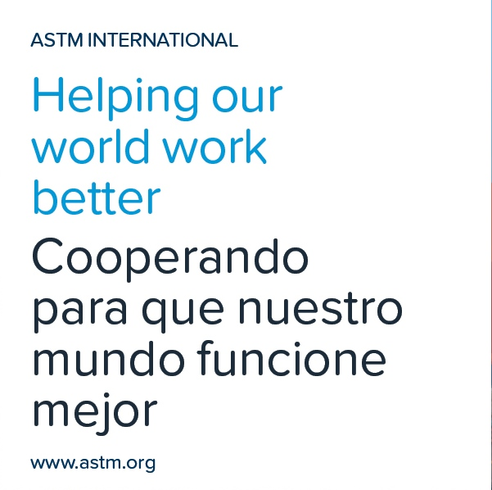
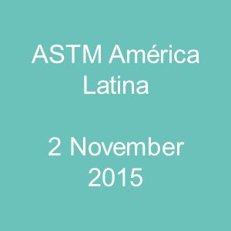

Slide 2
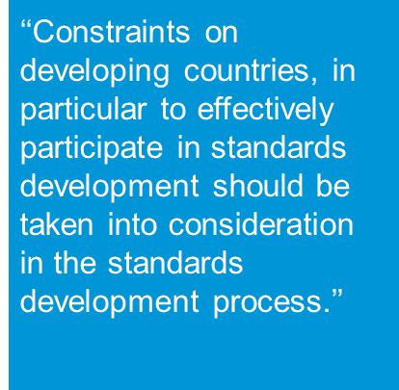
Global Cooperation Establishment – 2001
﻿WTO/TBT” Definition for International Standard
﻿ASTM’s compliance with the WTO/TBT principles for international standards:
﻿Transparency
Openness
Relevance
Coherence
Consensus/impartiality
Development Dimension
Notes:
ASTM’s Global Cooperation Department was established in 2001. One of the key programs of Global Cooperation is the MoU program and it was established specifically to allow ASTM to meet the “Development Dimension” principal as outlined by the World Trade Organization in its Technical Barriers to Trade agreement.

Slide 3
﻿Who We Are and What We Strive to Do
Staffing
Objectives
﻿Staffing
﻿Headquarters office – four staff
China office – two staff
Latin American office – consultant
Support
﻿Members of the Board
ASTM Staff
Volunteer Technical Experts
Our focus
﻿Minimize barriers to the use and application of ASTM standards
Encourage active participation on ASTM technical committees
Notes:
The staff is somewhat small but we depend also on the members of our Board of Directors, other ASTM staff, and volunteer technical experts to assist with our Global outreach. Global Cooperation has two major goals: Minimize barriers… and Encourage active participation…

Slide 4
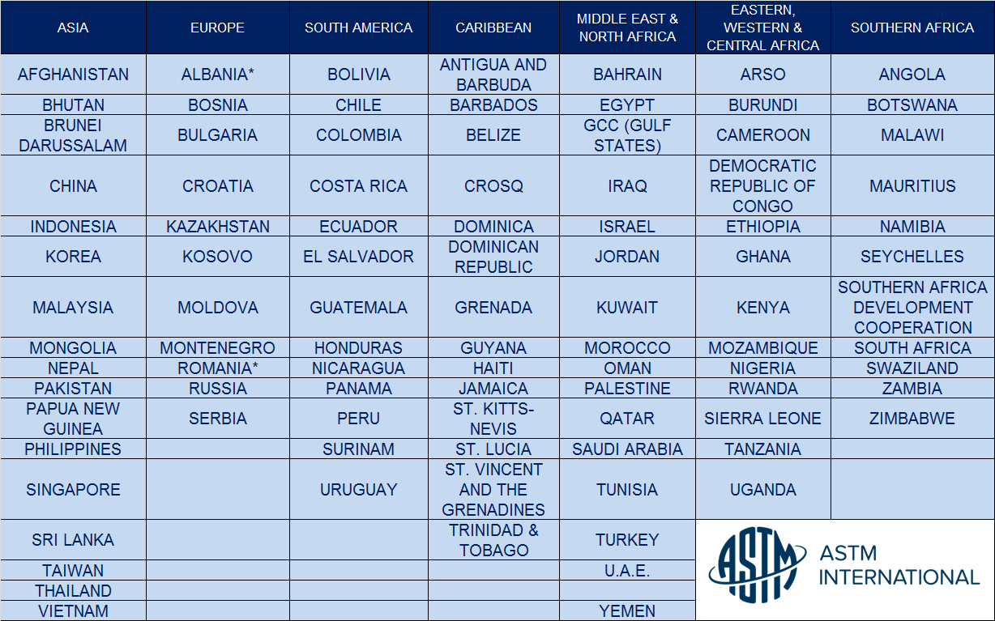
National Standards Bodies and Regional Bodies with ASTM MoU Agreements
Notes:
To date, these are the countries and regions with whom ASTM has signed MoU’s. Each country receives a free set of all 12,000+ standards each year free of charge to be adopted, referenced, or used as the basis of national standards. In addition, anyone with an interest from an MoU country can join an ASTM technical committee at no charge.

Slide 5
﻿MoU-Unique Training Programs
﻿Standards Expert Program
﻿MTVGP
﻿Other International Visitors
﻿Initiated in 2005; 25 MoU partners to date
Typically three nations each year
NSB selects candidates; ASTM makes final decision
Supports one month on site at ASTM
ASTM sponsors fully; focus is on ASTM organization and procedures, and the US-based standardization system
Participant becomes an expert and a resource at home NSB
Initiated in 2013
Competitive process; one recipient awarded﻿
Duration of three to six weeks
ASTM supports 50% to a limit of $5000; NSB or industry also provides funding
Focus is on technical content
2014 Awardee
Nana Sekyi, Ghana – GSA
Pipeline integrity for the oil/gas sector
﻿Attached staff
One week to eleven months
Sponsoring organization identifies focus of study
Recently: Botswana, South Africa, South Korea
For late 2015 and into 2016: Kenya and South Korea
Notes:
The Global Cooperation Department provides support to several different types of training programs. The Standards Expert program, MoU Technical Visitor Program, and Staff Attachments are three of the most active programs. ASTM is flexible and often works with its partners to design specific programs based on their individual needs.

Slide 6
﻿Other Models for Training
﻿Intensive Training Programs
Nation | Topic | Delegates
India | Plastics | 8
South Korea | Nuclear energy | 8
Chechen Republic | Public/private partnership | 8
Jamaica, Trinidad and Tobago | Steel | 6
Latin America | Concrete and cement | 6
China CJLU | Petroleum Renewable energy & roofing Standards Education | 13 14 9
GSO | Concrete and roads | 3
﻿Eight to twelve delegates
One to three weeks
Sector specific at sponsor’s request
Funded by participants’ industry or government
Virtual Training Sessions
On-site Contract Training
Notes:
Intensive Training Programs in the U.S. are available to representatives of industry and government who wish to utilize or better understand and apply ASTM International standards and/or contribute to or influence the content of the ASTM standards to reflect local market and regulatory needs. Participants meet with technical experts in their field and develop a network of contacts. The program typically includes 8 – 10 participants who are technical experts within a sector or technical area. Costs are covered primarily by the participants’ sponsoring industry or government, although ASTM staff plans and executes the ITP, including key site visits, for which it does not charge the ITP partner.

Slide 7
ASTM and INACAL
﻿
2003 – INDECOPI/ASTM MoU signed
2008 – Patricia Castro represents INDECOPI in the Standards Expert Program
2011 – Three technical presentations: Advances in Concrete, Biodegradable Plastics & Modelling of Concrete
2012 – Technical Presentation on Sustainability of Cement
2012 – ASTM CCRL Staff presentation at Asociación de Productores de Cemento (ASOCEM) regarding Proficiency Testing
Notes:
ASTM has a long relationship working with standards body in Peru, beginning with the signing of an MoU with INDECOPI in 2003. These are a few of the events.

Slide 8
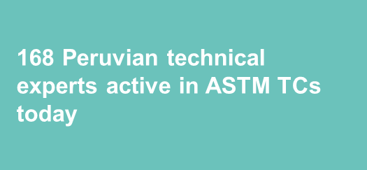
ASTM and INACAL
﻿
2013 – ASTM Staff participated in APEC Green Buildings Conference
2013 – ASTM Staff conducted outreach meetings for biofuels, amusement parks, water re-use, road safety, and with academia
2014 – EnginZone is contracted to serve as ASTM’s Latin America office
2015 – ASTM recognizes the change from INDECOPI to INACAL
2015 – Standards Alliance Program
780+ ASTM Standards have been either referenced, adopted or used as a basis of Peruvian National Standards
Notes:
ASTM continues to enjoy a strong presence in Peru and the activity is now growing even more with a new Latin American Representative and new partnership with EnginZone, as well as, a newly signed agreement with INACAL.

Slide 9
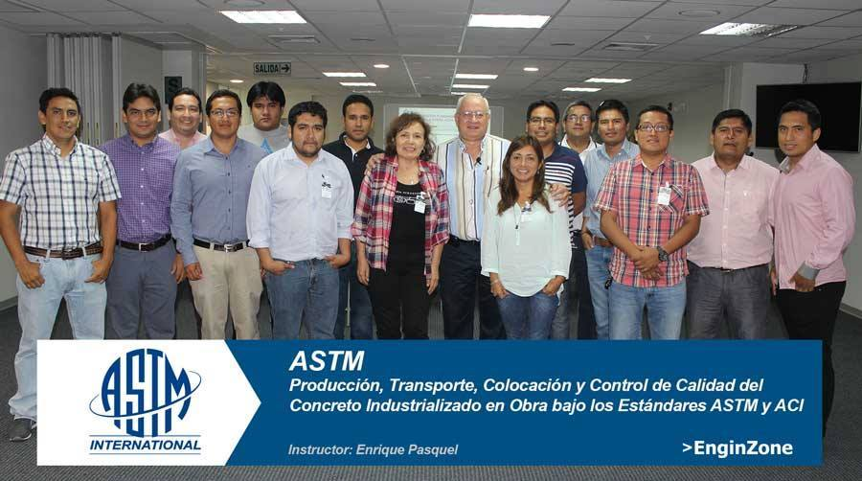
﻿Continuing to Explore Mutual Opportunities
﻿
Acting on Mutual Opportunities
International cooperation
Training
Outreach
Notes:
Together with our partners in Peru, we anticipate there will be a bright future.

Slide 10
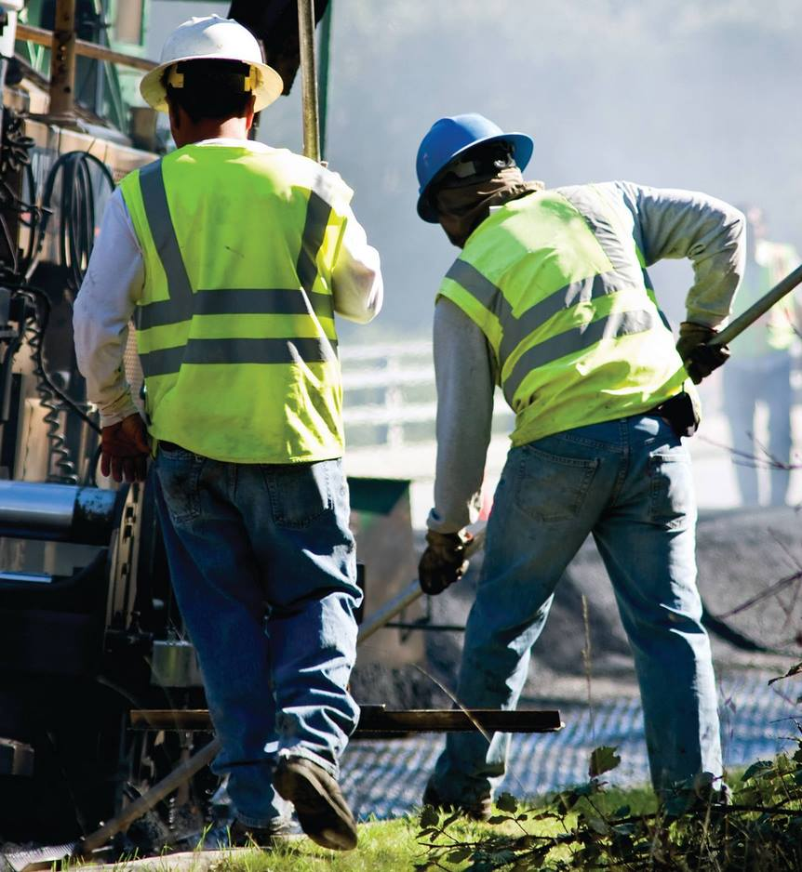
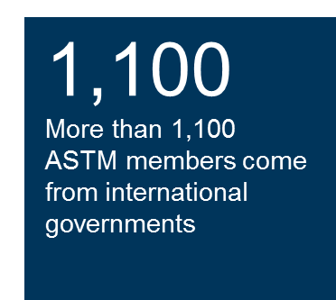
Collaboration with Governments
ASTM looks for close collaboration
Based on strong relationships with National Standards Bodies
91 individual Memorandums of Understanding (MoU) and 4 regional agreements
In the process, ASTM finds both public and private partnerships for the development of high quality standards and global relevance
Focus is on science and technology
ASTM standards are referenced by governments around the world for their high market relevance
No ASTM standard has been ever been citied by the World Trade Organization as a Technical Barrier to Trade
Notes:
When referring to the ASTM standards, many organizations and nations can more easily develop their own regulations necessary for a variety of projects or to protect their environmental resources.
The ASTM International standards also support the needs of various industries in several countries around the world in their efforts to comply with the import requirements of the United States and other global markets. The ASTM standards reduce confusion in the market, reduce production costs, and helps position companies manufacturing products to meet consumer needs and providing quality covering the reliability and safety.

Slide 11
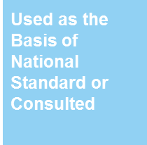
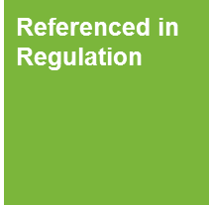
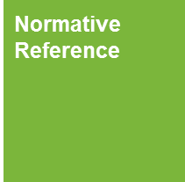
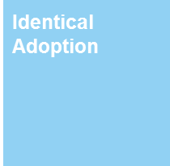
Six Ways to Adopt and Reference ASTM
Available to all Public and Private Standards’ Users
Referenced in Regulations
Normative Reference
Code Reference
Available Only to MoU Partners
Identical Adoption
Equivalent Adoption
Used as the Basis of a National Standard or Consulted
Simple Ways to Adopt or Reference ASTM International Standards
Notes:
In this part of the presentation, we’ll review in detail six different ways to use ASTM Standards. Three of the methods are available to all users of standards (those that appear in green). The three methods that appear in blue are only available to our MoU Partners.

Slide 12
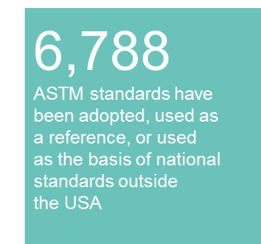
Uses of ASTM International Standards
Referenced in Regulation
ASTM International standard is called out, either in whole or in part, in a regulation, law, decree, rule, act, directive, order, edict, etc. (i.e. any official government document other than a National Standard) The content of the ASTM standard, either in whole or in part, is intended to be used as an additional requirement of the new regulation
Notes:
The first method, allowed by all users, is “Referenced in Regulation”…

Slide 13
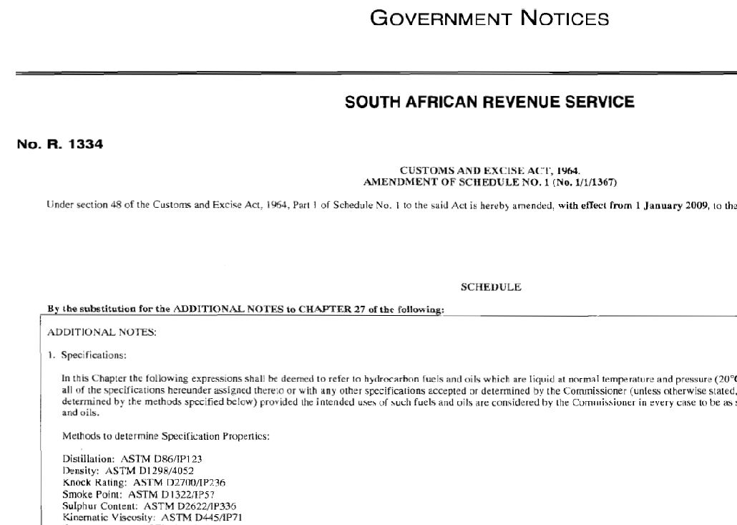
Referenced in Regulation
Notes:
This is an example of an ASTM standard referenced in regulation by the South African Revenue Service.

Slide 14
Uses of ASTM International Standards
Normative Reference
ASTM International standard (title only) is called out in the text of National Standard and its title also appears in the “Referenced Documents” section of the National Standard. The content of the ASTM standard, either in whole or in part, is intended to be used as an additional requirement of the new National Standard
7
ASTM International complies with all 7 principles of an International Standards Developer as defined by the WTO
Notes:
The next method is using ASTM standards as “Normative References”…
You can be confident using an ASTM standard because ASTM standards comply with all 7 principles of the WTO/TBT.

Slide 15
Normative Reference
Notes:
This is an example of a normative reference of an ASTM standard in an ISO document.

Slide 16
Uses of ASTM International Standards
Code Reference
A code consists of requirements and referenced standards that a jurisdiction or authority enforces through legislation, statutes, contracts etc. A jurisdiction or authority can adopt a model code without changing it, modify part of the code, or develop its own code. Examples of such codes include the International Building Code of the International Code Council (ICC) or the Boiler and Pressure Vessel Code of the American Society of Mechanical Engineers (ASME).
450
More than 450 ASTM standards are referenced in the International Building Code
Notes:
Then next example is a code reference. A code consists of requirements and reference standards that a jurisdiction or authority enforces through legislations, statues, contracts, etc.
Codes are often adopted by countries, states, or cities. When the codes are adopted, the referenced standards also become part of the law for that region.
Many of the codes like those from ICC and ASME, refer to ASTM material specifications and test methods into several sections.

Slide 17
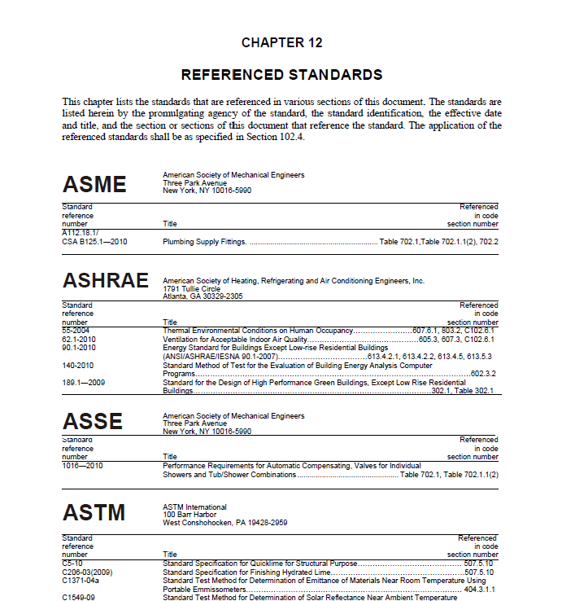
Benefits of Direct Reference
Minimizes duplication and conflicting guidance in industry
Able to stay current with most up-to-date technology generated by industry experts around the world
Reduces development time for new regulations and eliminate costs associated with developing new country specific regulations
Notes:
Referencing reduces development time for new regulations and also shortens the costs associated with developing new country-specific standards. It is also an effective way to reference technical information that is the latest in the industry when it is not necessary or desirable to include the entire content of the standard.
To review: Any standards’ user may use an ASTM standard title in its regulations, as a normative reference, or as a code reference without worry of copyright violation or having to pay ASTM a royalty of any kind.

Slide 18
Memorandum of Understanding (MoU)
ASTM
Signatory
Provides a full collection of ASTM standards as a resource
Offers membership to technical experts at no charge
Offers training programs to industry and government
Enables view only access to ASTM standards through a link in the Information Center
Provides an annual report
Can adopt or use ASTM International standards to develop national standards
Notes:
Now, let’s move on to the additional uses of ASTM standards by our MoU partners such as INACAL.
Initiated in 2001, ASTM International's MOU program promotes communication between ASTM International and national standards bodies worldwide, fostering awareness of the standardization systems of all parties involved. Through the program, each signatory receives a free set of ASTM’s 12,000 technical standards and the ability to add any technical expert to an ASTM technical committee at no cost. The national standard body partners are asked to annually submit a report to ASTM detailing the use of ASTM standards and any other related activity. ASTM MOU partners have special additional rights and obligations when it comes to the use of ASTM International standards.

Slide 19
Additional Uses of ASTM International Standards for MoU Countries
Adopted as an Identical Standard
ASTM International standard is considered, in its entirety, to be the National Standard recognized by the National Standards Body
Adopted as an Equivalent Standard (with deviation or amendment)
ASTM International standard is considered, with limited deviation, to be the National Standard recognized by the National Standards Body
“ASTM standards help us develop our national standards and are deeply utilized in industries such as construction, petroleum products and medical equipment.”
STAMEQ, Vietnam
NOTE: Refer to each individual MoU agreement for specific requirements
Notes:
An additional use of ASTM International standards by an MoU signatory includes the right to adopt a standard as identical or equivalent.
Both the adoption of an ASTM International standard, in its entirety, to be the National Standard recognized by the National Standards Body OR when an ASTM International standard is considered, with limited deviation, to be the National Standard recognized by the National Standards Body is permitted under the terms of the MoU agreement.

Slide 20
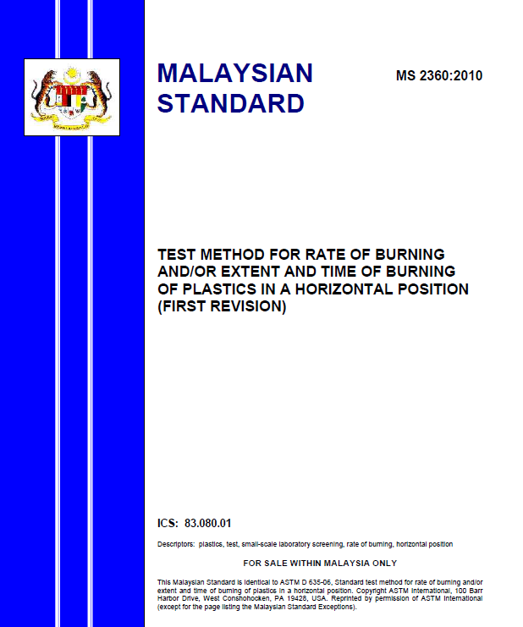
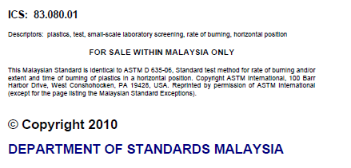
Identical National Adoption of an ASTM standard
Notes:
Example of an identical adoption by an MoU partner organization in Malaysia.

Slide 21
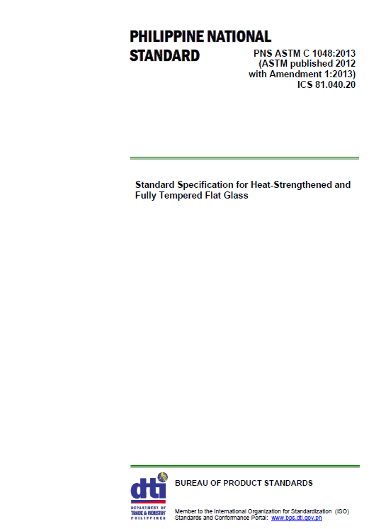
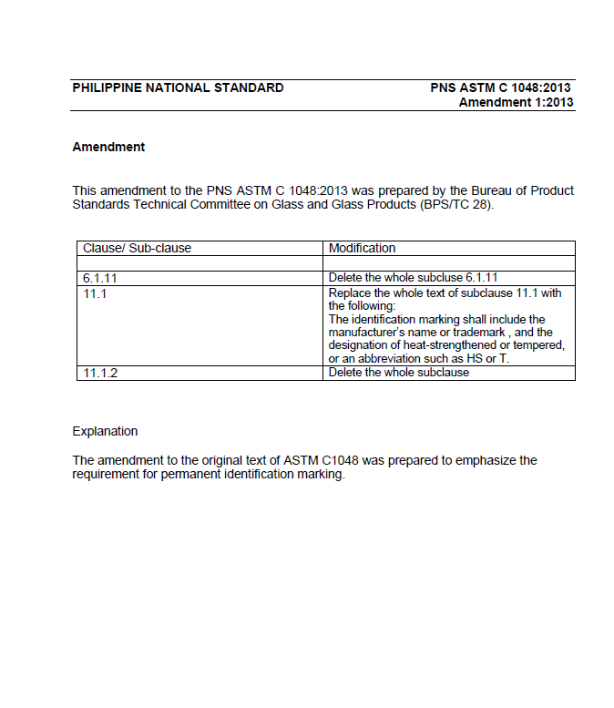
Equivalent National Adoption of an ASTM standard
Notes:
This is an example of an equivalent adoption. Please note the separate page with the deviations from the original ASTM standard listed.

Slide 22
Requirements for Adoptions
To provide ASTM written notice of the ASTM Standards it plans to adopt and will obtain written approval from ASTM prior to such adoption;
To publish its adoptions (derivative works) of ASTM Standards without, as much as possible, change to the original and agrees to maintain the integrity of the ASTM Standards;
Not to assign or transfer any rights it may have in its Adoptions, and not to submit or provide ASTM standards or its Adoptions to any other standards body(s) or organizations (whether national, international or other) for use, review or approval, without the prior written consent of ASTM International’s President;
To provide ASTM International with electronic files of the Adoptions;
To provide recognition: “This National Standard is identical to ASTM XXXX-XX, Title, Copyright ASTM International, 100 Barr Harbor Drive, West Conshohocken, PA 19428, USA. Published and reprinted pursuant to license agreement with ASTM International”;
To acknowledge and agree that the adoption, enactment, reference, or incorporation of any of the ASTM Standards by any government or agency, including the national standards body, has not and will not effect, transfer, modify or alter the copyrights of the ASTM Standards in any way;
To provide ASTM with a complete list of its adopted ASTM Standards in the Annual Report to ASTM or upon request.
NOTE: Refer to each individual MoU for specific requirements
Notes:
The fine print
(don’t go over in detail)

Slide 23
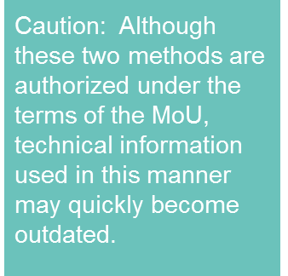
Additional Uses of ASTM International Standards for MoU Countries
Used as the Basis of a National Standard
ASTM International standard is reviewed by national technical experts during the development process and used as the basis of a new National Standard for the National Standards Body.
Consulted
ASTM document is reviewed by national technical experts during the development process of a new National Standard for the National Standards Body
Notes:
Two other options for MoU countries include…

Slide 24
As the Basis of a National Standard
This national standard is based on ASTM C969…
Notes:
This is an example of a National Standard from Costa Rica that used an ASTM standard as the basis of its National Standard.
Attribution must be given to ASTM as shown.

Slide 25
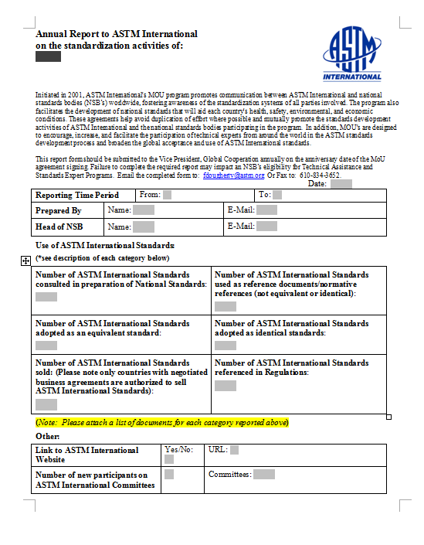
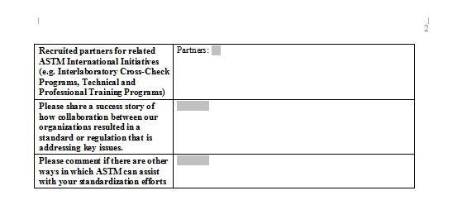
The MoU Annual Report
Due each year on the Anniversary date of the MoU signing
Notes:
Each year, the MoU country must provide an Annual Report to ASTM. This year, ASTM is launching an online tool to make it easier for our MoU partners to submit their data.

Slide 26
Conclusions
Regulations should use the best technical guidance regardless of the “brand” of standard
MoU nations are authorized to use ASTM International standards (with appropriate permission and attribution) if they meet the needs of the end users
Multiple paths exist to facilitate the use of ASTM information in your respective countries
The use of high quality, universally accepted standards is a benefit to industry, regulators and patrons
Notes:
Conclusions…
ASTM is very interested in working with you to address your needs.

Slide 27
Thank you
Maria Isabel Barrios
Representante oficial en Latino América
ASTMLatinAmerica@astm.org

