Slide 1
Day 2, Session 1
ASTM Resources
And Medical & Surgical Materials and Devices
Committee F04
November 3, 2015
Maria Isabel Barrios
Latin America Representative, ASTM
www.astm.org
Notes:
We would like to present the background on where ASTM’s standards in the Medical Device sector are developed. Plus present some ASTM resources which you might find very helpful.

Slide 2
Today’s Topics
1 ASTM Committee F04 on Medical and Surgical Materials & Devices
2 How to Find ASTM Standards
3
How to Participate
4
How to Use E-Tools
5
ASTM’s Standards Development Process
Notes:
This presentation will include:
An introduction to the ASTM Committee on Medical and Surgical Materials and Devices, designated ‘F04’ (1 of over 140 ASTM technical committees)
How to Find ASTM Standards online
How to participate and have a voice in a technical committee
How to use some of ASTM’s online tools—it is very simple
Some basics of the ASTM development process

Slide 3
Committee F04 on Medical and Surgical Materials and Devices
Organized in 1962
More than 950 Members
26 Subcommittees
300 Standards
International Membership Represented
Active industry participation from 35 countries
209 members currently from Peru
F04 meets twice each year as a whole, in May and November
Notes:
ASTM Committee F04 is one of ASTM’s 145 technical committees. Here is the background on the Committee…

Slide 4
ASTM – F04 Committee -- Scope
The Scope of the Committee Shall Be--
The development of standardized nomenclature and definitions of terms; test methods, recommended practices, guides, specifications and performance standards for medical and surgical materials, devices and systems.
The Committee will encourage research in this field and sponsor symposia, workshops and publications to facilitate the development of such standards. The Committee will promote liaison with other ASTM Committees and other organizations with mutual interests.
Notes:
The Scope of Committee F04 includes development of standardized definitions and terms, test methods, practices, guides and specifications for medical devices, materials and systems.
The committee will hold symposia and workshops to encourage research and then publish their reports. The committee will also liaise with other committees and groups with mutual interests, such as yourselves.

Slide 5
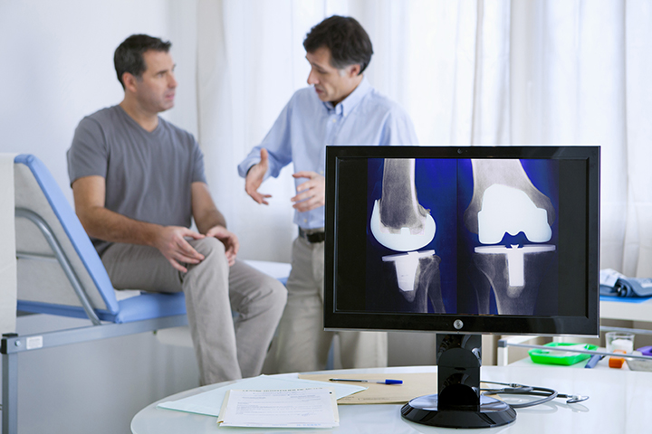
Committee Structure
4 Divisions
F04.01 Division I – Resources
F04.02 Division II – Orthopedic Devices
F04.03 Division III – Medical/Surgical Devices
F04.04 Division IV – Tissue Engineered Medical Products
Notes:
The structure of the ASTM F04 committee contains 4 divisions; Resources, Orthopedic Devices, Medical/Surgical Devices and Tissue Engineered Medical Products. These are called ‘Divisions’.

Slide 6
Structure of Subcommittees
DIVISION I DIVISION II
F04.11 Polymeric Materials
F04.12 Metallurgical Materials
F04.13 Ceramic Materials
F04.15 Material Test Methods
F04.16 Biocompatibility Test Methods
F04.18 Device Retrieval Analysis
F04.21 Osteosynthesis
F04.22 Arthroplasty
F04.25 Spinal Devices
DIVISION III
F04.30 Cardiovascular Standards
F04.31 Neurosurgical Standards
F04.32 Plastic and Reconstructive Surgery
F04.33 Medical/Surgical Instruments
F04.34 Urological Materials and Devices
F04.35 Gastroenterology Applications
F04.37 Implantable Hearing Devices
F04.38 Computer Assisted Orthopaedic Surgical Systems
Notes:
The F04 committee is served by a variety of subcommittees totaling 26, which are sub-categories of the 4 divisions. You can see that biocompatibility is in Division I, and the different devices are in Division II and Division III. Division IV is Continued in next slide.

Slide 7
Structure of Subcommittees
DIVISION IV
F04.41 Classification and Terminology for TEMPs
F04.42 Biomaterials and Biomolecules for TEMPs
F04.43 Cells and Tissue Engineered Constructs for TEMPs
F04.44 Assessment for TEMPs
F04.45 Adventitious Agents Safety
F04.46 Cell Signaling
Other Developing Areas:
Wound Dressings
Neurosurgical CAS & Neurotoxicity
Notes:
There is also a Division IV for tissue-engineered products and there are always innovative developing areas.

Slide 8
Finding Standards Quickly
From www.astm.org
Go to ASTM website www.astm.org
Homepage
Search Bar- in center
4. Enter your key words
Notes:
One of the main questions we hear at ASTM is “How can I find the standard, if there is one?”
So let’s see a simple way to find it quickly on the internet. If you are on your laptop, you can follow along now.
First, if you know the name of the standard or close to it, you can simply Google it, that will take you to the ASTM website.
You can also go to the ASTM website first, just www.astm.org (ASTM is a non-profit organization, hence the ‘.org’)
There are a couple of search bars on the ASTM homepage, just use the center one, the most obvious.
You don’t need the exact title, just enter your key words.
Let’s see what it looks like…

Slide 9
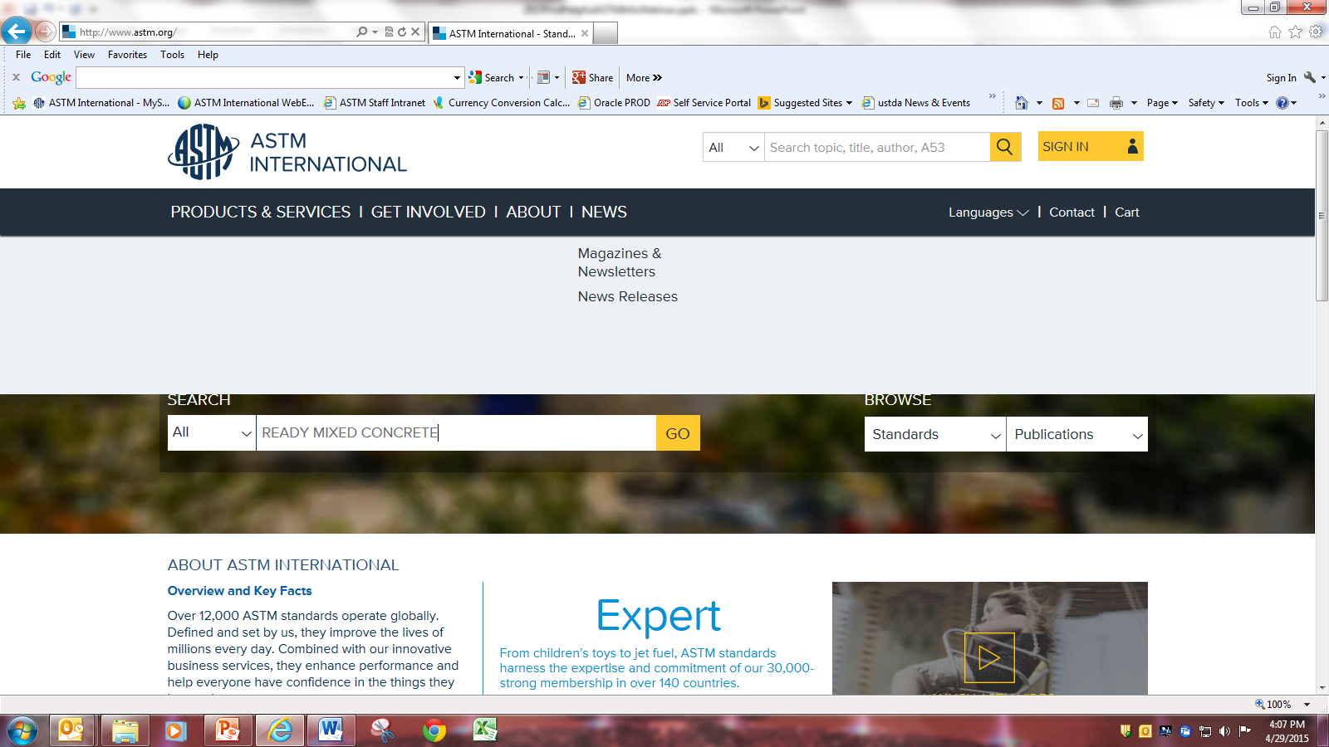
Standards: ASTM website Home page – Search bar
Notes:
Here is a screenshot of the ASTM homepage.
In the black ribbon you see “Languages” where you can click and select ‘Spanish’.
Then simply enter whatever key words you would like in the search box, I chose ‘Ready Mixed Concrete’.

Slide 10
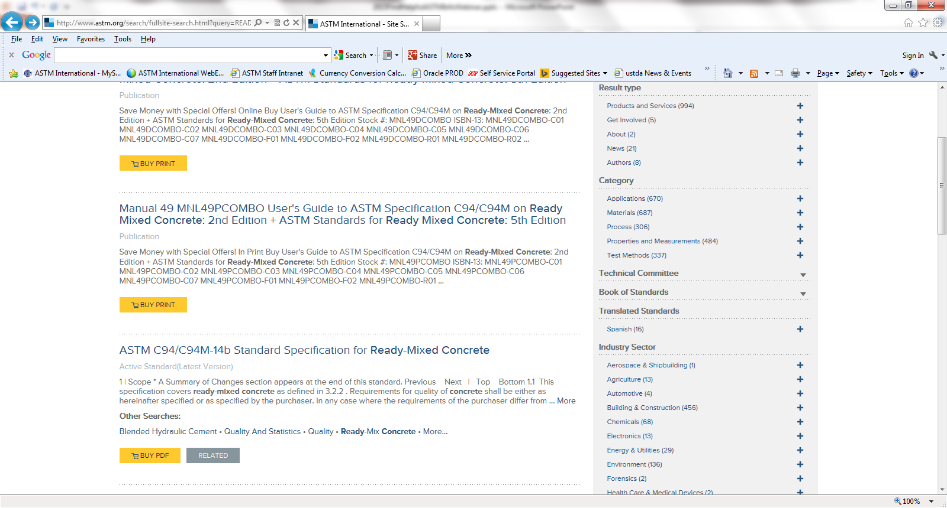
Find Standard –Concrete ‘ASTM C94/C94M ’
Notes:
The search will provide you with a list of ASTM publications-- from which you can choose the standard of interest.

Slide 11
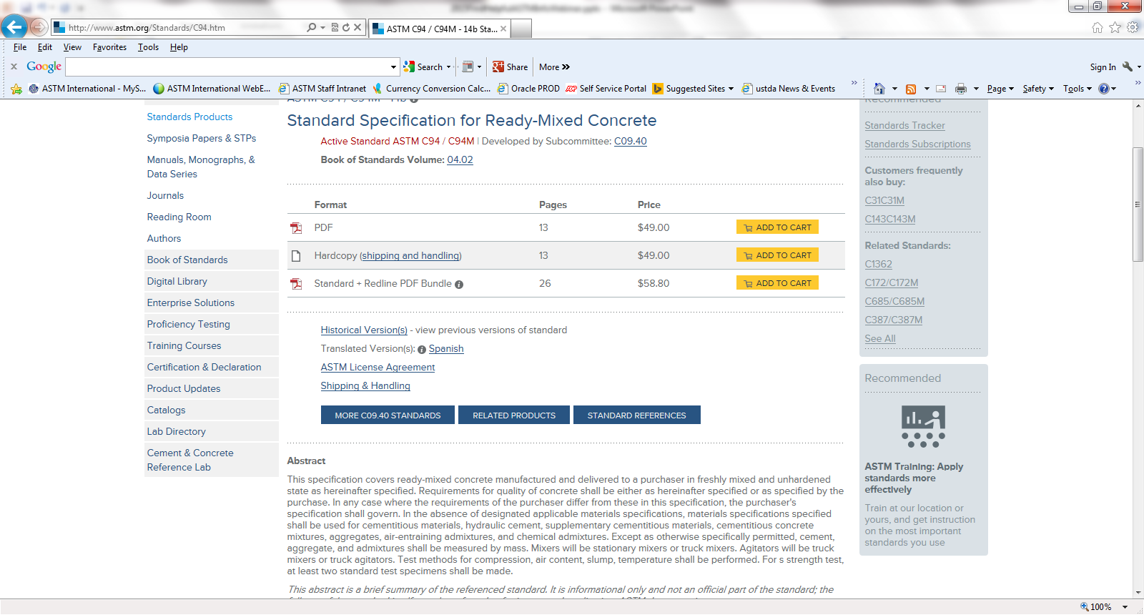
See what Standard is about, “Abstract, Scope”
Notes:
Once you click on the standard title, it will take you to a page with an overview of the particular standard, including:
if it has been translated into Spanish,
what the technical committee is, and the subcommittee,
if there are older ‘historical’ versions available,
a brief Abstract summary of the whole standard,
and the Scope of the standard.
When you review this, you might discover that you actually want a different standard. If so, just look in the right sidebar and this column tells you which are the ‘Related Standards.’ You can simply click on each of those designations, to see the same overview information pertaining to each of them.
So now you can find the ASTM standards online.
If you do not have a computer, you might try to phone INACAL and perhaps speak to Soraya, or if you’re in the San Isidro section of Lima, you could even go there and visit her.

Slide 12
ASTM Membership Application
Notes:
I encourage you to join ASTM , on the Medical Devices Committee F04. it would be helpful to have a voice from Peru on the F04 committee. (There are none now.) That way you can make sure your interests are incorporated into the standards. There are 28 countries represented on this committee, so please consider joining this international group. You can get a free membership through me--Maria Isabel Barrios.

Slide 13
Participation: Online
Notes:
I want to emphasize that when you are a member of an ASTM committee-- you can participate fully through your computer.
You don’t need to spend time and money on travel-- if you do not want to. The ASTM website is your strong partner; providing the standards, providing the training, and if you join ASTM, a global network of like-minded colleagues.

Slide 14
Committee Resources
Notes:
If you become a member, you’ll realize that the committees meet twice a year in person but you can participate online in that live meeting as well. The Manager of the committee can help you connect with our online conferencing through Webex.
It is easy to keep up on everything that happens in your committee(s), including voting, with your computer log-on, as a member.

Slide 15
Voting on Documents
A single negative vote halts the ballot process until resolution is reached
Technical changes require re-balloting
Notes:
As a technical committee member, you will be expected to review ballot documents as they are posted on the ASTM website in the Members Only area. You will receive a notification that a ballot has been posted by email and then you will go and view the ballot that looks something link this. If you vote negative on any item on the ballot, that item will not proceed to the next level of balloting or publication until the negative vote is resolved. If technical changes are accepted, the revised item has to be re-balloted.

Slide 16
Voting Interests
“Balance” in ASTM means that committees have more User, General Interest, and Consumer members than Producer members
Only one official vote is assigned per company
Every member receives ballots and should vote
Producer
User and General Interest
ASTM
Notes:
Technical committees are “classified” and “balanced”
Committee Members are “classified” as one of the following:
Producer, User, General Interest, or Consumer
The official voting Producers on a committee cannot be more than the sum of the User and General Interest voters.

Slide 17
Balloting
Documents are drafted and revised in the task group
New standards are required to be balloted at the subcommittee level at least once
After subcommittee approval, the main committee & entire Society
Committee on Standards
Society and Main Committee
Sub- committee
Task Group
Notes:
The ASTM process of voting on documents occurs from left to right:
The Task Group is an unofficial group that drafts the documents
The Subcommittee is a sub set of experts that reviews the document first on a Subcommittee Ballot (the first official ballot level)
Then the Main Committee reviews the items on ballot (All F04 members) PLUS at the same time, anyone in the ASTM society can request the item on ballot for review.
Lastly, ASTM’s Committee on Standards reviews the process of voting to make sure all the ASTM Regulations were followed.

Slide 18
Key Takeaways
In Summary
All are welcome to join ASTM Committee F04
It’s easy to find standards on the ASTM Homepage
Participation can be 100% online
Process is fair and balanced
Notes:
IN Summary

Slide 19
Thank you
Pat Picariello
ASTM Staff, Committee F04
ppicarie@astm.org

