Slide 1
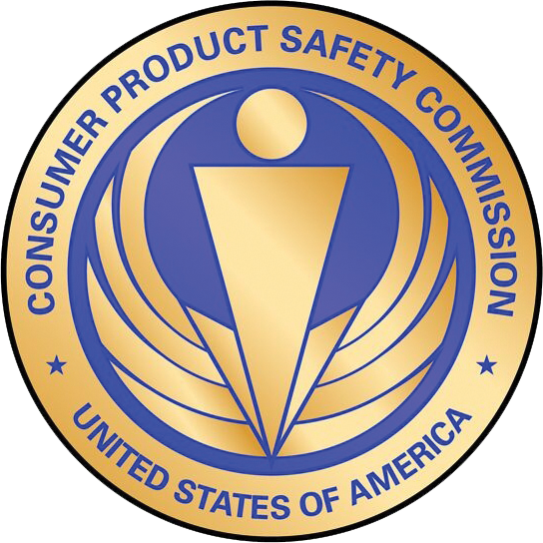
Conference on Textile Standards
Allyson Tenney
U.S. Consumer Product Safety Commission
June 27, 2016
This presentation was prepared by CPSC staff, has not been reviewed or approved by, and may not reflect the views of the Commission.

Slide 2
Session 2 Overview
What is the U.S. CPSC?
Organization
Jurisdiction
Requirements for Apparel and Clothing
Adult Wearing Apparel
Testing and Certification

Slide 3
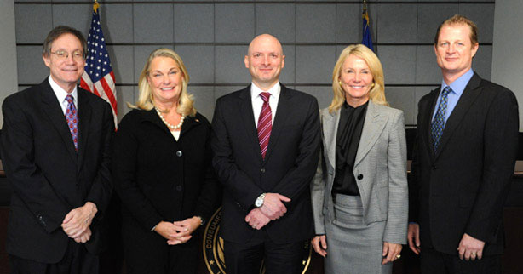
What Is the U.S. CPSC?
CPSC is an independent federal (United States government) regulatory agency created to protect the American public from unreasonable risks of injury associated with consumer products.
Commissioners are appointed by the President for multiyear terms, with confirmation by the Senate.

Slide 4
CPSC Organization*
*This is a simplified functional organization chart that does not include many key support groups within the CPSC, including Administration, Human Resources, Information Services, Budget, Planning, Inspector General, Equal Employment, Office of the Secretary, and Congressional Affairs.

Slide 5
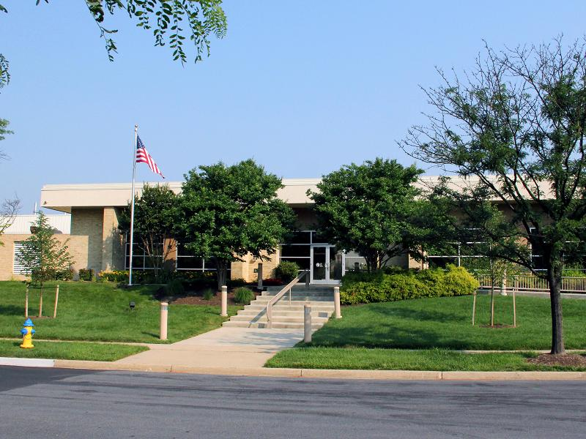
CPSC Locations
CPSC Offices
Address:
4330 East-West Highway, 4th Floor Bethesda, MD 20814
CPSC National Product Testing and Evaluation Center
Address: 5 Research Place Rockville, MD 20850

Slide 6
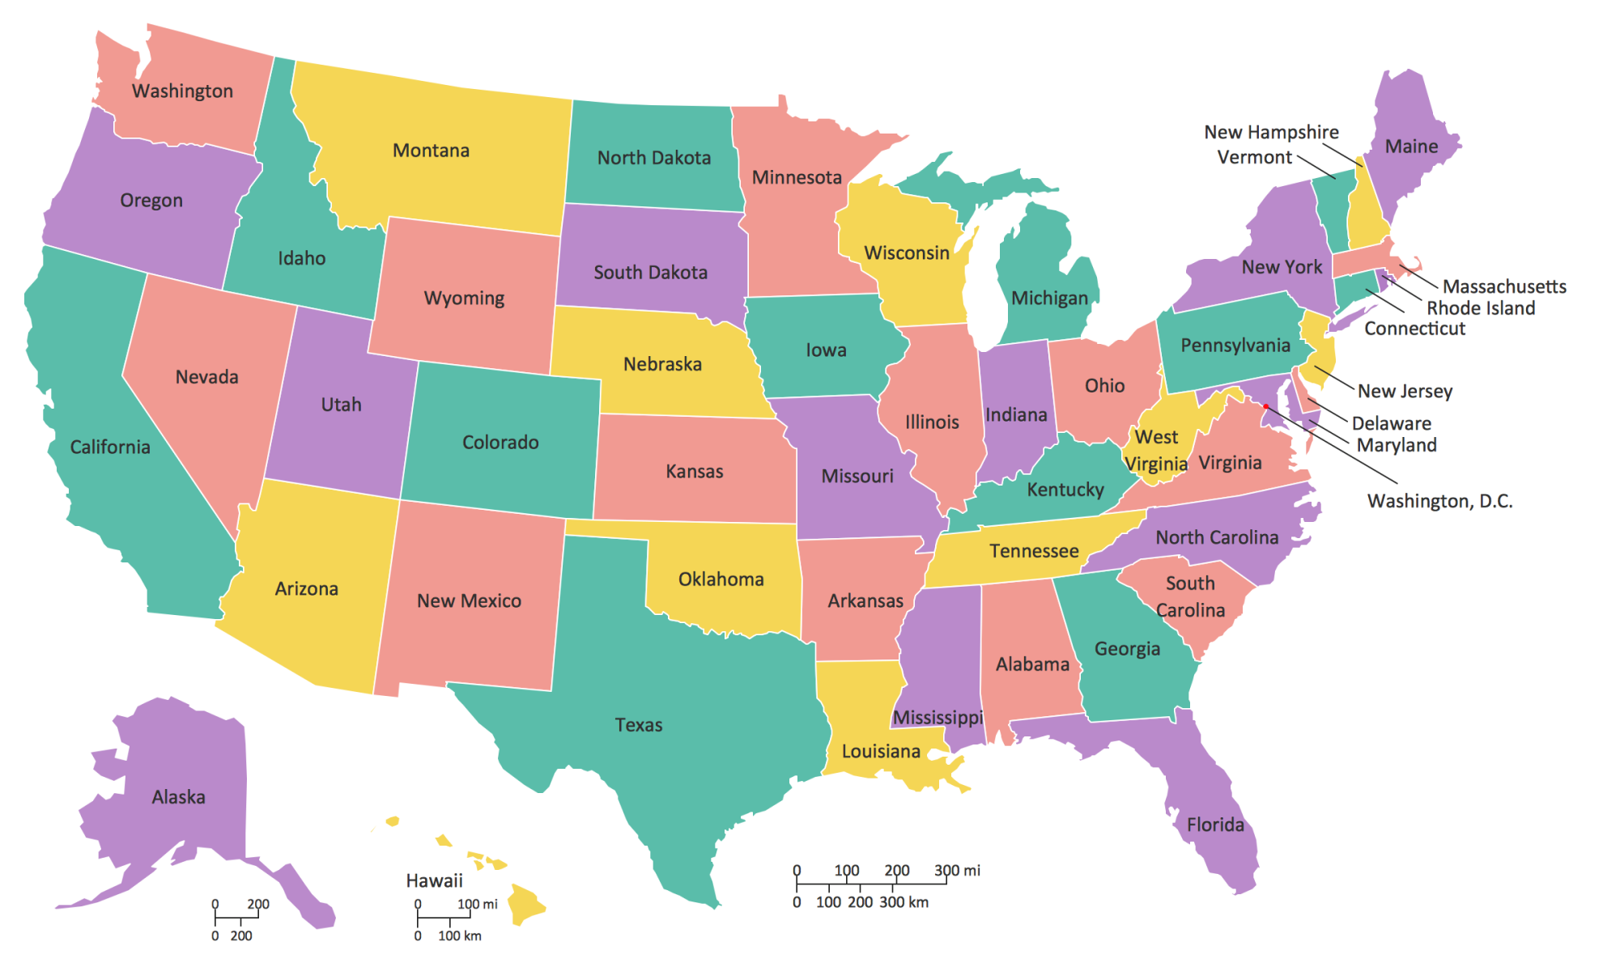
CPSC Investigators

Slide 7
CPSC Jurisdiction
Jurisdiction over thousands of different consumer products under the Consumer Product Safety Act
Excludes some products covered by other federal agencies, such as:
Cars and related equipment (NHTSA);
Food, drugs, medical devices, cosmetics (FDA);
Firearms (BATF);
Airplanes (FAA);
Boats (Coast Guard); and
Pesticides (EPA).
7

Slide 8
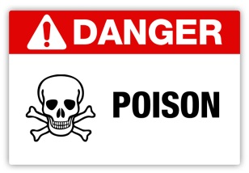
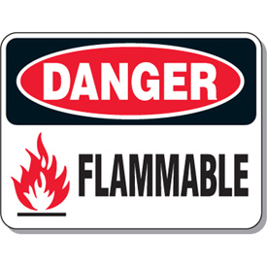
CPSC Jurisdictional Authority
Jurisdictional Authority in 7 Acts:
Consumer Product Safety Act (CPSA)
Federal Hazardous Substances Act (FHSA)
Poison Prevention Packaging Act (PPPA)
Flammable Fabrics Act (FFA)
Refrigerator Safety Act (RSA)
Virginia Graeme Baker Pool & Spa Safety Act (VGBA)
Children’s Gasoline Burn Prevention Act (CGBPA)

Slide 9
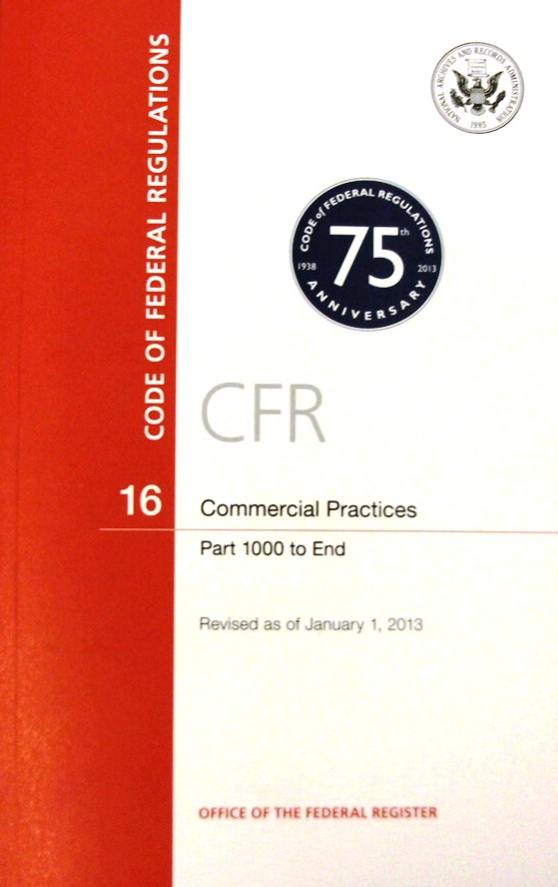
Code of Federal Regulations
www.ecfr.gov

Slide 10
Consumer Product Safety Act
Enacted in 1972, the CPSA is CPSC’s umbrella statute.
CPSA
Established the agency
Defines basic authority
Authorizes CPSC to develop standards and bans
Gives CPSC the authority to pursue recalls and to ban products under certain circumstances

Slide 11
Consumer Product Safety Improvement Act
Amendment to the statutes under which CPSC’s authorities are executed.
CPSIA
Established new consumer safety mandates
Reauthorized the CPSC
Amended civil penalties
Imposed new mandatory requirements for consumer products for both non-children’s products (adult) and children’s products

Slide 12
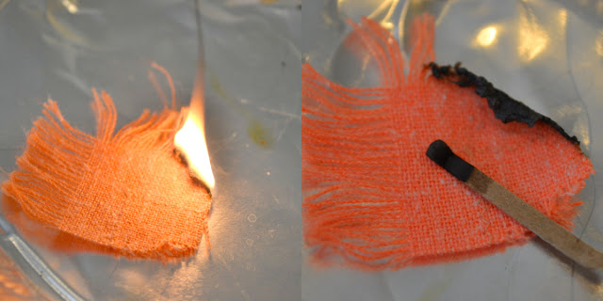
Flammable Fabrics Act (FFA)
Regulated Products:
Clothing Textiles, 16 CFR part 1610
Vinyl Plastic Film, 16 CFR part 1611
Children’s Sleepwear, 16 CFR parts 1615/1616
Carpets and Rugs, 16 CFR parts 1630/1631
Mattresses and Mattress Pads, 16 CFR part 1632
Mattress Sets, 16 CFR part 1633

Slide 13
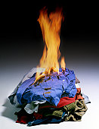
Standard for the Flammability of Clothing Textiles
16 CFR part 1610 – commonly known as the General Wearing Apparel Standard
Enacted in the 1950s
Keeps the most dangerously flammable textile products and garments out of the marketplace

Slide 14
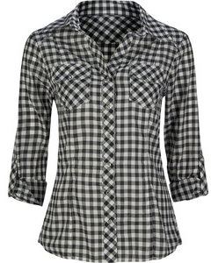
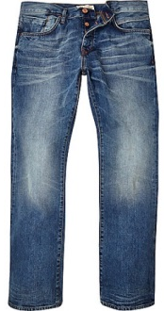
Clothing – Wearing Apparel
Wearing Apparel: The Standard applies to all textiles used for adult and children’s wearing apparel
Does not apply to:
Certain hats, gloves, footwear, interlining fabrics
Children’s sleepwear must meet a more stringent standard

Slide 15
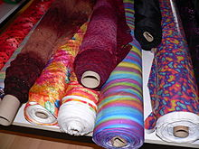
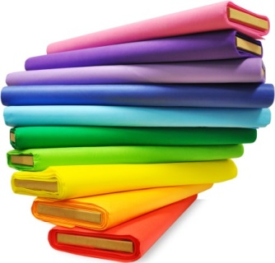
Part 1610 - Specific Exemptions
Fabrics that meet a specific exemption do not require testing.
Determined by fabric type and specifications
Plain-surface textile fabric or raised-fiber surface
Fabric weight
Fiber content
Plain-surface fabrics ≥88.2 g/m2 (2.6 oz/yd2), regardless of fiber content
Plain- and raised-fiber surface fabrics made of:
Acrylic, modacrylic, nylon, olefin, polyester, wool, or any combination of these fibers, regardless of weight;

Slide 16
Part 1610 - Testing
The Standard specifies testing procedures and determines the relative flammability of textiles used in apparel using three classes of flammability.
The burn time of several specimens is averaged and a Class (Class 1, 2, or 3) designation is made based on:
Average burn time (speed of burning)
Surface characteristics
Class 3 textiles are considered dangerously flammable and are not suitable for use in clothing, due to their rapid and intense burning.

Slide 17
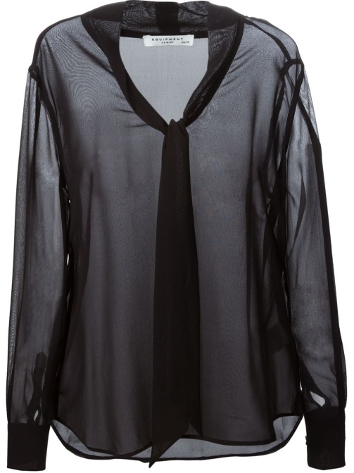
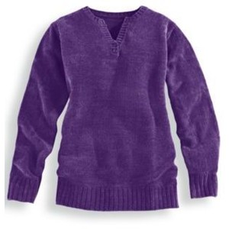
Common Noncomplying Fabrics
Sheer 100% rayon
Sheer 100% silk
100% rayon chenille
Certain rayon/nylon chenille
Certain polyester/cotton and 100% cotton fleece
100% cotton terry cloth

Slide 18
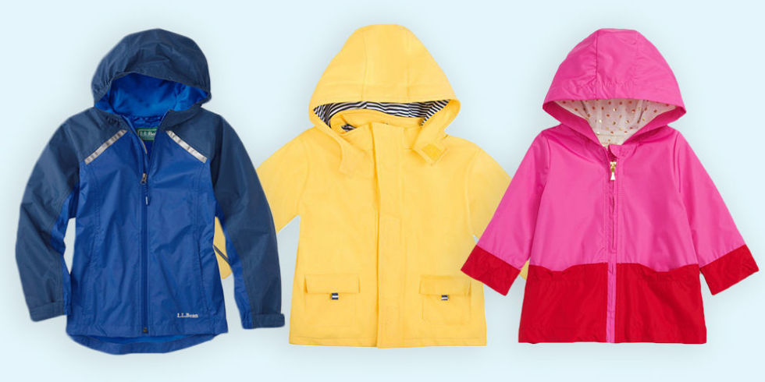
Standard for the Flammability of Vinyl Plastic Film
Part of original FFA commercial standard from the 1950s, codified as 16 CFR part 1611 in 1975
Applies to non-rigid, unsupported vinyl plastic film, including transparent, translucent, and opaque material used in wearing apparel subject to the FFA
Disposable diapers
Raincoats

Slide 19
Clothing and Wearing Apparel for Adults
Wearing apparel is tested to either Part 1610 or Part 1611 (Flammability)
Certification (GCC) is Required
Enforcement policy for products that meet testing exemptions, March 2016

Slide 20
General Certificate of Conformity (GCC)
Certification is required for all products subject to similar rule, ban, standard, or regulation under and enforced by the CPSC
Certification shows conformance to applicable requirements
Can be paper document or electronic
Accompanies product when it enters commerce
Furnished to CPSC or at import to CBP, upon request
GCC for manufacturers and importers of general use products (non-children’s products)

Slide 21
GCC Requirements
Elements Required in a GCC:
Identification of the product
Citation to each applicable product safety rule
Name of manufacturer or U.S. importer—name, mailing address, telephone number
Contact information for the individual maintaining records—must be an individual, name, mailing address, telephone number, e-mail address
Date of manufacture (month and year) and place of manufacture (city and country, factory specific)
Date and place of testing

Slide 22
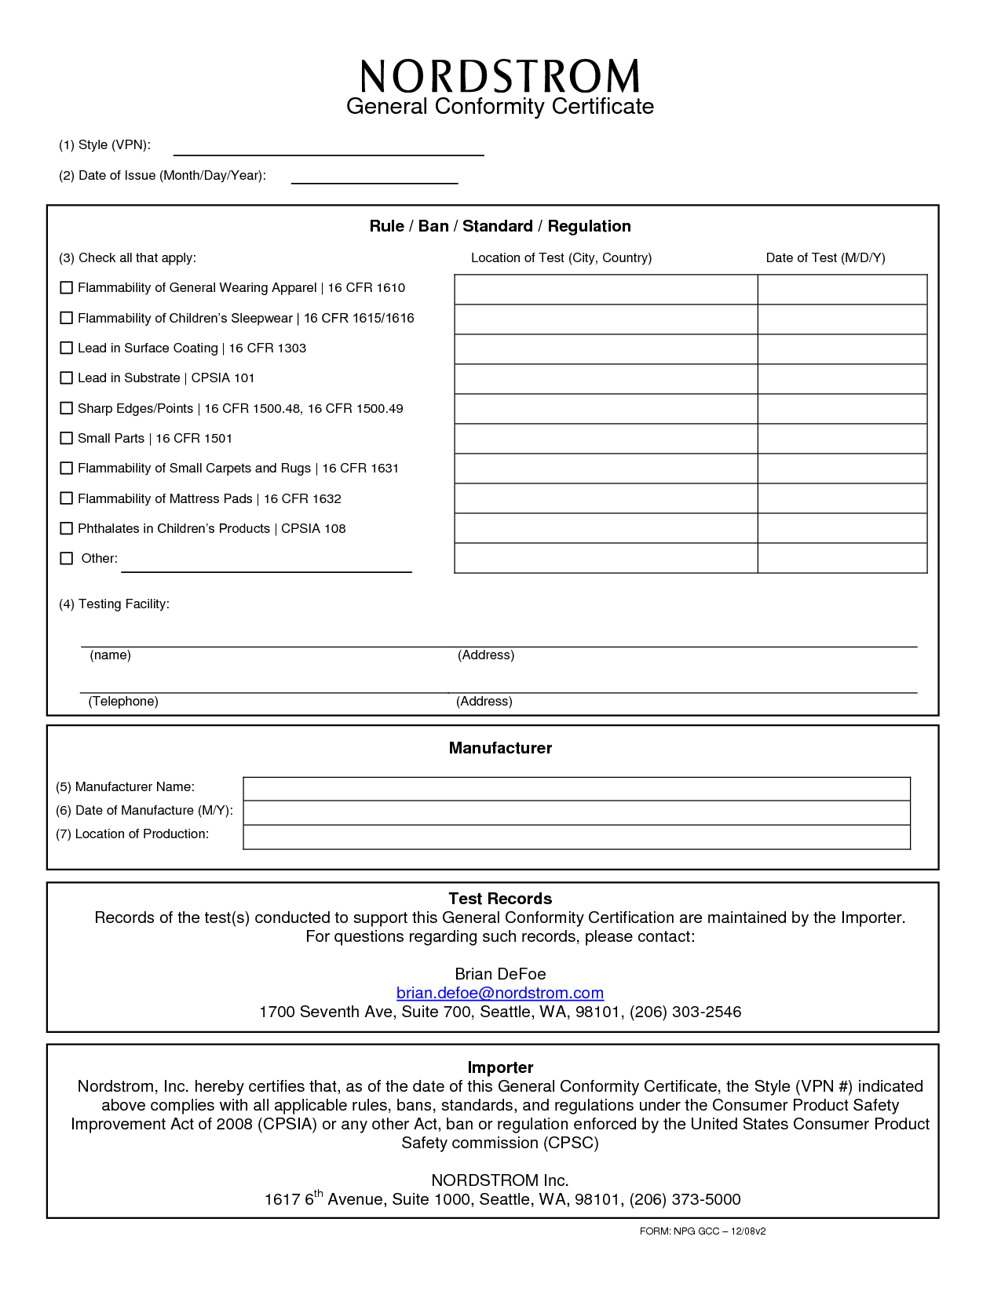
General Certificate of Conformity (GCC)
http://www.cpsc.gov/Business--Manufacturing/Testing-Certification/General-Certificate-of-Conformity-GCC/

Slide 23
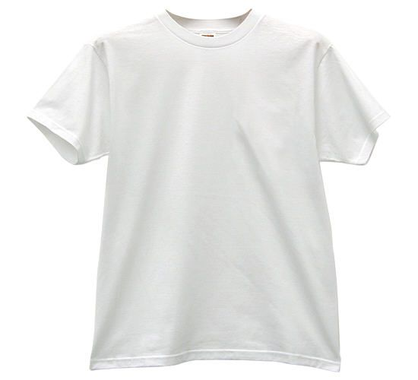
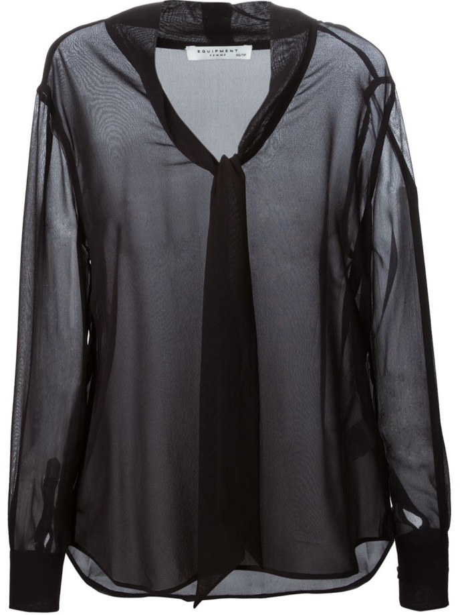
Adult Clothing Examples
Men's T-shirt
100% cotton knit
4oz/sq yd
Subject to 16 CFR 1610
Exempt under §1610(d)(1) – Fabric Weight; No GCC
Women’s Blouse
100% Silk Woven Fabric
2oz/sq yd
Subject to 16 CFR 1610
GCC Required

Slide 24
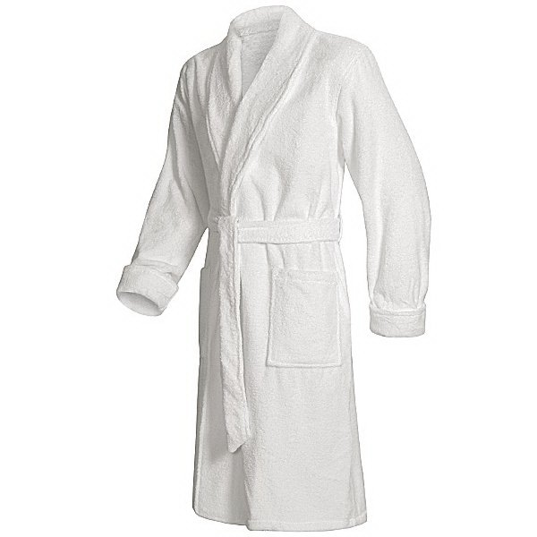
Adult Clothing Examples
Adult Bathrobe
100% Cotton Terrycloth
8oz/yd^2
Subject to 16 CFR 1610
GCC Required
Adult Sweater
100% Wool
6oz/yd^2
Subject to 16 CFR 1610
Exempt under §1610(d)(2)
No GCC

Slide 25
Questions?

Slide 26
Session 3 Overview
Requirements for Children’s Clothing
Flammability Standards
Lead Requirements
Requirements for Child Care Articles
Tracking Labeling Requirements
Certification
Compliance with the Requirements
Where to Find Additional Information

Slide 27
Flammability Requirements for Children’s Clothing
All Children’s Apparel and Sleepwear is subject to flammability requirements
Wearing apparel is tested to either Part 1610 or part 1611 (Flammability)
Examples include daywear clothing, outerwear, diapers, socks, infant garments
Children’s sleepwear is subject to more stringent standards

Slide 28
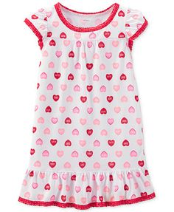
Standards for the Flammability of Children’s Sleepwear
The children’s sleepwear standards (16 CFR Parts 1615 and 1616) were developed in the early 1970s to address the ignition of children’s sleepwear, such as nightgowns, pajamas, and robes.
The standards are designed to protect children from small open-flame sources, such as matches/lighters, candles, fireplace embers, stoves, and space heaters.
The standards are not intended to protect children from large fires or fires started by flammable liquids, such as gasoline.

Slide 29
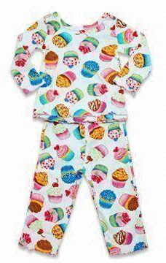
Parts 1615 & 1616 - Scope
Children’s sleepwear means any product of wearing apparel intended to be worn primarily for sleeping or activities related to sleep in size 0 through size 14.
Nightgowns, pajamas, robes, or similar or related items, such as loungewear, are included.
Several factors determine if a garment is sleepwear:
Suitability for sleeping, likelihood of garment to be used for sleeping
Garment and fabric features
Marketing, merchandising/display, intended use

Slide 30
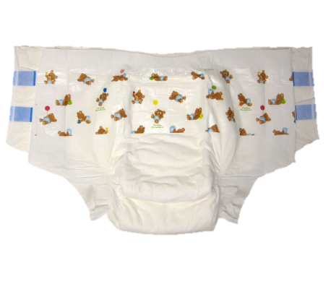
Parts 1615 & 1616 Exemptions
Category Exceptions
Diapers and Underwear (exempt)
Must comply with 16 CFR Part 1610
Infant garments (exempt)
Sizes 9 months or younger
One-piece garment does not exceed 64.8 cm (25.75”) in length
Two-piece garment has no piece exceeding 40 cm (15.75”) in length
Must comply with 16 CFR Part 1610

Slide 31
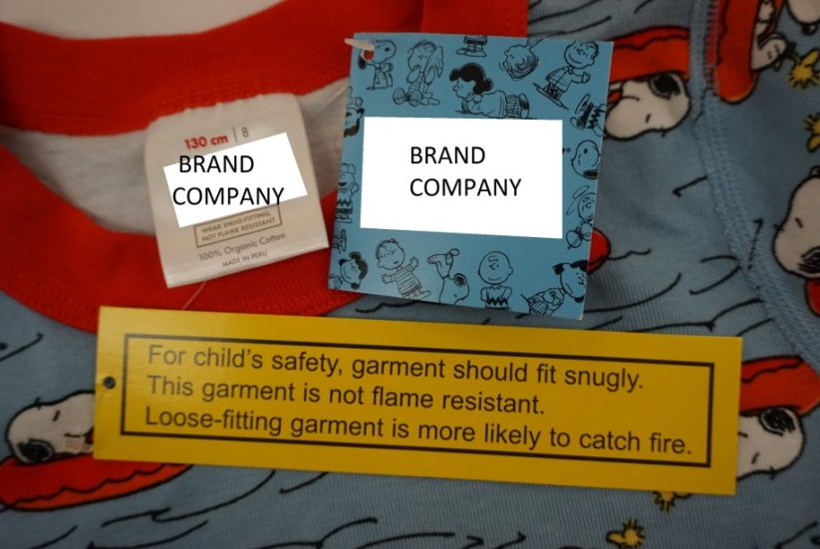
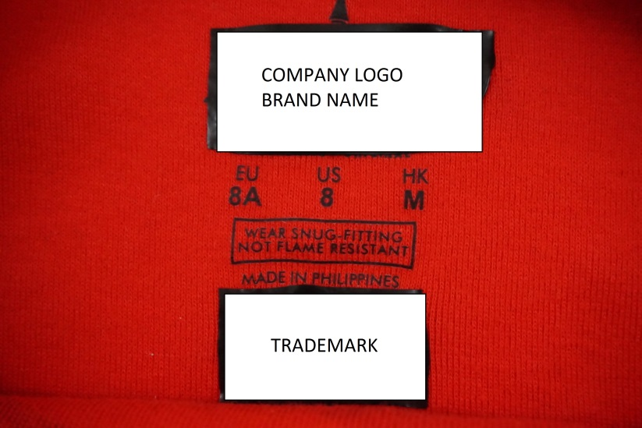
Tight-Fitting Exemption
Tight-Fitting Sleepwear (exempt)
Tight-fitting garments (defined by the Standards) are exempt from testing to the sleepwear requirements.
Must meet specific maximum dimensions.
Must comply with 16 CFR part 1610.
Must meet tight-fitting label and hang tag requirements.

Slide 32
Parts 1615 & 1616 - Testing
Children’s sleepwear (that is not tightfitting) must pass the flammability requirements
All fabrics and garments must be flame resistant and self-extinguish (not continue to burn) when removed from a small, open-flame ignition source
The fabric, garments, seams, and trims must pass certain flammability tests

Slide 33
Parts 1615 & 1616 - Testing
Standard requires tests of fabric, seams, trim, and finished garments
Each test sample consists of five specimens (minimum of three samples)
Each specimen is placed in a metal holder and suspended vertically in the test cabinet
Tests conducted in original state and after 50 laundering cycles (if the sample passes the original state test)

Slide 34
Parts 1615 & 1616 - Results
The average char length of five specimens cannot exceed 17.8 cm (7.0 inches)
No individual specimen can have a char length of 25.4 cm (10.0 inches) (full-specimen burn)
Tested samples are required to be retained
Standards include production testing and recordkeeping requirements

Slide 35
Consumer Product Safety Improvement Act
Many of the requirements are specifically for children’s products and child care articles.
Children’s products: Designed and intended primarily for children 12 years or younger.
Child care articles: Used to facilitate sleeping and feeding for children 3 years or younger. Additional requirements for child care articles.

Slide 36
CPSIA - Requirements
Comply with all applicable children’s product safety rules
Lead content and lead surface coating limits must be met
Child care articles (for children 3 and under) are subject to phthalate requirements
Issue a Children’s Product Certificate (CPC)
CPC shows conformance to applicable requirements (e.g., flammability, lead, phthalates) based on third party testing
Use accredited third party CPSC-accepted laboratory
Have permanent tracking information affixed to the product and its packaging, when practicable

Slide 37
CPSIA - Lead Requirements
Total Lead Content
Children’s products
Limits total lead in accessible parts to 100 ppm
Lead in Paint and Surface Coatings
16 CFR Part 1303: Protects consumers, especially children, from being poisoned by excessive lead in surface coatings on certain products
Children’s products, toys, and some furniture bearing a surface coating
Bans paint and other similar surface coatings that contain more than 0.009% lead (90 ppm)
Separate from the underlying substrate
www.cpsc.gov/lead

Slide 38
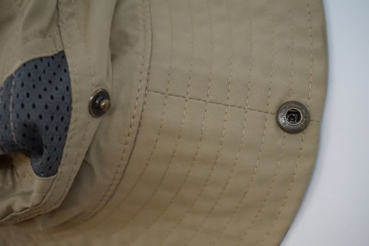
CPSIA Lead - Clothing and Textiles
Lead content and surface coating limits must be met for certain accessible components of textile products, clothing, and clothing accessories.
Buttons, snaps, grommets and zippers must meet total lead content requirements.
Painted buttons and snaps, painted zippers, heat transfers, and screen prints are subject to the lead in surface coating ban.
Inaccessible lead component parts are exempt.
Component part testing

Slide 39
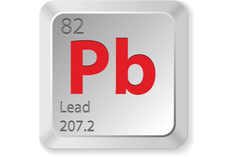
Lead Determinations - Textiles
16 CFR Section 1500.91: Certain materials will not exceed lead limits
Includes dyed or undyed textiles and nonmetallic thread
Currently do not require third party testing

Slide 40
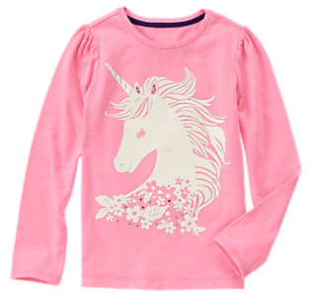
Screen Printing
Screen printing—generally considered to be a surface coating
Subject to the lead in paint and surface coating limits (90 ppm)
Compliance and Testing
Test finished product at accredited CPSC-accepted laboratory
Component part testing—Obtain testing results or CPC from print ink, paint, pigment supplier
Screen printing on children’s sleepwear for children under 3 (child care article) subject to phthalate requirements

Slide 41
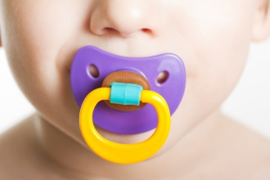
Phthalates - Child Care Articles
Phthalates are chemical plasticizers that are often used in the production of many types of plastics, certain inks, paints, and other products.
Six types of banned phthalates in toys and child care articles:
Three types permanently banned (DEHP, DBP, BBP) in any amount greater than 0.1 percent (computed for each phthalate, individually)
Three types interim banned (DINP, DIDP, and DnOP)
Applies to:
Plasticized component parts in toys and child care articles
Accessible component parts
www.cpsc.gov/phthalates

Slide 42
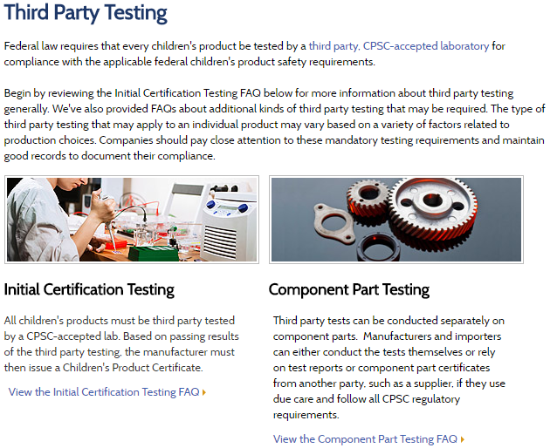
3rd Party Testing - Children’s Products
Children’s products must be tested by an accredited CPSC-accepted third party laboratory.
Types of third party testing for Children’s Products:
Initial Testing
Material Change Testing
Periodic Testing
Component Part Testing
Children's Product Certificate (CPC) based on passing results of the third party testing
www.cpsc.gov/testing

Slide 43
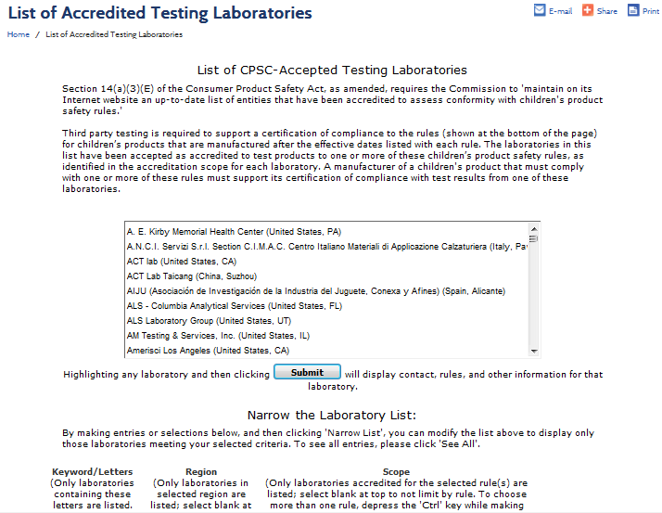
CPSC-Accepted Laboratory
Children’s products must be third party tested by a CPSC accepted laboratory. Your children’s product may be subject to multiple regulations, and you may need to conduct multiple searches to find a laboratory that meets your particular needs.
http://www.cpsc.gov/cgi-bin/labsearch/

Slide 44
Children’s Product Testing
Initial Testing/Certification: Tested for compliance with applicable children’s product requirements
Before exportation to the USA
Sufficient number of samples
Material Change/Reissue Certification: Tested when product design, manufacturing process, or component part changes
Recertification or material change resets the periodic testing interval
Periodic Testing: Tested on the continuing production of a children's product to ensure continued compliance over specified time frames.
Conducted at maximum testing intervals
One year
Two years (with production testing plan)
Three years (testing plan using ISO/IEC 17025:2005 laboratory)
Component part testing may be used to support the testing.

Slide 45
Component Part Testing
Allows testing of component parts:
Manufacturers and importers may use test results or certification from component part supplier
Exercise due care:
Ensure validity of results
Documentation and access to records
CPSC-accepted third party laboratory
Component part testing may be sufficient for a material change to only one component.

Slide 46
Small Batch Manufacturers
Small Batch Manufacturers
Total gross revenue from prior year is $1 million or less
Manufacture no more than 7,500 units of the same covered product
Must register and apply
Issued a number by CPSC
Registration required each year
Exclusion from some third party testing requirements for children’s products
http://saferproducts.gov/SmallBatchManufacturers/

Slide 47
Children’s Product Certificate (CPC)
Manufacturers and importers of children’s products must certify, in a written Children’s Product Certificate (CPC) based on test results from a CPSC-accepted laboratory, that their children’s products comply with applicable children’s product safety rules.

Slide 48
CPC Requirements
Elements Required in a CPC
Identification of the product
Citation to each applicable product safety rule
Name of manufacturer or U.S. importer—name, mailing address, telephone number
Contact information for the individual maintaining records—must be an individual, name, mailing address, telephone number, e-mail address
Date of manufacture (month and year) and place of manufacture (city and country, factory specific)
Date and place of testing
Identification of third party laboratory, if any—name, mailing address, telephone number

Slide 49
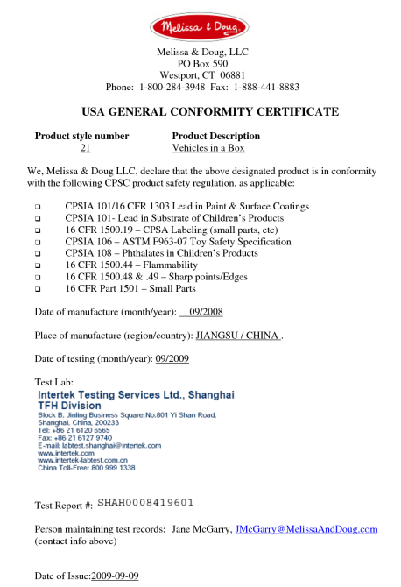
Children’s Product Certificate (CPC)
http://www.cpsc.gov/Business--Manufacturing/Testing-Certification/Childrens-Product-Certificate-CPC/

Slide 50
CPSIA - Tracking Information
Manufacturers of children’s products are required, to the extent practicable, to place distinguishing permanent marks (generally referred to as “tracking labels”) on the product and its packaging that provide certain identifying information

Slide 51
CPSIA - Tracking Information
A tracking label must contain certain basic information, including:
The name of the manufacturer or private labeler;
The location and date of production of the product;
Detailed information on the manufacturing process, such as a batch or run number, or other identifying characteristics; and
Any other information to facilitate ascertaining the specific source of the product.

Slide 52
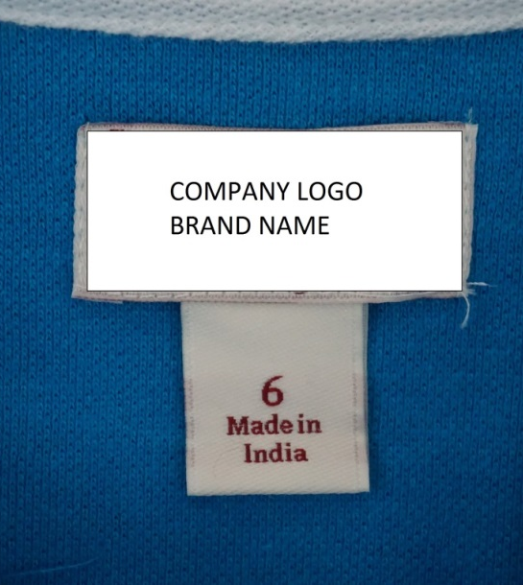
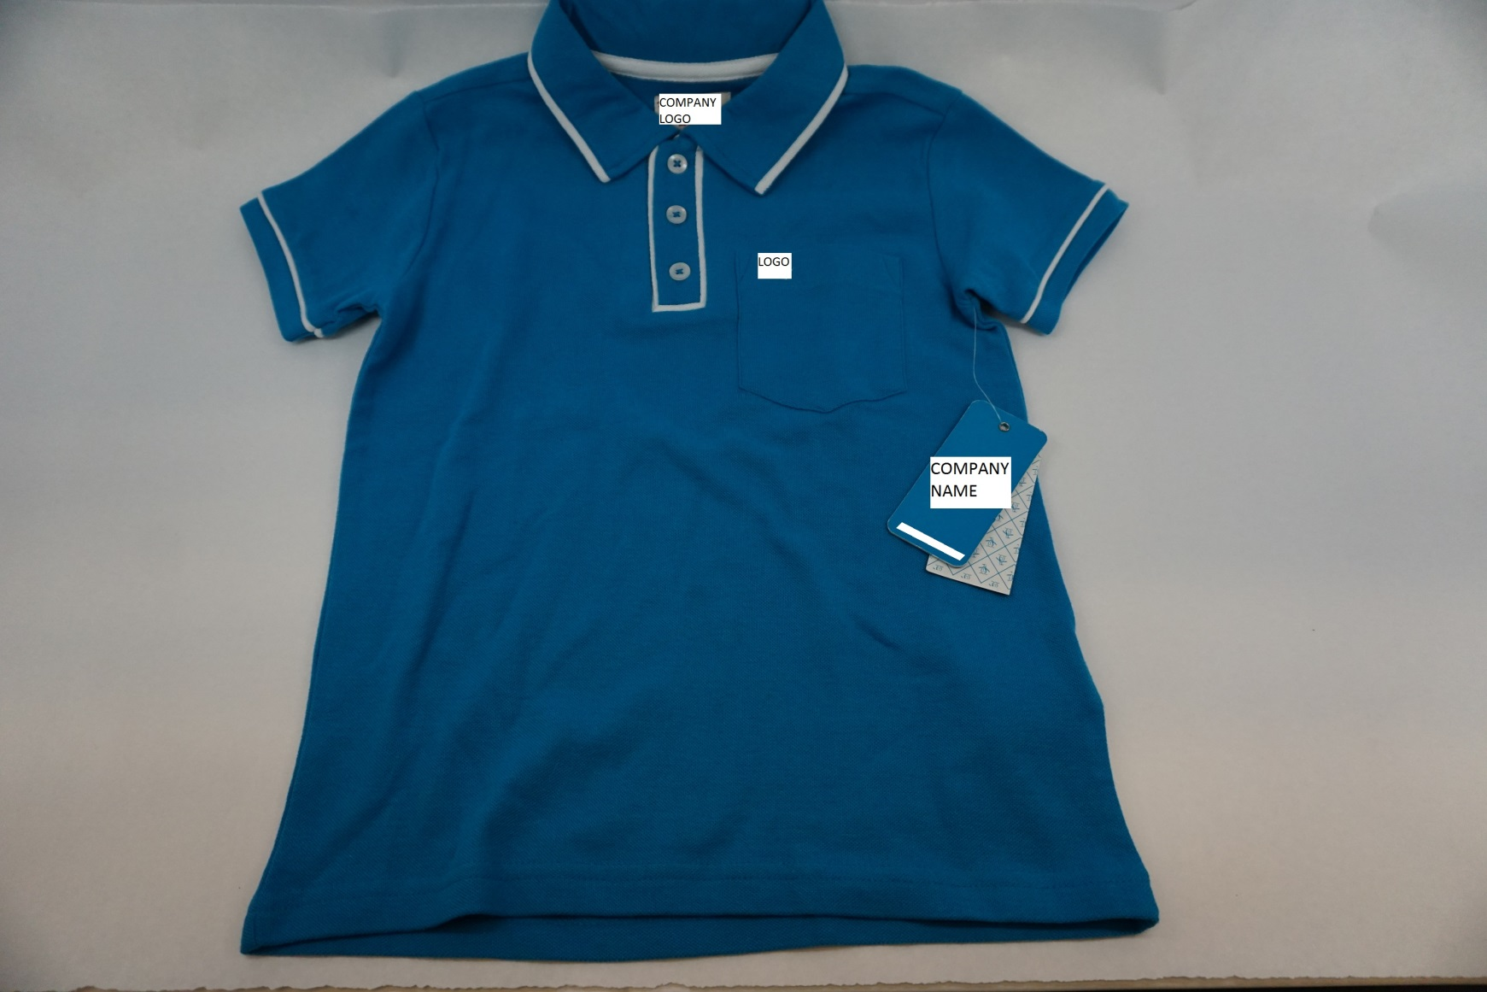
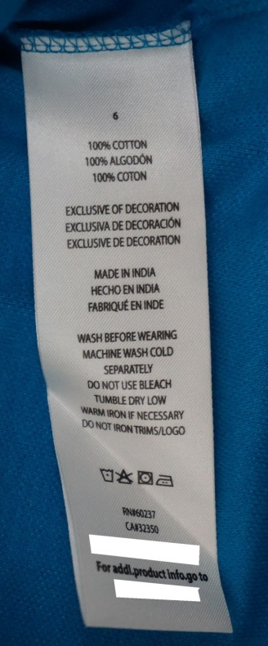
Examples of Tracking Information

Slide 53
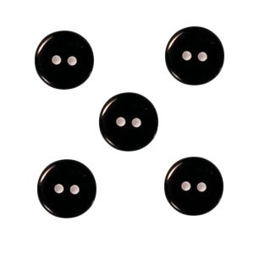
Small Parts on Clothing
CPSC regulations for small parts used on products for children under 3
Regulation prevents deaths and injuries to children from choking
Children’s Clothing and Accessories
Fabrics and buttons are exempted from small parts regulations and testing requirements.
Buttons and other fasteners are not required to be tested for small parts conformity but should be secure.
If buttons start falling off due to poor construction, they may pose a substantial product hazard; this should be reported to the CPSC as a possible hazard.

Slide 54
Drawstrings
Young children can be seriously injured or subject to fatal entanglement if the drawstrings of the upper outerwear they are wearing catches or snags.
In 2012, the Commission determined that drawstrings on children’s upper outerwear present a substantial product hazard and issued a rule under 15(j) under the Consumer Product Safety Act (CPSA).
Children’s upper outerwear sold in the United States should comply with the voluntary safety standard, ASTM F-1816 Standard Consumer Safety Specification for Drawstrings on Children’s Upper Outerwear.

Slide 55
Drawstrings- Definitions
Drawstring:
A non-retractable cord, ribbon, or tape of any material to pull together parts of upper outerwear to provide for closure and generally runs through a casing.
Fully Retractable Drawstrings:
Automatically retract from its full length without any user effort made for retractions, leaving only the cord lock, knot, or toggle flush against the outside of the garment. They are permitted but must not extend more than three inches below the hem of the upper outerwear garment.
Ties:
Ties are considered drawstrings and are subject to the requirements.
Belts:
Belts are not considered drawstrings and are not subject to the requirements.

Slide 56
Drawstrings Requirements
Drawstrings are not allowed at the hood and neck area on children’s upper outerwear in sizes 2T through 12.
Waist and bottom drawstrings in upper outerwear for sizes 2T to 16 must meet certain requirements.
CPSC defines “upper outerwear” as clothing such as jackets, ski vests, anoraks, and sweatshirts that generally are intended to be worn on the exterior of other garments, including lightweight outerwear that is appropriate for use in warmer climates.
Underwear, inner clothing layers, pants, shorts, swimwear, dresses and skirts are not considered upper outerwear.

Slide 57
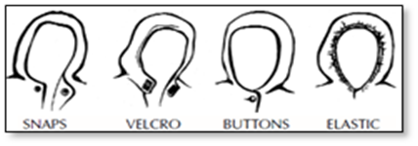
Drawstrings-Requirements
Hood & Neck
Children’s upper outerwear should use alternative closures, such as snaps, buttons, Velcro, and elastic, pictured above.
Waist & Bottom:
The length of the drawstring must not extend more than three inches from the channel when the garment is expanded to its fullest width. Drawstrings that are one continuous string must be bar tacked or stitched through to prevent the drawstring from being pulled through its channel.
Cord locks, knots, toggles, or other attachments at the free ends of drawstrings are prohibited (even on fully retractable drawstrings).

Slide 58
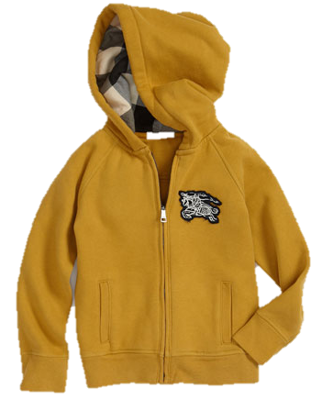
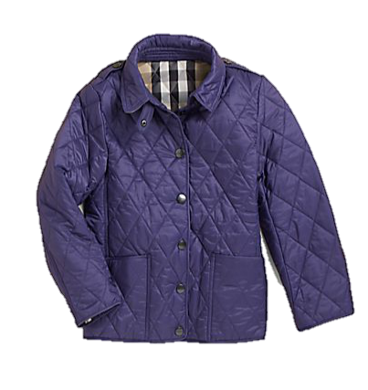
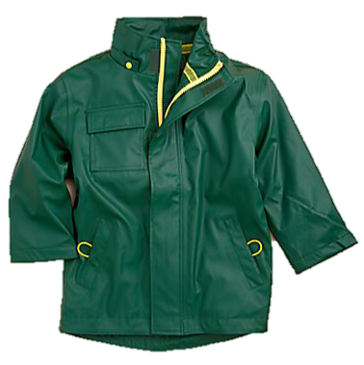
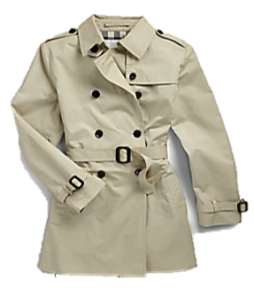
Non-Violative Upper Outerwear

Slide 59
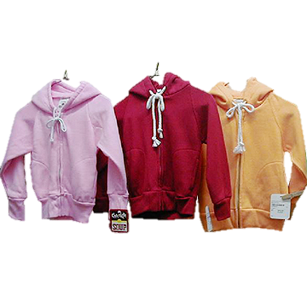
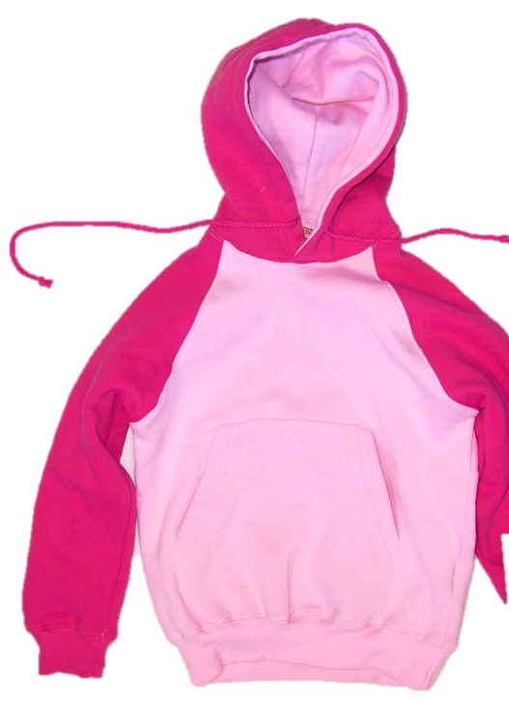
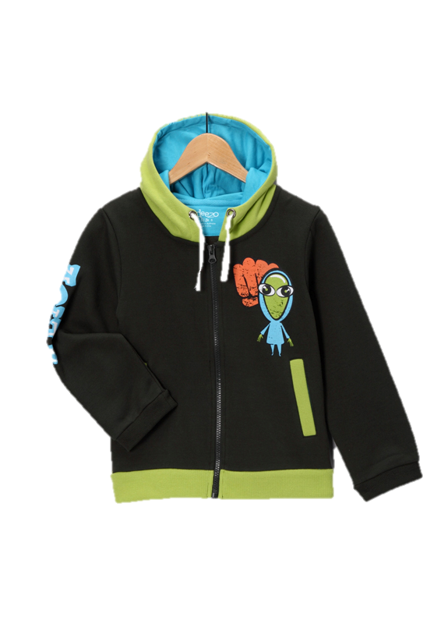
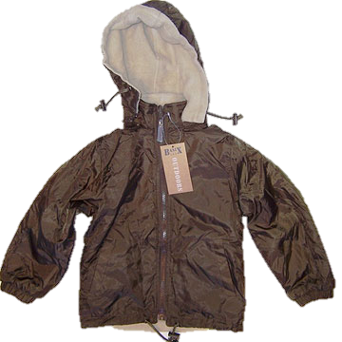
Violative Upper Outerwear

Slide 60
Children’s Clothing-Flammability
16 CFR part 1610 or part 1611 (Flammability)
A CPC is required showing third party testing.
Lead Content
Lead Surface Coating
Tracking Labels
Drawstring Requirements
Phthalate Requirements (bibs)

Slide 61
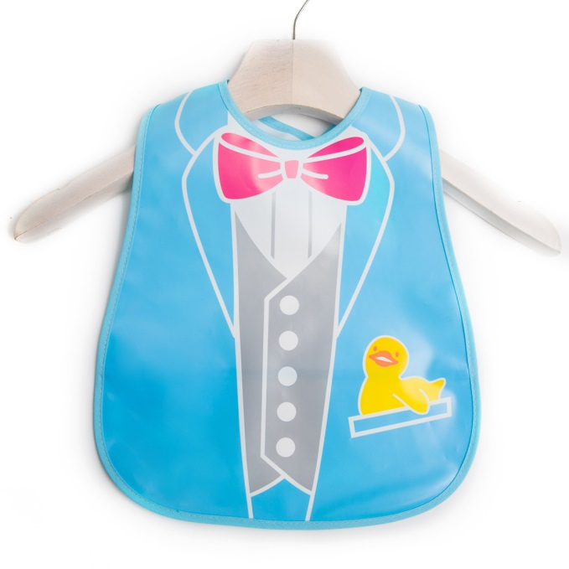
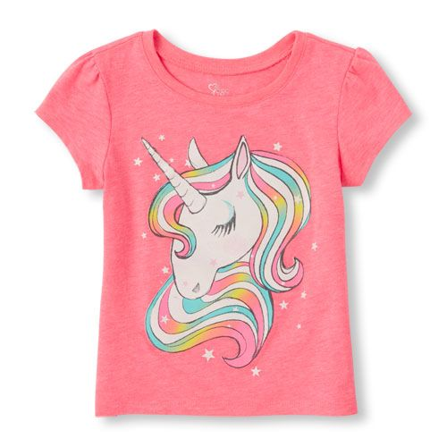
Children’s Clothing Examples

Slide 62
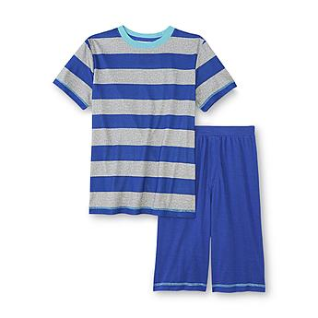
Children's Sleepwear Summary
16 CFR parts 1615 and 1616 (Flammability)
A CPC is required showing third party testing.
Lead Content
Lead Surface Coating
Tracking Labels
Phthalate Requirements (under age of three)

Slide 63
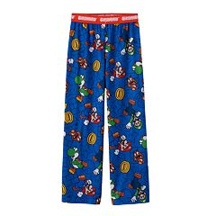
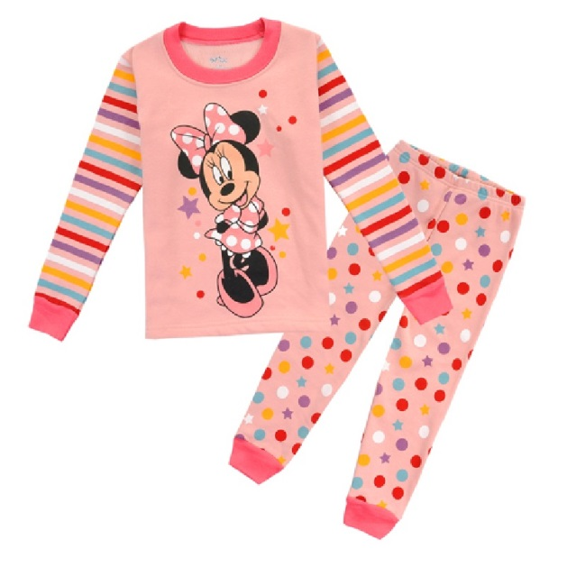
Examples

Slide 64
Product Safety Concerns
Products that fail to comply with a mandatory safety standard or ban under the Acts
Products that fail to comply with voluntary standards, and Commission staff has determined such failure to be a substantial product hazard
Product defects that could create a substantial risk of injury to the public

Slide 65
Violations/Prohibited Acts
The statutes make it unlawful to:
Manufacture for sale, sell, offer for sale, distribute, or import any product that does not comply with a mandatory standard or ban under any act the Commission enforces;
Fail to report information as required by section 15(b) (CPSA);
Fail to certify;
Fail to include tracking labels when appropriate; and
Sell any recalled products.

Slide 66
Reporting Requirements
The manufacturer, importer, retailer, and distributer is required to report immediately upon obtaining information that reasonably supports the conclusion that a product:
Fails to meet a rule, regulation, standard, or ban under any statute enforced by the CPSC
Contains a defect which could create a substantial product hazard, or
Creates an unreasonable risk of serious injury or death

Slide 67
How and What to Report
Initial report:
Details about product, stop-sale date, inventory and product details, potential defect, hazard, or violation and all available information
Full report:
Complete information with regard to details about manufacturer, product, test data, and incidents
Report online www.saferproducts.gov

Slide 68
Where to Report

Slide 69
Regulated Products - Corrective Actions
Violation of mandatory standard, ban, or rule, or regulation
Corrective Action, Recall
Seizure
Injunction
U.S. Customs action/Refuse admission
Penalties

Slide 70
Penalties
Any person who knowingly commits a violation is subject to a civil penalty of $100,000 for each violation (CPSIA).
The maximum civil penalty for a related series of violations is capped at $15,150,000 (January 2012).
Criminal penalties (including imprisonment) are also possible for willful violations.

Slide 71
Avoiding Product Recalls
Know and Comply with Federal Standards
Know and Comply with Voluntary Standards
Control the supply chain
Test, Test, Test
Monitor Product Use
Evaluate Complaints, Inquiries, Injuries, Customer Feedback
Respond to Retailer/Importer Notifications
Report Safety Issues

Slide 72
Publicly Available Information
CPSC Website
Regulations/Standards
Regulatory Summaries
Loungewear Policy
Laboratory Manuals
Import Stoppage Report
Regulatory Violations List
Consumer Recall Press Releases

Slide 73
CPSC Home Page
http://www.cpsc.gov/

Slide 74
Clothing Recall Examples

Slide 75
Stay Updated: CPSC Safety Blog
onsafety.cpsc.gov

Slide 76
For Further Information:
U.S. Consumer Product Safety Commission
Allyson Tenney
Director, Division of Engineering
(+) 301-987-2769
atenney@cpsc.gov
www.CPSC.gov

