Slide 1
High Level Symposium to
Enhance Regulator Expertise
on the WTO Agreement on
Technical Barriers to Trade
9-10 February 2016
Session 3:
Different Approaches to Conformity Assessment
How to Ensure That We Choose the Best Conformity Assessment Procedures Available, Given Our Options
Moderator: Ann Weeks, Vice President, Global Government Affairs, UL; ITAC 16 TBT Vice Chair
Panelists: Orlando Pérez, Director General for North America, SE
Erik Wijkström, Counsellor, Trade and Environment Division, WTO
Maribel López, Executive Director of the Mexican Accreditation Entity
Paul Moliski, Vice President, Accreditation, Intertek; ANSI Americas RSC
Abel Hernández, Director General, National Association for Normalization and Certification

Slide 2
Session 3: Agenda
9:05 Introduction of the Panel and Panelists
9:10 What is Conformity Assessment and Why Does it Matter?
Ann Weeks
What guidance does the WTO provide for Conformity Assessment?
Orlando Pérez
What is the TBT Committee’s Work Program on Conformity Assessment?
Erik Wijkström
9:55 How does Mexico apply the WTO TBT Conformity Assessment Principles?
Maribel Lopez
How does the US apply the WTO TBT Conformity Assessment Principles?
Paul Moliski
10:45 Break
11:00 What is the role of the private sector in applying WTO TBT Conformity Assessment Principles?
Abel Hernández
Paul Moliski
11:30 Open Discussion/Q&A
11:55 Panelists’ Closing Remarks
12:05 Adjourn

Slide 3
What is Conformity Assessment?
Product
Standards/
Tech Regs
Conformity Assessment
Marketplace
Accreditation
Integral Part of Framework That Facilitates Market Access and Market Acceptance

Slide 4
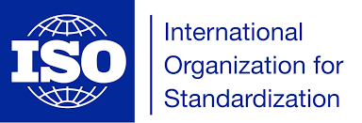
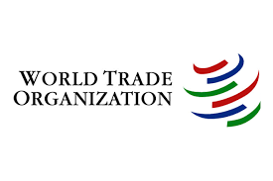
What Does Conformity Assessment Mean?
“Demonstration that specified requirements relating to a product, process, system, person or body are fulfilled.” (ISO/IEC 17000:2004)
“Any procedure used, directly or indirectly, to determine that relevant requirements in technical regulations or standards are fulfilled.” (Annex 1 of the WTO TBT Agreement)
Demonstrating requirements are met.

Slide 5
Who Does It? What Are the Mechanisms?
Who?
How?
Manufacturer (1st Party)
Governments (2nd Party)
Private Conformity (3rd Party)
Registration (Process)
Audit practices, procedures, mgmt
Testing (Product)
Test with “results” report
Inspection (Product)
Typically “visual”
Verification (Product)
Tests to validate claims
Certification (Product)
Test+Attest+Surveillance

Slide 6
Why Does Conformity Assessment Matter?
To provide confidence to stakeholders—consumers, retailers and regulators—that a product or system meets specific technical requirements – safety, quality, sustainability, security, etc...

Slide 7
Ann M. Weeks
Vice President, Global Government Affairs
UL LLC
1850 M Street NW, Suite 1000
Washington, DC 20036
Tel: +1 202 296-1435
Cell: +1 202 365-6951
E-mail: Ann.Weeks@ul.com
Thank You!
Muchimas Gracias!

