Slide 1
Stakeholder Organization & Participation
EAC Public-Private Sector Training Workshop on TBT and SPS
21 March 2016
Derek Greenauer
Director, Global Government Affairs UL LLC

Slide 2
Agenda
UL Company Overview
Overview of UL Standards Development Process

Slide 3
Agenda
UL Company Overview
Overview of UL Standards Development Process

Slide 4


Innovation, Commercialization, Global Trade
UL’s work is at the nexus of supporting regulators’ confidence needs and manufacturers’ and retailers’ market access needs.
Safety science research
Standards development
Full complement of conformity assessment
Consumer education and training
Photo Source: NOAA.Gov and UL

Slide 5
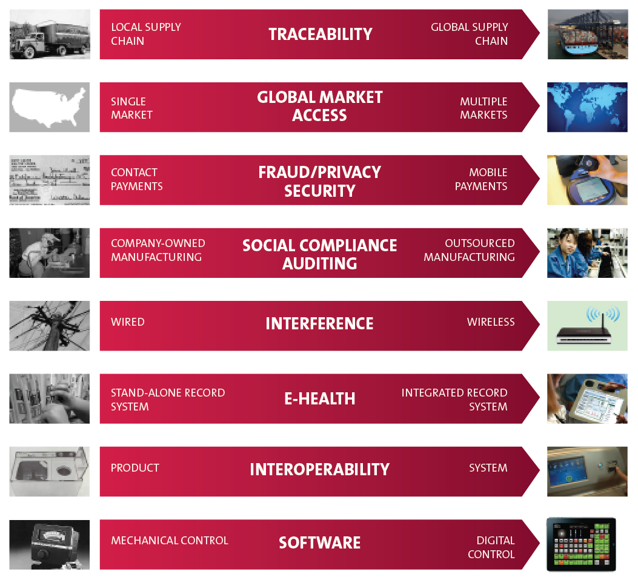
Innovation inherently creates risk
Notes:
Products and technologies have become more complex and are faster to market.
Safety, reliability and quality remain fundamental.
New considerations include the environment, transparency and worker treatment.

Slide 6

Services for today’s challenges
TESTING
INSPECTION
CERTIFICATION
AUDITING
VALIDATION
TRAINING
Notes:
With the definition of safety expanding, UL has extended our services and offerings to meet the growing and diverse needs of our customers.

Slide 7

Leading brand protection
Protect reputation regarding quality control while alleviating ethical and sustainability concerns
Services:
International IP Crime Investigators College (IIPCIC)
Social Responsibility and Accountability Auditing
Brand Protection and Supply Chain Security Audits
Sustainable Company Certification
Sustainability Audits
Social Responsibility Advisory Services
60%
OF CEOs IDENTIFY BRAND
AS THE SOURCE OF 40% OF THEIR COMPANIES’ VALUE.
Notes:
Source:
“Your Brand Reputational Value is Irreplaceable. Protect It!” Forbes, 1 Feb. 2010. Web: 12 Apr. 2013.
http://www.forbes.com/2010/02/01/brand-reputation-value-leadership-managing-ethisphere.html

Slide 8
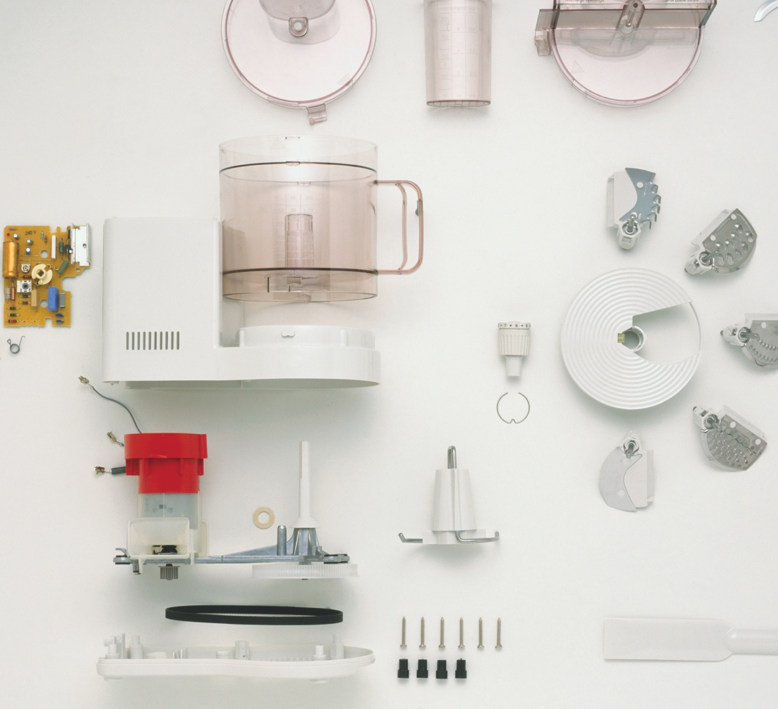
Easing supply chain complexity
Regulatory compliance and trade requirements
for manufacturers and retailers. Prioritizing ethical practices and enabling real-time information and decision making
Services:
Quality Inspections
Performance and Verification Testing
Information Insights
Supply Chain Traceability
Component Certification
Risk Identification and Management Audits
Social Responsibility and Accountability Audits
44%
OF GLOBAL EXECUTIVES CITED
“GROWING COMPLEXITY OF THE
SUPPLY CHAIN” AS THEIR TOP
BUSINESS PRESSURE.
Notes:
Source:
Heaney, B., “Supply Chain Visibility Excellence,” Aberdeen Group, Research Paper, March 2012.

Slide 9

Advancing transaction security
World’s leader in end-to-end transaction security services for financial institutions, merchants, third-party processors and wireless carriers
Services:
Transaction Security Consulting Services
Transaction Security Evaluation Services
Transaction Security Test Services
Transaction Security Training
THE MOBILE PAYMENTS INDUSTRY WILL QUADRUPLE
TO MORE THAN
$1.3
TRILLION OVER THE
NEXT FIVE YEARS.
Notes:
Source:
“Mobile Payments to Quadruple in Five Years,” Future of Payments Conference, 3 Sep. 2012. Web: 12 Apr. 2013. http://www.paymentsconf.com/2012/09/mobile-payments-to-quadruple-in-five-years/

Slide 10

Protecting the built environment
Focus on the structural integrity and safety
of built structures with architects, specifiers, contractors, authorities and fire service
Services:
Safety Research
Fire Service Training
Qualified Contractor Programs
Multi-Attribute Sustainable Product Certification
Safety Certification
Fire Behavior Consulting
Flammability Testing
MODERN HOMES
REACH FLASHOVER
8X
FASTER THAN HOMES BUILT
50 YEARS AGO DUE IN PART TO
NEW MATERIALS IN BUILDING
PRODUCTS AND FURNISHINGS
Notes:
Source:
“Comparison of Modern and Legacy Home Furnishings,” UL Research Demonstration, 2009. Web: 9 Oct. 2012.
https://www.ul.com/room_fire/room_fire.html

Slide 11
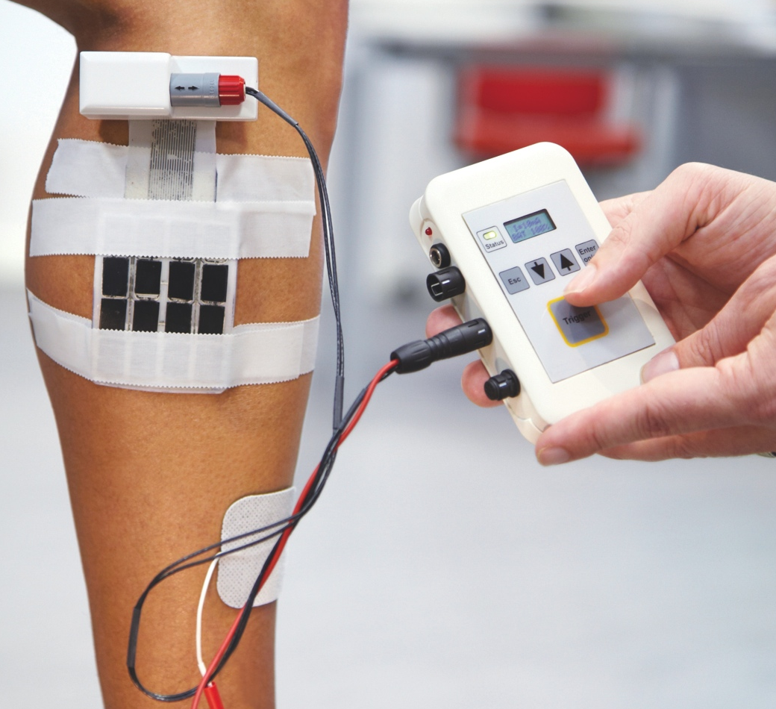
Modernizing health sciences
Focus on aging population and digitalization
of industry for healthcare facilities, providers
and insurers
Services:
Third-Party Regulatory Approval
Non-Clinical Testing
Clinical Services Audits
Management System Assessment
Usability Testing
Regulatory Support Advisory Services
Clinical Research Organization Advisory Services
BY 2050,
THE OVER-80 AGE GROUP IS PROJECTED TO REACH NEARLY 379 MILLION GLOBALLY. THIS IS ALMOST 5.5 TIMES AS MANY AS IN 2000.
Notes:
Source:
“World Population Ageing,” Department of Economic and Social Affairs, Population Division, United Nations. Web: 15 Apr. 2013.
http://www.un.org/esa/population/publications/worldageing19502050/pdf/90chapteriv.pdf

Slide 12

Facilitating sustainable energy
Working with manufacturers, governments,
utilities and leading research institutions on safety and security of new processes, technologies and products
Services:
Energy Efficiency Testing
Energy Efficiency Certification
Standards Development
Smart Meter and Appliance Services
Renewable Energy Infrastructure
Safety Certification
Performance Certification
80%
OF THE WORLD’S ENERGY
DEMAND COULD BE FULFILLED
BY RENEWABLES BY 2050.
Notes:
Source:
“Renewables could be 80 percent of energy by 2050: U.N.,” Reuters, 9 May 2011. Web: 12 Apr. 2013.
http://www.reuters.com/article/2011/05/09/us-energy-renewables-idUSTRE7481L220110509

Slide 13

Championing indoor air quality
Focus on pollutants and emissions and their impact on human health with manufacturers, retailers and built environment professionals
Services:
UL GREENGUARD Certification
Eco-INSTITUT Certification
Chemical Emissions Testing
Indoor Air Quality Certification
Environmental Claim Validation
INDOOR AIR IS
2-10X
MORE POLLUTED THAN OUTDOOR AIR DUE TO INCREASED CHEMICAL EMISSIONS AND TIGHTER,
MORE INSULATED BUILDINGS.
Notes:
Source:
“How big a problem is poor Indoor Air Quality in schools?” EPA, 12 Oct. 2010. Web: 20 Mar. 2013.
http://iaq.supportportal.com/link/portal/23002/23007/Article/16120/How-big-a-problem-is-poor-Indoor-Air-Quality-in-schools

Slide 14
Agenda
UL Company Overview
Overview of UL Standards Development Process

Slide 15
What Drives Standards Development?
In the US, standards development led by private sector, rather than government agencies.
US Standards are market driven:
- New technology (e.g. nanotechnology)
- Changing technology (e.g. biofuels products)
- Independent research
- Data on field use
- Need to safeguard the public

Slide 16
Tools Facilitating Private Sector Participation
National Technology Transfer Advancement Act (NTTAA) encourages reliance on private sector conformity assessment activities including accreditation to reduce duplication and complexity.
OMB Circular A-119, “Federal Participation in the Development and Use of Voluntary Consensus Standards in Conformity Assessment Activities” implements NTTAA requirements.
Notes:
Yesterday, Alex Hunt (OMB-OIRA) overviewed the US framework to regulation and GRP.
Today, Ileana Martinez spoke about the US application of TBT Agreement principles for CA.
I’d like to now talk about the US framework that enables private sector CA providers to (a) support regulatory objectives (b) in a trade facilitative way (c) that streamlines overall costs in the system

Slide 17
National Technology Transfer and Advancement Act (NTTAA)
Directs Federal Agencies to use consensus standards developed by consensus standards bodies.
Encourages participation in voluntary consensus standards bodies when compatible with missions, authorities, etc.
Directs the National Institute of Science and Technology (NIST) to coordinate federal standards and conformity assessment activities with those of the private sector.
The NTTAA brought civilian agencies into the practice of using private sector standards in place of government unique standards.
Notes:
Passed in 1995 and enacted in 1996, NTTAA directs Federal Agencies to rely on the private sector, wherever possible, both for standards and CA. Admittedly the guidance on conformity assessment is less robust than that for standards.
3 important dimensions of the law include: directing federal agencies to use consensus standards, encourages their participation in such standards development activities, and directs NIST to coordinate.
As a result of this policy direction and guidance, hundreds of government unique requirements have been replaced with private sector volume consensus based standards both for regulatory and procurement purposes.

Slide 18
OMB Circular A-119
Guides federal agencies on the implementation of the NTTAA.
Establishes policies on federal use and development of voluntary consensus standards and on conformity assessment activities.
Notes:
With NTTAA setting the high level direction on public-private partnership, the OMB circular provides more specific policy direction and guidance to agencies.
OMB Circular A-119 was originally issued in 1982 and revised in 1998 to be consistent with and reinforce the National Technology Transfer and Advancement Act (NTTAA). Currently, OMB Circular A-119 is under going another revision. One of the dimensions of the revisions is potential inclusion of more explicit policy direction for use of private sector in CA and parallel guidance as it exists today for standards.

Slide 19
UL Standards Development Process Overview
UL uses its Standards Technical Panel (STP) process for consensus standards development, which has been approved by the American National Standards Institute (ANSI). The intent is that standards developed under the STP Process will be designated as ANSI standards.
STPs are a central part of the process by which UL develops and maintains its Standards. An STP is a group of individuals, representing a variety of interests connected to the UL Standard, formed to review and vote on proposals for new Standards or revisions to existing Standards.
Notes:
Number of UL Standards = 856
Number of UL ANSI Approved Standards = 637
Number of Harmonized Standards = 228

Slide 20
Basic Process
New draft of UL standard submitted
Preliminary Review
(STP) (optional step)
Balloted Proposal and Public Review
Recirculation of Balloted proposal
(If necessary)
Final Publication
STP Meeting (If Necessary)
STP Meeting (If Necessary)
Comment Resolution
Notes:
Proposal submitted via UL’s Collaborative Standards Development system (CSDS)
Proposal undergoes preliminary review by the STP and Standards Subscribers
Proposal submitter reviews any comments received on their proposal
Proposal undergoes review and balloting by the STP, review by Standards Subscribers, and public review
Resolution of comments
Recirculation of any changes to the proposal based on comments received & STP confirms or changes votes
If consensus is achieved, then the proposal is adopted and has achieved ANSI approval. If consensus is not achieved, then the proposal fails.

Slide 21
UL’s Principles for Standards Development
Balance
Openness
Balloting
Consensus
Comment Resolution
Appeals and Publication

Slide 22
Balance
Producers
Supply Chain
Commercial / Industrial User
General Interest
AHJ/Regulators
Government
Testing and Standards Organizations (restricted to US voting)
Consumer
International Delegate

Slide 23
Expectations of STP Members
Vote timely and based on the technical merit of the proposal.
Share expertise when commenting on proposals being considered.
Help develop proposals to the standard.
Provide input for comment resolution, as determined by the STP Chair

Slide 24
Openness: The Collaborative Standards Development System (CSDS)
CSDS is UL's web-based standards development system used to submit proposals, comment, and vote on proposals at any time of the day from any computer system with internet access.
CSDS is open to anyone interested and is the designated and primary tool for participation in UL's standards development process.
CSDS can be accessed at: http://csds.ul.com/Home/Default.aspx
Any internal proposals for standards revisions are directed to the PDE, who will submit a Proposal Request via the CSDS system on behalf of UL.
UL’s Project Manager is available to help with questions regarding CSDS.

Slide 25
How external people can be involved in the Standards Development Process
Submit proposals via CSDS for revising standards: http://csds.ul.com/Home/Default.aspx
Attend STP Meetings either as an STP Member or a Guest: http://csds.ul.com/Home/MeetingsDefault.aspx
Join a Standards Technical Panel (STP): http://www.ul.com/global/eng/pages/solutions/standards/developstandards/stps/index.jsp
“Call for Members” indicates which STPs are seeking members: http://www.ul.com/global/eng/pages/solutions/standards/developstandards/participation/callformembers/index.jsp

Slide 26
Consensus
Returned ballots by a majority of the STP and
Approval by at least 2/3 of those who have submitted a vote.

Slide 27
UL and International Standards
UL staff participate and support IEC and ISO standards activities
UL has published a number of bi-national standards with Canada
UL participates in key IEC forums, including IEC SMT, IECEx, IECEE CTL, IEC ACOS
Notes:
When UL adopts an international standard, national differences are identified to address US concerns (code, safety, component)
UL publishes the IEC text along with the US ND.
Attempt to minimize NDs
Accept IEC text
Propose change to IEC text
More than 70 UL standards are based on IEC standards.
Currently no ISO-based UL standards, although we are considering these activities.
UL is very active in developing international requirements for new technologies, including fuel cells, nanotechnology
SMB = Standards Management Board, policy making board of IEC
IEC Ex = addresses hazardous location scheme
IECEE CTL = Committee of Testing Labs – UL works w/ other test labs to resolve issues.
IEC ACOS – Advisory Committee of Safety. Committee addressing global safety issues.

Slide 28
UL and International Engagement
Notes:
Not included here are countries with a single representative on a single STP:
Belgium
France
Hungary
Norway
Singapore
Thailand

Slide 29
THANK YOU.

