Slide 1
Conformity Assessment Best Practices and Advancing GRP in EAC:
The Value of Public-Private Partnerships
EAC Workshop on TBT and SPS
22 March 2016
Derek Greenauer
Notes:
There are two dimensions to my remarks regarding GRP and CA
Good GRP and policy direction for effective public and private partnerships
Good GRP regarding governance of private sector CA providers

Slide 2


Innovation, Commercialization, Global Trade
UL’s work is at the nexus of supporting regulators’ confidence needs and manufacturers’ and retailers’ market access needs.
Safety science research
Standards development
Full complement of conformity assessment
Consumer education and training
Photo Source: NOAA.Gov and UL
Notes:
Ask show of hands of all who know UL?
UL is a 119 year old company; our work preceded related regulatory activities
We do four basic things. We conduct safety science research, as that data is the foundation for both our standards and full complement of conformity assessment programs. While we believe much can be done to mitigate risks in product design and compliance programs, we also know that consumer behavior factors into product safety. So UL also spends a lot of time and effort undertaking related education and training programs.

Slide 3
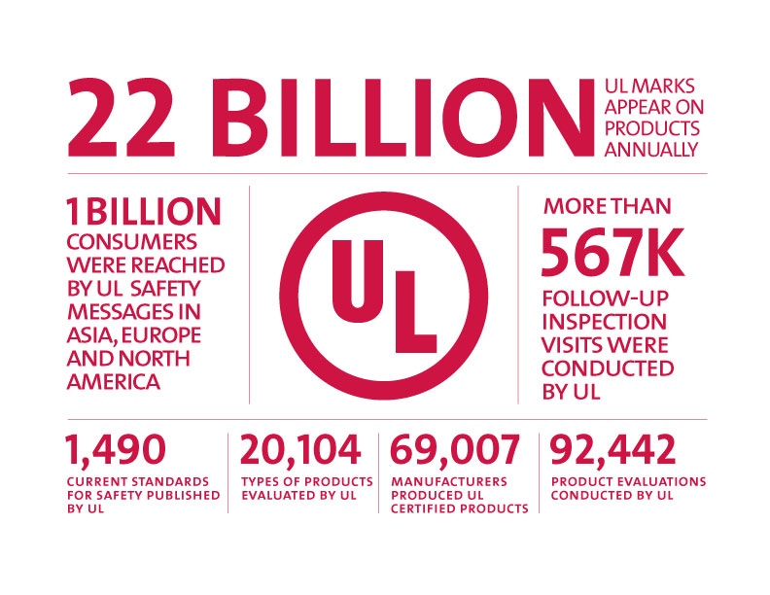
UL in Numbers
Notes:
The point of this slide simply is to show the breadth of UL’s work in helping get safe, reliable, and sustainable products to market.

Slide 4
Content
General US Product Safety System Attributes
Role of the Private Sector
Best Practices and GRP Considerations

Slide 5
US Product Safety System
Characteristics of the US system include:
Highly Decentralized
A mix of private sector (market-based) and government regulators
Elements of market access and market acceptance needs
Approaches vary by sector (including by Federal Agency)

Slide 6
Federal Regulatory System:
Market Acceptance
Federal Communications Commission (FCC)
Occupational Safety and Health Administration (OSHA)
Consumer Product Safety Commission (CPSC)
Food and Drug Administration (FDA)
Several federal agencies mandate product conformity and accredit private sector providers.
Notes:
In entrusting private sector labs, government agencies leverage accreditation as a means of assessing capabilities and whether they are adequate.
The characteristics of the US system lead regulatory agencies to leverage private sector standards and CA programs.
The four organizations listed on this slide, including the Federal Communications Commission (FCC), Occupational Safety and Health Administration (OSHA), Consumer Product Safety Commission (CPSC), and the Food and Drug Administration (FDA) all mandate conformity assessment for different products and entrust private sector third parties with varying levels of responsibility in assessing compliance. They leverage the private sector in different ways. The FCC oversees IT/telecom for safety and EMC. OSHA addresses safety of products in the workplace. CPSC addresses safety of products in home and places of enjoyment. And FDA addresses medical devices.
Will come back to OSHA as a case study shortly.

Slide 7
Content
General US Product Safety System Attributes
Role of the Private Sector
Best Practices and GRP Considerations

Slide 8
US Regulatory Reform and Alignment
EO 13609
EO 13563 13610
OMB A-119
Reshaping the Regulatory Mindset
International
Domestic
Promoting International Regulatory Cooperation
1 May 2012
Improving Regulation and Regulatory Review
18 January 2011
Identifying and Reducing Regulatory Burdens
10 May 2012
Public-Private
Federal Participation in the Development and Use of VCS and in CA Activities
FR Doc 2012-7602
Notes:
When we look at the high-level policy direction out of the White House since 2011, you see three integrated segments that are coming together to reshape the regulatory mindset.
The first is the policy guidance on agencies’ reliance on private sector standards and conformity assessment in meeting regulatory objectives. This guidance - OMB A-119 - is not new… It’s been in place for decades… But it is undergoing review in light of the broader regulatory reform and to better align with the realities of today. The anticipated revisions are important not only because they provide policy guidance around reliance on private sector conformity assessment, but also because the guidance is relevant to Good Regulatory Practices being leveraged in the international cooperation and trade discussions.
The second piece are the two domestic-oriented EOs. Both elevate the importance of periodic regulatory look-backs and stakeholder engagement in developing related agendas and in the execution of the lookback exercises.
The third piece is around enhancing international regulatory cooperation by providing greater direction to the agencies in considering trade impacts in their regulatory activities. This EO requires additional implementing guidance, which was issued in 2015. The Government Accountability Office that conducts research at the request of Congress released (August 1, 2013) its findings on international regulatory cooperation.

Slide 9
OMB Circular A-119: Goals
Eliminate costs of developing in-house standards.
Decrease cost of goods and services procured by the government.
Minimize burden of complying with agency regulation.
Provide incentives/opportunities to establish standards that serve national needs.
Encourage long-term growth for US enterprises.
Promote efficiency and economic competition.
Further the government’s policy of reliance upon the private sector to supply goods and services needed by the Federal Government.
Notes:
I won’t belabor the benefits of applying NTTAA and OMB because they reprise benefits articulated by others when GRPs are applied.
In the United States, the private sector has significantly expanded its expertise, capabilities, and capacity to conduct conformity assessment activities that support not only market-driven needs, but also the regulatory needs of various agencies.
We believe that expanding this type of public-private engagement as it relates to conformity assessment through the revision of OMB Circular A-119 can only further enhance the positive outcomes.

Slide 10
OMB Circular A-119
“Federal Participation in the Development and Use of Voluntary Consensus Standards in Conformity Assessment Activities”
Guides federal agencies on the implementation of the National Technology Transfer and Advancement Act
Establishes policies on federal use and development of voluntary consensus standards and on conformity assessment activities
Revisions to OMB A-119:
Standards IP Protections
Consensus Standards
Engagement of Private Sector
Updating Standards in Regulation
Use of Multiple Standards
Direct CA Guidance
Notes:
The National Technology Transfer and Advancement Act (NTTAA) requirements were implemented by OMB through revisions to its Circular A-119, “Federal Participation in the Development and Use of Voluntary Consensus Standards and in Conformity Assessment Activities” which was originally issued in 1982. The 1998 revisions helped to drive consistency with and reinforce provisions of NTTAA. [Note: NTTAA is the US law that directs the federal government to rely upon the private sector wherever practicable for standards and conformity programs, and by extension avoid unique technical regulations.]
The OMB A-119 (1998) Circular provisions today are very strong on reliance on the private sector for standards; the success of this guidance is reflected in the agency reports YOY that tell the story of increased reliance on private sector standards and reduction in related unique technical regulations.
At the same time, the world has evolved and a refresh of OMB A-119 is both warranted and timely. I’d like to frame this in two dimensions. The first of which is conformity assessment. The second dimension is related to standards. OMB A-119 actually directs NIST to provide guidance on the conformity assessment provisions. That guidance has been codified, but falls short of the provisions as outlined for standards in the Circular.
The 5 boxes you see grouped in the “revisions” section of the slide highlight what has changed in the 2016 version
Conformity Assessment:
Notes that conformity assessment procedures and systems can be used in many ways to support agencies’ missions and encourages agencies to “recognize the possible contribution of private sector conformity assessment activities”
Instructs agencies to work closely with NIST and OMB to identify CA needs for regulatory compliance and enforcement, procurement, and other programmatic contexts
Recommends that agencies consider whether reliance on international CA schemes would meet their conformity assessment needs and references alignment with WTO TBT Agreement
Standards:
Continues to require federal agencies’ usage of voluntary consensus standards (VCS), but provides flexibility to use other non-consensus standards where VCS do not exist or usage would be inconsistent with law, otherwise impractical or ineffective in meeting agency needs.
Includes consideration of “the extent to which the standard is an international standard” as a potential factor agencies should consider in determining which standards to use. Also seeks to align with US obligations under World Trade Organization (WTO) Agreement on Technical Barriers to Trade, instructing agencies to rely on relevant international standards except where they would be “ineffective or inappropriate…to fulfill the legitimate objective pursued” (p22)
Includes provisions that enhance transparency in how federal agencies engage SDOs, including: (1) annual reports to OMB and NIST on participation in VCS activities; (2) greater reliance on Agency Standards Executives; (3) explanations for decisions to issue government-unique standards in lieu of reliance on VCS; and (4) inclusion of a discussion on how agencies are implementing OMB A-119 and engaged with SDOs in the preambles that accompany rulemaking.
:
The first is standards IP protections reflected in the earlier Incorporation by Reference (IBR) presentations.
The second is a discussion over what constitutes consensus standards. Traditionally, the focus has been on ANSI-accredited consensus standards. But ISO provides consensus standards guidelines. And leadership standards, often in the environment space, are triggering related discussions about how to address in OMB guidance moving forward.
The third is how the government engages the private sector. There is a general perception that communication, coordination, and collaboration gaps exist and existing mechanisms inadequate.
The fourth is updating standards in regulation. Such guidance is important to ensure that products are being evaluated for compliance to the same version of a standard, and the most current version. The ability for regulators to update standards references to newer versions can be complex and cumbersome.
The fifth is around if and how regulators should rely upon multiple standards. This is particularly important in a time of increased emphasis on regulatory collaboration across borders. From UL’s point of view, such reliance on multiple standards should occur only if the technical equivalence can be assessed and determined.

Slide 11
Promoting International Regulatory Cooperation [EO 13609]
Policy Direction
“Regulatory Working Group” Role
Serves as a forum for discussing such international regulatory cooperation
Examine strategies and approaches
Agency Responsibilities
“International impact”
As a matter of policy, “… international regulatory cooperation, consistent with domestic law and prerogatives and US trade policy, can be an important means of promoting the goals of EO 13563.”
Established in EO 12866 and affirmed in EO 13563:
OMB’s OIRA leads Working Group
Includes international regulatory cooperation plans that are of significant consequence as part of regulatory plans per EO 12866
“Encourages” independent agencies to embrace and apply
Defined as: “a direct effect that a proposed or final regulation is expected to have on international trade and investment, or that otherwise may be of significant interest to the trading partners of the United States.”
Notes:
This brings us to the third segment of regulatory reform – EO 13609 – which is focused on collaborating and aligning regulation across national boundaries. There are four basic components to this EO

Slide 12
The NRTL Program and Benefits of Relying on Private Sector Organizations
OSHA’s Nationally Recognized Testing Laboratory (NTRL) Program recognizes private sector organizations as NRTLs to determine that specific products meet consensus-based safety standards to provide the assurance that these products are safe for use in the US workplace.
How does OSHA benefit from reliance on private sector NRTLs?
Recognition Process that Preserves Confidence
Reduces Government Costs
Lessens OSHA’s Market Surveillance Burdens
Positively Affects the Development of Standards
Promotes International Trade
Notes:
The US Occupational Safety and Health Admin (OSHA) public private program for safety of products in the workplace is both a success story and a “work-in-progress”. It’s a success story in applying GRP/and TBT ironically prior to passage of NTTAA and OMB. A “work-in-progress” because it illustrates areas that need to be reevaluated to reflect todays realities:
Accreditation who does it? ISO 17065
Acceptance of standards (international)
Under the program, OSHA:
Mandates conformance
Relies on private sector standards
Accredits 3rd parties
3rd parties carry out certification and surveillance
With respect to reducing government costs and lessening OSHA’s market surveillance burden, interestingly, OSHA would have to spend $360 million each year (more than half it’s budget) were it to shift from a 3rd party, public-private model to SDoC.
Before talking further about A-119 and how this process could be further enhanced, I would like to provide two case studies that demonstrate how reliance on the private sector has achieved some of the stated objectives around NTTAA and OMB A-119.
I will start with a case study on the OSHA NRTL Program and then talk about the CPSC.
OSHA’s Nationally Recognized Testing Laboratory (NTRL) Program is a perfect example of how the Federal Government benefits from relying on private sector organizations to help carry out its mission, which in OSHA’s case is to “promote the safety and health of America’s working men and women.” It has been documented by OSHA that they see the following benefits arising out of this reliance:
Reducing Government Costs
In 2008, OSHA issued a Request for Information on (RFI) on the question of whether to permit the use of Supplier’s Declaration of Conformity (SDoC) as an alternative to the NRTL approval process for products used in the US workplace. In its 2010 explanation as to why it chose not to initiate a rulemaking to permit the use of SDoC, OSHA cited costs as one of the factors. OSHA estimated that implementing an SDoC system in the US could cost the Agency approximately $360 million in addition annually. In contrast, the budget at that time associated with operating the NRTL Program was approximately $1 million per year. Based on this estimate, operating an effective SDoC program would require OSHA to incur substantial additional costs. OSHA’s budget at the time of the RFI for all of its operations was about $558 million. Thus, based on OSHA’s estimate, adopting an SDoC system would increase OSHA’s entire current budget by more than half.
Lessening OSHA’s Market Surveillance Burdens
Under the NRTL Program, each NRTL may conduct market surveillance to assure that manufacturers use only its mark on certified products, i.e., each NRTL is responsible for ensuring the integrity of its mark. OSHA has noted that market surveillance is an important means that NRTLs can use to detect incompliant products. Several NRTLs also collaborate with the US Customs and Border Protection to monitor for incompliant products imported into the US, including counterfeit products. If NRTLs did not carry out these market surveillance functions, OSHA would have to assume market surveillance obligations to monitor for incompliant products, which would require additional funding and staff resources. OSHA would have to seek funding for such a program, in whole or part, by charging fees to manufacturers or exporters.
Positively Affecting the Development of Standards
The NRTL program also positively affects the development of standards. Product requirements and standards are often updated as innovation occurs and product designs change over time to meet market needs and desires. Product certifiers also contribute to standards revisions based on their experiences evaluating products or investigating their impacts in the field. The standards development process is thus closely linked to the testing and certification process, and each informs and enhances the other.
Promoting International Trade
Rather than posing a trade barrier to manufacturers in exchange for safety benefits, OSHA’s NRTL system enables responsible reliance on internationally harmonized standards in two ways. First, OSHA has formally recognized US standards that are harmonized with International Electrotechnical Commission (IEC) standards, with US national differences. By recognizing these standards, OSHA indicates they are acceptable for use by NRTLs to certify products according to OSHA requirements. OSHA has also permitted NRTLs to use the Worldwide System for Conformity Testing and Certification of Electrotechnical Equipment and Components (IECEE CB Scheme) for certifications to US standards that have been harmonized with IEC standards. These OSHA practices recognize that internationally harmonized standards help streamline requirements in a way that makes conformity assessment less burdensome and expedites market access for manufacturers accordingly. OSHA also fosters international trade by accrediting foreign bodies to be NRTLs on the same terms as US certifiers, as long as the host country also provides a similar mechanism for accrediting US conformity assessment bodies.

Slide 13
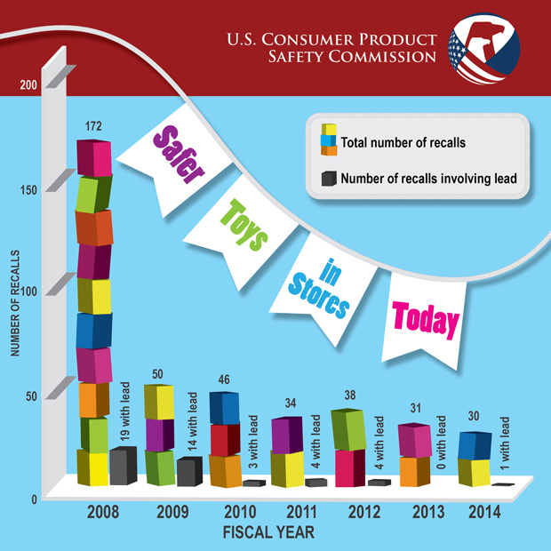
Case Study: Impact of Third Party Testing on Toy Recalls in the US
Notes:
The Consumer Product Safety Improvement Act (CPSIA) of 2008 introduced new third-party testing requirements for toys and children’s products, and that the testing be conducted by an accredited CPSC-recognized third party lab and that the domestic manufacturer or importer issue a Certificate of that compliance.

Slide 14
Content
General US Product Safety System Attributes
Role of the Private Sector
Best Practices and GRP Considerations

Slide 15
UL Recommendations
Enhance Transparency of Process
Transparency with respect to informing and soliciting feedback from standards development organizations, conformity assessment providers, industry, and the public at-large of a particular government bodies’ goals for a specific program or activity, the rationale for use or non-use of private sector standards and conformity assessment capabilities, and periodic reviews of current policy.
Consistency in Approach
Government bodies should follow a consistent process when determining how to incorporate private sector standards and conformity assessment programs into their activities.
Notes:
The GRP principles captured here were covered yesterday.
With respect to consistency in approach, let me just emphasize that a consistent process can still be flexible and adaptable to result in models that best suit regulator needs, as illustrated in my earlier slide with the 4 US regulatory agencies.

Slide 16
UL Recommendations
Government as Coordinator
Actively coordinate the engagement of stakeholders on emerging issues, convene fora and other information sharing events, facilitate public-private partnerships for the advancement of priority sectors, and provide oversight for the efficacy of government activities involving standards development and conformity assessment.
Government as Champion of Competitive Environment
Where regulators rely on private sector-based conformity programs, they should ensure and preserve fair and robust competition within the private sector.
Notes:
With respect to government as a coordinator, the government role is critical and must include formal AND INFORMAL engagement that is open to ALL relevant stakeholders.
With respect to government as a champion of competitive environment, I’d like to pause here and explain several aspects:
MRAs should be used sparingly and under the right circumstances – where regulatory systems across countries are similar. If applied in other sectors where that alignment is not present, then it can add unnecessary burdens to the private sector conformity assessment bodies.
With respect to accreditation, the process should be open and based on objective criteria; there should be open and free competition. No government “assessment of need” and related “call for conformity providers” should be a pre-requisite.
Quantitative restrictions. Similar to the accreditation comment, restrictions on the quantity of providers should be avoided. Market should facilitate free and open competition.
With respect to investment, in-country presence requirements, forced joint venture partners, and the like should be minimized and eliminated. Such artificial requirements for entry can affect the cost-effectiveness of serving manufacturers and reducing barriers to trade.

Slide 17
UL Recommendations
Sustained Engagement – early and often
Prioritize engagement with the public, particularly with standards development and conformity assessment communities, throughout the development and implementation of regulations, programs, or policies that will reference or utilize private sector standards and/or conformity assessment schemes.
Avoid Least Common Denominator Safety
Where a regulator determines that independent third party testing or certification is not required to demonstrate compliance with requirements, the recognition of results should include a means of recognizing results and certification marks of third-party organizations when manufacturers prefer to engage them.
Notes:
Again, these two principles or themes were repeated by several speakers yesterday.
With respect to sustained engagement, this is a perceived shortcoming of the US Executive Orders today. Language simply notes that the government “may confer” with stakeholders.
With respect to avoiding least common denominator safety, where 3rd party certification is not required, some manufacturers still seek it – competitive advantage or as part of liability risk management. Governments should ensure that programs recognize higher rigor programs. (Did not verbally comment but CPSC and COC’s; EPEAT for procurement are two US examples)

Slide 18
UL Recommendations
Continuous Improvement
Support look-back initiatives to ensure regulatory programs reflect changing market and regulatory and whether technological or material changes in an industry pose new risks and warrant a change in the conformity mechanism relied upon.
Rational Regulatory Alignment
Support initiatives to harmonize technical and conformity requirements domestically and internationally. Ensure parity of technical requirements, conformity measures, accreditation criteria, and government oversight infrastructure.
Notes:
With respect to continuous improvement, risk is not linear. Technology changes and is applied to old and new products in different ways. Thus a “mature” product simply can’t be deemed “safe” and associated with a less rigorous conformity model. This needs to be revisited and changing technology and implications accounted for in the model chosen.
With respect to rational regulatory alignment, I appreciate the interest in focusing on outcomes expressed over past two days. Would argue that proceed with caution, however, because this can pose risks in ineffective implementation and oversight if proper attention not paid to conformity assessment and regulatory infrastructure/oversight differences.

Slide 19
Thank you
Derek Greenauer
Director, Global Government Affairs
UL LLC
Derek.Greenauer@ul.com
Tel: +001 202 296-8092
Notes:
Like manufacturers, service providers that help get product to market also depend on GRP to provide open, transparent and predictable frameworks. With GRP and practices that align with the TBT Agreement, then open transparent, and predictable frameworks are possible.
Earlier in the workshop, a question was asked about the “future.” Would like to leave with one thought regarding the future and emerging trends: issues crossing agency regulatory boundaries. Inter ministerial collaboration/coordination is critical to private sector helping to provide solutions; absent alignment across ministries, private sector stakeholders may be disincented to help identify and implement a solution because of ambiguity around which regulatory point of view may prevail.
An example where regulator alignment is critical is in the chemicals area. In the United States, CPSC is interested in fire resistance of products. EPA is interested in human health impact (toxicity). In the area of furniture, fire resistance has often been met via use of flame retardant chemicals (FRs). Increasingly, consideration is being given to both acute (fire) and chronic (day-to-day) exposures from their use. In defining regulatory requirements that meet both over time, regulators must come together with the private sector and define a common path forward – doing so will ensure against conflict and/or overlap-duplication in resulting regulation and mitigate “unintended consequences” that require costly fixes later.
Thank you for your time and investment in this workshop. I look forward to any questions your might have and welcome the opportunity for UL to remain engaged and supportive of the SCSC’s work.

