Slide 1
Charles Azuka , PhD, Leader- Regulatory and Safety (GPS) P&G Sub-Saharan Africa
Strategies to increase Stakeholders Participation in the Regulatory Process

Slide 2
Outline
Definition of a stakeholder (who is a stakeholder)
Characterization and classification
Regulator’s Role in increasing participation
Importance of building lasting relationship
Questions

Slide 3
Who is a StakeHolder?
General definition of a stakeholder
An individual or group influenced by or has ability to significantly impact (EngI and Glicken, 1995)
How do you define one or groups in the context of Regulation?
Characteristics
Purpose
level of interest
Composition
Level of organization
Power of influence

Slide 4
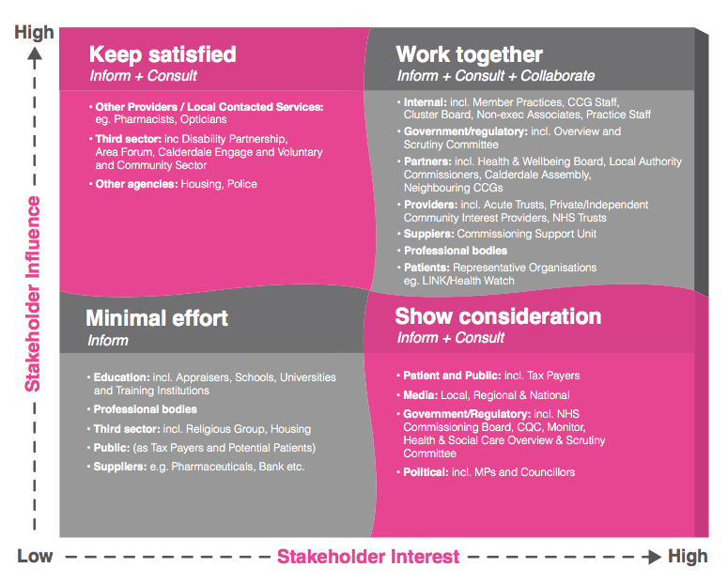
Categories of Stakeholders

Slide 5
Categories of Stakeholders
High interest High influence (Must work together)
Inform, consult and collaborate
Very critical group (internal leadership, Ministers or their office, , Professional bodies-asso of med doctors other govt agencies, etc)
High interest Low influence (Keep satisfied)
Inform and consult
Get buy ins and alignment (trade asso, business asso, etc)
High influence Low interest ( Show consideration)
Inform and consult
Groups that can influence public (Media Orgs Bloggers, Trade Unions, etc)
Low influence low interest (Minimal effort)
Inform and educate
Requires understanding (Schools and Universities, other professional asso, suppliers, etc)

Slide 6
The Regulator’s role in increasing Stakeholders participation
Engaging in a “deliberative process that aims toward the achievement of a rational consensus over the regulatory decision.”
Create avenues to inform stakeholders (associations, coalition, industrial leaders, NGO).
Create interest or curiosity
Do what it takes to get engagement
Work engagement from their perspective
Remove barriers to encourage
Use internet or a repository-where people can have most access-a campaign or newspaper publication (freely take baby steps)

Slide 7
The Regulator’s role in increasing Stakeholders participation
Be very clear on the intention and outcome of the regulation
Specify how you want the response (a response form or tool kit) and by WHEN.
Do it early in the process (very critical)
Be open to a dialogue and public hearing
Have back up or follow up options

Slide 8
References
Administrative Conference of the United States. “Administrative Conference Recommendation 2014-4, “Ex Parte” Communications in Informal Rulemaking.” June 6, 2014. http://www.acus.gov/sites/default/files/documents/Recommendation%202014-4%20%28Ex%20Parte%29_0.pdf. (accessed Feb 2, 2016)
Balla, Steven J. “Legislative Organization and Congressional Review of Agency Regulations.” Journal of law, Economics, and Organization 16, no. 2 (Fall 2000): 424-448.
Bohman, James. Public Deliberation: Pluralism, Complexity, and Democracy. Cambridge, MA: The MIT Press, 2002
Coglianese, Cary. “Assessing Consensus: The Promise and Performance of Negotiated Rulemaking.” Duke Law Journal 46, no. 6 (April 1997): 1298.
How to improve your stakeholder engagement strategy in 2015, http://cloud-collaboration.kahootz.com/how-to-improve-your-stakeholder-engagement (accessed March 12, 2016).
Dudley, Susan E. “Opportunities for Stakeholder Participation in U.S. Rulemaking.” George Washington University Regulatory Studies Center, September 23, 2014. http://regulatorystudies.columbian.gwu.edu/opportunities-stakeholder-participation-us-regulation (accessed March 10, 2016)
Gliken J: 2000: Getting stakeholder participation ‘right’: a discussion of .., https://www.deepdyve.com/lp/elsevier/getting-stakeholder-participation-right-a-d (accessed March 10, 2016).

Slide 9
Acknowledgements
ANSI and their affiliates
USAID
EAC
The Organizing Committee
P&G and my leaders

Slide 10
Questions

