Slide 1
Introduction to NIST
and
International Metrology

Slide 2
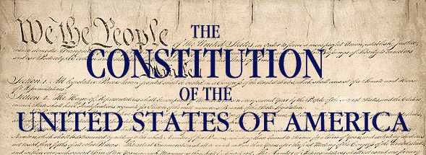
The History of Standards
“Uniformity in the currency, weights, and measures of the United States is an object of great importance, and will, I am persuaded, be duly attended to.”
George Washington, State of the Union Address, 1790
Article I, Section 8: “The Congress shall have the power to…fix the standard of weights and measures”

Slide 3
Importance of standards and measurement
Standards for electrical industry
Measurement infrastructure for commerce
Consumer products unreliable
Instruments calibrated overseas
National Bureau of Standards established by Congress in 1901
Notes:
The National Bureau of Standards was established by Congress in 1901 to address national needs:
Eight different “authoritative” values for the gallon, no uniformity among states for measures affecting basic commerce, no national measurement infrastructure, no way to train or equip weights and measures inspectors
Growing electrical industry needed standards to make better quality and safer products (primary justification cited in organic act)
Lack of a national measurement infrastructure meant U.S. scientists had to send their instruments abroad for calibration, slowing the pace of scientific discovery and technological innovation (another primary justification cited in organic act)
Consumer products and construction materials uneven in quality and unreliable, caveat emptor

Slide 4

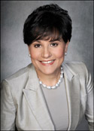

NIST is in the Department of Commerce
Penny Pritzker
Secretary of Commerce
National Oceanic and Atmospheric Administration
International Trade Administration
Patent and Trademark Office
National Institute of Standards & Technology
Economics and Statistics Administration
Other Agencies….
Census Bureau
National Telecommunications and Information Administration
Bureau of Economic Analysis
(National Weather Service)
Willie May
Acting NIST Director,
Acting Under Secretary of Commerce for Standards and Technology

Slide 5
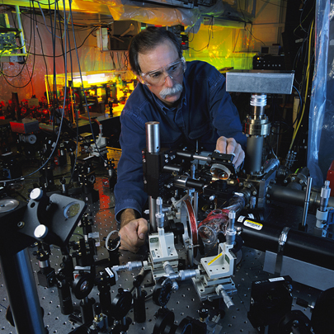
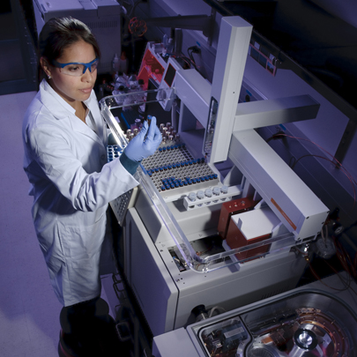
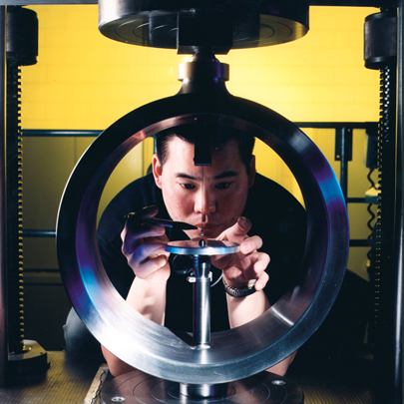
NIST: Nobel Prize-winning science, real-world engineering
With an extremely broad research portfolio, world-class facilities, national networks, and an international reach, NIST works to promote U.S. innovation and industrial competitiveness by advancing measurement science, standards, and technology in ways that enhance our economic security and improve our quality of life.
© G. Wheeler
© Robert Rathe
© Robert Rathe

Slide 6
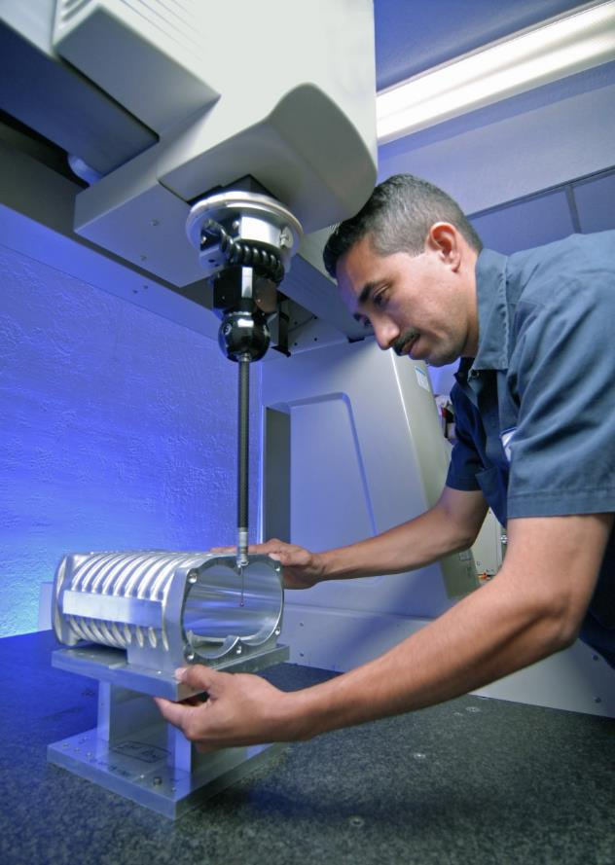
NIST Priority Research Areas
Forensic science
Disaster resilience
Advanced manufacturing
Healthcare
IT and cybersecurity
Cyberphysical systems
Advanced communications
Fotocrisis/shutterstock
Designersart/shutterstock
Yuri Arcurs/shutterstock
StillFX/shutterstock
USGS
Chuck Rausin/shutterstock
Ensuper/shutterstock
shutterstock

Slide 7
Basic Stats and Facts
Gaithersburg
Joint Institutes: JILA, JQI, HML, IBBR, NCCoE
Centers of Excellence
Boulder
©Christina Kiffney Photography
JILA
©HDR Architecture
  ~ 3,000 employees
  ~ 2,800 associates and facilities users
  ~ 1,300 field staff in partner organizations
Notes:
~ 3,000 employees
~ 2,700 associates and facilities users
~ 1,200 field staff in partner organizations
Two main locations:
Gaithersburg, Md.
Boulder, Colo.
Four main programs:
Labs
Hollings Manufacturing Extension Partnership (MEP)
Advanced Manufacturing Technology Consortia Program (AMTech)
Baldrige Performance Excellence Program
Six external collaborative institutes:
JILA – with the Univ. of Colorado
JQI – with the Univ. of Maryland
IBBR (Institute for Bioscience & Biotechnology Research) – with the Univ. of Maryland
HML (Hollings Marine Lab) in Charleston, S.C. – with NOAA,
CHiMaD (Center for Hierarchical Materials Design) – a Center of Excellence led by Northwestern Univ.
NCCoE (National Cybersecurity Center of Excellence) – with the state of Md., and Montgomery County. Supported by DOC’s first Federally Funded Research and Development Center

Slide 8
NIST FY 2015 Operating Budget: $863.9 Million
Construction: $50.3 M
ITS: $138.1 M
NIST Labs: $675.5 M

Slide 9

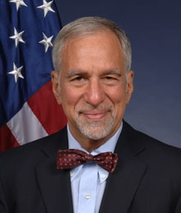
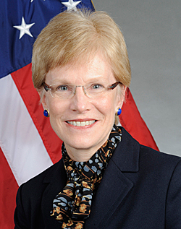
NIST Organization
Director
Executive Administration
Chief of Staff
Laboratory Programs
Innovation and Industry Services
Management Resources
Kent Rochford
Associate Director
of Laboratory Programs
Phillip Singerman
Associate Director
for Innovation and Industry Services
Mary Saunders
Associate Director
for Management Resources

Slide 10
Chief of Staff
Director
Under Secretary of Commerce for Standards and Technology
Associate Director for Laboratory Programs
Associate Director for Management Resources
Associate Director for Innovation and Industry Services
Material Measurement Laboratory
Office of Acquisition and Agreements Management
Economic Analysis
Physical Measurement Laboratory
Office of Safety, Health, and Environment
Baldrige Performance Excellence Program
Information Technology Laboratory
Office of Human Resource Management
Technology Partnerships
Engineering Laboratory
Office of Financial Resource Management
Advanced Manufacturing National Program Office
Communications Technology Laboratory
Office of Information Systems Management
Hollings Manufacturing Extension Partnership
Center for Nanoscale Science and Technology
Office of Facilities and Property Management
NIST Center for Neutron Research

Slide 11

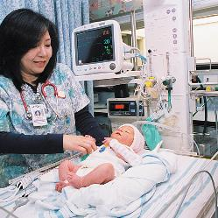
NIST Industry and Technology Services
Hollings Manufacturing Extension Partnership
  Helps smaller manufacturers compete globally
Marten Czamanske/shutterstock
Baldrige Performance Excellence Program
  Promotes and recognizes performance excellence
Sharp

Slide 12
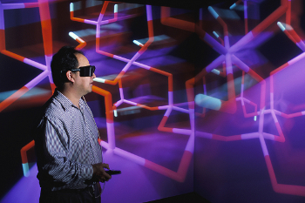
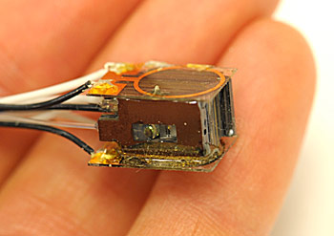
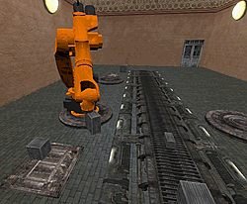


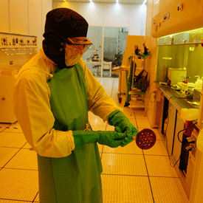
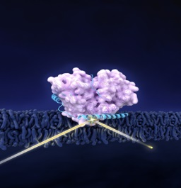
NIST Laboratory Programs
Material
Measurement
Laboratory
Physical Measurement
Laboratory
Engineering Laboratory
Information Technology Laboratory
Communication
Technology Laboratory
Center for Nanoscale Science and Technology
NIST Center for Neutron Research
Metrology Laboratories
Technology Laboratories
National User Facilities
Driving innovation through
Measurement Science and Standards
Accelerating the adoption and deployment of advanced technology solutions
Providing world class, unique, cutting-edge research facilities

Slide 13

Metrology in a Global Context
  Measurement traceability enables international trade and supports manufacturing
  World-wide metrology supports legal and regulatory aims
  “Mutual Recognition” and “Equivalency” allow comparability within stated uncertainties
  Comparisons provide basis of analysis and confidence to customers
  International approach brings robustness and validity to measurements

Slide 14





Metrology in a Global Context
NMI → Sub-regional Metrology Organization → RMO → CIPM
NORAMET
NIST
INM
ANDIMET

Slide 15
CIPM Mutual Recognition Arrangement
International Equivalence of Measurements
Established 1999.
Need for open, transparent and comprehensive scheme to give users reliable quantitative information on the comparability of national metrology services
Technical basis for agreements on international trade, commerce and regulatory affairs.
Originally signed by directors of NMIs of 38 member states of the Metre Convention and formalized existing ad hoc relationships, the MRA has now been signed by 98 (NMIs and International organizations and covers a further 153 Designated Institutes)
Requires:
Declaring and documenting calibration and measurement capabilities (CMCs)
Evidence of successful participation in formal, relevant international comparisons
Demonstration of system for assuring quality of each NMI’s measurement services.
Notes:
Growing importance of metrology
Enable world trade
Overcome technical barriers
Recognized foundation for variety
of scientific and societal activities
Secure technical foundation for wider agreements
NMIs of Member States of the Metre Convention or Associate States (economies) of the CGPM
“Consultative committees” focus on metrology in sound, length, mass, electricity/magnetism, time, thermometry, photometry, chemistry, and ionizing radiation

Slide 16
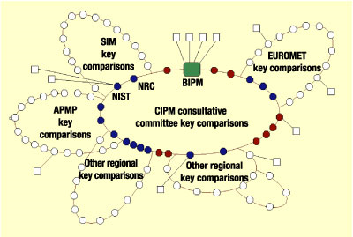
The CIPM MRA
    To provide the technical basis for the worldwide acceptance of
      National measurement standards
      Calibration and measurement certificates
Structure
  RMOs
  Member States
  Associates of the CGPM
  Designated Institutions
Notes:
Role of equivalence
At a meeting held in Paris on 14 October 1999, the directors of the national metrology institutes (NMIs) of thirty-eight Member States of the BIPM and representatives of two international organizations signed the International Committee for Weights and Measures’ Mutual Recognition Arrangement (CIPM MRA) for national measurement standards and for calibration and measurement certificates issued by NMIs. A number of other institutes have signed since then.
This Mutual Recognition Arrangement is a response to a growing need for an open, transparent and comprehensive scheme to give users reliable quantitative information on the comparability of national metrology services and to provide the technical basis for wider agreements negotiated for international trade, commerce and regulatory affairs.
The CIPM MRA has now been signed by the representatives of 74 institutes – from 47 Member States, 25 Associates of the CGPM, and 2 international organizations – and covers a further 123 institutes designated by the signatory bodies.
The General Conference on Weights and Measures (Conférence Générale des Poids et Mesures, CGPM) is made up of delegates of the governments of the Member States and observers from the Associates of the CGPM. The General Conference receives the report of the International Committee for Weights and Measures (CIPM) on work accomplished; it discusses and examines the arrangements required to ensure the propagation and improvement of the International System of Units (SI); it endorses the results of new fundamental metrological determinations and various scientific resolutions of international scope; and it decides all major issues concerning the organization and development of the BIPM, including the dotation of the BIPM for the next four-year period.
The CGPM currently meets in Paris once every four years; the 24th meeting of the CGPM was held in October 2011, and the 25th will be held in 2013.

Slide 17
Calibration and Measurement Capabilities (CMCs)
Must satisfy the following criteria:
Available to customers under normal conditions
Supported by approved quality system
Validated through comparisons, other published results
Delineated by quantity of interest, range of measurement, measurement conditions, uncertainty
The term NMI is intended to include Designated Institutes (DIs) within the framework of the CIPM MRA
Notes:
Total of 30 CMCs in dosimetry (Brazil, Canada, US)
Total of 515 CMCs in radioactivity (Brazil, Argentina, US)
Total of 10 CMCs in neutrons (Brazil, Canada, US)

Slide 18
Role of an RMO
Review and approval of Quality Systems
Review and approval of CMC claims
Regional Key and Supplementary Comparisons
Training, development, comparisons that demonstrate/improve the capabilities of developing NMIs
Representation in Global Metrology Fora

Slide 19
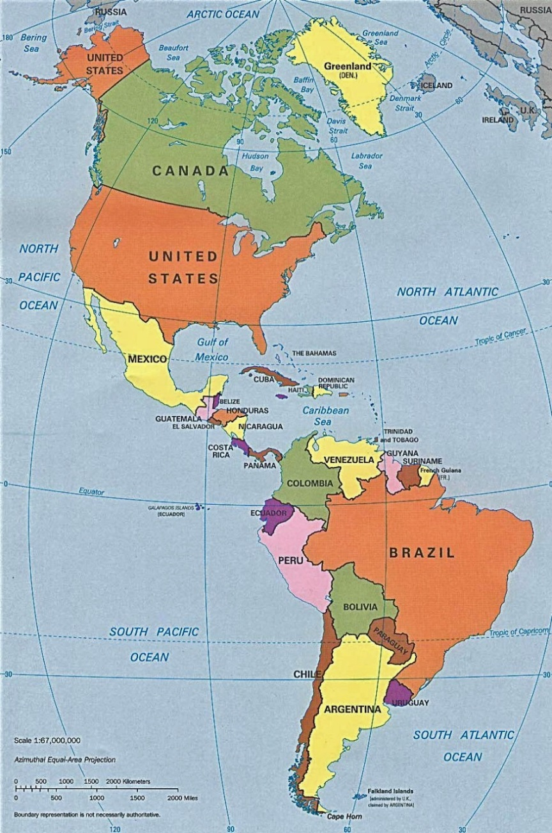
Sistema Interamericano de Metrología (SIM)
Membership: National Metrology Institutes (NMIs) located in the 34 member nations of the OAS
Mission: To promote and support an integrated measurement infrastructure in the Americas that ensures equity in the marketplace, improves the quality of life and facilitates international trade.
International Role: Regional Metrology Organization (RMO) for the Western Hemisphere, one of 5 RMOs currently recognized within the framework of the International Committee on Weights and Measures Mutual Recognition Arrangement (CIPM MRA).
Notes:
Since the recognition of the importance of a measurement and standards infrastructure at the 1994 Summit of the Americas, with support from OAS/FEMCIDI, the institutions responsible for measurements and measurement standards throughout the hemisphere have been working together to strengthen the metrology component of the National Quality Infrastructure.
SIM includes institutions in all 34 member states of OAS although the level of participation varies by country, and is obviously impacted by economics, politics and, unfortunately natural disasters. Our formal membership is the NMIs, but we also have participation by DIs in many of the countries.
SIM’s Mission is to promote and support an integrated measurement infrastructure in the Americas that ensures equity in the marketplace, improves the quality of life and facilitates international trade.
SIM is the internationally recognized regional metrology body for the Americas (one of 5 in the world) – and plays a key role in the international recognition of measurements made in each of its participating member states, as well as those made in other regions of the world.
SIM is divided into 5 sub-regions: Noramet, Carimet, Camet, Andimet, and 109
We have 13 Metrology groups which, in addition to planning training events, organize measurement comparisons necessary to establish traceability and international recognition, and review measurement claims made by participating institutions.
MWG 1:Electricity and Magnetism
MWG 2:Photometry and Radiometry
MWG 3:Thermometry
MWG 4: Length
MWG 5:Time and Frequency
MWG 6:Ionizing Radiation and Radioactivity
MWG 7:Mass & Related Quantities
MWG 8:Chemistry (Amount of Substance)
MWG 9:Acoustics, Ultrasound and Vibration
MWG 10:Flow and Volume
MWG 11:Legal Metrology Working Groups
MWG 12:Quality System
MWG 13: Statistics and Uncertainty (new)

Slide 20

Information about SIM
Promotes regional cooperation in metrology
Committed to the implementation of a Global Measurement System
  Reviews and approves Quality Systems (QSTF)
  Reviews and approves CMC claims
  Organizes regional key and supplementary comparison
  Represents western hemisphere in Global Metrology event/efforts
Includes 13 Technical Working Groups: Electricity and Magnetism; Photometry and Radiometry; Thermometry; Length; Time and Frequency; Ionizing Radiation; Mass; Chemistry; Acoustics and Vibration; Flow and Volume; Legal Metrology; Quality Systems; and Statistics and Uncertainty
Organizes training events
  Physical, Chemical and Legal Metrology, Awareness Activities, Pilot studies and Measurement Comparisons

Slide 21

Measurements are Critical to Innovation
If you know how to measure something, you can design it, improve it, and compare it
Measurement science provides foundation for innovation in every industry and economic sector, from manufacturing to health care to defense
80 percent of global trade influenced by measurements
https://www.youtube.com/watch?v=2j9BGVKbzS4

Slide 22
THANK YOU
Katya Delak
International and Academic Affairs
katya.delak@nist.gov
Office of International and Academic Affairs
100 Bureau Drive, Mail Stop 1090
Gaithersburg, Maryland 20899-1090
Phone: +1 301 975 2520
Fax: +1 301 975 3530
http://www.nist.gov

Slide 23
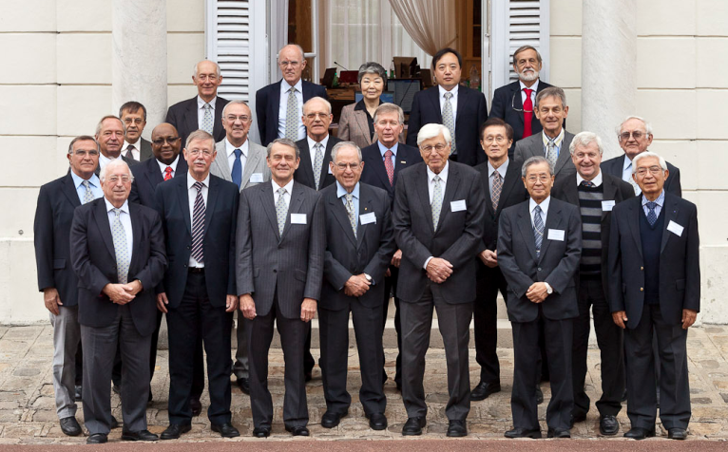
CIPM: Comité International des Poids et Mesures
Individuals (18) from member states under Metre Convention
Promoting world-wide uniformity in units of measurement
  Direct action
  Draft resolutions to CGPM (delegates of all member states and observers from associates; “board of directors” of BIPM)
Activities
  Reporting
  BIPM workings (technical)
  Coordination, recommendations
  Exclusive supervision of CCs
Notes:
The CIPM meets annually at the BIPM and, among other matters, discusses reports presented to it by its Consultative Committees. Reports of the meetings of the CGPM, the CIPM, and all the Consultative Committees, are published by the BIPM.
Other duties of the CIPM include the responsibility to: discuss the work of the BIPM under the delegated authority of the CGPM;
issue an Annual Report on the administrative and financial position of the BIPM to the governments of the Member States of the Metre Convention;
discuss metrological work that Member States decide to do in common, and set up and coordinate activities between specialists in metrology;
make appropriate Recommendations;
commission reports in preparation for CGPMs, for example the "Blevin" and "Kaarls" reports, and others such as the SI Brochure.
Members of the CIPM act as Presidents of the Consultative Committees.
The General Conference on Weights and Measures (Conférence Générale des Poids et Mesures, CGPM) is made up of delegates of the governments of the Member States and observers from the Associates of the CGPM. The General Conference receives the report of the International Committee for Weights and Measures (CIPM) on work accomplished; it discusses and examines the arrangements required to ensure the propagation and improvement of the International System of Units (SI); it endorses the results of new fundamental metrological determinations and various scientific resolutions of international scope; and it decides all major issues concerning the organization and development of the BIPM, including the dotation of the BIPM.
The CGPM meets in Paris, usually once every four years; the 24th meeting was held from 17-21 October 2011.

Slide 24
International

